Slide 1
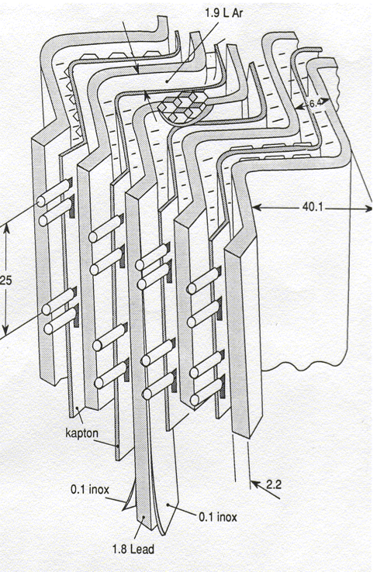
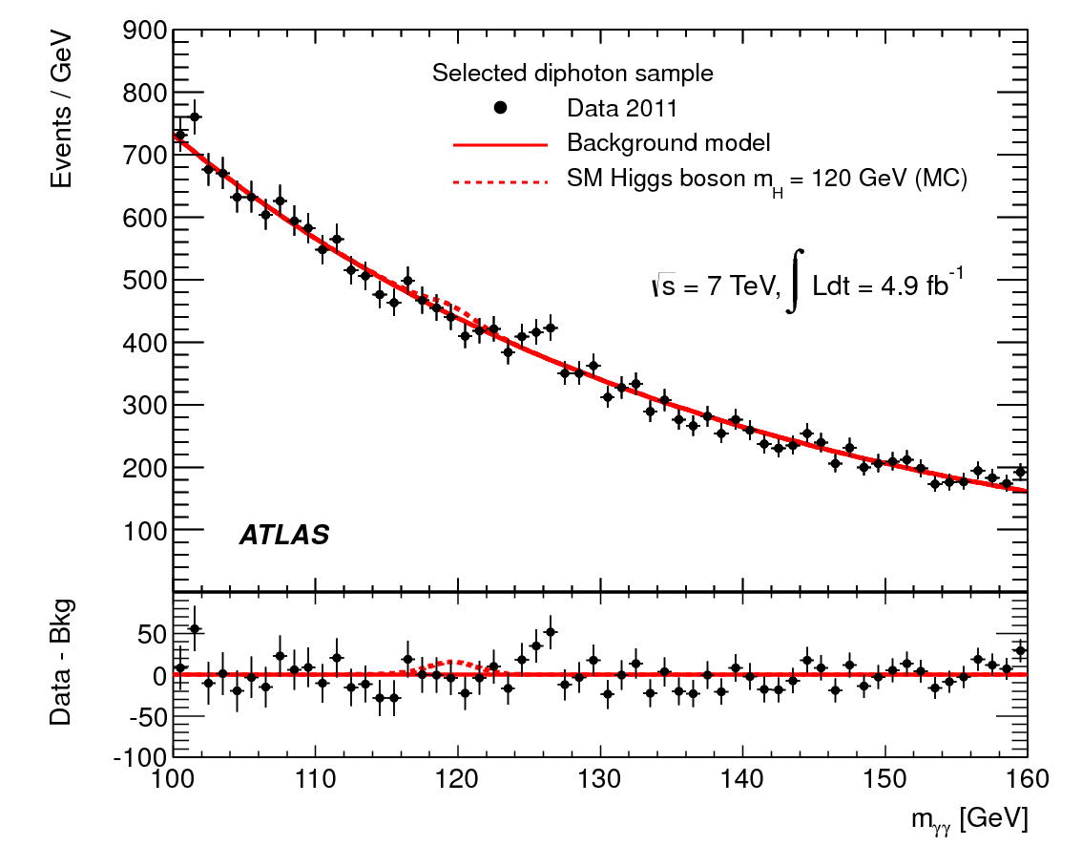
Daniel et ATLAS:
du calorimètre au boson de Higgs
Cérémonie de remise du Prix J.Ricard à Daniel Fournier
Peter Jenni and Fabiola Gianotti

Slide 2
From P. Jenni
Message from Peter Jenni, today at JINR Dubna in Russia…
My cordial congratulations,
Daniel, for this great and so
well-deserved honour of
receiving the prestigious
Prix J. Ricard SFP 2011 !
It would have been a great pleasure
for me to spend some friendly moments
here celebrating and remembering with
you the fantastic time we have shared
over more than two decades on ATLAS
already, and which, of course, I’m looking
forward to continuing with great results soon !

Slide 3
Main milestones of a very challenging and successful project born from a
very bright idea
First ideas on paper: January 1990
Construction and beam-test of first prototype: May-July 1990
→ followed by numerous test-beams of more prototypes between 1990 and 1992
Design optimization: 1993-1996
(several options considered: e.g. LAr vs LKr, preshower vs presampler, U/V vs η-strips, etc)
Technical Design Report: December 1996
Construction, assembly, surface tests: 1996-2004
Installation in the ATLAS underground cavern started in October 2004
First LHC data recorded in December 2009
~ 20 years from the first idea to first data

Slide 4
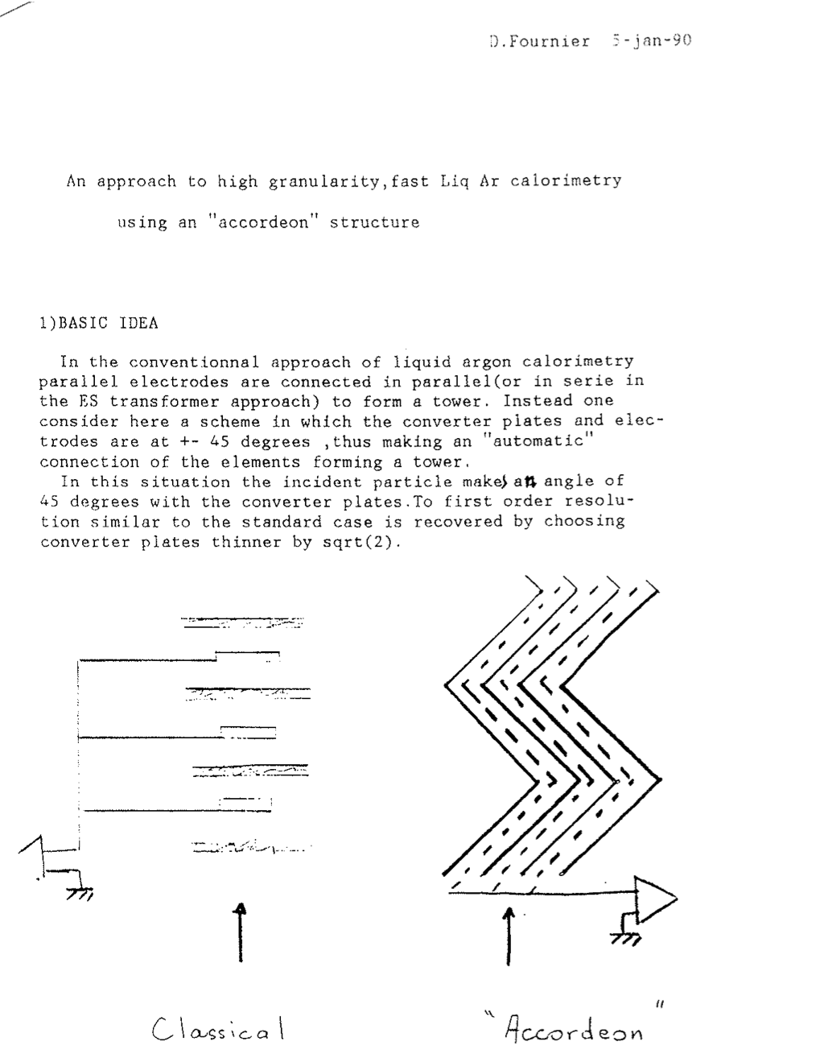
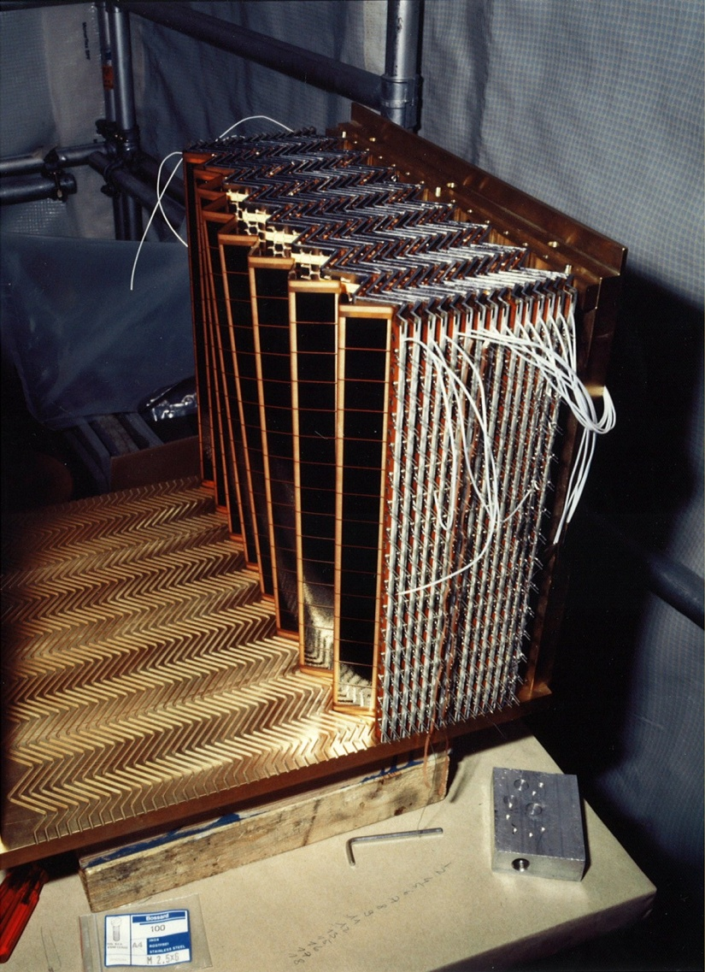
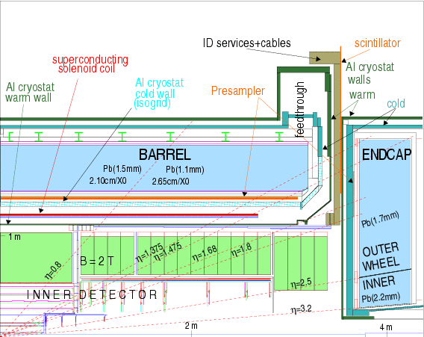
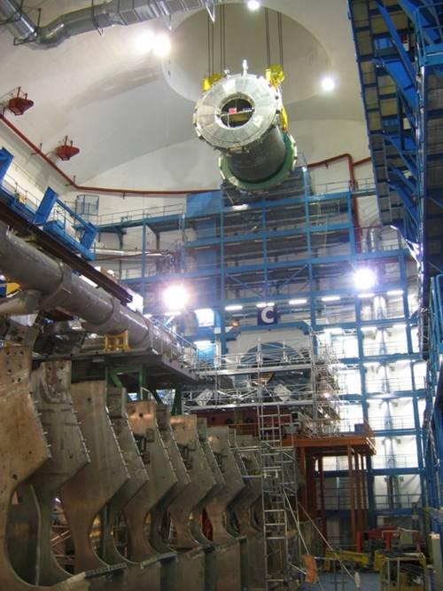
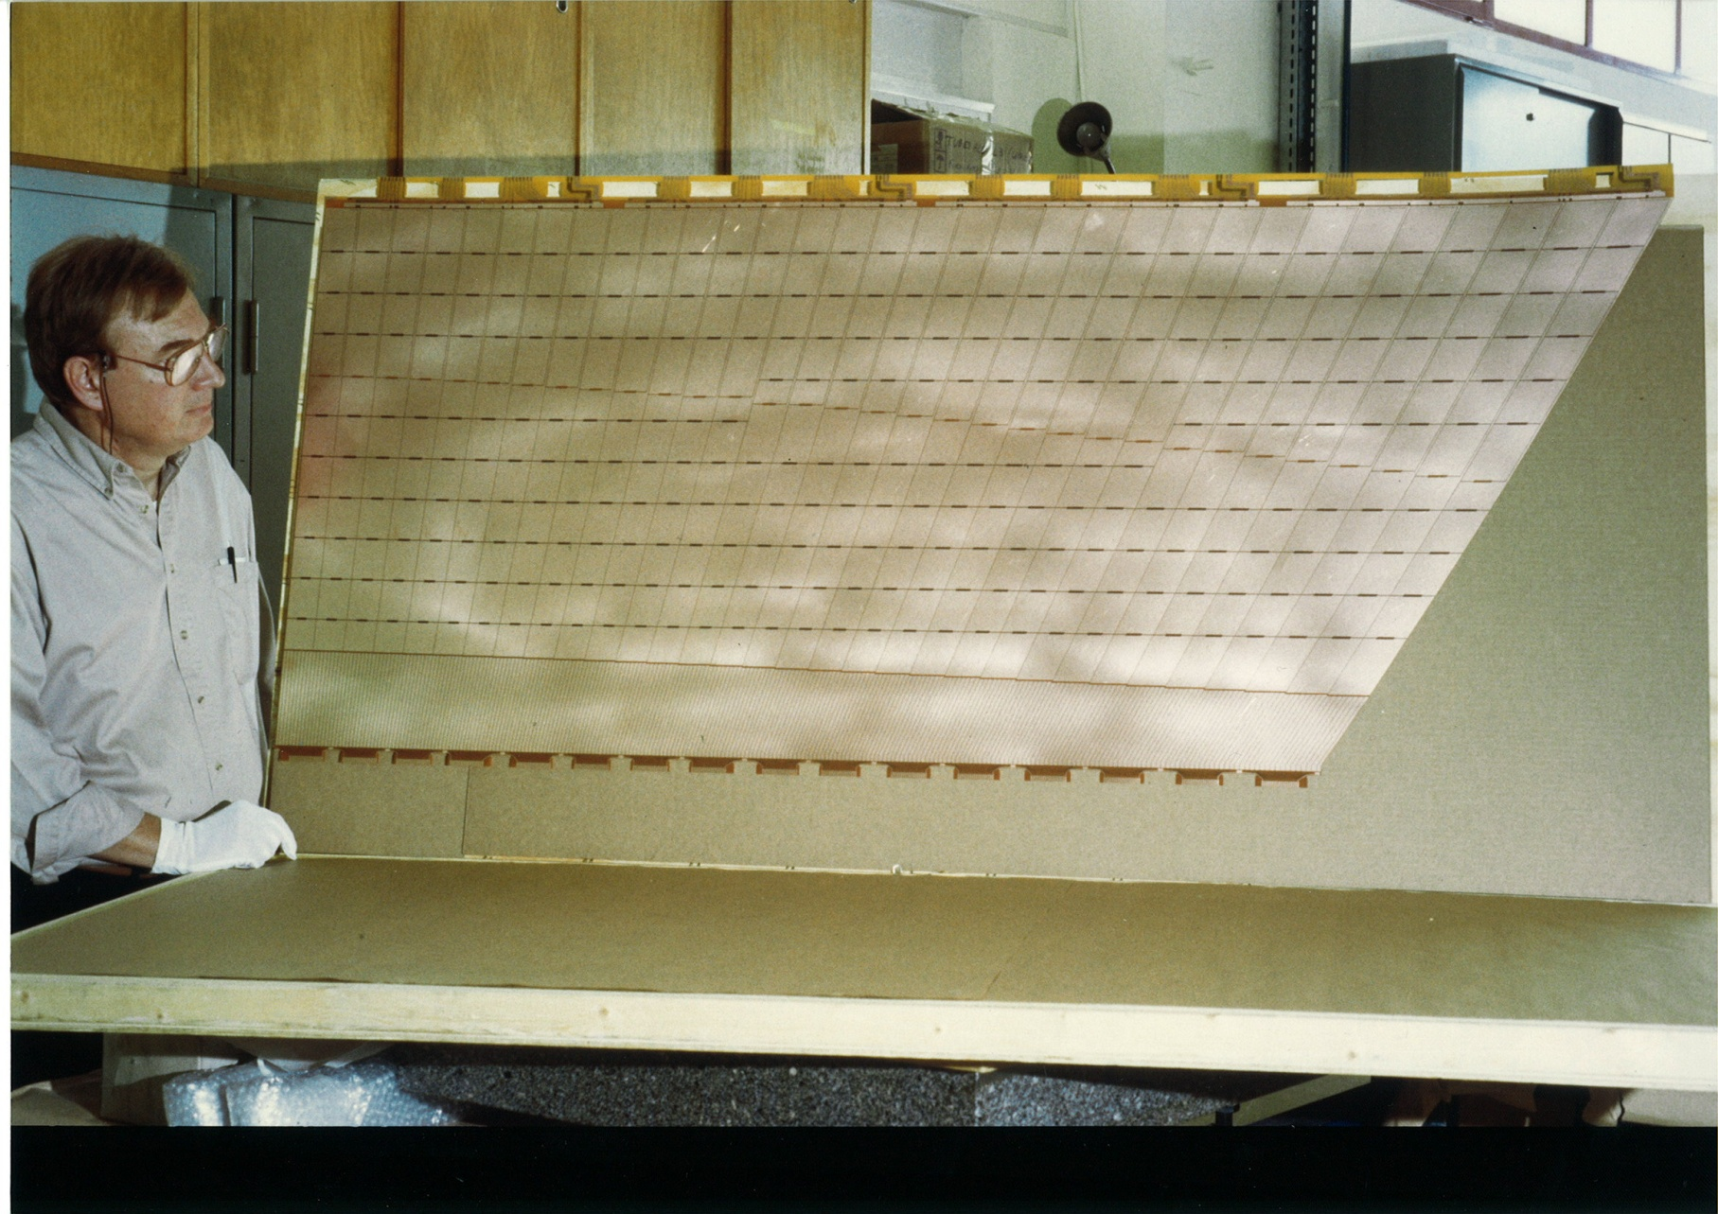
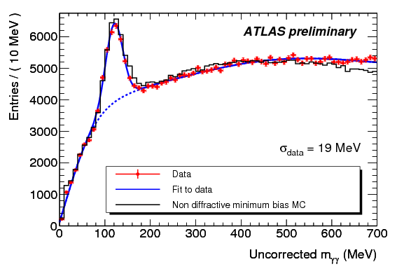
Technical Design Report Dec. 1996
First ideas Jan 1990
First prototype Jun 1990
Installation Oct.2004
Construction 1998
First π⁰ → γγ peak Dec. 2009

Slide 5
Technical Design Report Dec. 1996
H→ γγ ?? December 2011
First ideas Jan 1990
First prototype Jun 1990
Installation Oct.2004
Construction 1998
First π⁰ → γγ peak Dec. 2009

Slide 6
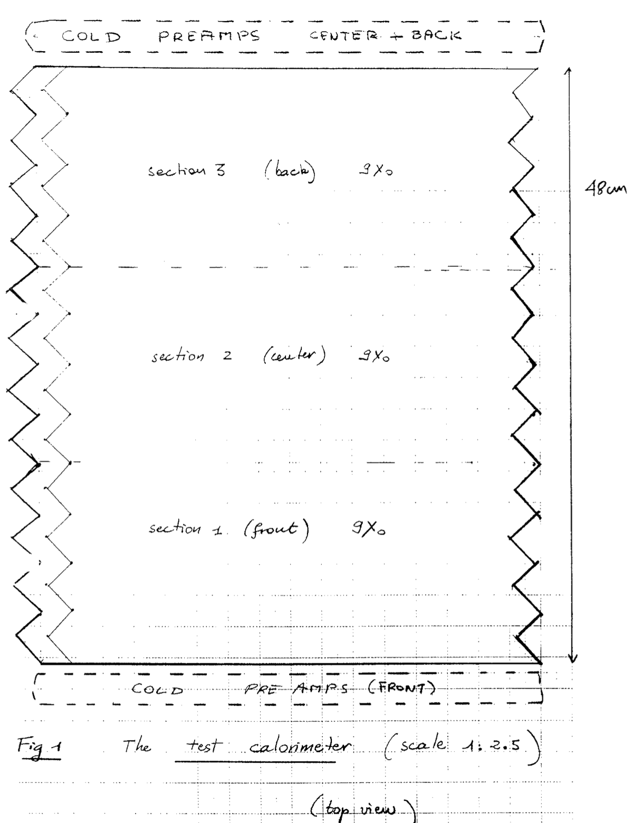
The first detailed engineering drawings ..

Slide 7
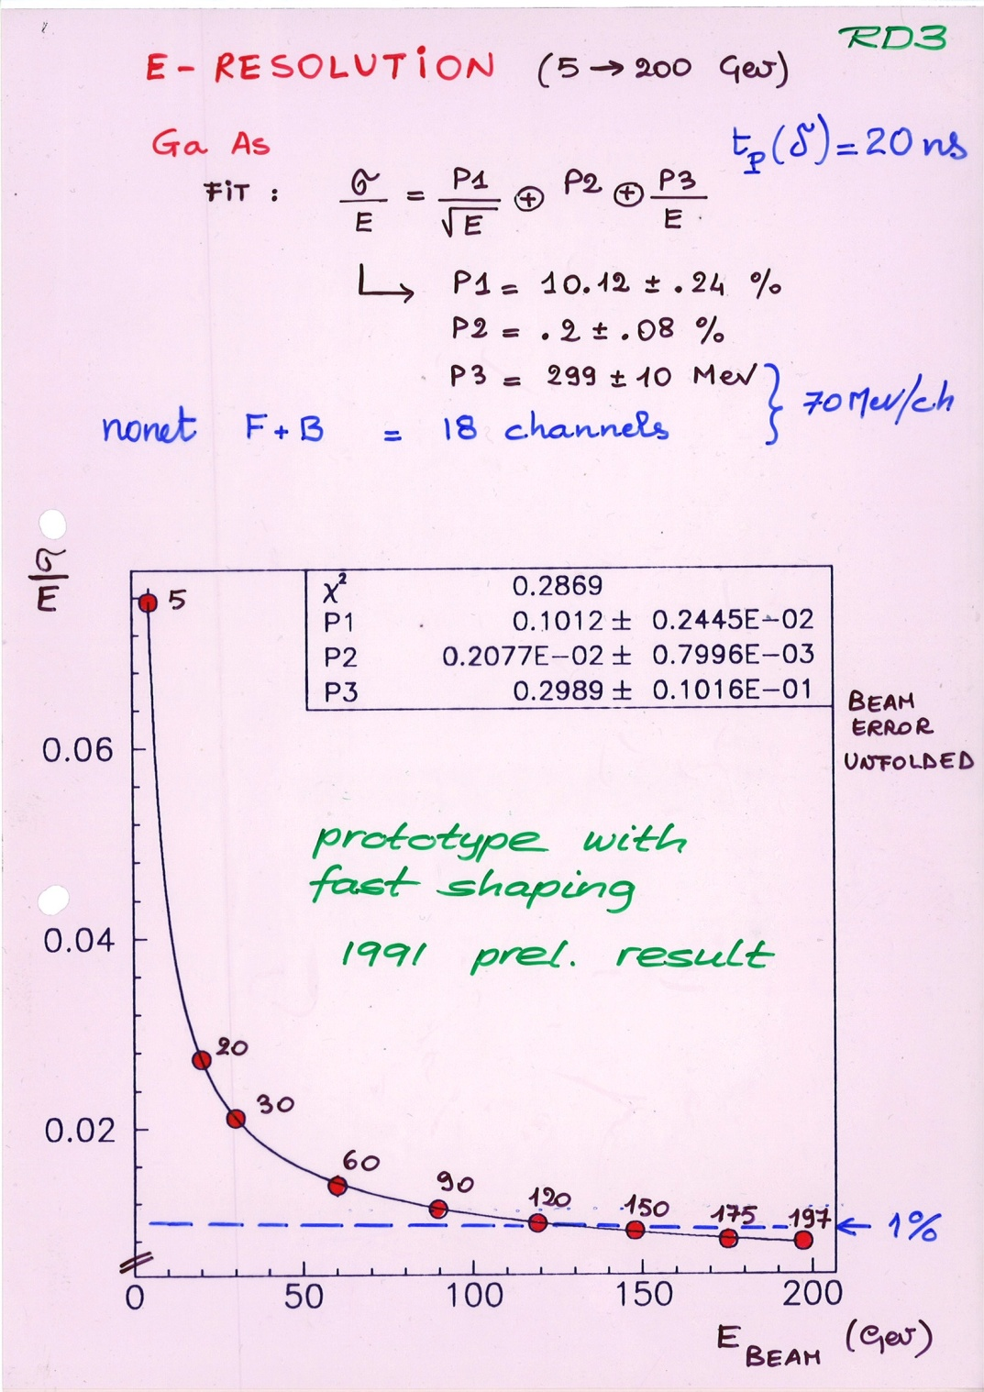
From P. Jenni
Test beam results obtained
with the prototype equipped
with fast electronics
(Note the historic document with the
handwriting of Daniel, Fabiola and PJ…)

Slide 8

From P. Jenni
Daniel’s role and impact in
shaping ATLAS as a whole since
the beginning is tremendous
Here some impressive examples of his top
responsibilities in the ATLAS project:
LAr Project Leader 1994 -2001
Executive Board 1994 – 2008
IN2P3 National Contact Physicist
Chair of the Inner Detector Review Panel
who managed to make the Collaboration
approve unanimously its tracking detector
system (in 1995) …

Slide 9
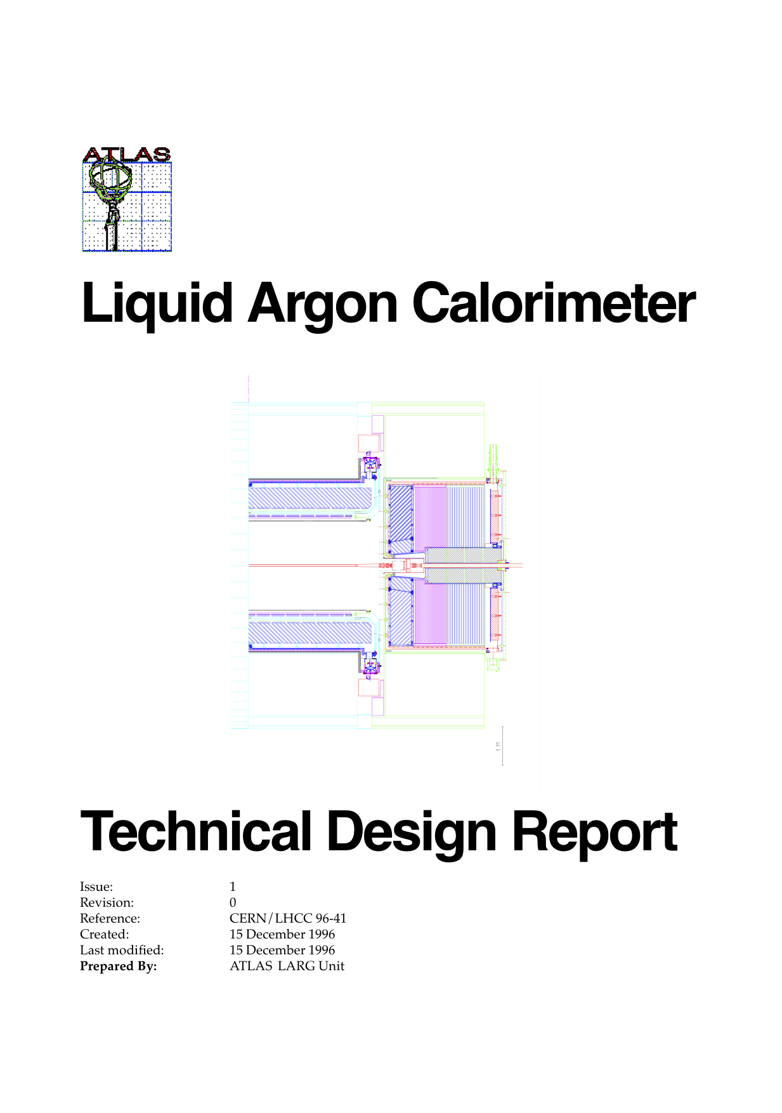
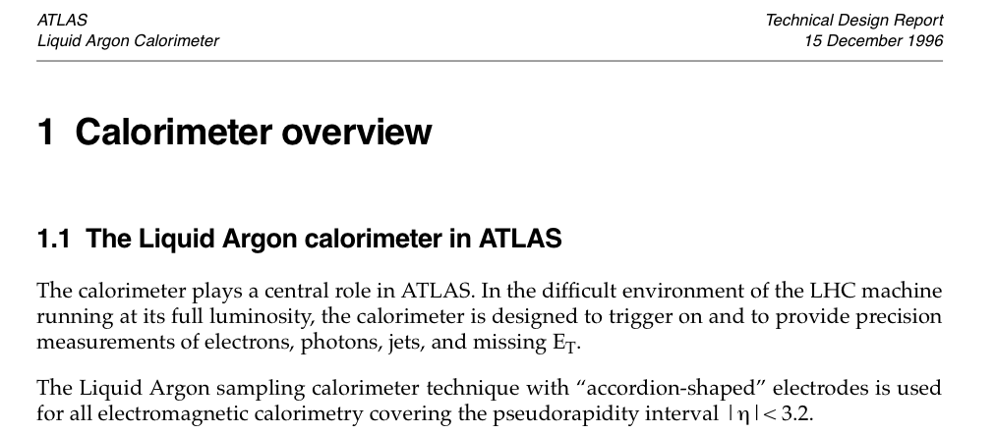
The 3 Calorimeter TDRs (Liquid Argon, Tiles, Performance)
were the first ones (out of a series of 15 ) submitted by ATLAS
The first version of this sentence (written by Daniel) was:
“The liquid-argon calorimeter is the masterpiece of ATLAS”
Peter Jenni, in his role as Spokesperson, managed to get it changed
to “The calorimeter plays a central role in ATLAS” after long
negotiations with Daniel

Slide 10
Main calorimeter requirements to meet the challenges of the difficult
LHC environment and physics goals:
radiation resistance
speed: ~ 50 ns → thanks to the Accordion geometry !
very good energy resolution → small constant term (~0.7%) → response uniformity !
lateral and longitudinal segmentation:
→ measure the shower direction
→ electron and photon identification, e.g. γ/jet and γ/π⁰ separation
H→ γγ has been the main benchmark channel for the technical choices
and and design optimization of the ATLAS EM calorimeter

Slide 11
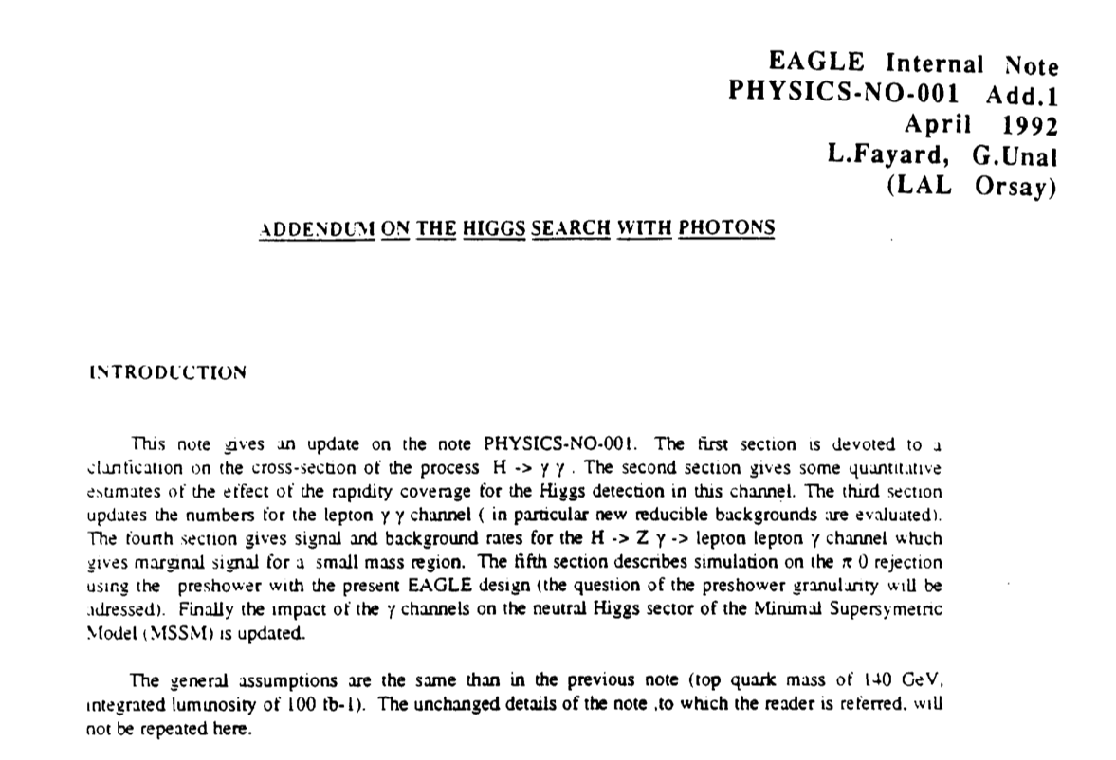
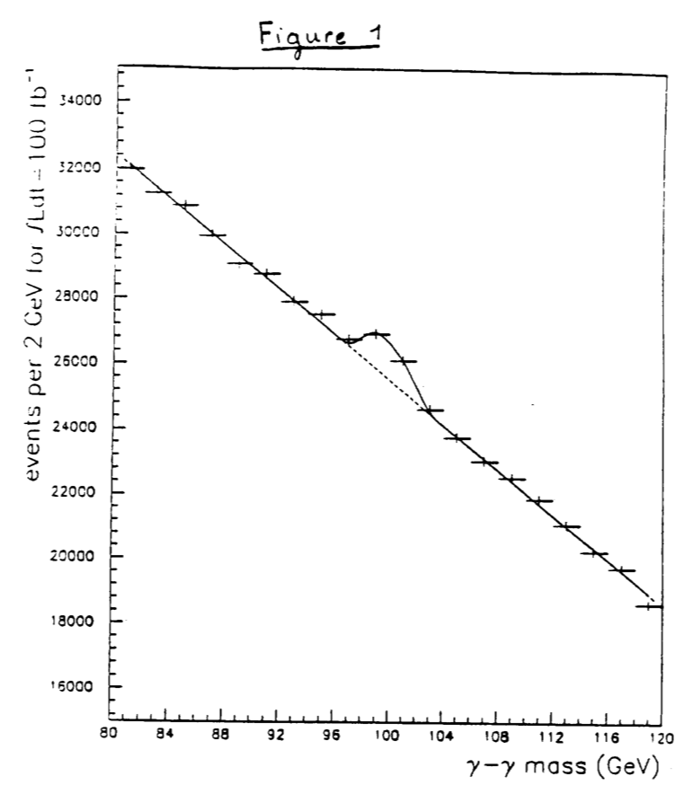
Since the first EAGLE/ATLAS note: L.Fayard and G.Unal ATLAS-PHYSICS-001
Small cross-section: σ ~ 40 fb
Huge irreducible background (γγ continuum) → S/B ~ 0.02
Potentially very large reducible background from γ-jet and jet-jet production with
jet → π⁰ faking single γ
Crucial experimental aspects:
very good γγ mass resolution to observe narrow signal peak above irreducible background
powerful γ/jet separation to suppress γj and jj background

Slide 12
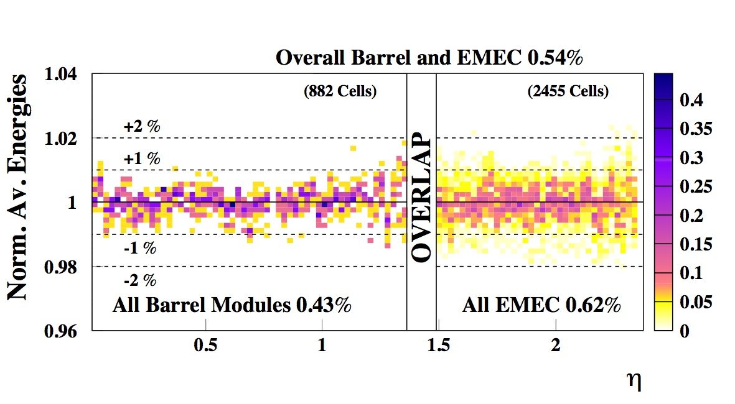
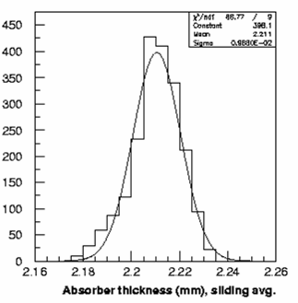
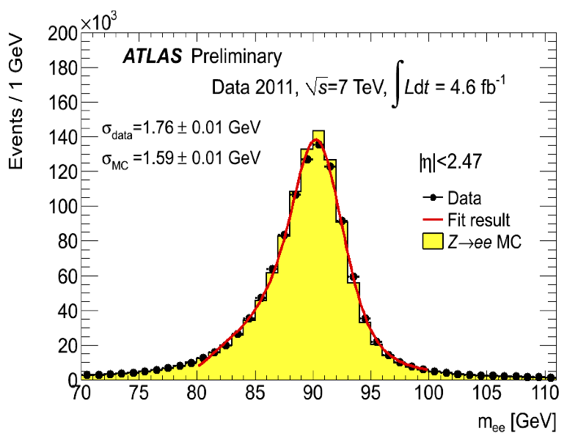
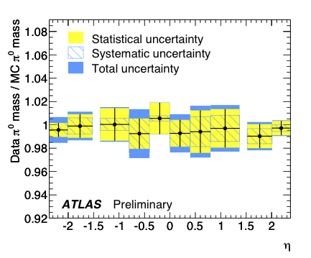
Construction: thickness of Pb plates
must be uniform to ~ 0.5% (~10 μm)
Beam tests : scans with high-E electrons of 4 (out of 32)
barrel and 3 (out of 16) end-cap modules
End-cap
(1536 plates)
< > ~ 2.2 mm
σ ≈ 9 μm
Overall uniformity: ~0.54%
m²_{γγ}= 2 E₁ E₂ (1-cosα)
Absorber thickness (mm)
Dec 2011: ~ 2M Z→ ee events
March 2010: π⁰→ γγ data (√s=900 GeV)
MC has no
constant term
in this case
Overall uniformity: ~±2%
Costant term:1%(barrel), 1.7% (end-cap)

Slide 13

At each step: a huge amount of detailed work made to understand and correct for
many subtle effects → Enormous progress, excellent accomplishments, but still
some work to do to achieve the ~0.7% goal over the full calorimeter coverage
Courage ! After all
“a liquid-argon calorimeter is easy to calibrate .. ”
(Daniel Fournier dixit)

Slide 14
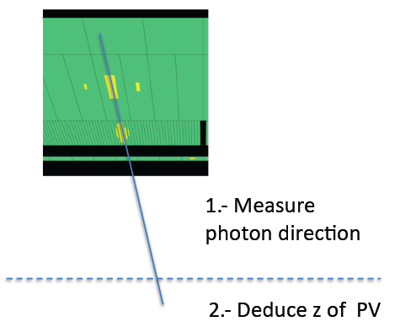
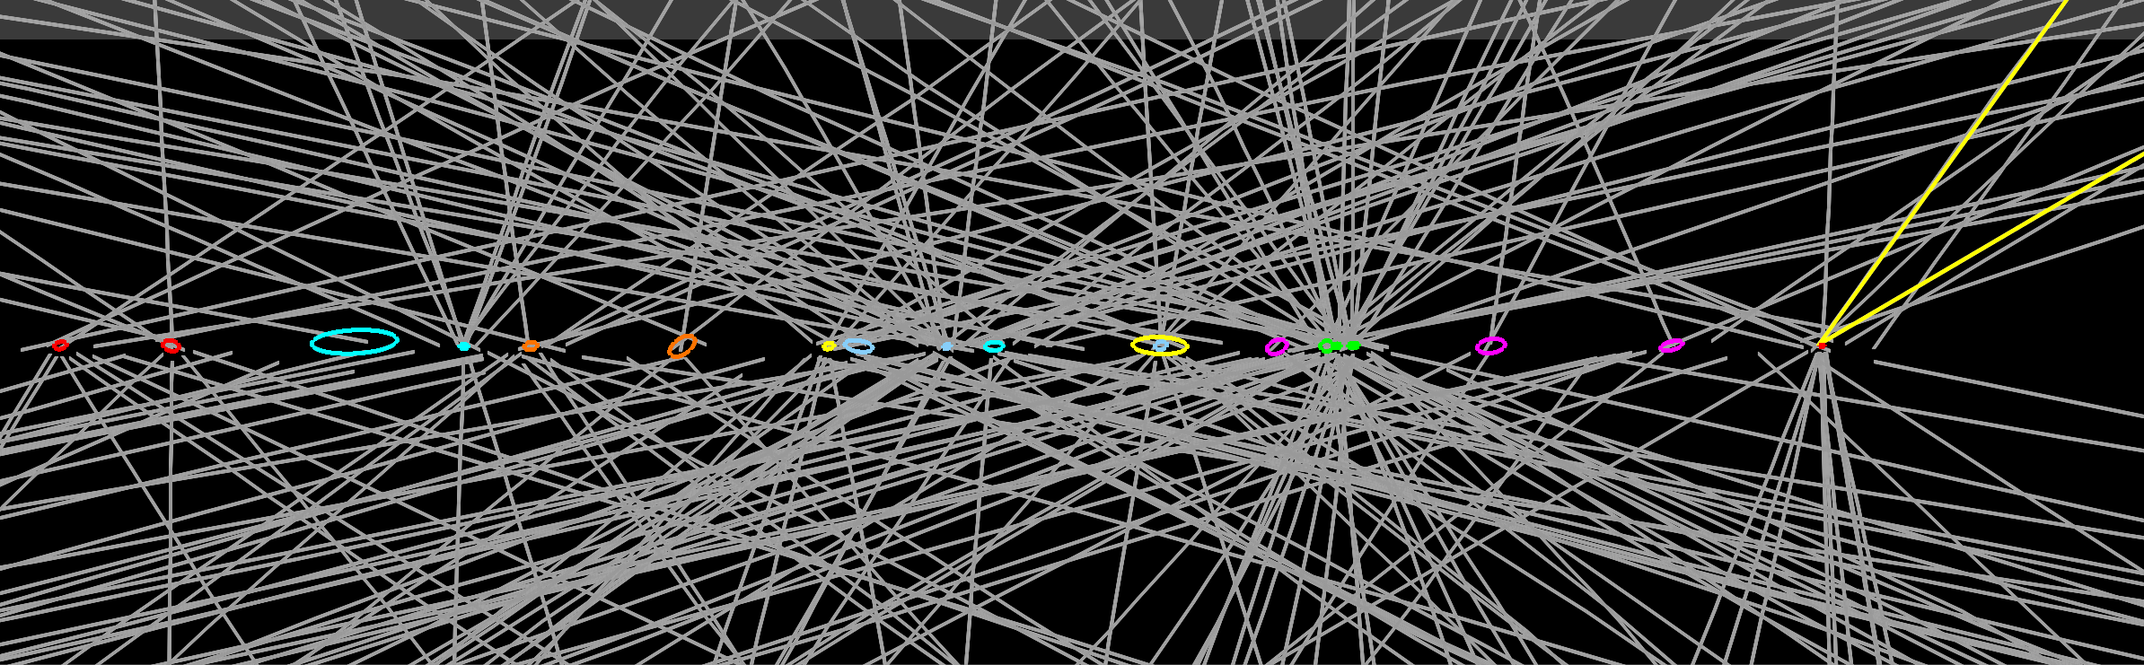
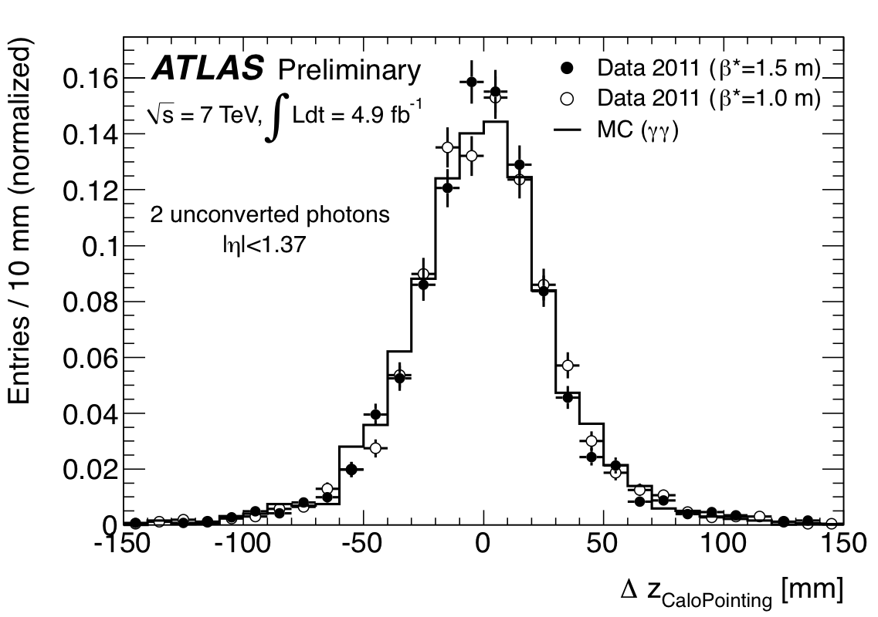
m²_{γγ}= 2 E₁ E₂ (1-cosα)
α=opening angle of
the two photons
Since the early days, one of the reasons for the longitudinal (and lateral) segmentation of the EM calorimeter was the possibility of measuring the photon polar angle ϑ independently of the knowledge of the primary vertex → crucial at high pile-up: many vertices distributed over σ_{Z} (LHC beam spot) ~ 5.6 cm → difficult to know which one produced the γγ pair
ϑ
Deduce Z
of primary
vertex
Z-vertex from calorimeter “pointing”
as measured in γγ events
σ_{Z} ~ 1.5 cm
Calorimeter pointing capability
reduces vertex uncertainty from
~ 5.6 cm (LHC beam spot) to ~ 1.5 cm
Contribution to mass resolution from
angular term is negligible with calo
pointing (γ →ee vertex also used)
Robust against pile-up
Z (γ₁) – Z (γ₂)

Slide 15
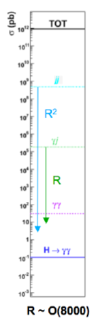
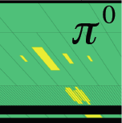
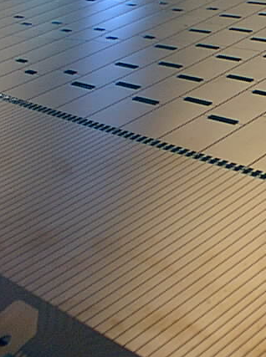
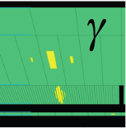
Potentially huge background from γj and jj production with jets fragmenting into a single
hard π⁰ and the π⁰ faking single photon
Determined choice of fine lateral segmentation (4mm η-strips)
of the first compartment of ATLAS EM calorimeter
jj
~ 500 μb
Data
γj
~ 200 nb
E_{T}~ 21 GeV
Layer 2
~ 30 pb
η-strips
η
H → γγ
~ 40 fb
E_{T}~ 32 GeV
Layer 1

Slide 16
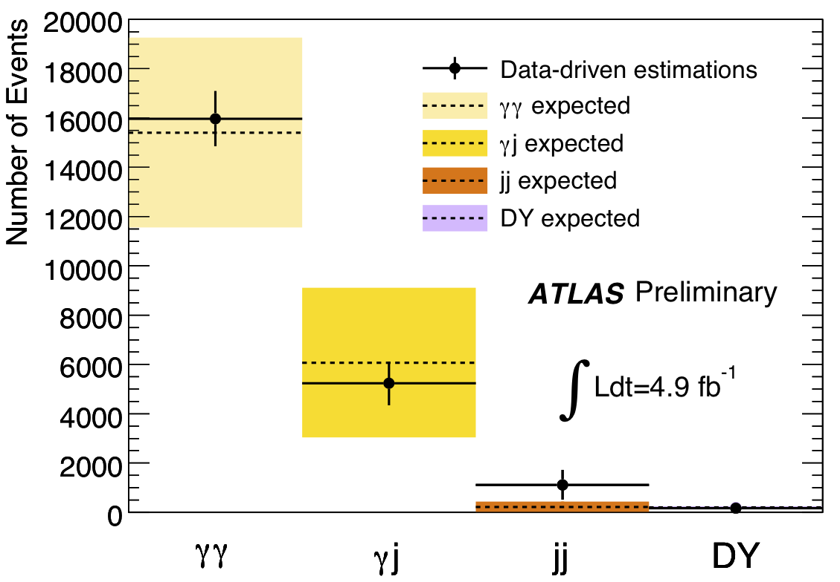
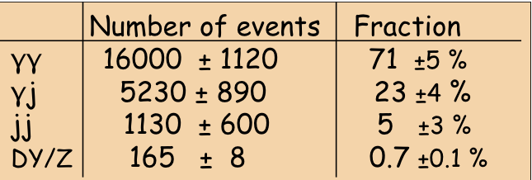
R(π⁰)
γ/π⁰ separation power of the η-strips demonstrated
with extensive simulations and, in 1999-2000, with
a dedicated test-beam of the calorimeter module zero”
factor ~ 3 rejection needed for H→ γγ achieved;
good agreement data-MC
However: huge uncertainties on σ (γj, jj) !!
→ not obvious γj, jj could be suppressed
well below irreducible γγ until we measured
them with data
E_{min}(γ)/E(π⁰)
Final γγ sample selected by the H→ γγ analysis : 22489 events with 100 < m_{γγ} < 160 GeV
γj + jj << γγ irreducible (purity ~ 70%)

Slide 17
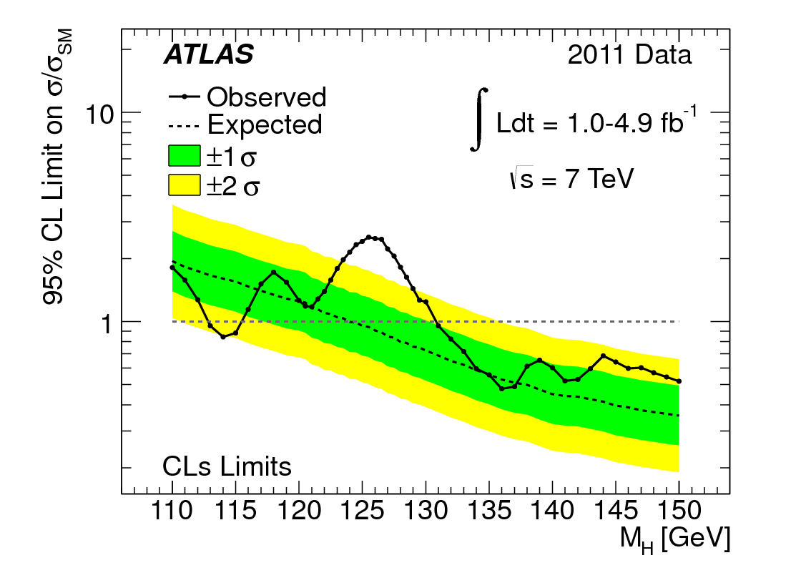
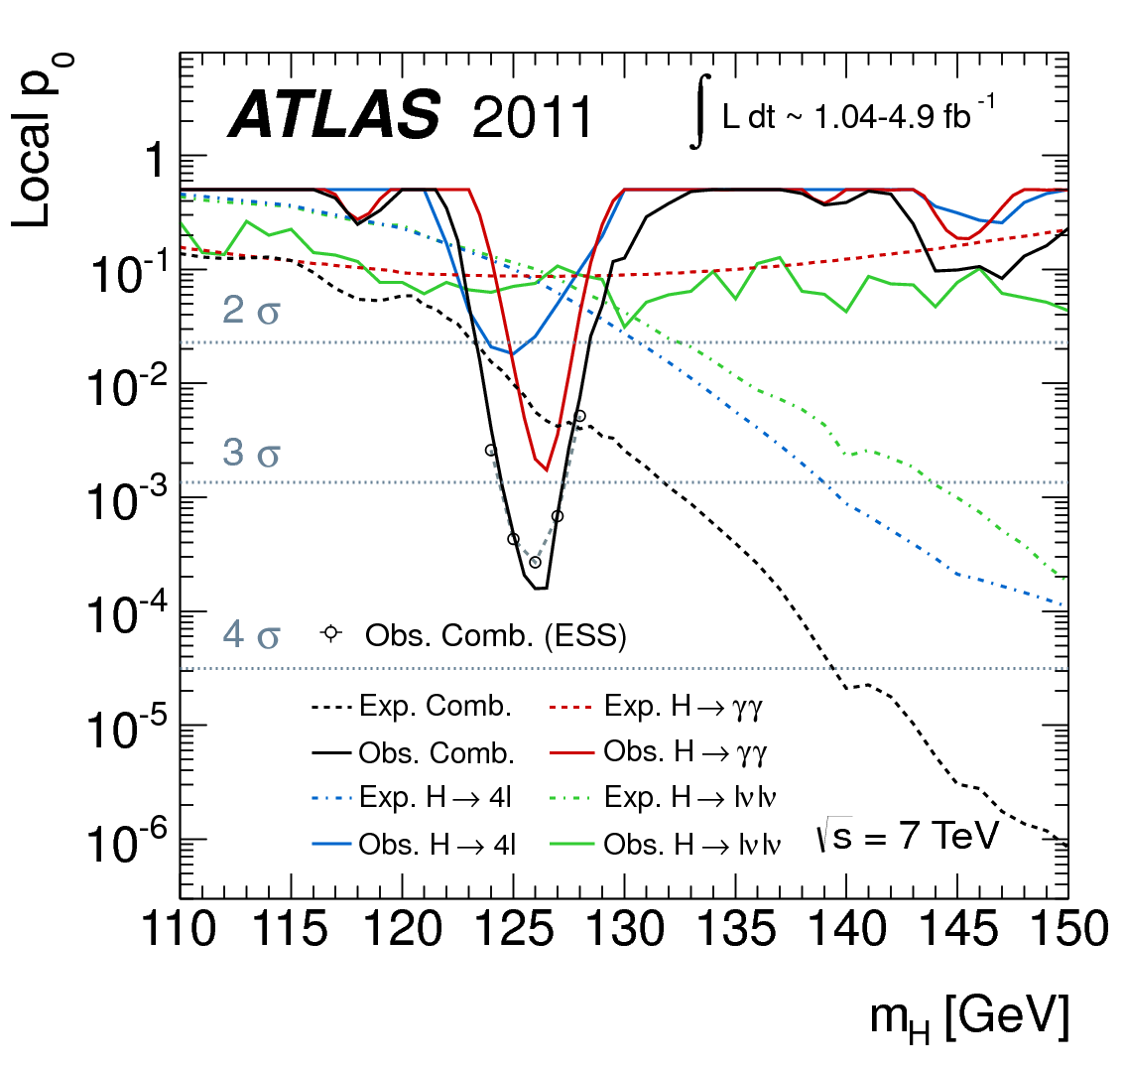
lO
Latest SM Higgs results from ATLAS
(based on data and results present on 13/12/2011;
papers submitted to PLB and PRL on 7/2/2012)
Un-excluded (95% CL) window in the low-mass region:
115.5-131 GeV
Excess around m_{H} ~ 126 GeV:
-- local significance: 3.5 σ (expect 2.5σ)
-- global significance (with Look-Elsewhere-Effect): 2.2σ

Slide 18
lO
Latest SM Higgs results from ATLAS
(based on data and results present on 13/12/2011;
papers submitted to PLB and PRL on 7/2/2012)
Un-excluded (95% CL) window in the low-mass region:
115.5-131 GeV
Excess around m_{H} ~ 126 GeV:
-- local significance: 3.5 σ (expect 2.5σ)
-- global significance (with Look-Elsewhere-Effect): 2.2σ
More work and more data are needed to draw definite conclusions
2012 will be the “year of the Higgs” (whatever the search results)
For sure the EM calorimeter has been and will be a “masterpiece”
(note: in the sense of pièce maîtresse) in these searches !

Slide 19
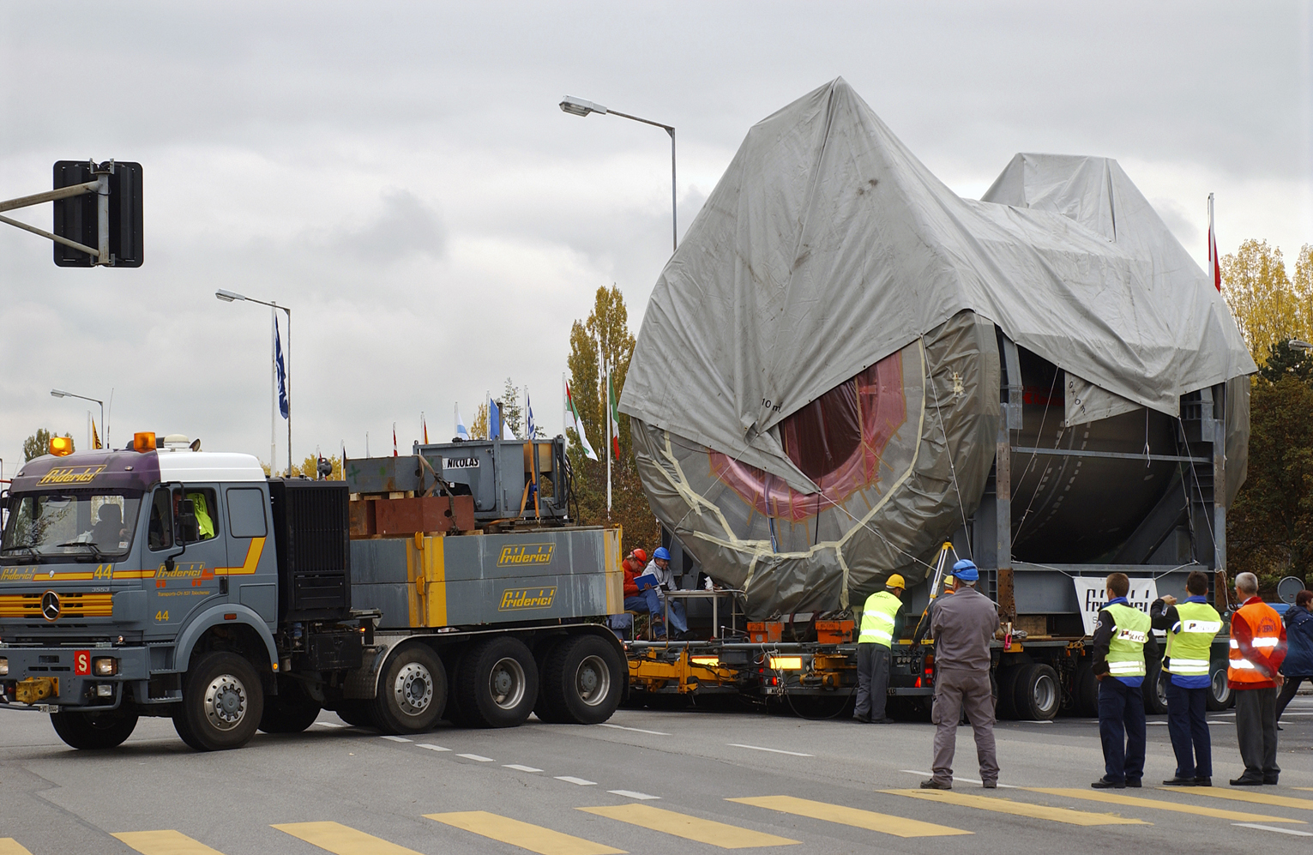
A masterpiece of ATLAS ready for installation
Thank you, Daniel !
for
A GREAT idea
The determination and the strength to pursue it
The ingenuity and energy to face a huge amount of challenges and difficulties
in a long (~ 20 years) path from first conception to operation
The attention to details without losing sight of the overall goal
The capability of attracting, motivating and organizing a huge international community
(37 Institutions and > 400 scientists were involved in the Liquid-Argon TDR)
MORE IN GENERAL, YOUR OUTSTANDING (PAST, PRESENT
AND FUTURE) CONTRIBUTIONS TO ATLAS
Barrel LAr EM calorimeter transport to LHC Point-1 (27-Oct-2004)

Slide 20
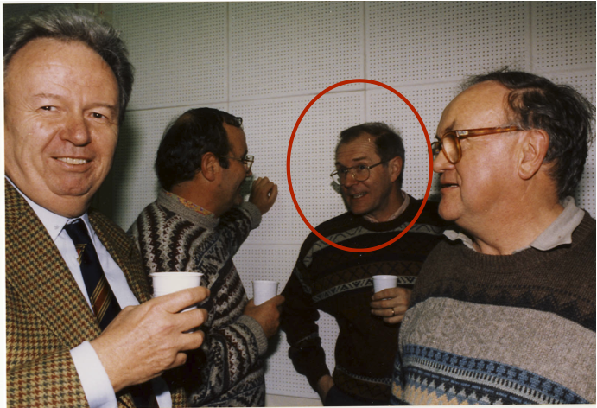


OUR BEST CONGRATULATIONS TO
DANIEL ON SUCH A PRESTIGIOUS
AND WELL-DESERVED AWARD !

Slide 21
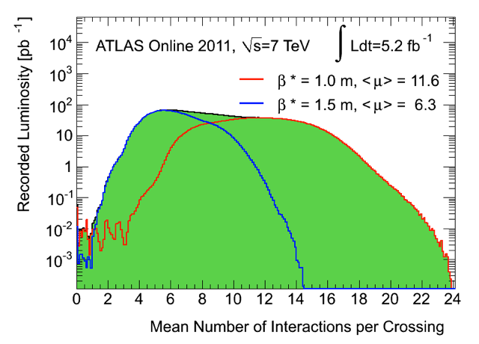
Price to pay for the high luminosity:
larger-than-expected pile-up
Pile-up = number of interactions per crossing
Tails up to ~20 → comparable to design luminosity
(50 ns operation; several machine parameters pushed beyond design)
LHC figures used over the last 20 years:
~ 2 (20) events/crossing at L=10³³ (10³⁴)
Period A:
up to end
August
Period B:
Sept-Oct
Event with 20
reconstructed vertices
(ellipses have 20 σ size for
visibility reasons)
Z→ μμ
Challenging for trigger, computing resources, reconstruction of physics objects
(in particular E_{T}^{miss}, soft jets, ..)
Precise modeling of both in-time and out-of-time pile-up in simulation is essential

Slide 22
A full set of slides prepared
by Peter Jenni follows

Slide 23
Message from Peter Jenni, today at JINR Dubna in Russia…
My cordial congratulations,
Daniel, for this great and so
well-deserved honour of
receiving the prestigious
Prix J. Ricard SFP 2011 !
It would have been a great pleasure
for me to spend some friendly moments
here celebrating and remembering with
you the fantastic time we have shared
over more than two decades on ATLAS
already, and which, of course, I’m looking
forward to continuing with great results soon !

Slide 24
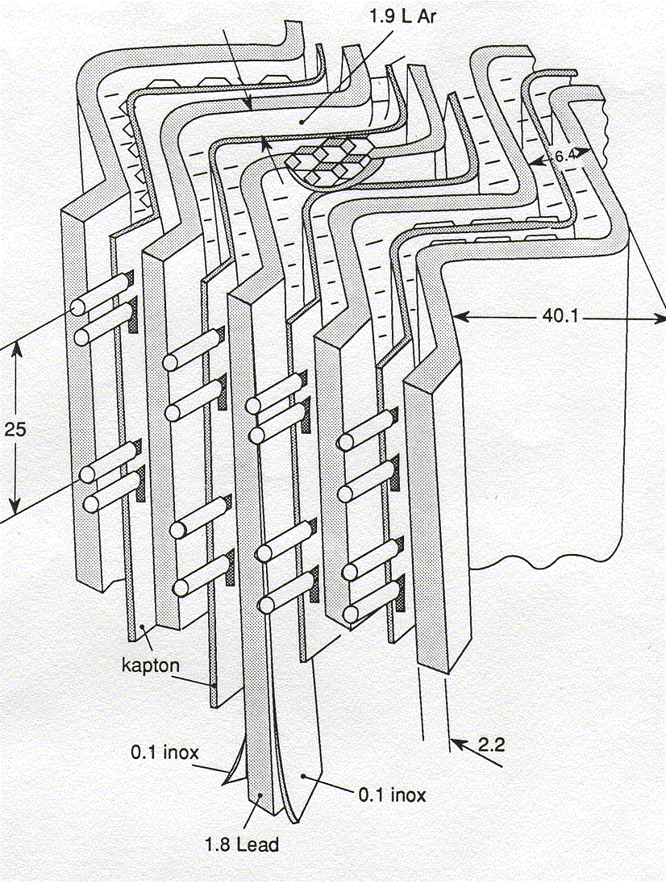
Our friendship and collaboration
started in the late 1980s with
Daniel’s brilliant idea of how to
make a LAr EM calorimeter for LHC
The famous LAr Accordion
EM Calorimeter of ATLAS was
born!
In the following a few historical pictures and
plots recall the very early years…

Slide 25
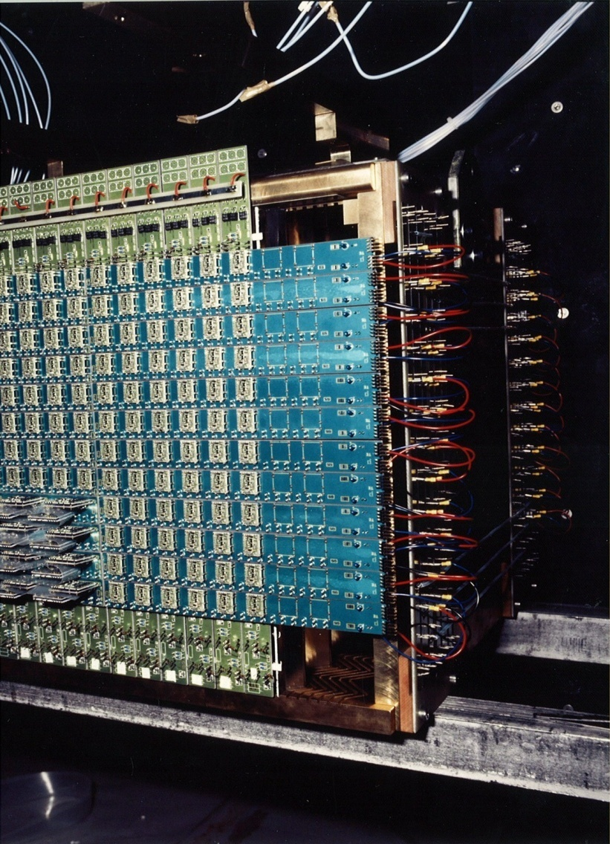
First prototype built in the very early 1990s when Daniel
was at CERN for an exciting year …

Slide 26
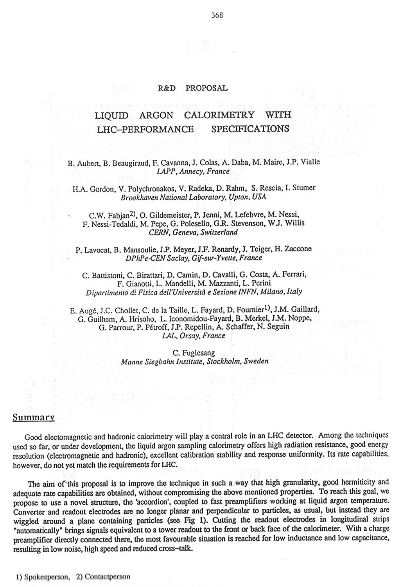
Daniel presented the concept
and first results at the famous
LHC Workshop in Aachen
4-9 October 1990 (as an R&D
Proposal), which then became
known as the highly successful
RD3 project.
Of course, Daniel was
the Spokesperson of RD3

Slide 27
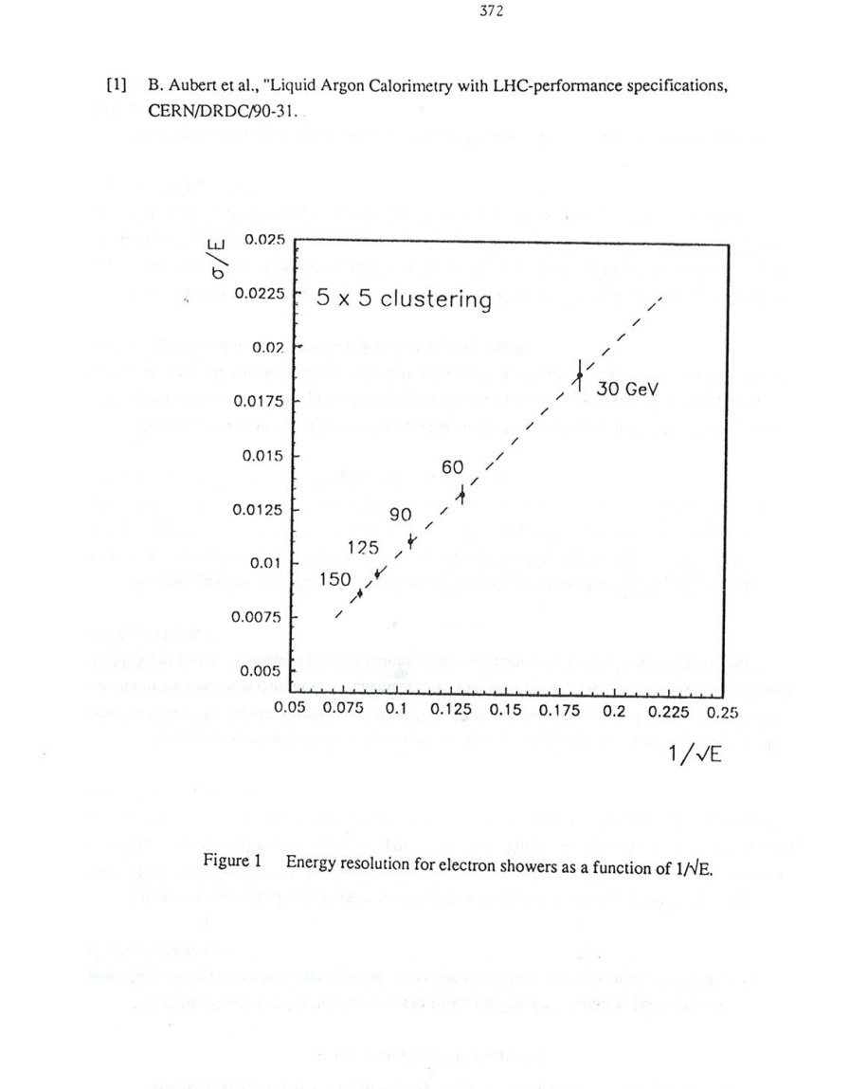
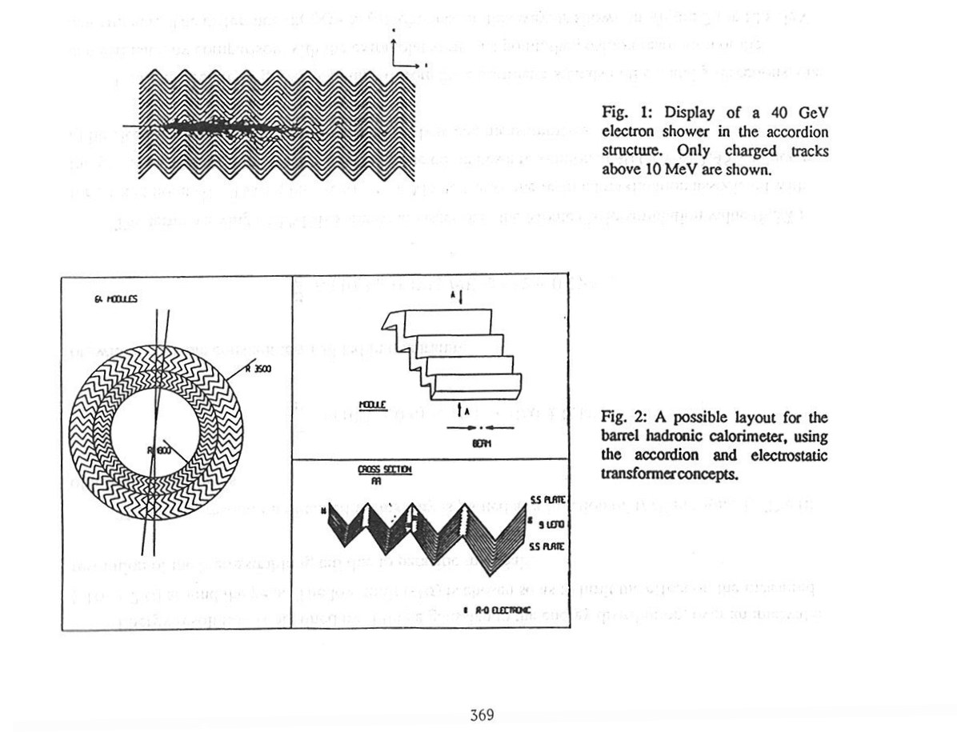
From the Aachen proceedings: the concept, and result of the first prototype

Slide 28
Test beam results obtained
with the prototype equipped
with fast electronics
(Note the historic document with the
handwriting of Daniel, Fabiola and PJ…)

Slide 29
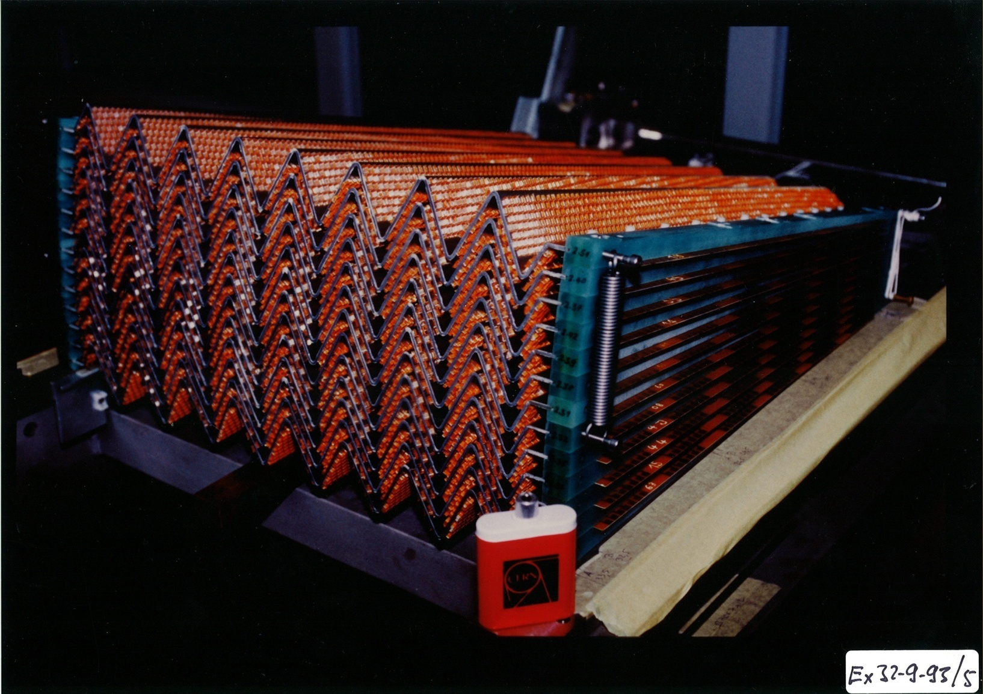
First prototype of an end-cap LAr EM Accordion
(an optimized version was implemented later on)

Slide 30
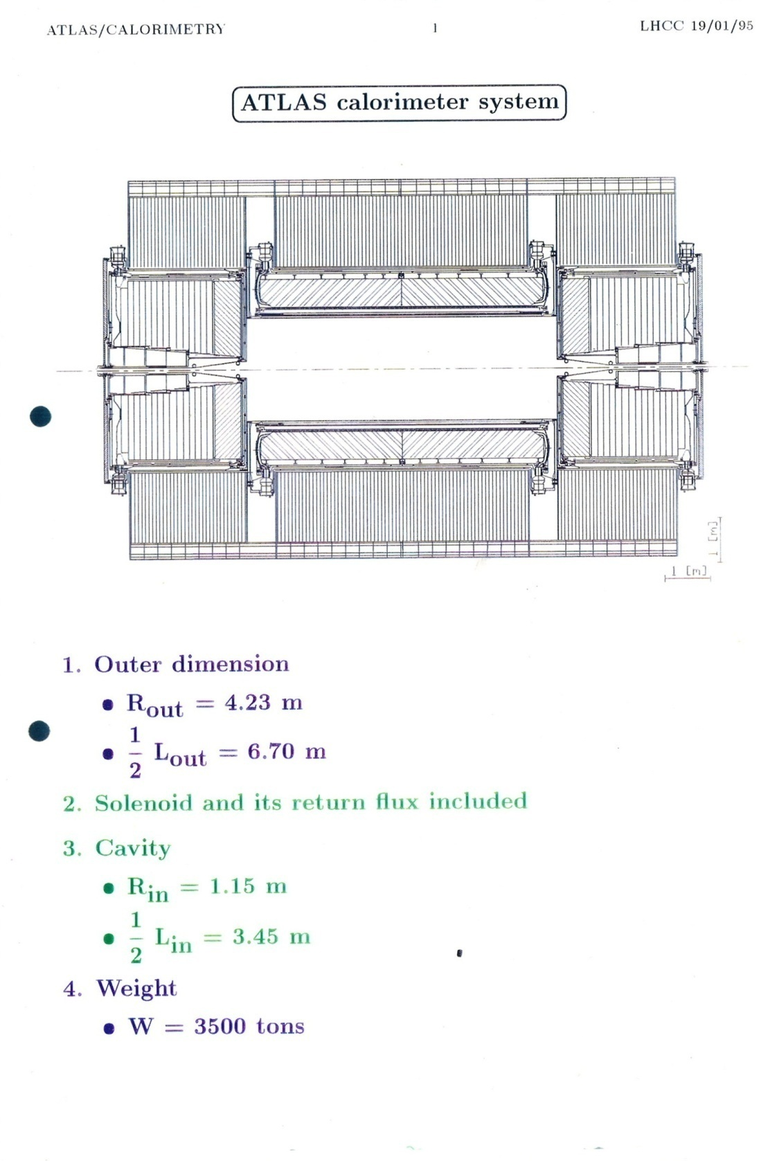

Daniel presented the ATLAS
Calorimetry at the LHCC on
19 January 1995

Slide 31
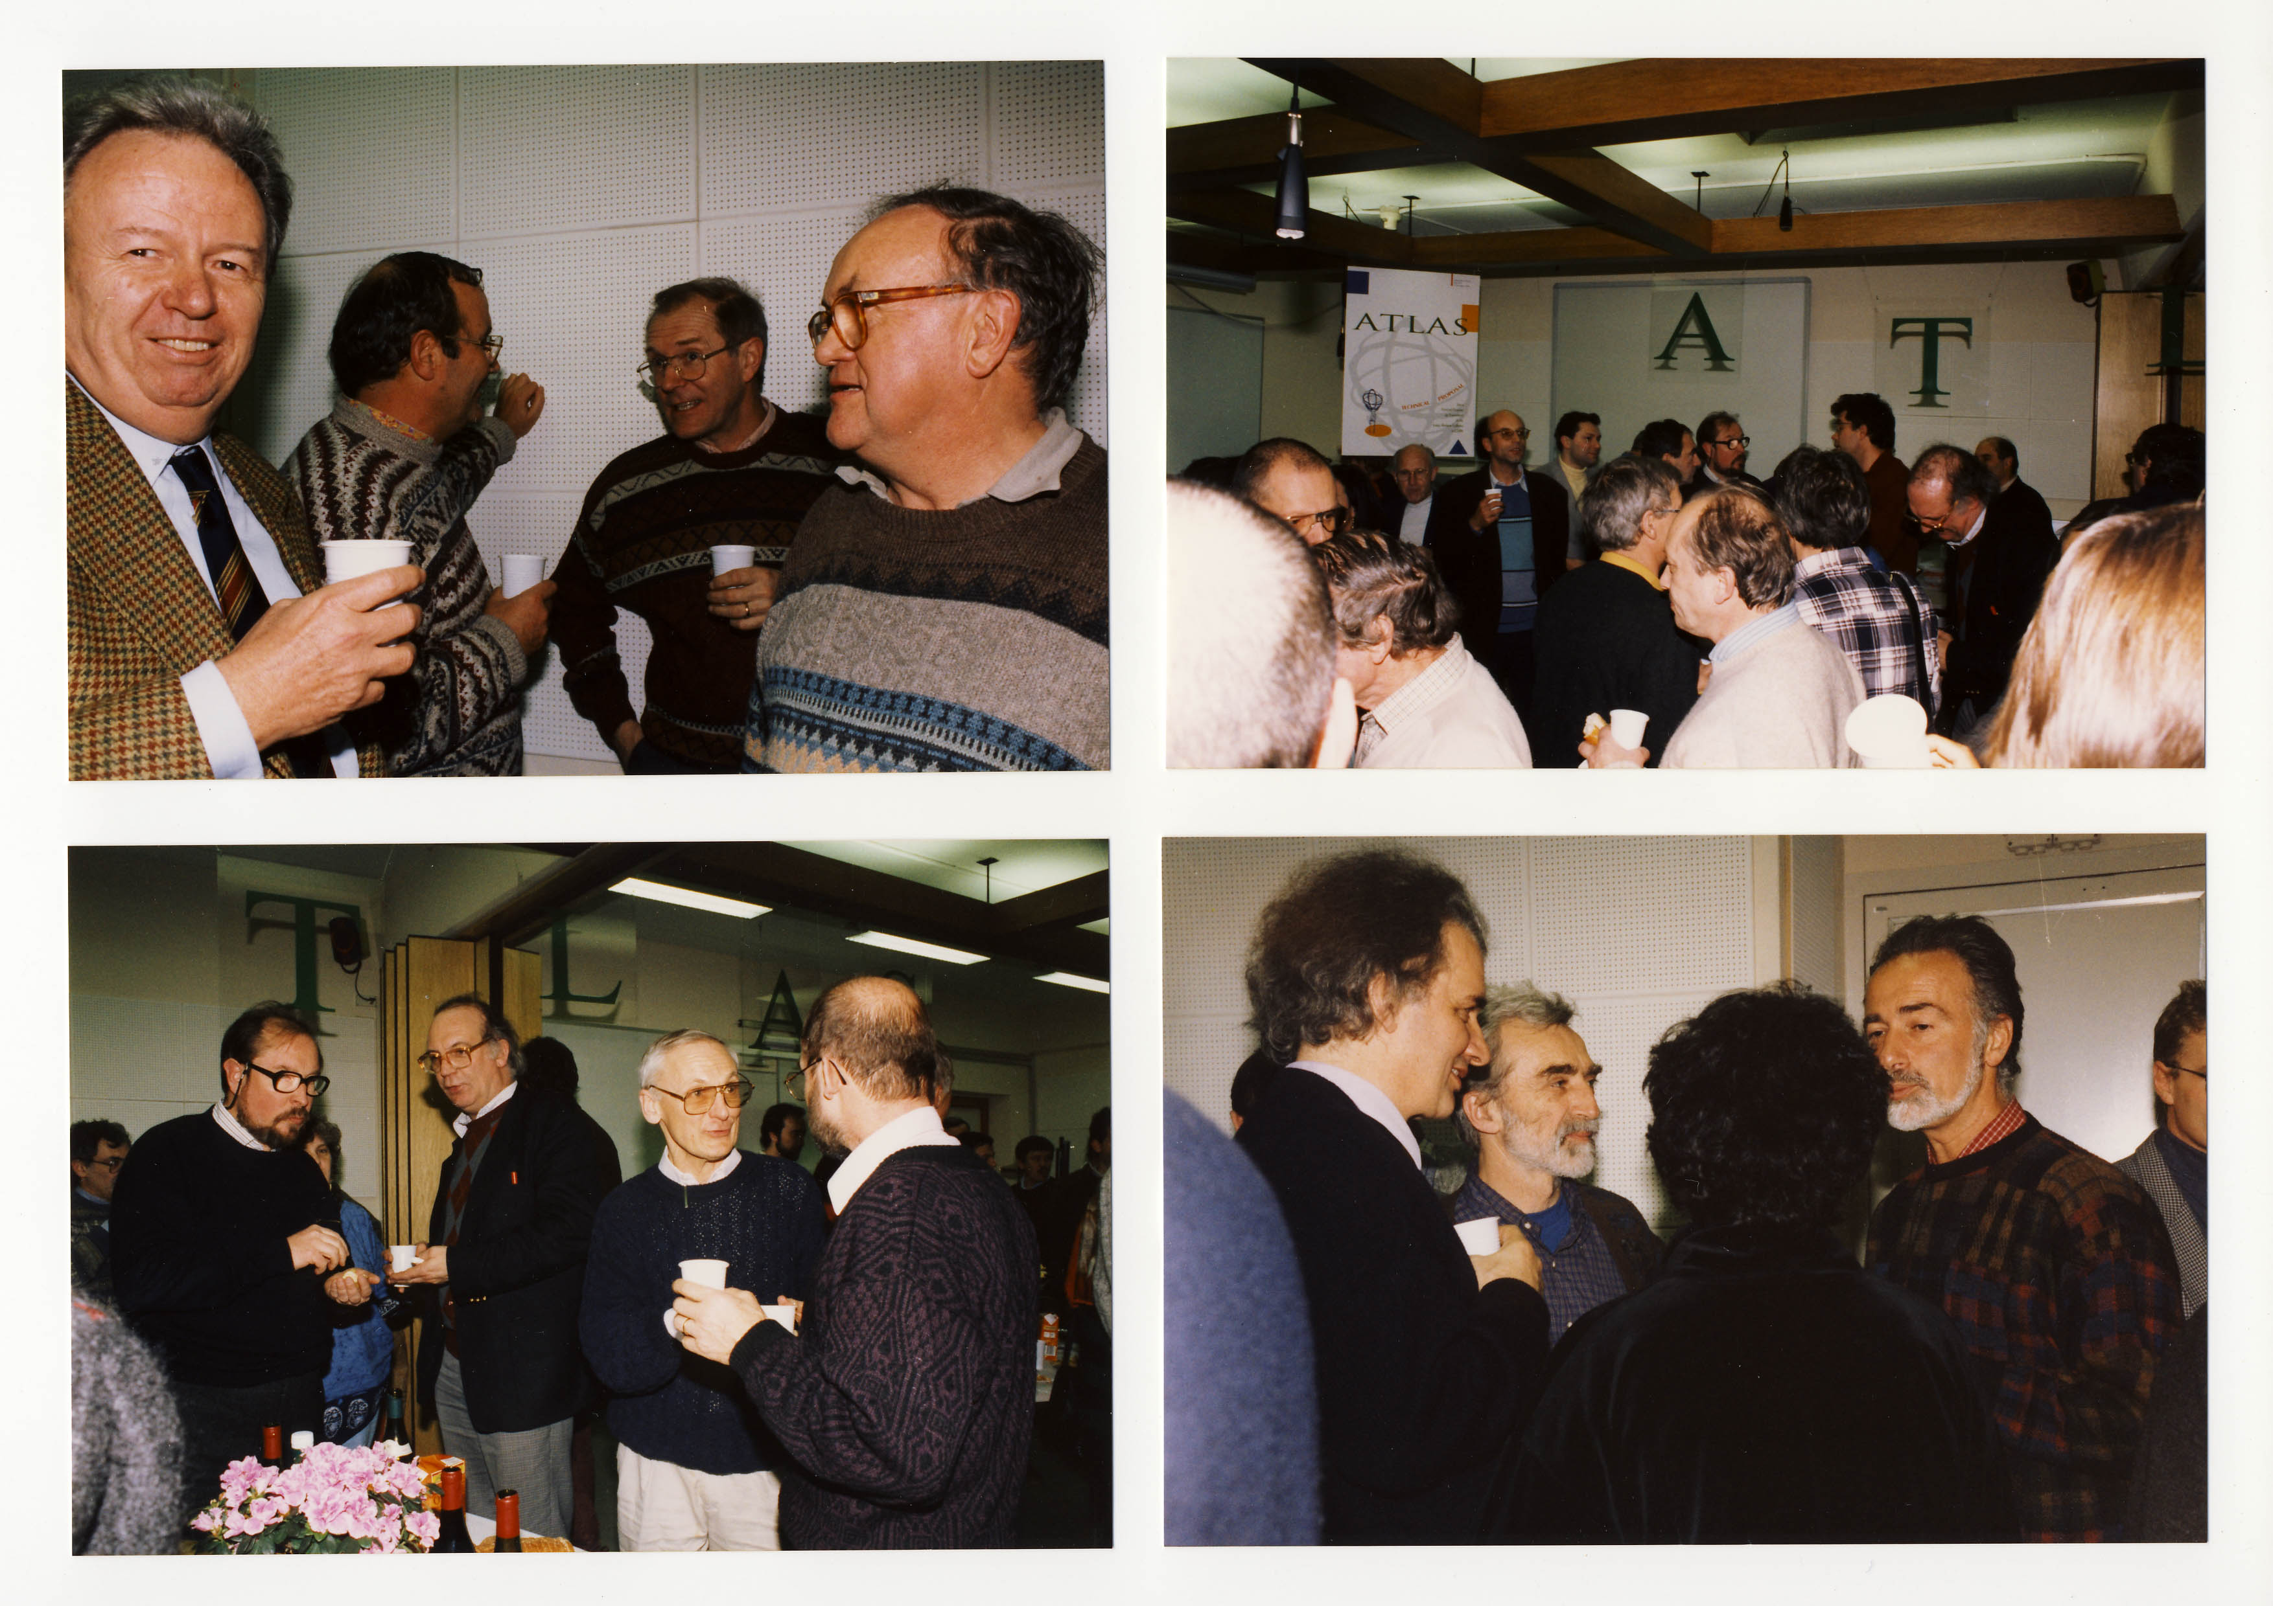
The submission of the Technical Proposal was duly celebrated …

Slide 32
Daniel’s role and impact in
shaping ATLAS as a whole since
the beginning is tremendous
Here some impressive examples of his top
responsibilities in the ATLAS project:
LAr Project Leader 1994 -2001
Executive Board 1994 – 2008
IN2P3 National Contact Physicist
Chair of the Inner Detector Review Panel
who managed to make the Collaboration
approve unanimously its tracking detector
system (in 1995)
…

Slide 33
A masterpiece of ATLAS ready for installation
Thank you, Daniel !
Barrel LAr EM calorimeter transport to LHC Point-1 (27-Oct-2004)

