Slide 2
Layout & Param.s
0.4 T Solenoid
AMD
TM020
L BAND
L BAND
0.5 m
3.33 m
6. m
AMD field drop from 5 to 0.4 T in 0.5 meters
Input distribution 1.5 GeV

Slide 3
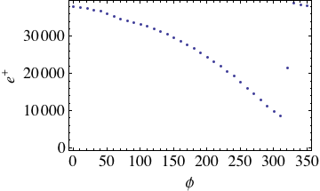
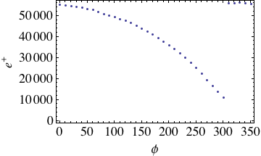
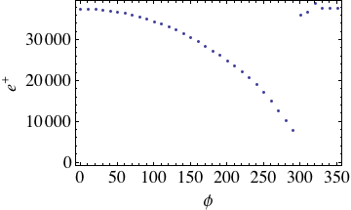
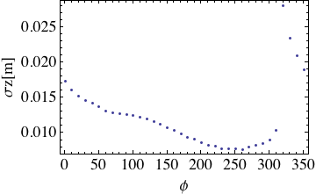
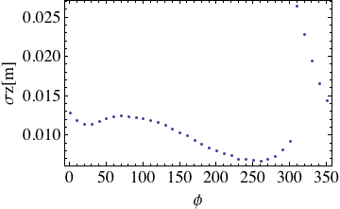
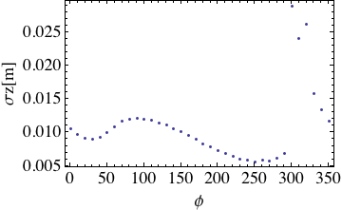
TM020 Phase & Field Scan
Emax=10 Mv/m
Emax=15 Mv/m
Emax=20 Mv/m
Number of particle and length of the e+ distribution at the end of the TM020 cavity.
Only e+ in [-.05,.05] interval are taken into account

Slide 4
TM020 Output
ϕ=30
ϕ=280

