Slide 1
Management Overview
StratusLab Final Periodic Review
Brussels, Belgium
10 July 2012

Slide 2






StratusLab Project
Goal
  Create comprehensive, open-source,
  IaaS cloud distribution
  Focus on supporting grid services
Information
  1 June 2010—31 May 2012 (2 years)
  6 partners from 5 countries
  Budget : 3.3 M€ (2.3 M€ EC)
Contacts
  Site web: http://stratuslab.eu/
  Twitter: @StratusLab
  Support: support@stratuslab.eu
CNRS (FR)
UCM (ES)
GRNET (GR)
SIXSQ (CH)
TID (ES)
TCD (IE)

Slide 3
Introductions
All partners and all activities are represented.
Charles LOOMIS | CNRS/LAL | Project coordinator, WP2 manager
Ruben MONTERO | UCM | Technical coordinator
Kathryn CASSIDY | TCD | WP3 manager
Marc-Elian BEGIN | SixSq | WP4 manager
Vangelis FLOROS | GRNET | WP5 manager
Henar MUNOZ | TID | WP6 manager
Christophe BLANCHET | CNRS/IBCP | WP2, presenter
Ignacio LLORENTE | UCM | WP6

Slide 4
Thanks to the full collaboration…
Alexandre Joseph • Athanasia Asiki • Brian Coghlan • Carlos Martin • Charles Loomis • Chema Peribanez • Christelle Eloto • Christian Helft • Christina Boumpouka • Christophe Blanchet • Clement Gauthey • Cristian Jaramillo • Daniel Molina • Daniel Moran • David O'Callaghan • Diego Perez • Eduardo Huedo • Evangelos Angelou • Evangelos Floros • Gabriel Tezier • Guillaume Philippon • Henar Munoz • Ignacio M. Llorente • Ioannis Konstantinou • Javier Fontan • Jose Ignacio Carretero • Jose Lopez • Juan Caceres • Juan Mora • Kathryn Cassidy • Konstantin Skaburskas • Laura Fernandez • Luis Vaquero • Marc-Elian Begin • Michel Jouvin • Miguel Penalvo • Mohammed Airaj • Panos Louridas • Rafael Moreno-Vozmediano • Ruben S. Montero • Stefanos Gerangelos • Stuart Kenny

Slide 5
Context…
Amazon provides first complete, public cloud infrastructure, spurring interest in cloud technologies, but…
1) No open-source, cloud distribution available for private or non-commercial clouds.
2) Can cloud technology handle complex, production services, like grid services?
Motivations

Slide 6
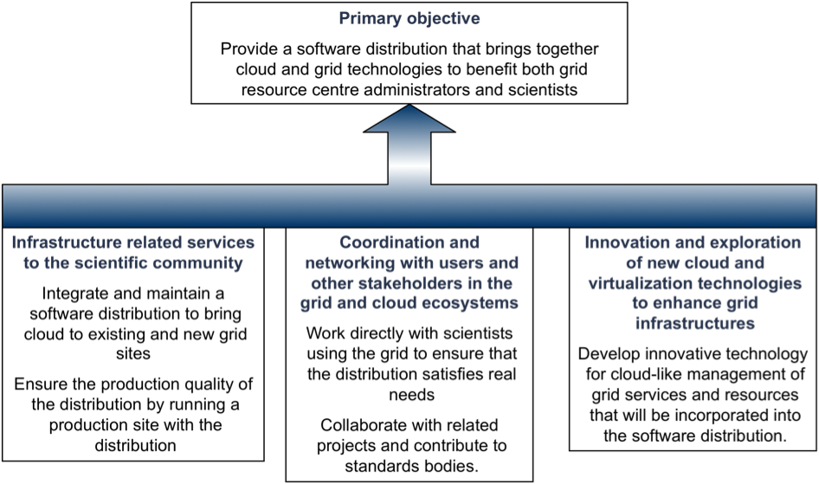
Objectives
WP1
WP4
WP2
WP5
WP6
WP3
Detailed objectives in each work package presentation

Slide 7
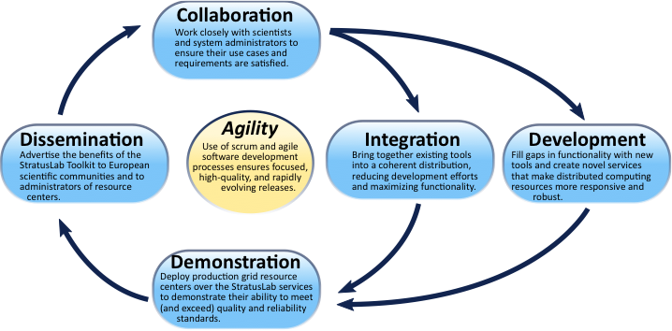
Work Package Interactions
WP2 (NA)
Interactions with Targeted
Communities
WP1 (MGT)
Project Management
WP6 (JRA)
Innovative Cloud-like Service for
Grid Site Management
WP3 (NA)
Dissemination
WP4 (SA)
Integration
WP5 (SA)
Infrastructure Operations

Slide 8
Project Organization
Project Management Board
  Sets overall goals of project and monitors progress
  Project coord., technical coord., one representative from each partner
  Meets quarterly
Technical and Scientific Coordination Group
  Defines overall architecture and development priorities
  Technical coord., activity manager from each work package
  Meets before each sprint planning meeting
Technical Team
  Coordinates sprints and daily execution of tasks in work plan
  WP4 activity leader (chair), all developers
  Daily “stand-up” meetings; planning/demo meeting every 3 weeks

Slide 9
Deliverables
Number | Title | Due Date
D2.3 | Survey of Targeted Communities Concerning StratusLab | PM14
D4.4* | Reference Architecture for StratusLab Toolkit 2.0 | PM15
D6.4* | Cloud-like Management of Grid Sites 2.0 Design Report | PM17
D5.4* | Economic Analysis of Infrastructure Operations | PM18
D6.5 | Cloud-like Management of Grid Sites 2.0 Software | PM23
D2.4 | Final Report on StratusLab Adoption | PM24
D2.5 | Report on Evaluation of StratusLab Products | PM24
D3.4 | Final Review of Diss., Collaboration and Standardization Activities | PM24
D3.5 | Exploitation and Sustainability Final Plan | PM24
D4.5 | StratusLab Toolkit 2.0 | PM24
D4.6 | Software Integration Final Report | PM24
D5.5 | Infrastructure Operations Final Report | PM24
D6.6 | Cloud-like Management of Grid Sites Research Final Report | PM24

Slide 10
Milestones
Number | Title | Due Date
MS4 | Adoption of StratusLab Software by External Grid Sites | PM14
MS12 | Delivery of Virtual Appliance Repository | PM18
MS5 | Opening of Virtual Appliances Repository to External App. Communities | PM20
MS15 | Release of Cloud-like Mgt. of Grid Services and Resource 2.0 Beta | PM21
MS9 | Release of StratusLab 2.0 Beta | PM22
MS13 | Operation of Site Running StratusLab Toolkit v2.0 | PM22
All milestones, deliverables, quarterly reports, and periodic report have been produced.
General StratusLab paper and economic analysis paper have been published.

Slide 11
Effort and Spending (Year 2)
Comments
  Spending and effort higher in second year
  All numbers are preliminary (but very close to final numbers)
  Second year in isolation not very meaningful…
 | Effort (PM) | Total Costs (Euro)
CNRS | 45.17 | 596,910.
UCM | 62.90 | 420,160.
GRNET | 33.40 | 275,094.
SIXSQ | 27.33 | 496,991.
TID | 36.00 | 457,965.
TCD | 12.94 | 116,108.
TOTAL | 217.74 | 2,343,228.

Slide 12
Budget for Full Project Duration
Comments
  Slightly over budget in total
  Some significant deviations at partner level
  Under-spending from first year recovered in second
 | Planned | Actual | Difference
CNRS | 623,463 | 894,804 | 271,341 | 44%
UCM | 591,040 | 519,627 | -71,413 | -12%
GRNET | 494,460 | 450,841 | -43,619 | -9%
SIXSQ | 721,744 | 715,479 | -6,265 | -1%
TID | 663,958 | 688,097 | 24,139 | 4%
TCD | 222,992 | 190,321 | -32,671 | -15%
TOTAL | 3,317,657 | 3,349,169 | 141,512 | 4%
NOTE: SixSq is now recognized as an SME. Budget was calculated using 60% overheads.

Slide 13
Effort for Full Project Duration
 | WP1 | WP2 | WP3 | WP4 | WP5 | WP6 | TOTAL
CNRS | 12.00 | 39.00 | 6.00 |  | 24.00 |  | 81.00
UCM |  |  | 5.00 | 36.00 |  | 30.00 | 71.00
GRNET |  |  | 6.00 |  | 48.00 | 5.00 | 59.00
SIXSQ |  |  | 3.00 | 48.00 |  |  | 51.00
TID |  | 9.00 | 3.00 | 12.00 |  | 30.00 | 54.00
TCD |  |  | 12.00 |  | 12.00 |  | 24.00
TOTAL | 12.00 | 48.00 | 35.00 | 96.00 | 84.00 | 65.00 | 340.00
NOTE: All effort given in Person-Months (PM).
Planned Effort
 | WP1 | WP2 | WP3 | WP4 | WP5 | WP6 | TOTAL
CNRS | 5.95 | 42.96 | 2.85 |  | 20.78 |  | 72.54
UCM |  |  | 4.10 | 28.30 |  | 45.40 | 77.80
GRNET |  |  | 6.07 |  | 44.58 | 3.44 | 54.09
SIXSQ |  |  | 4.00 | 42.50 |  |  | 46.50
TID |  | 9.09 | 2.95 | 12.40 |  | 29.55 | 53.99
TCD |  |  | 12.48 |  | 12.00 |  | 24.48
TOTAL | 5.95 | 52.05 | 32.45 | 83.20 | 77.36 | 78.39 | 329.40
-3%
Actual Effort

Slide 14
Deviations in Effort
Comments
  Overall slightly less effort than planned.
  Some shifts between work packages.
NOTE: All effort given in Person-Months (PM).
NOTE: Negative numbers are less effort than planned.
 | WP1 | WP2 | WP3 | WP4 | WP5 | WP6 | TOTAL
CNRS | -6.05 | 3.96 | -3.15 |  | -3.22 |  | -8.46 | -10%
UCM |  |  | -0.90 | -7.70 |  | 15.40 | 6.80 | 10%
GRNET |  |  | 0.07 |  | -3.42 | -1.56 | -4.91 | -8%
SIXSQ |  |  | 1.00 | -5.50 |  |  | -4.50 | -9%
TID |  | 0.09 | -0.05 | 0.40 |  | -0.45 | -0.01 | 0%
TCD |  |  | 0.48 |  | 0.00 |  | 0.48 | 2%
TOTAL | -6.05 | 4.05 | -2.55 | -12.80 | -6.64 | 13.39 | -10.60 | -3%
 | -50% | 8% | -7% | -13% | -8% | 21% | -3%

Slide 15
Reviewer Recommendations
Detailed Responses
  All responses included in periodic report
  Evolution can be seen through the quarterly reports
  Work package presentations highlight particular recommendations
Actions
  All recommendations were carefully considered
  Most recommendations were implemented
  Few were not taken on board for various reasons
Ask if you want more detail on any recommendation.

Slide 16
Reviewer Recommendations
Delayed Start (#1, #2)
  Effort at correct level overall for 2 years of project
  Effort and spending skewed towards second year of project
Documents (#7, #18, #19)
  Effort to make documents leaner
  All reports provided well in advance of review
External Advisor (#15)
  Agreed with recommendation, but…
  Could not find right level of intervention in management organization

Slide 17
Lessons Learned
  Would like to see EC project selection and verification schemes that do not presume a waterfall management approach.
  Sprint summaries rather than quarterly reports
  More flexible definition of deliverable and milestone contents.
  More frequent, regular contact between reviewers and project.
  …
Agile Project Management
  Extremely efficient and
  excellent method for
  coordinating development
  Easy to customize to project
  constraints (e.g. distributed
  team)
Integrated Tools
  Using integrated development tools for the code and for the production of documents was very effective.
Financial Reporting
  Require partners to provide quarterly effort and budget information
  Automate the collection and reporting of this information

Slide 18
Setting the stage…
Validation of Concept
Other projects, like OpenStack, identify the same needs and start concurrently with StratusLab.
Amazon provides first complete, public cloud infrastructure, spurring interest in cloud technologies, but…
Development
Continued collaboration between partners
to further advance the StratusLab cloud distribution.
Project Results
1) Complete, open-source cloud distribution suitable for academic and commercial use.
1) No open-source, cloud distribution available for private or non-commercial clouds.
Exploitation
Continued operation of reference cloud infrastructures.
2) Can cloud technology handle complex, production services, like grid services?
2) Reference cloud infrastructures to provide services to the European scientific community.
3) Cloud technology validated for grid services and wide variety of applications.
Motivations
Project Execution
Evolution

Slide 19
Questions?

