Slide 1
Technical Overview
StratusLab Final Periodic Review
Brussels, Belgium
10 July 2012

Slide 2
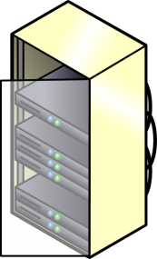
The StratusLab Vision (before…)
Access
Grid Middleware
LRMS (PBS, SGE…)
Provision

Slide 3




The StratusLab Vision (Year 1)
Access
Grid Middleware
Cloud API
LRMS (PBS, SGE…)
HTTP, SSH…
Service
Virtual Machines
  Service-Provisioning Decoupling
Provision

Slide 4

The StratusLab Vision (Year 2)
But…
  Identity on multiple clouds
  Different API’s
  Access to Images
  Networking
Cloud API
Cloud API
Cloud API
Cloud API

Slide 5

The StratusLab Vision (Year 2)
Marketplace
  Sharing existing VM images
  Registry of metadata
  Image are kept elsewhere
  Supports trust
Cloud API
Hybrid Cloud
Cloud API
Cloud API
Cloud API

Slide 6
The StratusLab Vision (Year 2)
Marketplace
BROKER
  Sharing existing VM images
  Registry of metadata
  Image are kept elsewhere
  Supports trust
Cloud API
Cloud API
Cloud API
Cloud API

Slide 7
Cloud Services & Infrastructures
StratusLab Distribution
Cloud Services
Cloud Components
Easy to install
Thoroughly tested
Regularly released
Supported
Virtualized Grid Site
2 x IaaS Sites
Marketplace
Show-case
Know how

Slide 8
StratusLab Distribution
Marketplace
Users
REST
Cloud, Web, Grid…
Tcloud
IaaS Cloud
Service Mang.
XML-RPC
REST
REST
Networking
VM Manager
Persistent Disk
Monitoring
& Acct
802.1Q, FW
KVM
Hybrid
iSCSI, NFS…
Physical Resources

Slide 9
Reference Deployments
IaaS Clouds
  Operated in production exposing StratusLab IaaS APIs
  GRNET + LAL
  Operated in a Federated Way
  Demonstration, Validation & Best practices
  Host production applications
Virtualized Grid Site
  Deploy a production site in an IaaS cloud
  Typical Grid configuration (CE, SE, WNs, APEL)
  Certified by the Greek NGI
  Integrated within the Greek NGI

Slide 10
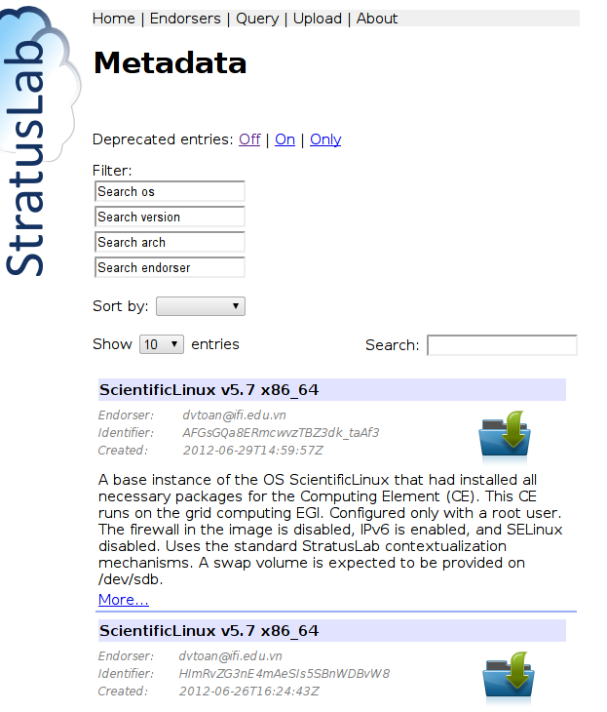


Cloud Services
Marketplace
  Image sharing facility
  Stores image metadata
  Actual images stored elsewhere
  Support trust: users, admin, devs
use
distribute
authorize

Slide 11
Achievements I
StratusLab Distribution
  Stable, periodically released & comprehensive software distribution
  Easy to build a IaaS Cloud
  In use by several EGI sites & commercial solutions
Cloud Services & Reference Deployments
  Operation of a virtualized Grid site
  Operation of 2 IaaS clouds
  MarketPlace

Slide 12
Achievements II
Support for Production Applications & Adoption
  Production use-cases for a wide-range of application domains
  Reference services attracted and served multiple users
Multi-Cloud Federation
  Demonstrated a federated set-up of IaaS Clouds
  Deployed complex (multi-tier) applications in multiple-clouds
  Federated tools (Marketplace) being adopted by EGI

Slide 13
Questions?

