Slide 1
Work Package 4
Software Integration and Distribution
StratusLab First Periodic Review
Brussels, Belgium
10 July 2012

Slide 2
Introduction
Work Package 4:
  Integration, testing and creation of an open source production quality cloud software distribution
  Definition of a clear architecture and features able to fulfill grid sites requirements
  Provide simple usage patterns for end-users and system administrators
Objectives
  Definition of a reference architecture and selection of software components
  Integration and management of open-source distribution, definition and maintenance of reference configurations
  Technical support for installation and configuration of the distribution, following industrial practices in terms of quality, maintainability, testability and usability
  Definition of a process for contextualisation of the virtual appliances
Tasks
  T4.1: Definition of Reference Architecture (SixSq, UCM, TID)
  T4.2: Integration of Open-source Distribution (SixSq)
  T4.3: Contextualisation of Grid Services (UCM, TID)
  T4.4: Technical Support (SixSq, UCM, TID)

Slide 3
Achievements
Open source production quality IaaS cloud distribution
  Twelve (12) public releases of StratusLab with incremental functionality
  StratusLab v2.0, a complete distribution for foundation cloud services
Simple installation procedure
  Simple manual installation procedure with single configuration file
  Automated installation with Quattor to better integrate with site management
Multiple operating system support
  Server: Fedora 16, CentOS 6.2, OpenSuSE 12
  Client: all (including Windows using tarball)
Multiple storage solution support
  iSCSI (LVM, NetApp, V7000 – soon)
  File (shared file system)

Slide 4
Achievements
Automated build and test system
  Built a comprehensive build and test infrastructure, spanning two sites and over 12 machines (physical and virtual) – at GRNet, LAL and in the StratusLab cloud
  Automated procedure including systematic installation, configuration and system-testing of all StratusLab services, from clean (re-imaged) machines daily
  Key services: Hudson, Maven/Nexus, YUM and APT repositories

Slide 5
JIRA Task Board

Slide 6
Hudson in action

Slide 7
Achievements
Agile/Scrum methodology
  Put in place agile/Scrum methodology, to which all work packages and partners contributed
  26 sprints and demos
  Producing 12 production releases
Clear IaaS Architecture (v1.0 and v2.0)
  IaaS Cloud Architecture able to fulfill grid site requirements
  Smooth evolution from v1.0 to v2.0

Slide 8
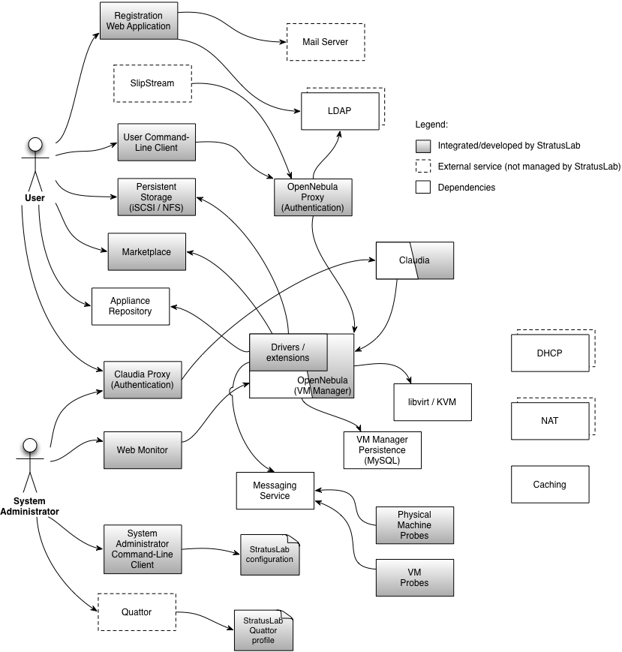
Reference Architecture v2.0

Slide 9
v2.0 Services and Components
Marketplace
Persistent Storage Service (iSCSI or NFS)
User Command-Line Client
System Administrator Command-Line Client
StratusLab configuration and Quattor profiles
OpenNebula, Proxy, StratusLab extensions and drivers
Registration Web Application
Claudia

Slide 10
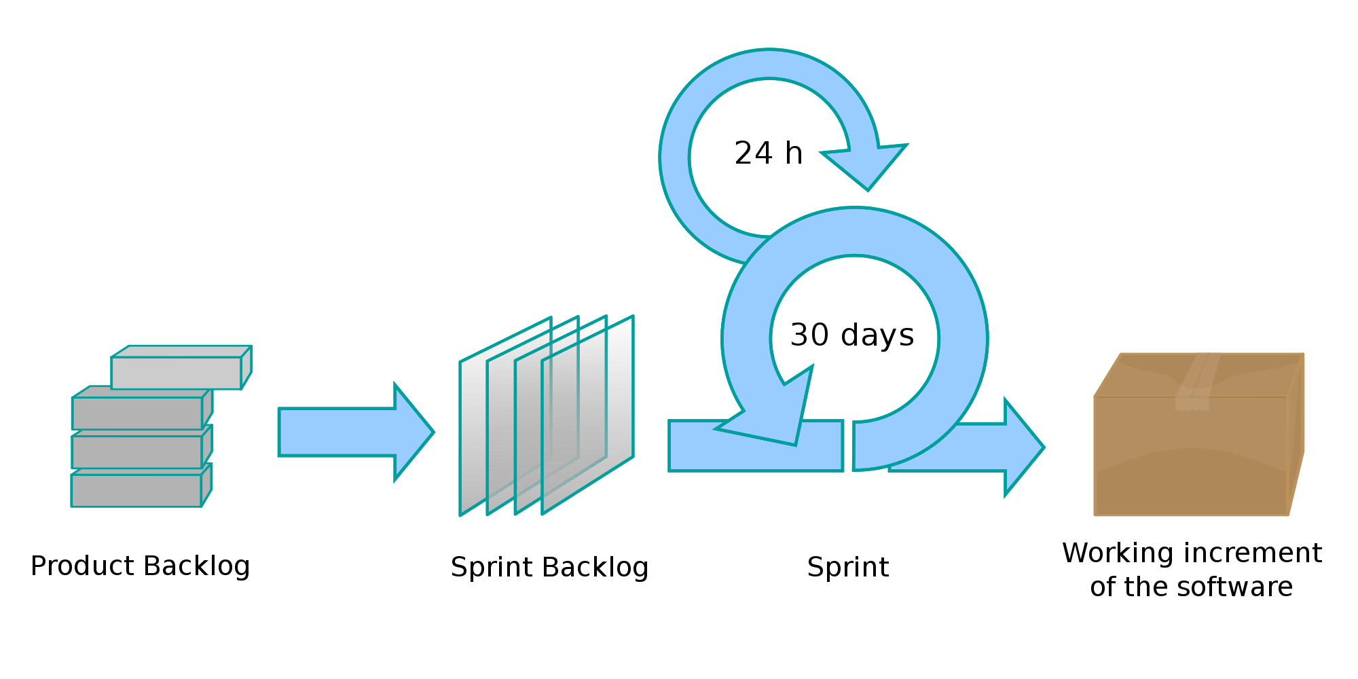
Scrum in StratusLab
TSCG
~3 weeks

Slide 11
Benefits from Agile and Scrum
Incremental development
  Generate early and regular feedback
  Improve robustness through each sprint
  Validate assumptions with real implementation
Prioritized functionality
  Skills across all activities and all partners maximized at every sprint
  Ability to react to opportunities and changes by steering incremental development
  Reduce integration and configuration risk with continuous integration and deployment

Slide 12
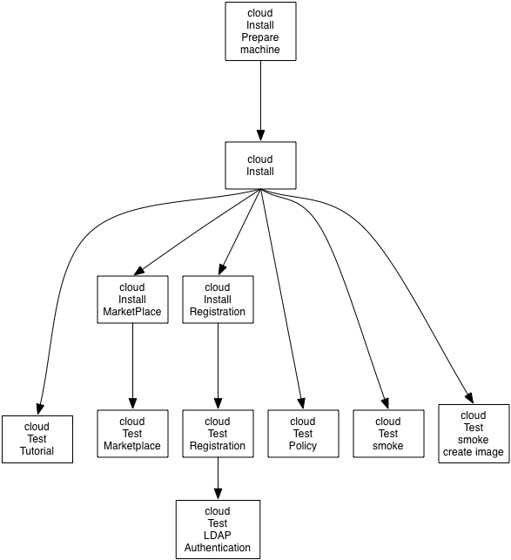
Hudson jobs – continuous testing
Triggered daily
Triggered following every commit

Slide 13
Metrics
Scrum metrics include work from all partners and WPs
  Steady sprint rate
  Steady implementation of work items
Metric | Q2 | Q3 | Q4 | Q5 | Q6 | Q7 | Q8
No. of completed sprints | 5 | 5 | 4 | 3 | 3 | 3 | 4
No. of releases | 1 | 1 | 1 | 2 | 1 | 2 | 2
No. of open user stories | 38 | 72 | 101 | 118 | 107 | 121 | 102
No. of implemented user stories | 69 | 40 | 67 | 50 | 48 | 57 | 61
No. of open bugs | 6 | 15 | 22 | 28 | 51 | 51 | 66
No. of fixed bugs | 7 | 11 | 27 | 14 | 20 | 17 | 14
Note: No targets defined.

Slide 14
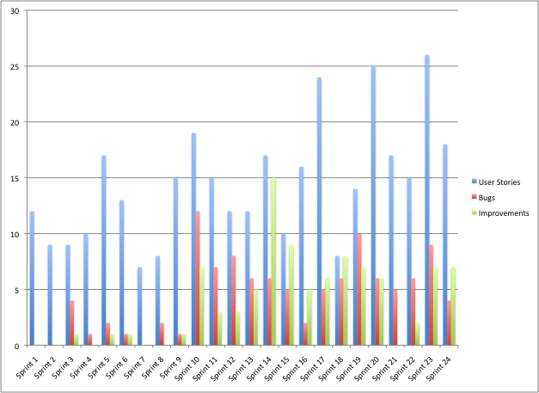
Sprint Highlights – Completed Items

Slide 15
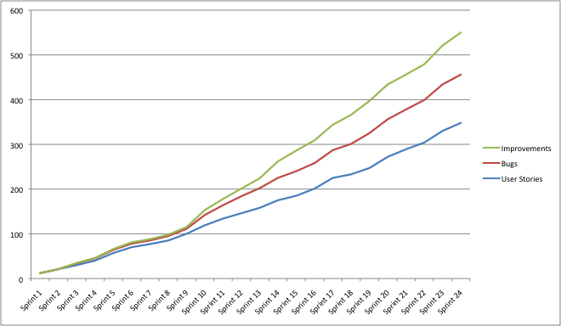
Sprint Highlights – Aggregate Completed Items

Slide 16
Lessons Learned
Process Automation
  Upgrade: to avoid downtime and better control upgrade procedures, automate them and run them regularly on release candidates
  Invest: invest time and effort regularly on the continuous integration, build and test infrastructure to improve quality and reduce release time
  Clean environments: create pristine environments (with Quattor and the cloud) to test in controlled conditions
  Release often: not all users are interested in fast release cycles. Release only the components that users will benefit from
  Commit often in head: work on head/master, avoid branches and commit often. Our culture of favoring small updates directly into head/master is paying off in reduced integration effort
  Stop the line culture: to keep the feedback from our CI flowing, the main jobs have to remain green (i.e. success). Effort is required for this remains the case

Slide 17
Lessons Learned
Ensure documentation keeps up
  The documentation was not always kept up-to-date with the releases. This meant more support required to help confused users
Several installation patterns
  Supporting manual and automated installation allows us to reach to a wider audience

Slide 18
Lessons Learned
Having an opinion matters
  In the busy cloud space, StratusLab stands out by its opinionated choices – e.g. technology (KVM), access pattern (REST), configuration strategy (unified configuration)
Keep it simple
  Our constant quest to resist the next cool feature in favor of a simpler system means that StratusLab is the simplest cloud distribution available, yet able to deliver industrial strength solutions

Slide 19
Questions?

