Slide 1
Work Package 3
Dissemination
StratusLab Final Periodic Review
Brussels, Belgium
10 July 2012

Slide 2
Introduction
Description of Work Package
  WP3 coordinates the project’s activities in dissemination, collaboration with related projects and standards bodies, and exploitation and sustainability.
Objectives
  Disseminate results of the project to resource providers, end-users and the general public
  Identify project contributions to standards bodies and standardization efforts
  Coordinate interactions with related projects, developing Memoranda of Understanding between projects where appropriate
Tasks
  T3.1 Dissemination (TCD, all)
  T3.2 Collaboration with standards bodies and related projects (TCD, all)
  T3.3 Development of Exploitation and Sustainability plan (SixSq, all)

Slide 3
Review Recommendations
Establish more ambitious KPI metrics (#4)
  Targets increased but not all met
Expand dissemination audience (#3, #20)
  Submitted demo for EU Innovation Convention (not accepted)
  General paper and introductory video aimed at scientific and non-technical users
  Video demos aimed at less technical audiences
  Presentations at several scientific community events
  Articles in more general press outlets
Make dissemination more marketing-driven (#17)
  Documented use cases (D2.3) and success stories (D2.4)
  Dissemination around some of these success stories
  Video demos

Slide 4
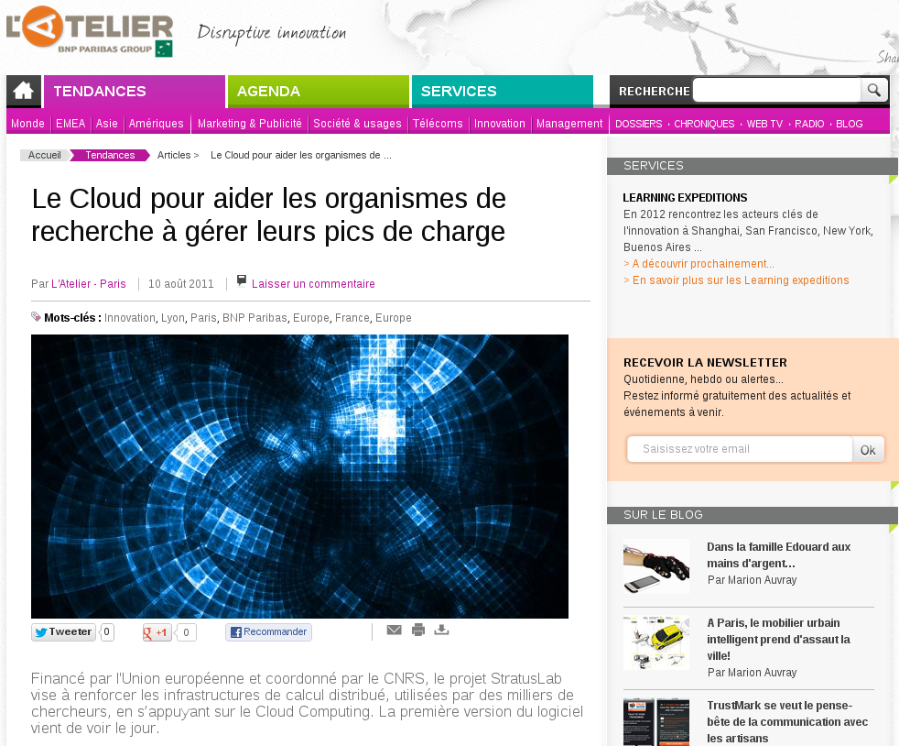
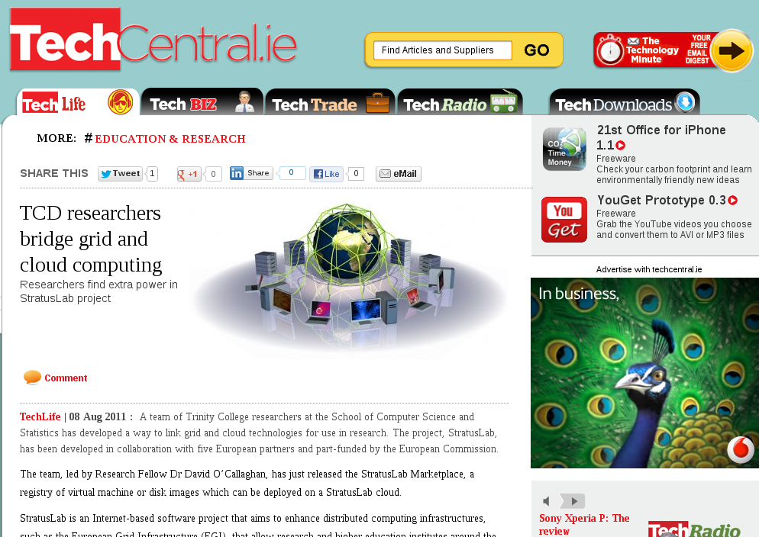
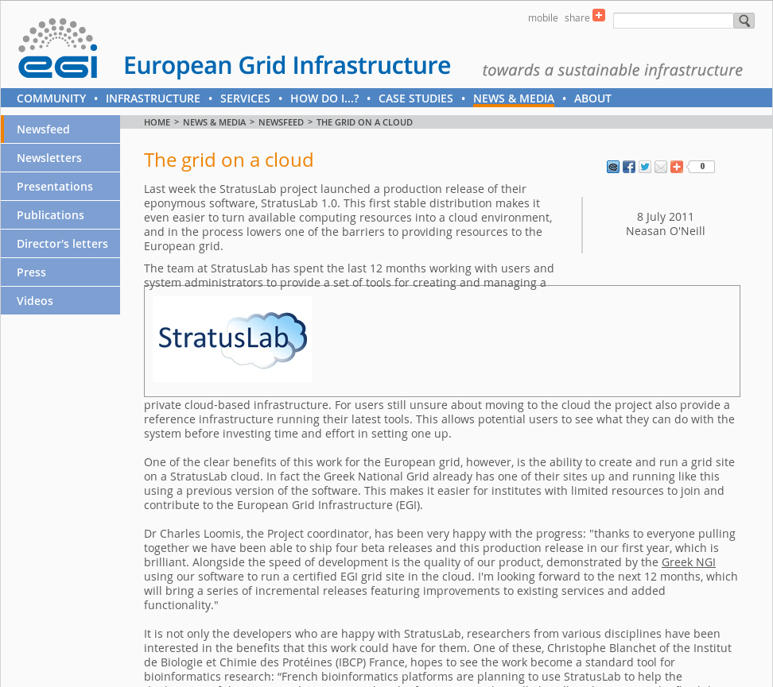
Achievements - Dissemination
Press / media
  Press releases for new versions / features
  EGI story focused on StratusLab
  iSGTW, HPCWire, HPC in the Cloud
  Mainstream technical press

Slide 5
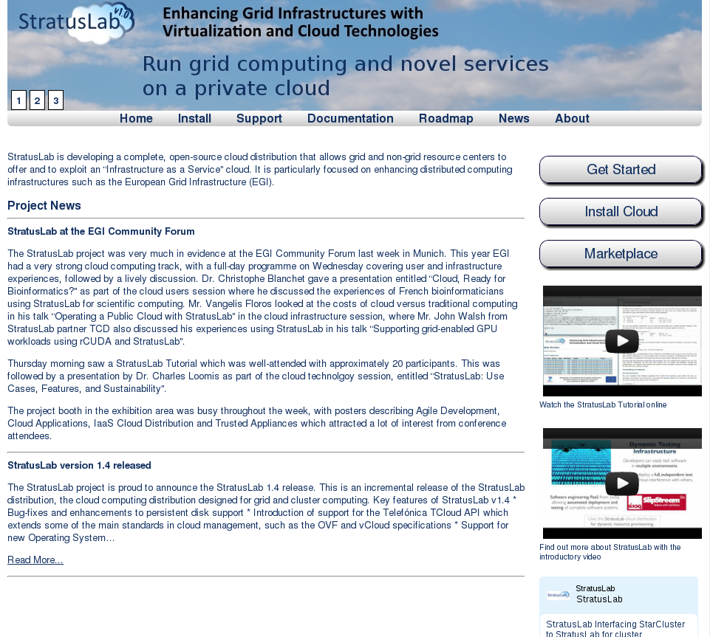
Achievements - Dissemination
Website / online
  Website continually updated
  Online discussion forum
  Twitter @StratusLab, RSS news feed

Slide 6
Achievements - Dissemination
EGI TF / CF
FOSDEM
CloudCamp Valencia 2011
Cloud Day 2011
ParCo 2011
OGF33
HPCS 2011
JOBIM 2011
ISC Cloud 2011
EGU General Assembly
IBM Technical University
CloudCP
eScience 2011
Events
  Continued presence at Grid events
    Talks, demos, booth, posters, tutorials,
    promotional materials
    Co-chairing sessions in Virtualization and Cloud
    tracks with EGI
  Cloud events
    Paper and presentations, promotional materials
  User-focused / Scientific community events
    Posters and presentations, promotional materials
  Over 40 talks, events and tutorials during Y2
    http://www.stratuslab.eu/doku.php/presentations

Slide 7
Achievements - Dissemination
Release Dissemination
  Dissemination plan for each release
  News item on website and announcement sent out
    Announcement mailing list
    User-announcement mailing list
    User forum
  Release announcements widely circulated to technical media outlets
  More formal press releases around rollout of specific features (e.g. Marketplace)

Slide 8
Achievements - Collaboration
MoU
EGI
EDGI
CYFRONET
VENUS-C
IGE
ERINA+
EGI
  Adoption of Marketplace by EGI
  Participation in Federated Clouds Task Force
  UMD1 appliances in the Marketplace
  Input to EGI documents and activities
IGE
  Globus Toolkit 5.0.4 appliances in the Marketplace
VENUS-C
  Feedback and sharing experience
  Support to develop OVF4ONE
ERINA+
  Completion of the ERINA+ socio-economic self-assessment

Slide 9
Achievements - Standardisation
SIENA
  Input to SIENA gap analysis document
  Input to NIST Cloud Computing Technology Roadmap
  Input to SIENA Roadmap
  Response to SIENA Call for Actions
  Participation in CloudScape events
EGI
  Input on recommended standards
VENUS-C
  Support to develop OVF4ONE
Adoption of standards within StratusLab Distibution
  OCCI, OVF, TCloud, IPv6, JSON, SPARQL…

Slide 10
Metrics
Dissemination Metrics
  Additional non-measured items include
    Twitter followers (increased from 60 to 121 in Y2)
    User announce list (47 members)
Metric | Q1 | Q2 | Q3 | Q4 | Y1 Tgt. | Q5 | Q6 | Q7 | Q8 | Y2 Tgt.
Announce mailing list | - | 67 | 67 | 67 | 25 | 70 | 72 | 72 | 73 | 75
Website views | - | 2922 | 4623 | 4579 | - | 5472 | 4985 | 4442 | 5372 | -
Discussion Forum | - | - | - | - | 50 | - | 12 | 13 | 16 | 100

Slide 11
Lessons Learned
Creation of StratusLab community
  Efforts to create an active StratusLab community should have been started earlier
Agile and regular incremental releases affects dissemination
  Regular releases allowed regular announcements
  Project had a good profile in the press throughout Y2
Dissemination to the general public
  Dissemination to a more general audience is difficult
  Require a ‘hook’ or angle in order to get coverage

Slide 12
Questions?

