Slide 1
Work Package 4
Software Integration and Distribution
StratusLab First Periodic Review
Brussels, Belgium
4 July 2011

Slide 2
Introduction
Work Package 4:
  Integration, testing and creation of an open source production quality cloud software distribution
  Definition of a clear architecture and features able to fulfill grid sites requirements
  Provide simple usage patterns for end-users and system administrators
Objectives
  Definition of a reference architecture and selection of software components
  Integration and management of open-source distribution, definition and maintenance of reference configurations
  Technical support for installation and configuration of the distribution, following industrial practices in terms of quality, maintainability, testability and usability
  Definition of a process for contextualisation of the virtual appliances
Tasks
  T4.1: Definition of Reference Architecture (SixSq, UCM, TID)
  T4.2: Integration of Open-source Distribution (SixSq)
  T4.3: Contextualisation of Grid Services (UCM, TID)
  T4.4: Technical Support (SixSq, UCM, TID)

Slide 3
Achievements
Open source production quality IaaS cloud distribution
  Twelve (12) public releases of StratusLab with incremental functionality
  StratusLab v2.0, a complete distribution for foundation cloud services
Simple installation procedure
  Simple manual installation procedure with single configuration file
  Automated installation with Quattor to better integrate with site management
Multiple Operating System support
  Server: Fedora 16, CentOS 6.2, OpenSuSE 12
  Client: all (including Windows using tarball)
Multiple Storage Solution support
  iSCSI (LVM, NetApp, V7000 – soon)
  File (shared file system)

Slide 4
Achievements
Automated build and test system
  Built a comprehensive build and test infrastructure, spanning two sites and over 12 machines (physical and virtual) – at GRNet, LAL and in the StratusLab cloud
  Automated procedure including systematic installation, configuration and system-testing of all StratusLab services, from clean (re-imaged) machines daily
  Key services: Hudson, Maven/Nexus, YUM and APT repositories

Slide 5
Achievements
Agile/Scrum methodology
  Put in place agile/Scrum methodology, to which all work packages and partners contribute
  26 sprints and demos
  Producing 12 production releases
Clear IaaS Architecture (v1.0 and v2.0)
  IaaS Cloud Architecture able to fulfill grid site requirements
  Smooth evolution from v1.0 to v2.0

Slide 6
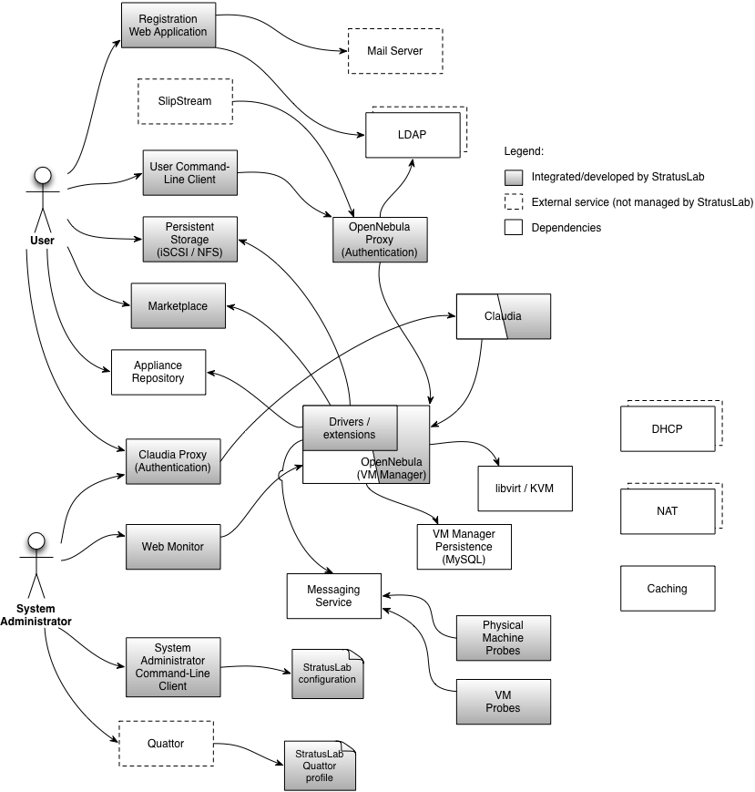
Reference Architecture v2.0

Slide 7
v2.0 Services and Components
Marketplace
Persistent Storage Service (iSCSI or NFS)
User Command-Line Client
System Administrator Command-Line Client
StratusLab configuration and Quattor profiles
OpenNebula, Proxy, StratusLab extensions and drivers
Registration Web Application
Claudia

Slide 8
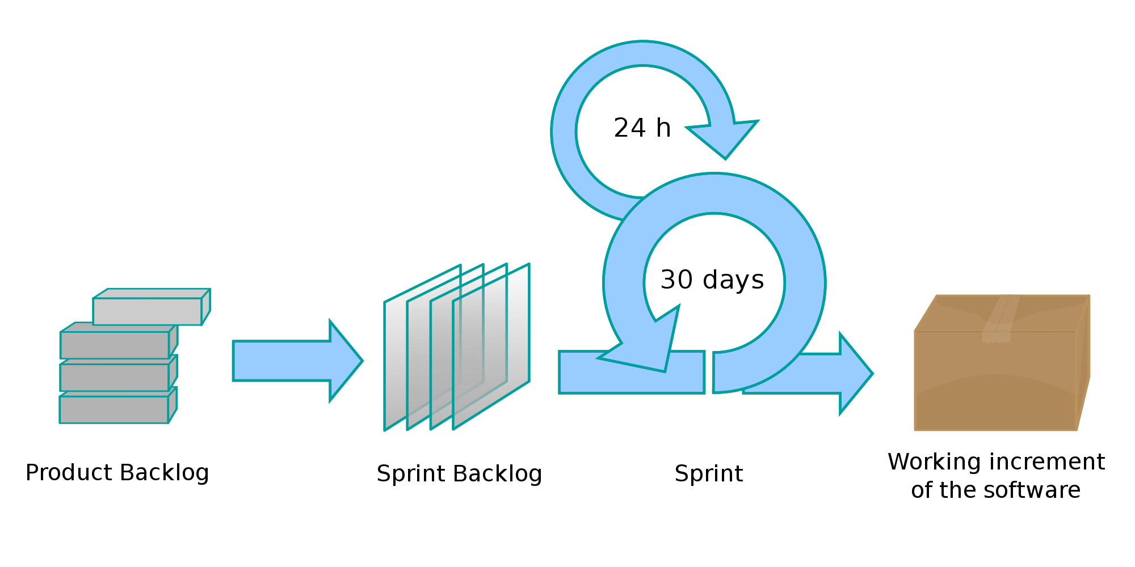
Scrum in StratusLab
TSCG
Stategic
Daily meeting
over phone!!
All WPs
All partners
Aim at producing
new StratusLab
release every 2
sprints
Planning
Meeting
Tactical
~3 weeks
Captured in JIRA

Slide 9
Benefits from Agile and Scrum
Incremental development
  Generate early and regular feedback
  Improve robustness through each sprint
  Validate assumptions with real implementation
Prioritised functionality
  Skills across all activities and all partners maximised at every sprint
  Ability to react to opportunities and changes by steering incremental development
  Reduce integration and configuration risk with continuous integration and deployment

Slide 10
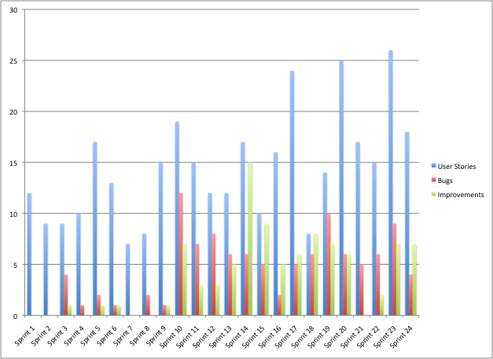
Sprint Highlights – done!
408 User Stories Completed
140 Bugs Fixed
118 Improvements Implemented

Slide 11
JIRA Task Board

Slide 12
Hudson in action

Slide 13
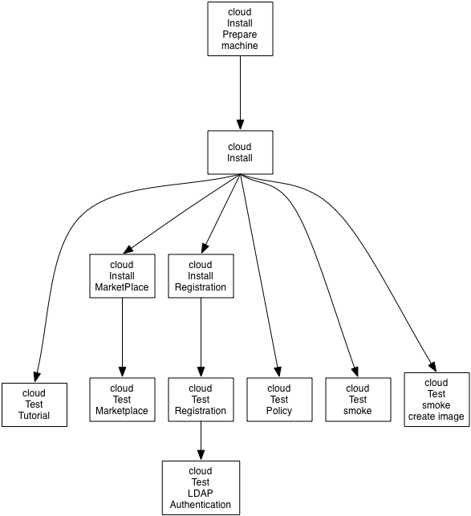
Hudson jobs – continuous testing
Triggered daily
Triggered following every commit

Slide 14
Metrics
Scrum metrics include work from all partners and WPs
  Steady sprint rate
  Steady implementation of work items
  Note: no target defined
Metric | Q2 | Q3 | Q4 | Q5 | Q6 | Q7 | Q8
No. of completed sprints | 5 | 5 | 4 | 3 | 3 | 3 | 4
No. of releases | 1 | 1 | 1 | 2 | 1 | 2 | 2
No. of open user stories | 38 | 72 | 101 | 118 | 107 | 121 | 102
No. of implemented user stories | 69 | 40 | 67 | 50 | 48 | 57 | 61
No. of open bugs | 6 | 15 | 22 | 28 | 51 | 51 | 66
No. of fixed bugs | 7 | 11 | 27 | 14 | 20 | 17 | 14

Slide 15
Lessons Learned
Having an opinion matters:
  In the busy cloud space, StratusLab stands out by its opinionated choices – e.g. technology (KVM), access pattern (REST, with the exception of OpenNebula), configuration strategy (unified configuration).
Keep it simple
  Our constant quest to resist the next cool feature in favor of a simpler system means that StratusLab is the simplest cloud distribution available, yet able to deliver industrial strength solutions
Continuous Integration:
  Invest time and effort regularly on the continuous integration, build and test infrastructure to improve quality and reduce release time
  Create pristine environment (with Quattor and the cloud)

Slide 16
Lessons Learned
Automate upgrade:
  To avoid downtime and better control upgrade procedures, automate them and run them regularly on release candidates
Releasing often is good:
  Not all users are interested in fast release cycles. Release only the components that users will benefit from.
Ensure documentation keeps up:
  The documentation was not always kept up-to-date with the releases. This meant more support required to help confused users.

Slide 17
Lessons Learned
Work on head/master, avoid branches and commit often:
  Our culture of favoring small updates directly into HEAD/master is paying off in reduced integration effort
Stop the line culture works:
  In order to keep the feedback from our CI flowing, the main jobs have to remain green (functioning). Effort is required that this remains the case
Several installation patterns:
  Supporting manual and automated installation allows us to reach to a wider audience

Slide 18
Questions?

