Slide 1
Work Package 6
Innovative Cloud-like Management of Grid
Services and Resources
StratusLab Final Periodic Review
Brussels, Belgium
10 July 2011

Slide 2
Introduction
Description of Work Package
  WP6 develops advanced technology/features for deployment on existing Cloud infrastructures through automatic deployment and dynamic provision of grid services as well as scalable cloud-like management of grid site resources
Objectives
  The extension of currently available service-level open-source elasticity frameworks on top of cloud infrastructures
  The invention of new techniques for the efficient management of virtualized resources for grid services
  The inclusion of novel resource provisioning models based on cloud-like interfaces
Tasks
  Task 6.1: Dynamic Provision of Grid Services (TID, GRNET)
  Task 6.2: Scalable and Elastic Management of Grid Site Infrastructure (UCM, TID)
  Task 6.3: Cloud-like Interfaces Specific for the Scientific Community (UCM, TID)

Slide 3
Review Recommendations
Provide a clear map of the components of the toolkit (#6)
  Work in WP6 deliverables to describe clearly the project’s work with respect to individual components
Focus on cloud API rather than grid (#11)
  The latest release of the StratusLab cloud distribution has support for OCCI, TCloud and Deltacloud

Slide 4
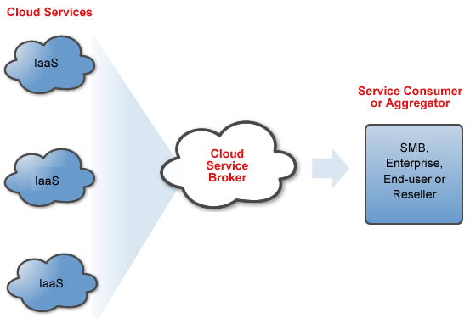
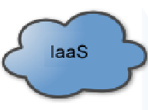
Achievements
Multi-Cloud (Task 6.2, Task 6.3)
  InterCloud component in StratusLab architecture
  Hybrid Cloud (OpenNebula as the Cloud manager)
    Federation of StratusLab sites (new ONE2ONE driver)
    Cloud bursting to public providers (improved Amazon EC2 driver)
  Brokering among clients and different sites (Claudia as the broker)
Site 1
Hybrid Cloud
Brokering
Site 3
Site 2
Site 3

Slide 5
Achievements
Cloud-like APIs (Task 6.3)
  OCCI and Deltacloud as the OpenNebula APIs
  TCloud as the Claudia API
  TCloud as monitoring API
 | OCCI | DeltaCloud | TCloud
VM Manager | X | X
Service Manager |  |  | X
Network Manager | X
Storage Manager | X | X
Monitoring |  |  | X

Slide 6
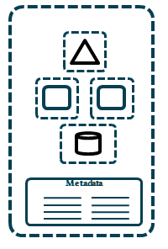
Achievements
Multi-tier service management (Task 6.1)
  N-tier services or application as a whole
  Service specification as a whole in a OVF (images, networks, software…)
  Claudia manages and configure the service
  StratusLab contextualization for configuring complexity
  Database stored in StratusLab persistent disk
Web server
App server
Database

Slide 7
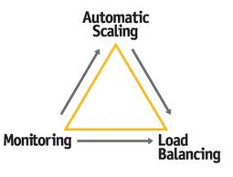

Achievements
Service Scalability and Balancing (Task 6.1)
Scalability driven by KPIs
Tier horizontal scaling
Load Balancers support
New Scaling policies
  Advanced monitoring: Different metrics (KPIs, hardware and software metrics)

Slide 8
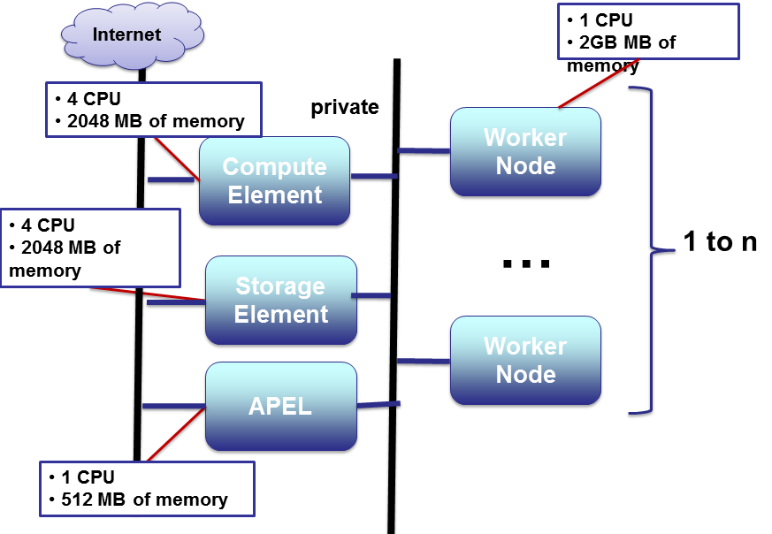
Grid site deployment and scalability
  Grid site specified as a whole in the OVF (images, networks, software…)
  Automatically Grid site deployment
  Worker Nodes deployed in a VLAN
  Grid site scalability based on KPI (job queue utilization)
  Compute Element as the balancer for managing WN replicas

Slide 9
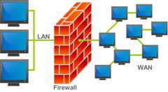
Achievements
Network management (Task 6.2)
  New networking model for better integration with specific network requirements of data centers
  Flexible network definition, using ranges, CIDR notation...
Network security (Task 6.2)
  Network isolation through 802.1Q VLAN tagging and Open vSwitch
  Firewall management for TCP/UDP ports, ICMP traffic, and Linux bridge

Slide 10
Achievements
Image and storage management (Task 6.2)
  Support for multiple datastores (aka Image Repositories), including four types: system, file-system, iSCSI/LVM and VMware
  New transfer drivers for qcow2, iSCSI, VMware, which add to shared and ssh ones
  Support for user data injection in VMs

Slide 11
Achievements
Authentication (Task 6.3)
  Improved Auth module, with increased security, special server accounts for public cloud access, and caching of session tokens
  New driver for LDAP and improved ones for X509 and SSH
  New CloudAuth driver, delegating the authentication to the OpenNebula core, so any auth driver can be used to authenticate cloud users or the Sunstone web UI
Multi-tenancy (Task 6.2, Task 6.3)
  Authorization using groups and ACLs
  Cloud partitioning, extending the previous cluster concept

Slide 12
Lessons Learned
Advanced developments as part of agile methodology
  Lower speed in developments than WP4
  Easier integration and testing of new developments
  Development and integration tasks in each sprint
Advanced Cloud services
  Building on top of current IaaS platform provides more complex functionality
  Scalablity, Balancing, Advanced Monitoring
  Scalablity driven by service KPIs not by hardware information
  Only stateless tier can be scaled
    Data should be stored in persistent place (e.g. StratusLab persistent disk)
    Scaling down only is possible when VMs without sessions
Software configuration and installation
  Complement StratusLab Contextualization with configuration engine (Chef, Puppet..) like SlipStream is doing

Slide 13
Lessons Learned
Multiple offers for different data center designs
  Hypervisors and Cloud interfaces
  Authentication methods
  Storage and transfer mechanisms
  VLAN and firewall technologies
Importance of security in multi-tenant environments
  Groups and ACLs
  Network isolation
  Cloud partitioning

Slide 14
Questions?

