Slide 1
Work Package 2
Interactions with Targeted Communities
StratusLab Final Periodic Review
Brussels, Belgium
10 July 2012

Slide 2
Introduction
Description of Work Package
  Manage interactions with targeted communities: users and system administrators.
Objectives
  Manage communication with resource providers regarding their needs concerning virtualization and cloud technologies and their feedback on StratusLab software.
  Manage communication with end-users regarding their use of resources running StratusLab software and their needs for direct access to virtualization and cloud features.
  Training sessions will be organized to encourage dissemination of technical information and adoption of the StratusLab software.
  Evaluate early versions of StratusLab software from a users perspective with respect to utility and stability.

Slide 3
Introduction
Tasks
  T2.1: Interactions with Resource Providers and End-users
  (CNRS/LAL, CNRS/IBCP, TID)
  T2.2: Intensive Evaluation of StratusLab Products
  (CNRS/LAL, CNRS/IBCP, TID)

Slide 4
Review Recommendations
Demonstrate cloud benefits (#5)
  Created general video focusing on benefits, although still technical
  There have been more efforts in WP3 to try to reach general public
Focus on cloud API rather than grid (#11)
  Clear direction based on applications using StratusLab
Specific use cases and real value (#14)
  Defined in D2.3 and used for evaluation of features
  Useful feedback for post-project evolution of cloud distribution
Commercial adoption (#16)
  Several excellent examples described later in presentation

Slide 5
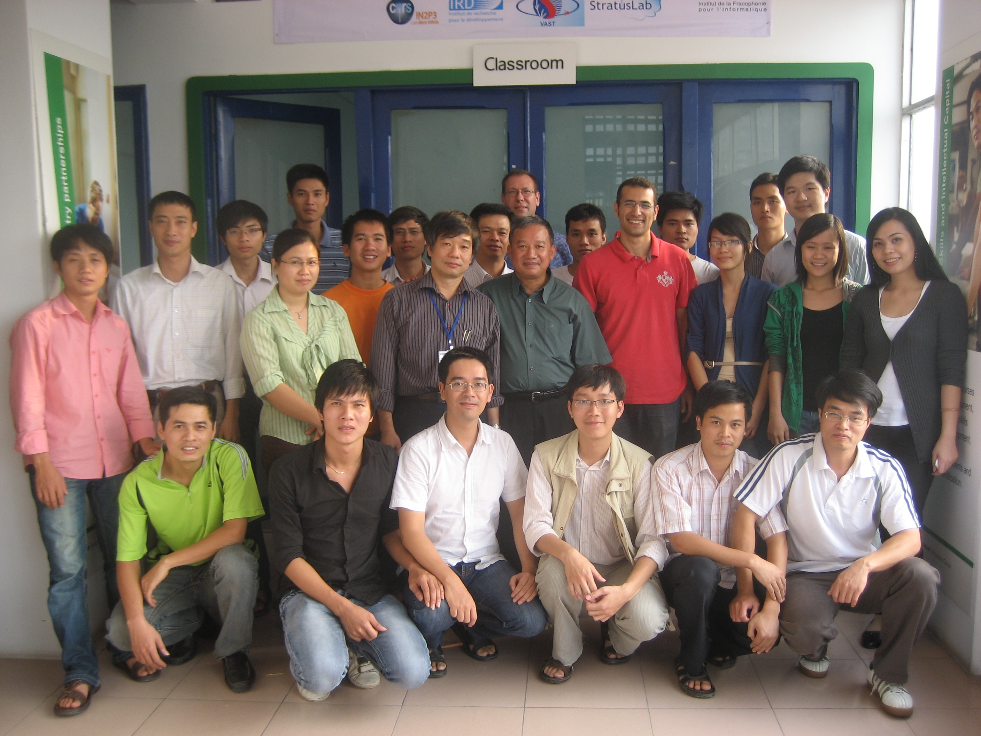
Achievements
Cloud & Grid School
Hanoi, Vietnam
Tutorials
  Development of tutorial
  material (user and
  administrator)
  Cloud/Grid School (Hanoi)
  EGI Community Forum (Munich)
  APC Training (Orsay)
Evaluation
  Defined use cases (D2.3) used to evaluate features of StratusLab
  N-tier web application prototype (see video…) and others
  Useful requirements and features to focus evolution of cloud distribution

Slide 6
Scientific Applications
Astrophysics
  Astrophysics application developer looking to use cloud resources
  Use of cloud as raw computing resource
  MPI applications in cluster model
National Observatory of Athens
  Meteorological application (MM5) for weather analysis, prediction
  MPI applications in cluster model

Slide 7

Scientific Applications
Machine Learning
  Researchers looking to test and improve machine learning algorithms
  Use of cloud as raw computing resources
  Heavy use of persistent storage, desire for object storage as well
  Appreciate ability to fully configure machines as root
Globus Grid Service Appliances
  IGE project has created customized appliances with Globus services
  Used internally for testing of the provided services
  Also intended for use by system administrators

Slide 8



Scientific Applications
NARVAL
  Data acquisition software framework for nuclear physics experiments
  Provide individual NARVAL training environment for students
  Subsequently used cloud to test new features of NARVAL
High-Energy Physics
  Large, diverse community needing raw computing power and flexible platform for deploying their own services
  CernVM: Appliance with standard LHC computing environment can be used by scientists and application developers
  Atlas/CMS/LHCb: Use of cloud resources from within the standard experiment analysis frameworks

Slide 9


Scientific Apps. & Deployments
Bioinformatics Web Services (see video)
  Provision of standard services to bioinformatics community as platform
  Connection with existing resources: public data sources, portals.
  Provides both an infrastructure and customized services
TOSCANI (see video)
  Improving protein structural information with NMR data
  Provide an infrastructure to NMR laboratory
  Deployment of ARIA software as IaaS
=> Collaboration with French bioinformatics community
  IBCP’s public cloud (172 cores, 536 GB, 25 TB pdisk)
  Outreach: several meetings with RENABI GRISBI network, presentation at Intelligent Systems for Molecular Biology 2012

Slide 10


Commercial Apps. & Deployments
SlipStream (see video…)
  Uses cloud resources to deploy and test full software systems
  Can directly use StratusLab resources as well as Amazon WS
  Rapid deployment (7 min.) of SCOS-2000 (ESA central framework) with SlipStream/StratusLab combination
DS-Cloud Ready Pack
  Offers of a turnkey private cloud solution
  Includes IBM hardware with SlipStream
  and StratusLab pre-installed
  Certified on IBM hardware
Helix Nebula
  Test of public/private partnerships for European scientific clouds
  Atos deployment is currently the largest StratusLab deployment
  Large scale testing by CERN, ESA, and EMBL
SixSq has played a central
role in the commercial
adoption of StratusLab.

Slide 11
Lessons Learned
Application Partners in the Project
  Provided constant check on the utility of features and changes
  Contributed directly to development of several important features
High-Level Services
  Areas where high-level services have been demonstrated are auto-scaling, federation, sandboxing, and multi-service deployment.
  These services can be further improved and expanded, for example by providing full multi-service workflows and orchestration
Reference Infrastructures
  Invaluable for demonstrations and bringing in new users

Slide 12
Lessons Learned
Mechanism for Creating/Growing Community
  Have had good interactions with a number of communities
  But… most are closely related to project partners
  Haven’t found the “magic” for interacting with “outside” users
Ease of Use
  A recurring theme is simplifying the overall use of the cloud.
  The command line client has been well received by the community; however, they also desire a unified web interface.
Cloud Focus
  Grid site deployment was excellent demonstration of cloud infrastructures for running production services
  Nonetheless, most administrators and users want direct access to cloud services
  Maintain the cloud focus in the post-project StratusLab evolution

Slide 13
Questions?

