Slide 1
Work Package 5
Infrastructure Operations
StratusLab Final Periodic Review
Brussels, Belgium
10 July 2011

Slide 2
Introduction
Description of Work Package
  WP5 is responsible for the provision and operation of the project’s computing infrastructure
Objectives
  Deployment and provision of public cloud services
  Deployment and operation of grid sites on top of cloud services
  Testing and benchmarking of StratusLab distribution
  Distribution and maintenance of Virtual Machine appliances
  Provision of project support services’ infrastructure (development & pre-production sites, build service etc.)
  Operational user support (internal and external)
Tasks
  Τ5.1 Deployment and Operation of Virtualized Grid Sites (GRNET, LAL)
  Τ5.2 Testing of the StratusLab distribution (LAL, GRNET)
  Τ5.3 Virtual Appliances Creation and Maintenance (TCD, GRNET)

Slide 3
Achievements
Operation of public Cloud services
  Started during the very first months of the project
  Attracted numerous external users (~70) from external projects
  Closely followed the evolution of StratusLab distribution. Provided feedback, bug fixes and feature requests.
  Two large sites operational by the end of Y2 (GRNET, CNRS) sharing common authentication (LDAP) service.
Operation of the first fully virtualized Grid Site
  First experimental (pre-production) deployment at the end of Y1. In full production at the beginning of Y2.
  Certified by the Greek NGI. Part of the national grid initiative (HellasGrid)

Slide 4
Achievements (ctd.)
Development and operation of Appliance Marketplace
  Developed and hosted by TCD
  Attracted numerous endorsers
  Used from external projects for their cloud experiments
  Adopted as a service by EGI.
Studied the economic impact of Cloud operations
  Compared open source private clouds to commercial ones (Amazon EC2)
  Results presented in various venues (e.g. EuroSys/CloudCP 2012 paper)
Developed a comprehensive benchmark suite
  Integrated with StatusLab CLI tools

Slide 5
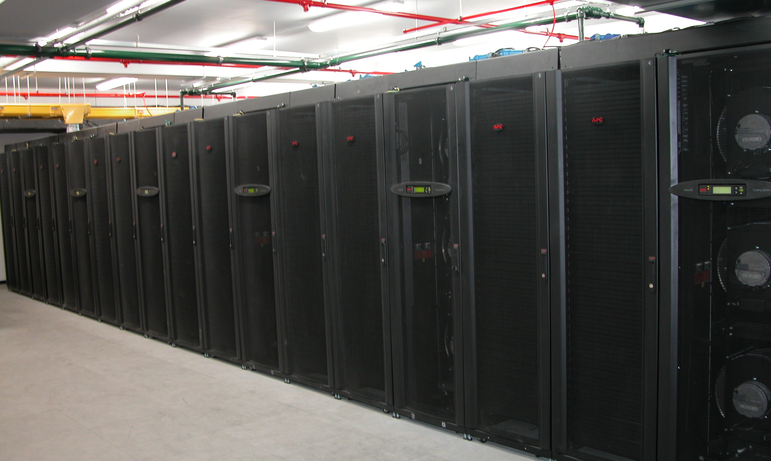
Allocated Hardware Resources
GRNET
32 nodes
  48GB memory,
  2x140GB HD,
  Dual quad-core Xeon E5520 2.26 GHz,
  16 HT cores
20TB total NAS storage space (EMC Celerra NS-480)
1 GbE local connectivity
2x10 Gb link to GEANT
Public Cloud Service
16 + 1 Nodes
256 cores (Hyper-threaded)
864GB total main memory
3TB storage space over NFS
CNRS
9 nodes
  36GB memory,
  300GB SAS HD,
  Dual hexa-core Xeon X5650 2.67 GHz,
  24 HT cores
Storage: 20TB HP MDS600 disk array
1 GbE local connectivity
10 Gb/s link to GEANT
Public Cloud Service
8 + 1 Nodes
192 cores (Hyper-threaded)
288GB total main memory
5TB shared files system (NFS) + 15TB pDisk over iSCSI
TCD
Marketplace & Appliance repository hosting

Slide 6
Metrics
WP5 metrics goal
  Collect statistics of services’ usage (IaaS cloud, hosted grid services, Marketplace)
  Monitor service QoS (Availability and reliability)
  Track the level of committed physical resources
IaaS Cloud
Metric | Q1 | Q2 | Q3 | Q4 | Y1 Tgt. | Q5 | Q6 | Q7 | Q8 | Y2 Tgt.
No. of prod. sites running StratusLab dist. | - | 1 | 1 | 1 | 5 | 1 | 3 | 5 | 5 | 10
Delivered CPU through cloud API (cores) | - | - | 256 | 256 | - | 256 | 288 | 256 | 448 | -
Storage used | - | - | 3 TB | 3 TB | - | 1 TB | 1 TB | 1 TB | 23TB | --
Notes:
Some metrics from Y1 have been removed or transformed to different ones in Y2. Some numbers are different from Q8 (took into account CNRS reference cloud service)

Slide 7
Metrics (ctd.)
Appliance Repository
Metric | Q1 | Q2 | Q3 | Q4 | Y1 Tgt. | Q5 | Q6 | Q7 | Q8 | Y2 Tgt.
No. base machine images | - | 5 | 7 | 8 | 5 | 8 | 13 | - | - | 10
No. of base machine image downloads | - | 783 | 2628 | 7072 | - | 7225 | 6657 | - | - | -
No. appliances | - | - | 6 | 7 | 5 | 7 | 7 | - | - | 15
No. of appliance downloads | - | 0 | 252 | 687 | - | 1010 | 426 | - | - | -
Marketplace
Metric | Q1 | Q2 | Q3 | Q4 | Y1 Tgt. | Q5 | Q6 | Q7 | Q8 | Y2 Tgt.
No. of Marketplace metadata entries | - | - | - | - | - | - | - | 111 | 114 | -
No. of Marketplace endorsers | - | - | - | - | - | - | - | 24 | 35 | -
No. of Marketplace base images | - | - | - | - | - | - | - | 86 | 71 | -
No. of Marketplace appliances | - | - | - | - | - | - | - | 25 | 43 | -

Slide 8
Metrics (ctd.)
Grid site
Metric | Q1 | Q2 | Q3 | Q4 | Y1 Tgt. | Q5 | Q6 | Q7 | Q8 | Y2 Tgt.
Availability of sites | - | - | - | 100% | 80% | 91% | 74% | 93% | 98% | 95%
Reliability of sites | - | - | - | 100% | 80% | 92% | 78% | 93% | 98% | 95%
No. of VOs served via StratusLab sites | - | - | 1 | 1 | 10 | 21 | 18 | 18 | 18 | 30
No. of sci. disciplines served via StratusLab sites | - | - | 0 | 0 | 3 | 11 | 9 | 9 | 9 | 15
Delivered CPU (cores) | - | - | 16 | 16 | - | 32 | 32 | 32 | 32 | -

Slide 9
Recommendations
Rec. 9: “The Data Management layer should be improved. In particular, StratusLab should be able to use existing and robust parallel file-systems which have better scalability than NFS such as Panasas or GPFS.”
Performed extensive tests with various File Systems: Gluster, PVFS, Ceph, GPFS, NFS. No clear winner:
  GPFS best performance but expensive,
  Ceph most cloud oriented but still in alpha phase. Gluster, PVFS and NFS similar performance.
  NFS simpler to setup (de facto available from the infrastructure).
  Gluster and PVFS provide better scalability.
Rec. 10: “Testing and benchmarking in WP5 should be more detailed including performance aspects.”
Systematic testing procedures supported by respective infrastructure was put into place in Y2. Certification procedure before new releases. Benchmarking suite available as part of StratusLab CLI package.
Notes:
Maybe move the filesystem reporting in the lessons-learned section

Slide 10
Recommendations (ctd.)
Rec. 10: “The security incident as reported in Q3 should be analysed thoroughly and measurements should be taken to prevent this to happen again on the live production system.”
These security incidents were taken seriously and analysed thoroughly in QRs and Deliverables.
  Motivated the design of Marketplace.
  Implemented enhanced logging and image policy enforcement.
  Image endorser liable for his/her appliances. (… more in the lessons learned below)

Slide 11
Lessons learned
Security
Cloud Service Provisioning
Economic Impact
Service Deployment and Evolution
Physical Infrastructure
Daily Operations

Slide 12
Computing power
Fat nodes increase density and provide more computing power per rack footprint. Also offer flexibility to provide variety of VM configurations.
Large local disks useful for temp files and caching. Crucial if shared file system is used
HyberThreading (and oversubscription) can increase utilization but may impact performance in high loads and for certain kinds of applications.
No real scalability issues: The more (nodes) you add the more (VMs) you get

Slide 13
Storage
Crucial component for Cloud infrastructures:
  VMs need space to run and expand
  More space for additional volumes (persistent disk service)
  Large number of I/O operations
  Space for extras: Image caching (crucial for short instantiation times), snapshotting.
Scalability affected by implemented storage architecture
  Different variations studied during the course of the project
  Proper selection and combination of hardware/software solutions largely impact the delivered storage performance and scalability

Slide 14
Infrastructure setup variations
(1) Basic setup. Single frontend. NFS shared file system or SSH.
(2) Separate VM / storage control. iSCSI/LVM used for persistent storage management
(3) Dedicated network storage server. iSCSI/LVM used for persistent storage management. NFS or SSH for image sharing between frontend and hosting nodes
(4) Distributed solution. GPFS, Gluster or PVFS used for shared storage. Better scalability, improved performance, avoids single point of failures

Slide 15
Network
No traffic congestion experienced in nodes due to VM multitenancy
Bandwidth hasn’t been the issue also in the centralized pDisk server setup. Storage I/O the main cause of performance bottleneck
Channel bonding available but never used due to the above.
Notes:
CNRS experience on this? Add a cool graph about network communication

Slide 16
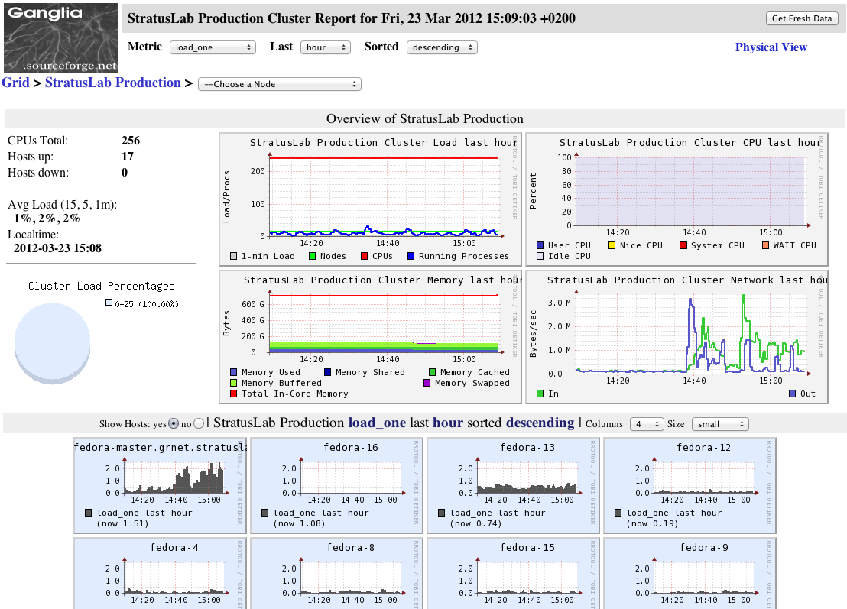

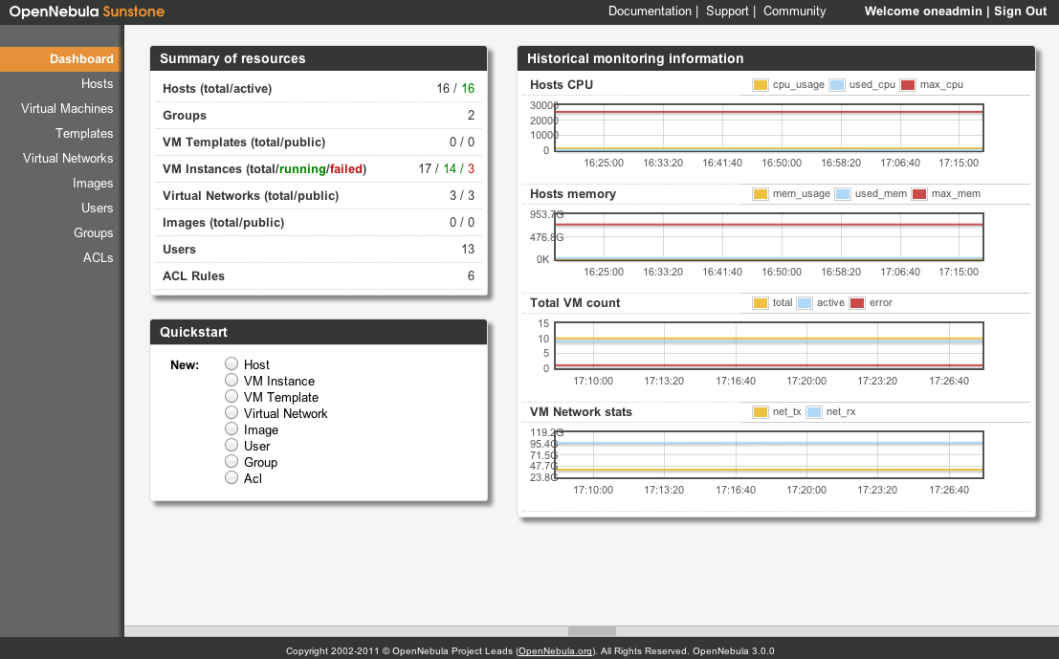
Cloud service operations
Hardware failures impact availability. Obviously, although virtualization offers flexibility.
Global downtimes are… bad. In some cases may take days. Make proper decisions early in order to minimize them.
Monitoring at all levels is vital.

Slide 17
Software integration
Development
Develop
Certify
Deploy
Operate
New requirements and bugs
Aimed for…
Less downtimes
Faster upgrades
by using…
Common tools and procedured
Automated S/W certification and deployment
thus applying…
DevOps principles
Operations
Notes:
Cloud software upgrade is the usual cause for downtimes
6 week release cycle (spread between two 3-week sprints)
Necessary to have a streamlined process:
Development ➔ Certification ➔ Deployment
DevOps principles
Close interaction between development and operations team
Ops participating in the daily scrum meetings together with Dev people
Integration of various tools (Jira, Hudson, Maven, Nexus, RPM repos)
Automation whenever possible

Slide 18
Security
Three security incidents in 2 years of operation
  Exploitation of VM vulnerabilities
  Hacking of a physical node used for testing & development
Immediate response to security incidents vital, e.g.
  Bring VM down
  Remove VM image from Marketplace
  Notify endorser
Strong IT security practices necessary for cloud service provisioning
VM images is a component we cannot fully control
Need to establish certification procedures or otherwise make image endorsers liable for their VMs

Slide 19

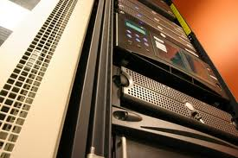
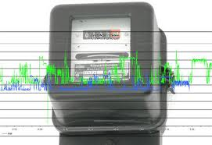
Economic impact
Goal
  Calculate TCO of private cloud,
  Compare expenses for hosting grid services in private cloud and in Amazon EC2
What we took into account
Outcome
  Open-source based private clouds offer a cost-effective solution even for small-scale deployments
Infrastructure CapEx
Human resources
Power consumption

Slide 20
Questions?

Slide 22
Cloud service TCO
Calculated for the first year of operations
(Nov 2010 – Nov 2011)
Total extrapolated to the duration of the project (2 years)
Hardware and hosting infra. | 115.200,00 €
Network line leases | 30.000,00 €
Power Consumption | 6.600,00 €
Datacenter administration | 20.000,00 €
Cloud site administration | 80.000,00 €
Total Cost of Ownership (2yrs) | 251.800,00 €
TCO=251K €, Cost/hr = 14.37 €/hr, Cost/core= 0.0712 €/core
Notes:
Price of core

Slide 23
Comparison with Amazon EC2
Calculated average memory and core per VM over a period of year: 1 core, 613 MB.
Found matching VM profile in Amazon EC2: t1.small
Calculated cost for hosting our production grid site in Amazon EC2 using t1.small: 21,888.00 €
Calculated similar cost with StratusLab:21,896.00 €
Arguably a modest comparison: Cluster instance more appropriate and more expensive for running Grid site

