Slide 1
StratusLab Cloud Distribution
StratusLab Tutorial (Orsay, France)
28 November 2012

Slide 2
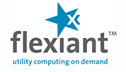
Infrastructure as a Service (IaaS)
Abstraction
Access to remote virtual machines
Aimed at service providers
Advantages
Customized environment
Simple and rapid access
Access as “root”
Pay-as-you-go model
Disadvantages
Non-standardized and multiple interfaces (vendor lock-in)
Virtual machine creation is difficult and time-consuming
Software as a Service (SaaS)
Platform as a Service (PaaS)
Infrastructure as a Service (IaaS)

Slide 3
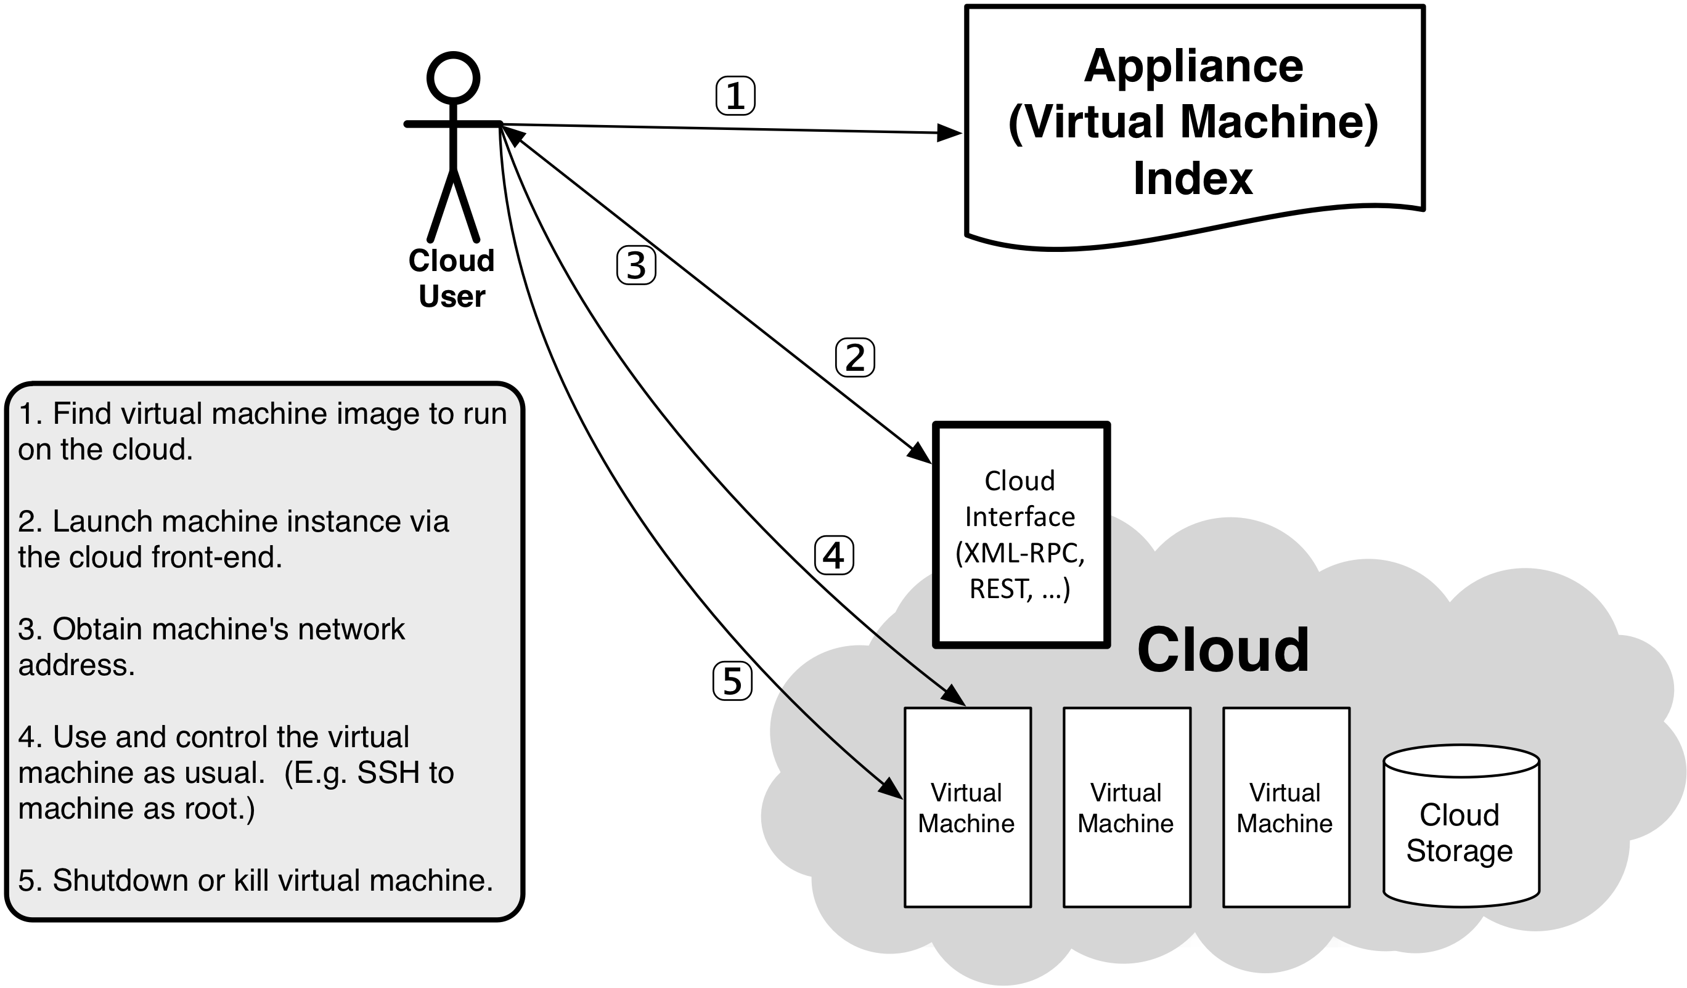
Using an IaaS Cloud

Slide 4
Why use a cloud?

Slide 5
Customized Environment
Operating system(s) suited to your application
Your applications preinstalled and configured
CPU, memory, and swap sized for your needs

Slide 6
Bioinformatics
Deluge of Data
Huge databases that grow quickly in size and number
Numerous Applications
Written for different environments and having different requirements
Variety of Databases
Different topics (genetics, proteins, …), subject to continuous updates
Challenge: Creating the proper environment to use them simultaneously for a complete analysis.

Slide 7
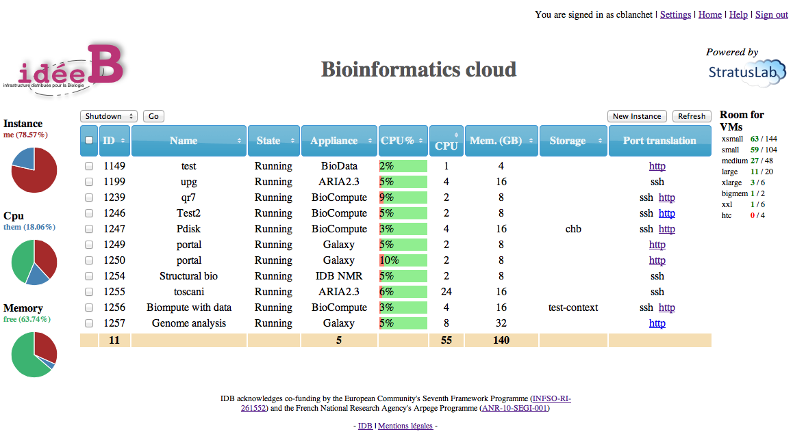
Customized Appliances
Biocompute
Common bioinformatics applications and libraries preinstalled
BLAST, ClustalW2, FastA, …
Biodata
Gives access to the latest updates of common databases
SwissProt, Prosite, …
Customized portal
Easy access to cloud infrastructure
Streamlined for bioinformatics use

Slide 8
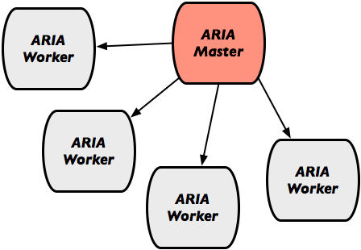
TOSCANI
“TOwards StruCtural AssignmeNt Improvement”
Improve the determination of protein structures based on Nuclear Magnetic Resonance (NMR)
ARIA
Calculates structures based on NMR
Variable resource utilization during calculation

Slide 9
Dynamic Provisioning
New storage and compute resources in minutes
Used resources freed just as quickly
Ideally suited to variable workloads

Slide 10
Dynamic Training Infrastructure
Benefits
No need for a dedicated training infrastructure; create it as needed.
Provides students each with their own personal playground
NARVAL
Data acquisition software used by several nuclear physics institutes, like IPNO, INFN, GSI, Ganil, …
Understanding the system requires installing, using and customizing it
Successfully trained 20 NARVAL students using the StratusLab cloud infrastructure.

Slide 11
Dynamic Testing Infrastructure
Developers Dream
Easily test software in multiple environments
Deploy full, independent test systems without interference from others
SlipStream
Software engineering PaaS from SixSq allowing automated deployment and testing of complete software systems
Uses the StratusLab cloud distribution for dynamic resource provisioning

Slide 12
Flexible Service Deployment
Deploy user-level, network-accessible services
Create domain-specific analysis platforms

Slide 13
High Energy Physics
HEP Experiments
Have 1000s of users, analyze PB of data, and use 100s of sites around the world
Develop and maintain their own software services and platforms to manage the data and control access to it
Grid Infrastructure
Heavily used to support HEP data management and analysis
Consists of a large number of complex services
Grid site in a StratusLab cloud
Production site maintained for nearly 2 years
Demonstrates cloud’s ability to support complex services

Slide 14
StratusLab History
Informal collaboration to investigate running grid services on Amazon EC2 (2007)
Project (June 2010 to May 2012) co-funded by EC with 6 partners from 5 countries
Open collaboration to continue the development and support of the StratusLab software
Website: http://stratuslab.eu
Twitter: @StratusLab
Support: support@stratuslab.eu
Source: http://github.com/StratusLab

Slide 15
StratusLab Principles
Simple to deploy and simple to use!
Command line client for all major platforms
Web interface for most services
REST interfaces for programmers
Focused, practical development
Develop for real needs of users
Focus on providing IaaS services well
License (Apache2) that allows academic and commercial use
Maintain production quality with rapid evolution
Iterative integration: always maintain working distribution
Public releases approximately every 3 months
Welcome contributions by institutes and individual developers

Slide 16
StratusLab Architecture

Slide 17
Compute Services
Virtual Machine Management
OpenNebula (opennebula.org) provides core of VMM (start, stop, kill)
Plug-in architecture allows use of multiple hypervisors (kvm, …)
Features
StratusLab-specific caching allows low-latency startup of VMs
Quarantine of stopped images for forensic analysis
Detailed logging of user and resource information
Improved error feedback from plug-ins to user
Integration with StratusLab user management

Slide 18
Storage Services
Persistent (Read-Write) Disks
Allows the storage of service state or user data
Mounted as a disk on VMs
Disks are persistent and have a lifecycle independent of a single VM
Can be mounted by single VM at any time
Only available within a single cloud instance
Static (Read-Only) Disks
Useful for distribution of quasi-static databases
Handled and shared like VM images via Marketplace
Volatile (Read-Write) Disks
Useful for temporary (!) data storage
Data will disappear when VM instance is destroyed

Slide 19
Other Storage Types
File-based Storage
Normal client tools can be installed in VMs
Access services normally from VM (e.g. tools for SRM)
May provide CDMI interface to StratusLab storage
Object Storage
Simple object storage, usually minimal hierarchy and chunked data
StratusLab works well with Swift from OpenStack
Key-value Pair Database
Exposes simple API for “database” of key-value pairs (e.g. Cassandra)
Can deploy VM with persistent disk to provide this service
Unlikely to see StratusLab implementations, but distribution may facilitate co-deployment of such services from others.

Slide 20
Networking Services
IP Address Classes & Selection
Public: Internet-accessible services
Local: Batch systems or parallel calculations
Private: Slaves in pilot job systems
IPv6
Software supports IPv6 networking for VMs
Not available on reference infrastructure yet
Future Services
User specified firewalls
IP address reservation
Dynamic VLANs

Slide 21
Image Management
Machine image creation is a barrier to cloud adoption
Creating virtual machine images is time-consuming
Ensuring that machines are secure and correct is difficult
Sharing existing machines lowers this barrier
Marketplace facilitates sharing of images
Registry of metadata for machine & disk images
Image contents are kept in cloud, grid, or web storage
Supports trust between creators, users, and administrators
Benefits
End-users: browse and use existing images for their analyses
Creators: publicize their work and attract larger user base
Cloud Admins.: Use metadata to evaluate trustworthiness of images

Slide 22
Appliances
Virtual machines with pre-installed/configured services
Makes it easier to get started quickly using cloud resources
Good way to package software to avoid installation hurdles
Utilities for making and publishing customized images
Security guidelines
Incremental changes to base image
Marketplace for publication
StratusLab supported appliances
Base images: ttylinux, CentOS, OpenSuSE, Ubuntu, Debian
Bioinformatics: Data server and analysis images

Slide 23
User Management
Authn/Authz
Authentication done through common proxy service
Allows username/password from LDAP or from file
Allows use of grid certificates and VOMS proxies
Authorization done in individual services
Delegation currently not needed/used (will change if machine or disk images are protected)
Registration Service
Web service for user registration
LDAP DB for easy integration with cloud and other services

Slide 24
Accessing Services
StratusLab Client
Command line scripts in python/java with minimal dependencies
Fully tested on Mac OSX and Linux
Core functionality works on Windows
Be sure to use client version corresponding to cloud infrastructure
Programming Interfaces
All services except VMM provide proprietary REST interface
VMM exposes OpenNebula XML-RPC interface
Transitioning to using CIMI for all services (incl. VMM)
StratusLab plugin for rOCCI impl. of OCCI is available
Web Interfaces
Provided for all services except virtual machine management
Expect to have complete, unified interface after transition to CIMI

Slide 25
Cloud Infrastructures
Reference Cloud Infrastructure
Allow users to test a StratusLab cloud without having to install one
Two sites: LAL (Orsay, France) and GRNET (Athens, Greece)
Registration Service accounts work on both sites
Problems, ask questions via support@stratuslab.eu
Other StratusLab Infrastructures
South Africa
Vietnam
UK
Bordeaux
…

Slide 26
Questions and Discussion

Slide 27
Exercises
StratusLab Website
Find information for system administrators
Find information for users
Code
http://github.com/StratusLab
Can you find the code related to the various types of resources?
Any code that you can’t understand in a IaaS context?

