Slide 1
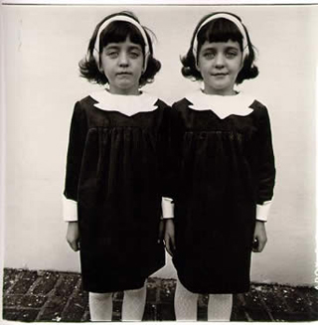
CP Asymetries in the B_{s} system
Diane Arbus
Yasmine Amhis
LAL, Orsay 16 Avril 2013

Slide 2
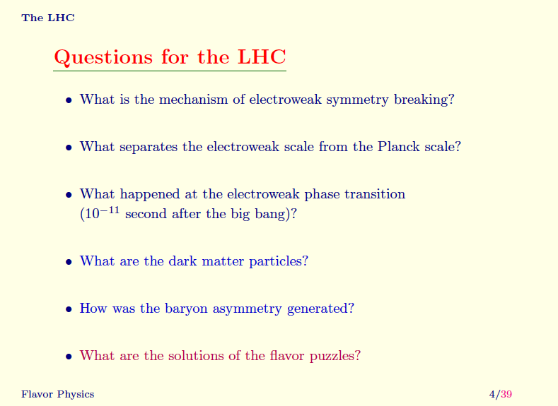
Nir

Slide 3
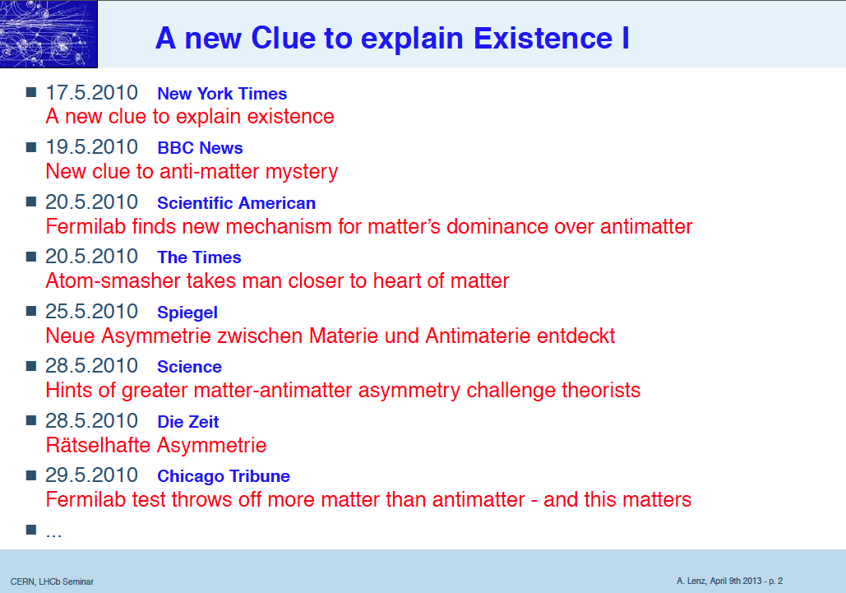
Lenz

Slide 4
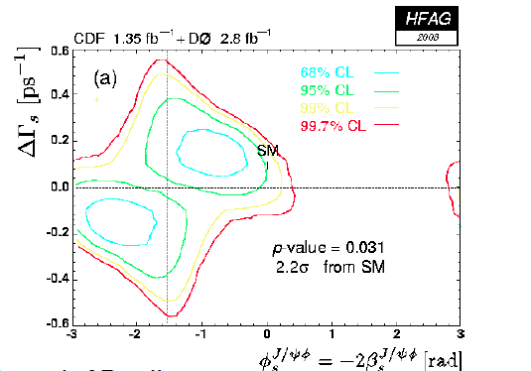
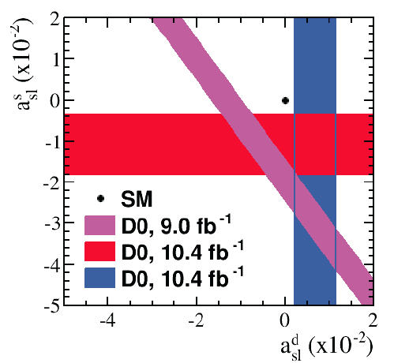
Lenz

Slide 5
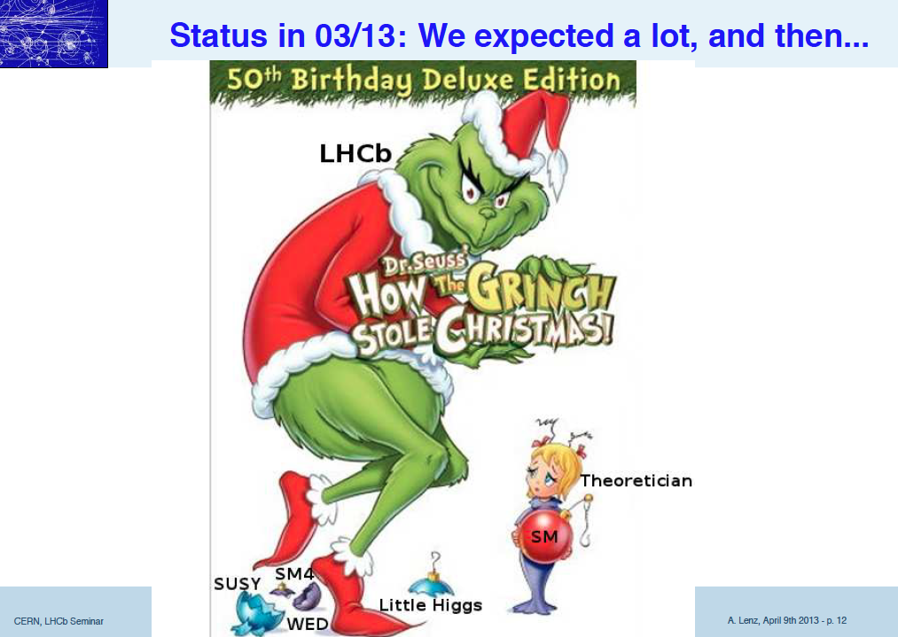
Lenz

Slide 6
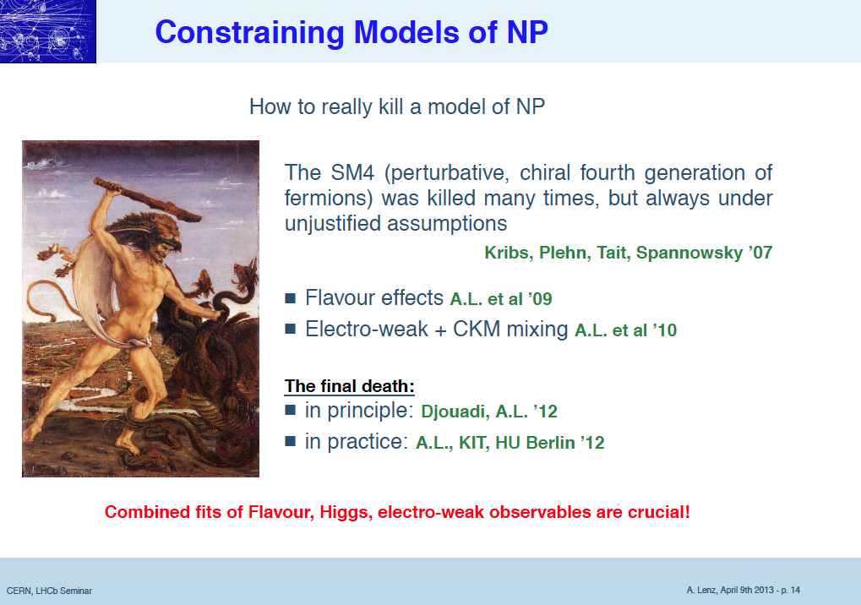
Lenz

Slide 7
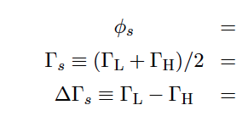
La Sainte Trinité du jour
ϕ_{s}
ΔΓ_{s}
Γ_{s}

Slide 8
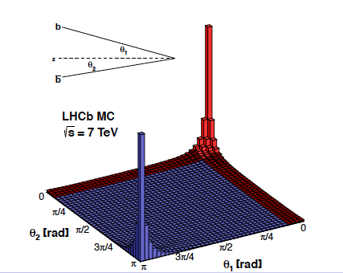
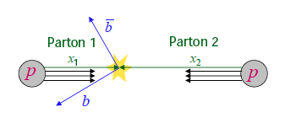
LHC a Flavour Factory
Large cross sections @ 7 TeV :
σ^{inel}_{pp} ~ 60 mb [JINST 7 (2012) P01010
σ^{inel} (pp → charm) ~ 6 mb [LHCb-CONF-2010-013]
σ^{inel} (pp → beauty ) ~ 0.3 mb [PLB 694 (2010) 209]
In high energy collisions, bb/cc pairs
are produced predominantly in
the forward or backward directions
Initial motivation for the design

Slide 9
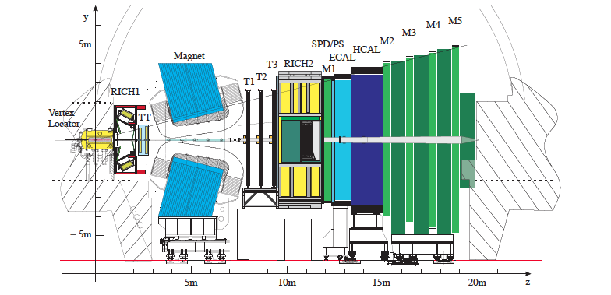
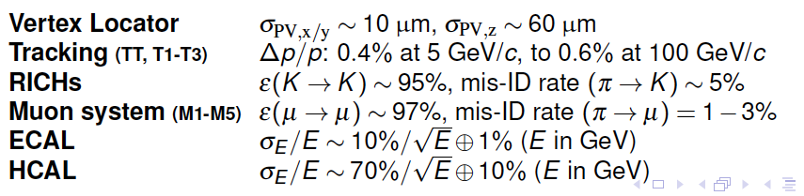
The LHCb detector

Slide 10
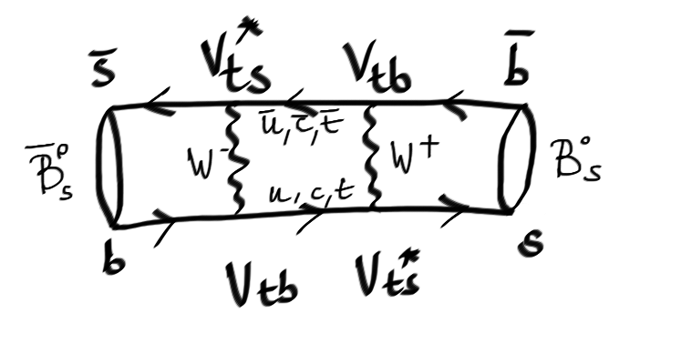
More diagrams
Neutral B_{s} meson

Slide 11
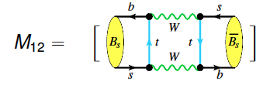
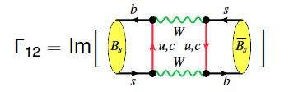
More diagrams
Neutral B_{s} meson

Slide 12
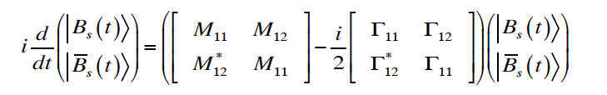
More diagrams
Neutral B_{s} meson
Time Evolution :
Diagonalizing this Hamiltonian leads to two mass
eigenstates with masses M_{H(L)} and decay width Γ_{H(L)}

Slide 13
The B⁰_{(s)} neutral system
Time Evolution
Diagonalizing this Hamiltonian leads to two mass
eigenstates with masses M_{H(L)} and decay width Γ_{H(L)}

Slide 14
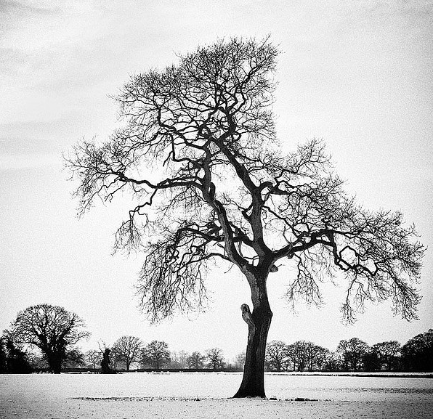
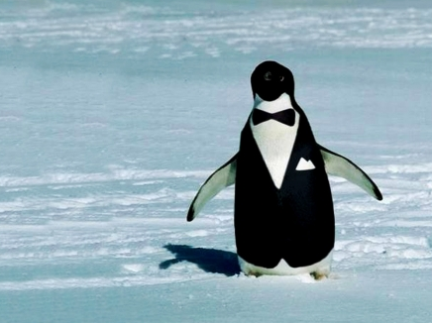
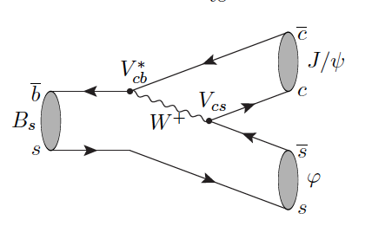
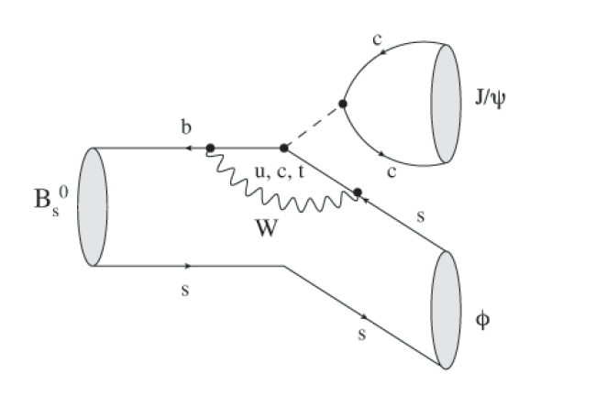
Color Suppressed Tree & Penguin(s) Feynman diagrams

Slide 15
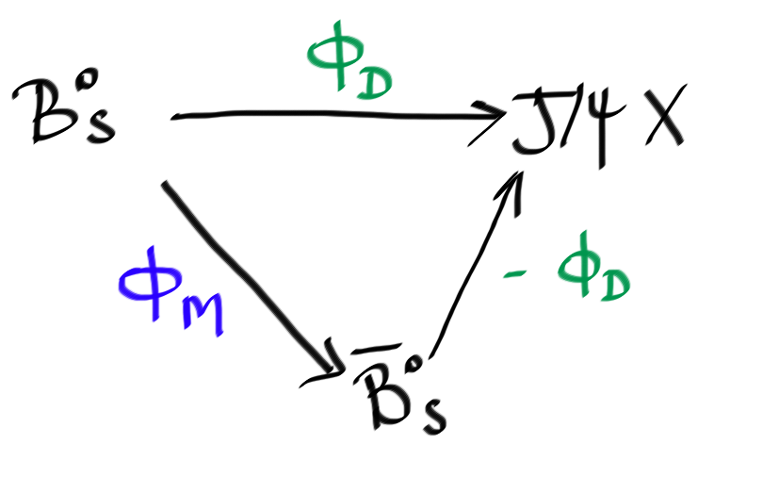
Phases phases
Measure relative phase difference
ϕ_{s}= ϕ_{M} − 2ϕ_{D} between two “legs”.
In SM + Ignoring penguins
ϕ_{D} ~ 0
ϕ_{s}SM ~ ϕ_{M}
is predominantly determined by arg(V_{ts} )
is predicted to be small ~ -0.04
[Charles et al. Phys. Rev. D84 (2011) 033005]
New Physics (NP) can add large phases:
ϕ_{s} = ϕ_{s}SM + ϕ_{s}^{NP}

Slide 16
Theoretically :
b→ccs tree dominance leads to precise prediction of ϕ_{s} in SM.
SP → VV, admixture of CP-odd and CP-even states, measure also ΔΓ_{s}.
Experimentally :
Relatively large branching ratio.
Easy to trigger on muons from J/ψ → μ⁺μ⁻.
The Observables
3 “P-wave” amplitudes of KK system ( A₀, A_{perp}, A_{para})
1 “S-wave” amplitude (A_{s})
10 terms with all the interferences (see the next slide)
ϕ_{s} , ΔΓ_{s,} , Γ_{s} …

Slide 17
Theoretically :
b→ccs tree dominance leads to precise prediction of ϕ_{s} in SM.
SP → VV, admixture of CP-odd and CP-even states, measure also ΔΓ_{s}.
Experimentally :
Relatively large branching ratio.
Easy to trigger on muons from J/ψ → μ⁺μ⁻.
The Observables
3 “P-wave” amplitudes of KK system ( A₀, A_{perp}, A_{para})
1 “S-wave” amplitude (A_{s})
10 terms with all the interferences (see the next slide)
ϕ_{s} , ΔΓ_{s,} , Γ_{s} …

Slide 18
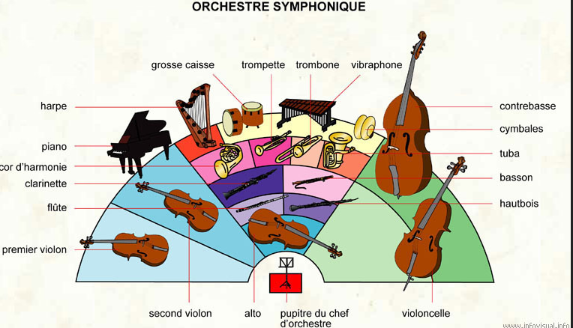
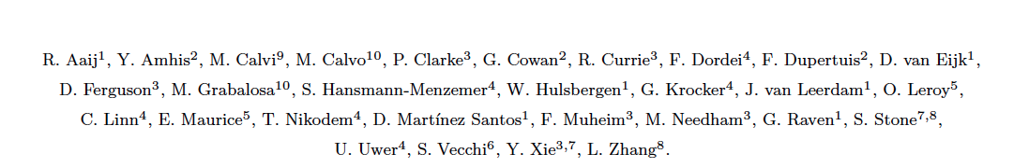
How we work together ?

Slide 19
How we work together ?
Mass
Time
Flavour Tagging
Angles

Slide 20
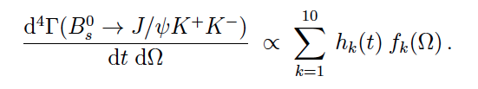
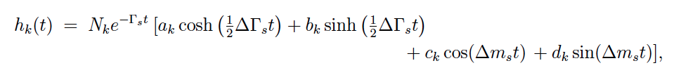
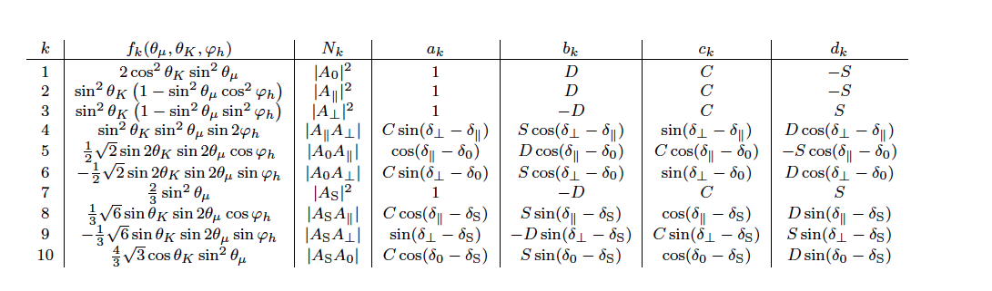




A few more words
Time dependent
Angular terms

Slide 21
A few more words
Time dependent
Angular terms

Slide 22

http://fr.wikipedia.org/wiki/Keep_Calm_and_Carry_On

Slide 23
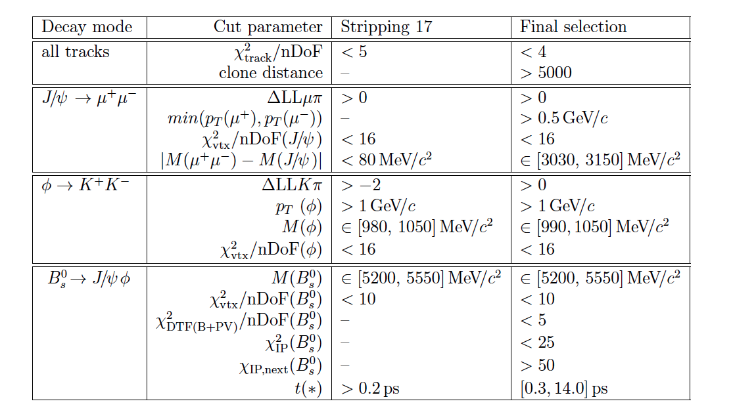
Event selection
Simple cut based selection kinematics + pid
Attempts to use MVA, but no significant improvement was observed

Slide 24
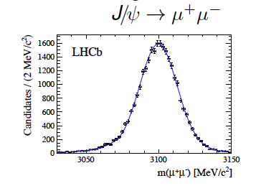
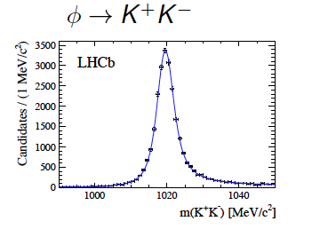
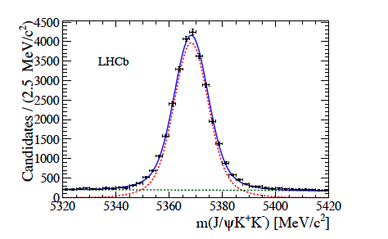
Selection Results
About 28 000 signal events
with very high purity !

Slide 25
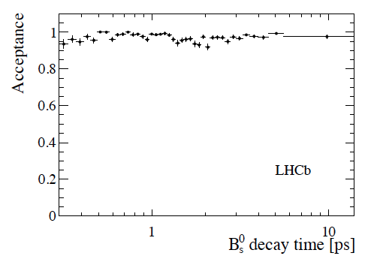
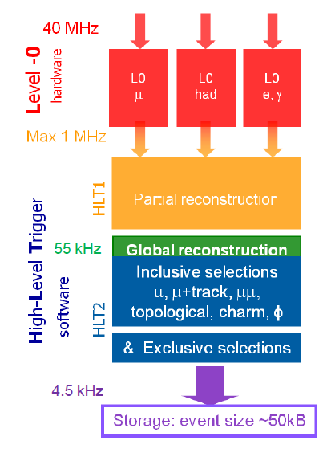
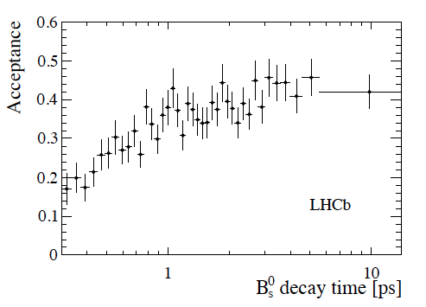
Trigger Acceptance^{(*)}
“Unbiased”
“Very biased”
^{(*)} C’est quand même une machine hadronique !

Slide 26
Mode acceptances on the decay time
Corrections needed:
Track Reconstruction
Online and Offline
Vertexing
φ and PV
Total systematic error on the lifetime is 8.7 fs .
Main effect due to the track reconstruction in the Velo.
Partly due to the limited size of the control sample.

Slide 27
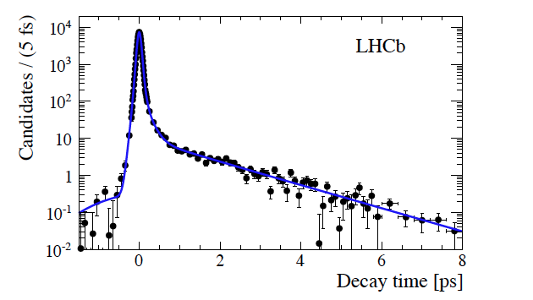
Decay time resolution
sWeights extracted
from J/ψ mass
sWeights extracted from J/ψ mass fit
We measure from data using prompt J/ψ which decay at
t = 0 ps triggered with the unbiased triggers.
Model is a triple Gaussian.
Width is found to be about 45 fs.

Slide 28
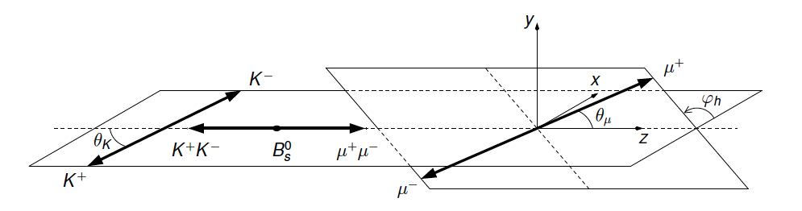
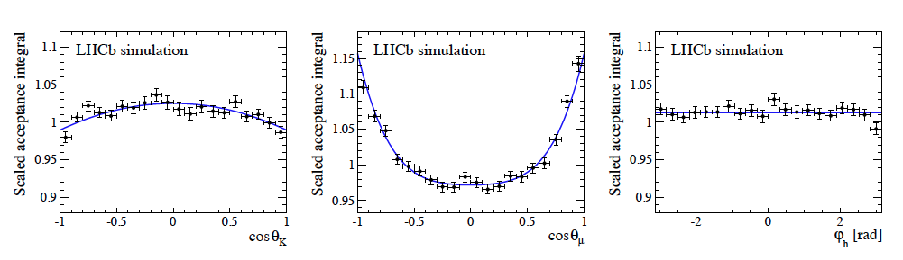
Angles and their acceptances
Forward geometry of LHCb + selections cuts :
distorted angular acceptance Determined using MC

Slide 29
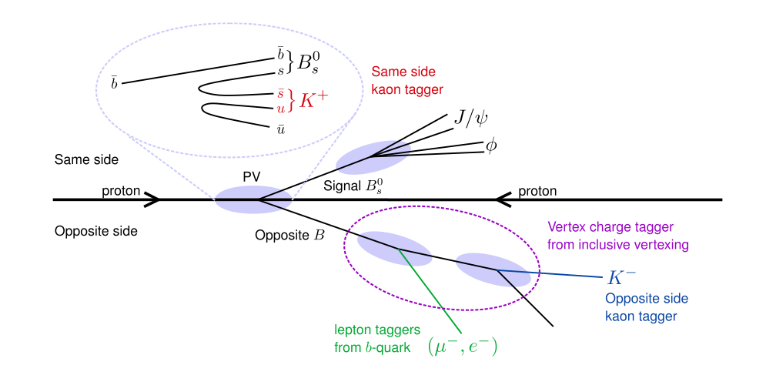
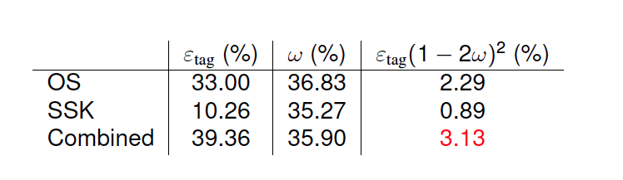
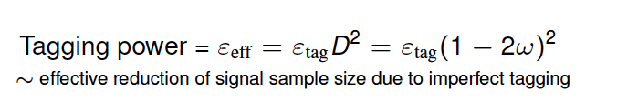
Quelle est la saveur initiale ?
Time dependent CP asymmetry needs to identify the initial flavour of reconstructed B_{s}⁰ mesons (initial state a b or b quark).

Slide 30
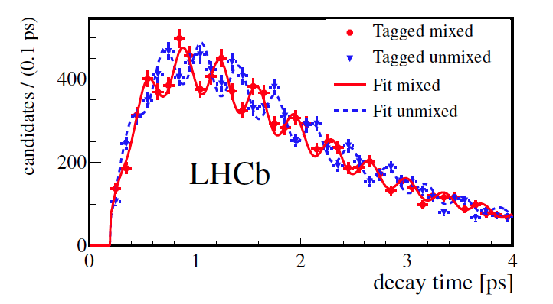
Quelle est la saveur initiale ?
Time dependent CP asymmetry needs to identify the initial flavour of reconstructed B_{s}⁰ mesons (initial state a b or b quark).

Slide 31
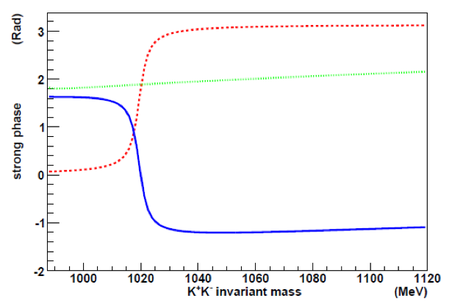
How do we make the fit to the data ?
Use the mass fit to extract sWeights → Need to model “only the signal component”.
Split the data in 6 bins of m_{KK} → increase sensitivity
K⁺K⁻ P-wave :
Phase of Breit-Wigner amplitude
increases rapidly across φ(1020)
mass region
K⁺K⁻ S-wave:
Phase of Flatté amplitude for f0(980)
relatively flat (similar for non-resonance)
“Pheno” work
Phase difference between S- and P-wave amplitudes
Decreases rapidly across φ(1020) mass region

Slide 32
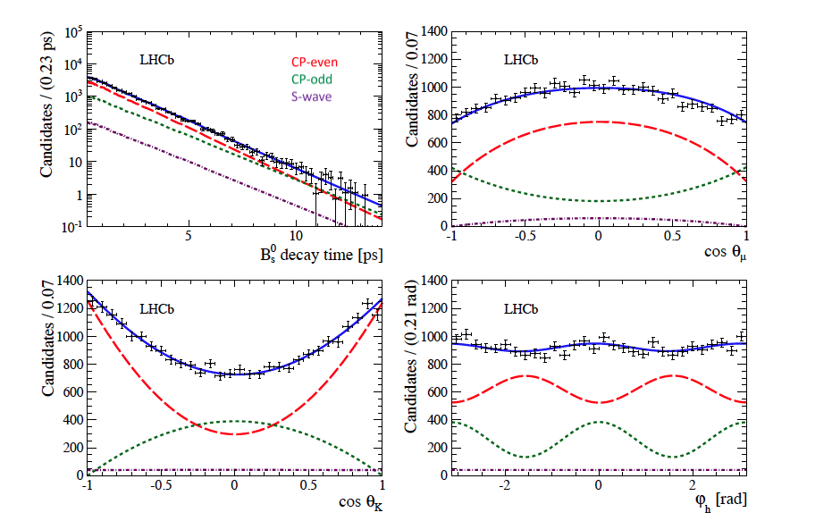
Sticking all the pieces together Results I

Slide 33
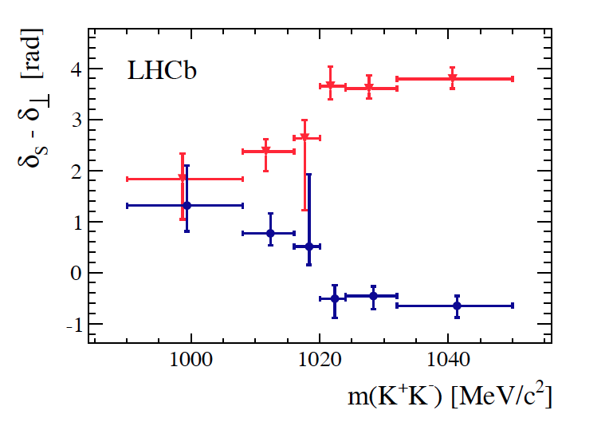
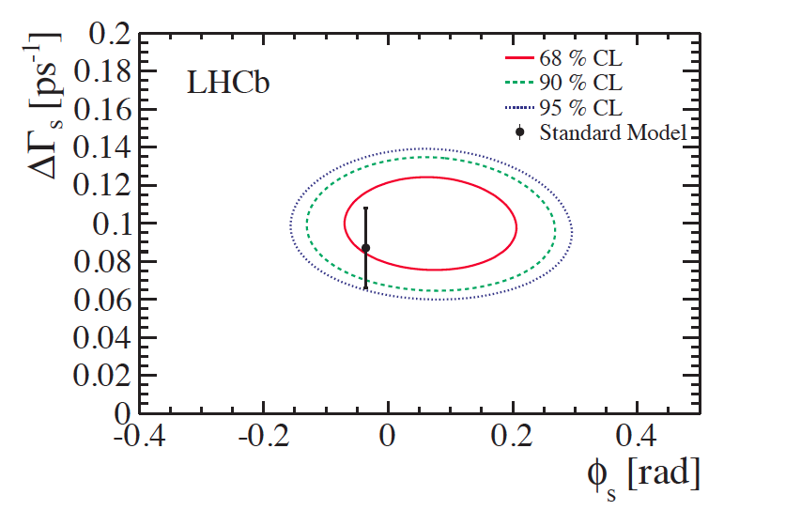
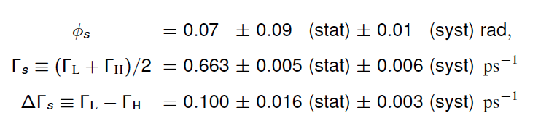
Sticking all the pieces together Results II
ΔΓ_{s} > 0 and Φ_{s} compatible with SM – oh well !

Slide 34
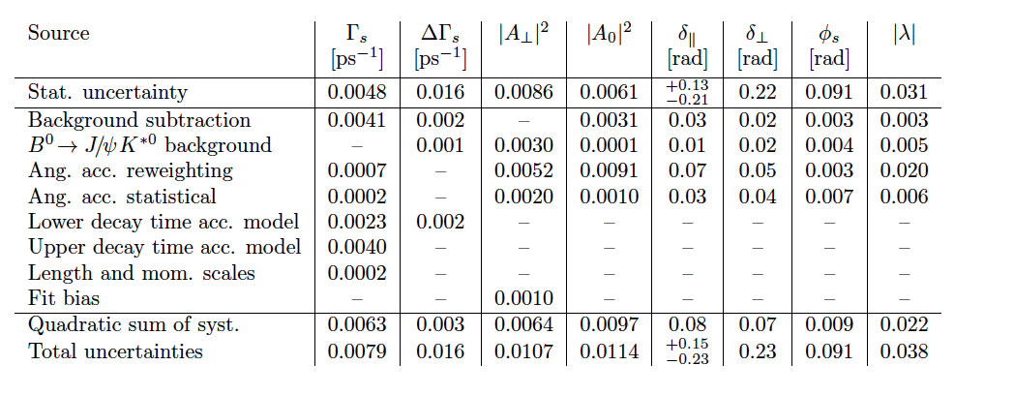
Systematiques

Slide 35
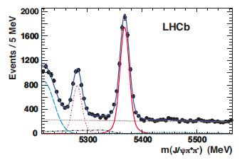
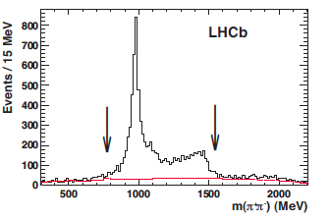
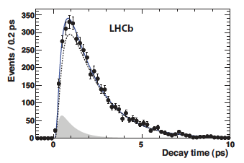
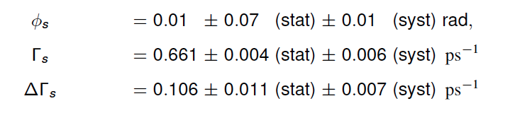
Pour améliorer la précision
Combining with the J/Ψππ channel

Slide 36

It wouldn’t be fun without competition !

Slide 37

C.Heller

Slide 38

C.Heller

Slide 39

C.Heller

Slide 40

C.Heller

Slide 41

C.Heller

Slide 42


Conclusion
arXiv:1304.2600

Slide 43


Slide 44

Backup slides

Slide 45




Semileptonic asymmetries
The observales :
How we measure it :
Yields 190 k B_{s}⁰ candidates in 1.0 fb⁻¹:
LHCb-CONF-2012-022
D_{s}⁺
D_{s}⁻

Slide 46


Semileptonic asymmetries
Delicate systematic treatement is needed :
Obtain any corrections from data/control samples.
Pay attention to the π and μ detection asymmetries.
Swap magnetic field to help cancel effects.
LHCb-CONF-2012-022

Slide 47

Semileptonic asymmetries
We measure :
a_{sl} ^{s} = (-0.24 ± 0.54 ± 0.33 ) %
Most precise measurement !
And also in agreement with SM
as quoted in arXiv:1205.1444
a_{sl} ^{s} = (0.0019 ± 0.0003 ) % and
a_{sl} ^{d} = (-0.0041 ± 0.0006 ) %
Dominant systematic is from limited statistics in control sample.
3 tension with SM in the D0 result, not confirmed or excluded by LHCb.
More decay modes, data are needed. But also the B⁰ mode!
LHCb-CONF-2012-022

Slide 48




This is us !
Sandrum

Slide 49

Silvestrini

Slide 50



CP-Content & B_{s} Lifetimes
Pseudo Scalar – Pseudo Scalar
CP-Even Ex : K⁺K⁻
Vector – Pseudo Scalar
CP-Even Ex : J/ψ f₀
Vector – Vector
CP-Odd and CP-Even
Ex : J/ψ ϕ
Requires angular analysis
Example of Flavor Specific

Slide 51


Bs→ φφ

Slide 52


S-wave fraction

Slide 53


