Slide 1



Test of Diamond Sensors at PHIL
Philip Bambade, Pierre Barillon, Frédéric Bogard,
Selma Conforti, Patrick Cornebise, Shan Liu, Illia Khvastunov
Journée PHIL 30. 01.2013

Slide 2
Contents
ATF2 and Beam Halo Measurement
Diamond Detector Characteristics
Mad-X Simulation Results
Diamond Detector Test @ PHIL
Expected Signal @ PHIL
Electronics Setup
Summary and Future Plan

Slide 3
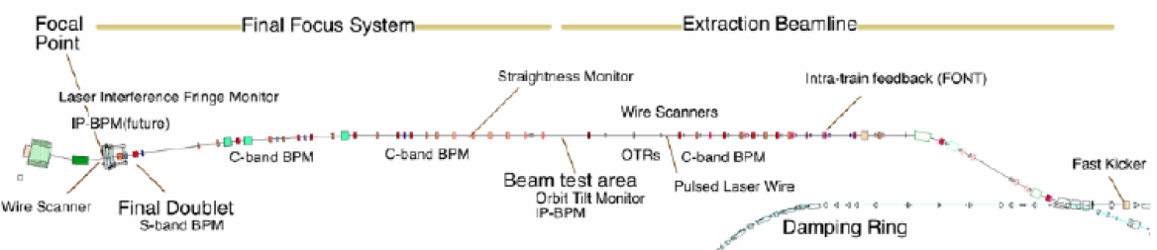
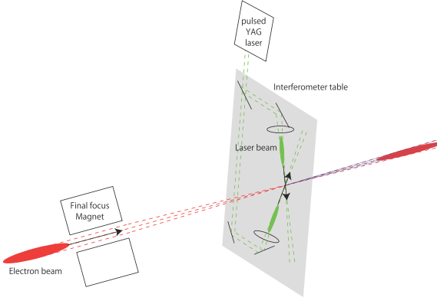
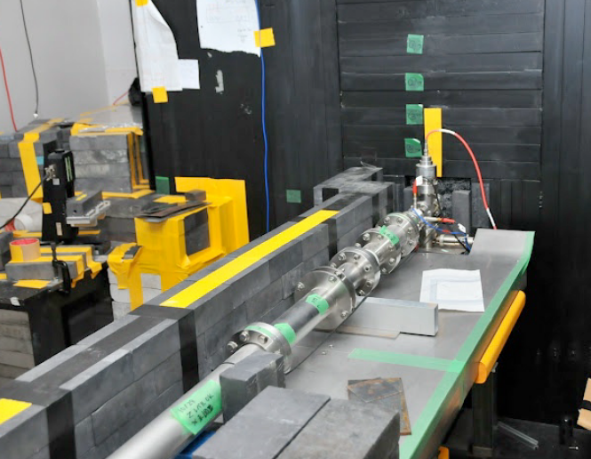
ATF2 & Beam Halo Measurement
Shintake Monitor
Sensor
Motivations:
Beam halo transverse distribution unknown → investigate halo model
Probe Compton recoiled electron→ investigate the higher order contributions to the
Compton process

Slide 4
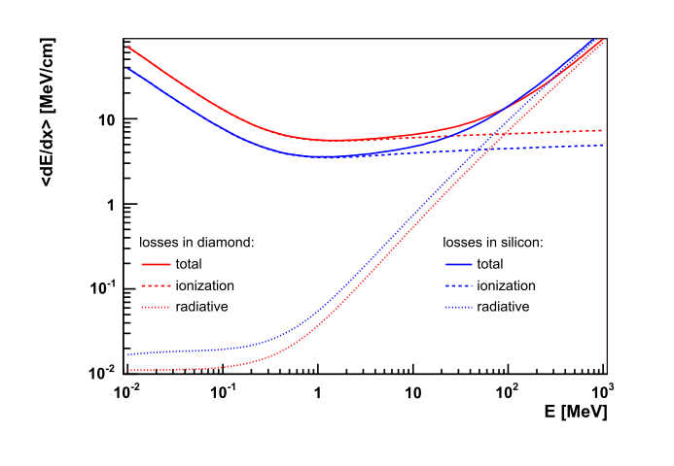
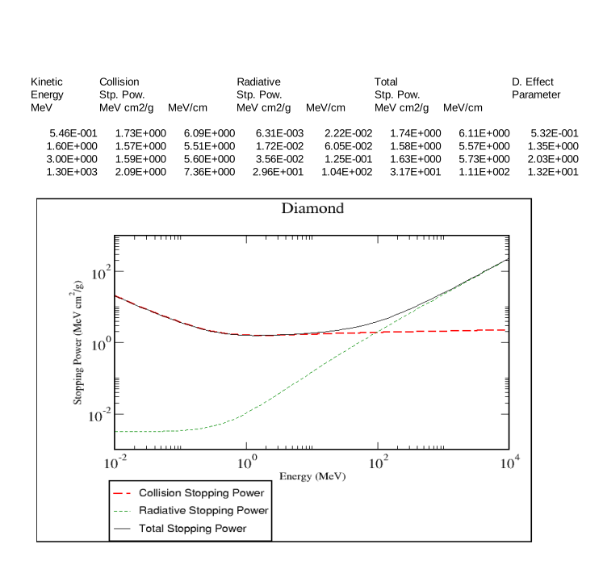
Diamond Detector Characteristics
ADVANTAGES
Property Diamond Silicon
Density (g m⁻³) Band gap (eV) Resistivity (Ω cm) Breakdown voltage (V cm ⁻¹) Electron mobility (cm³ V⁻¹ s⁻¹) Hole mobility (cm³ V⁻¹ s⁻¹) Saturation elocity (μm ns⁻¹) Dielectric constant Neutron transmutation cross-section(mb) Energy per e-h pair (eV) Atomic number Av.min.ionizing signal per 100 μm (e) | 3.5 5.5 >10¹² 10⁷ 1800 1200 220 5.6 3.2 13 6 3600 | 2.32 1.1 10⁵ 10³ 1500 500 100 11.7 80 3.6 14 8000
• Large band-gap⇒ low leakage current
• High breakdown field
• High mobility⇒ fast charge collection
• Large thermal conductivity
• High binding energy⇒ Radiation hardness
Energy loss of an electron in diamond & silicon
PHIL →
ATF2 →

Slide 5
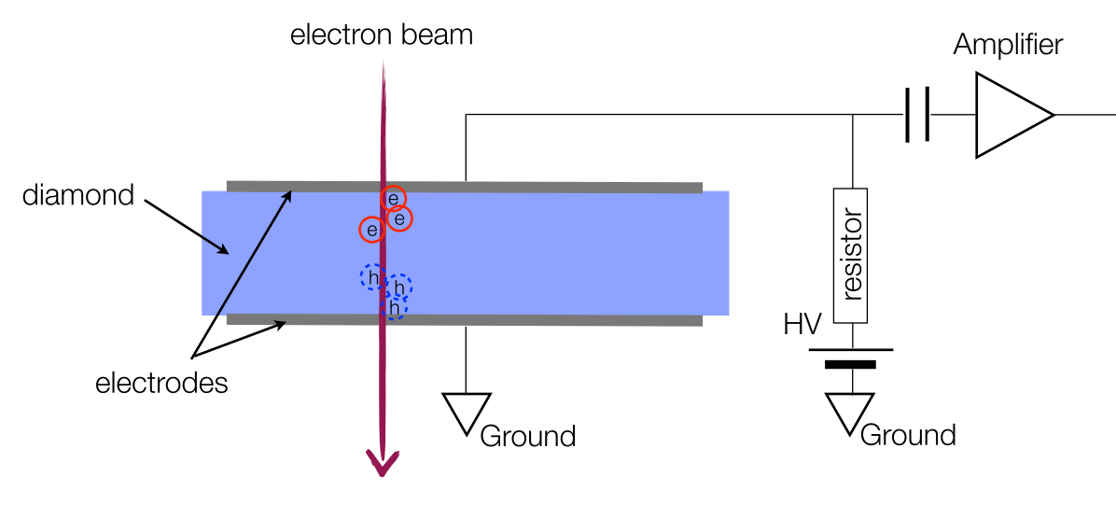
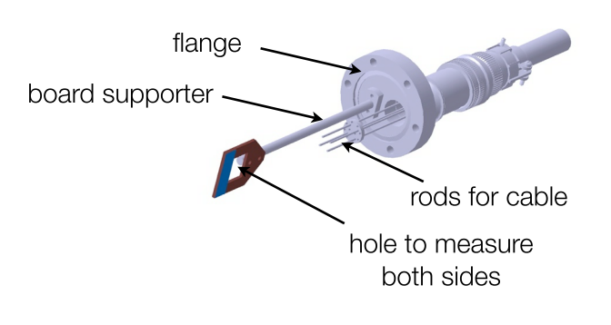
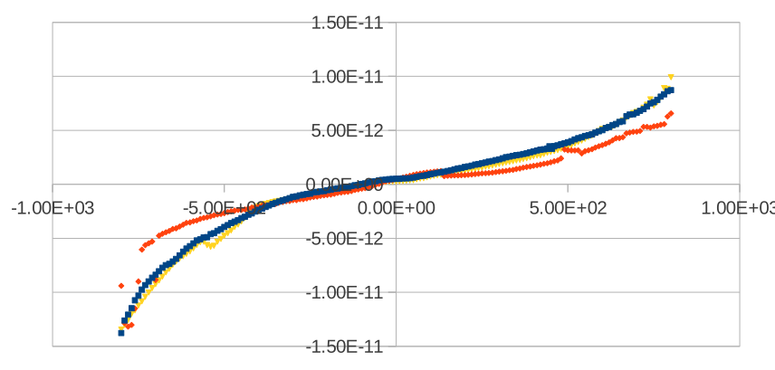
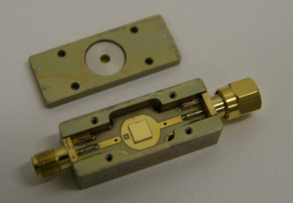
Diamond Detector Characteristics
Diamond detectors
Configurations:
- Pads : mm² x 500 μm
- Strips & pixels
- Membranes (→ 5 μm)
- Orthogonal/ Parallel orientation
Types:
- Poly crystalline diamond
- Single crystalline diamond
Charge created by 1MIP in diamond → 2.74 fC
Current Measurement

Slide 6
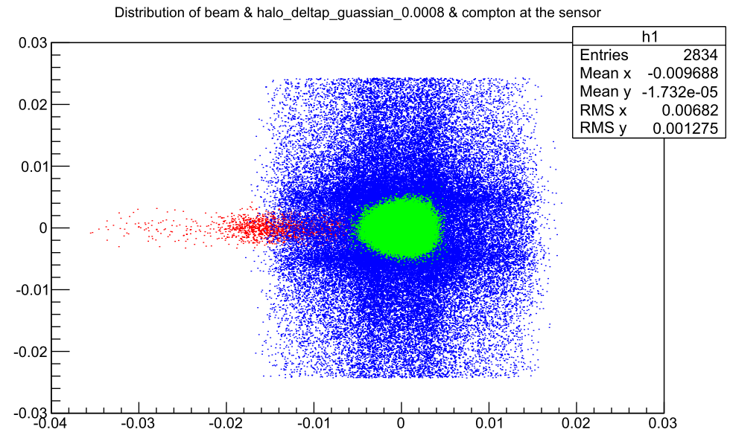
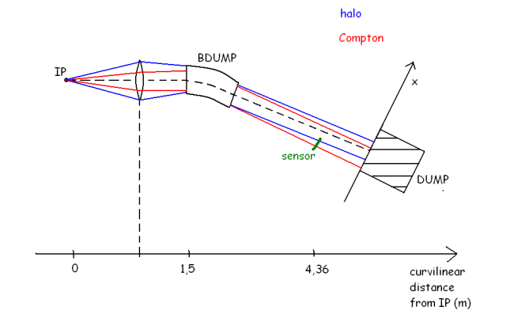
Mad-X Simulation Results for Beam & Halo & Compton Signal @ Sensor
 | Total Number (in simulation) | Total Number (in experiment) | Min.～Max. Number/mm² @ Sensor | Charge signal/mm²
Beam | 10⁵ | 10¹⁰ | 6163*10⁵ | 1.6887*10⁻⁶C=1.6887μC
Halo (δp/p₀=0.01) | 10⁵ | 10⁷ | 114 *10² | 3.1236*10⁻¹¹C=31.236pC
Halo (δp/p₀=0.0008) | 10⁵ | 10⁷ | 224*10² | 6.1376*10⁻¹¹C=61.376pC
Compton | 2834 | 28340 | 3*10～52 *10 | 82.2fC～1.4284pC

Slide 7
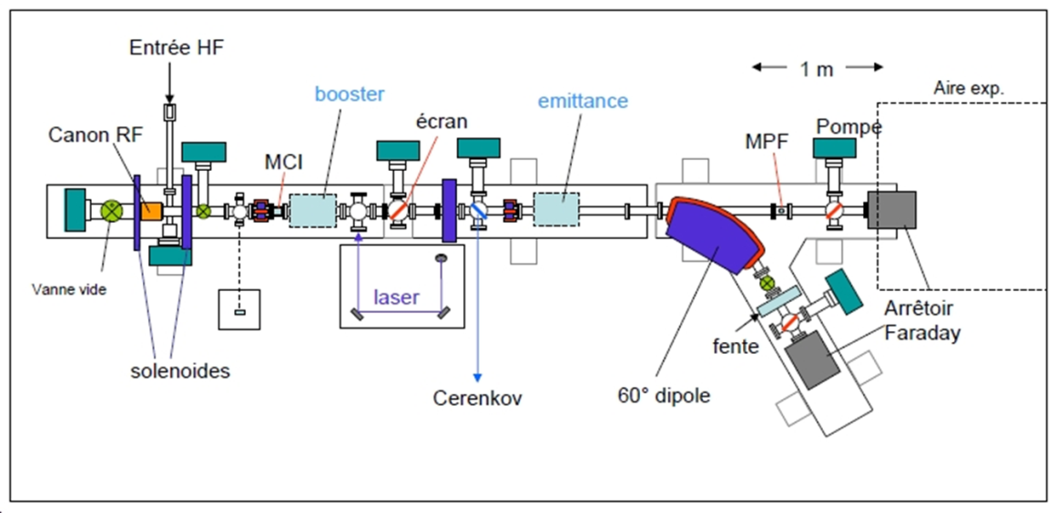
Diamond Detector Test @ PHIL
ATF2 in-vacuum 2x2mm single crystal
CVD diamond sensor profile scanner -> test and diagnostic for PHIL
PHIL Electron Beam Parameters
(given by Hugues Monard)
Charge: 10 pC-250 pC/bunch (1 bunch per RF pulse) ;
Duration of Charge: 7 ps FWHM;
Charge Stablility: < 2%;
Maximum Energy: 3MeV;
Minimum Dispersion: < 1%;
Beam Size -> ?
Fixed (moveable) beam profile and halo monitor as diagnostic for PHIL: large area poly crystalline CVD sensor
Test of fast remote readout (fast heliax coax cable + ASIC) with particles at end of beam line, using existing single crystal 4.5x4.5mm CVD diamond pad sensor

Slide 8
Expected Signal @ PHIL
Charge created by 1MIP in diamond : 2.74 fC;
Charge @ PHIL: 10 pC-250 pC/bunch (1 bunch per RF pulse)
Signal pulse length of diamond: t=1ns;
Minimum charge obtained from PHIL (in case all the electrons hit on the diamond):
Convert the charge into voltage:
Too Large!

Slide 9
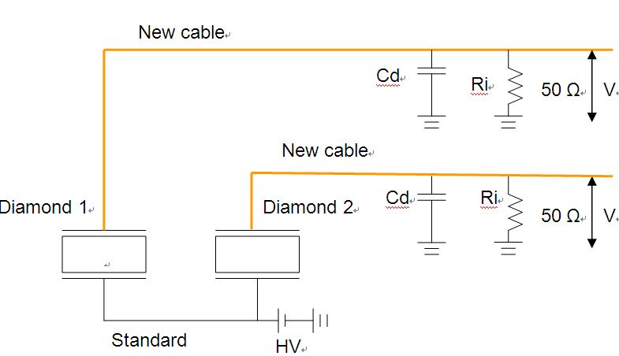
Electronics Setup
Agilent DSO6104L Fast Sampling Oscilloscope
4-channel Agilent 6000L Series
1 GHz analog bandwidth and up to 4 GSa/s
sample rate
8 bit vertical resolution (extensible to 12 bits)
Maximum input : 400 V pk
BNC connector used
Cable length: 25 m to 50 m (measured by Jean-Noel Cayla)
Cable Type
LDF4-50A, HELIAX 1/2 "
LDF1-50, HELIAX® 1/4 "
Connector R185A.216.020 ECO 7/16 1/2"
Connector ECO 7/16 1/4"
PARISROC2
Photomultiplier Array Integrated in SiGe Read Out Chip
16 independent channels and each channel has a variable gain
Charge dynamic range: 50 fC to 200 pC
Shaper with variable shaping time (from 25 ns to 100 ns)
Self triggering and ADC integrated
Both charge and time data can be measured

Slide 10
Summary and Future Plan
The charge obtained from PHIL (from 0.17μC to 4.25μC ) is very close to the charge created by the ATF2 beam (1.6887μC/mm²);
To calibrate the halo and Compton measurement results we will also need to use the diamond detector to measure the beam itself, with an attenuator; the beam intensity will also be measured by other existing instruments;
We can reduce the signal by changing the input beam density and changing the position of diamond detector (distance or angle relative to the beam) and also the signal can be attenuated by high bandwidth attenuator or the diamond bias voltage can be reduced;
Measure signals from diamond sensors using the PHIL beam and a set of fast Agilent 1 GHz bandwidth / 4 GHz sampling oscilloscopes;
Test diamond sensors using PARISROC II by reducing the signal;
Discuss the design of diamond based profile monitor for PHIL.

Slide 11
Thank you for your attention !

