Slide 1
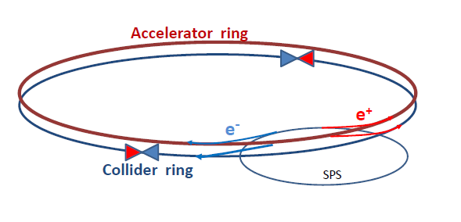
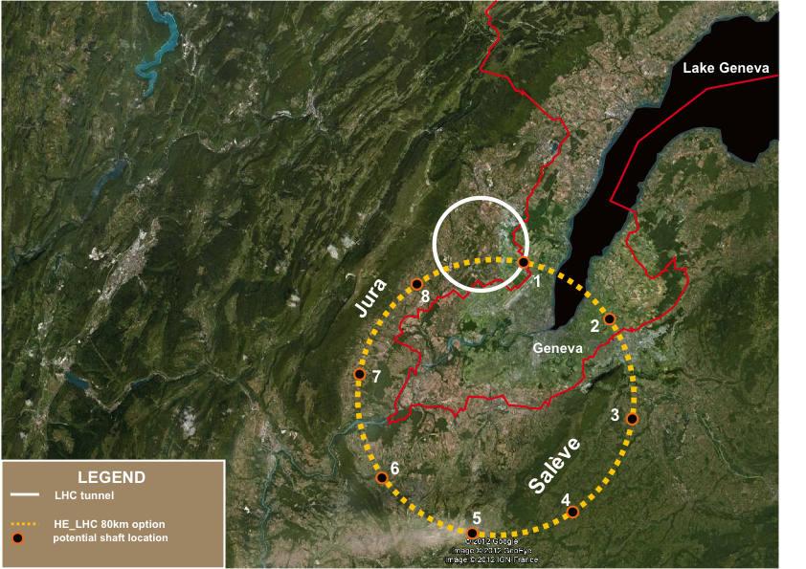
Physics at TLEP (and LEP3)
Outline
Introduction
What precision for future measurements ?
Possible paths towards the future
[Frank : the challenges for the TLEP/LEP3 machine]
Measurements at TLEP/LEP3 and comparative study
Higgs Factory mode (and top threshold)
TeraZ and MegaW modes
Upgradeability at higher energies
Other issues : detectors, cost, timescale, …
Conclusions

Slide 2
Bibliography
[1] G. Gomez-Ceballos, “Study of SMS Production in bosonic decay channels with CMS”, talk given at the Rencontres de Moriond (Mar. 2013)
[2] F. Hubaut, “Study of SMS production in bosonic decay channels with ATLAS”, talk given at the Rencontres de Moriond (Mar. 2013)
[3] B. Mansoulié, “Combination of SMS results with ATLAS”, talk given at the Rencontres de Moriond (Mar. 2013)
[4] K. Monig, “ATLAS and CMS Physics Prospects at the HL-LHC”, talk given at the CLIC Workshop (Jan. 2013)
[5] R. Kogler, „The EW fit after the SMS discovery at LHC”, , talk given at the Rencontres de Moriond (Mar. 2013)
[6] LHCb, “First evidence for the decay B_{s}⁰ → μ⁺μ⁻”, Phys.Rev.Lett. 110 (2013) 021801
[7] P. Janot and G. Ganis, “The HZHA Generator” in Physics at LEP2, CERN Report 96/01 (Vol.2) 309
[8] S. Dittmaier et al., “Handbook of LHC Higgs cross sections: inclusive observables”, CERN-2011-002 (Vol.1) 76
[9] R.S. Gupta, H. Rzehak, J.D. Wells, “How well do we need to measure Higgs boson couplings?”, arXiv:1206.3560 (2012)
[10] H. Baer et al., “Physics at the International Linear Collider”, in preparation, see http://lcsim.org/papers/DBDPhysics.pdf
[11] CMS, “CMS at the High-Energy Frontier”, ESPP Contribution #177
[12] ATLAS, “Physics at a High-Luminosity LHC with ATLAS”, ATL-PHYS-PUB-2012-004 (2012), ESPP Contribution #174
[13] M. Zanetti, talk given at the 2nd LEP3 day (Oct. 2012)
[14] H. Stoeck et al., “ILD Letter of Intent”, arXiv:1006.3396 (2010)
[15] P. Azzi et al., “Prospective studies for LEP3 with the CMS detector”, arXiv 1208.1662 (2012)
[16] J.E. Brau et al., “The physics case for an e⁺e⁻ linear collider”, ESPP Contribution #69
[17] C.F. Duerig, “Determination of the Higgs Decay Width at the ILC”, talk given at the LCWS12 (Oct. 2012)
[18] P. Janot, “Higgs beyond the LHC”, talk given at the HF2012 ICFA Workshop (Nov. 2012)
[19] M. Peskin, “Ultimate Higgs Measurements at ILC, LEP3 and TLEP”, talk given at the 3rd TLEP3 day (Jan. 2013)
[20] A. Blondel et al., Report of the ICFA Beam Dynamics Workshop,“Accelerators =for a Higgs Factory: Linear vs. Circular”, HF2012 (2013)
[21] M. Martinez and R. Miquel, “Multi-parameter fits to the tt threshold observables at a future e+e- linear collider”, Eur. Phys. Jour.C27 (2003) 49.
[22] Electroweak fits run by M. Gruenewald (private communication, Nov. 2012)
[23] P. Janot, “Physics Landscape and TLEP/LEP3 motivation”, talk given at the 1st TLEP3 day (Jun. 2012)
[24] A. Blondel, “Possibilities and conditions for very high precision electroweak measurements”, talk given at the 3rd TLEP3 day (Jan. 2013)
[25] M.L. Mangano et al., “Higgs cross sections in pp collisions at very high energy”, ESPP Contribution #176
[26] T. Price, “Measurement of the top Yukawa coupling at the ILC”, talk given at the LCWS12 (Oct. 2012)
[27] J. Tian, “Higgs self-coupling study at ILC”, talk given at the LCWS12 (Oct. 2012)
[28] T. Laštovička and J. Strube , “Higgs self-coupling study at CLIC”, talk given at the LCWS12 (Oct. 2012)
[29] E. Meschi, “Detectors for SHE-LHC and TLEP”, talk given at the 3rd TLEP3 day (Jan. 2013)

Slide 3
Introduction : Mis-conceptions about TLEP
A compendium of mis-conceptions about TLEP
TLEP is more expensive than the ILC
TLEP parameters are stretched by many-order-of-magnitude extrapolations
TLEP will come later than ILC
TLEP is superfluous once ILC is approved and starts construction
TLEP physics is the same as that of ILC
TLEP will delay VHE-LHC
TLEP can only do Higgs couplings
We need a machine upgradeable beyond 350 GeV to make discoveries beyond LHC
TLEP precision is an overkill
Higgs couplings do not need to be measured so precisely
All are wrong
With the upgrade path to a 100 TeV machine (unique to TLEP)
TLEP is the first step in a long-term vision for particle physics
And might be the only way to secure high-energy physics in Europe

Slide 4
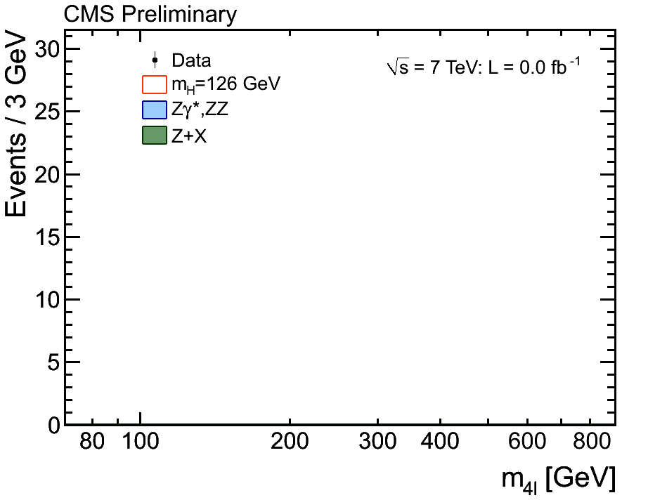
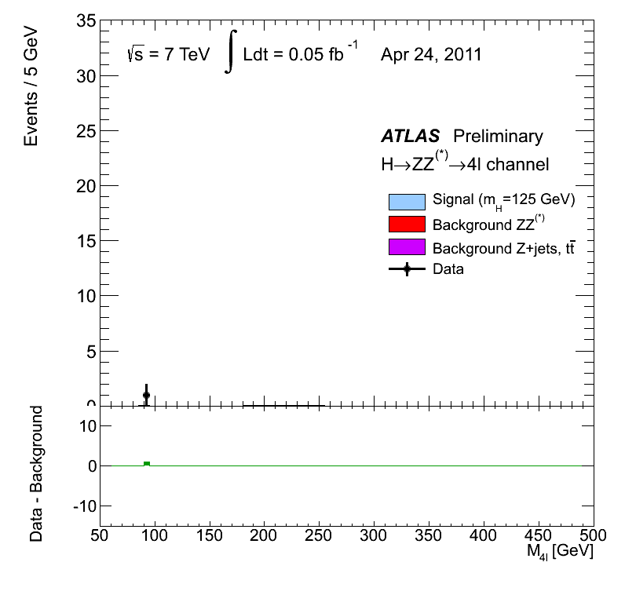
Introduction : Motivations for TLEP (1)
A new boson with mass ~ 126 GeV, and with SMS properties
Example : H(126) → ZZ → 4 leptons in CMS and ATLAS
H(126) couples to the Z boson (important for e⁺e⁻ colliders)
All couplings compatible with those of the Standard Model Scalar
Scalar hypothesis favoured over pseudo-scalar or spin-2 particle
m_{H} known to ~ 400 MeV
A factor 100 luminosity will bring the statistical uncertainty on μ to a couple %.
[1,2,3]

Slide 5
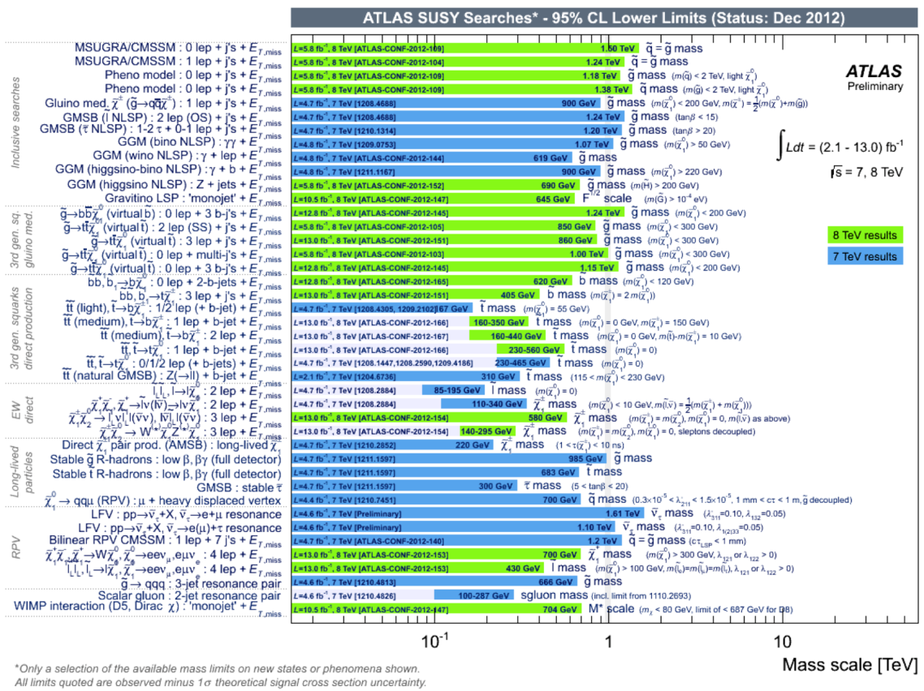
Introduction : Motivations for TLEP (2)
No sign of new physics below a scale of several 100’s GeV
Supersymmetry (ATLAS) Exotics (CMS)
Data at higher √s will extend the mass reach to ~500 GeV for SUSY
Will know more after the next LHC run at 14 TeV (2015-2017)
Air is getting very thin for e⁺e⁻ colliders with √s = 500 GeV (and even 1 TeV)
[4]

Slide 6
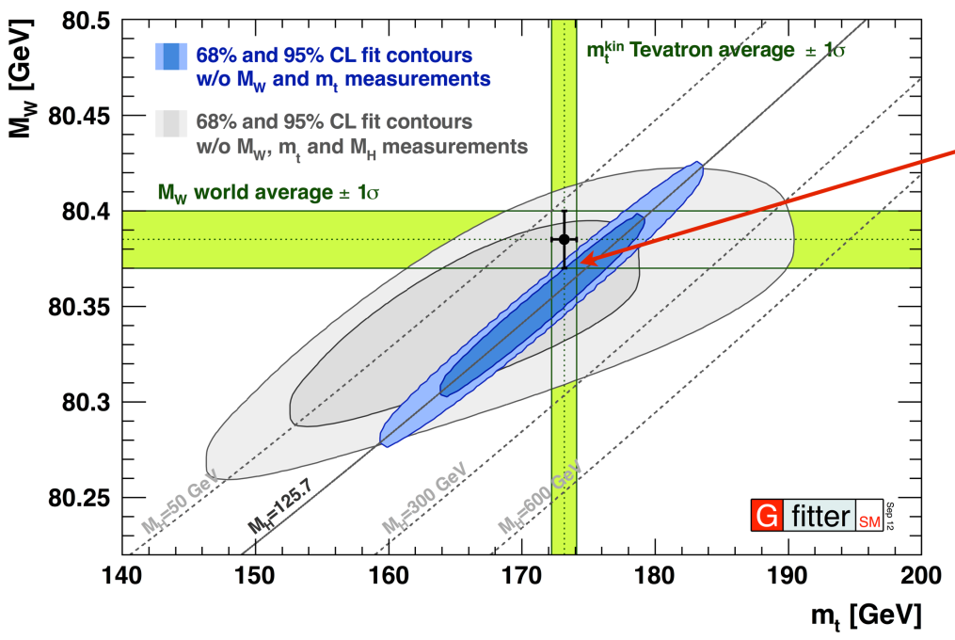
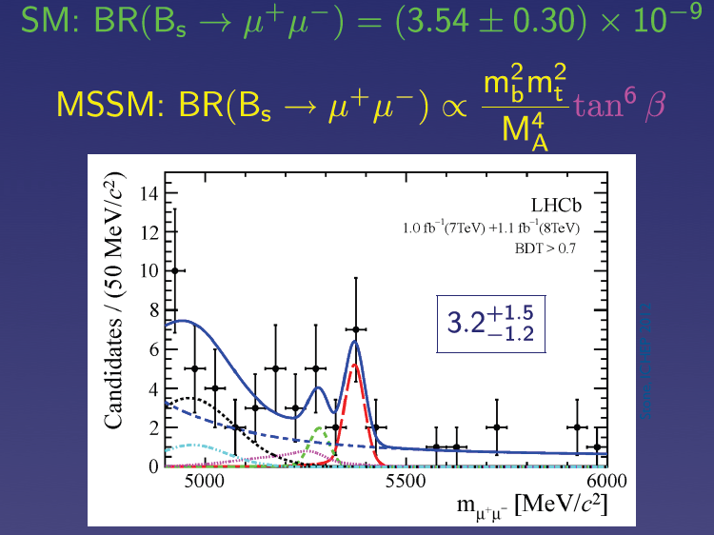
Introduction : Motivation for TLEP (3)
If no new physics is found, what next ?
Once m_{H} is known, the standard model has nowhere to go !
Very strong incentive to revisit and improve all precision measurements
Z pole, WW threshold
Higgs couplings
Top quark properties
Rare decays (B_{s} → μμ, etc.)
… and find indirect effects of new physics at larger scales
[5,6]
Best done with e⁺e⁻ collisions at
√s ~ m_{Z}, 2m_{W}, m_{H}+m_{Z}+30, 2m_{top}
and very large luminosities

Slide 7
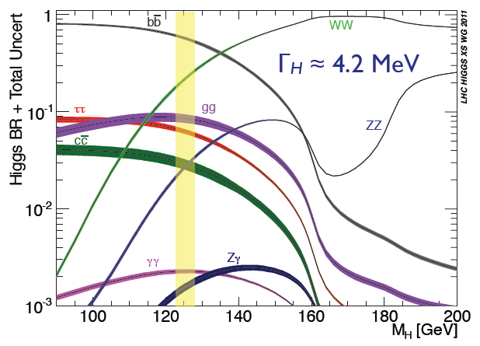
What is the precision needed ? (1)
Example : Precision for Higgs measurements
Does H(126)
Couple to fermions ?
Account for fermion masses ?
Fully account for EWSB ?
Has SM coupling to gauge bosons ?
Decay to new, visible, particles ?
Decay to invisible particles ?
Have the “proper” mass and width ?
Show any sign of new physics ?
What is the precision needed to answer all these questions in a useful manner ?
Simple answer : predict and measure as precisely as possible
Not very informative
[7,8]
57.9 ± 1.7 %
21.6 ± 0.6 %
6.4 ± 0.4 %
8.2 ± 0.8 %
2.8 ± 0.3 %
2.6 ± 0.1 %
0.27 ± 0.02 %

Slide 8
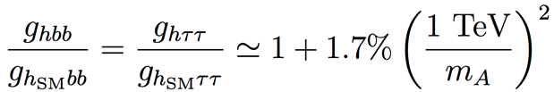
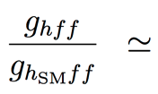
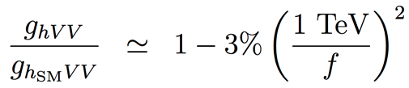
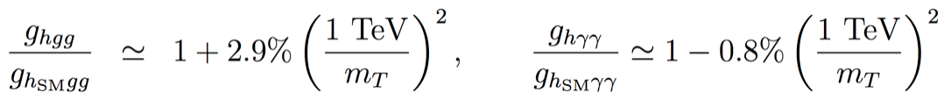
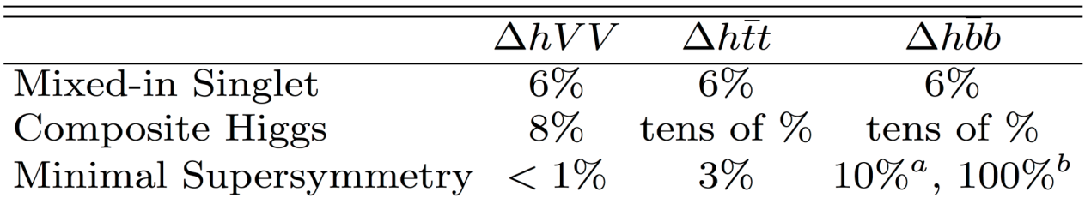
What is the precision needed ? (2)
Example : Precision for Higgs couplings
Maximal deviations with respect to SM couplings, as a function of new physics scale
SUSY , for tanβ = 5
Composite Higgs
Top partners
Other models may give up to 5% deviations with respect to the Standard Model
Maximal deviations for the new physics scale still allowed by LHC results
Strongly influences the strategy for Higgs factory projects
Need at least a per-cent accuracy on couplings for a 5σ “observation”
And sub-percent precision if new physics is at or beyond the TeV scale
[9,10]

Slide 9
Paths towards the future : (HL-)LHC (1)
Executive summary
Approved LHC, 300 fb⁻¹ at 14 TeV :
Higgs mass at 100 MeV
Disentangle Spin 0 vs Spin 2 and main CP component in γγ/ZZ*
Coupling precision / Experiment
ZZ, WW, 5-6%
bb, ττ 10-15%
tt, μμ 3-2 σ effect
γγ , gg 5-11%
HL-LHC, 3000 fb⁻¹ at 14 TeV:
Higgs mass at 50 MeV
More precise studies of Higgs CP sector
Coupling precision / Experiment
ZZ, ZW, 1-5%
bb, ττ, tt, μμ 3-10%
γγ and gg 2-7%
HH >3 σ (2 Expts)
Assuming sizeable reduction of theory errors
[11,12]

Slide 10
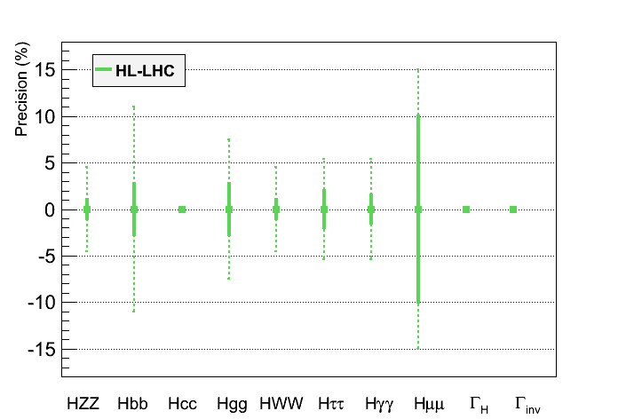
Paths towards the future : HL-LHC (2)
Graphic representation of HL-LHC projected performance
Much better than originally expected before LHC started
Will need vigorous upgrade of CMS and ATLAS detectors
Per-cent to sub-percent precision will require new collider(s)
Assumptions :
No new decay
Γ_{H} fixed in the fit
(or fixed BR(cc) )
?
?
?
In bold, theory uncertainty are assumed to be divided by a factor 2,
experimental uncertainties are assumed to scale with 1/√L,
and analysis performance are assumed to be identical as today
ATLAS upper limit at 65%
(Moriond EW 2013)
[11]

Slide 11
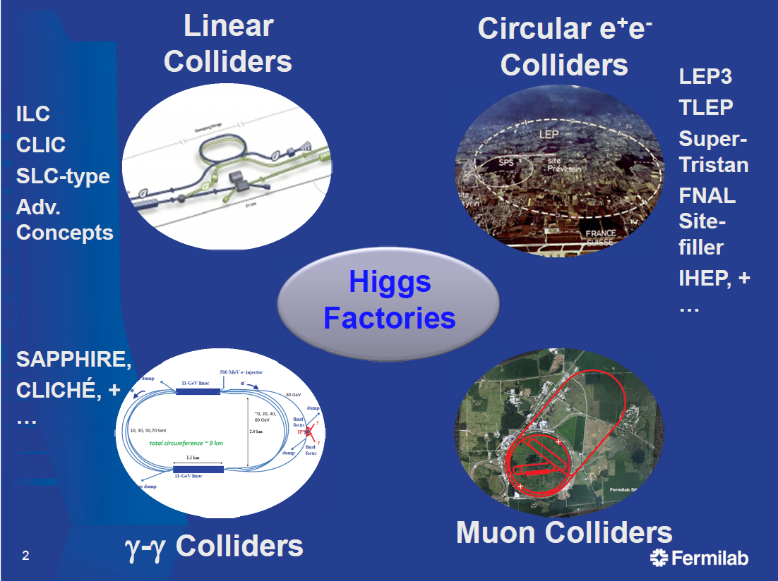
Paths towards the future : Precision Higgs Factories (1)
Several options for Higgs factories are being studied
Studied for decades
This talk
(mostly TLEP)
Not encouraged by
European Strategy
Smaller Physics
Potential
e⁺e⁻ colliders have largest potential
as Precision Higgs Factories

Slide 12
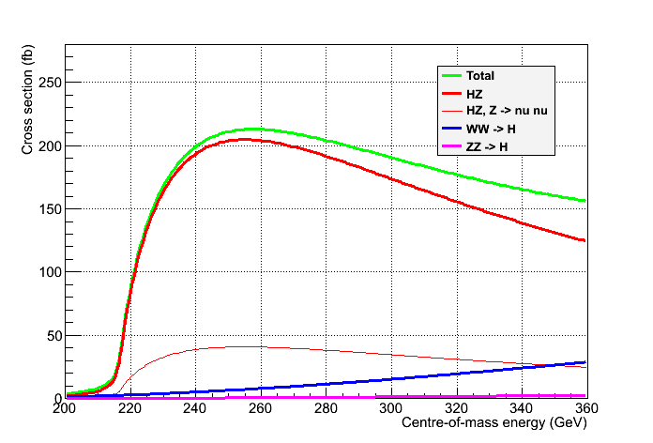
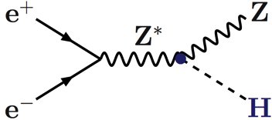
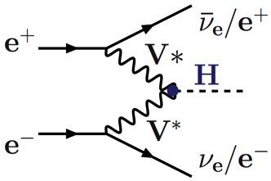
Precision Higgs Factories in e⁺e⁻ collisions (1)
Physics case not driven by the fact that the collider is linear or circular
Scan of the HZ threshold : √s = 210-240 GeV Spin
Maximum of the HZ cross section : √s = 240-250 GeV Mass, BRs, Width, Decays
Just below the tt threshold : √s ~ 340-350 GeV Width, CP
Unpolarized cross sections
Need 100’s fb⁻¹
Z → All
Z → νν
[7]

Slide 13
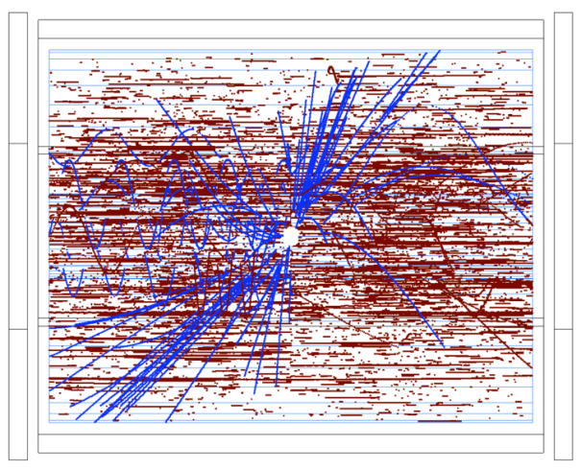
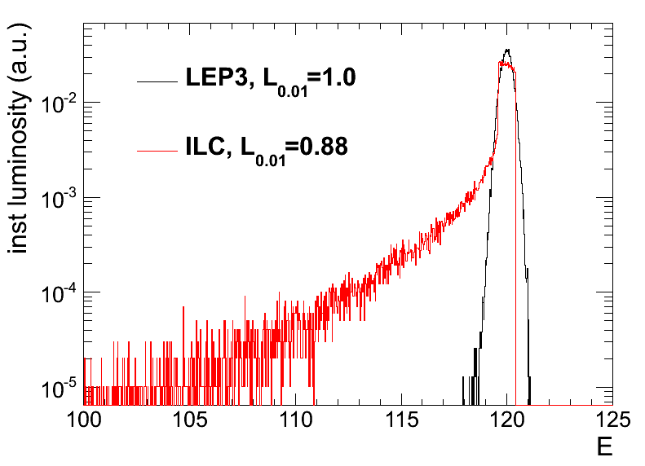
Precision Higgs Factories in e⁺e⁻ collisions (2)
A few specificities :
e⁻ (e⁺) beam polarization is easy at the source (possible) for a linear collider.
Not critical for Higgs studies.
No beam disruption from Beamstrahlung for a circular collider (σ_{y} ~ 300 nm vs. 5 nm @ ILC)
No EM backgrounds in the detector (photons, e+e- pairs);
No beam energy smearing – energy spectrum perfectly known (lumi measurement)
Negligible pile-up from γγ interactions
No drastic requirements for the detector and the background simulation
Possibility of operating several IP’s simultaneously in circular collider
vs. only one IP in linear collider
ILD TPC at 500 GeV
[13,14]

Slide 14
Precision Higgs Factories in e⁺e⁻ collisions (3)
Number of Higgs bosons produced at √s = 240-250 GeV
LEP3 : 4-8 times more luminosity and 3-6 times more Higgs bosons than ILC
TLEP : 20-40 times more luminosity and 15-30 times more Higgs bosons than ILC
In a given amount of time, Higgs coupling precisions scale like
2% for ILC : 1% for LEP3 : 0.3% for TLEP
One year of TLEP = five years of LEP3 = 15-30 years of ILC (at 240 GeV)
 | ILC-250 | LEP3-240 | TLEP-240
Lumi / IP / 5 years | 250 fb⁻¹ | 500 fb⁻¹ | 2.5 ab⁻¹
# IP | 1 | 2 - 4 | 2 - 4
Lumi / 5 years | 250 fb⁻¹ | 1 - 2 ab⁻¹ | 5 - 10 ab⁻¹
Beam Polarization | 80%, 30% | – | –
L_{0.01} (beamstrahlung) | 86% | 100% | 100%
Number of Higgs | 70,000 | 400,000 | 2,000,000
Upgradeable to | ILC 1TeV CLIC 3 TeV | HE-LHC 33 TeV | SHE-LHC 100 TeV

Slide 15
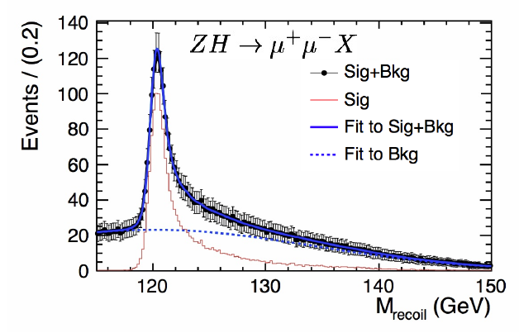
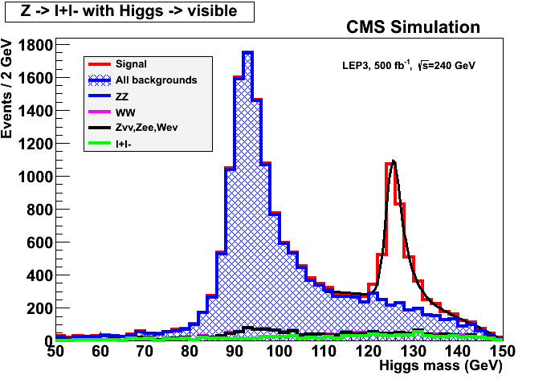
Higgs measurements at √s ~ 240 GeV (1)
With e⁺e⁻ → ZH → e⁺e⁻X and μ⁺μ⁻X events
Measure HZ cross section in a model independent way
Find m_{H} peak from the leptons and E,p conservation
Determine spin with three-point threshold scan
10 fb⁻¹ / point suffice
Determine σ_{HZ} and g_{HZZ} coupling at 240 GeV
3% (1.5%) precision on σ_{HZ} (g_{HZZ})with 250 fb⁻¹
Good tracker needed, but details mildly depend on the actual performance
Plots below with ILD@ILC and CMS@LEP3
e⁻
H
Z*
e⁺
g_{HZZ}
Z
e⁻, μ⁻
e⁺, μ⁺
[9,10,11]
e⁺e⁻ → ZH → e⁺e⁻X and μ⁺μ⁻X
e⁺e⁻ → ZH → μ⁺μ⁻X
e⁺e⁻ → ZH → μ⁺μ⁻X
Δp/p ~ 0.2%
Δp/p ~ 2%
[15,16]

Slide 16
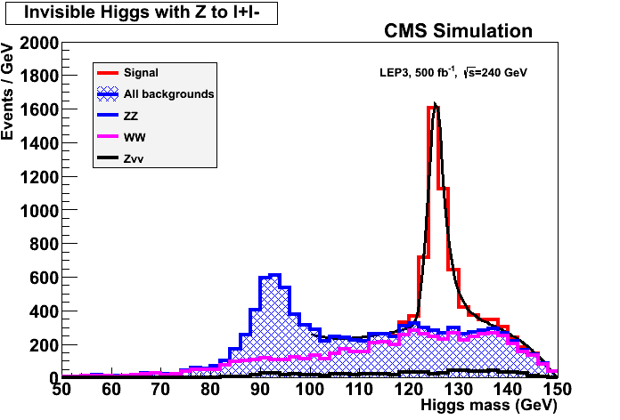
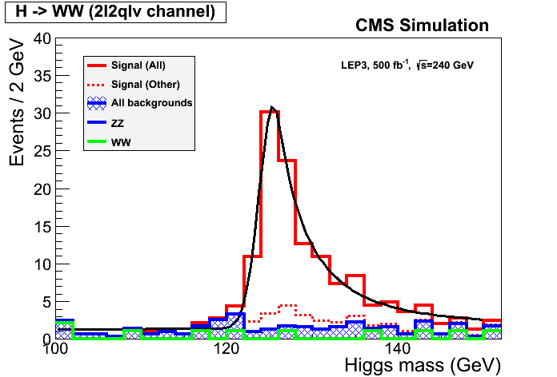
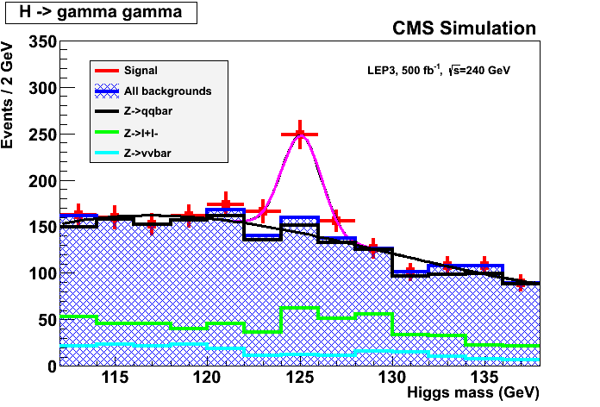
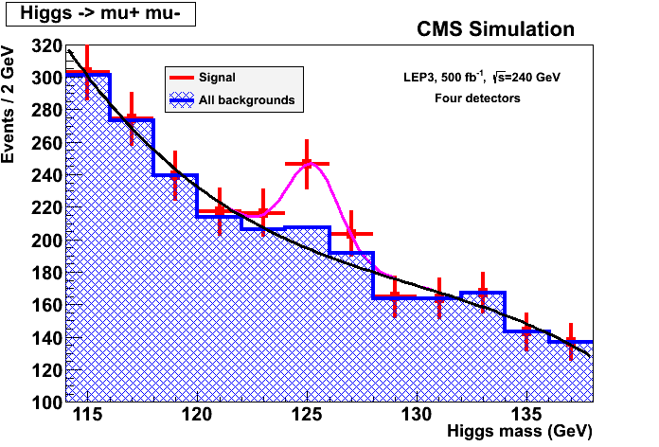
Higgs measurements at √s ~ 240 GeV (2)
With ZH → e⁺e⁻X and μ⁺μ⁻X events (cont’d)
Measure invisible decay branching ratio (X = nothing)
Precision on BR_{INV} ~ 1% with 250 fb⁻¹
Or exclude BR_{INV} > ~2% at 95% C.L.
Measure other σ_{HZ}×BR(H→ ff,VV)
With exclusive selections of Z and H decays
Precision of 1.5% to 8% with 250 fb⁻¹ for the copious decays (bb, WW, gg, ττ, cc)
Need more luminosity for rare decays (γγ, Zγ, μμ)
Particle flow, b and c tagging, lepton and photon capabilities needed
ZH→ qqbb, 250 fb⁻¹ ZH→ llWW→ lllνqq, 500 fb⁻¹ ZH→ Xγγ, 500 fb⁻¹ ZH→ Xμμ, 2 ab⁻¹
[10,15,16]

Slide 17
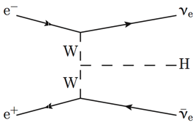
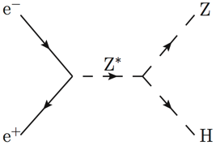
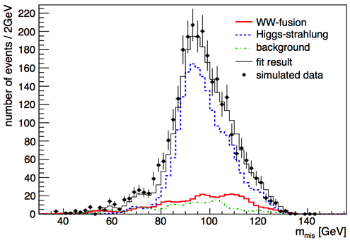
Higgs measurements at √s ~ 240 GeV (3)
Higgs width from the Hνν final state
From σ_{WW→H} and BR(H→ WW)
σ_{WW→H} ~ g²_{HWW}
BR(H→ WW) = Γ_{H→WW} / Γ_{H} ~ g²_{HWW} / Γ_{H}
Γ_{H} ~ σ_{WW→H} / BR(H→ WW)
Contribution to Hνν from HZ ~ 40 pb
Known from ZH → e⁺e⁻X and μ⁺μ⁻X
Contribution from WW fusion ~ 6 pb
To be measured
Select ννbb events from ZH and WW fusion
Needs adequate b tagging and particle flow
Fit the missing mass distribution for N_{WW→H→bb}
σ_{HZ} x BR(H→ bb) known to ~1.5% or better
σ_{WW→H} = N_{WW→H→bb} / BR(H→ bb)
Precision on σ_{WW→H} ~ 14% with 250 fb⁻¹
Γ_{H} ~ σ_{WW→H} / BR(H→ WW), measured up to 15% precision with 250 fb⁻¹
g_{HWW}
[17]

Slide 18
Higgs measurements at √s ~ 240 GeV (4)
Z
Higgs width from the ZZZ final state
Number of ZZZ events ~ σ_{HZ} × BR(H→ ZZ)
σ_{HZ} ~ g²_{HZZ}
BR(H→ZZ) = Γ_{H→ZZ}/Γ_{H} ~ g²_{HZZ} / Γ_{H}
Number of ZZZ events ~ g⁴_{HZZ} / Γ_{H}
Select l⁺l⁻ l^{’+}l^{’−} X events ( ~ background and H →WW free)
Number of events in 250 fb⁻¹ @ 240 GeV :
250 fb⁻¹ × 200 fb × BR(H→ZZ) × BR(Z→ll)² × 3
→ About 40 events, of which ~25 selected
Hence measure the total width Γ_{H} with a precision of 21%
Reduced to 12% in combination with WW fusion measurement
Could be further reduced with other Z decays
(Need full simulation and WW/ZZ simultaneous fit)
Note : Precision of a few % can be reached on Γ_{H} if one assumes no exotic Higgs decays
e⁻
Z∗
H
Z
e⁺
Known to 6%
from l⁺l⁻X events
with 250 fb-1
Z∗

Slide 19
Linear vs Circular at √s ~ 240 GeV
Precision on H(125) branching fractions, width, mass, … after 5 years
LEP3 numbers obtained from a CMS simulation x 4, except (*) extrapolated from ILC
Need a refined vertex detector for gg and cc BR accurate measurements
TLEP numbers extrapolated from LEP3 column
 | ILC | LEP3 (4) | TLEP (4)
σ_{HZ} | 2.5% | 1.3% | 0.4%
σ_{HZ} ✕BR(H→bb) | 1.0% | 0.5% | 0.1%
σ_{HZ} ✕BR(H→cc) | 6.9% | 4% (*) | 1.3%
σ_{HZ} ✕BR(H→gg) | 8.5% | 4.5% (*) | 1.4%
σ_{HZ} ✕BR(H→WW*) | 8.0% | 3.0% | 0.9%
σ_{HZ} ✕BR(H→ττ) | 5.0% | 3.0% | 0.9%
σ_{HZ} ✕BR(H→ZZ*) | 28% | 7.1% | 3.1%
σ_{HZ} ✕BR(H→γγ) | 27% | 6.8% | 3.0%
σ_{HZ} ✕BR(H→μμ) | – | 28% | 13%
σ_{WW→H} | 12% | 5% (*) | 2.2%
Γ_{H} , Γ_{INV} | 10% , < 1.5% | 4% , < 0.7% | 1.8% , < 0.3%
m_{H} | 40 MeV | 26 MeV | 8 MeV
[10,15,16]

Slide 20
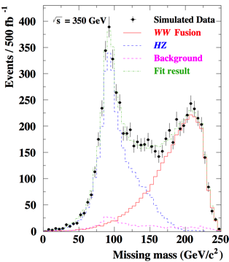
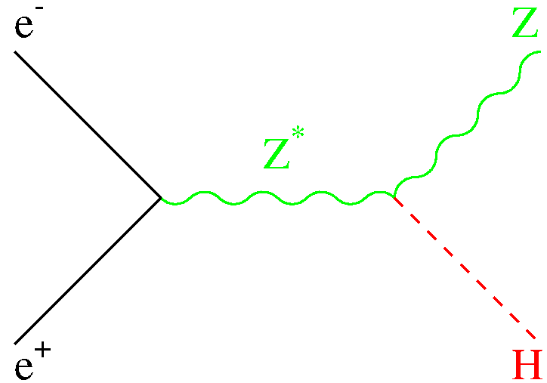
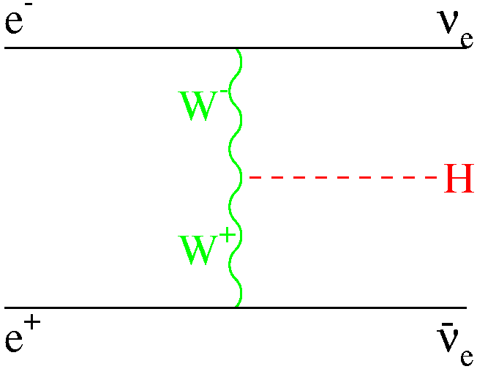
Measurements at √s ~ 350 GeV (ILC/TLEP) [1]
Luminosity similar for ILC and TLEP
At each IP : 350 fb⁻¹ over 5 years
With possibly 4 detectors at TLEP
More study of the Hνν final state with H→bb
Contribution from HZ : ~ 25 fb
Contribution from WW→H : ~ 25 fb
Improves precision on Γ_{H} and HWW coupling
Smaller improvement of other σ✕BR measurements
 | ILC (250+350) | TLEP (240+350)
σ_{WW→H} | 12% → 4% | 2.2% → 1.5%
Γ_{H} | 10% → 5.5% | 1.8% → 1.3%
[10,17]

Slide 21
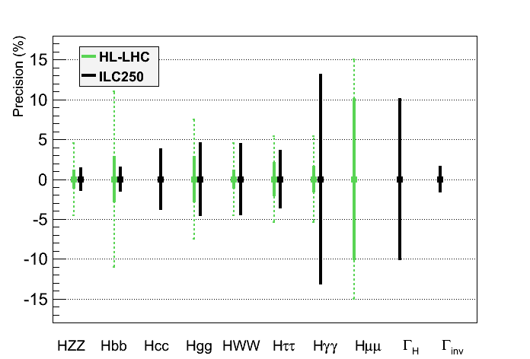
Higgs couplings for Precision Higgs Factories (1)
Same assumptions as for HL-LHC for a sound comparison
No exotic decay, fixed decay width
ILC250 would be a good complement to LHC (Γ_{H} , Γ_{inv} , g_{Hcc} , g_{Hbb})
[11,16]

Slide 22
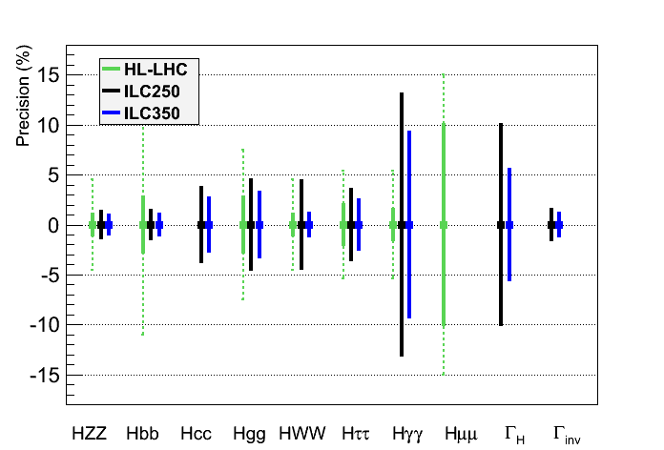
Higgs couplings for Precision Higgs Factories (2)
Same assumptions as for HL-LHC for a sound comparison
No exotic decay, fixed decay width
ILC250/350 would be a good complement to LHC (Γ_{H} , Γ_{inv} , g_{Hcc} , g_{Hbb})
[11,16]

Slide 23
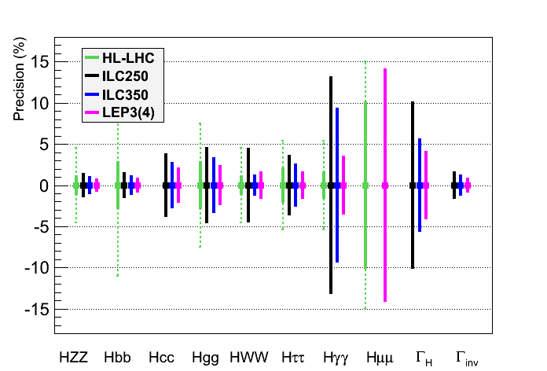
Higgs couplings for Precision Higgs Factories (3)
Same assumptions as for HL-LHC for a sound comparison
No exotic decay, fixed decay width
LEP3 would be an advantageous back-up : larger lumi, several IP, smaller cost
[11,16,18]

Slide 24
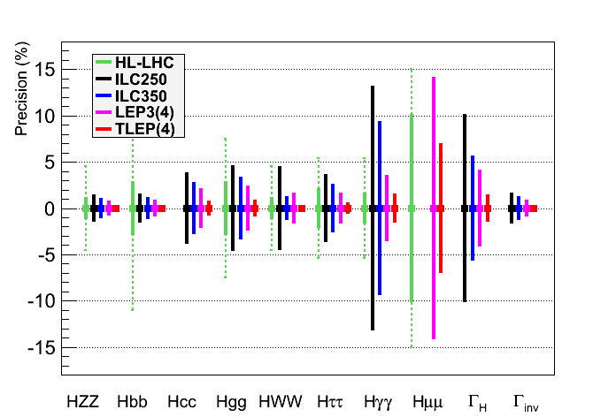
Higgs couplings for Precision Higgs Factories (4)
Same assumptions as for HL-LHC for a sound comparison
No exotic decay, fixed decay width
TLEP would be a superior option (see zoom next page)
See zoom
Next page
[11,16,18]

Slide 25
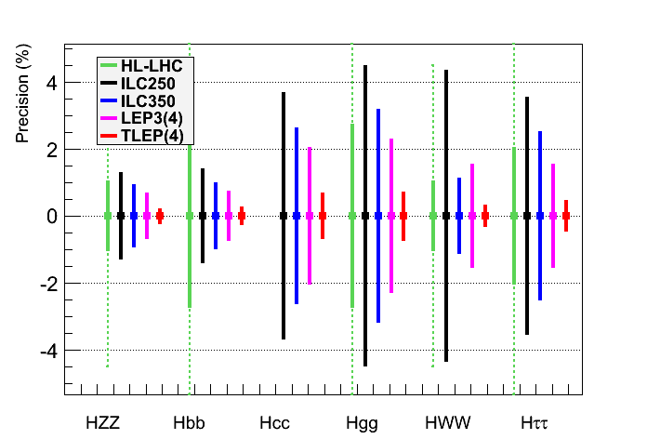
Higgs couplings for Precision Higgs Factories (5)
Same assumptions as for HL-LHC for a sound comparison
No exotic decay, fixed decay width
TLEP : sub-percent precision, needed for NP sensitivity beyond 1 TeV
[11,16,18]

Slide 26
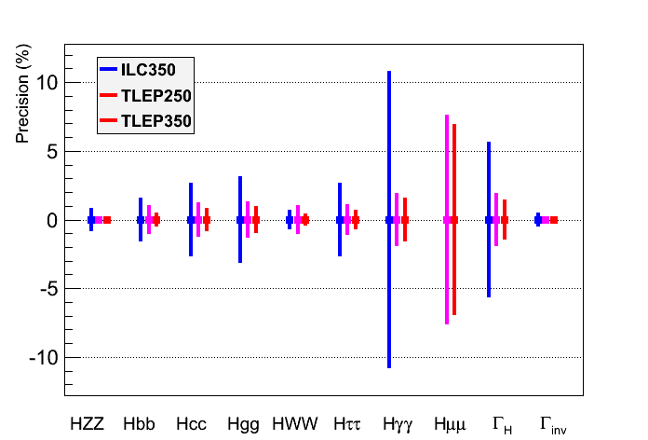
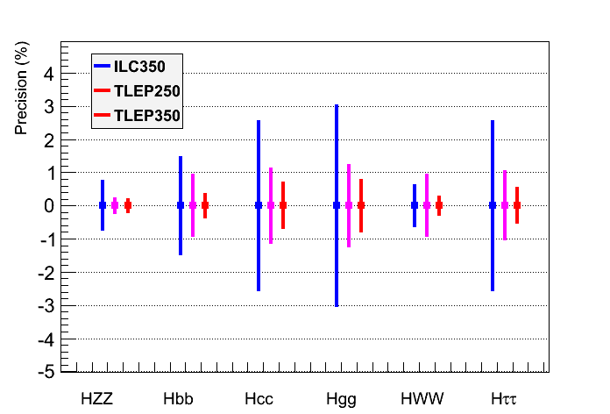
Higgs couplings for Precision Higgs Factories (6)
Same conclusion when Γ_{H} is a free parameter in the fit
Plot shown only for ILC350 and TLEP, with an accurate width measurement
TLEP : sub-percent precision, adequate for NP sensitivity beyond 1 TeV
[19]

Slide 27
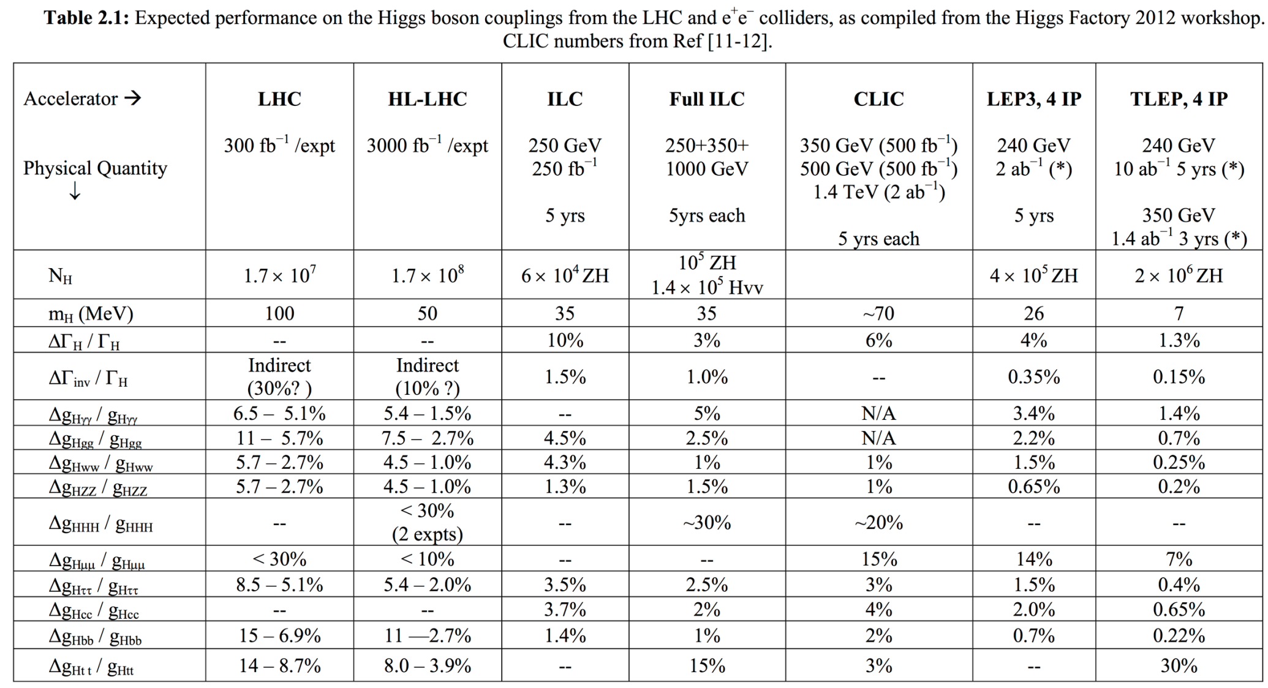
Higgs couplings for Precision Higgs Factories (7)
[20]

Slide 28
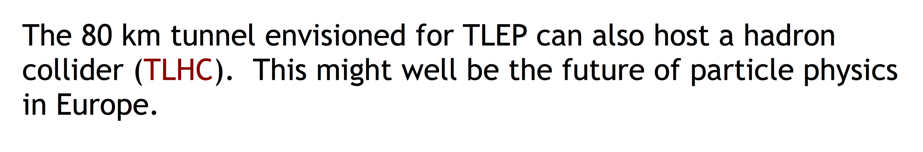
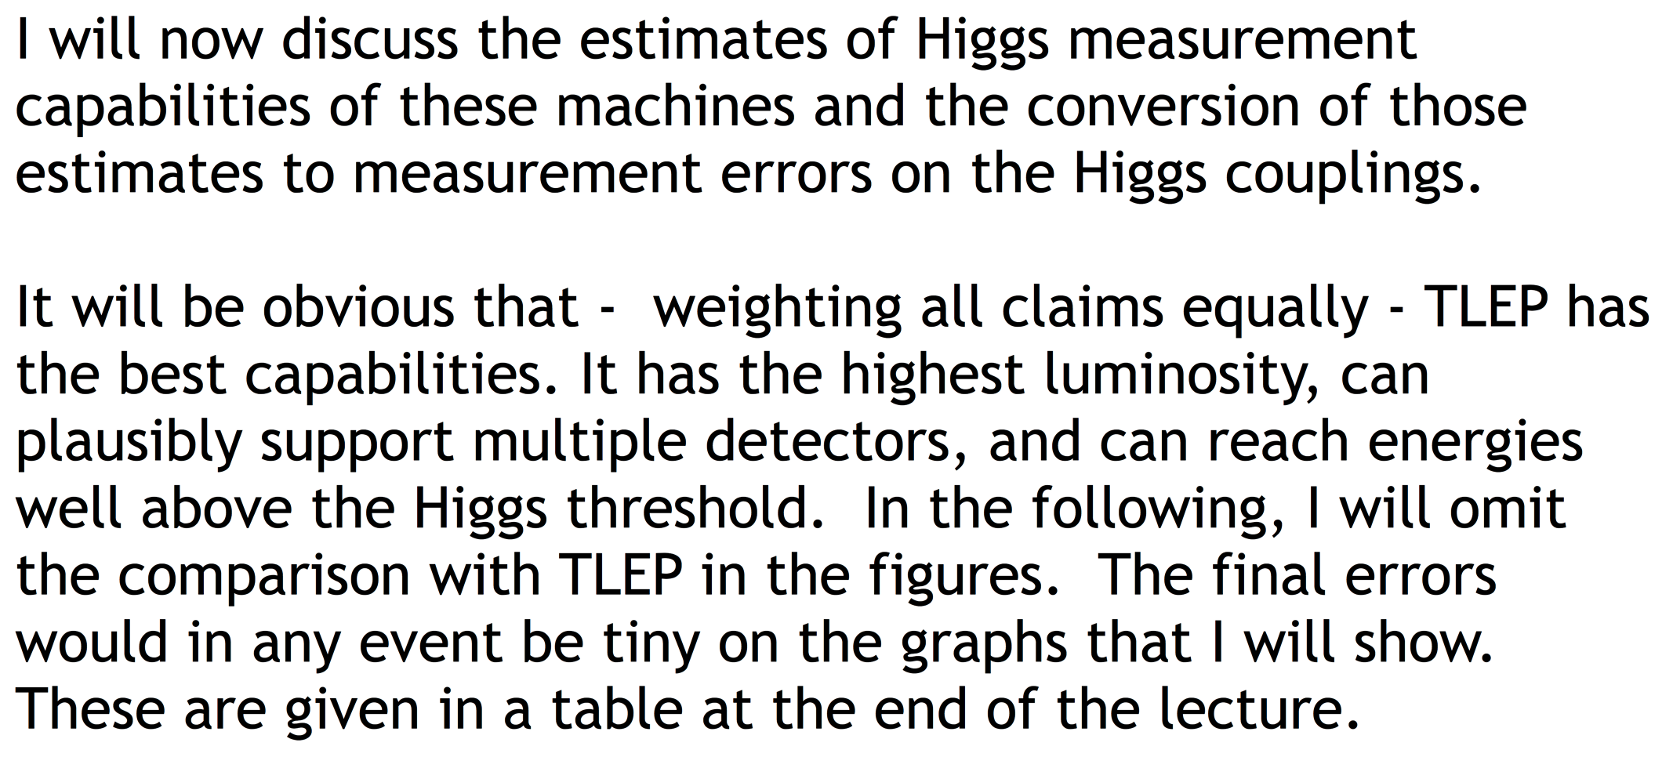
Higgs couplings for Precision Higgs Factories (8)
A slide from M. Peskin at the 3rd TLEP/LEP3 Worskshop (10-Jan-2013)
[19]

Slide 29
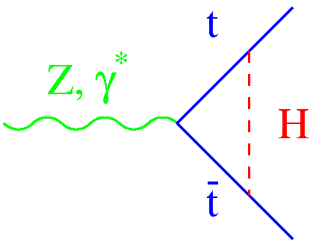
Measurements at √s ~ 350 GeV (ILC/TLEP) [2]
Scan of the tt threshold
Observables σ_{tt}, A_{FB} and <p_{t}^{max}> sensitive to m_{top} , Γ_{top} , and λ_{top} (ttH Yukawa coupling)
Sensitivity to (e.g.) λ_{top} , varied by ±25%
No beamstrahlung is a advantage
Sensitivity with 300 fb⁻¹ for ILC (expected to be better for TLEP)
Studies of rare top decays
m_{top} = 175 GeV
σ_{tt}
p_{t}^{max}
A_{FB}
Δm_{top} | ΔΓ_{top} | Δλ_{top}/λ_{top}
30 MeV (0.02%) | 35 MeV (3%) | 30%
[21]

Slide 30
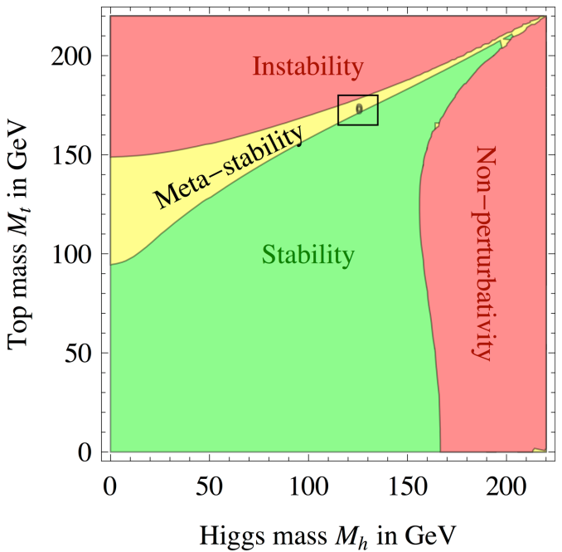
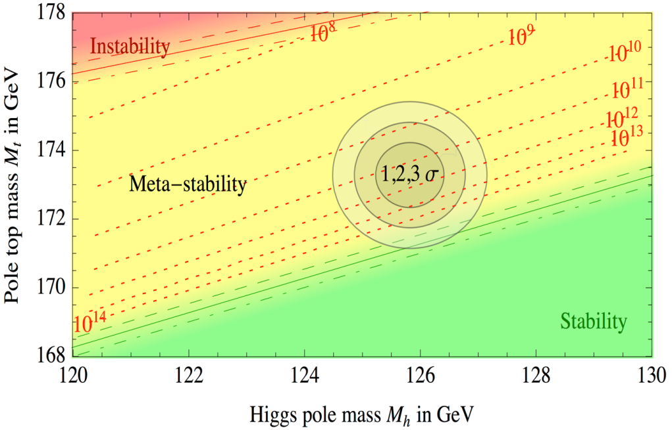
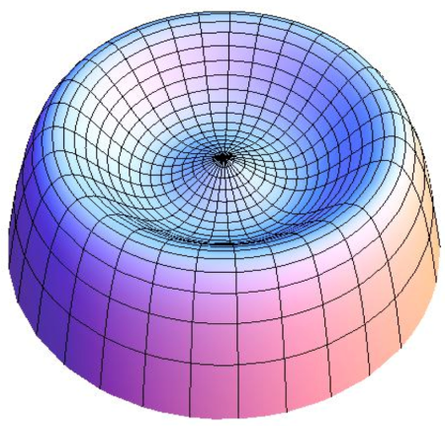
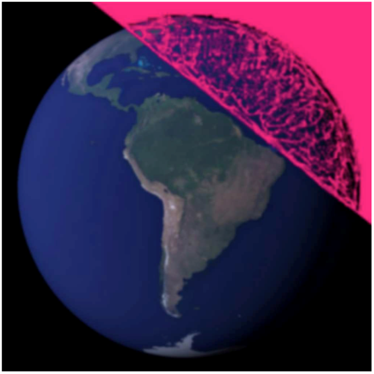
Measurements at √s ~ 350 GeV (ILC/TLEP) [3]
Measurement of m_{top} perhaps more important than originally thought

Slide 31
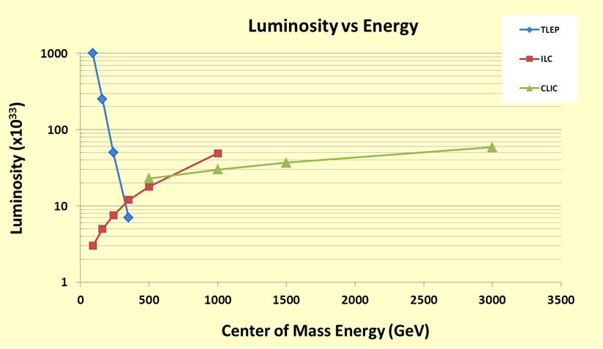
Measurements at smaller √s (1)
Larger luminosity at smaller √s for circular colliders
Use the RF power to accelerate more bunches : L ~ 1/E⁴
Crossing point with ILC at √s ~ 350 GeV

Slide 32
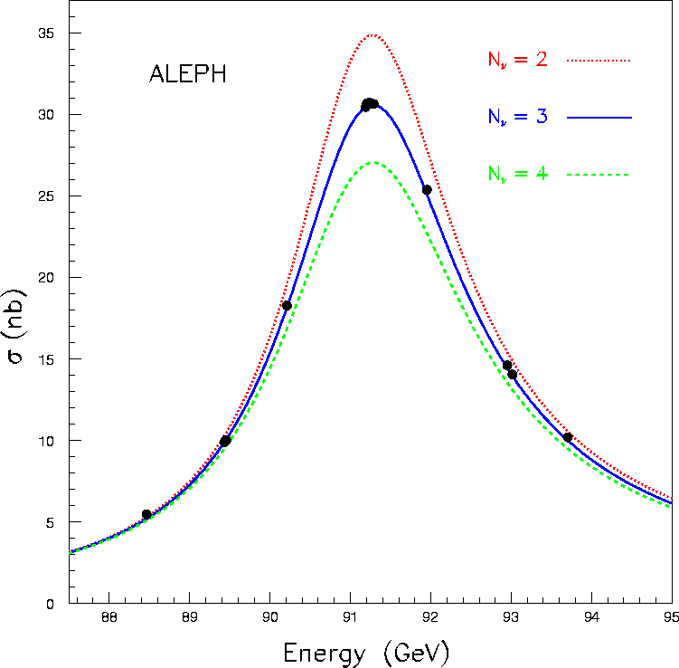
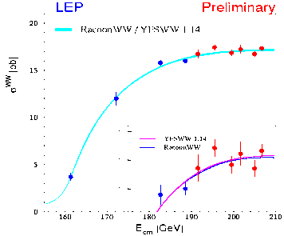

Measurements at smaller √s (2)
Revisit and improve the LEP precision measurements
Can do the entire LEP1 physics programme
In 5 minutes (TLEP) ; in 1h (LEP3); or in a week (ILC)
Huge potential in a year of TLEP (LEP3) at √s = m_{Z} or 2m_{W} :
 | LEP | ILC | LEP3 | TLEP
√s ~ m_{Z} | MegaZ | GigaZ | ~TeraZ | TeraZ
Lumi (cm⁻²s⁻¹) #Z / IP / year Polarization vs LEP1 | Few 10³¹ 2x10⁷ no 1 | Few 10³³ Few 10⁹ easy ~5-10 | Few 10³⁵ Few 10¹¹ maybe ~50 | 10³⁶ 10¹² maybe ~100
√s ~ 2m_{W}
Lumi (cm⁻²s⁻¹) Lumi / IP / year Error on m_{W} | Few 10³¹ 10 pb⁻¹ 220 MeV | Few 10³³ 50 fb⁻¹ 7 MeV | 5x10³⁴ 500 fb⁻¹ o.7 MeV | 2.5x10³⁵ 2.5 ab⁻¹ 0.4 MeV
√s ~ 200-250 GeV
Lumi (cm⁻²s⁻¹) Lumi / IP / 5 years Error on m_{W} | 10³² 500 pb⁻¹ 33 MeV | 5x10³³ 250 fb⁻¹ 3 MeV | 10³⁴ 500 fb⁻¹ 1 MeV | 5x10³⁴ 2.5 ab⁻¹ 0.4 MeV
Asymmetries, Lineshape
WW threshold
[15,16]

Slide 33





Measurements at smaller √s (3)
Would open a whole new book in EWSB precision measurements
Case 1 : Only SM physics in EW Radiative Corrections
With TeraZ and m_{W} to 0.3 MeV at TLEP :
Predicts m_{top} to 100 MeV (SM) - was 10 GeV at LEP.
With m_{top} and m_{H} measured at TLEP240/350:
SM accurate closure test
Case 2 : Some weakly interacting new physics in the loops ?
Will cause inconsistency between the various observables
m_{H} = 126 GeV
+
(m_{top} from LHC or TLEP350)
Circular
(LEP3)
m_{W}
Linear
(ILC)
[22]
Circular
(TLEP)
?

Slide 34
Measurements at smaller √s (4)
Experimental challenges are numerous : TLEP(Z)
At TLEP(Z), the hadronic Z event rate will be 30 kHz
Same rate of bunch crossings as at LHC (40 MHz)
CMS current high-level trigger rate is about 1 kHz
(But hadronic Z events typically 20 times smaller than typical LHC event)
Need to design a detector and a DAQ system able to cope with these rates
A clever mixture of LHC detector (rate) and ILC detector (precision)
Need to study what is the precision needed for each sub-detectors
Is a CMS-like detector sufficient ? (~OK for Higgs studies)
Small angle Bhabha event rate (lumi measurement) will be even larger
Essential to measure cross sections, hence the Z lineshape (m_{Z}, Γ_{z})
Negligible beamstrahlung is a great advantage
No background in the luminometers
Energy spectrum perfectly known (hence Bhabha cross section)
Will need theoretical developments to understand σ_{e+e−} to better than 5 x 10⁻⁵
Limiting uncertainties on α_{QED}(m_{Z}) and α_{s}(m_{Z}) must be overcome
Possible with the billions of e⁺e⁻ → e⁺e⁻(γ) , μ⁺μ⁻(γ) and qq(g) events ?
Will affect all Z peak asymmetries, and m_{Z} vs m_{W} interpretation
[23,24]
N_{ν}
-

Slide 35


Measurements at smaller √s (5)
Experimental challenges are numerous : TLEP(Z)
Z lineshape needs a precise beam energy measurement
Resonant depolarization unique @ circular machines
Intrinsic precision ~ 100 keV (LEP1) / measurement
Decreases like 1 / √#(Measurements)
Requires beam transverse polarization
In one non-colliding bunch, during operations
Continuous energy measurement
No extrapolation needed (tides, trains, rain…)
Will require installation of polarization wigglers
Natural polarization time ~ 150 h at TLEP …
Polarized asymmetry (A_{LR}) requires longitudinal polarization
Hence spin rotators and polarimeters at each IP
Then need to keep polarization in collisions
That’s the main unknown
Dedicated operations with lower luminosity ?
Dedicated study is needed here
[23,24]

Slide 36

Measurements at smaller √s (6)
Experimental challenges are numerous : m_{W} at TLEP(W) and TLEP(H)
With 2.5 ab⁻¹ at TLEP(W) and 10⁷ WW events/expt at threshold : σ(m_{W}) ~ 0.4 MeV
With 2.5 ab⁻¹ at TLEP(H), 4x10⁷ W pairs/expt : σ(m_{W}) ~ 0.2 MeV
Need to know beam energy to few 0.1 MeV
Use the precision Z mass measurement from the Z pole
With 5x10⁷ Z(γ) events (Z ➔ e⁺e⁻, μ⁺μ⁻) / expt at TLEP(W)
With 2x10⁶ Z pairs and 5x10⁶ Z(γ) events (Z ➔ e⁺e⁻, μ⁺μ⁻) / expt at TLEP(H)
Can reach combined statistical precision on E_{beam} of 0.2 MeV and 0.4 MeV
Beam transverse polarization possible at TLEP(W) : precision better than 0.1 MeV
Need to understand both theoretical and experimental uncertainties…
[23]

Slide 37




Upgradeability at larger √s (1)
All existing proposals have access to larger √s
To discover New Physics in a direct manner
To measure more difficult Higgs couplings : g_{Htt} and g_{HHH}
ILC350 can be upgraded to ILC500/ILC1TeV, or even to CLIC (3 TeV)
LEP3 can be upgraded to (or preceded by) HE-LHC (33 TeV)
TLEP can be upgraded to SHE-LHC (100 TeV)
[25]
Cross sections in e⁺e⁻ collisions
H
H
Cross sections in pp collisions

Slide 38

Upgradeability at larger √s (2)
Summary for Htt and HHH couplings
Other Higgs couplings benefit marginally from high energy
For similar/larger new physics reach :
ttH/HHH precision with pp similar to/better than e⁺e⁻
[11,12,26,27,28]
√s, NP
√s, NP
ILC500, HL-LHC ILC1TeV, HE-LHC CLIC3TeV, SHE-LHC

Slide 39


Detectors for TLEP and LEP3 (1)
For LEP3, obvious detectors are CMS and ATLAS
CMS demonstrated to be adequate with today’s design + upgraded pixel detector
Phase 2 upgrades : LEP3 could be seen as an alternative to HL-LHC
Tunnel By-passes need to be dug out for the accelerating ring
For TLEP, new detectors are in order (used CMS for Higgs studies in this talk)
Holistic view : design caverns and detectors to be re-used in pp collisions (as new)
TeraZ sets the scale for DAQ (2600 bunches) + forward EM calorimetry (lumi)
TLEP(H) sets the scale for precision (tracker, ECAL, particle flow, b tagging)
SHE-LHC sets the scale for magnetic field, calorimeter depths, tracker p_{T} reach
Could envision a staged approach
[29]

Slide 40
Detectors for TLEP and LEP3 (2)
Basic requirements (examples)
Vertex detector with impact parameter resolution ~ 5 μm (CMS : 20 μm)
For b and c tagging
Very large number of channels (cf ILC)
Tracker detector with σ(p_{T})/p_{T}² ~ 10⁻⁵ (CMS : 10⁻⁴)
For precise recoil mass determination in (Z → l⁺l⁻) + H and in H → μ⁺μ⁻
All silicon, with large number of channels
ECAL resolution of the order of 1% at 60 GeV (~same as CMS)
For H → γγ (and all decays with electrons : WW, ZZ, ττ)
ECAL and HCAL with decent transverse and longitudinal segmentation, inside the coil
For Particle Flow towards HZ and WW → H discrimination (and precise jets, p_{miss})
Study trade-offs between ILC proposals and CMS crystals
Efficient and pure muon Id
For H → ZZ, W⁺W⁻, μ⁺μ⁻, τ⁺τ⁻
Extremely fast DAQ
Detector with ~10¹⁰ channels
TLEP-H : low occupancy, zero suppression, read out each BX (100 kHz)
Simple trigger needed for TeraZ (40 MHz -> 100 kHz)
[29]

Slide 41
Possible Timescales
Similar timescales for TLEP and LEP3
TLEP
Design study : 2013-2017
Next European Strategy Workshop : 2017-2018
Decision to go and start digging : 2018-2019
Start installation in parallel with HL-LHC running : 2023 - …
Start running at the end of HL-LHC running : 2030 - …
LEP3
Design study : 2013-2017 (spin-off of TLEP design study)
Next European Strategy Workshop : 2017-2018
Decision to go : 2018-2019
Start installation at the end of LHC running : 2022 - …
Tunnel probably irradiated at the end of HL-LHC
LEP3 is an alternative of HL-LHC, and could be followed by HE-LHC in 2040
Start running when ready : 2027 - …

Slide 42
Cost (can be wrong by a factor 2)
LEP3 : A cost-effective option
Tunnel : 0 $ - Cryoplant : 0$
Two detectors : 0$ - Four detectors : 1 G$ Total : 1 – 2 G$
RF + Magnets + Injector Ring : 1 G$
100,000 Higgs boson / detector / 5 years @ 240 GeV : 5 k$ / Higgs boson
TLEP : A long-term vision
Tunnel : 3 G$ - Cryoplant : 1 G$
Four detectors : 2 G$ Total : 7 G$
RF + Magnet + Injector Ring : 1 G$
500,000 Higgs boson / detector / 5 years @ 240 GeV : < 3.5 k$ / Higgs boson
Comparison with ILC
Total Cost : ~ 10 G$
70,000 Higgs boson / 5 years @ 240 GeV
of which 6 G$ in common
with SHE-LHC
150 k$ / Higgs boson

Slide 43
Conclusions (1)
A very much SM-like Higgs boson was discovered at the LHC
So far with no evidence of BSM Physics or of an extended Higgs sector
Up to a scale of several hundred GeV to 1 TeV
A sub-per-cent precision Higgs factory will be critical
For establishing whether the SM-like boson is THE Higgs boson
To see whether there is any evidence for small deviations from SM predictions
To provide hints for the energy scale of the BSM physics that couples to the Higgs boson
To possibly unravel an extended Higgs sector
Adequately high-statistics Z and W factories will also be important
To do the ultimate closure test of the SM from the knowledge of m_{top} and m_{H}
To probe Weakly-Interacting New Physics beyond to TeV scale

Slide 44
Conclusions (2)
The LHC run at 13 TeV may revolutionize the current physics perspective
New discoveries will strongly influence the strategy for future collider projects
And so will absence of new discoveries, possibly even more strongly
We will know much more in 2015-2017
Future projects should therefore encompass
A high-precision Higgs factory
Including high-statistics Z, W, and possibly top, factories
A high-energy-frontier facility able to study the new physics discovered at the LHC
And to probe much higher scales
It is probably too early (and maybe imprudent) to decide now
The European Strategy Group encourages studies of e⁺e⁻ and pp colliders at CERN
The TLEP + SHE-LHC package is a (the?) long term vision for Europe
The LEP3 + HE-LHC package would be a cost-effective back-up solution

Slide 45
Conclusions (3)
The e⁺e⁻ collider dashboard
 | LEP3 | TLEP | ILC | CLIC
Higgs Factory | ++ | +++ | ++ | −
Z Peak | ++ | +++ | + | − −
W Threshold | ++ | +++ | + | − −
Top Threshold | − − | ++ | +
Upgrade Higgs | + | +++ | + | ++
Upgrade N.P. | + | +++ | ? | ++
Cost | +++ | + | − | − −
Technology/Risk | ++ | ++ | ? | ?
Hubner | +++ | +++ | − | −
Power | − | − | − | − −
European Strategy | + | +++ | − − | ?

Slide 46

Design Study : 2013 – 2017

