Slide 1
A Glimpse of VSIM, a PIC simulation software
Faissal Bakkali

Slide 2


VSIM – A product of TECH-X Corp
Software available in two languages :
- ENGLISH
- CHINESE (mandarin)

Slide 3
How to use it?
- PIC → small scale simulation
Needs Supercomputing ressources:
example : Q: SPR block 2cm x 1cm ?
A: 64 cores/3h30 (non-gaussian)
however : Flat CS/ 1D: 30 min (64 cores)

Slide 4
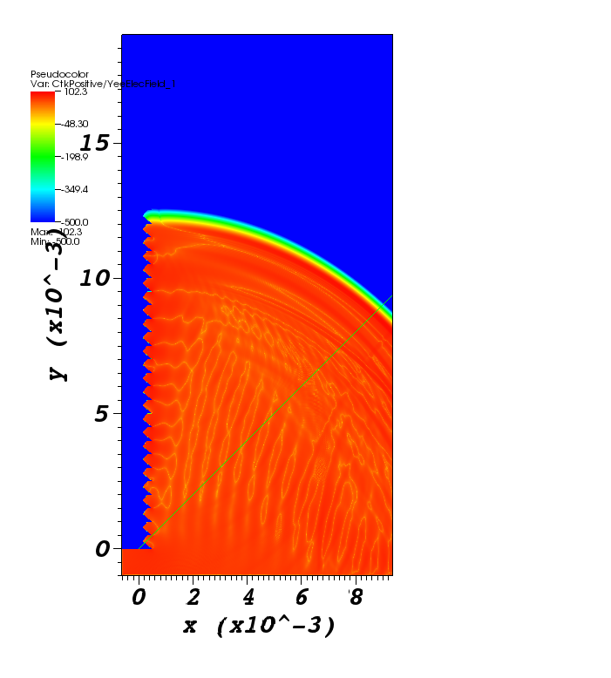
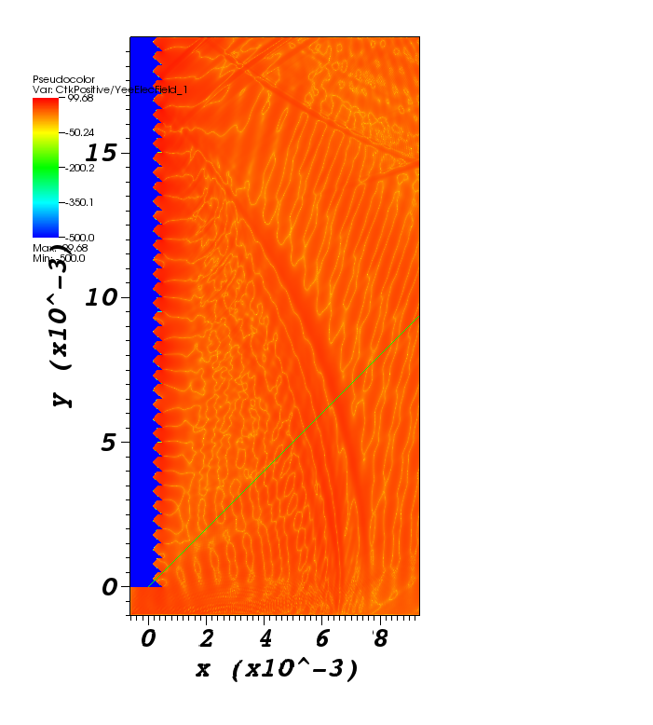
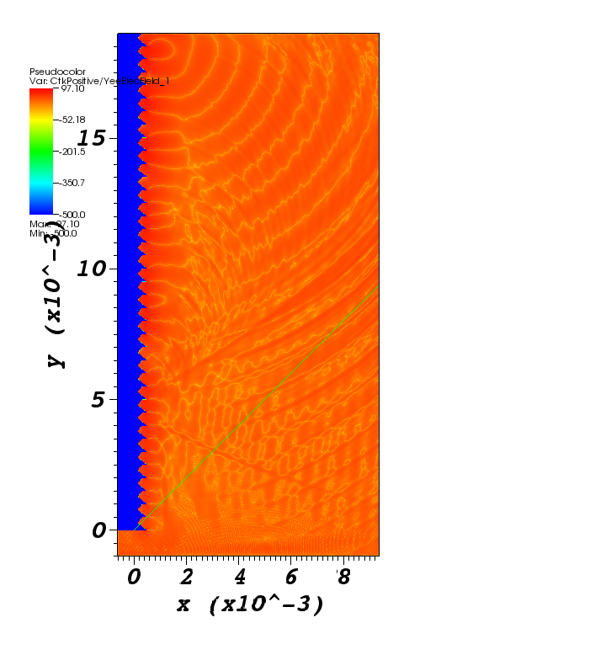
Preliminary results (non-gaussian)

Slide 5
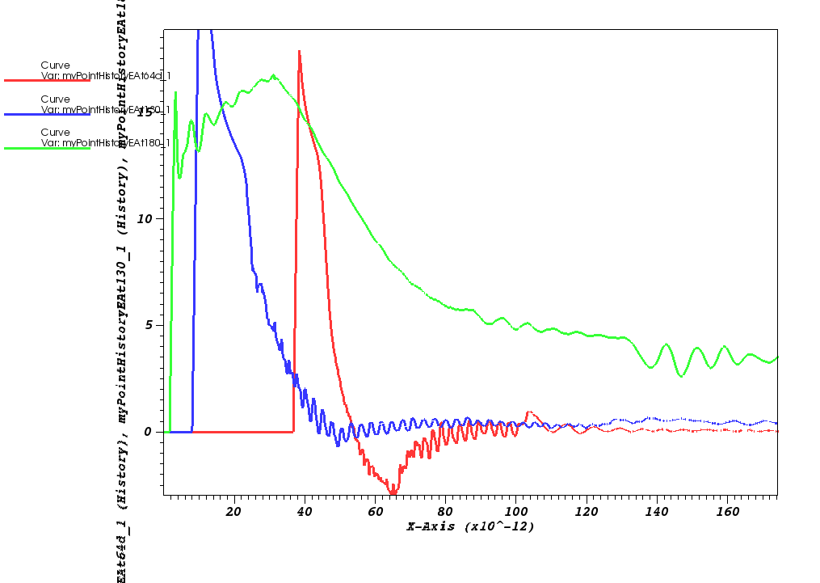
Detection of SP signals : time profiles

Slide 6
Currently working on three aspects
FFT extends far in high frequencies : relevance of these results?
Gaussian population and building up of a “phase space construct” to be imported in Vorpal, as beam model
Design of a realistic grating (python import)

Slide 7
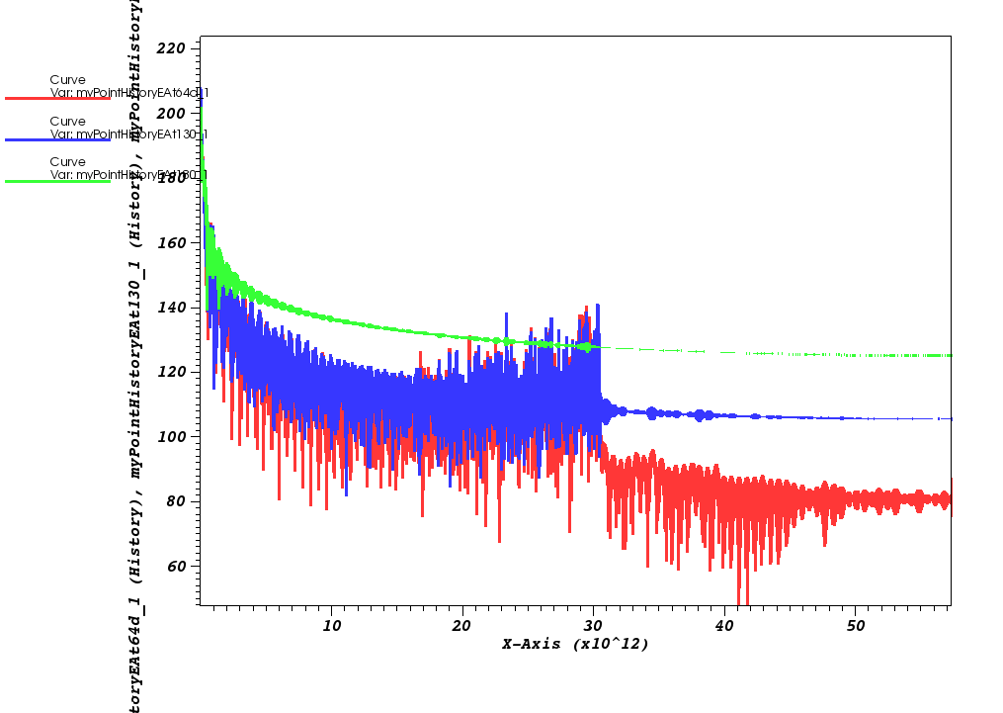
Existence of a signal at higher frequencies than expected…Numerical Artefact or Physics?

Slide 8
Beam Model
Not ok:
Much better
bunch model:

Slide 9
End of the talk, thanks

