Slide 1
Proposal for Smith-Purcell radiation experiment at SPARC_LAB
E. Chiadroni, A. Cianchi, F. Giorgianni, S. Lupi, R. Pompili

Slide 2
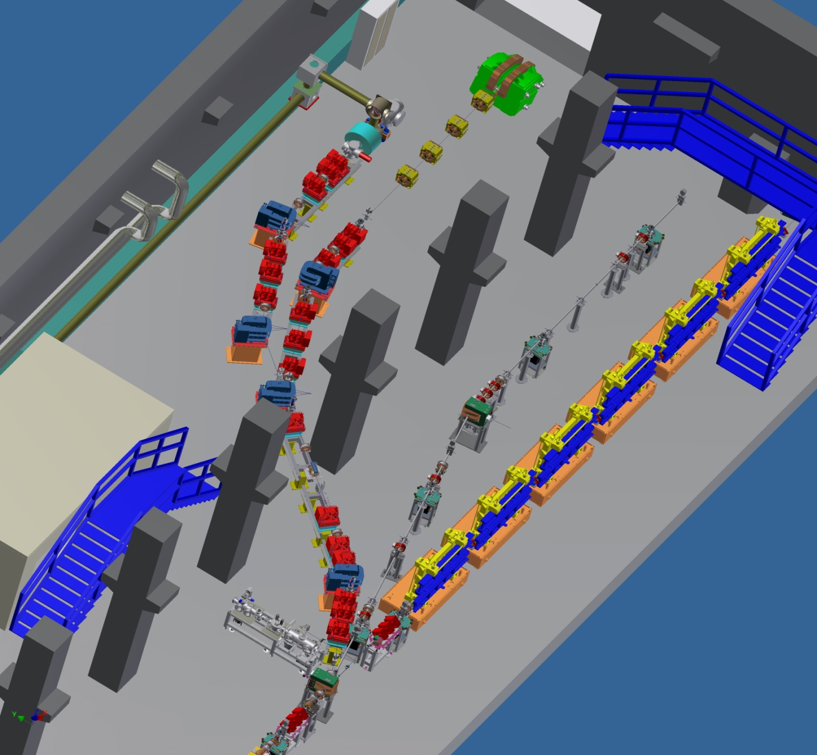
The SPARC_LAB Facility
Test bench beamline
for THz, EOS, advanced BPMs
Thomson scattering
beamline
B
laser input line
A
Undulator beamline
Possible places for the
Smith-Purcell experiment
Plasma Acceleration
beamline
New THz beamline

Slide 3
The SPARC Photo-injector
Beam energy 90 – 180 MeV
Bunch charge 50 – 500 pC
Rep. rate 10 Hz
ε_{n} < 2 mm-mrad
σ_{γ} 0.05% - 1%
Laser Pulse length 200 fs – 5 ps (FWHM)
Velocity Bunching
170 MeV S-band linac
12 m
Diagnostic and Matching
Undulator Beamline
Long Solenoids
S-band Gun

Slide 4
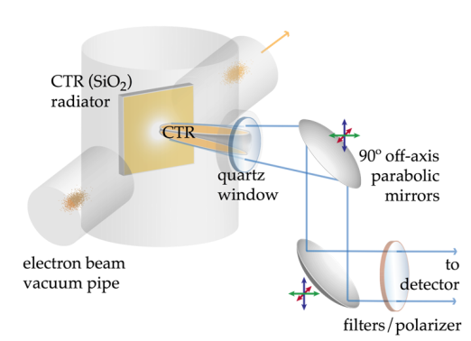
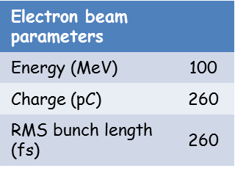
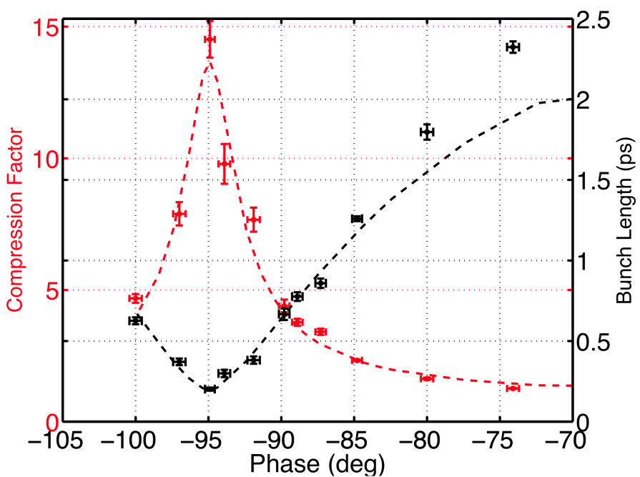
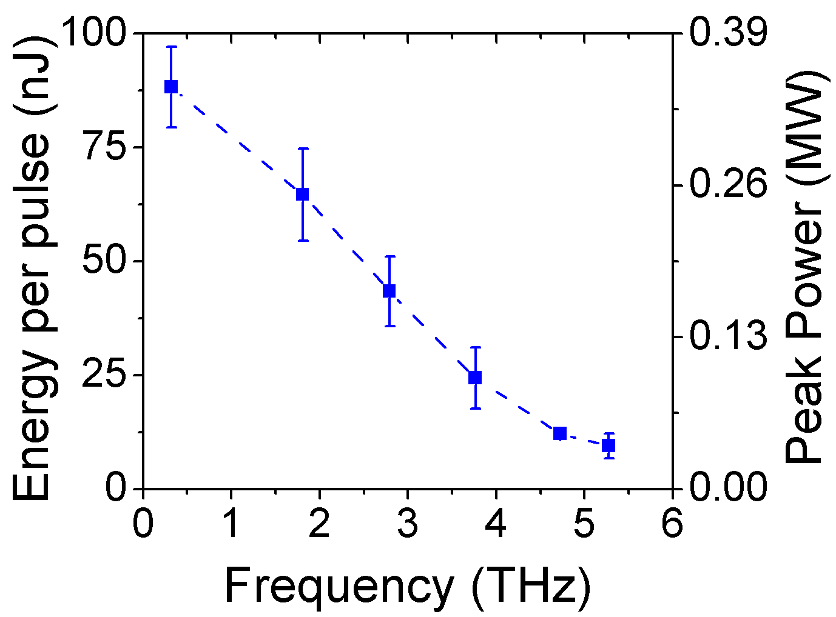
RF compression: VELOCITY BUNCHING
Single Bunch
Coherent Transition radiation radiation experimental data in
A
Over-compression
180 deg<<90 deg
Compression
<90 deg

Slide 5
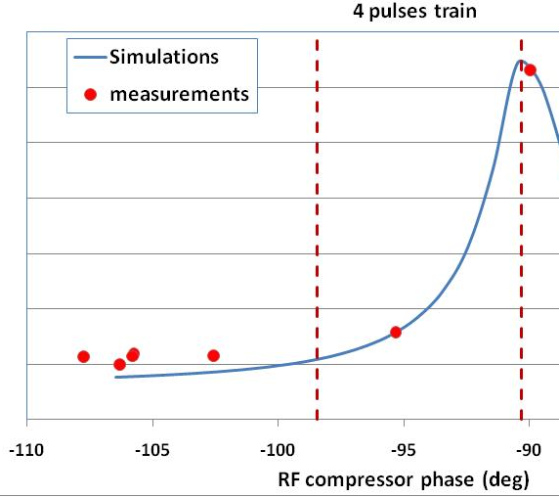
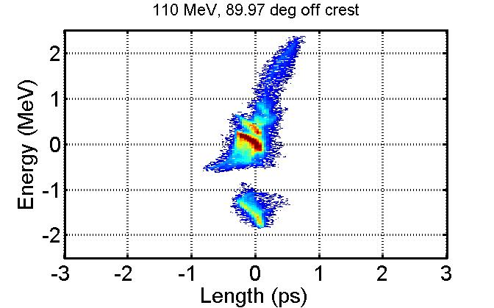
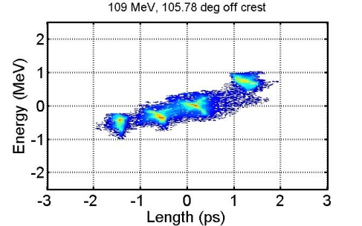
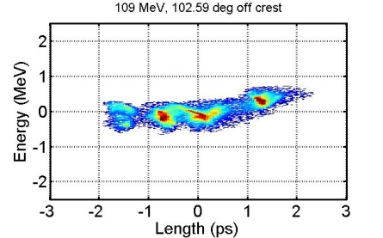
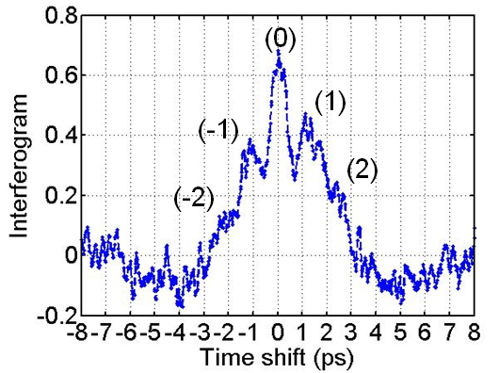
4-bunches per train
Deep over-compression
>180 deg
Coherent Transition radiation radiation experimental data in
A
5

Slide 6
Electron Beam Parameters
Energy (MeV) | 90 - 180
Charge (pC) | 50 - 500
RMS Bunch Length (fs) | <200

