Slide 1
Roadmap for high energy physics in Japan and KEK
Yasuhiro Okada (KEK)
April 24, 2013
LAL, Orsay, France

Slide 2
content
Present status of HEP projects in Japan
Future planning by the Japanese HEP community and KEK

Slide 3
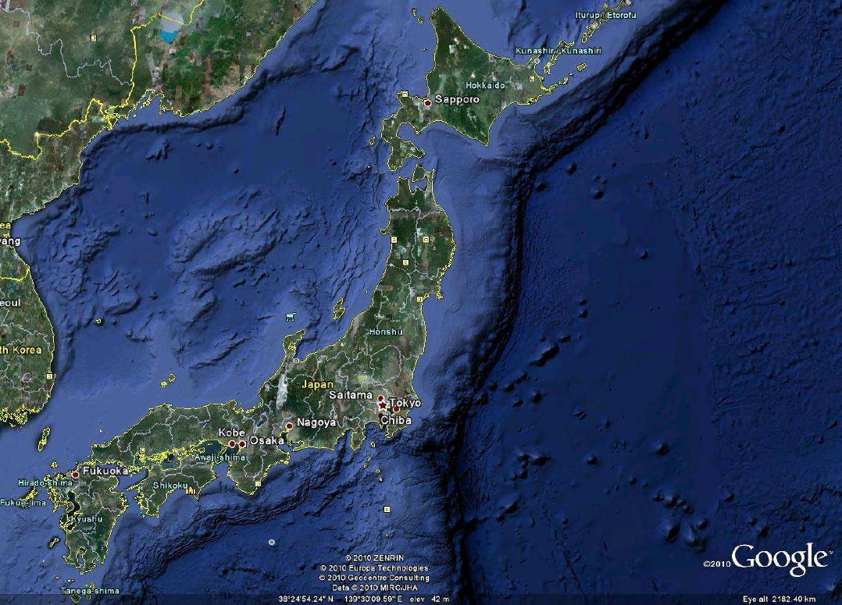

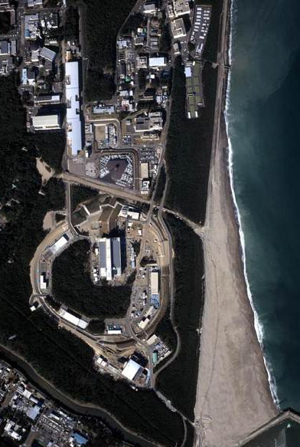
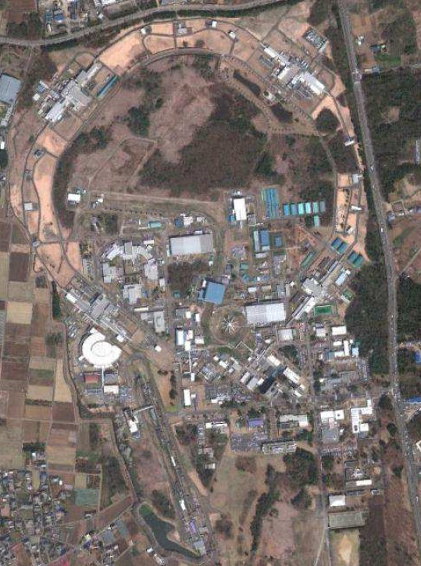
Electron machines in Tsukuba
and proton machines in Tokai
KEK
J-PARC
Tokai
KEKB
Tsukuba
ATF
Synch. light
facilities

Slide 4

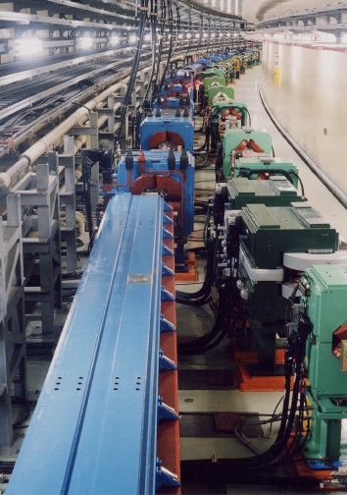
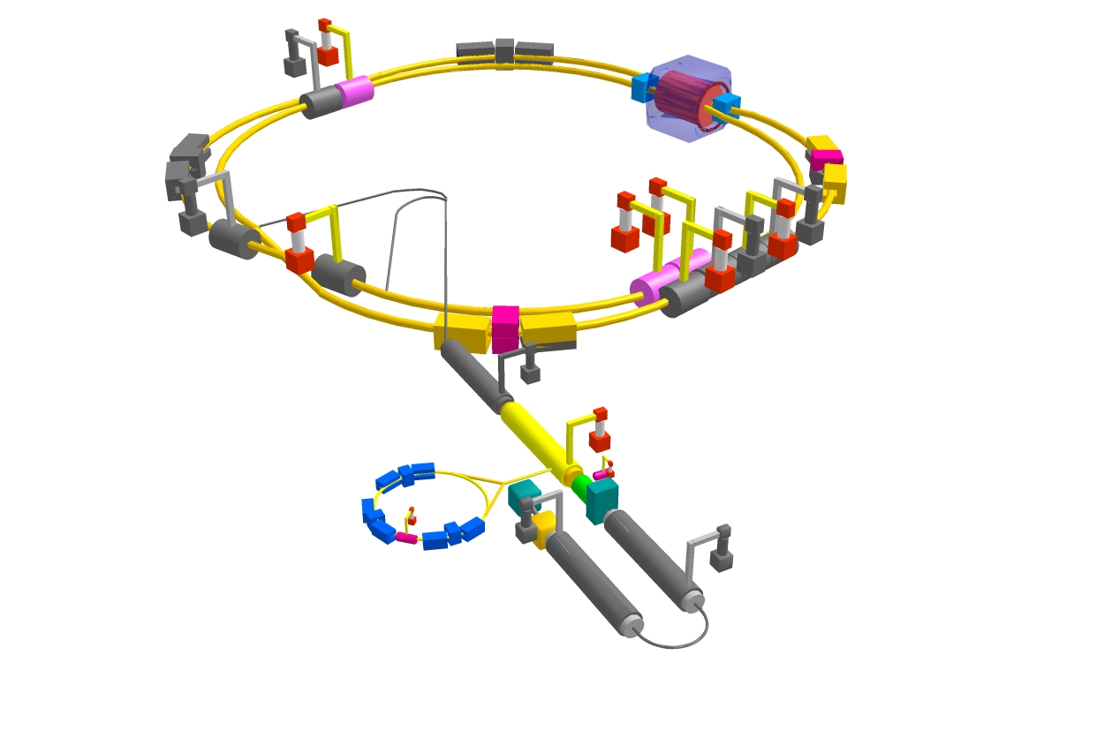
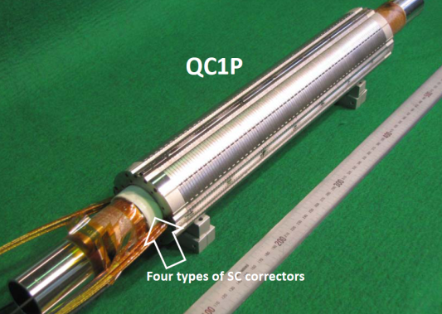
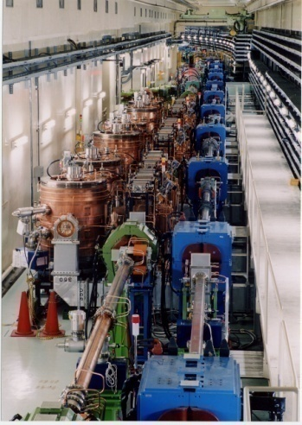
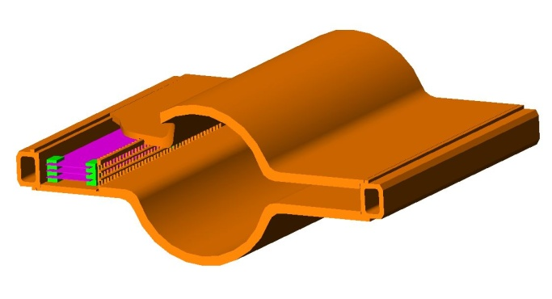
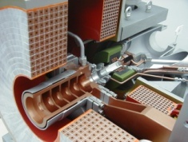
KEKB upgrade to SuperKEKB
Low emittance lattice
Beam commissioning scheduled in 2015
IR with β_{y}*=0.3mm
SC final focus system
e⁻(2.6A)
SuperKEKB
Add RF systems for higher beam current
e⁺(3.6A)
Damping ring for low emittance positron
injection
Positron
capture section
NEG pumps
LER beampipe to suppress
photoelectron instability
Beam
SR
Target: L = 8x10³⁵/cm²/s

Slide 5
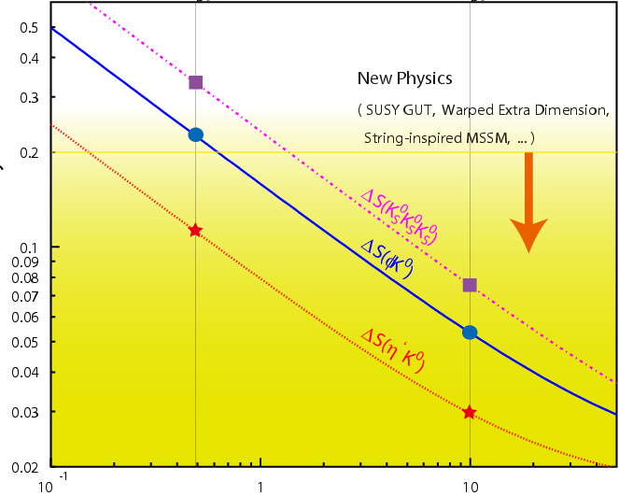
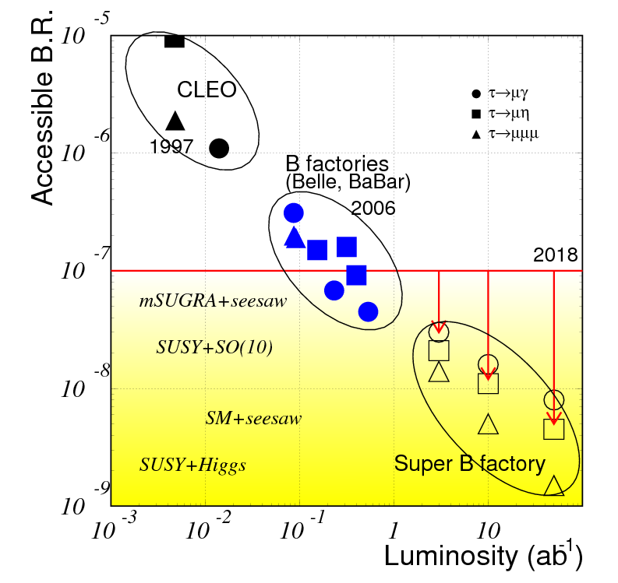
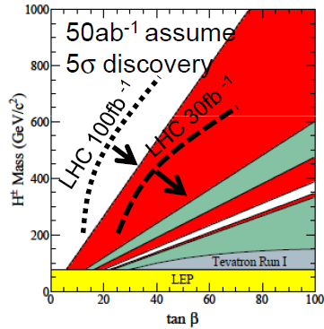
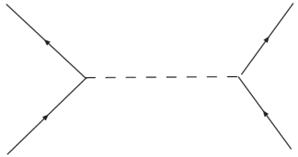
Physics at SuperKEKB
CPV in new FCNC
If New Physics scale is at TeV region,
It is natural to assume that the NP
effects are seen in B/D/τ decays.
Flavor structure of new physics?
CP violation in new physics?
Otherwise…
Search for deviations from SM in flavor physics will be one of the best ways to find new physics.
0.5
Present upper
limits
0.1
Deviation from SM
Measurements
at SuperKEKB
0.02
0.1
1
10
LFV τ decays
（ ab⁻¹ ）
Upper limits
H± in B decays
B->τν: H-b-u coupling
B->Dτν : H-b-c coupling
b
ν
H⁻
u
B→τν
τ
τ
H
ν
b
c
B→Dτν

Slide 6
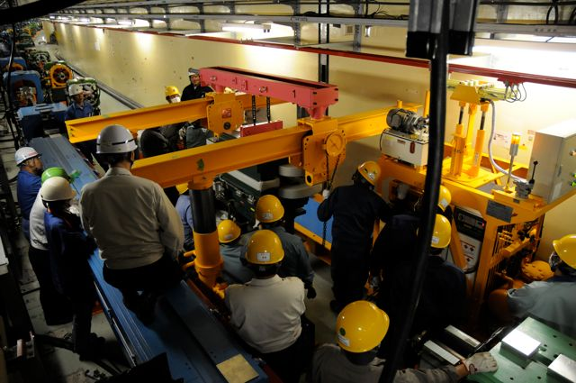
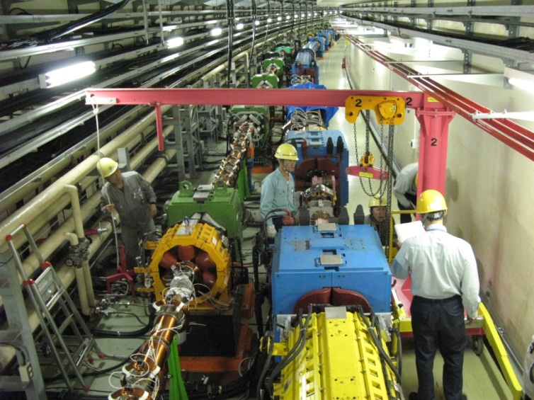
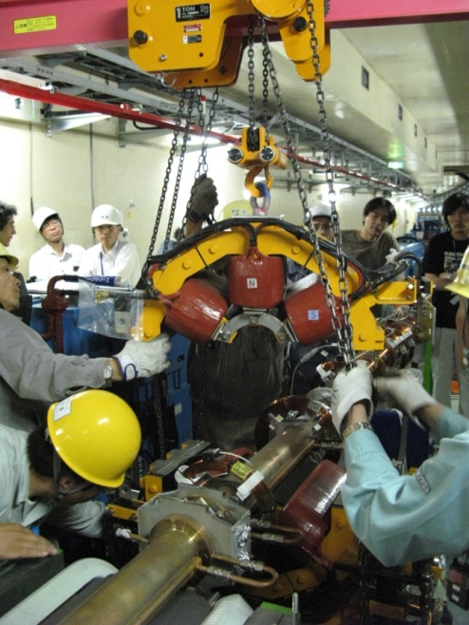
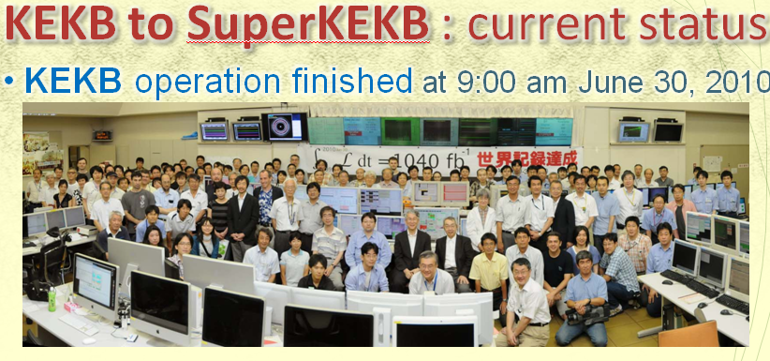
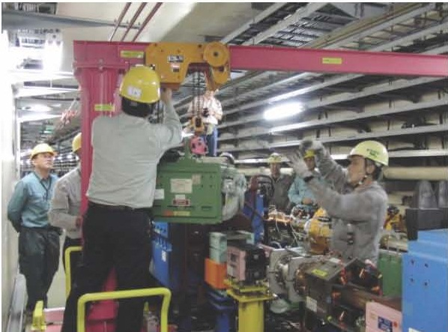
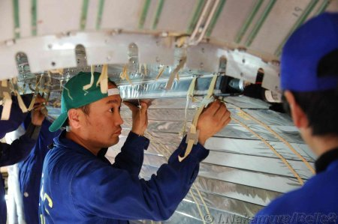
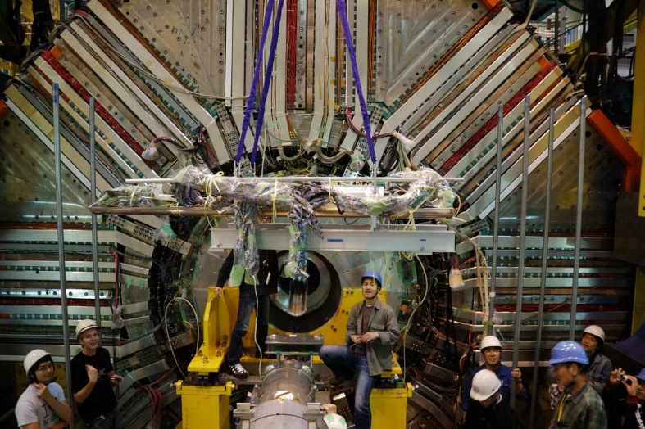
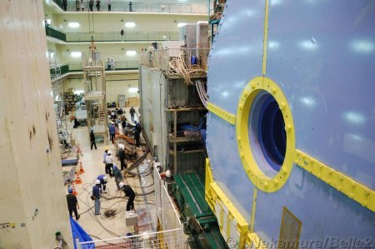
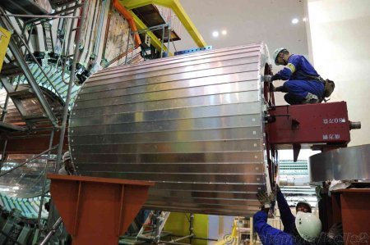

Slide 7

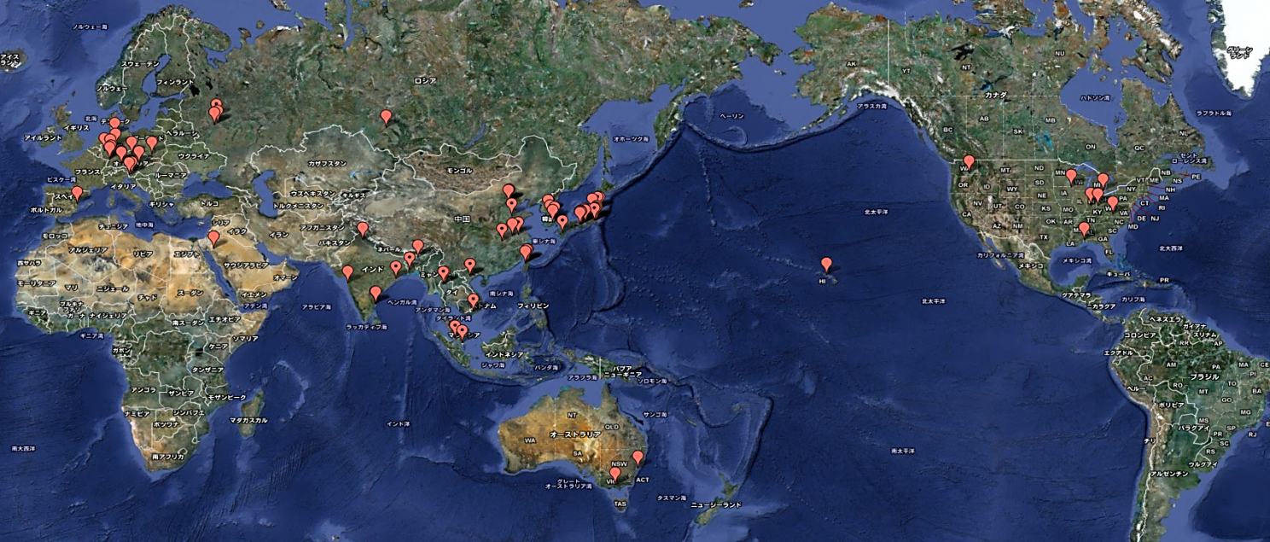
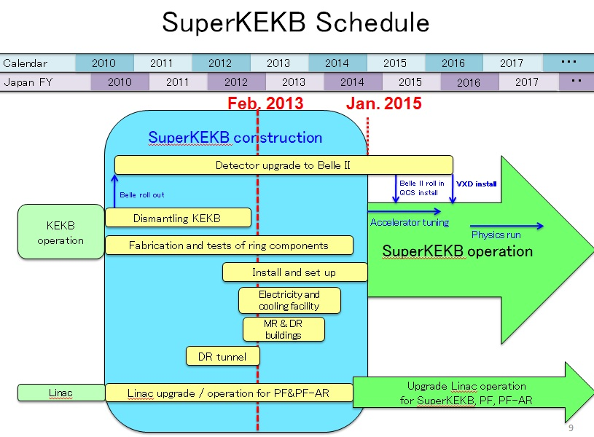
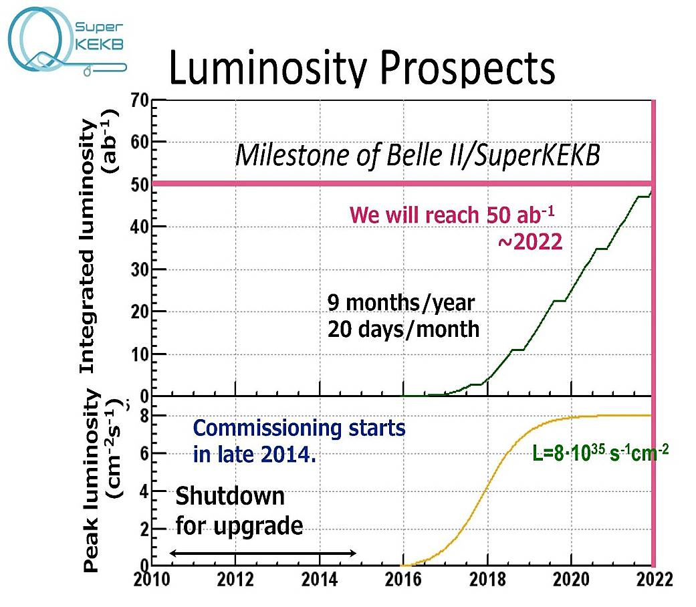
SuperKEKB : International Collaboration
~ 400 collaborators from 15 countries

Slide 8
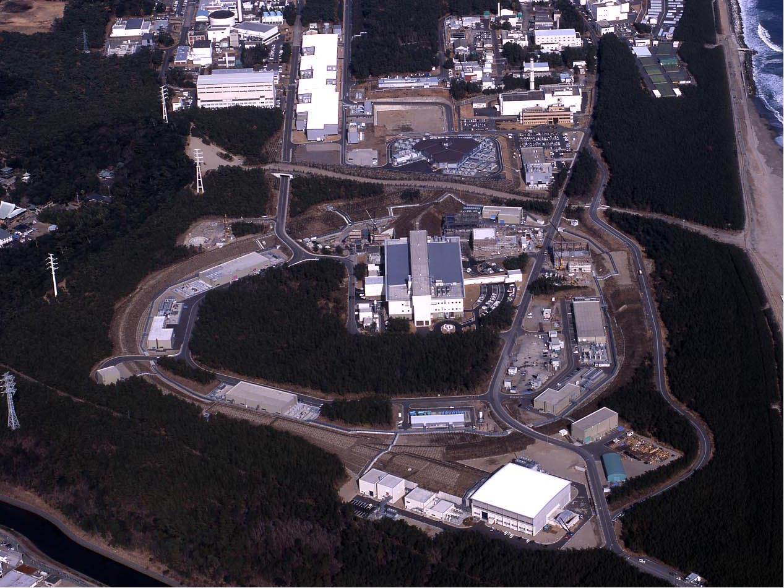
J-PARC
Joint project between KEK and JAEA
Linac
KEK
3 GeV Booster
Neutrino beam (to Kamioka)
30 GeV MR
Hadron exp. facility
Bird’s eye photo in January 2008
Notes:
The J-PARC consists of three accelerators and three experimental facilities.
●In calendar year of 2007 the linac and 3 GeV synchrotron were completed. ● Then, in fiscal year of 2008 the 50 GeV synchrotron and two experimental facilities, the materials and life experimental facility with neutron and muon beams, and the hadron experimental facility with primarily kaon beams were completed. ● Finally, in fiscal year of 2009, which is the last year, the neutrino facility to send the neutrino beams to Superkamiokande was completed.

Slide 9
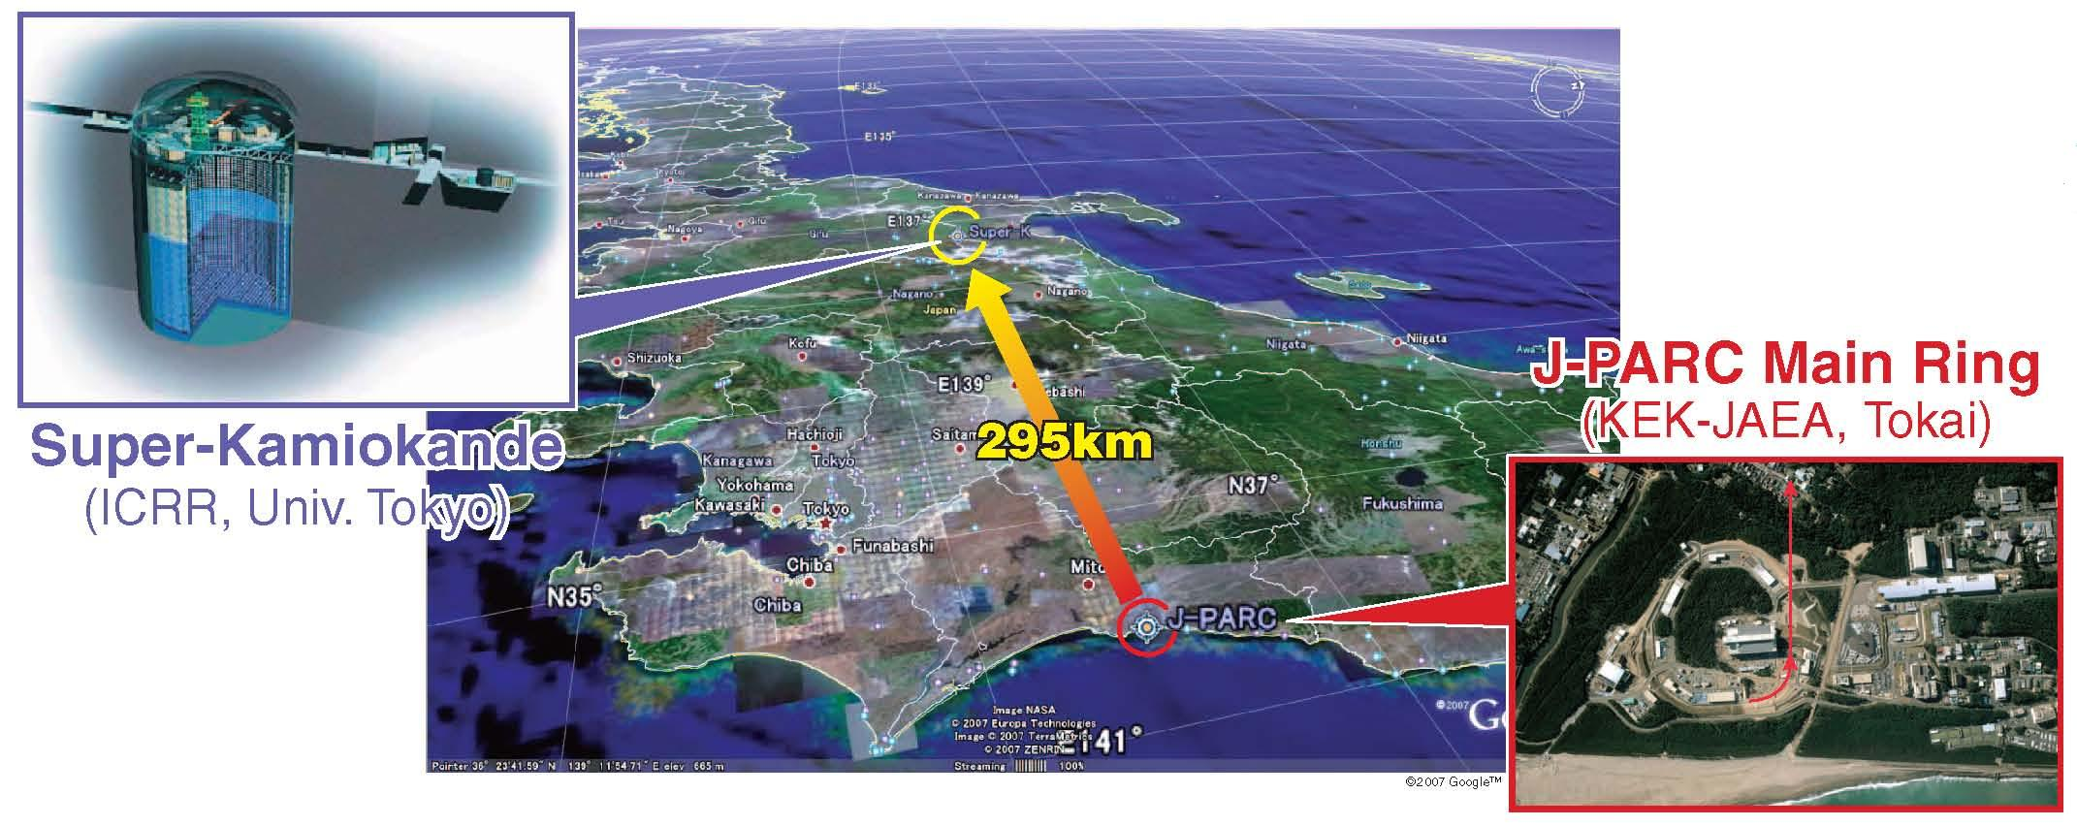
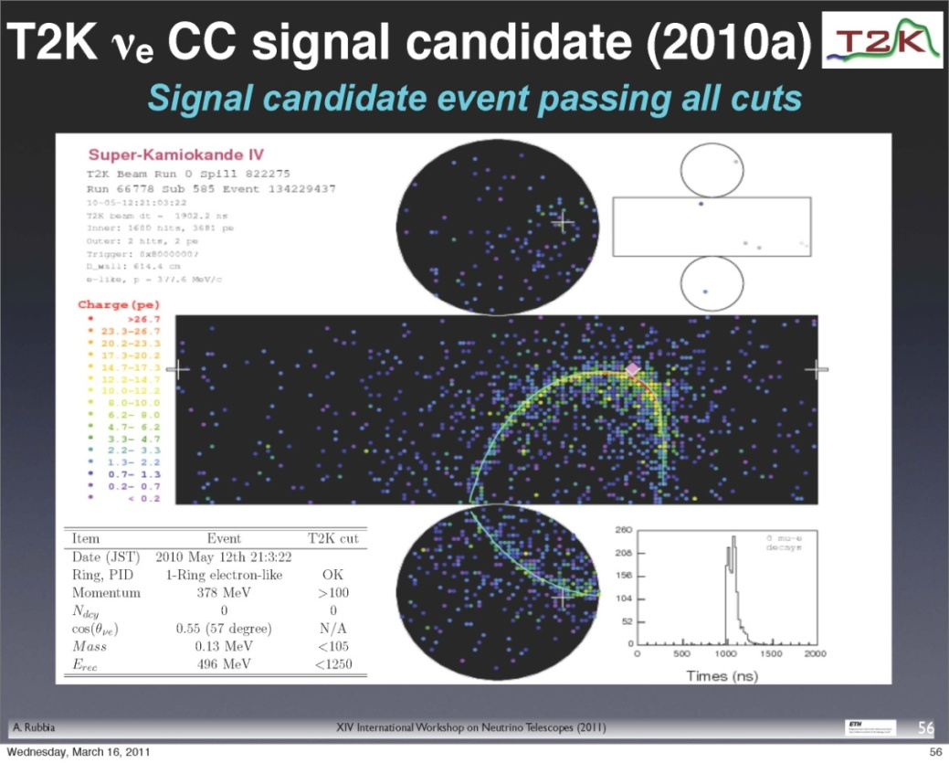
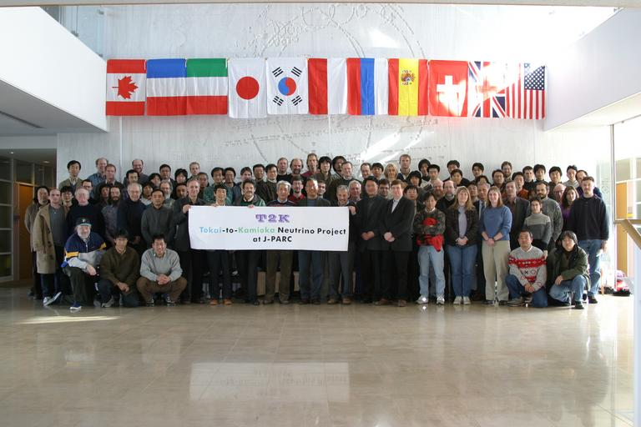
T2K : Long Baseline Neutrino Experiment
E11: T2K experiment
~500 members from 12 Countries:
Japan, US, Canada, France, UK, Switzerland,
Poland, Korea, Russia,
Spain, Italy, Germany

Slide 10
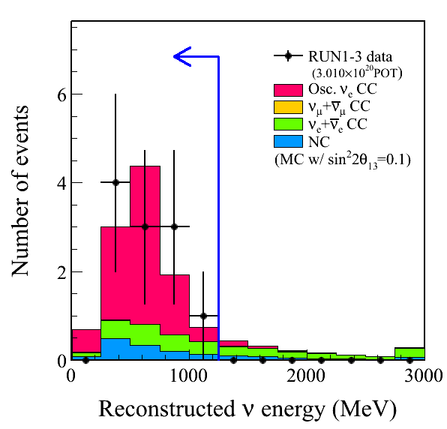
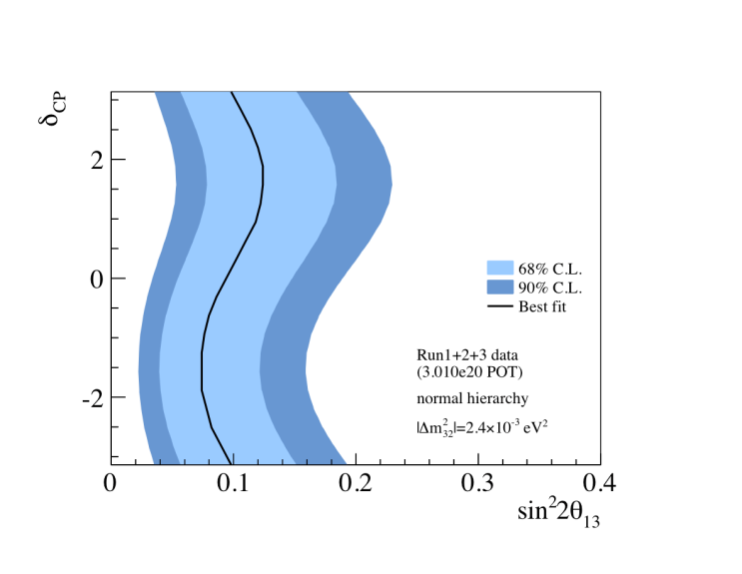
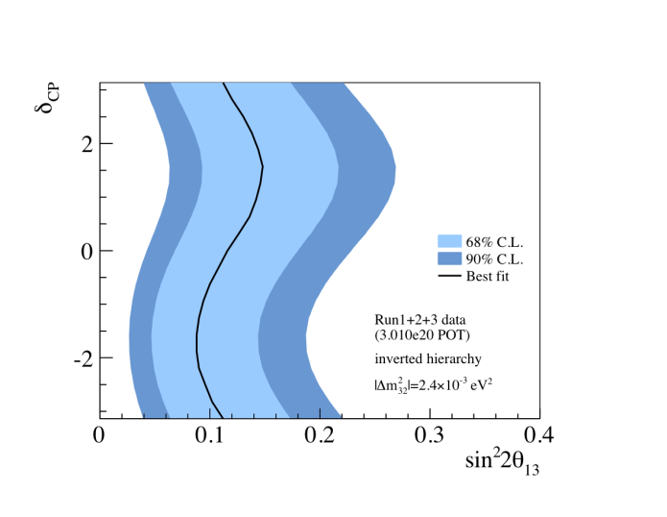
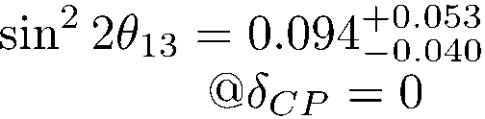
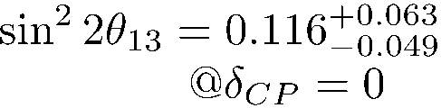
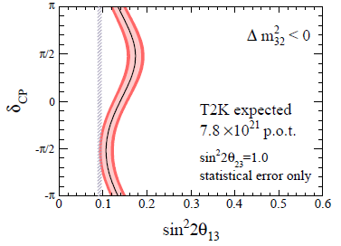
Latest Result of ν_{μ} →ν_{e} from T2K
11events
3.01x10²⁰ POT
All the plots here are preliminary.
Normal hierarchy
Inverse hierarchy
Aim to 5σ by this summer
Improvement of both reactor and accelerator experiments will provide first handle on the CP violating complex phase δ_{CP}.
Stat err only!
Expectation with ~50 times more data
(750kWx 5x10⁷s)
Expected beam power
May 2012 | 2014~2015 | 2018
190kW | 300kW 500kW | 750kW

Slide 11
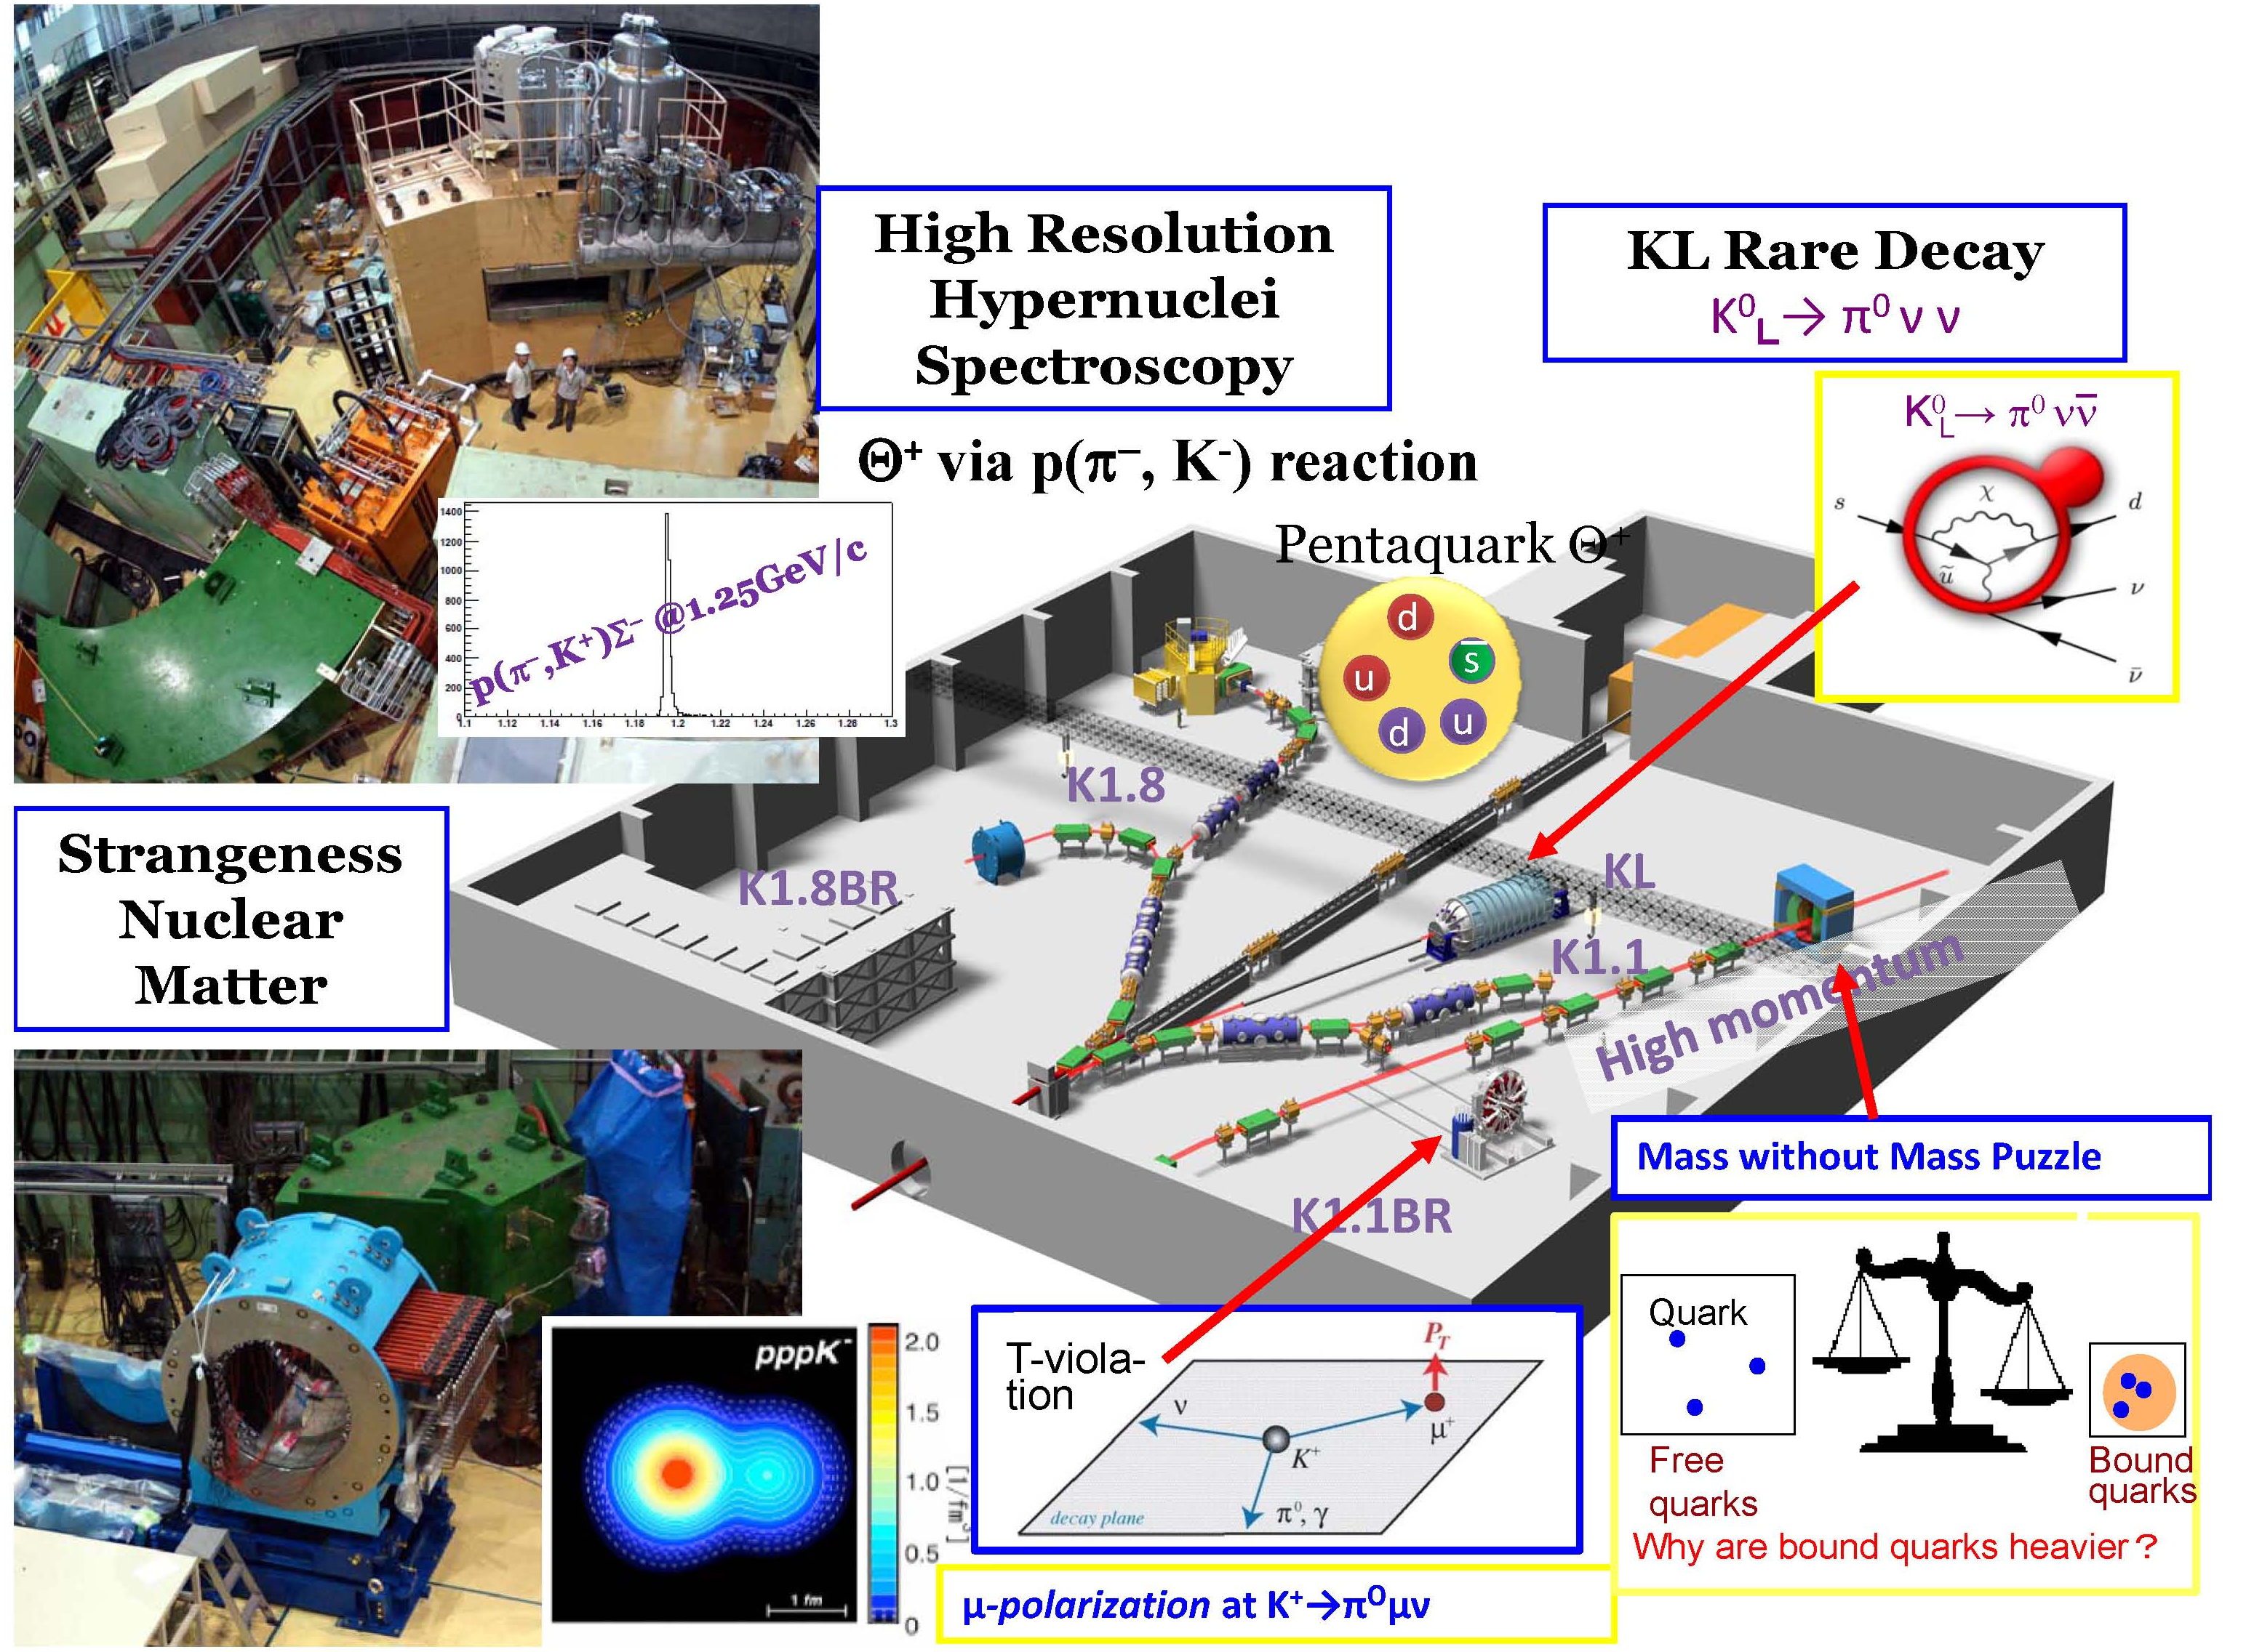
Nuclear and Particle Physics at Hadron Hall
KOTO

Slide 12

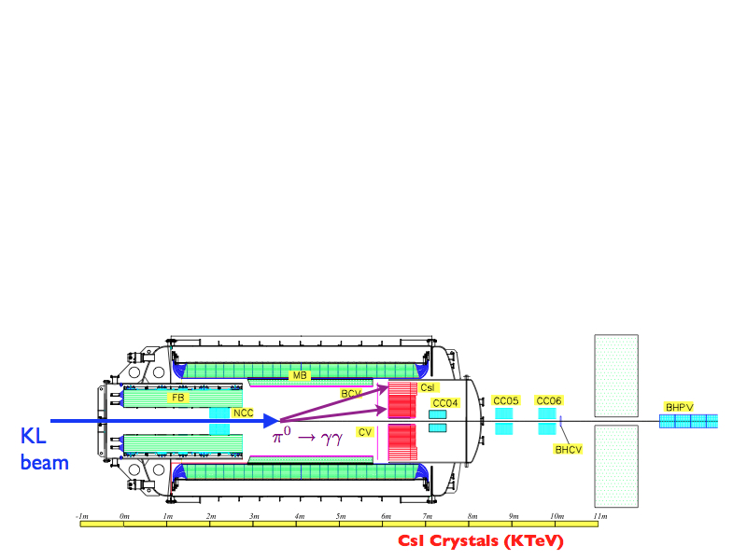
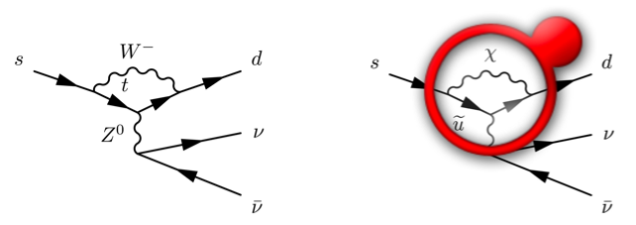
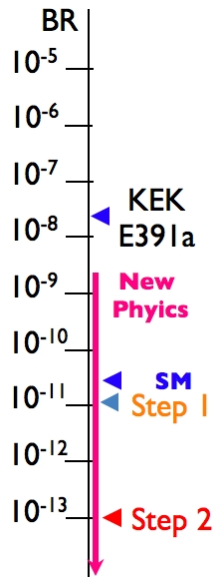

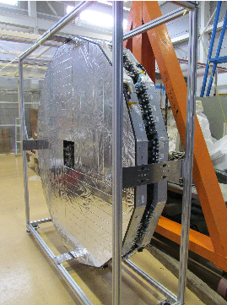
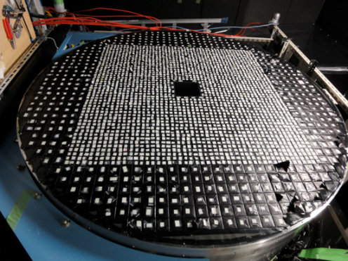
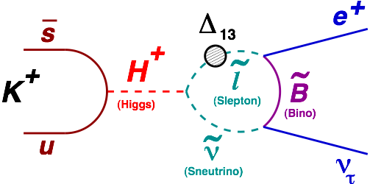

E36 (LFU)
Rare Kaon Decay
J-PARC HADRON HALL
CV
CsI
KL beam line (KL decay in flight)
K1.1BR beam line (K+ decay at rest)
SM: (2.477±0.001)·10⁻⁵
SUSY LFV loop

Slide 13
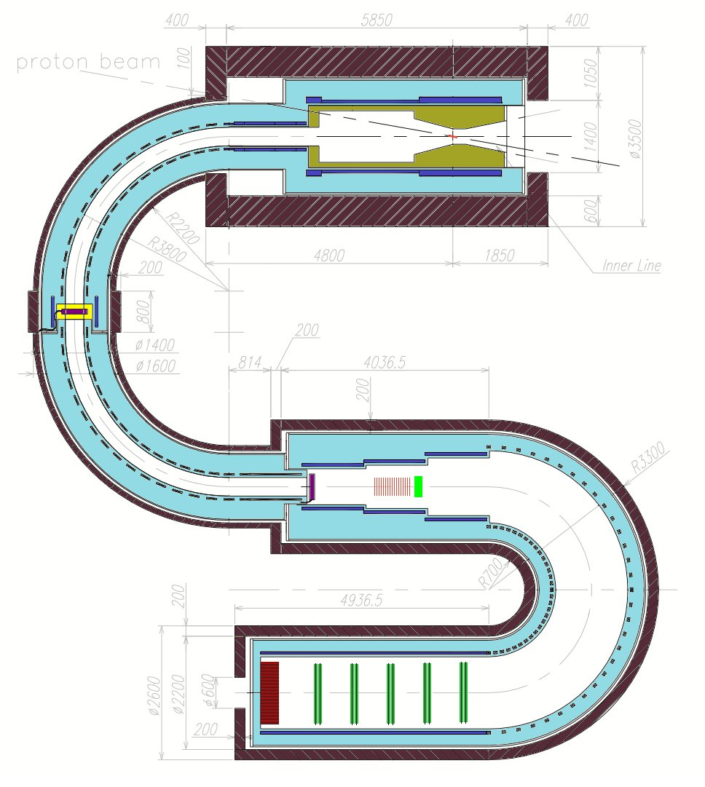
COMET μ-e conv. search
Search for cLFV mu-e conv.
10⁻¹⁶ sensitivity (Target S.E.S. 2.6×10⁻¹⁷)
Improve O(10⁴) than present upper bound such as SINDRUM-II BR[μ⁻ + Au → e⁻ + Au] < 7 × 10⁻¹³
Signature: 105MeV monochromatic electron
Beam requirement
8GeV bunched slow extraction
1.6x10²¹ pot needed to reach goal
7 uA (56kW) x 4 SN year (4x10⁷sec)
Extinction <10⁻⁹
COMET Phase-I physics run in 2017 => 10⁻¹⁴
Full COMET run in 2021-2022 => 10⁻¹⁶
Pion collection
Proton Beam
Pion production target
Muon transport
Muon stopping target
COMET Phase-I construction is approved
by the JYF 2102supplementary budget.
Electron Spectrometer

Slide 14
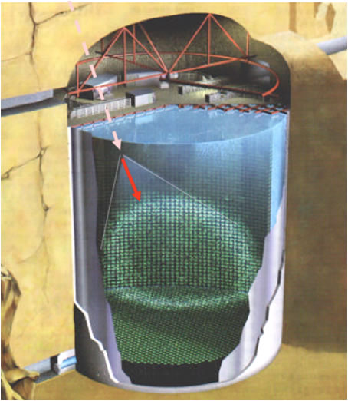
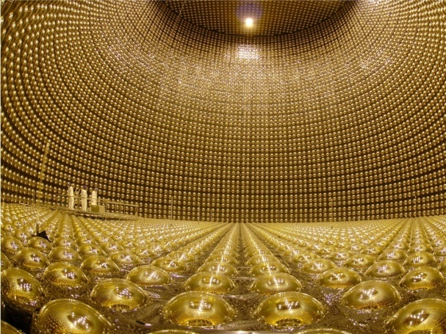
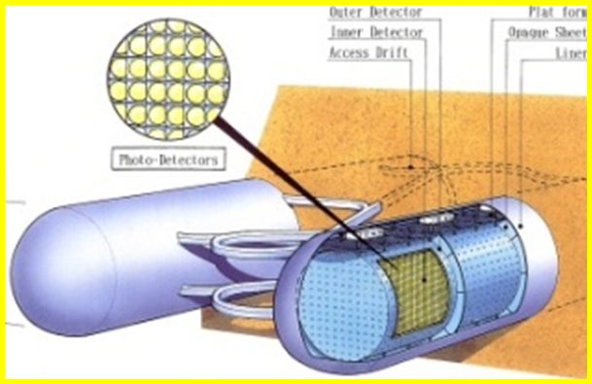
Super-Kamiokande
Super-K
SK have obtained many important results
Discovery of ν oscillation: atmospheric (1998), solar(2001 w/SNO), K2K (2004)
Discovery of ν_{μ}→ν_{e}(2011, T2K)
Remaining tasks
Determine Mass hierachy, CP Violation
T2K and Hyper-Kamiokande
Supernova
8,000 neutrino events from a SN at 10 kpc
Supernova Relic Neutrinos search (with Gd)
→ ∼33 SRN signals for E =10∼30 MeV (> 4σ)
Will start in a few years
Solar
Observe ‘upturn’ (to confirm oscillation or exotics?)
50kt H₂O
12,000 20” PMTs
SuperKamiokande
→HyperKamiokande
1Mt H₂O
99,000 20” PMTs

Slide 15
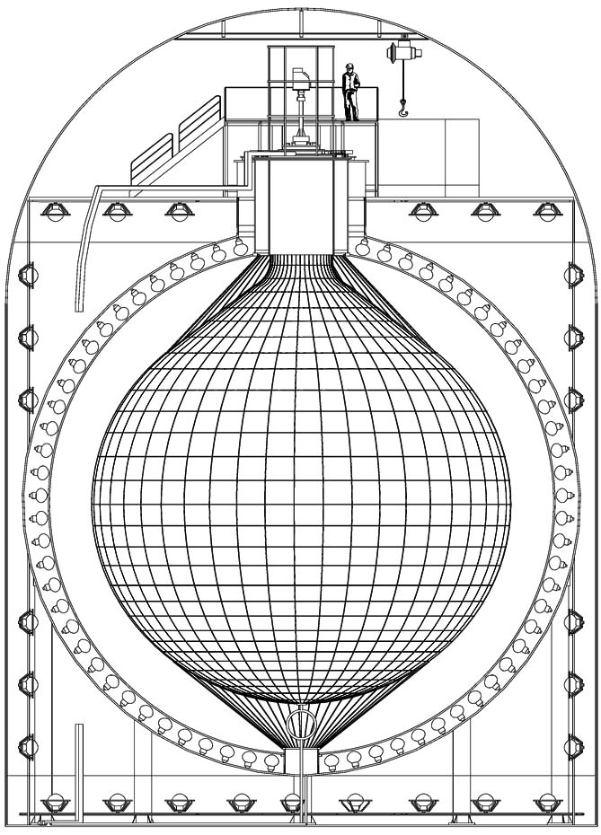

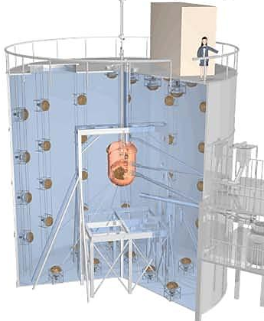
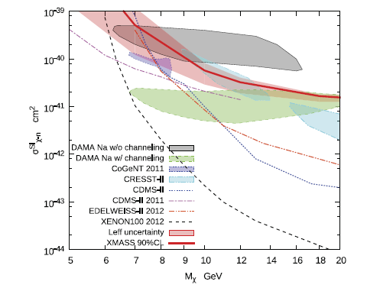
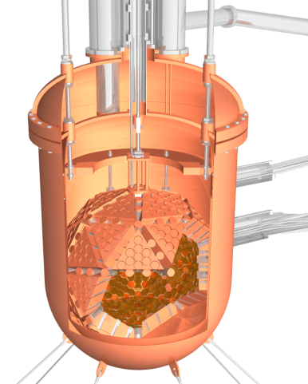

XMASS
KamLAND-Zen
Zero Neutrino double beta decay search
Phase-1: 100kg liq. Xe for dark matter search → first result published.
XMASS1.5 : upgrade to 5t for better sensitivity σ_{SI}< 10⁻⁴⁶ cm² (at m_{χ}∼100 GeV)
To be launched in 2015
Final Goal: 10t fiducial mass
Dark Matter (sensitivity σ_{SI}< 10⁻⁴⁷ cm² ),
Double Beta decay and pp-⁷Be solar neutrinos
1st run with ~320kg
90% enriched ¹³⁶Xe
Planned improvement
(2013)
~40mV sensitivity with
700kg Xe
Proposed upgrade
(2016~)
~20mV sensitivity with
winstone cone, higher
yield LS and 1000kg Xe
First result published
Results from initial 38.5kg-yr data
〈mββ〉
<0.26~0.54 eV
@90% C.L.
PLB713(2013)78

Slide 16
Future Planning for HEP in Japan/KEK
High Energy Physics Committee (HEPC) in Japan Association of High Energy Physicists (JAHEP)
The Subcommittee on future projects was formed under HEPC.
The final report of the Subcommittee on Future Projects of High Energy Physics was published in February 2012. http://www.jahep.org/office/doc/201202_hecsubc_report.
A Proposal for a Phased Execution of ILC by JAHEP in October 2012.

Slide 17

Recommendations in the subcommittee report
February 11, 2012

Slide 18
A Proposal for a Phased Execution of the International Linear Collider Project
October, 2012 The Japan Association of High Energy Physicists
http://www.jahep.org/office/doc/201210_ILC_staging_e.pdf
In March 2012, the Japan Association of High Energy Physicists (JAHEP) accepted
the recommendations of the Subcommittee on Future Projects of High Energy
Physics and adopted them as JAHEP's basic strategy for future projects. In July
2012, a new particle consistent with a Higgs Boson was discovered at LHC, while in
December 2012 the Technical Design Report of the International Linear Collider
(ILC) will be completed by a worldwide collaboration.

Slide 19
On the basis of these developments and following the subcommittee's recommendation on ILC, JAHEP proposes that ILC be constructed in Japan as a
global project with the agreement of and participation by the international
community in the following scenario:
(1) Physics studies shall start with a precision study of the "Higgs Boson", and then
evolve into studies of the top quark, "dark matter" particles, and Higgs selfcouplings,
by upgrading the accelerator. A more specific scenario is as follows:
(A) A Higgs factory with a center-of-mass energy of approximately 250 GeV shall
be constructed as a first phase.
(B) The machine shall be upgraded in stages up to a center-of-mass energy of
~500 GeV, which is the baseline energy of the overall project.
(C) Technical extendability to a 1 TeV region shall be secured.
(2) A guideline for contributions to the construction costs is that Japan covers 50%
of the expenses (construction) of the overall project of a 500 GeV machine. The
actual contributions, however, should be left to negotiations among the governments.

Slide 20

Update of KEK roadmap
KEK was established in 1971 as National Laboratory for High Energy Physics. This was the first Inter-University Research Institute Organization in the nation .
Since then, KEK has developed to be one of leading international accelerator science facilities world-wide.
KEK now covers a wide range of scientific fields, from particle and nuclear physics to materials and life science.

Slide 21
KEK established its first Roadmap (5year plan, 2009-2013) in 2008. We have been pursuing realization of research projects according to this roadmap.
We have been updating our Roadmap since April 2012.
This is a bottom-up process since KEK is an Inter-University Research Institute Corporation. We took into account inputs from relevant science communities: HEP, Nuclear Physics, Synchrotron radiation research, Neutron science, Muon science.
The final draft is available http://kds.kek.jp/conferenceDisplay.py?confId=11728
The roadmap review committee was held on April 5-6, 2013.
The new roadmap “KEK Roadmap 2013” is open to public soon.

Slide 22
Context of 5 year plan (2009-2013) in the KEK roadmap (2008)
1. Operation of JPARC, early realization of the design performance and reinforcement of the beam intensity
2. KEK B Factory upgrade
3. PF/PF-AR Operation and Upgrade
4. Commitment to the LHC Experiment
5. R&D of Advanced Accelerator and Detector Technologies
R&D Program for the ERL
R&D Program for the ILC
R&D for the Particle Detectors
=>Strong on-going
program
=>SuperKEKB/Belle II construction
=> Start of LHC experiments
=> Construction of c-ERL
=>R&D at test facilities: STF and ATF/ATF2
=> Support Activities at KEK Detector Technology Project
We have been successfully carried out research programs following the roadmap.

Slide 23
KEK Roadmap 2013 (Final draft)
1. Preamble
2. Long-Term Prospects and KEK’s Role for Each Research Area
Strategy for Next Five Years (2014-2018)
3.1 J-PARC
3.2 SuperKEKB/Belle II
3.3 LHC/ATLAS
3.4 ILC
3.5 Photon Science (Synchrotron Radiation Research)
3.6 New Development of Accelerator and Detector Technologies
4. Summary

Slide 24
Japan Proton Accelerator Research Complex (J-PARC)
J-PARC Neutrino Experimental Facility
At the neutrino facility, a significant improvement in the measurement precision of the T2K experiment will be pursued. In addition, new research plans will be developed for the next generation of long-baseline neutrino oscillation experiments, while relevant preparatory studies are pushed forward in parallel.
J-PARC Hadron Experimental Facility
In research activities at the Hadron Experimental Facility, experiments at the present and new primary proton beam lines will be steadily advanced, while additional efforts will be made toward future extension of the facility.
Materials and Life Science Experimental Facility (Neutron Science Facility)
Materials and Life Science Experimental Facility (Muon Science Facility)
Accelerator Upgrades
Regarding the program for improving J-PARC’s accelerator systems, a high-priority item is to rapidly meet the design beam intensity goal, to be supplemented soon thereafter with preparation for the next-stage upgrade plans for the facility, which will enable a major increase in the beam intensity.

Slide 25
SuperKEKB/Belle II
The goal at SuperKEKB/Belle II is to complete the construction of the accelerator and detector facilities, and then to achieve the design luminosity performance on schedule and to initiate in-depth exploration of new physics.
Large Hadron Collider (LHC)/ATLAS
The main agenda at LHC/ATLAS is to continually participate in the experiment and to take a proactive initiative in upgrade programs within the international collaboration at both the accelerator and detector facilities.
International Linear Collider (ILC)
KEK will play a central role in creating an international preparatory group and will lead the effort on advanced R&D, the engineering design of the apparatus and facility, and the organizational design toward groundbreaking for the linear collider project to be hosted in Japan, within the framework of a global collaboration.

Slide 26
Photon Science (Synchrotron Radiation Research)
KEK will continue to advance photon science by upgrading the Photon Factory (PF) and Photon Factory Advanced Ring (PF-AR) to improve their performance and efficiency. At the same time, KEK will construct and then operate the compact energy recovery linac (c-ERL) and will demonstrate the key technologies required for the ERL. By proving the potential of the ERL as a new accelerator to open new scientific frontiers, KEK will work toward construction of a 3 GeV ERL facility. In addition, KEK will continue to play a leading role in the development of synchrotron radiation (SR) research in Japan.
New development of accelerator and detector technologies
KEK will contribute its expert knowledge and technical capabilities with respect to particle accelerators and detectors to collaboration with scientists from research fields of overlapping interest and to numerous industrial and medical applications for the benefit of society. KEK will also promote research that has the potential to significantly expand accelerator and detector technologies in the long term.

Slide 27



Promotion of the ILC project in Japan
The Japanese HEP community has reached a consensus to host ILC in Japan.
A Higgs boson has been supposed to be an indicator to the future direction of
the High energy physics and this is still true.
Integrated luminosity(ab⁻¹)
2
HHZ
1.5
1
0.5
HZ
ννH
ttH
tt
200
300
400
500
600
ILC TDR
CM Energy (GeV)

Slide 28



ILC Accelerator R&D at KEK
Ultra-small beam
Low emittance : KEK ATF (Accelerator Test Facility)
Achieved the ILC goal.
Small vertical beam size : KEK ATF2
Goal = 37 nm, ~70 nm achieved in December 2012
Stabilize the beam at nm scale: KEK ATF2
Feedback system successful (FONT)
Main acceleration
Accelerating cavity
Spec: 31.5 MV/m ±(<20%)
80% yield achieved (90% goal is in sight)
Cryomodule assembly
Combine cavities from all over the world
KEK S1-global successful
KEK has made a significant contribution
to completion of the ILC TDR.
ATF/ATF2
STF

Slide 29








Two Candidate Sites in Japanese mountainous locations
5 m
SEFURI
- GDE-CFS group visited two candidates sites,
Oct. 14 and 15, 2011
Japanese government’s third supplementary budget in 2011: 5 oku-yen to ILC

Slide 30
ILC promotion in academic sector, industry, policy makers in Japan
The ILC project and the next generation neutrino detector are listed in current Science Council of Japan’s (SCJ) Master Plan of Large Research Projects, and MEXT of Government, Roadmap of Large Research Projects. The update process of the Master Plan is underway.
Advanced Accelerator Association for Promotion and Science & Technology (AAA) was established in 2008 as a nation-wide joint effort in industry and science. AAA plays a very active role to promote the ILC project.
Federation of Diet members for promoting ILC was formed in 2006. ILC was mentioned in the LDP (the current ruling party) policy statement for the general elections of December 2012.
The government has expressed positive interest to host ILC. For instance, the MEXT minister mentioned the ILC, saying that the MEXT prepares to start preliminary discussions on the international framework of the ILC with the countries which are interested in, as his answer to the question in the regular press meeting on January 18, 2013.
The ILC project receives increasing support and understanding in Japan as an opportunity to create global cities. (recommendations of the Japan Policy Council)

Slide 31








Quest for
Birth-Evolution
of Universe
Quest for Unifying
Matter and Force
International Linear Collider（ILC）
Lepton CP Asymmetry
Scientific Activities
Technology Innovation
Encouraging Human Resources
Beyond Standard Physics
Power-Upgrade
Super-KEKB
J-PARC
KEK-B
Quark CP Asymmetry
LHC
Lepton
Quark
ν_{τ}
[Origin of Matter]
ν_{μ}
Quest for Neutrinos
ν_{e}
Quest for 6 Quarks
[Origin of Force]
Higgs Particle [Origin of Mass]

Slide 32
Summary
Japan has very active on-going research programs.
SuperKEKB/Belle II, T2K, K and muon rare decay experiments at J-PARC, SuperKamiokande, XMASS, KamLand-Zen, etc.
Japan is vigorously carrying out preparatory works for future.
ILC, the next generation long–baseline neutrino oscillation experiment
The Japanese HEP community strongly hopes to host ILC in Japan as a global project. KEK is planning to play a central role for the purpose.

