Slide 1
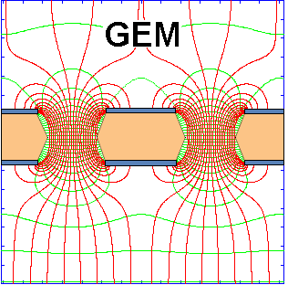
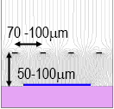

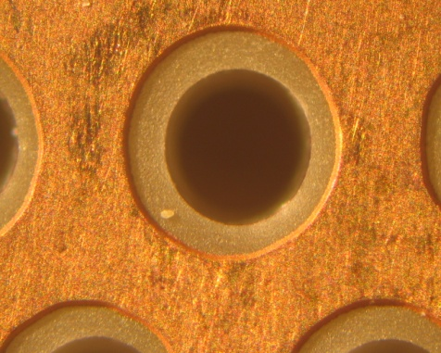
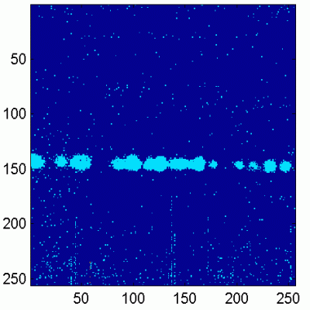
50 μm
140 μm
The RD51 Collaboration:
« Development of Micro-Pattern
Gas Detector Technologies »
Micromegas:
Maxim Titov, CEA Saclay, France
OUTLINE:
RD51 Motivation and Main Objectives
RD51 Collaboration Activities and Results
(Large area MPGD developments, Software & Simulation,
SRS Electronics, CERN MPGD Production Facility & Industrialization, RD51 Test Beam Facility, Training)
RD51 Plans and Outlook
Thick GEM +
(THGEM)
GEM +
CMOS ASIC
Workshop LAL-Ukraine on instrumentation
LAL Orsay, France, May 22-24, 2013

Slide 2
MPGD Developments: Historical Roadmap*
(*Many more micro-pattern structures were developed;
only widely spread technologies are shown)
MicroMEGAS (CEA Saclay, Y. Giomataris)
RD51
collaboration
MSGC (ILL, A. Oed)
GEM (CERN, F. Sauli)
RD28
1988
1996
1992
1997
2003
LEM (Periale)
THGEM(Chechik)
2008
1996
2000
2005
InGrid
μ-PIC (A. Ochi, T. Tanimori)
Capillary plate (Yamagata U., H. Sakurai)
From A.Ochi ADA2012@Kolkata (updated)

Slide 3
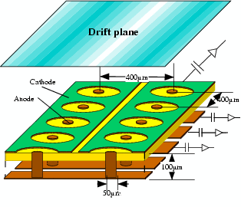
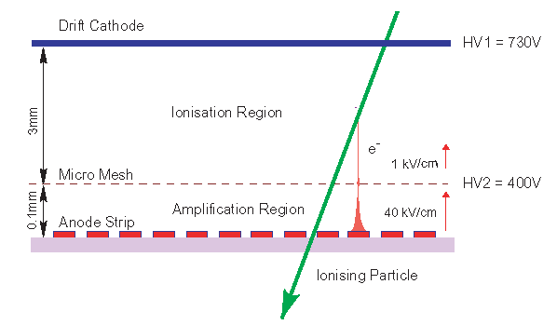
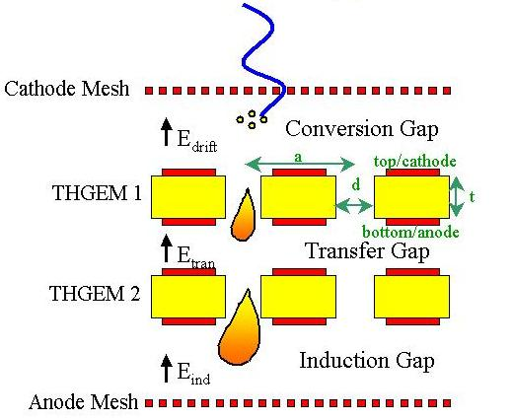
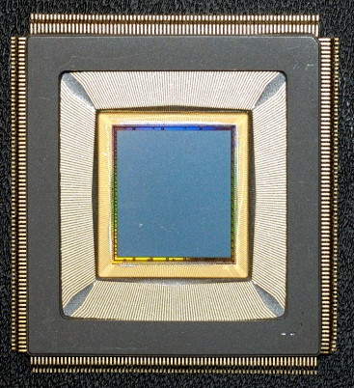
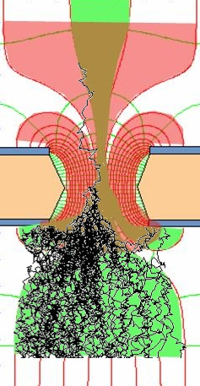

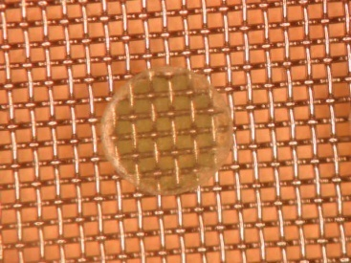

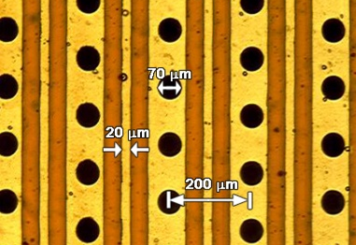
Micro-Pattern Gaseous Detectors: Technologies for Future Projects
Micromegas
GEM
Thick-GEM, Hole-Type Detectors and RETGEM
MPDG with CMOS pixel ASICs (“InGrid”)
Micro-Pixel Chamber (μPIC)
μPIC
CMOS high density
readout electronics
Ions
0.18 μm CMOS VLSI
40 %
60 %
Electrons
Micromegas
GEM
THGEM
MHSP
Ingrid

Slide 4
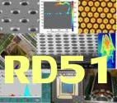
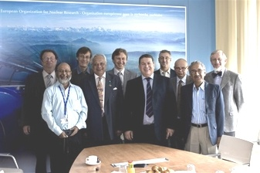
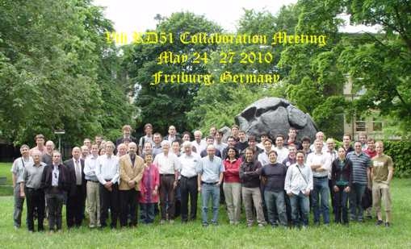
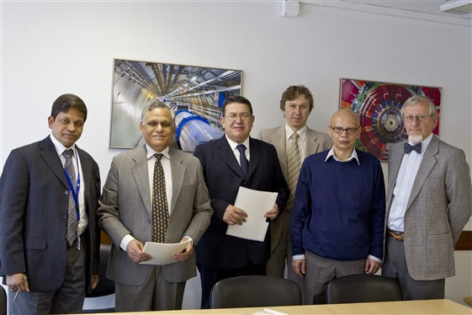
RD51 Collaboration Milestones
CERN MPGD workshop (10-11 September 2007)
Micro Pattern Gas Detectors. Towards an R&D Collaboration. (10-11 September 2007)
1st draft of the proposal presentation during Nikhef meeting (17 April 2008)
Micro-Pattern Gas Detectors (RD-51) Workshop, Nikhef, April 16-18, 2008
Gas detectors advance into a second century - CERN Courier
Proposal presentation in CERN/LHCC open session (2 July 2008)
94th LHCC Meeting Agenda (02-03 July 2008);
CERN‐LHCC‐2008‐011 (LHCC‐P‐011)
CERN/LHCC committee close session (24 September 2008)
Meeting with LHCC referees (23 September 2008); LHCC-095 minutes
2nd RD51 Collaboration meeting (Paris 13-15 October 2008)
2nd RD51 Collaboration Meeting (13-15 October 2008)
CERN Research Board approval(5 December 2008)
186th Research Board meeting minutes
4

Slide 5
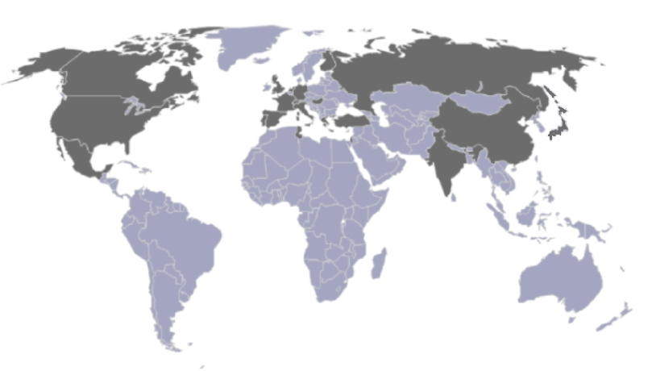
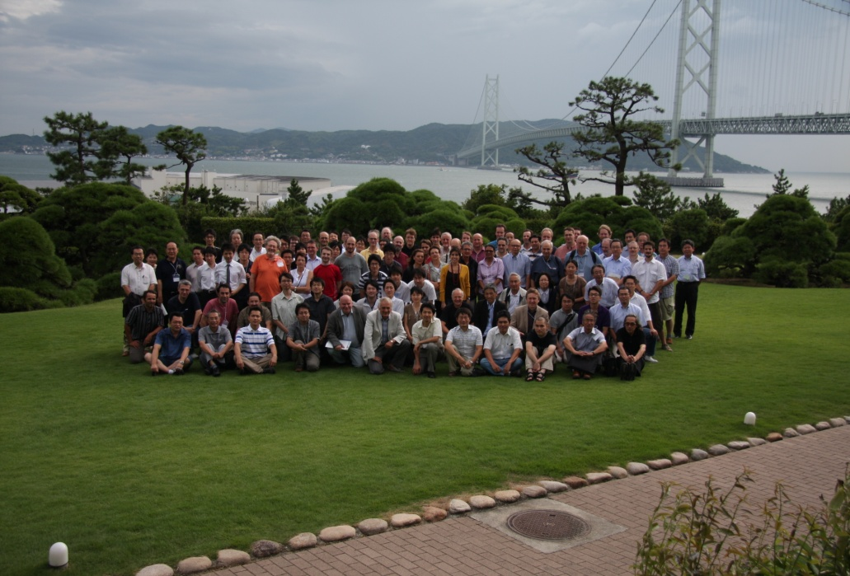
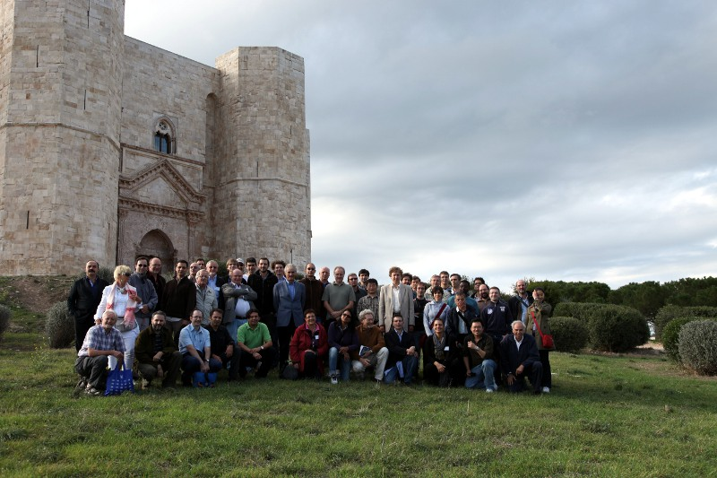
RD51 Collaboration: “Development of MPGD Technologies”
GEM
THGEM
The main objective of the R&D programme is to advance
technological development of Micropattern Gas Detectors
MPGD2011, the first conference
in the international series in Asia
~ 85 institutes
~ 450 people involved
Representation (Europe, North America,
Asia, South America, Africa)
80 institutes worldwide
~ 450 people involved
Representation (Europe, Asia
North/South America, Africa)
Kobe, Japan, September 2011
“RD51 aims at facilitating the development of advanced gas-avalanche detector technologies and associated electronic-readout systems, for applications in basic and applied research”
RD51 contributes to the LHC upgrades, BUT, the most important is:
RD51 serves as an access point to
MPGD “know-how” for the world-wide community
Bari, Italy, October 2010

Slide 6
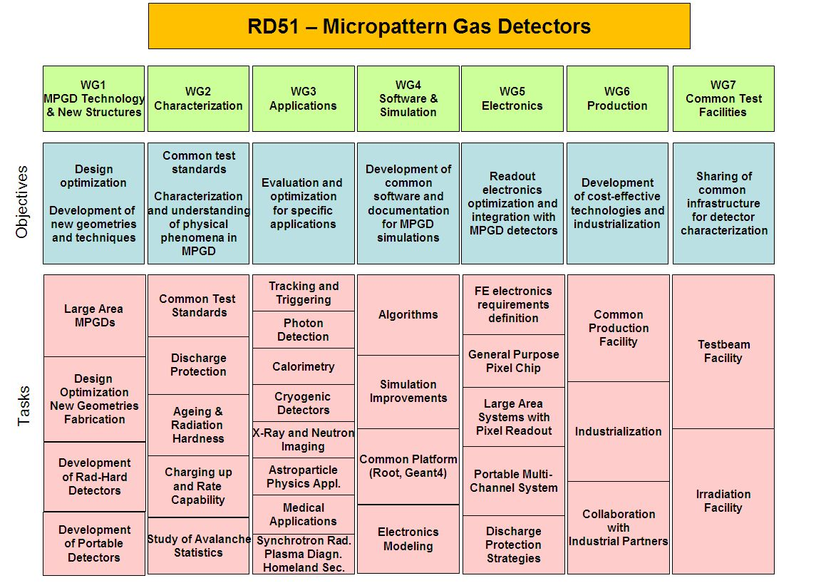
RD 51 Collaboration - Working Groups
“Transverse organization” of MPGD activities in 7 Working Groups
http://rd51-public.web.cern.ch/RD51-Public

Slide 7
RD 51 Collaboration - Working Groups
“Transverse organization” of MPGD activities in 7 Working Groups
http://rd51-public.web.cern.ch/RD51-Public

Slide 8
RD 51 Collaboration Organization
Consolidation around common projects: large area MPGD R&D, CERN/MPGD
production facility, common electronics developments, software tools, beam tests
http://rd51-public.web.cern.ch/RD51-Public
WG1: large area Micromegas, GEM; THGEM R&D; MM resistive anode readout (discharge protection); design and detector assembly optimization; large area readout electrodes and electronics interface
WG2: double phase operation, radiation tolerance, discharge protection, rate effects, single-electron response, avalanche fluctuations, photo detection with THGEM and GridPix
WG3: applications beyond HEP, industrial applications (X-ray diffraction, homeland security)
WG4: development of the software tools; microtracking; neBEM field solver, electroluminescence simulation tool, Penning transfers, GEM charging up; MM transparency and signal development, MM discharges
WG5: scalable readout system; Timepix multi-chip MPGD readout
WG6: CERN MPGD Production Facility; industrialisation; TT Network
WG7: RD51 test beam facility

Slide 9
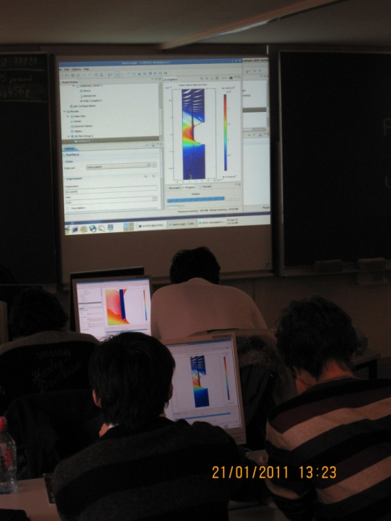
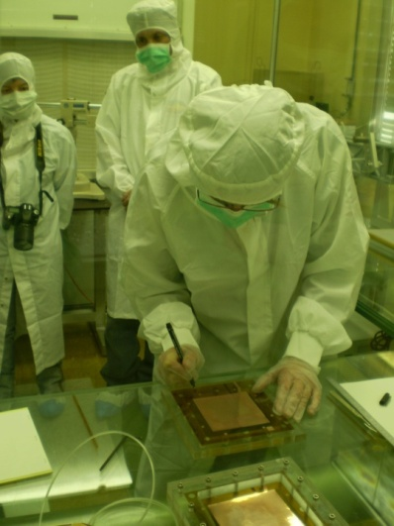
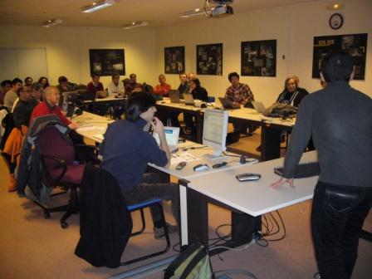
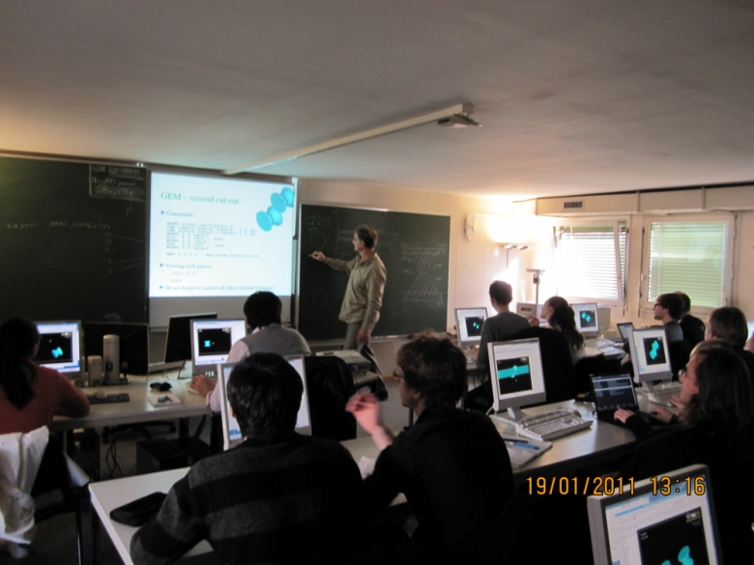

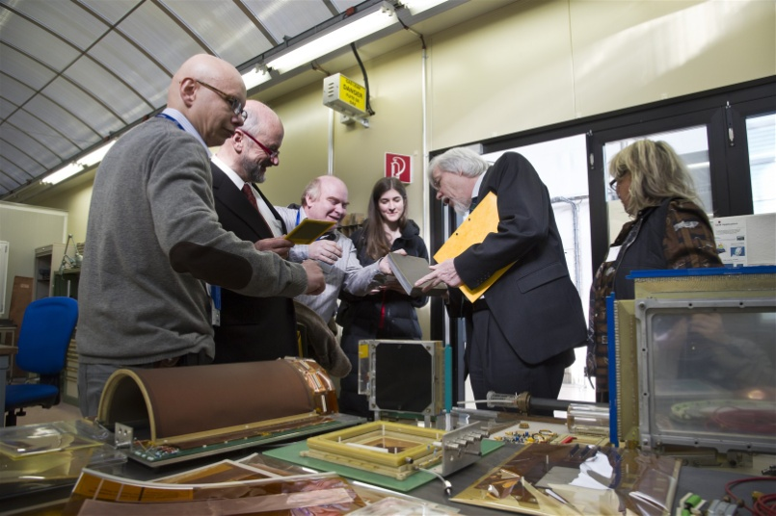
MPGD Training and Education Events
Feb. 2009 @ CERN: RD51 GEM & Micromegas & assembly and training
Jan. 2010 @
RD51 Simulation School
Contributions to the
EDIT School:
2011 @ CERN; 2012 @ Fermilab
RD51

Slide 10
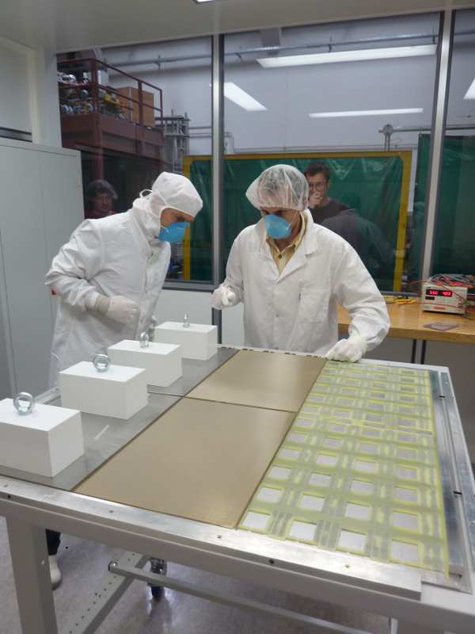
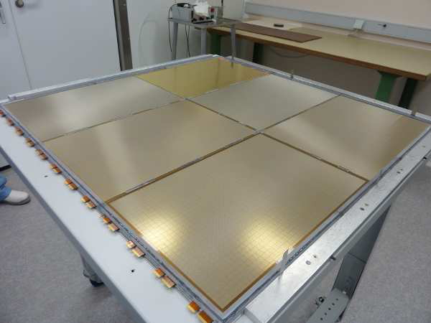
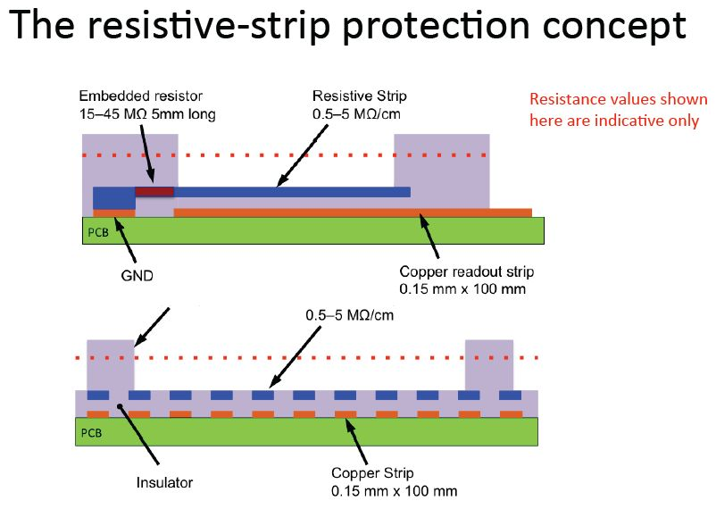
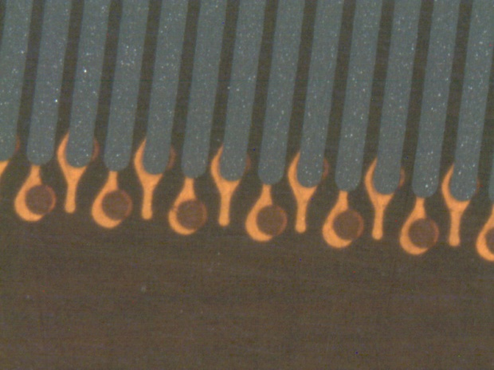
WG1: Large Area Detectors – “Bulk Micromegas” Technology
Bulk Micromegas:
PCB
lamination
Mesh deposit
lamination
ILC DHCAL (Large area MM 1m² prototype:
(6 Bulk of 32 *48 cm²)
development
Since 2010: “Resistive Bulk Micromegas”
Technology
Spark neutralization and/or suppression
Resistive strip parallel to readout strips
Uniformity, robustness, easy fabrication,
large area detectors & small dead area→
“Full path of industrial production”

Slide 11
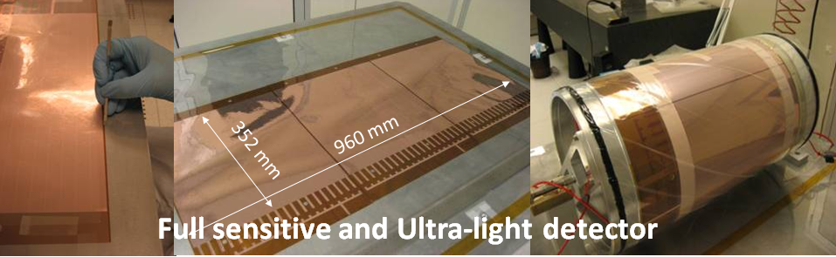
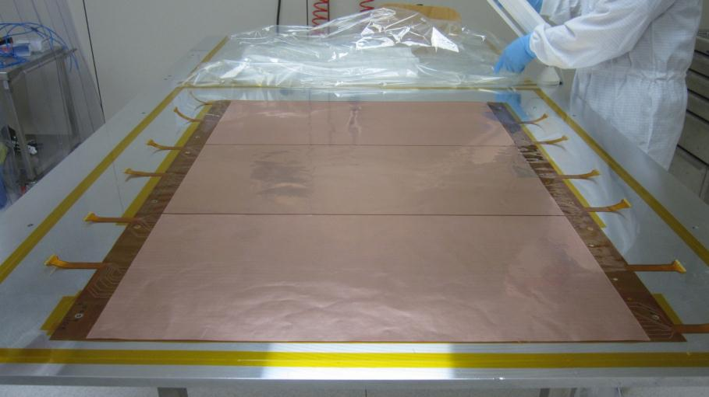
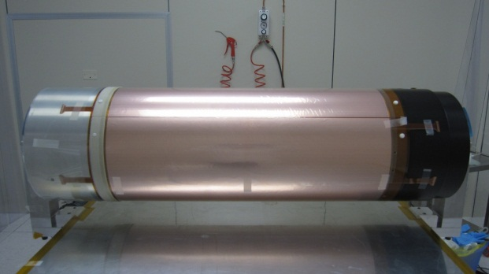
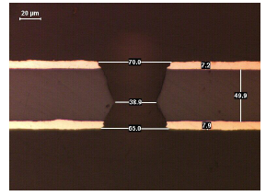
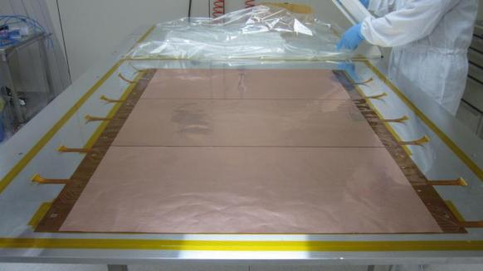
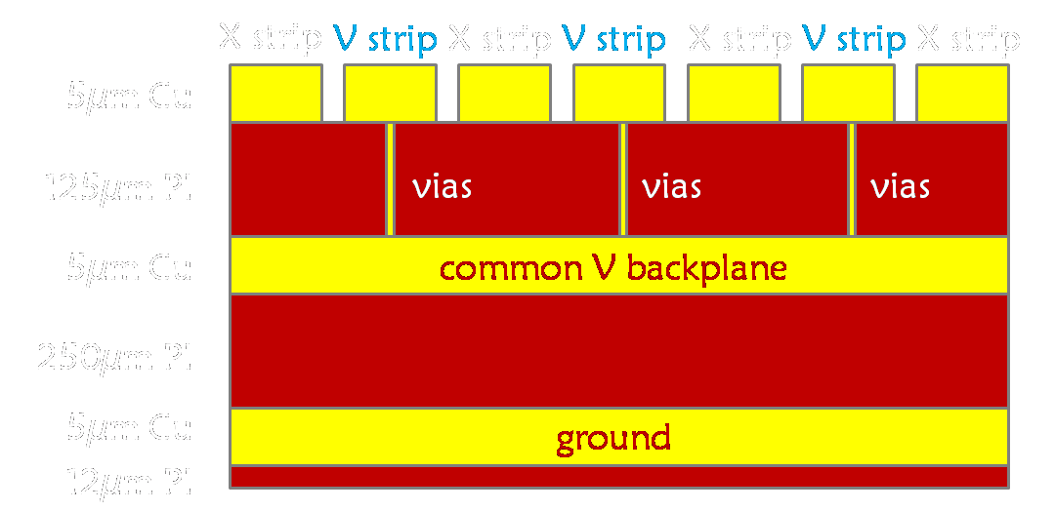
WG1: Large Area Detectors – Single Mask GEM Technology
Since 2009: Single Mask GEM:
Large Area Cylindrical GEM Detectors for KLOE2 Tracker:
Chemical
Polyimide
etching
Copper
electro etching
Stripping
Second
Polyimide
etching
Result
KLOE2: 3 GEM foils spliced (120 * 70 cm²)
The readout is a multilayer flexible circuit on a polyimide substrate providing a 2-dim point with XV strips at 650 µm pitch

Slide 12
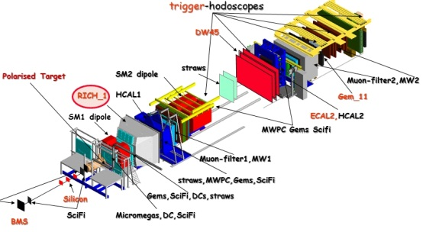
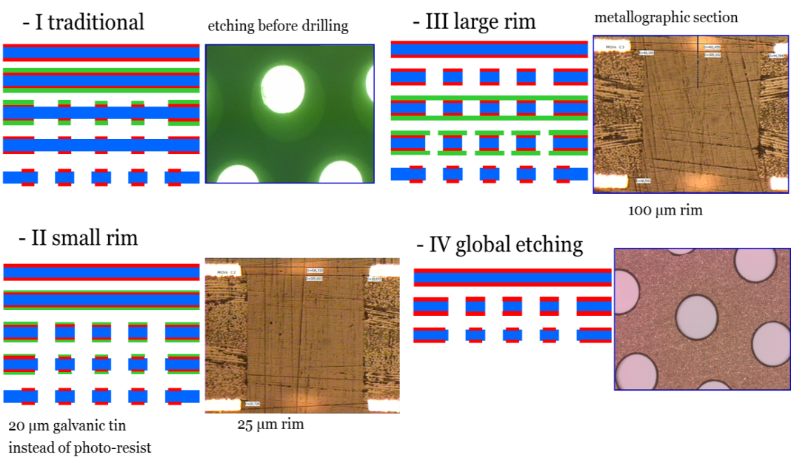
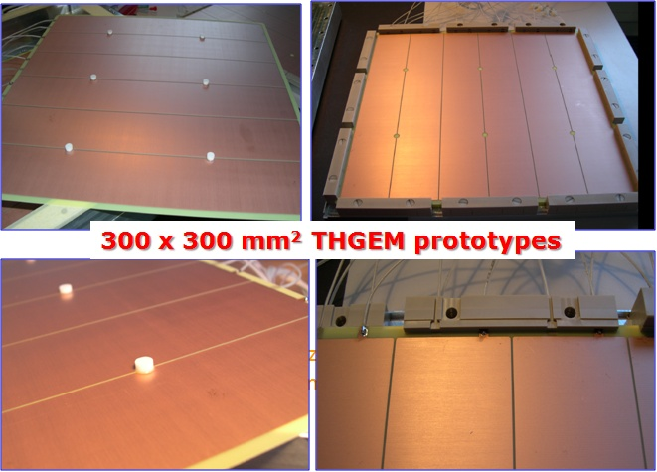

WG1: Large Area Thick-GEM for Photon Detection in COMPASS RICH 1
THGEM
GENERIC
R&D:
Novel Photon Detectors based on MPGDs offer:
Reduced photon and Ion backflow (IBF)
Intrinsically fast gaseous detectors
Reduced IBF in triple THGEM:
  Aligned holes : ~ 20%
  Staggered holes : < 5%
  Flower configuration: 2 THGEM layers: <5%
“Flower THGEM” configuration:
THGEM 1 - holes of 0.6 mm diameter, 1.2 mm pitch
THGEM 2 - holes of 0.3 mm diameter, 0.6 mm pitch, with 1/3 of the holes missing:
the ones below the THGEM 1 holes
This configuration
provides charge
splitting and allows
for ion backflow
minimization
60 x 60 cm² THGEM Prototypes

Slide 13
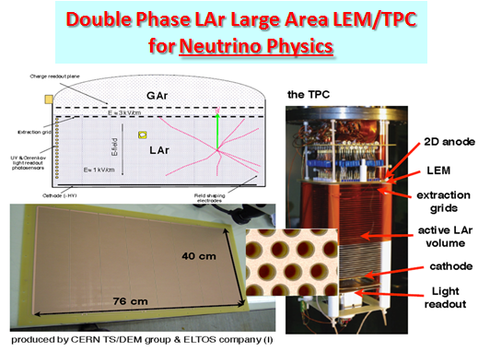
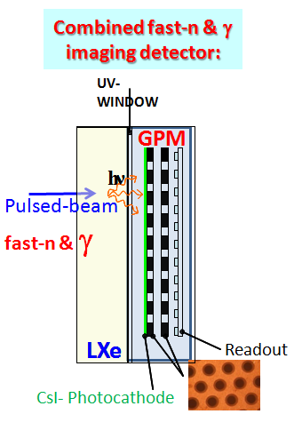
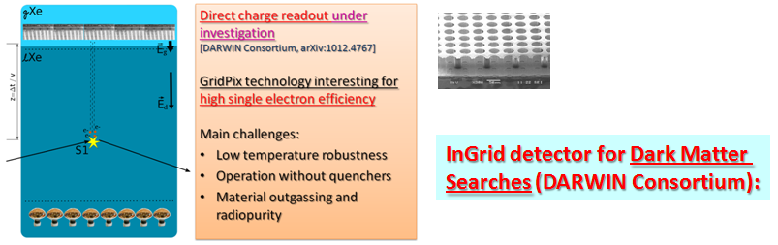
WG2: Physics Issues: Growing Demand for the Cryogenic MPGDs (LAr, LXe)
… MPGD are used/proposed for dark matter & rare event searches and neutrino physics

Slide 14
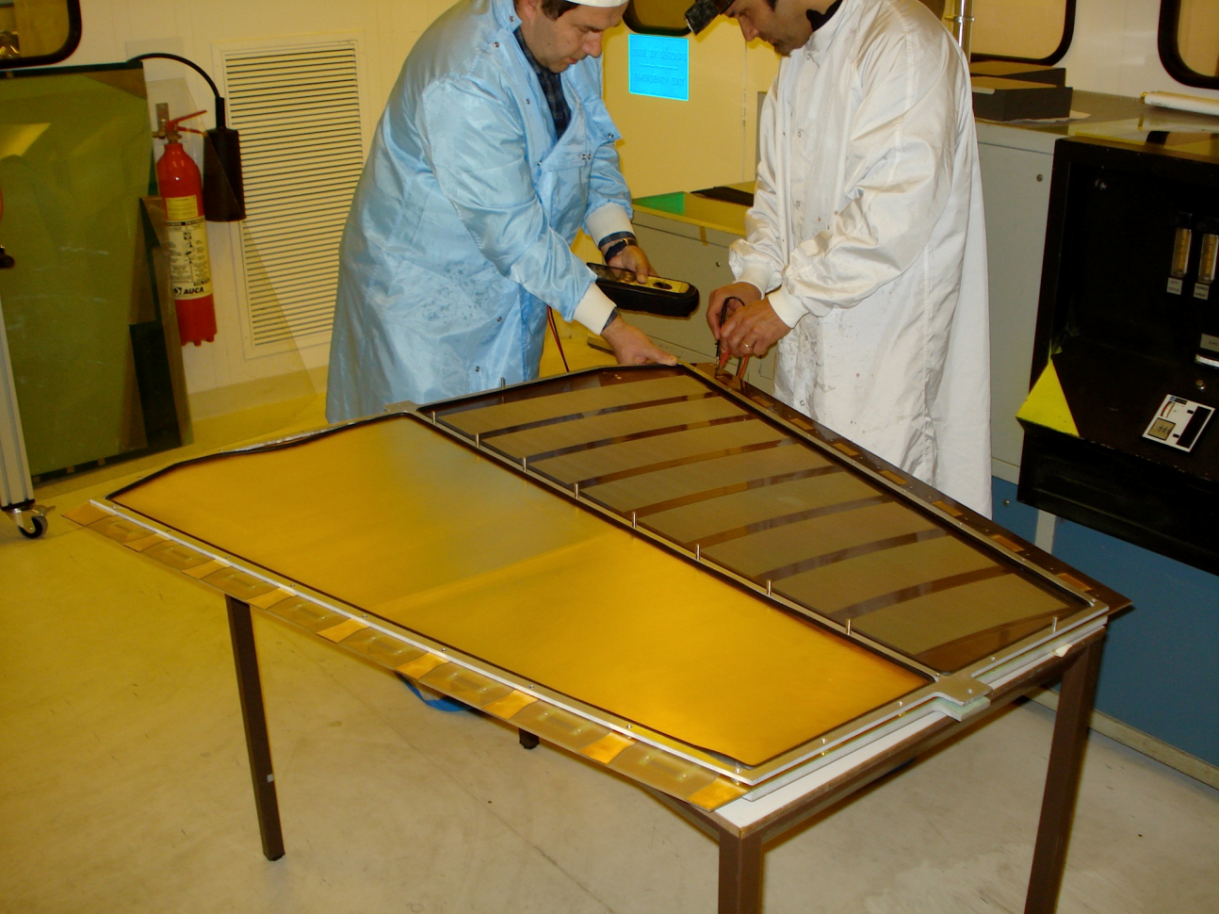
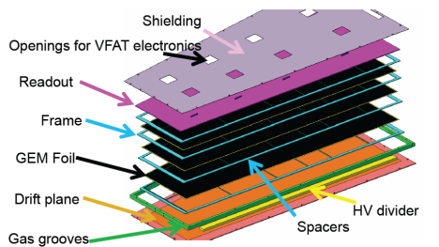
WG3: MPGD Technologies for Energy Frontier (sLHC, LC)
Ongoing R&D Projects using MPGDs in the framework of HEP Experiments
 | Vertex | Inner Tracker | PID/ photo- det. | EM CALO | HAD CALO | MUON Track | MUON Trigger
ATLAS | GOSSIP/InGrid | GOSSIP/InGrid |  |  |  | Micromegas | Micromegas
CMS |  |  |  |  |  | GEM | GEM
ALICE |  | TPC (GEM) | VHPMID (CsI-THGEM)
Linear Collider |  | TPC(MM,GEM, InGrid) |  |  | DHCAL (MM,GEM,THGEM)
ATLAS Micromegas:
On a road to large-area detectors:
(1.2 * 0.6 m²)
CMS GEM:
Trapezoidal GEM Prototype (99 x 45-22 cm2)

Slide 15
WG3: Growing Demand for the Micro-Pattern Gaseous Detectors
… MPGD are mostly used/proposed for high-rate tracking and photodetectors
COMPASS Upgrade:
Micromegas and GEM detectors for high-rate tracking
Photon Detectors Using THGEM technology for RICH 1
KLOE2 Upgrade:
Large-area cylindrical GEMs for Inner Tracker
RHIC Upgrades:
GEM Tracking for STAR Experiment
GEM Tracking for PHENIX Experiment(+ drift micro-TPC);
development of Ring Imaging version of HBD for particle ID
Future JLAB Projects:
Thin-Curved Micromegas for JLAB/CLAS12
GEM Tracker for JLAB/Hall A High Luminosity (SBS) experiments
Future FAIR Facility:
GEM Tracker and GEM TPC for the PANDA Experiment
GEM/Micromegas tracking in CBM Muon Chamber (MUCH)
Future Electron - Ion Collider Facility:
Tracking and particle ID detectors based on MPGD-technology
… not even a complete list …

Slide 16
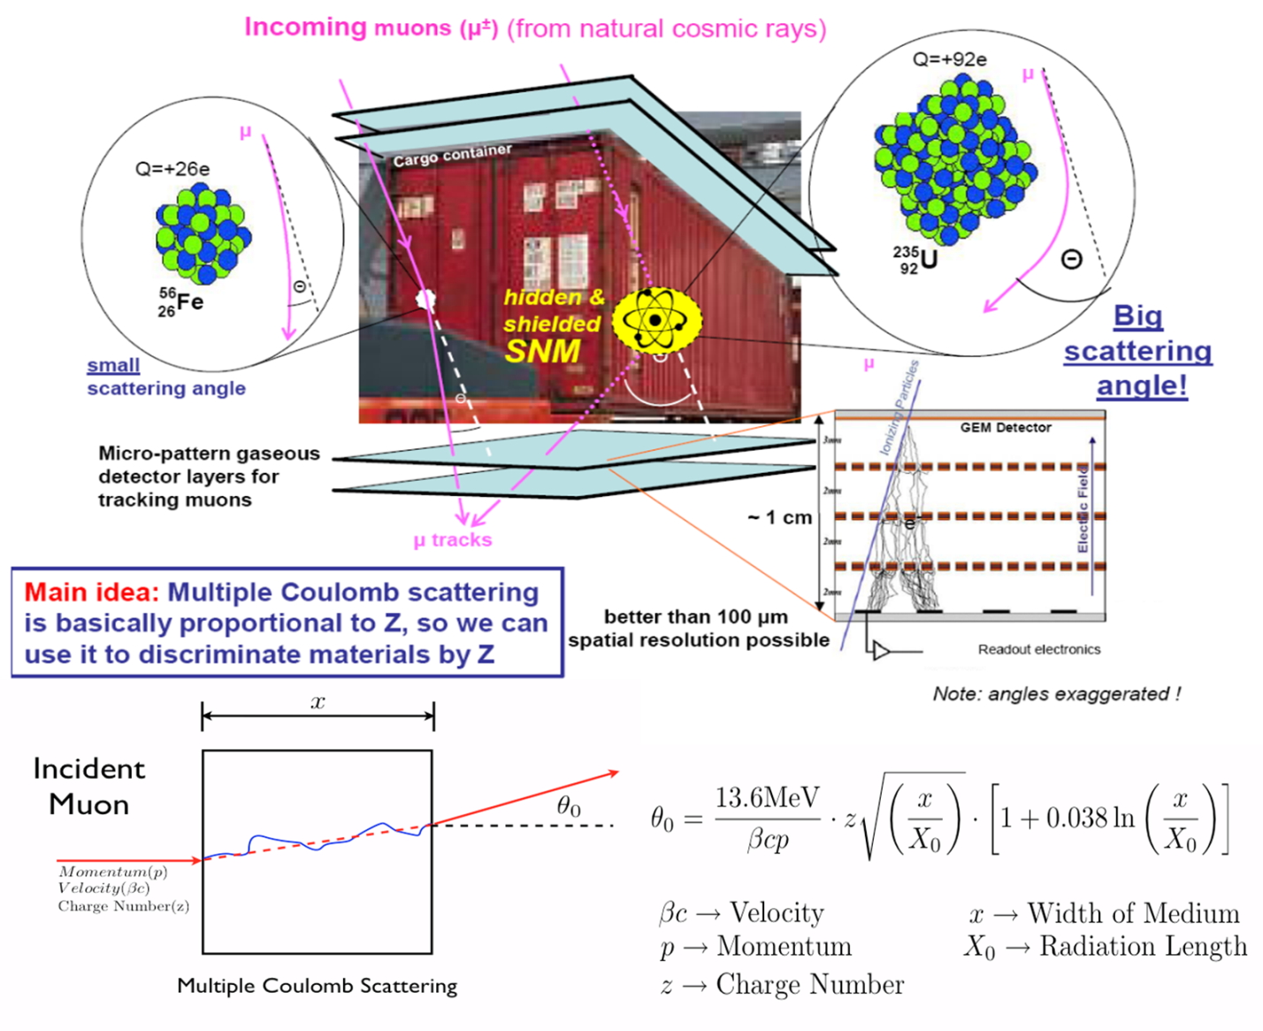
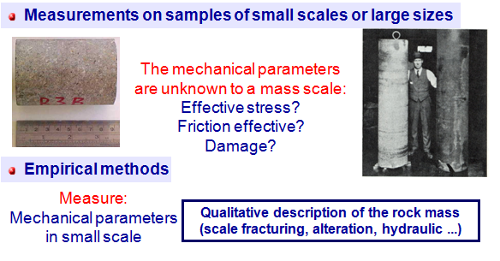
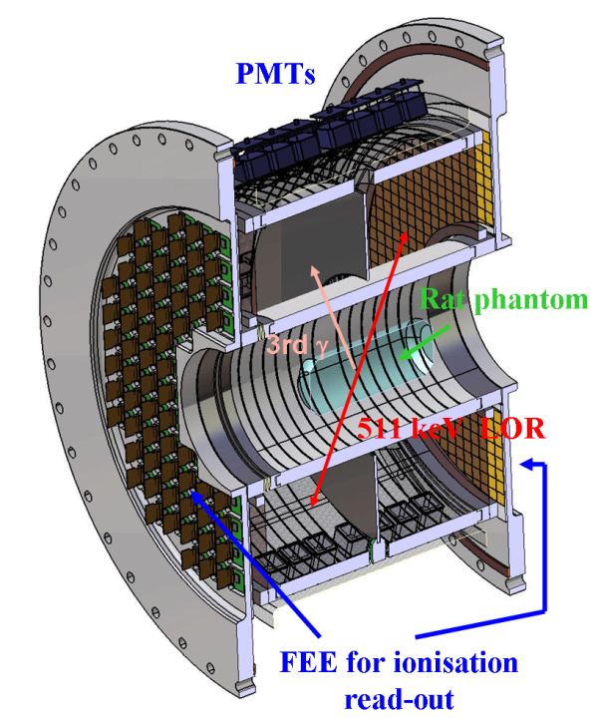
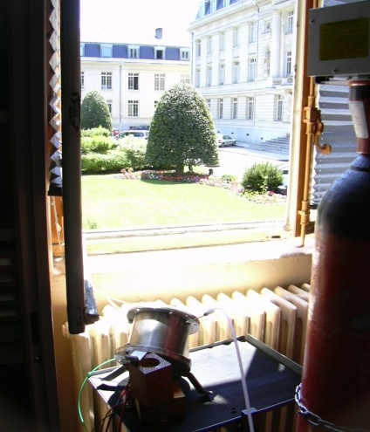
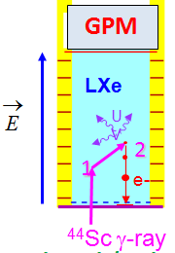
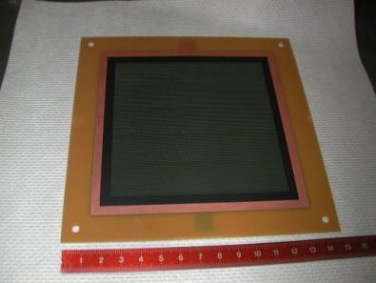
WG3: Spin off is important key word for the HEP labs to survive …
Cosmic Ray Muon Tomography
Using GEMs for Homeland security
T2DM2: Temporal Tomography
Densitometric by the Measure of Muons
Technology
RD51
Technology
Liquid xenon detectors for functional medical imaging
CsI-RETGEM for UV
flame detection
Applications area will benefit from the technological developments developed by the RD51
The responsibility for the completion of the application projects lies with the institutes themselves

Slide 17

RD51 WG4: MPGD Simulation Tools
Focus on providing techniques for calculating electron transport in small-scale structures
The main difference with traditional gas-based detectors is that the electrode scale
(~ 10 μm) is comparable to the collision mean free path
1) Development and Maintenance of Garfield++:
Garfield++ is a collection of classes for the detailed simulation of small-scale detectors.
Garfield++ contains:
- electron and photon transport using cross sections provided by Magboltz
- ionisation processes in gases, provided by Heed and MIP
- ionisation and electron transport in semi-conductors
- field calculations from finite elements, boundary elements, analytic methods
- Magboltz cross sections (Ar, Xe, He, Ne; GeH₄, SiH₄, C₂H₂F₄ ) are frequently
updated in collaboration with LXCAT (http://www.lxcat.laplace.univ-tlse.fr)
2) Simulation Improvements:
- Penning transfers; gain fluctuations; Neutron detection; Photon feedback; VUV fluorescence
3) Modeling for MPGD Applications:
- Micromegas transparency
- GEM gain and charging up
- IBF for TPC Applications (e.g. ALICE GEM TPC)

Slide 18
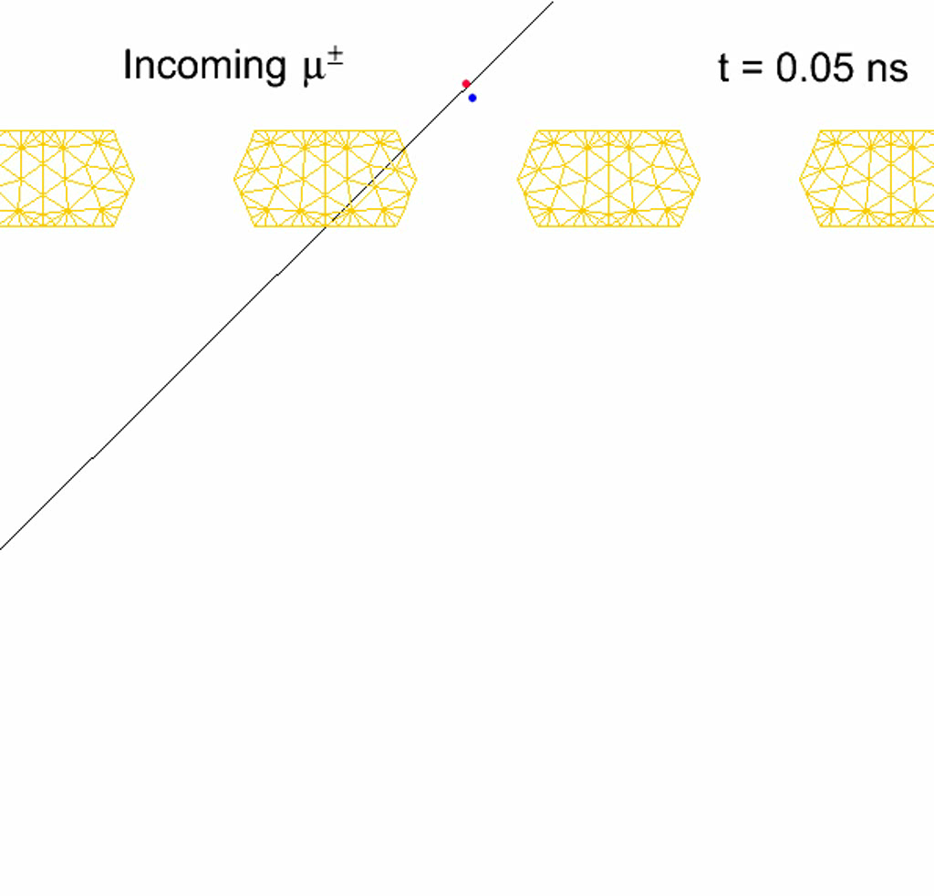
WG4: MPGD Simulation Tools (Avalanche Simulation in GEM)
Animation of the avalanche process
(monitor in ns-time electron/ion
drifting and multiplication in GEM):
electrons are blue, ions are red, the
GEM mesh is orange
ANSYS: field model
Magboltz 8.9.6: relevant
cross sections of electron-matter interactions
Garfeld++: simulate
electron avalanches
Sven Dildick,
Heinrich Schindler,
Rob Veenhof
http://cern.ch/garfieldpp/examples/gemgain

Slide 19
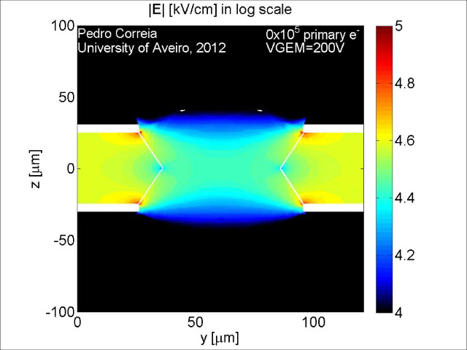
WG4: GEM Charging-Up Simulation
Electric Field Intensity during
the charging-up process:
each iteration correspond to
the number of primary electrons
that already reached to the hole
ANSYS: field model
Magboltz 9.0.1: relevant
cross sections of electron-matter interactions
Garfeld++: simulate
electron avalanches
Pedro Correia
Rob Veenhof
Charging effects are much smaller after (100 – 150) *10⁵ avalanches
→ GEM gas gain stabilizes

Slide 20






WG5: Development of Scalable Readout System (SRS) for MPGD
Development of a portable multi-channel readout system (2009-2012):
Scalable readout architecture: a few hundreds channels up to very large LHC systems (> 100 k ch.)
Project specific part (ASIC) + common acquisition hardware and software
Physical Overview of SRS:
Scalability from small to large system
Common interface for replacing the chip
frontend
Integration of proven and commercial
solutions for a minimum of development
Default availability of a very robust and
supported DAQ software package
ADC frontend adapter
for APV and Beetle chips
ADC plugs into FEC to make a
6U readout unit for up to 2048
channels
FEC cards (common):
Virtex-5 FPGA, Gb-Ethernet, DDR buffer, NIM and LVDS pulse I/O, High speed Interface connectors to frontend adapter cards
Frontend hybrids:
so far all based on
APV25 chip, VFAT,
Beetle, and Timepix
being designed

Slide 21

WG6: CERN Workshop Upgrade for the MPGDs
Today, CERN-MPGD workshop is the UNIQUE MPGD production facility (generic R&D,
detector components production, Q&A quality control)
Future Upgrade of the workshop has been approved by CERN management (Nov. 2009):
New infrastructure to fabricate 2x1m Bulk Micromegas and 2x0.5 m GEMs is delivered to
CERN; installation to be completed in September 2012
Large Area Detectors: ATLAS Muon System Upgrade (Micromegas) and CMS Muon System
Upgrade (GEM) has been approved as “official R&D projects” (April/May 2012)
2009 RD51 Survey:
2012 Status/Machine Delivery:

Slide 22



WG6: MPGD Technology Offer for Industry
Pooling of RD51 developments as a basis
for common technology offer:
2007- 2013:
Technology Transfer – GEM licenses signed:
Scalable Readout systems:
TECH-Etch, signed 06/03/2013
China Institute of Atomic Energy, signed 10/01/2012
Sci Energy, signed 06/04/2009
Techtra, signed 09/02/2009
CDT, signed 25/08/2008
PGE, signed 09/07/2007
Example
Technology Transfer - MM license:
Both CEA and CERN will be entitled to
grant licenses on Micromegas technology
(based on co-ownership agreement)
Licenses for ELTOS & CIREA for MM industrialization are under preparation

Slide 23




WG6: MPGD Technology Industrialization
Technology Industrialization → transfer “know-how” from CERN workshop to
Industrial partners for MASS PRODUCTION
THGEM Technology: ELTOS S.p.A (Italy), PRINT ELECTRONICS (Israel)
Micromegas Technology
TRIANGLE LABS (USA, Nevada)
ELTOS S.p.A. (Italy)
SOMACIS (Italy, Castelfidarco)
CIREA (France, CHOLET)
GEM Technology:
Tech-ETCH (USA, Boston)
Scienergy (Japan, Tokyo)
Techtra (Poland)
POTENTIAL
PARTNERS:
2011 - 2012: Industrial test runs for GEM and Micromegas Technology
First evaluation of 10*10 cm²
GEM Foils and Bulk MMs
New Flex
Eltos

Slide 24




WG7: Common Test Beam Facility at H4 SPS
Common RD51 infrastructure: GEM and MMs beam telescopes, HV, gas & power lines …
2012: 3-periods (14+14+13days)
(4 – 18 June, 9 – 23 July, 2 – 15 November)
Major WG7 organization & coordination efforts:
Y. Tsipolitis (NTU Athens) and E. Oliveri (CERN)
2012: New beam telescope with 5 resistive-strip μmegas chambers with x-y readout,
250 μm strips, active area 9x9 cm²
MM telescope
+ SRS Readout

Slide 25






WG7: Common Test Beam Facility at H4 SPS
GEM-TRT 1-period
CALICE-umegas 1 period
JLAB-GEM 1-period
CMS-GEM 3-periods
TOTEM-GEM 3-periods
RD51-umegas-telescope
RD51-GEM-telescope
2011
3-periods (9+12+6 days)
CMS-GEM 3-periods
JLAB-GEM 1-period
TOTEM-GEM 3-periods
COMPASS-THGEM 2 periods
DHCAL-THGEM 1 period
CALICE-umegas 1 period
GEM-TRT 1 period
~ 25 m
DHCAL-THGEM 1 period
COMPASS-THGEM 2 periods

Slide 26






RD 51 Collaboration Organization
Consolidation around common projects: large area MPGD R&D, CERN/MPGD
production facility, common electronics developments, software tools, beam tests
Large area (MM, GEM, THGEM)
Design optimization
(e.g. THGEM, Resistive MM)
“RD51 Common Projects”
(Generic R&D)
WG2:
WG1:
MPGD SRS
Electronics
WG5:
Software and
Simulation
RD51
WG4:
WG7:
WG6:
RD51 Common
Test Beam Facility
CERN MPGD Workshop
& Industrialization

