Slide 1
Accelerators at KINR
V.M. Pugatch
Institute for Nuclear Research
NASU, Kiev
LAL-KINR Seminar
22-24 May, 2013, Orsay

Slide 2
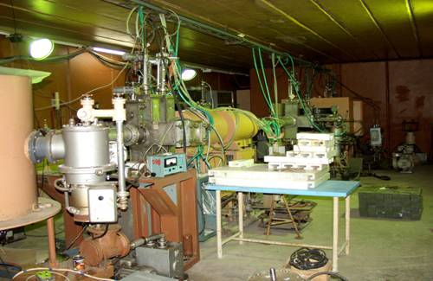
Isochronous Cyclotron U-240
The cyclotron permits to obtain the beams of protons with the slide control of their energy in the range of 8 – 80 MeV; the beams of deuterons with the energy 5 – 70 MeV and heavy ions up to the energy 140 Z²/A MeV, where Z is an ion charge, A is an ion mass. The energetic beam resolution is 10⁻² – 10⁻³

Slide 3
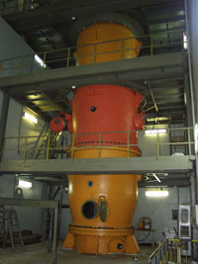
10 MV Electrostatic Tandem Accelerator.
The tandem accelerator was put into operation in 1996. The beams of protons and deuterons with the energy in the range of 3 – 10 MeV and the beams of α-particles with the energies 5 – 15 MeV may be obtained on the accelerator. The heavy ions may be accelerated in the tandem in the wide mass range. The beam flux reaches 5 mkA, monochromaticity is 10⁻³. The total area of two experimental halls is 50 m².

Slide 4
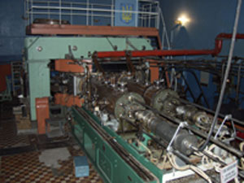
Cyclotron U-120
The beams of protons, deuterons and α-particles with the energies 6,8 MeV, 13,6 MeV and 27,2 MeV, respectively, may be obtained on the cyclotron . The highest flux of the beam reaches 50 mkA. The beam monochromaticity is 10⁻³. It is also possible to obtain the beams of nitrogen and carbon with the energies up to 1 MeV/nucleon.

Slide 5
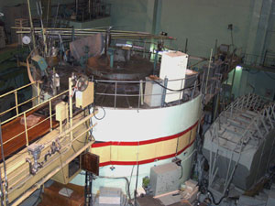
Research Reactor WWR-M
WWR-M is a pool-type reactor with the power 10 MW with the maximum neutron flux in the core up to 1,2 ∙ 10¹⁴n/cm² ∙ s. The reactor has 27 vertical and 10 horizontal technological channels for performing scientific and applied research.

Slide 6
Department of Nuclear Reactions
Experimental studies of nuclear reactions induced by the beams of light particles, heavy ions and sec-ondary radioactive nuclei at low and intermediate energies.
• Mechanisms of the binary and many-particle re-actions with light nuclei.
• The structure of weakly-bound nuclei with neu-tron and proton excess.
• The decay properties of nuclear unbound states produced in many-particle reactions.
• Resonance spectroscopy of exotic radioactive nuclei.

Slide 7
Nuclear Structure Department
Experimental studies of structure and properties of atomic nuclei exited states that are filled as in radioactive decay, as in charged particle beams.
Study of nuclear reaction mechanism by isomer relation method and on charged particle beams.

Slide 8
Heavy Ions Physics Department
Experimental research of nuclear reactions on the light and heavy beams and light targets.
Mechanisms of nuclear reactions and nuclear core structure.
Nucleus-nucleus interaction and its optical potential.
Exotic nuclei and reactions with exotic products.
Threshold and anomalous effects in scattering of nuclei.
Nuclear physics of few nucleon systems.

Slide 9
Heavy Ions Physics Department
new experimental data for nuclear scattering and reactions of one- and multinucleon transfer at interaction of light (deuterons, 3He, α-particles) and heavy (10,11В, 12С, 14N, 18O) ions with light nuclei is obtained.
Energy dependences of optical model parameters for stable and unstable nuclei were obtained using both as own as known from scientific literature experimental data of scattering and transfer reactions.
Important role of reorientation process at large angle scattering of nuclei with spin larger than ½ was found.
Important role of two-steps nucleons and light clusters transfers at charge exchange and multinucleon transfer reactions depending on nuclear structure were deduced.

Slide 10
High Energy Physics Department
HERA-B
LHCb
CBM
HEP instrumentation development

Slide 11
Nuclear-Atomic Processes Department
Experimental investigations of the static magnetic dipole and electric quadrupole moments of excited nuclei and study of the probabilities of electro-magnetic transitions.
On-line γ-spectroscopy on the beams of the charged particles and heavy ions.
Nuclear spectroscopy in the transfer reactions.
Development of the methods of nuclear microanalysis. Extension of their analytical possibilities by using the orientation effects in the crystalline materials.
Radiospectroscopic research of the radiation damages in the crystalline organic compounds.

