Slide 1

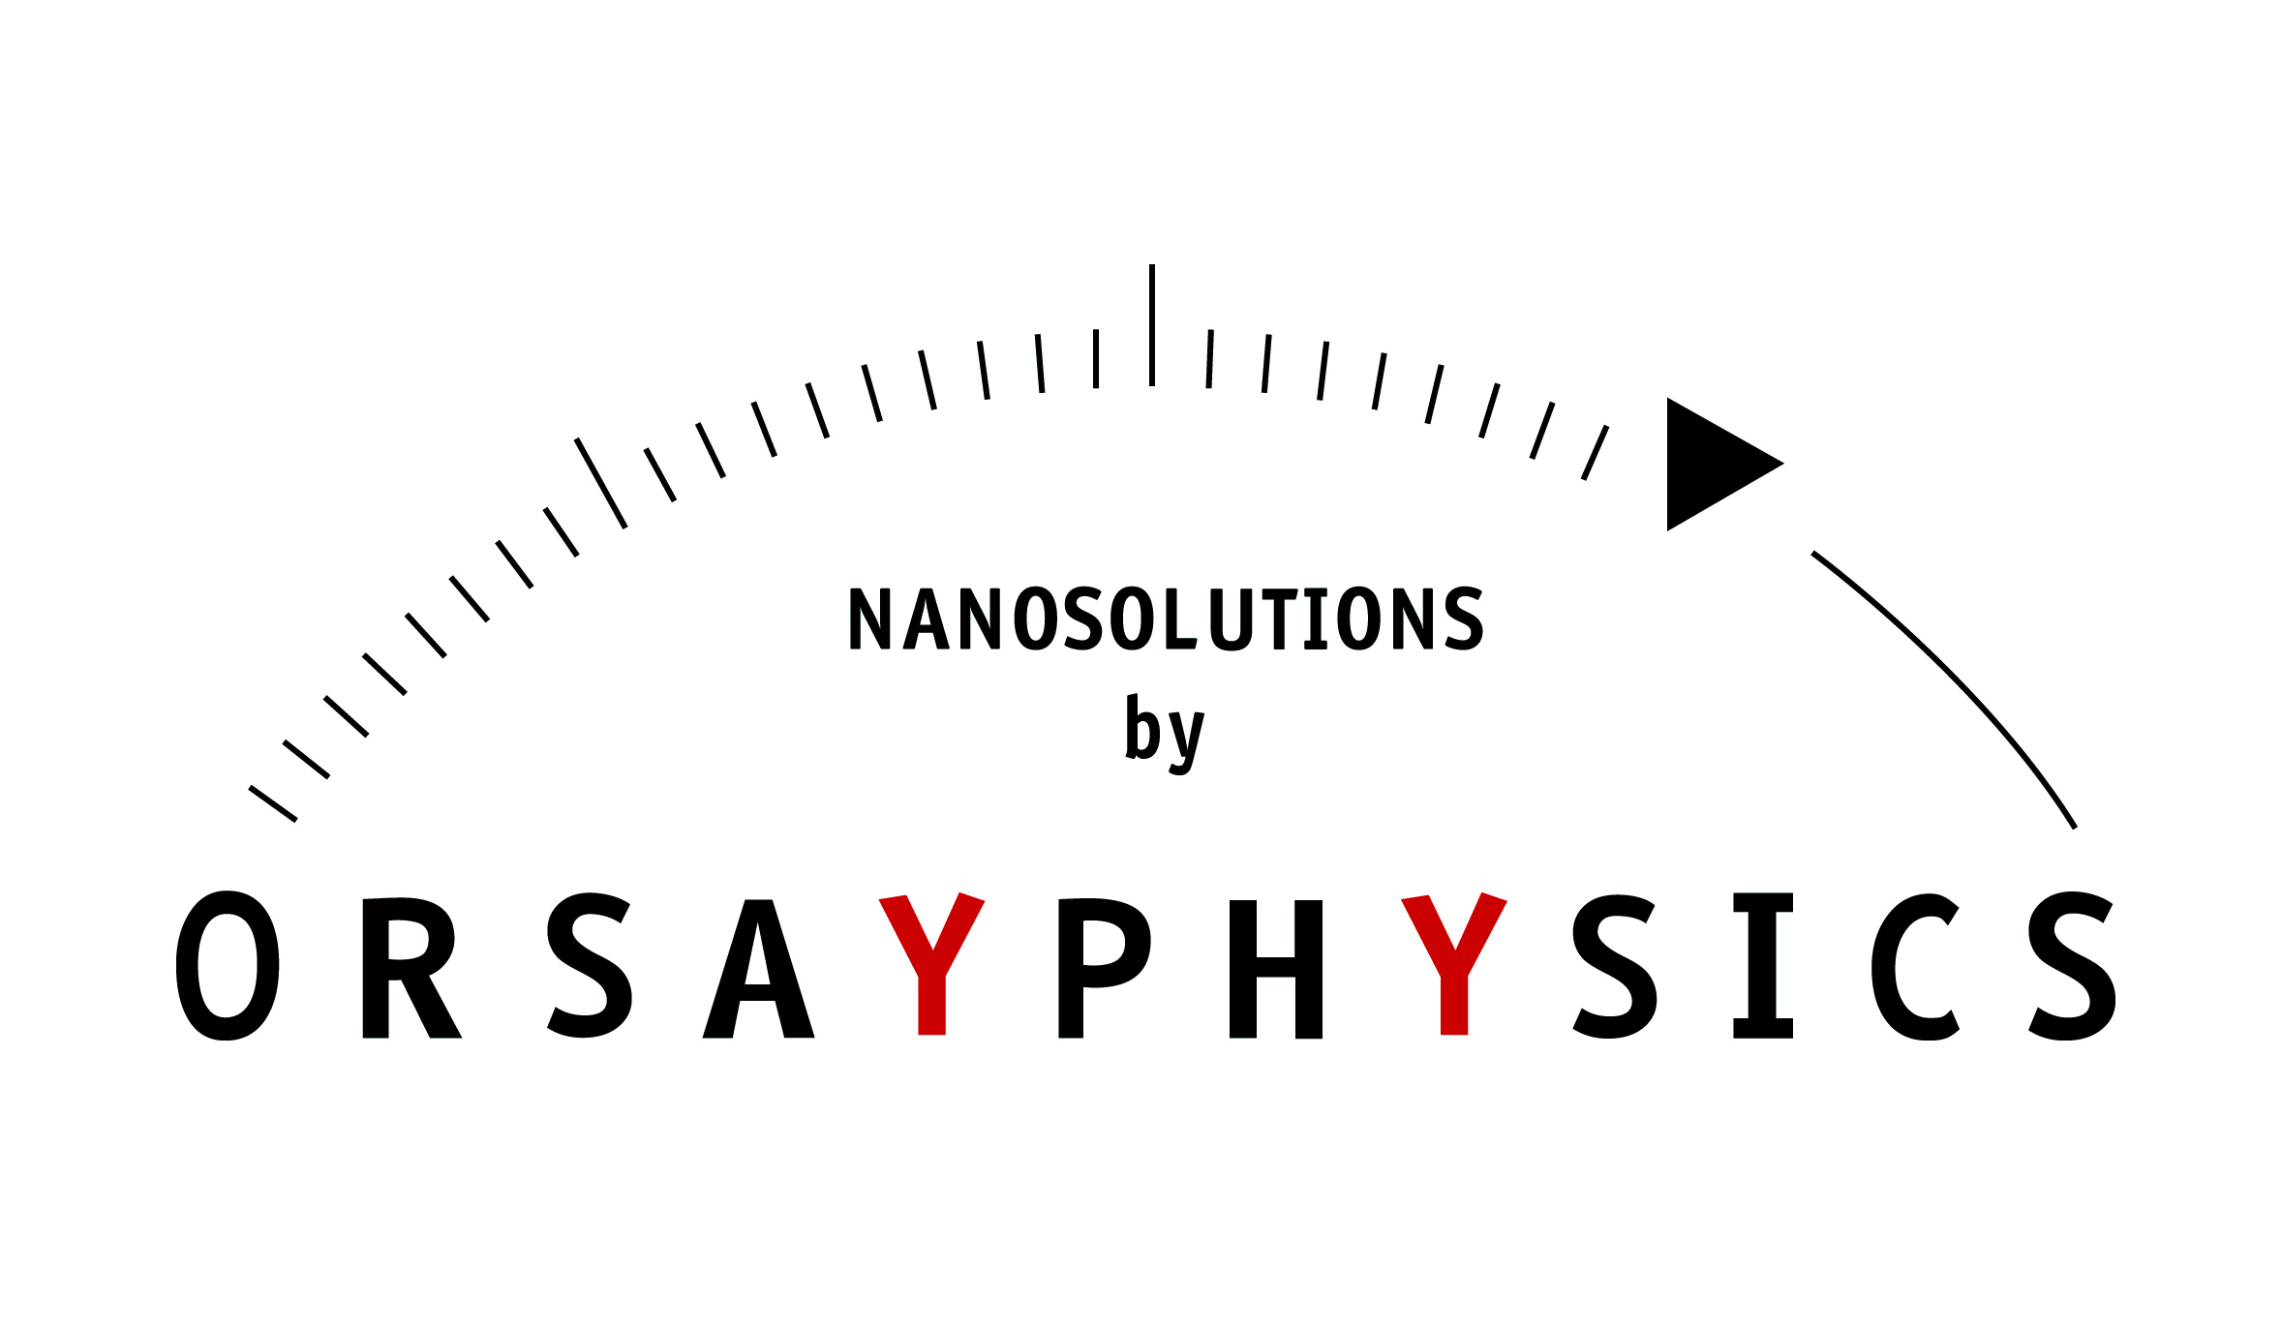

Equipex S. Della Negra

Slide 2
Introduction
ANDROMEDE : analysis by mass spectrometry of nano objects present on a surface with a spatial resolution of about 100 nm
    under vacuum
    near atmospheric pressure
Equipex obtained by S. Della Negra
OUTLINE
    Interest of clusters
    Orion and Pegase : precursors of Andromede
    Andromede
    IGLEX
    Schedule

Slide 3

Sketch
(M+/-H)^{+/-}
CN⁻
AuX^{+/-}
(2M+/-H)^{+/-}
Fragments
(3M+/-H)^{+/-}
Crater
Au
Synthesis region

Slide 4

Fast cluster ions
a unique way to deposit a large energy density in a solid
U ions at 1 GeV dE/dx 4 keV/Å
C₆₀ at 30 MeV dE/dx> 4 keV/Å
dE/dx (C_{n}) = n dE/dx (C₁)
U
GeV
C₆₀
R
e⁻
r
e⁻
e⁻
e⁻
Each carbon = 500 keV
Large range of electrons (R>100nm)
Large volume of transient energy deposition
Small range of electrons (r~ nm)
Small volume of transient energy deposition
SMALL DENSITY
LARGE DENSITY

Slide 5
Differences between Au₅ and Au₄₀₀⁴⁺
Au₅
Au₄₀₀⁴⁺
S.I.
S.I.
Neutrals
Neutrals
Au
10 nm
Damage zone

Slide 6
Influence of the cluster mass
at the same energy per charge
Increase of the S.I. Yield
Increase of the signal to noise ratio
Rapid Comm. Mass Spectrom., 18, 371-376 (2004)

Slide 7
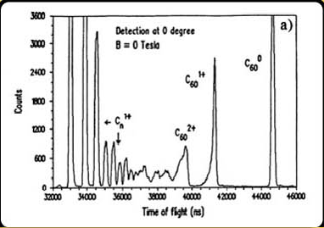
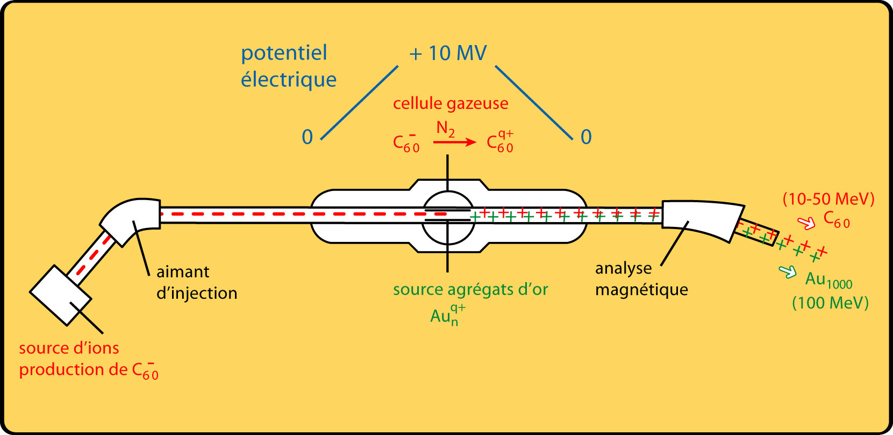
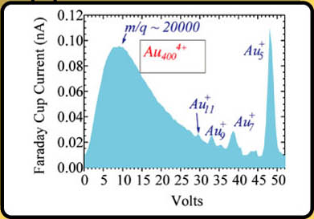
Orion project (1990-1993)
15 MV Tandem Accelerator
Electrical
Potential
Gas cell
L.E. pulsation
Injection
magnet
Gold cluster ion source
HE analyser
Sputtering Cs Ion source
Atomic clusters from C to Au
C₆₀⁻ ion production
Diagnostics:
XY slits
ToF (MCP)
Si detector
Faraday cup

Slide 8
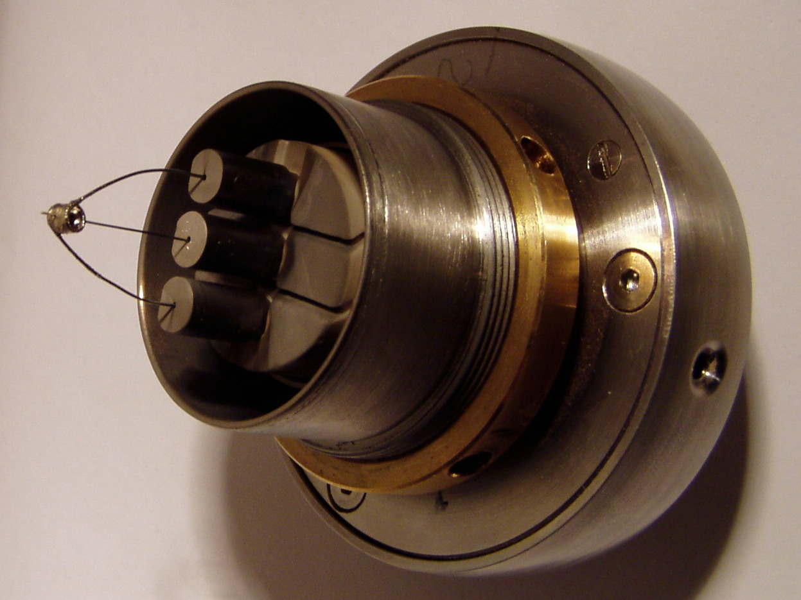
Gold and Bismuth ion source
filament
reservoir
needle (nm - µm)

Slide 9
Gold cluster impact on a metallic surface
Au_{n}
~200 keV/Au
Neutrals
Gold target
Phys. Rev. Lett. 80 (1998) 5433.
Phys. Rev. B 65 (2002) 144106

Slide 10
Massive clusters or nanodroplets
Au₄₀₀⁴⁺
Glycine sample
C₂H₁₅NO₂
Notes:
Emission yields of the negative ions emitted from a glycine target under the impact of Au_{100q}^{q+} as a function of the projectile energy
These yields are much greater than those obtained with SIMS

Slide 11
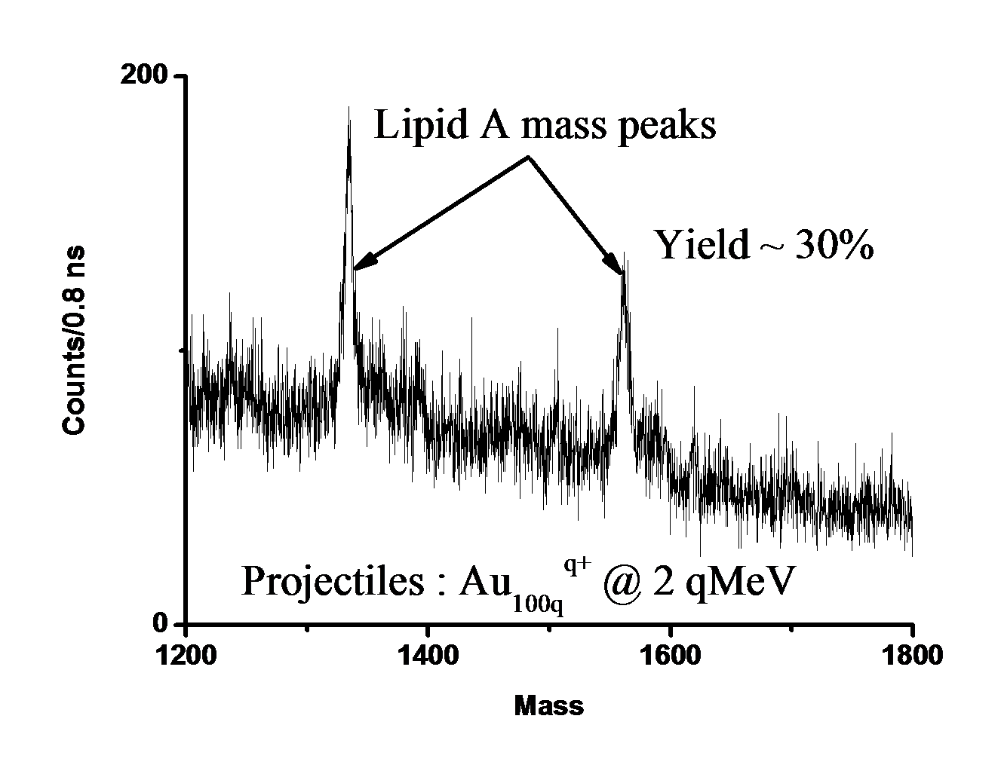
Time of flight spectrum (1)
Time of flight mass spectrum of the emitted negative ions from the Lipid A target under the impact of Au_{100q}^{q+} at 2 qMeV.
Notes:
1000 times higher than with commercial SIMS cluster probes

Slide 12
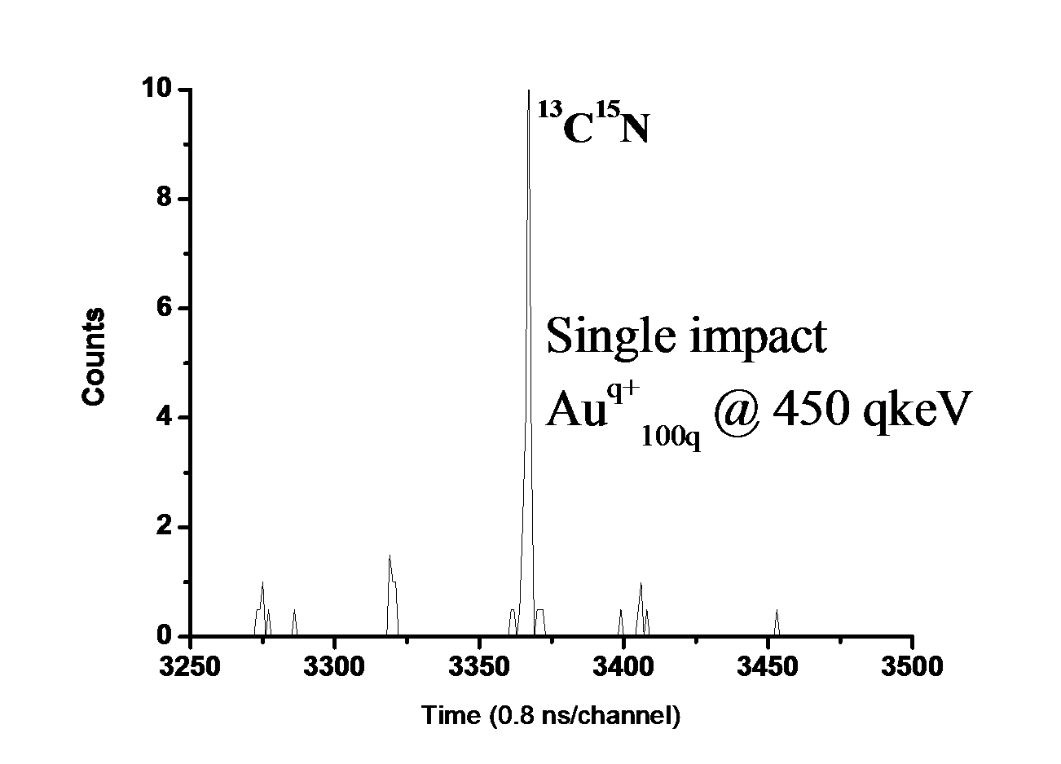
Time of flight spectrum (2)
Time of flight mass spectrum of the emitted negative ions from glycine target under a SINGLE impact of Au_{100q}^{q+} at 450 qkeV.

Slide 13
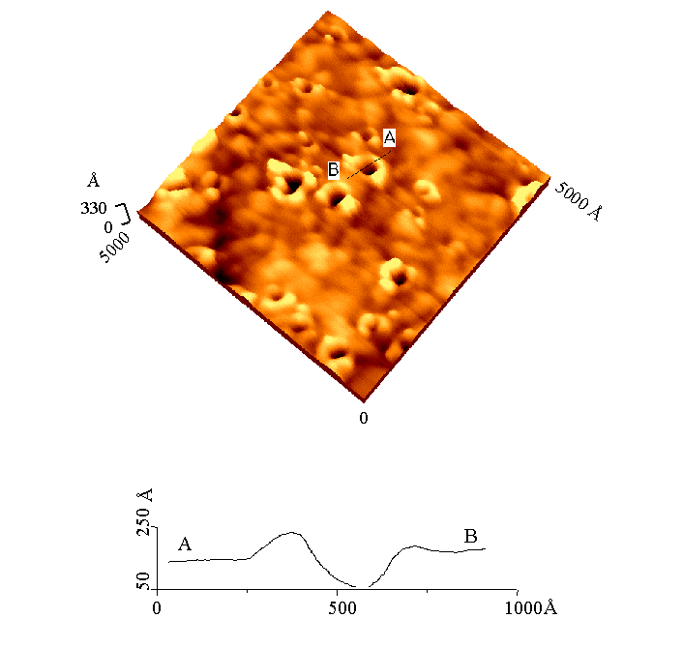
Gold cluster in the meV range
Atomic Force Microscope
Measurements
Au₁₁
E =1.4 MeV
Gold Target
Range = 120 Å
(dE/dx)nuc = 100 keV/nm
Notes:
Atomic force microscopy image of a gold surface bombarded with 1.4 MeV Au11 clusters.
10nm depth and 10 nm diameter

Slide 14

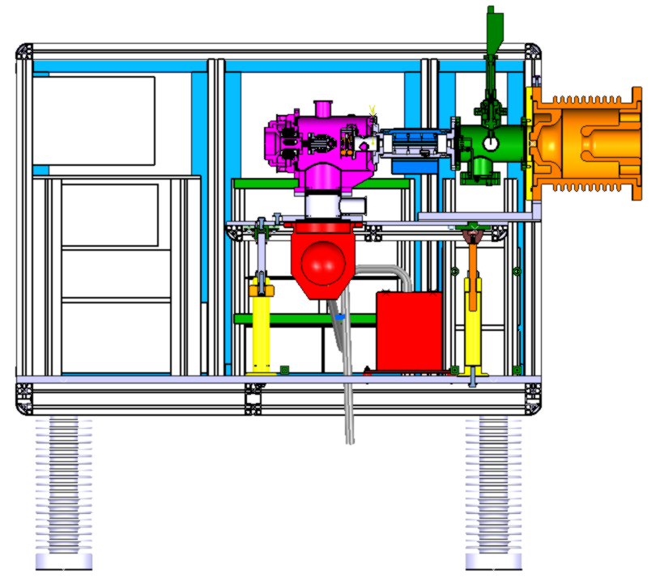
The Pegasus project
130 kV platform
NSF grant CHE –
0750377
IPNOrsay
S. Della-Negra,
J. Arianer, J. Depauw
Texas A&M U
S.V. Verkhoturov,
E.A. Schweikert

Slide 15
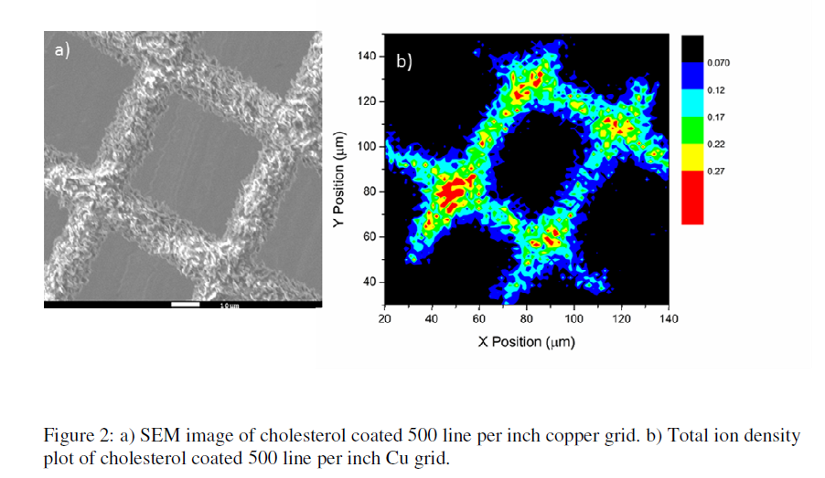

Electron emission microscope
III
MCP
L₃
CMOS camera
Fiber optics
L₂
Objective lens
L₁
Phosphor screen
II
MCP
Correction lens
IV
Anode
Micro-beam lens
Ion source
I
J. Phys. Chem. C, 2010, 114 (12), pp 5637–5644

Slide 16
Experimental setup

Slide 17

Work supported through the EQUIPEX program – Ministère de la recherche,
CNRS-IN2P3 and Université Paris Sud XI (ANR-10-EQPX-23)
Goal of Andromede : create a new instrument for the analysis by mass spectrometry of nano-fields and objects present on a surface with a spatial resolution of ~ 1 µm
Surface analysis at atmospheric pressure → mass spectrometry analysis of native hydrated biological surfaces
Impact of a Nano-particle accelerated in the MeV range → molecular information (mass and structure)
Very efficient alternative to SIMS.

Slide 18
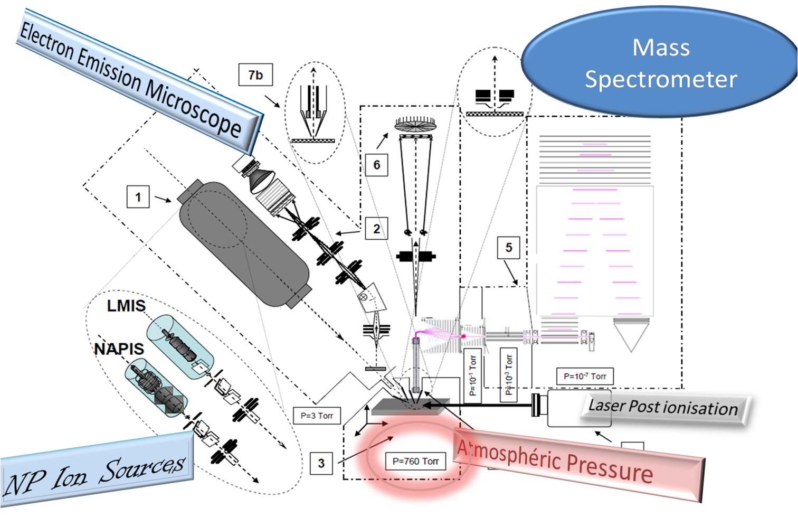
ANDROMEDE : schematics
Notes:
EEM localisation de l’impact, spectro de masse à temps de vol haute résolution sous vide et à pression ambiante, l’ionisation par laser non incluse dans le projet

Slide 19
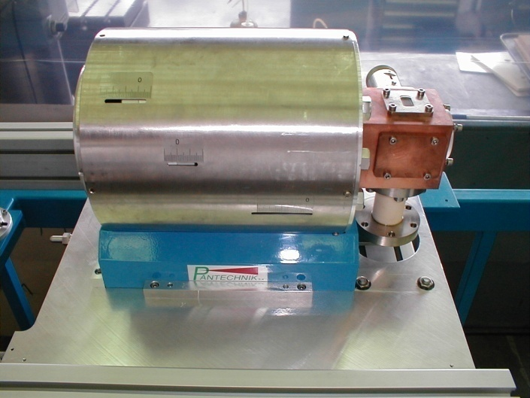
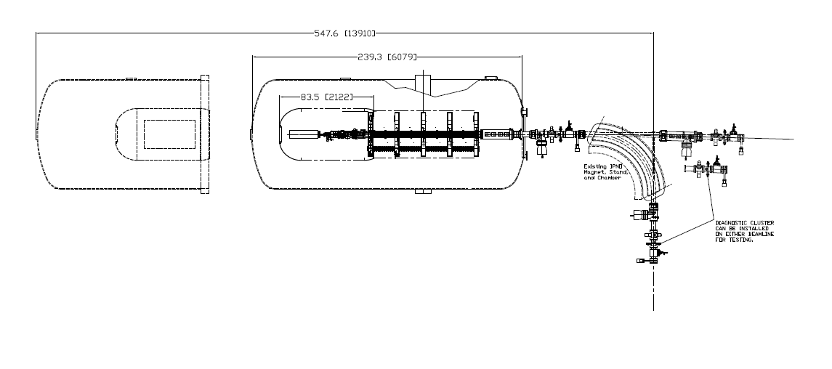
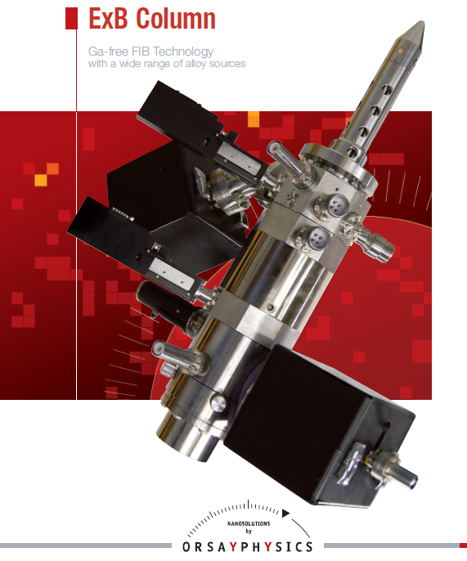
Andromede
NEC 4 MV Van de Graaff accelerator
10 GHz ECRI Source
Pantechnik
Cluster MeV-SIMS
&
……….
LMIS & NAPIS
OrsayPhysics
nuclear astrophysics
research
µ-IBA

Slide 20
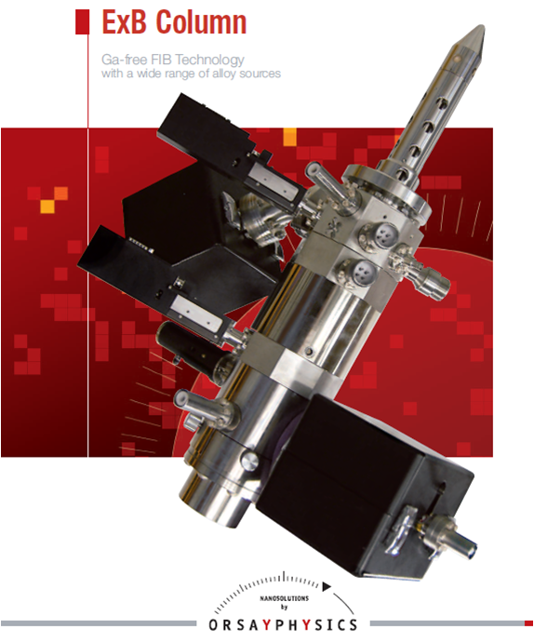
LMIS : cluster ion Source
  Cluster ion source : Orsay Physics (Fuveau, France)
  Positioning of the cartridge : ± 10 µm max
mass selection apertures
Wien filter
Intensities expected at 4 MV :
  > 20 nA Au⁺
  > 2 nA Au²⁺
  > 100 pA Au₄₀₀⁺
Beam diameter at 4 MV < 2 mm

Slide 21
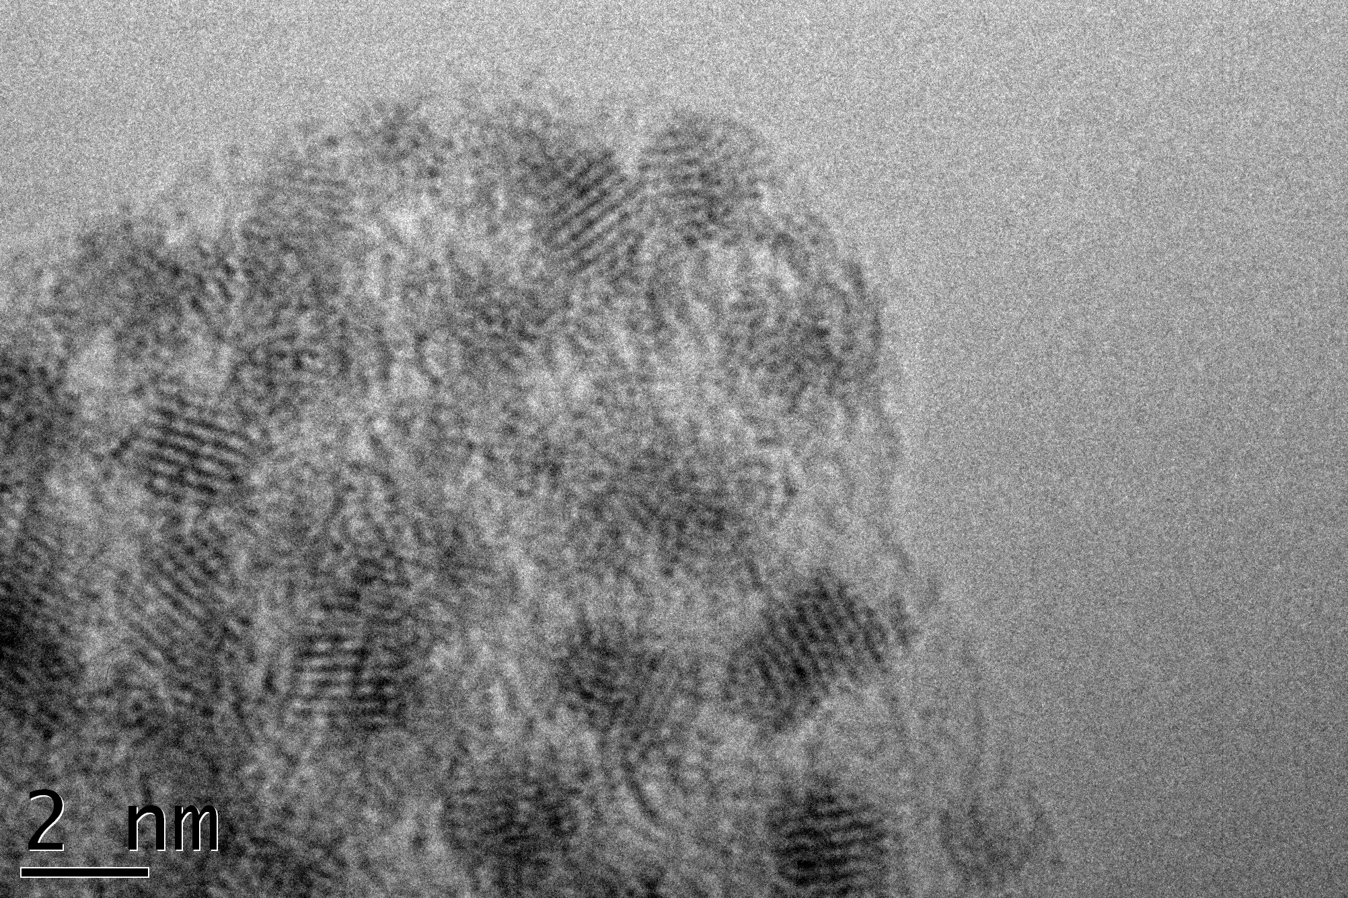

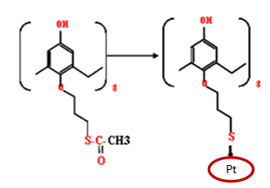
Napis : nanoparticle ion source
Collaboration IPNO – Orsay Physics - ICMMO
NAPIS will allow to increase the experiments possible with nano-particle beams.
The nano-particles are incorporated
in a conductive solid polymer,
melted by heating
Mono-dispersed Pt nano-particles produced by V. Huc (ICMMO)
Notes:
7 molécules de calixarènes fixent la taille de l’agrégat ~ nm Pt, image de HRTEM

Slide 22
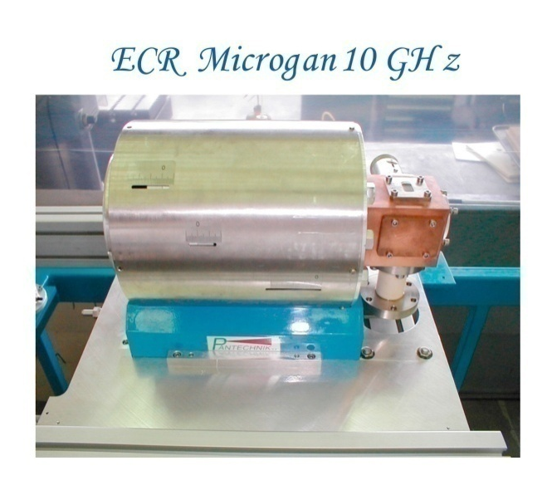
ECR ion source
  ECR ion source : Pantechnik (Bayeux, France)
          ⁴He⁺ 1.3 MeV 100 to 200 µA
          ¹²C⁺ 4 MeV 100 to 200 µA
          fullerenes C₆₀
          coronene C₂₄H₁₂
          decacyclene C₃₆H₁₈
      Optimization of the
      extraction optics to
      decrease the emittance
      Tests on the 20 kV Tancrede
      platform at IPNO

Slide 23
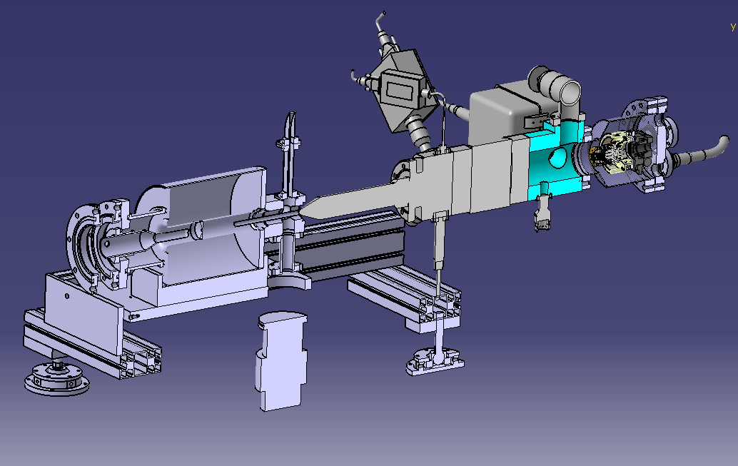
Multicharged clusters (1)
  LMIS + ECR configuration developed in collaboration between Orsay Physics and IPNO

Slide 24
Multicharged clusters (2)
Ionic column
RF 10 GHz
ECR
LMIS
0
U - ε
U
insulator
U
0

Slide 25
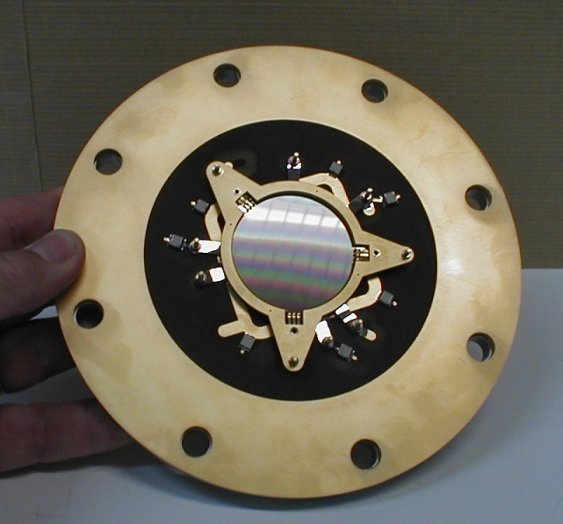
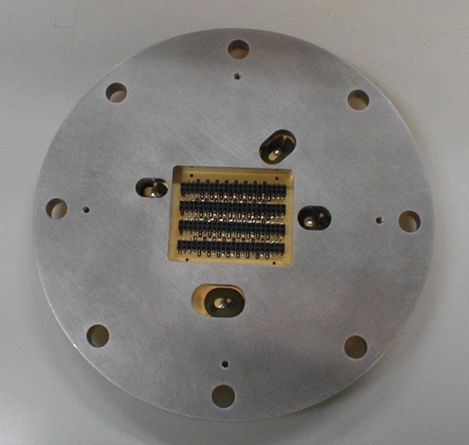
Analysis
Analysis chamber
  Sample holder : plate 50 x 50 mm
  Sample positioning at some 0.5 µm
  Manual introduction of the samples
  through a lock chamber
MCP detectors for spatial localization
(LAG) developed at IPNO
Acquisition system currently under
development at IPNO

Slide 26
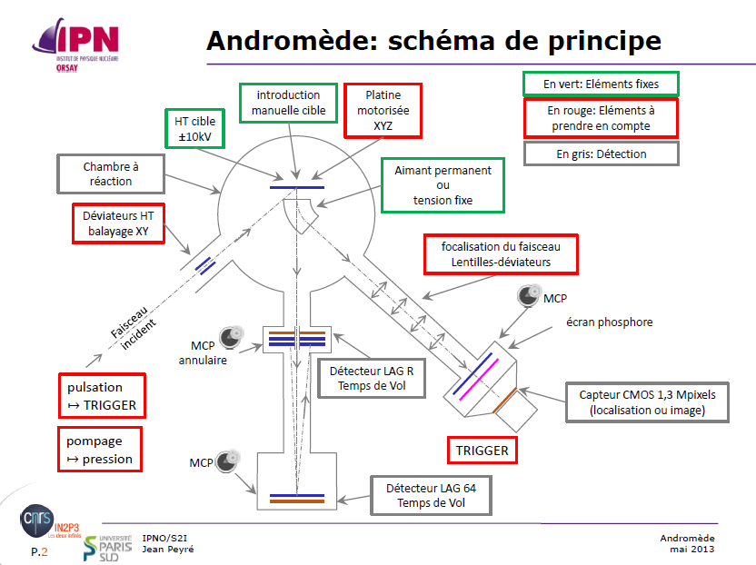
Schematics of the analysis chamber

Slide 27
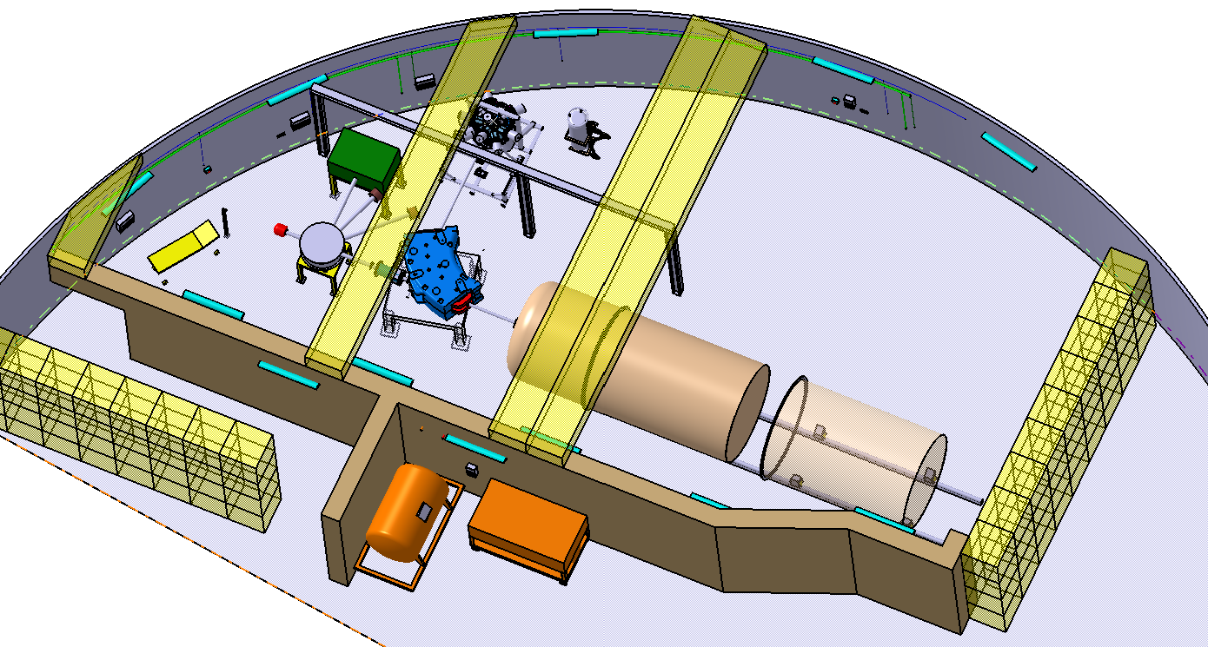
IGLEX

Slide 28

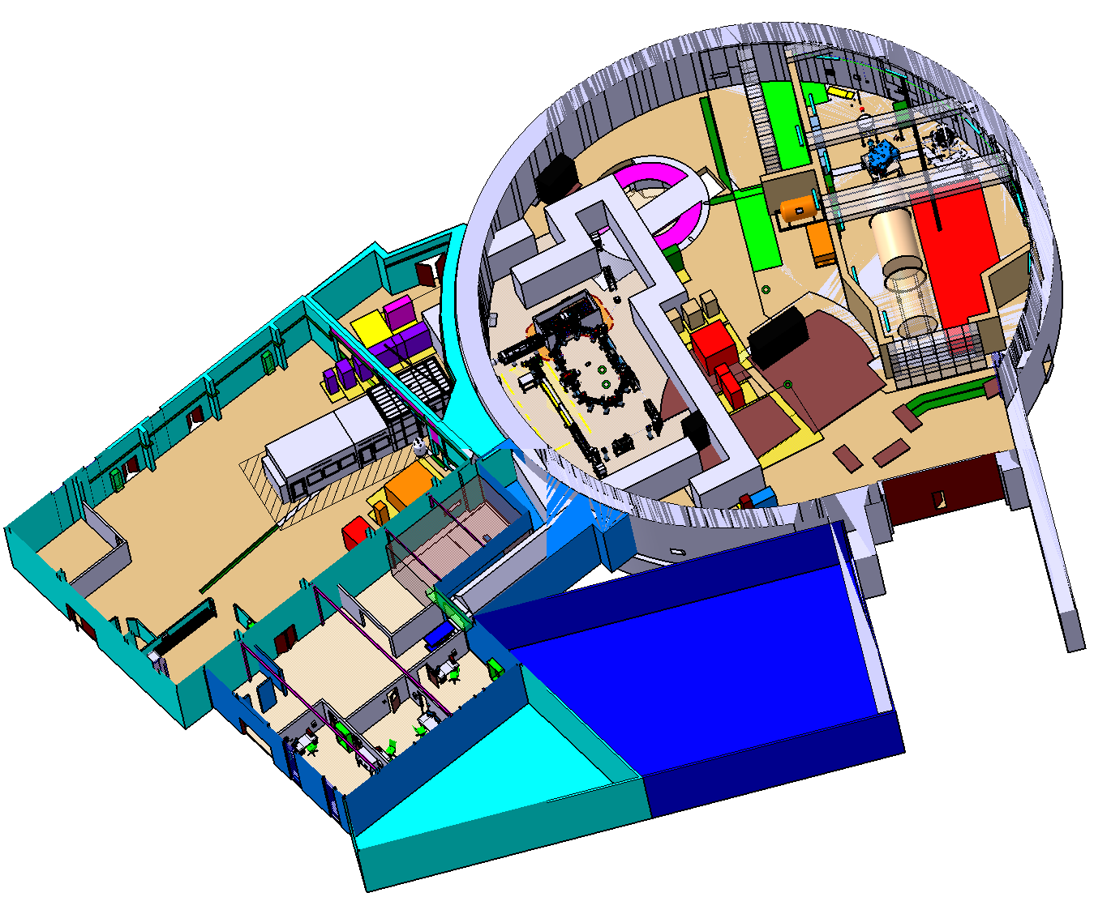


IGLEX

Slide 29
planning

Slide 30
S. Della-Negra
Ph. Blache, Ph. Dambre, V. Poux and their colleagues in the mechanical engineering group
X. Grave and his group Acquisition systems and Y. Aubert
C. Joly and his group Electronique Accélérateurs
F. Launay
J.F. Le Du and his group Radioprotection
L. Mathis and J. Leterrier
L. Porcheron and the Administrative division
Ph. Rosier and his group Detectors
N. Rouvière and J.P. Prestel
Said and his group at the ALTO facility
E. Wanlin and his group Electronics (SEP)
and our colleagues from LAL for the IGLEX project
with a special tribute to M. Langlet
Thank you for your attention

