Slide 1
Installation Overview
Charles (Cal) Loomis & Mohammed Airaj
LAL, Univ. Paris-Sud, CNRS/IN2P3
24-25 October 2013

Slide 2
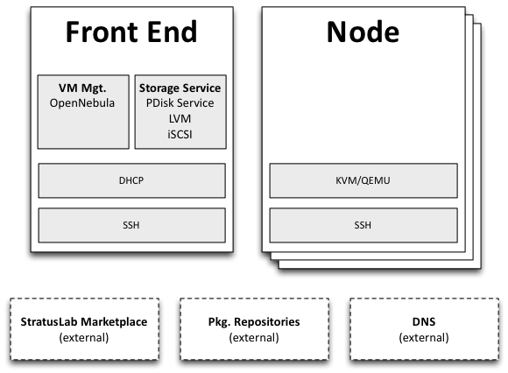
Goal of Tutorial
Install minimal StratusLab cloud
2 “modern” physical machines
Basic networking services
Deployment
Frontend: Contains user-facing cloud services
Node: Hosts virtual machines
External: Basic infrastructure services some of which may be installed on cloud machines.
Tutorial uses simplest deployment; other configurations are possible.

Slide 3
Installation Methods
Scripted Installation (used for tutorial)
Official, supported method from StratusLab collaboration
Automates the installation from a set of configuration parameters
Requires password-less, root access between machines with SSH
Will use this for tutorial.
Quattor Installation (not used for tutorial)
Supported by Quattor community and LAL
Used at LAL for all cloud deployments
May contain LAL-isms, help with making templates generic welcome
Usually a delay between a StratusLab release and template availability

Slide 4
Prerequisites
Hardware
Two physical machines with minimum configuration:
1 64-bit multi-core CPU with VT-x extensions
4 GB RAM
200 GB of local disk space
Virtualization extensions enabled in BIOS
Operating System
Minimal installation of latest, updated CentOS 6 release
SELinux disabled!
Python 2 (2.6+) installed
LVM for system volumes with two groups vg.01 (OS) and vg.02 (data)
Configured for EPEL and StratusLab yum repositories
“Fat” machines are
preferred for cloud
resources!

Slide 5
Prerequisites
Networking
DNS must be configured with names for physical and virtual machines
DNS must support reverse-DNS lookups
DCHP server is required, but can be installed on cloud
Connectivity
SSH to machines as root must work
Password-less root access between all machines must also work
Frontend → Node(s)
Node(s) → Frontend
Frontend → Frontend (!!)

Slide 6
Testing
Command Line Client (CLI)
Use standard user commands to test installation
stratus-test command will run standard workflows
Helpful to create standard user account for running tests
Troubleshooting
Lots of moving parts in the system, interactions sometimes complex
Look at CLI error messages (although sometimes not helpful)
Investigate errors in the service log files

Slide 7
Tutorial Roadmap
Transversal Capabilities
Authentication and authorization
Core Services
Marketplace
Networking
Storage
Computing
Evolution
CIMI and Couchbase
SlipStream for cloud federation
Will point out where significant changes will occur in future releases.

Slide 8
Exercises
Log into your machines
Verify prerequisites
Ensure EPEL and StratusLab repositories are accessible
/etc/yum.repos.d/sl.repo
[StratusLab-Releases
name=StratusLab-Releases
baseurl=http://yum.stratuslab.eu/releases/centos-6-v13.10.0/
enabled=1
gpgcheck=0

Slide 9
Questions and Discussion
website | http://stratuslab.eu
twitter | @StratusLab
support | support@stratuslab.eu
StratusLab source | http://github.com/StratusLab
SlipStream source | http://github.com/slipstream

