Slide 1
Storage Services
Charles (Cal) Loomis & Mohammed Airaj
LAL, Univ. Paris-Sud, CNRS/IN2P3
24-25 October 2013

Slide 2
Storage
Features
Volume abstraction for storage service
Provide users with persistent storage for data
Serves also as cache of images for VM instances
(No file-based or object-based storage service)
Implementation
API: Proprietary REST interface with CRUD actions
Java-based service using MySQL database for state information
Can use iSCSI or shared file system for physical storage
Can use simple files or LVM volumes for disk content

Slide 3
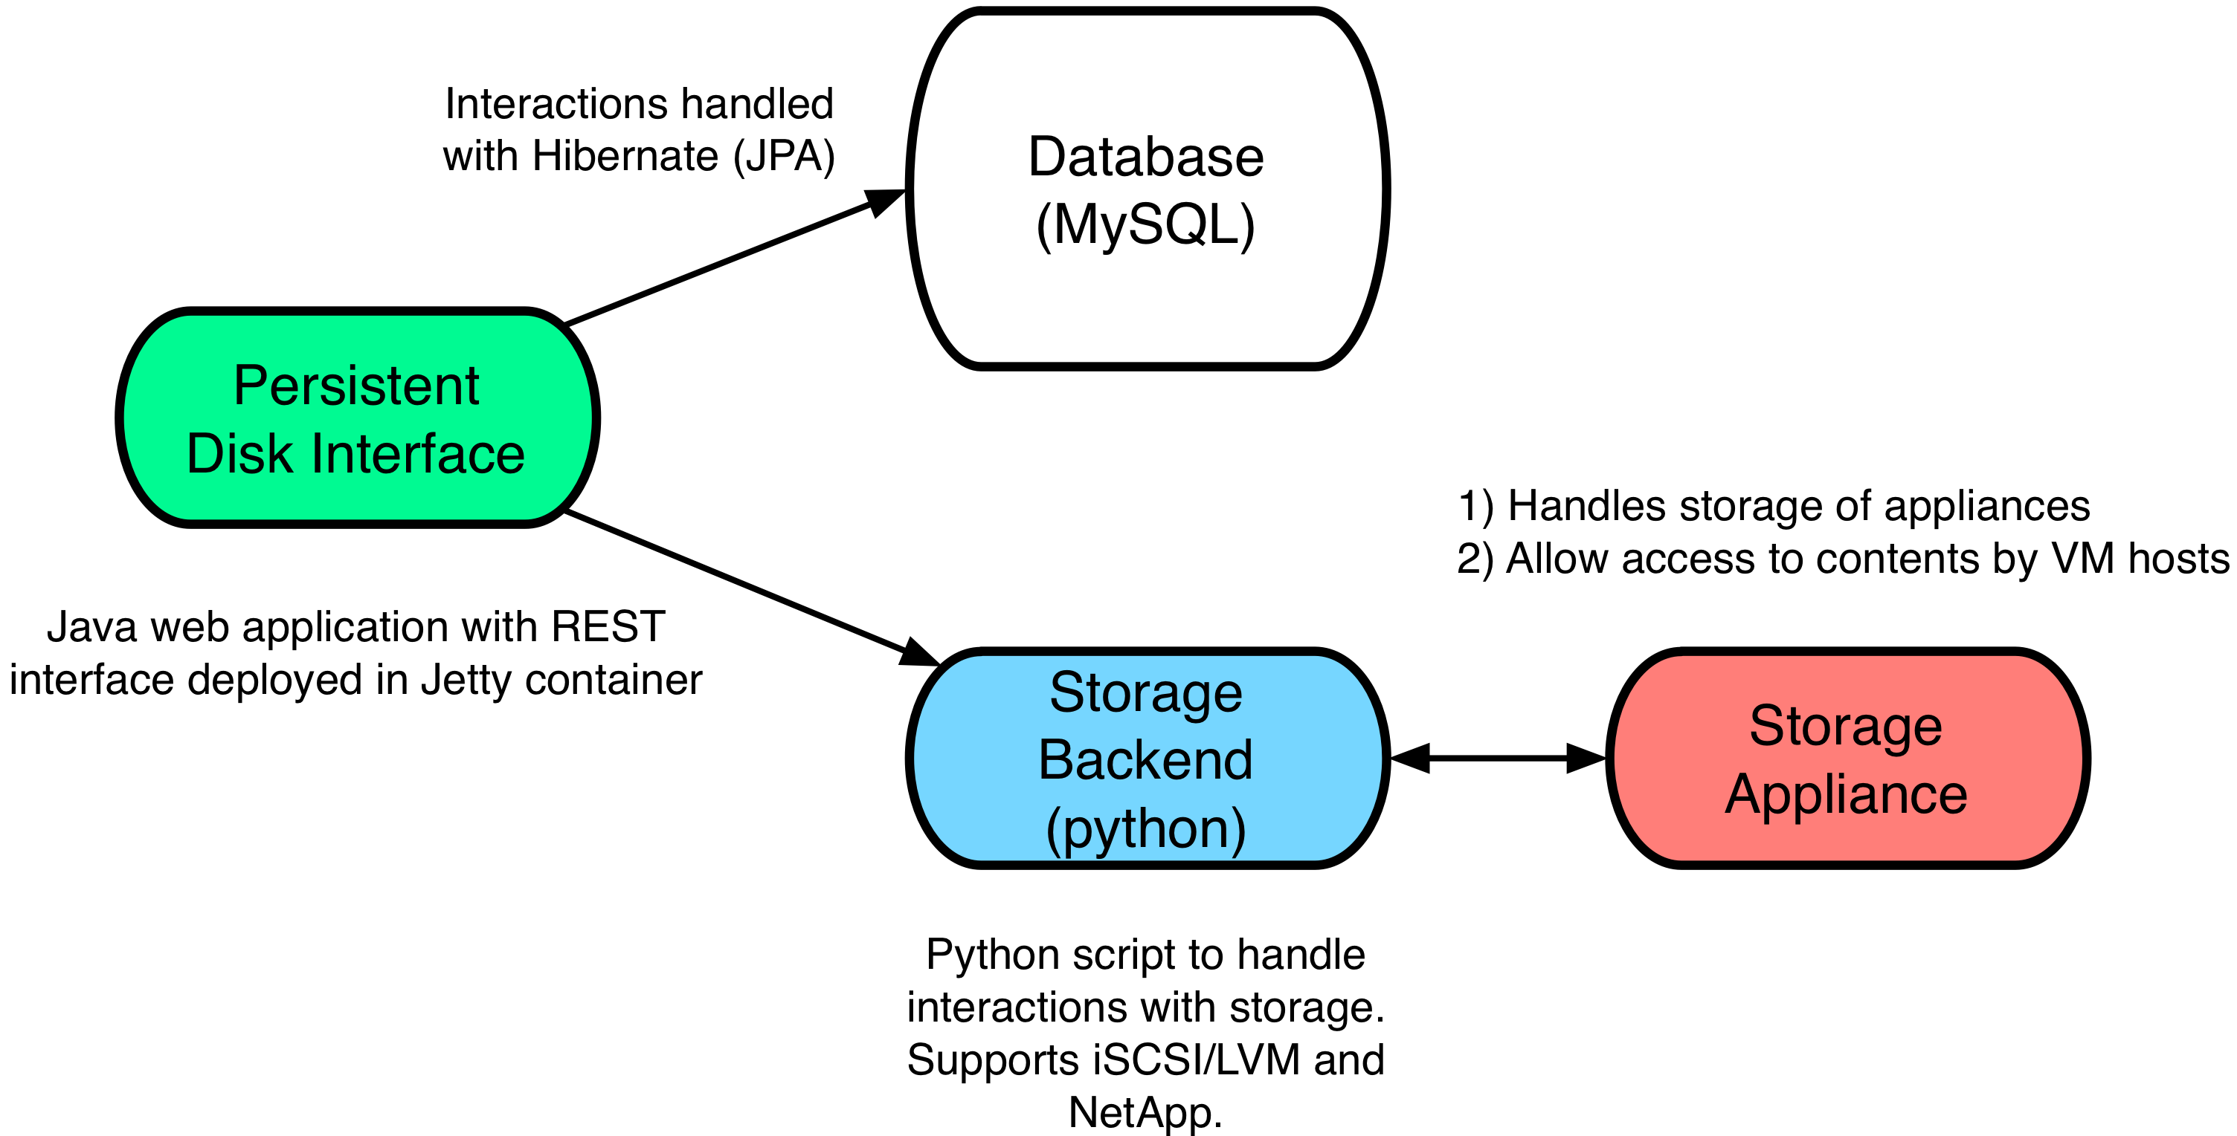
Architecture

Slide 4
Persistent Disk Service
Persistent Disk Service
daemon | pdisk
purpose | interface to storage
ports | 8445
language | java (deployed in Jetty container)
external requirements | database (MySQL), storage service
config. files | /etc/stratuslab/pdisk.cfg
logs | /opt/stratuslab/storage/pdisk/logs/*

Slide 5
Persistent Disk Configuration
List and Set Parameters
WARNING: Do not use localhost IP (127.0.0.1) for service
$ stratus-config --keys -s persistent-disks
$ stratus-config persistent_disk_ip ${FRONTEND_IP}
$ stratus-config persistent_disk_merge_auth_with_proxy True
$ stratus-config persistent_disk_lvm_device /dev/vg.02
$ stratus-config persistent_disk_backend_sections \ " [%(persistent_disk_ip)s]
type=LVM
volume_name = /dev/vg.02
lun_namespace = stratuslab
volume_snapshot_prefix = pdisk_clone
initiator_group =
"

Slide 6
Database (MySQL)
Install Database
Normally MySQL is installed as part of OpenNebula installation
Will do manually as we’re doing this out of the usual order
$ yum install -y mysql-server
$ service mysqld start
$ mysqladmin -u root password 'root’
$ mysql -uroot -p root

Slide 7
Persistent Disk Installation
Normal Install Command
Check
Connect with a browser to https://your-machine:8445/pswd/
Administrator account is called ‘pdisk’
Automatically generated random password in
/etc/stratuslab/authn/login-pswd.properties
$ stratus-install --persistent-disk

Slide 8
Exercises
Configure and install persistent disk service
Verify that the service is running via a browser
Create, list, and destroy a persistent disk

Slide 9
Questions and Discussion
website | http://stratuslab.eu
twitter | @StratusLab
support | support@stratuslab.eu
StratusLab source | http://github.com/StratusLab
SlipStream source | http://github.com/slipstream

