Slide 1
Computing Services
Charles (Cal) Loomis & Mohammed Airaj
LAL, Univ. Paris-Sud, CNRS/IN2P3
24-25 October 2013

Slide 2
Compute
Features
Fast provisioning of VMs, with low latency start-up
Contextualization
HEPiX & OpenNebula CDROM contextualization by default
CloudInit (disk based) also supported
Implementation
Authentication proxy sitting in front of OpenNebula
API: XML-RPC interface of OpenNebula
OpenNebula (C++, Ruby) with customized hooks
Hooks primarily for caching, snapshots, and storage access
On VM hosts, libvirtd is used as interface to hypervisor

Slide 3
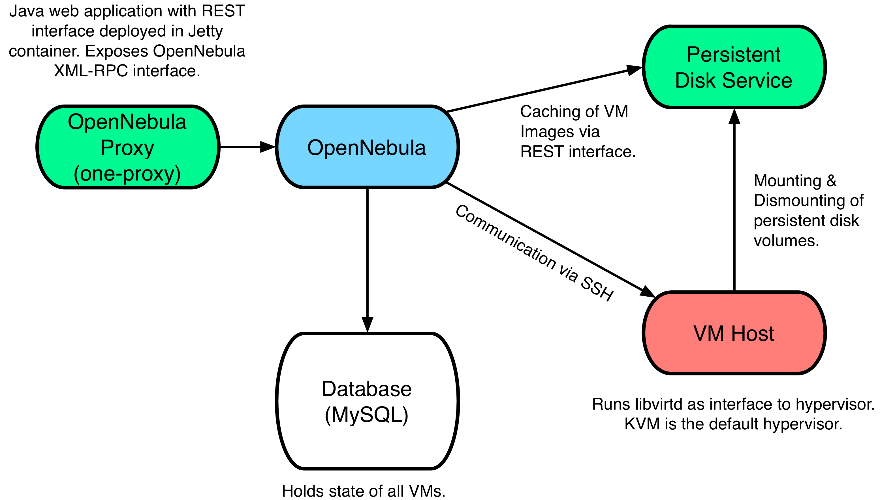
Architecture

Slide 4
Authentication Proxy (one-proxy)
Authentication Proxy
daemon | one-proxy
purpose | authn proxy for OpenNebula
ports | 2634
language | java (deployed in Jetty container)
external requirements | none
config. files | /etc/stratuslab/authn/*
logs | /opt/stratuslab/one-proxy/logs/*

Slide 5
OpenNebula
OpenNebula
daemon | oned
purpose | interface to libvirtd
ports | 2633
language | C++, scripts in ruby, bash, …
external requirements | database (MySQL)
config. files | /etc/one/*
logs | /var/log/one/*

Slide 6
Services to Configure
OpenNebula
Installed on the front end
Usually also installs MySQL, but this is already done in our case
“Node”
Host for virtual machines
Done via SSH from front end (password-less access required!)
DHCP
Installed on the front end
Turn off if using an external DHCP server
Must still provide network addresses, etc. for OpenNebula

Slide 7
Configuration
Setup Node Parameters
Quotas
$ stratus-config node_system centos
$ stratus-config node_bridge_name br0
$ stratus-config node_bridge_configure True
$ stratus-config default_gateway ${FRONTEND_IP}
$ stratus-config frontend_ip ${FRONTEND_IP}
$ stratus-config frontend_system centos
$ stratus-config network_addr 134.158.75.0
sudo stratus-config quota_cpu 5
sudo stratus-config quota_memory 1GB

Slide 8
VM Network Configuration
Private
Public
$ stratus-config one_private_network 192.168.0.0
$ stratus-config one_private_network_addr 192.168.0.1
$ stratus-config one_public_network_addr \
134.158.75.42 134.158.75.43 134.158.75.44 \
134.158.75.45 134.158.75.46 134.158.75.47 \
134.158.75.48 134.158.75.49 134.158.75.50 \
134.158.75.51
$ stratus-config one_public_network_mac \
0a:0a:86:9e:49:2a 0a:0a:86:9e:49:2b 0a:0a:86:9e:49:2c \
0a:0a:86:9e:49:2d 0a:0a:86:9e:49:2e 0a:0a:86:9e:49:2f \
0a:0a:86:9e:49:30 0a:0a:86:9e:49:31 0a:0a:86:9e:49:32 \
0a:0a:86:9e:49:33

Slide 9
VM Network Configuration
Local
$ stratus-config one_local_network_addr \
172.17.16.43 172.17.16.44 172.17.16.45 \
172.17.16.46 172.17.16.47 172.17.16.48 \
172.17.16.49 172.17.16.50 172.17.16.51
$ stratus-config one_local_network_mac \
0a:0a:86:9e:50:2b 0a:0a:86:9e:50:2c 0a:0a:86:9e:50:2d \
0a:0a:86:9e:50:2e 0a:0a:86:9e:50:2f 0a:0a:86:9e:50:30 \
0a:0a:86:9e:50:31 0a:0a:86:9e:50:32 0a:0a:86:9e:50:33

Slide 10
NAT (Optional)
NAT_GW=172.17.16.2
$ stratus-config nat True
$ stratus-config nat_network 172.17.16.0
$ stratus-config nat_gateway $NAT_GW
$ stratus-config nat_netmask 255.255.255.0
$ stratus-config nat_network_interface eth0

Slide 11
DHCP
$ stratus-config dhcp True
$ stratus-config dhcp_subnet 134.158.75.0
$ stratus-config dhcp_netmask 255.255.255.0
$ stratus-config dhcp_lease_time 3600
$ stratus-config dhcp_one_local_network True
$ stratus-config dhcp_one_local_network_subnet 172.17.16.0
$ stratus-config dhcp_one_local_network_broadcast \
172.17.16.255
$ stratus-config dhcp_one_local_network_netmask \
255.255.255.0
$ stratus-config dhcp_one_local_network_routers $NAT_GW
$ stratus-config dhcp_one_local_network_domain_name \
lal.in2p3.fr
$stratus-config dhcp_one_local_network_domain_name_servers\
134.158.91.80, 134.158.88.149

Slide 12
Persistent Disk
Turn off since this is already done!
$ stratus-config persistent_disk False

Slide 13
Installation
Normal Install Command
Check
Look carefully at output to see if there are any errors
Correct them if there are!
Can find state of OpenNebula from oneadmin account
$ stratus-install -n {NODE_IP} -vvv
$ su - oneadmin
$ onehost list # VM hosts and status
$ onenet list # defined networks
$ onevm list # running VMs

Slide 14
Exercises
Configure parameters for front end and node
Verify the parameters with stratus-config --keys
Launch the installation
Check carefully for errors in output
Check that everything looks OK in OpenNebula

Slide 15
Setup Normal User
Setup test accounts using the root account.
Create Normal Unix Account
Usual adduser command
Use any username that you’d like
Create Associated Account for StratusLab
Add account to /etc/stratuslab/login-pswd.properties
Username and password are independent of the unix account

Slide 16
Configure StratusLab Client
Log into the unix account you created.
SSH Configuration
Generate new ssh key pair using ssh-keygen
StratusLab Client Configuration
Create a default configuration file: stratus-copy-config
Edit file $HOME/.stratuslab/stratuslab-user.cfg
Replace “username” and “password” values
Replace “endpoint” value
Verify Configuration
Try: stratus-describe-instance

Slide 17
Launch a Virtual Machine
Log into the unix account you created.
Create CentOS VM
Follow Status
Log into VM
$ CENTOS=H8dg0ssw_j4jg67FTwXysCUrJPl
$ stratus-run-instance --type m1.large ${CENTOS}
$ stratus-describe-instance
$ ssh root@machine-ip

Slide 18
Exercises
Verify that you can start a virtual machine
Check out the ways of controlling allocated resources
Try connecting LDAP server to one-proxy service
Verify that account in LDAP works

Slide 19
Questions and Discussion
website | http://stratuslab.eu
twitter | @StratusLab
support | support@stratuslab.eu
StratusLab source | http://github.com/StratusLab
SlipStream source | http://github.com/slipstream

