Slide 1
Prehistory of the Higgs
Tom Kibble
Imperial College London
Higgs Hunting 2014

Slide 2
Outline
Early history of the idea of spontaneous symmetry breaking in gauge theories and the Higgs boson
— as I saw it from my standpoint in Imperial College
• Physics around 1960
• The aim of electroweak unification
• Obstacles to unification
• Higgs mechanism
• The electroweak theory
• Later developments
• Discovery of the Higgs boson

Slide 3
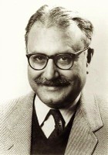
Imperial College in 1959
• IC theoretical physics group was founded in 1956 by Abdus Salam
— he already had a top-rank international
reputation for his work on renormalization
— in 1959 he became the youngest FRS
at age 33
• I joined also in 1959
• It was very lively, with numerous visitors:
— Murray Gell-Mann,
— Stanley Mandelstam,
— Steven Weinberg, ...

Slide 4
Physics in the 1950s
• After QED’s success, people searched for field theories of other interaction (or even better, a unified theory of all of them)
— also gauge theories?
• Most interest in strong interactions
— there were candidate field theories (e.g. Yukawa’s meson theory),
but no one could calculate with them because perturbation theory
doesn’t work
• Many people abandoned field theory for S-matrix theory
— dispersion relations, Regge poles, …
• In a few places, the flag of field theory was kept flying
— Harvard, Imperial College, …
— but perhaps weak interactions were more promising?

Slide 5
Symmetries
• Experimenters found many new particles
— to bring order to this zoo, we sought (approximate) symmetries
• Isospin (Heisenberg, Kemmer)
— SU(2), broken by electromagnetism
— now seen as a symmetry of two lightest quarks (u, d)
• Eightfold Way (Gell-Mann, Ne’eman)
— SU(3) symmetry
— now seen as symmetry of three lightest quarks (u, d, s)
— broken by whatever gives different mass to quarks of different
generations
• These are approximate, broken symmetries
— spontaneously broken?

Slide 6
Yang-Mills theory
• First example of a gauge theory beyond QED was the Yang-Mills theory (1954), a gauge theory of isospin SU(2) symmetry.
— same theory proposed by Salam’s student Ronald Shaw, but
unpublished except as a Cambridge University PhD thesis
— ultimately not correct theory of strong interactions, but the
foundation for all later gauge theories.
• Because isospin is an approximate symmetry, this symmetry must be broken in some way
— but adding symmetry-breaking terms destroys many of the nice
properties of gauge theories
— could the symmetry be spontaneously broken?

Slide 7
Goal of Unification
• Because we couldn’t calculate with strong-interaction theory, interest began to shift to weak interactions
— especially after V–A theory
– Marshak & Sudarshan (1957), Feynman & Gell-Mann (1958)
— they could proceed via exchange of spin-1 W± bosons
• First suggestion of a gauge theory of weak interactions mediated by W⁺ and W– was by Schwinger (1957)
— could there be a unified theory of weak and electromagnetic?
• If so, it must be broken, because weak bosons
— are massive (short range)
— violate parity

Slide 8
Solution of Parity Problem
• Glashow (1961) proposed a model with symmetry group SU(2) x U(1) and a fourth gauge boson Z⁰, showing that the parity problem could be solved by a mixing between the two neutral gauge bosons.
• Salam and Ward (1964), unaware of Glashow’s work, proposed a similar model, also based on SU(2) x U(1)
— Salam was convinced that a unified theory must be a gauge theory
• But in all these models symmetry breaking, giving the W bosons masses, had to be inserted by hand
— spin-1 bosons with explicit mass were known to be
non-renormalizable.
• Big question: could this be a spontaneously broken symmetry?

Slide 9
Spontaneous Symmetry Breaking
• Spontaneous breaking of gauge symmetry, giving mass to the plasmon, was known in superconductivity — though not well understood and still controversial within that community. Nambu (1960) suggested a similar mechanism could give masses to elementary particles.
• Nambu and Jona-Lasinio (1961) proposed a specific model
exact, but chiral symmetry
spontaneously broken by
• Model has a massless pseudoscalar, identified with pion
— N & J-L suggested chiral symmetry was not quite exact even before spontaneous symmetry breaking, hence pion has a small mass

Slide 10
Spontaneous Symmetry Breaking
• Particle physics exhibited many approximate symmetries
— natural to ask: could they be spontaneously broken?
• Spontaneous symmetry breaking
— when ground state or vacuum state does not share the
symmetry of the underlying theory
— ubiquitous in condensed matter physics
• Often there is a high-temperature symmetric phase, and a critical temperature below which the symmetry is spontaneously broken
— crystallization of a liquid breaks rotational symmetry
— so does Curie-point transition in a ferromagnet
— gauge symmetry is broken in a superconductor
• But there was a big problem — the Goldstone theorem.

Slide 11
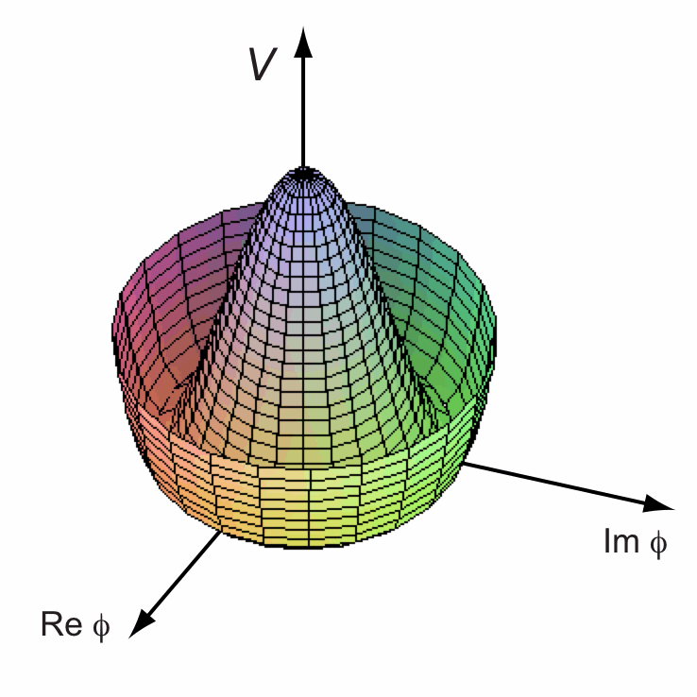
Nambu-Goldstone bosons
• Spontaneous breaking of a continuous symmetry existence of massless spin-0 Nambu-Goldstone bosons.
• e.g. Goldstone model
— vacuum breaks symmetry:
— choose
and set
cubic and quartic terms
So (Goldstone boson)
• This was believed inevitable in a
relativistic theory

Slide 12
Goldstone theorem
• Proof (Goldstone, Salam & Weinberg 1962): assume
1. symmetry corresponds to conserved current:
2. there is some field whose vev is not invariant: ,
thus breaking the symmetry
• Now would seem to imply
• The broken symmetry condition is then
• But if Q is time-independent, the only intermediate states that can contribute are zero-energy states which can only appear if there are massless particles.

Slide 13
Impasse
• In a relativistic theory, there seemed no escape
— spontaneous symmetry breaking ⇒ zero-mass spin-0 bosons
— no such bosons known ⇒ no spontaneous symmetry breaking
— models with explicit symmetry breaking were clearly
non-renormalizable, giving infinite results
• Weinberg commented:
‘Nothing will come of nothing; speak again!’ (King Lear)
• In 1964 Gerald Guralnik arrived at Imperial College as a postdoc
— a student of Walter Gilbert, who had been a student of Salam
— he had been studying this problem, and already published some
ideas about it
— we began collaborating, with another US visitor, Richard Hagen
— we (and others) found the solution.

Slide 14
Higgs mechanism
• The argument fails in the case of a gauge theory — proof assumed explicit relativistic invariance, not true for e.g. Coulomb-gauge QED
— Englert & Brout (1964), Higgs (1964), Guralnik, Hagen & TK (1964)
• Higgs model (gauged Goldstone model):
Again set
cubic terms ...
Thus the massless gauge and Goldstone bosons have combined to give a massive gauge boson.
But: there is more to it.

Slide 15
Gauge modes
• Field equations
are also satisfied for any so long as
(gauge invariance of original model)
• To tie down not only but also and , we need to impose a gauge condition:
• With the Coulomb gauge condition requires
(or constant)
• However the Lorentz gauge condition only requires that
satisfy
— in this manifestly covariant gauge, the Goldstone theorem does
apply, but the Goldstone boson is a pure gauge mode.

Slide 16
How is the Goldstone theorem avoided?
• Proof assumed that implied
• But this is only true if we can drop a surface integral at infinity:
• This is permissible in a manifestly Lorentz-invariant theory (e.g.
Lorentz-gauge QED), because commutators vanish outside the light
cone — but not in Coulomb-gauge QED
• When the symmetry is spontaneously broken, the integral
does not exist as a self-adjoint operator, e.g. in Higgs model
diverges. [GHK]
• Distinct degenerate vacua belong to distinct orthogonal Hilbert spaces
carrying unitarily inequivalent representations of the commutation
relations — a defining property of spontaneous symmetry breaking

Slide 17
Electroweak unification
• The three papers attracted very little attention at the time
— by 1964 we had both the mechanism and the SU(2) x U(1) model
but it still took three more years to put the two together.
• I did further work in 1967 on application to non-Abelian theories
— especially how symmetry breaking pattern determines
numbers of massive and massless particles
— this work helped, I believe, to renew Salam’s interest, and was
also noted by Weinberg.
• Unified model of weak and electromagnetic interactions of leptons proposed by Weinberg (1967)
— essentially the same model was presented independently by Salam
in lectures at IC in autumn of 1967 and published in a Nobel
symposium in 1968 — he called it electroweak theory.

Slide 18
Nobel Prizes
• Salam and Weinberg speculated that their theory was renormalizable. This was proved by Gerard ’t Hooft in 1971 — a tour de force using methods of his supervisor, Tini Veltman, especially Schoonship.
• In 1973 the key prediction of the theory, the existence of neutral current interactions — those mediated by Z⁰ — was confirmed at CERN.
• This led to the Nobel Prize for Glashow, Salam & Weinberg in 1979
— but Ward was left out (because of the ‘rule of three’?)
— ’t Hooft and Veltman gained their Nobel Prizes in 1999.
• In 1983 the W and Z particles were discovered at CERN
— Nobel Prizes for Rubbia and van der Meer in 1984
• In 2012 the Higgs boson was discovered at CERN
— Nobel Prizes for Englert and Higgs in 2013

Slide 19
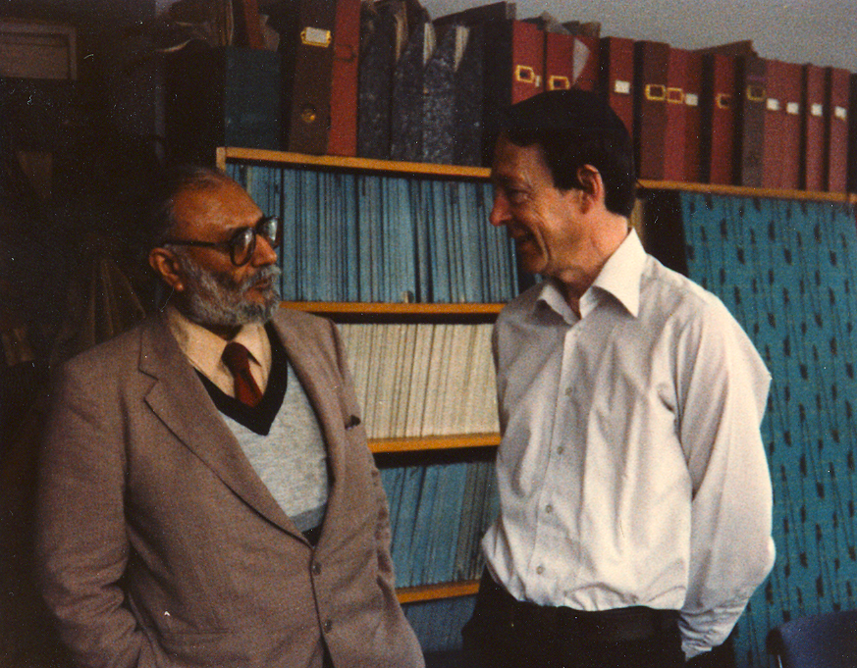
I am deeply indebted to:
Abdus Salam
Gerald Guralnik

