Slide 1
Future Lepton Linear Colliders
Mike Harrison
Why Linear – Issues
LC General Topology
Variations on a theme – CLIC & ILC
The Technology Challenge (ILC)
System Tests
Japan

Slide 2
Why Linear
The dominant advantage of a linear collider is that it avoids synchrotron radiation thus, in principle, it is not subject to the same limitations on collision energy as circular machines.
The dominant feature of a linear collider is that it is a single pass machine. (Beam current x energy -> power which is then dumped.) This raises issues of:
  Efficiency -> Power Consumption -> 2-beam, SRF
  Luminosity -> Very Small Beams at the IP (nm) -> state-of-the-art damping rings, emittance dilution sensitivity, complex beam delivery optics, IP & beam stability
  Accelerating Gradient -> higher gradients -> shorter linac -> less cost

Slide 3
Why Linear
There are some positive aspects:
  Energy increases feasible -> build it longer
  Polarisation possible (e- 80%, e+ 30% for the ILC)

Slide 4
Machine Topology – CLIC (3 TeV)

Slide 5
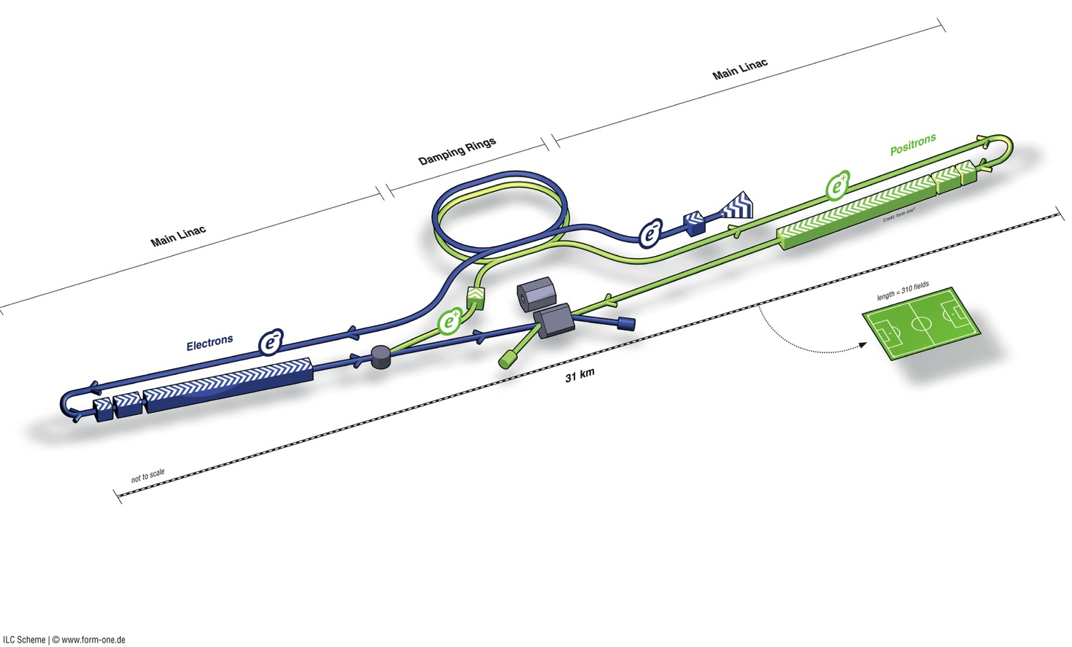
Machine Topology – ILC (500 GeV)
Polarised electron source
Damping Rings
Ring to Main Linac (RTML)
(inc. bunch compressors)
e+ Main Linac
Beam Delivery System (BDS) & Experiments
Polarised positron
source
Beam dump
e- Main Linac

Slide 6
Two-beam technology - CLIC
Copper structures, 12 GHz
  Advantages: the accelerating gradient ( ~100 MV/m), relatively efficient
  Challenges: tolerances (12 GHz), short pulse train (wakes), new concept

Slide 7
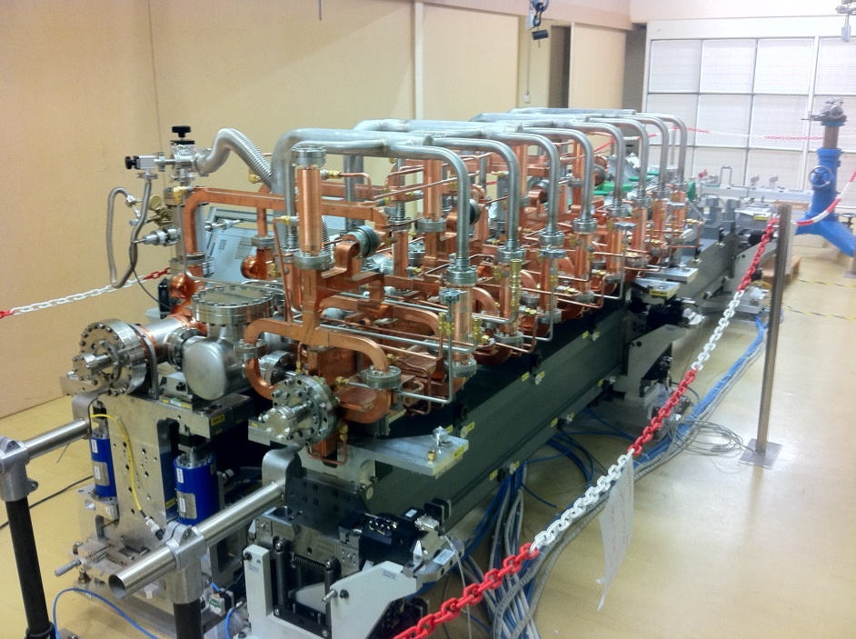
Two-beam technology - CLIC

Slide 8
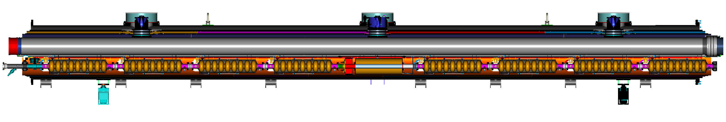
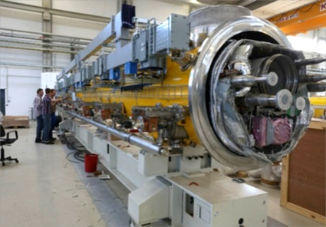
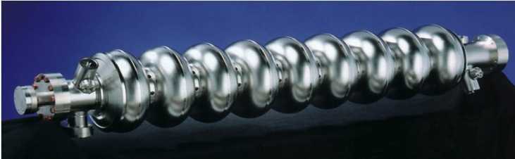
SRF Technology - ILC
1.3 GHz
Type-B module
Type-A has 9 cavities and no quadrupole
cavities (8)
SC quad package
12.652 m (slot length)
Advantages: superconducting (cavity absorbs little
power), long pulse train, large aperture, low
impedance, high beam currents, conservative
linac design
Disadvantages: limited gradient, demanding (though widespread) technology, not cheap

Slide 9
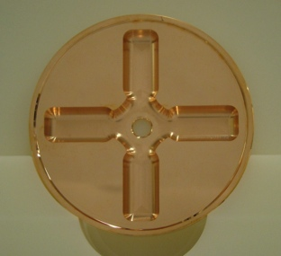
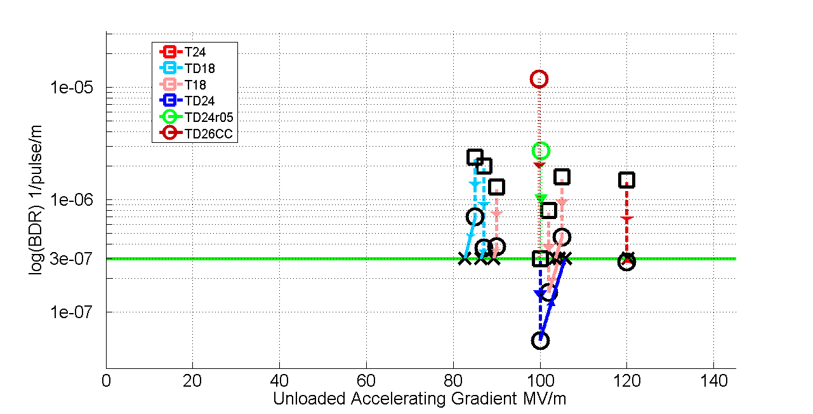
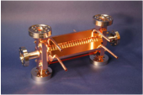
Gradient - Why don’t we just turn them up ?
Structure Tests – CLIC – spark rate & conditioning

Slide 10
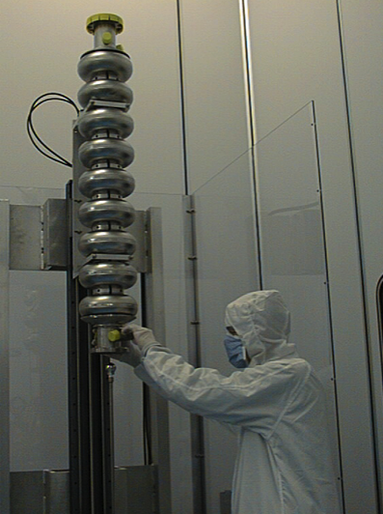
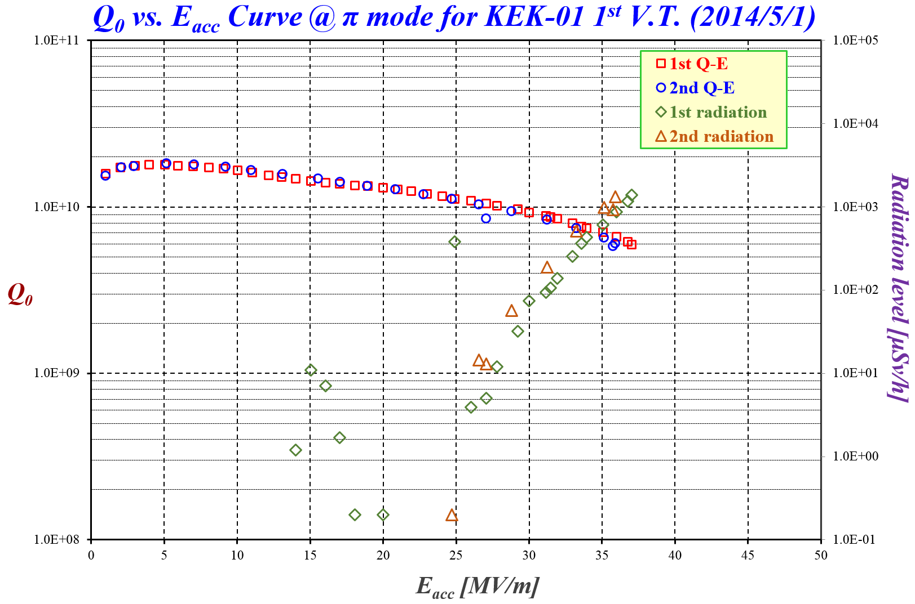
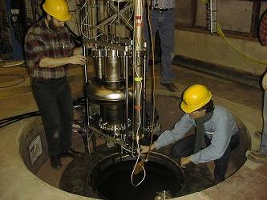
Gradient - Why don’t we just turn them up ?
SRF vertical cavity testing – field emission

Slide 11
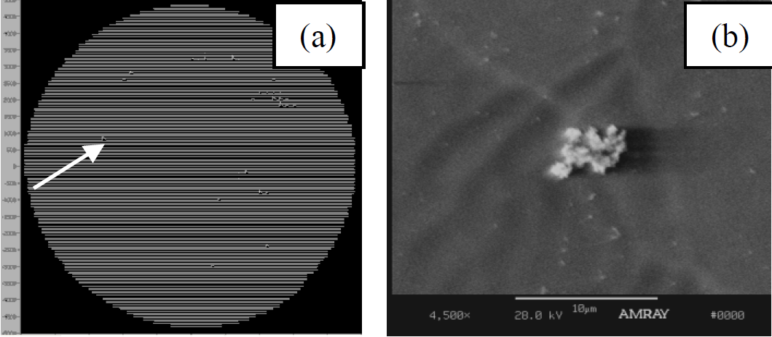
Particulate Field Emitters
Step-wise scanning of high-voltage tip reveals field emitters
Sample transferred into integrated SEM chamber
Identified field emitter analyzed
Nb_{x}O_{y} granules

Slide 12
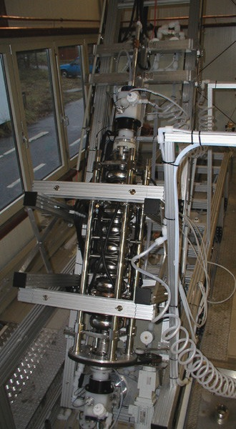
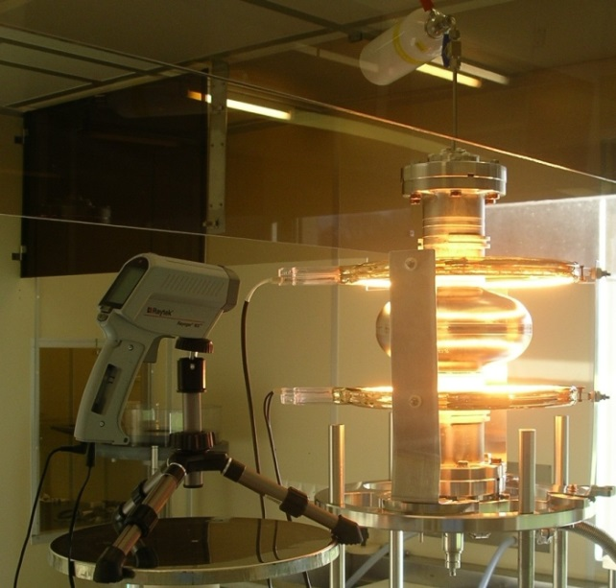
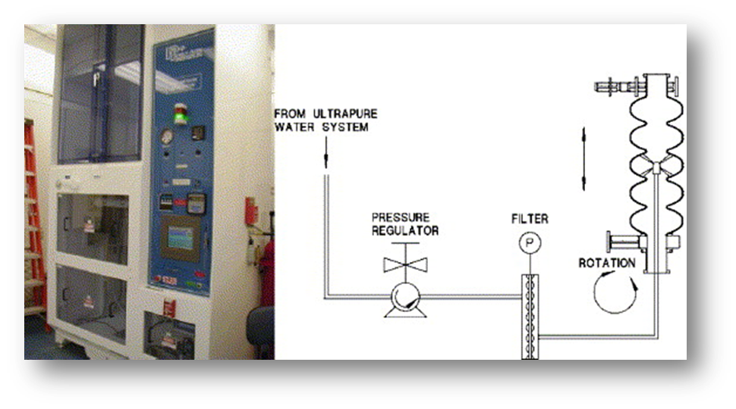
SRF: High Performance Cavities
Electron-beam welding:
Control of niobium material
Mechanical construction
  electron-beam welding (EBW)
Preparing RF (inner) surface ultra-clean
mirror surface
  electro-polishing (EP)
Removing hydrogen from the surface layer
  800 deg C baking
Removing surface contamination
  alcohol and/or detergent rinsing
  high-pressure rinsing (HPR)
Electropolishing
800 C annealing
& 120 C baking
High-pressure rinsing (HPR)

Slide 13
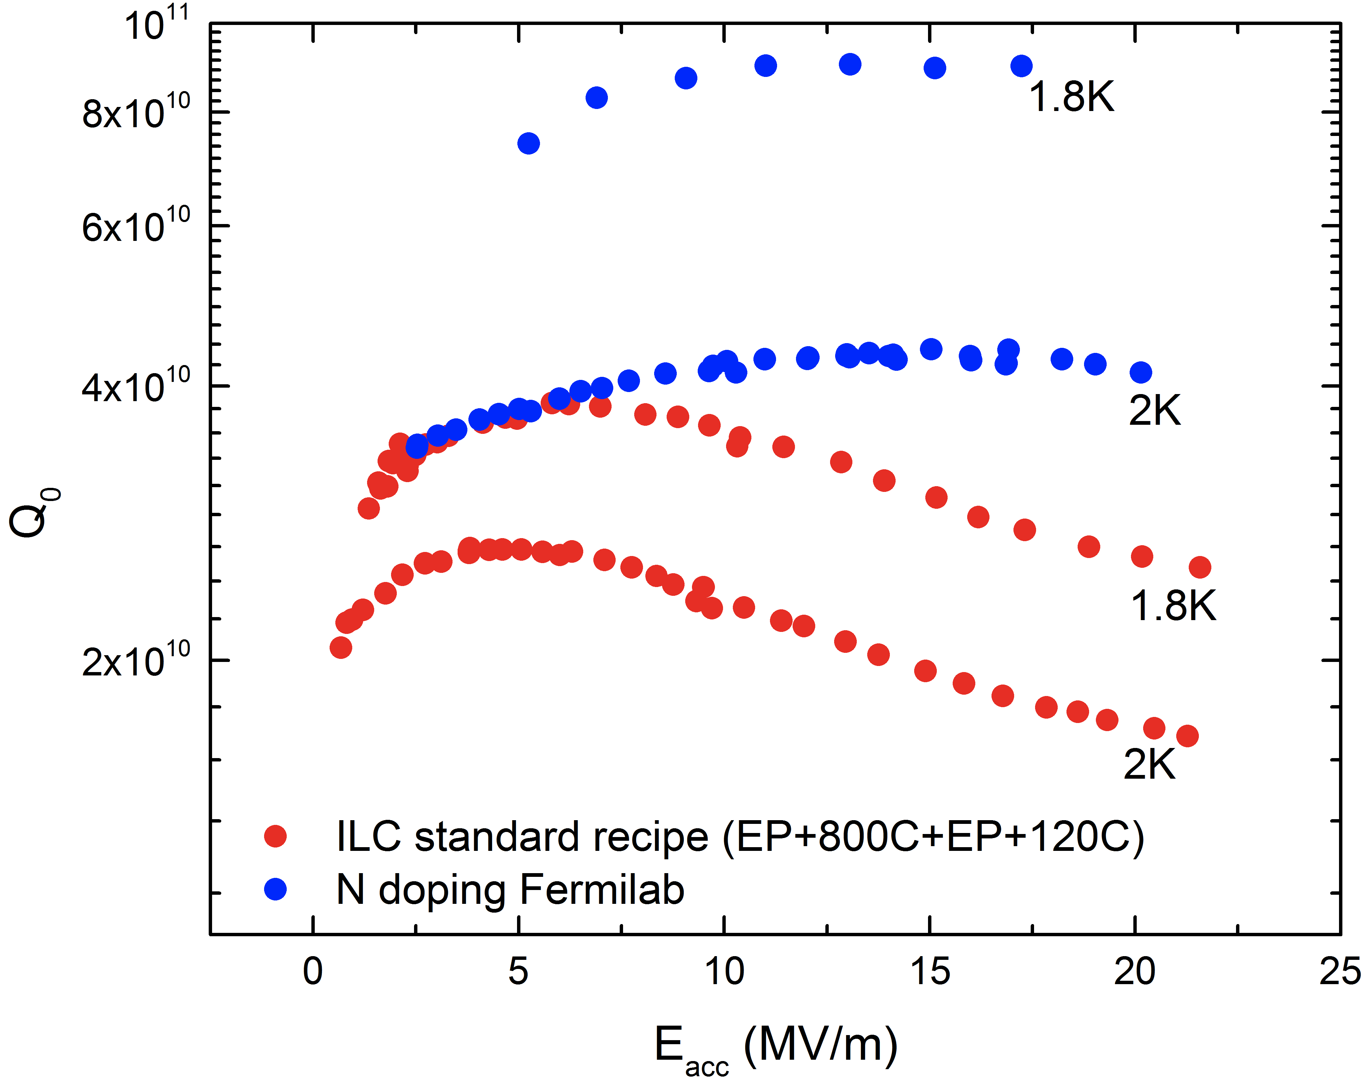
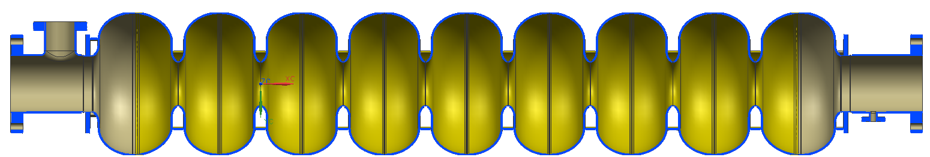
SRF Technology: R&D
Fermilab
Better cavity shapes - JLAB
Higher Q via nitrogen doping surface processing
High Q via efficient flux expulsion cooling

Slide 14
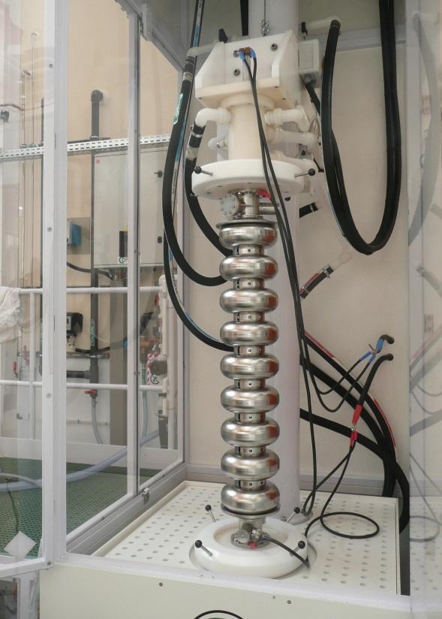
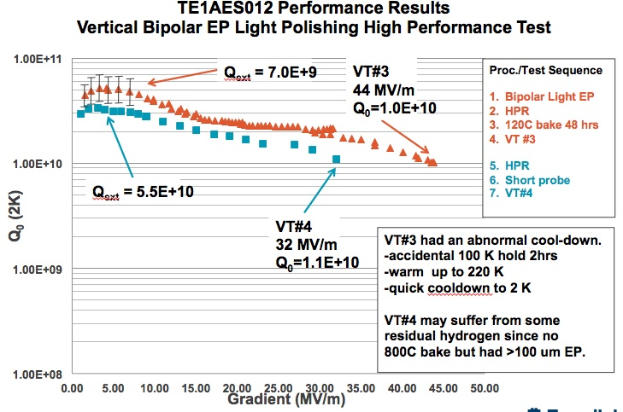
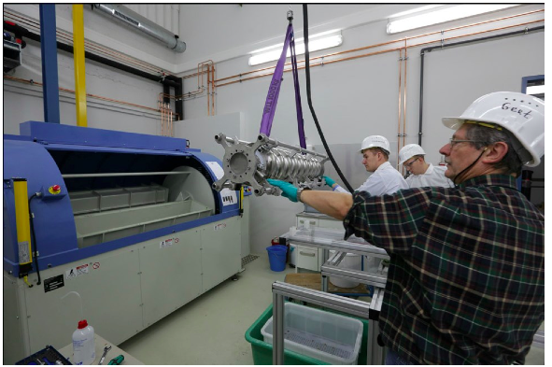
Technology: Production R&D
Bi-polar EP – Faraday Technology Co
Vertical EP - Saclay
Barrel Polishing DESY – No EP ?

Slide 15
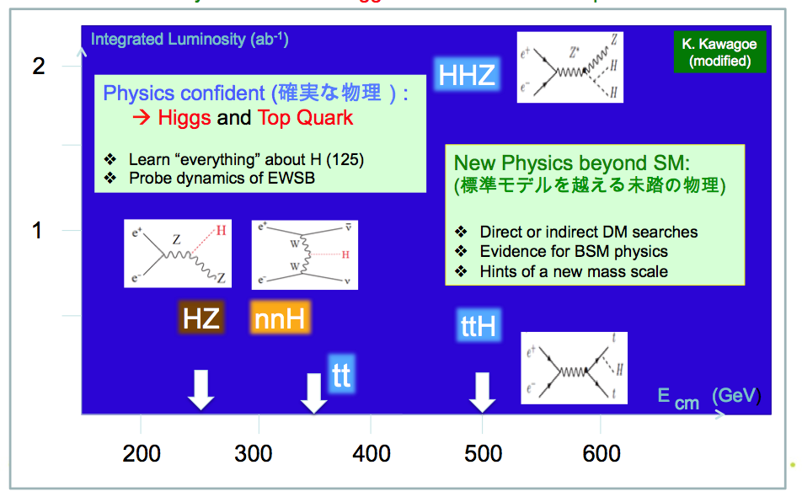
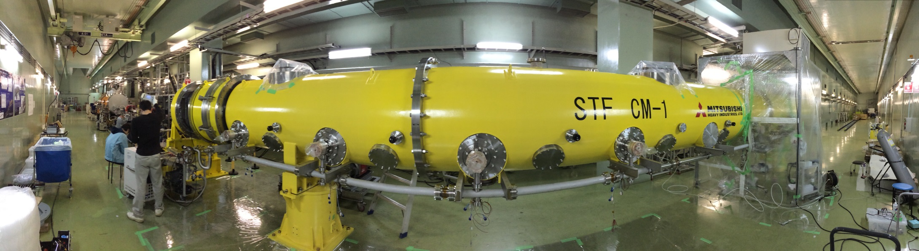
What’s the Collision energy ?
Cavity gradient performance is not uniform
Cavities are powered in pairs to
ensure optimal use of available
gradient performance

Slide 16
XFEL – 100 ILC-like cryomodules (17.5 Gev)
XFEL Cavity results – 230 cavities

Slide 17
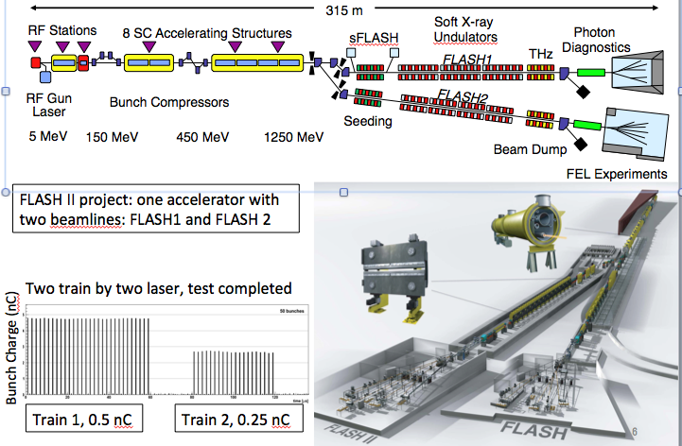
Will it work ? System Tests FLASH FEL @ DESY

Slide 18
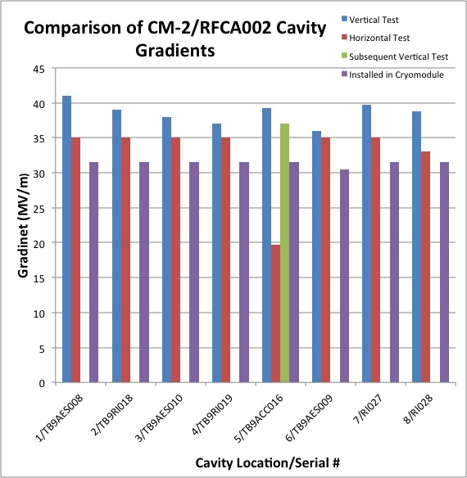
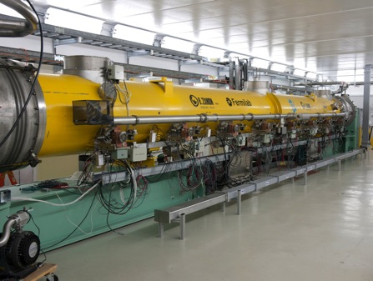
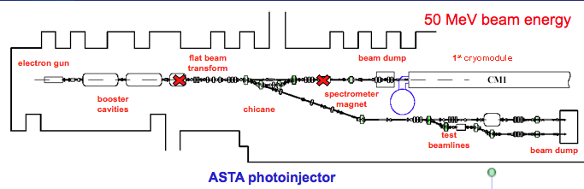
Will it work ? System Tests - Fermilab
ILC Milestone
31.5 MV/m

Slide 19
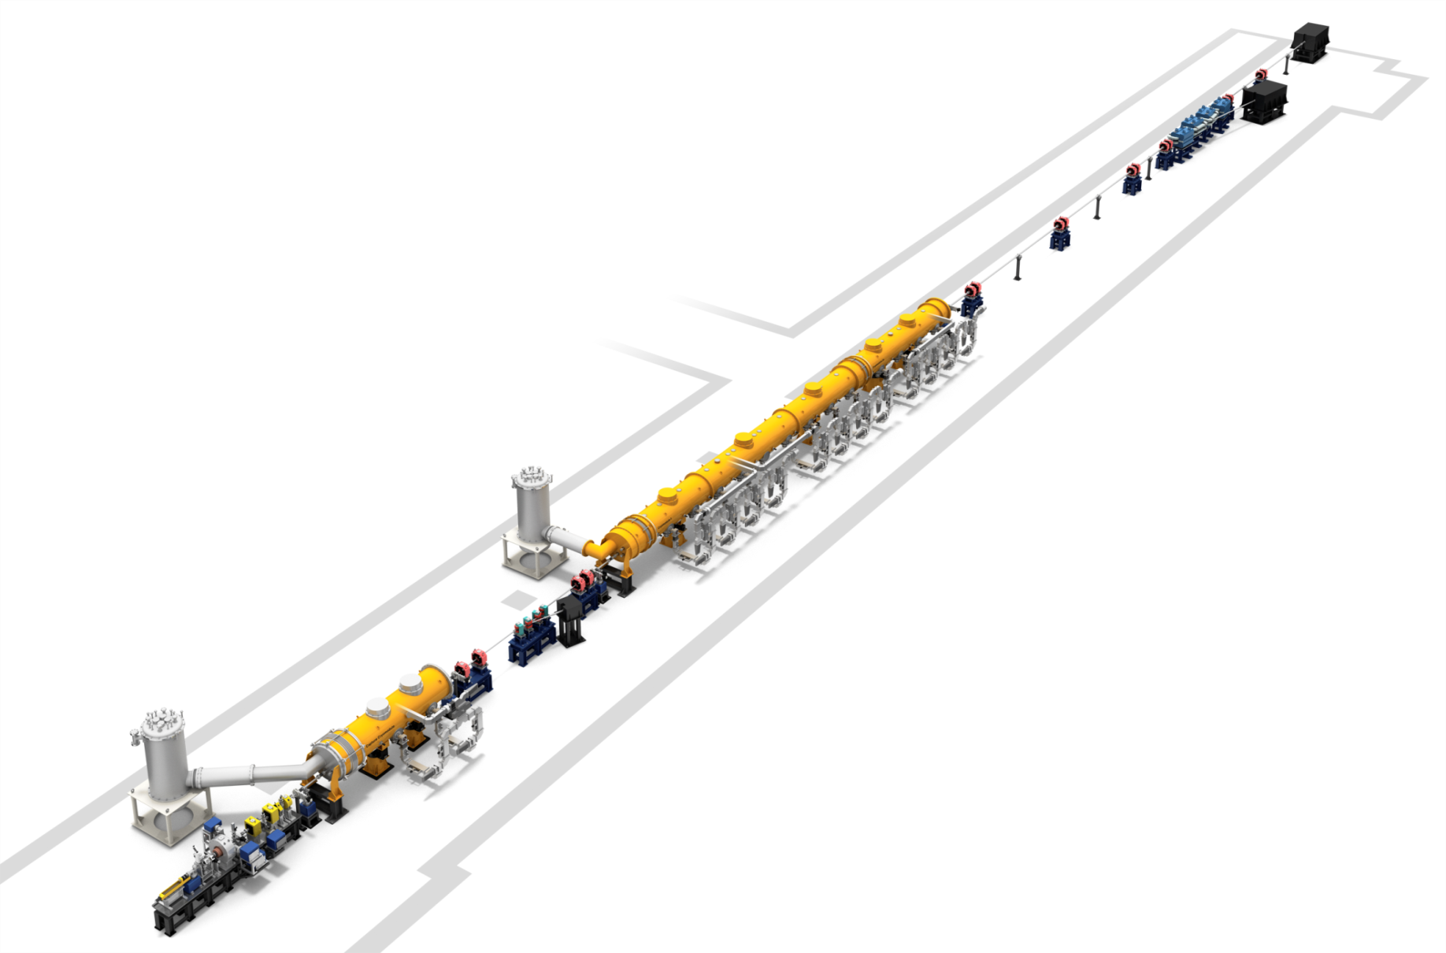
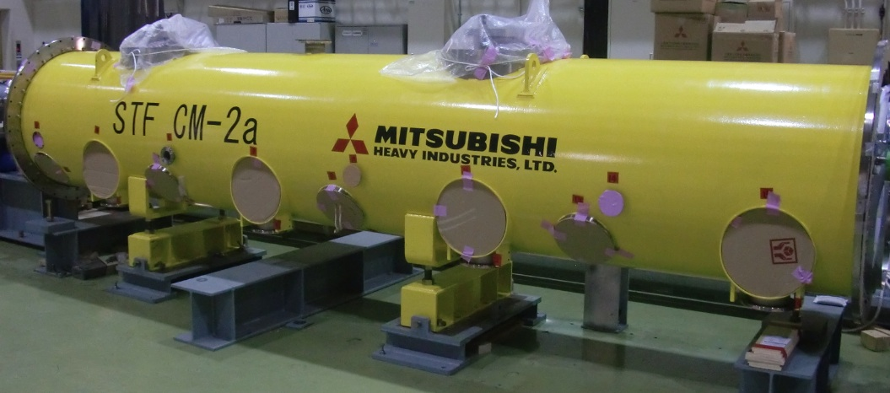
Will it work ? System Tests - KEK
CM-1
STF cryomodule development history
2011 disassemble S1-Global,
start construction of STF accelerator(Injector + QB)
2012 Feb: QB accelerator commissioning
Apr: beam acceleration
Jun: beam focus for Laser-Compton
Jul to Mar: experiment of Laser-Compton (QB)
2013 Apr: disassemble Laser-Compton
start installation of CM-1
Sep: two set of 4-cavity train completed
Oct: Cryomodule assembly in STF tunnel
Dec: CM-1 completed
2014 Apr: start CM-2a assembly
Jul: CM-1 and CM-2a connection will be completed
Oct: Cool-down test
CM-2a
CM-1
STF Accelerator
CM-2a

Slide 20
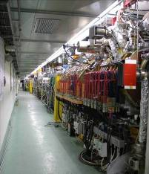
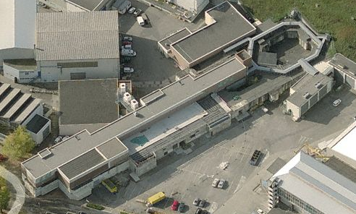
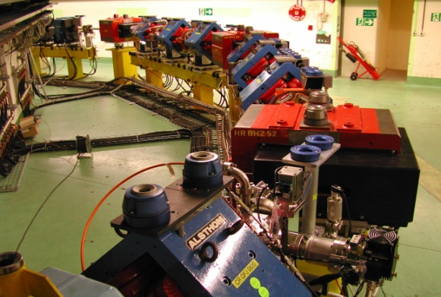
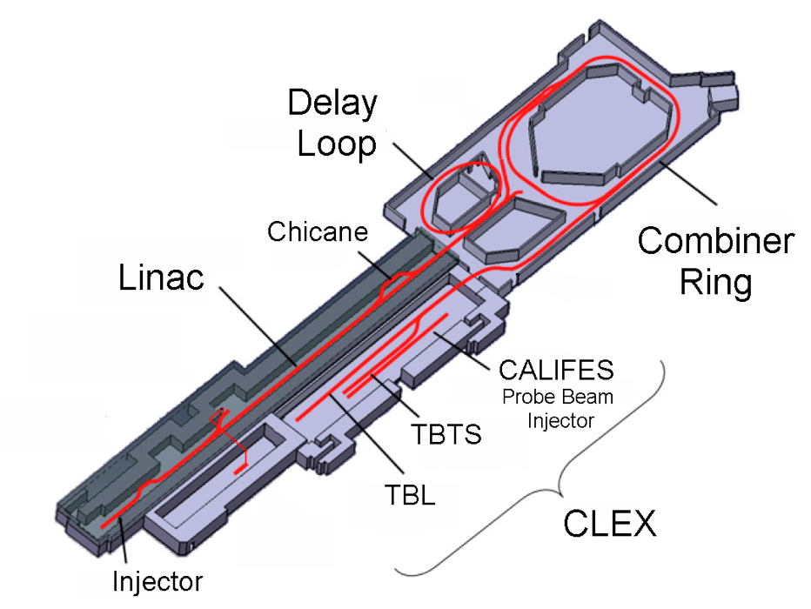
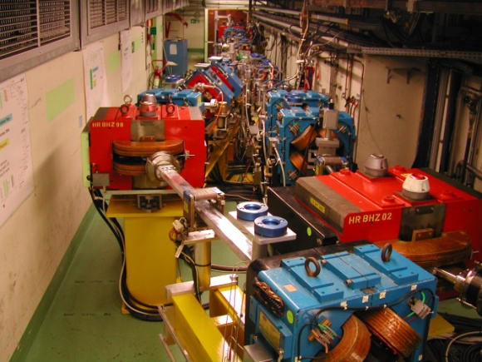
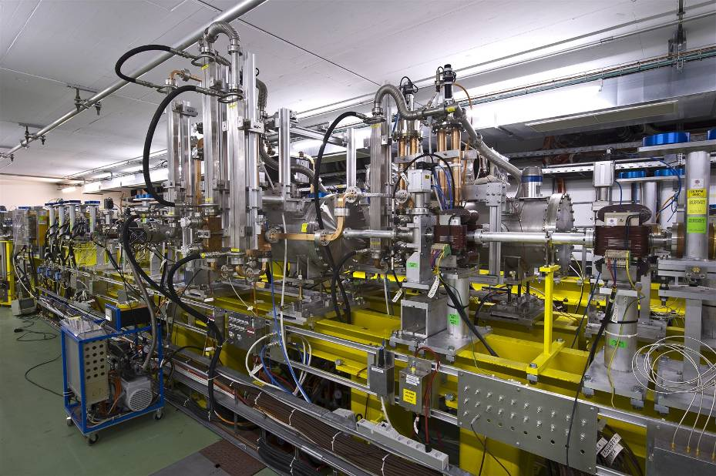
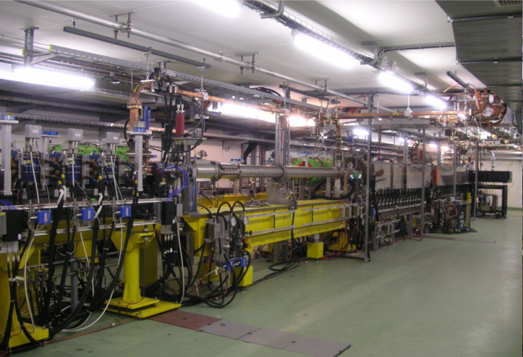
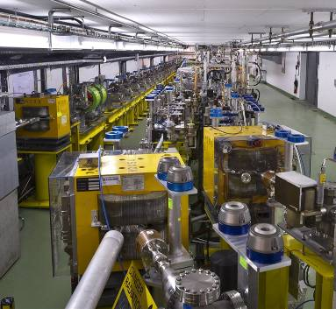
Will it work ? System Tests – CLIC CTF3 @ CERN
Operation of isochronous lines and rings
4 A, 1.4us
120 MeV
30 A, 140 ns
120 MeV
High current, full
beam-loading operation
Beam recombination and current multiplication by RF deflectors
12 GHz power generation by drive beam deceleration
High-gradient two-beam acceleration
30 A, 140 ns
60 MeV
Bunch phase coding

Slide 21
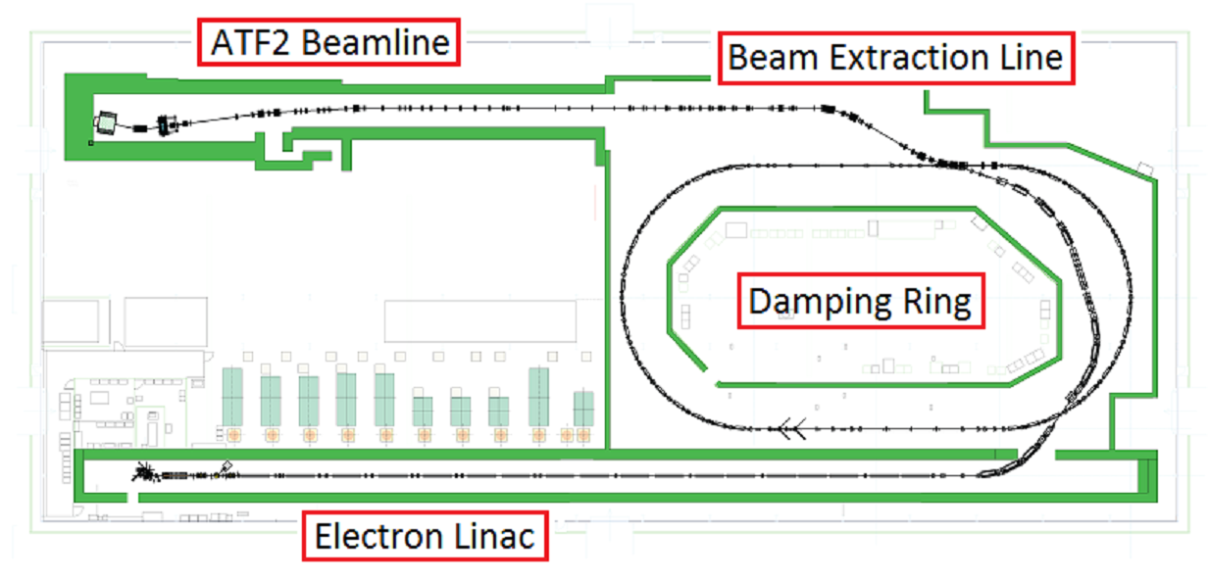
Will it work ? System Tests: ATF 2 @ KEK
Goal 1: demonstrate optics, tunability
Goal 2: beam stabilisation through
feedback
Local chromatic corrections
From Kubo at al

Slide 22
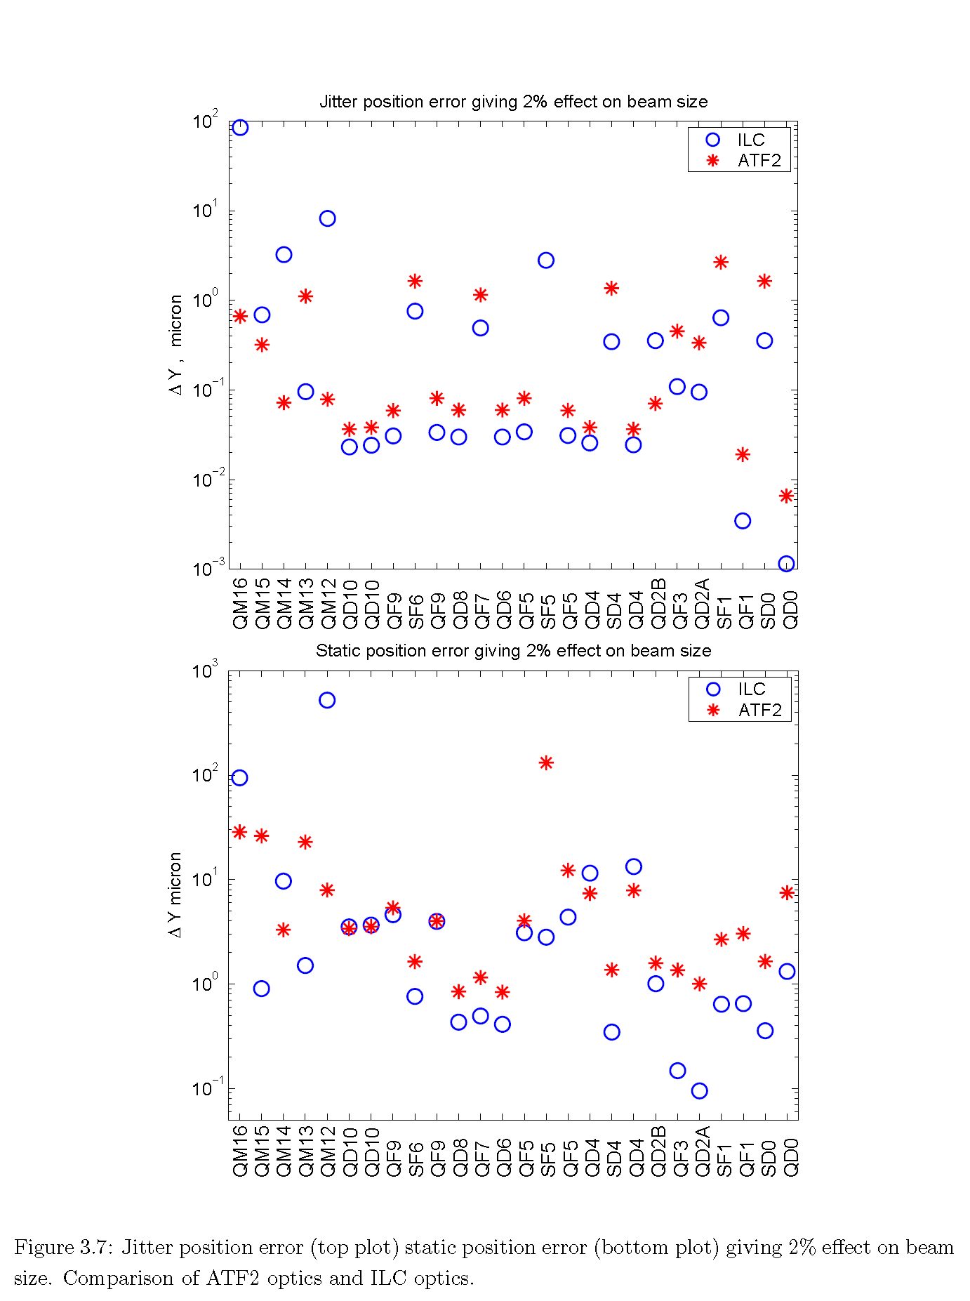
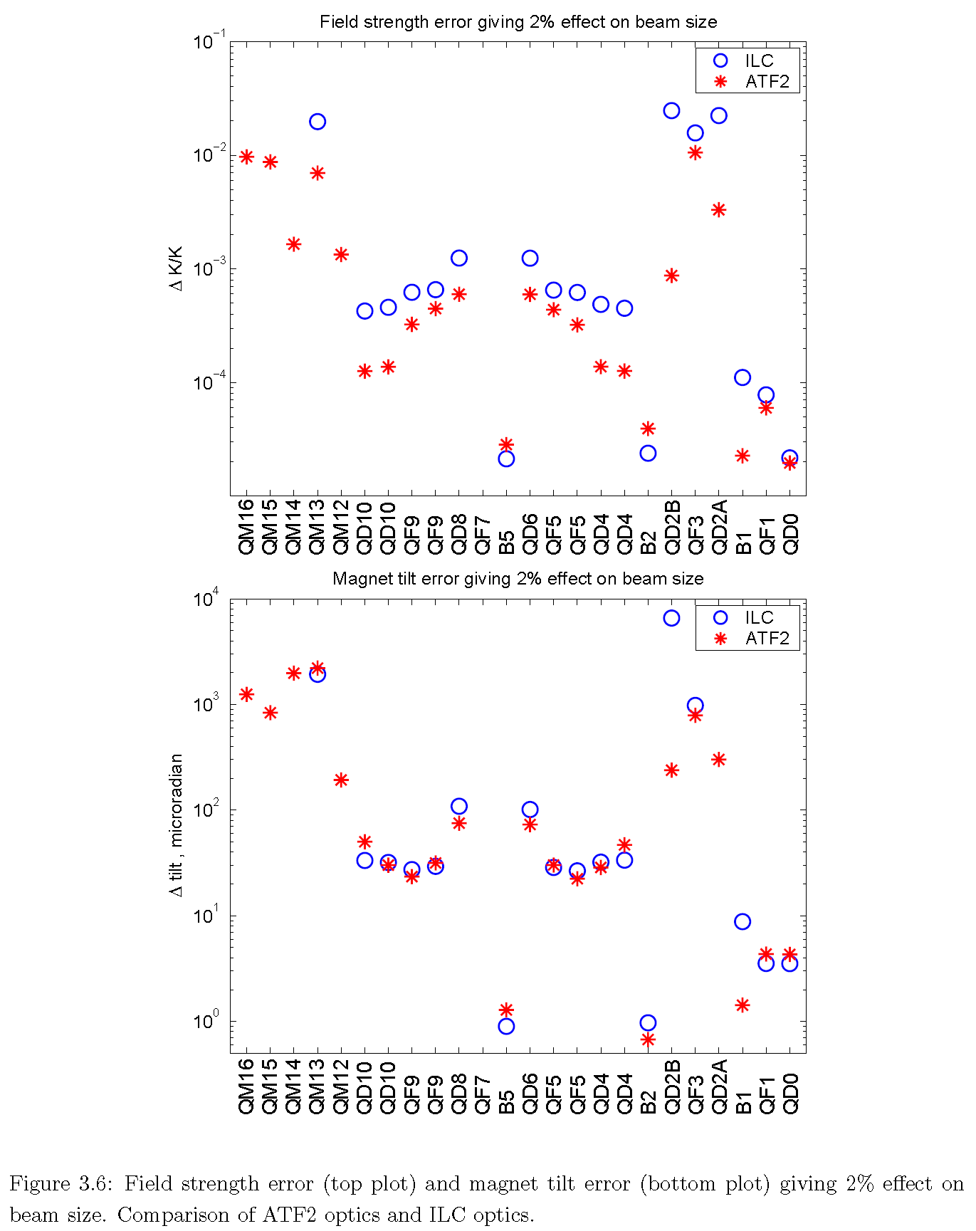
Tolerances for Final Focus System
Field strength
Jitter position
ILC
ATF2
Rotation
Static position
Similar optics, similar tolerances.
From Kubo at al

Slide 23
ATF2 Timeline of results
Currently 45± 3 nm
Field quality improvements, orbit stabilisation through feedback, shorted turn in 6-pole magnet, beam size monitor improvements
From Kubo at al

Slide 24
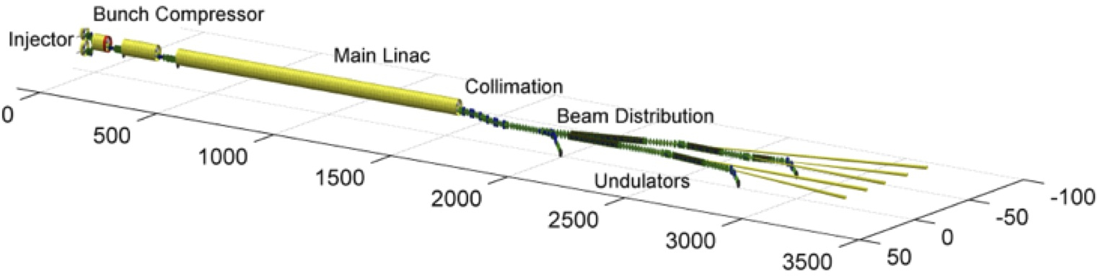





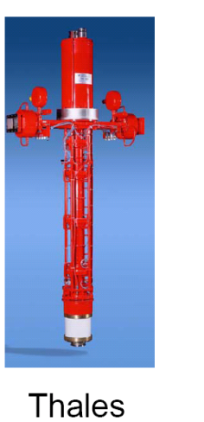
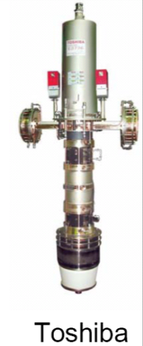
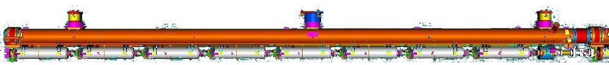
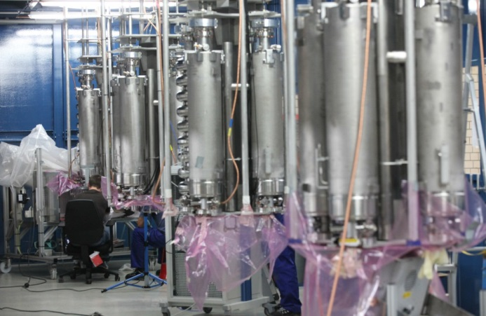
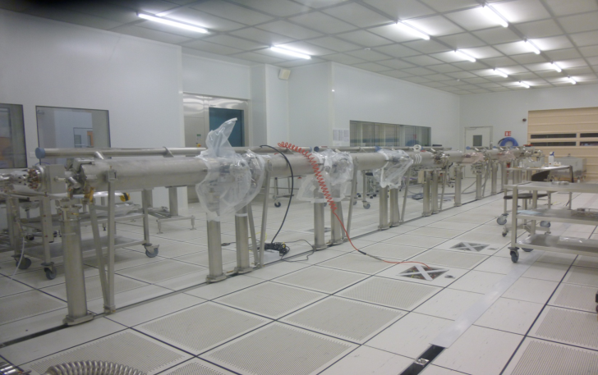
SRF Construction Projects – XFEL @ DESY
808 cavities
1.3 GHz / 23,6 MV/m
101 cryomodules / 17,5 GeV
26 RF stations (10 MW) operating at 5,2 MW
Vertical Cavity RF Test @ DESY
Cavity String Assembly @ CEA
XFEL Cryomodule
XFEL Linac: the ultimate ‘integrated systems test’ for ILC
Commissioning with beam:
beginning of 2016

Slide 25
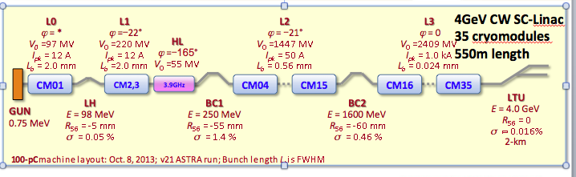
SRF Construction Projects – LCLS II @ SLAC
Construction 2015-19

Slide 26
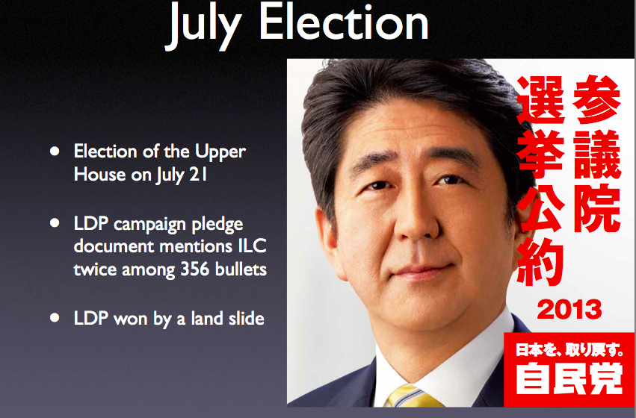
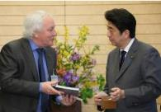
  Japan – Political Support

Slide 27
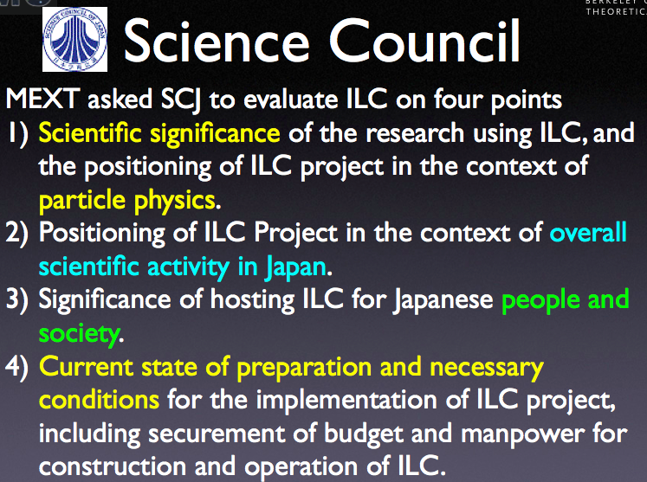
  Japan – Science Council of Japan

Slide 28
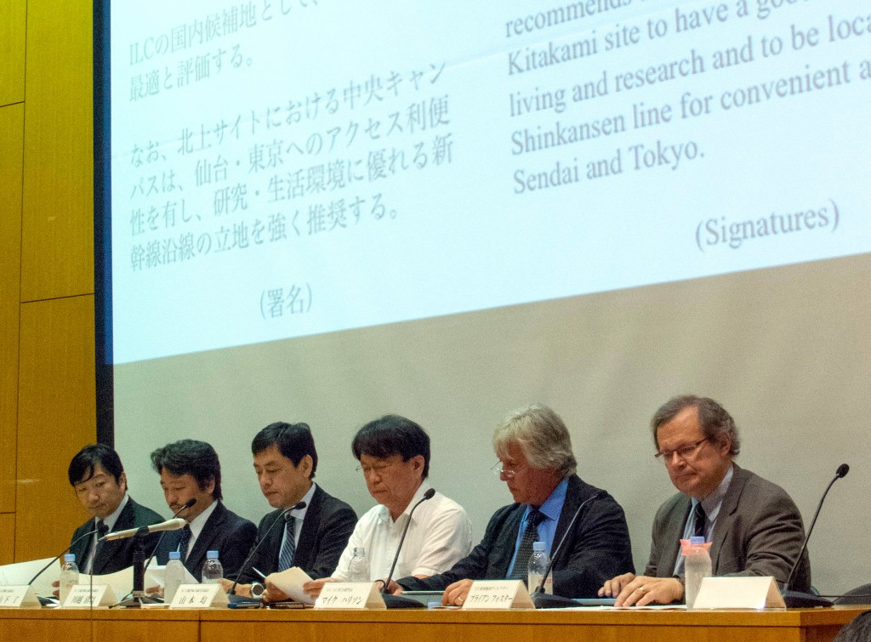

  Japan – Site Evaluation
Both sites would work – Kitakami preferred
“

Slide 29


Establish a site-specific Civil Engineering Design - map the (site independent) TDR baseline onto the preferred site - assuming “Kitakami” as a primary candidate
High-way
Proposed by JHEP community
Endorsed by LCC
Not yet decided by Japanese Government
Ofunato
Oshu
Express-
Rail
Kesen-numa
Sendai
Ichinoseki
Need to finalize:
IP / Linac orientation and length
Access points and IR infrastructure
Conventional Facilities and Siting (CFS)
…

Slide 30

Local Support
From Nakai et al

Slide 31



Preferred Site - Kitakami
From Enomoto et al

Slide 32

Cryogenic Concept
From Nakai et al

Slide 33

Helium supply at CERN
From Delikaris et al

Slide 34
Tunnel Layout - Baseline
From Enomoto et al

Slide 35

Tunnel Shielding
From Sanami et al

Slide 36
Detector Hall evolution - ongoing
Baseline (TDR) | Hybrid - A (ADI-CFS Joint Meeting)
2 Vertical Shafts (SiD Proposal) | Hybrid - A’ (KEK-CFS Proposal)
Assembly
Yd
DR
Surface
Yd
Assembly
Yd
DR Surface
Yd
UT Sht
Main Sht
DR/ AT
W8m Grad10%
DH/AT
W11m Grad7%
DR/ AT
W8m Grad10%
DH/AT
W8m Grad10%
D/H
D/R
D/H
D/R
DR
Surface Yd
Assembly
Yd
DR
Surface Yd
Assembly
Yd
UT Sht
UT Sht
DR/AT
W8m Grad10%
DR-DH Common AT
W8m Grad10%
Second Sht
Main Sht
D/H
D/R
D/H
D/R
Converge in September ? – CFS/MDI meeting
From Miyahara at al

Slide 37
Thus ………
The highest energy e+e- collisions in the foreseeable future are given by linear colliders
ILC 500 GeV (250 GeV -> 1 TeV) – relatively conservative approach, could start soon
CLIC 350 GeV -> 3 TeV – less conservative, R&D program until 2018 (the next European Strategy process)
SRF technology development continues
LHC ~ 13 TeV starting
Japan ponders (physics, money, global HEP, etc…) – decision in 2016

Slide 38
Backup

Slide 39

Storage ring or LC?
Cost scaling (and length)
  Already identified 50 year ago
250 GeV favours storage ring
350-500 GeV and up: linear collider starts to look better
  above 500 GeV likely only option
Physics, cost (and opportunity!) must decide!
The ultimate future of e⁺e⁻ colliders is linear
  or not at all
LEP scaling ~E² uncertainty
ILC scaling ~E
Note: over simplified. Need to wait for
robust and defendable cost estimates
from storage ring studies
LC represents a PARADIGM shift
22

Slide 40

ℒ ×E_{CM} → MWatt
at least for lepton machines
LHC machine <100 MW
Where are the acceptable limits?
(not the technical limits)
High running costs may
need to be shared
(global project)
R&D needed in increasing
efficiencies and/or recovering the
energy
28

