Slide 1
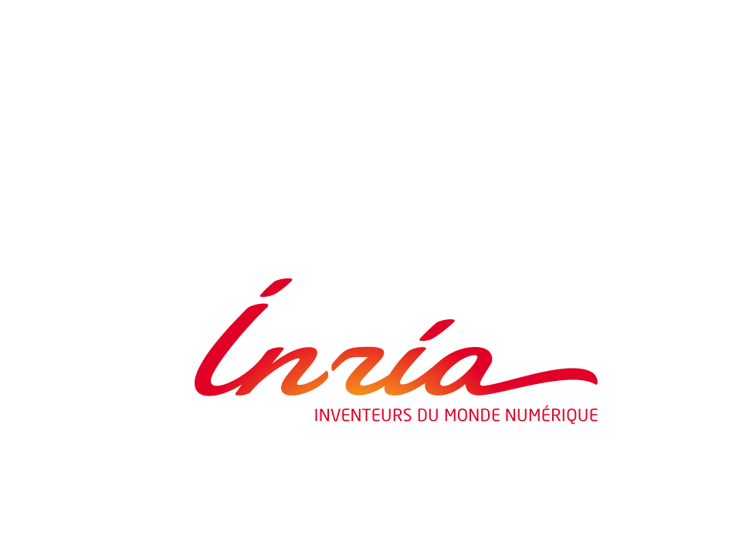
Les données du Web : quand nos vies numériques deviennent des bases des connaissances
Serge Abiteboul
INRIA & ENS Cachan
@sergeabiteboul

Slide 2
The context
The Pims
The Pims are arriving
The advantages
From information to knowledge
Conclusion
Managing your digital life with a Personal information management system, with Benjamin André & Daniel Kaplan, to appear in Communications of the ACM
ERC Webdam, http://webdam.inria.fr

Slide 3
Data explosion
Data and metadata we produce
Pictures, reports, emails, tweets, annotations, recommendation, social network…
Data we like/buy
Books, music, movies…
Data various organizations & vendors produce about us
Public administration, schools, insurances, banks…
Amazon, retailers, netflix, applestore…
Data that sensors capture with/without our knowledge
GPS, web navigation, phone, "quantified self" measurements, contactless card readings, surveillance camera pictures…
Others data: work, social contacts, friends, family
Security data: credentials on various systems
…

Slide 4
Data dispersion
Computer, systems, clouds, devices (phone, tablet, car…)…
Residential boxes (tvbox), NAS, electronic vaults…
Mail, address book, agenda, todo-lists
Facebook, LinkedIn, Picasa, YouTube, Tweeter
Amazon (books), iTunes (music), Netflix (movies)
Svn, Google docs, Dropbox
Government & business services
Also machine and systems from
family, friends, associations, work
Systems even unknown to the user
third party cookies

Slide 5
Data heterogeneity
Type: text, relational, HTML, XML, pdf…
Terminology/structure/ontology
Systems: MS, Linux, IOS, Android
Distribution
Security protocols
Quality: incomplete / inconsistent information

Slide 6
Bad news
Limited functionalities because of the silos
Difficult to do global search, synchronization, task sequencing over distinct systems…
Loss of control over the data
Difficult to control privacy
Leaks of private information
Loss of freedom
Vendor lock-in

Slide 7
Alternatives
Continue with this increasing mess
Use a shrink to overcome frustration
Regroup all your data on the same platform
Google, Apple, Facebook, …, a new comer
Use a shrink to overcome resentment
Study 2 years to become a geek
Geeks know how to manage their information
Use a shrink to survive the experience
And, of course,
there is the Pims’ way

Slide 8
Information is a vital asset
We have little control over our personal info
Thesis 1: We should regain control of our information, e.g., with PIMS

Slide 9
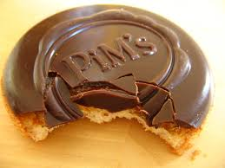
The Pims
Personal information management system
What is a successful Web service today
Some great software
Some machines on which it runs
And a business model
Separate the first two facets
Some company provides the software
It runs on your machine
With a business model

Slide 10
The Pims
The user selects a server
The user owns/pays for a hosted server
Physically located at the user’s home (e.g., a tvbox) or not
Running on a single machine or distributed
On the cloud so reachable from anywhere
The Pims runs the application software
The user chooses the code to deploy on the server
The software is open source, a requirement for security
The Pims manages the user's data
All the user’s personal information
Possibly replicated from external services

Slide 11
The Pims: the 2 main issues
Security
Hard to be riskier than today’s model
The Pims is ran by a professional operator
Data of different users are isolated
System administration
It should require epsilon competence
It should be epsilon work

Slide 12
The context
The Pims
The Pims are arriving – 3 angles
Society
Technology
Industry
The advantages
From information to knowledge
Conclusion

Slide 13
Society is ready to move
Growing resentment
Against companies: intrusive marketing, cryptic personalization and business decisions (e.g., on pricing), creepy "big data" inferences
Against governments: NSA and its European counterparts)
Increasing awareness of the dissymmetry
between what these systems know about a person, and what the person actually knows
Emerging understanding of the value of personal data for individuals
Quantified self

Slide 14
Society is ready to move (2)
Privacy control: regulations in Europe
Information symmetry: Vendor relation management
Many reports/proposals that affirm the ownership of personal data by the person
Personal data disclosure initiatives
Smart Disclosure (US); MiData (UK), MesInfos (France)
Several large companies (network operators, banks, retailers, insurers…) agreeing to share with customers the personal data that they have about them

Slide 15
Technology is gearing up
System administration is easier
Abstraction technologies for servers
Virtualization and configuration management tools
Open source technology more and more available for services
Price of machines is going down
A hosted-low cost server is as cheap as 5€/month
Paying is no longer a barrier for a majority of people
You may have friends already doing it

Slide 16
Technology is gearing up (2)
Many systems & projects
Lifestreams, Stuff-I’ve-Seen, Haystack, MyLifeBits, Connections, Seetrieve, Personal Dataspaces, or deskWeb.
YounoHost, Amahi, ArkOS, OwnCloud or Cozy Cloud
Some on particular aspects
Mailpile for mail
Lima for a Dropbox-like service, but at home.
Personal NAS (network-connected storage) e.g. Synologie
Personal data store SAMI of Samsung...
Many more

Slide 17
Industry is interested Pre-digital companies
E.g., hotels or banks
Disintermediated from their customers by pure Internet players such as Google, Amazon, Booking.com, Mint.
In Pims, they can rebuild direct interaction
The playing field is neutral
Unlike on the Internet where they have less data
They can offer new services without compromising privacy

Slide 18
Industry is interested (2) Home appliances companies
Many boxes deployed at home or in datacenters
Internet access provider "boxes”, NAS servers, "smart" meters provided by energy vendors, home automation systems, "digital lockers”…
Personal data spaces dedicated to specific usage
Could evolve to become more generic
Control of private Internet of objects

Slide 19
Industry is interested (3) Pure Internet players
Amazon: great know-how in providing services
Facebook,Google: cannot afford to be out of a movement in personal data management
Very far from their business model based on personal advertisement
Moving to this new market would require major changes & the clarification of the relationship with users w.r.t. data monetization

Slide 20
Advantages – rebalance the Web
User control over their data
Who has access to what, under what rules, to do what
User empowerment
They choose freely services & they can leave a service
Participation to a more “neutral” Web
With the "network effects", the main platforms are accumulating data/customers and distorting competition
The Pims bring back fairness on the Web
Good practices are encouraged, e.g., interoperability, portability

Slide 21
Advantages – new functionalities
Semantic global search with (personal) ontology
Synchronization/backups across services
Access control management across services
Task sequencing across services
Exchange of information between “friends”
Connected objects control, a hub for the IoT
Personal big data analysis

Slide 22
This is getting too complicated for humans
We need the support of machines
Thesis 2: We should turn the Web into a distributed knowledge base

Slide 23
People like text but machines prefer data/knowledge
Integration of information sources
It is easier to integrate knowledge than information
Collaboration between services & devices
It is easier for services to collaborate using knowledge than with information
Problem solving based on knowledge inference

Slide 24
Where can we find knowledge?
In encyclopedia, e.g., Wikipedia
In recommendations, e.g., TripAdvisor
In databases, e.g., IMDb
In social networks, e.g., Facebook
In personal data, e.g., Calendar, mail
In the crowd, e.g., Mechanical Turk
…
But often under the form of text

Slide 25
Digression: How is knowledge acquired?
Edited by humans – rarely
Extraction by machines from text
In the style of Yago’s extraction for Wikipedia
By aligning different ontologies
Alignment between ontologies (Paris system)
Production by services
Mining by data analysis/mining
Inference of knowledge (inference engines)
Most of the knowledge is produced by machines

Slide 26
The thesis
We should turn the Web into a distributed knowledge base with machines/systems
Storing knowledge
Producing knowledge
Extracting knowledge
Reasoning
Exchanging knowledge
We need a simple language for distributed knowledge processing ➔ Work on Webdamlog

Slide 27
Conclusion: The two thesis of this talk
We should regain control of our information, e.g., with PIMS
We should turn the Web into a distributed knowledge base where peers share facts and rules, and collaborate

Slide 28
Many R&D issues to consider
The data is out there – open world
Data is imprecise, possibly missing, inconsistent
Users want explanations
Privacy should be guaranteed
Too much adapted to you may be boring – serendipity
What to forget - hypermnesia

Slide 29
http://abiteboul.com
@sergeabiteboul
binaire.blog.lemonde.fr

