Slide 1

International Collaboration for Data Preservation and
Long Term Analysis in High Energy Physics

Slide 2
Data Preservation (in HEP) and Open Science Data
Jamie.Shiers@cern.ch
DPHEP Project Manager – 25 November 2014
https://indico.cern.ch/category/4458/

Slide 3
Overview
This talk will review the status and plans of data preservation in High Energy Physics (HEP)
It will be placed in the context of on-going work in multiple disciplines + EU projects
I will introduce “the golden triangle” and lead towards the conclusion (or next destination?):
Beyond Open Data: Open Knowledge

Slide 4
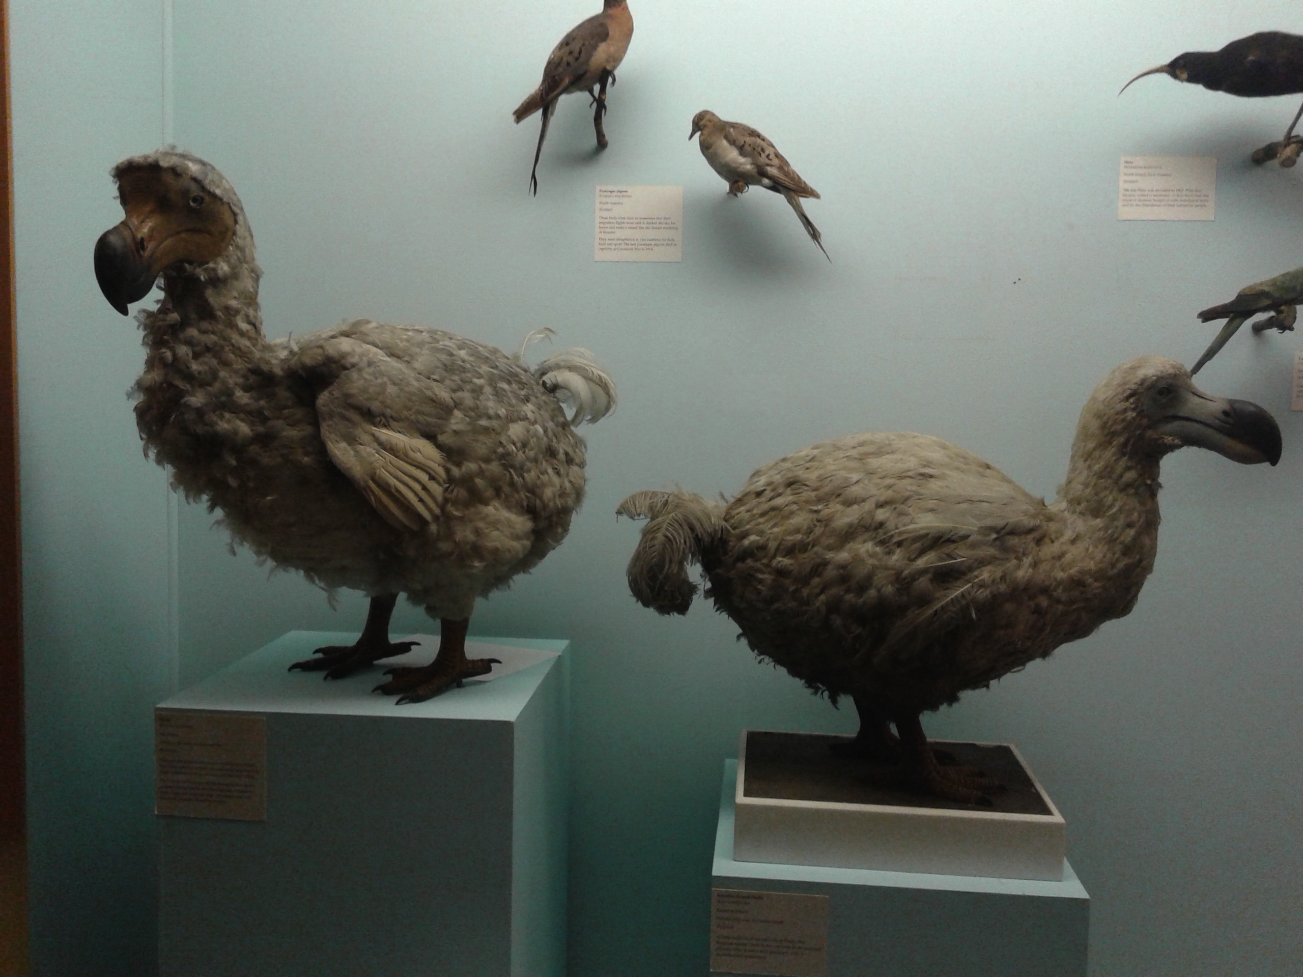

Slide 5
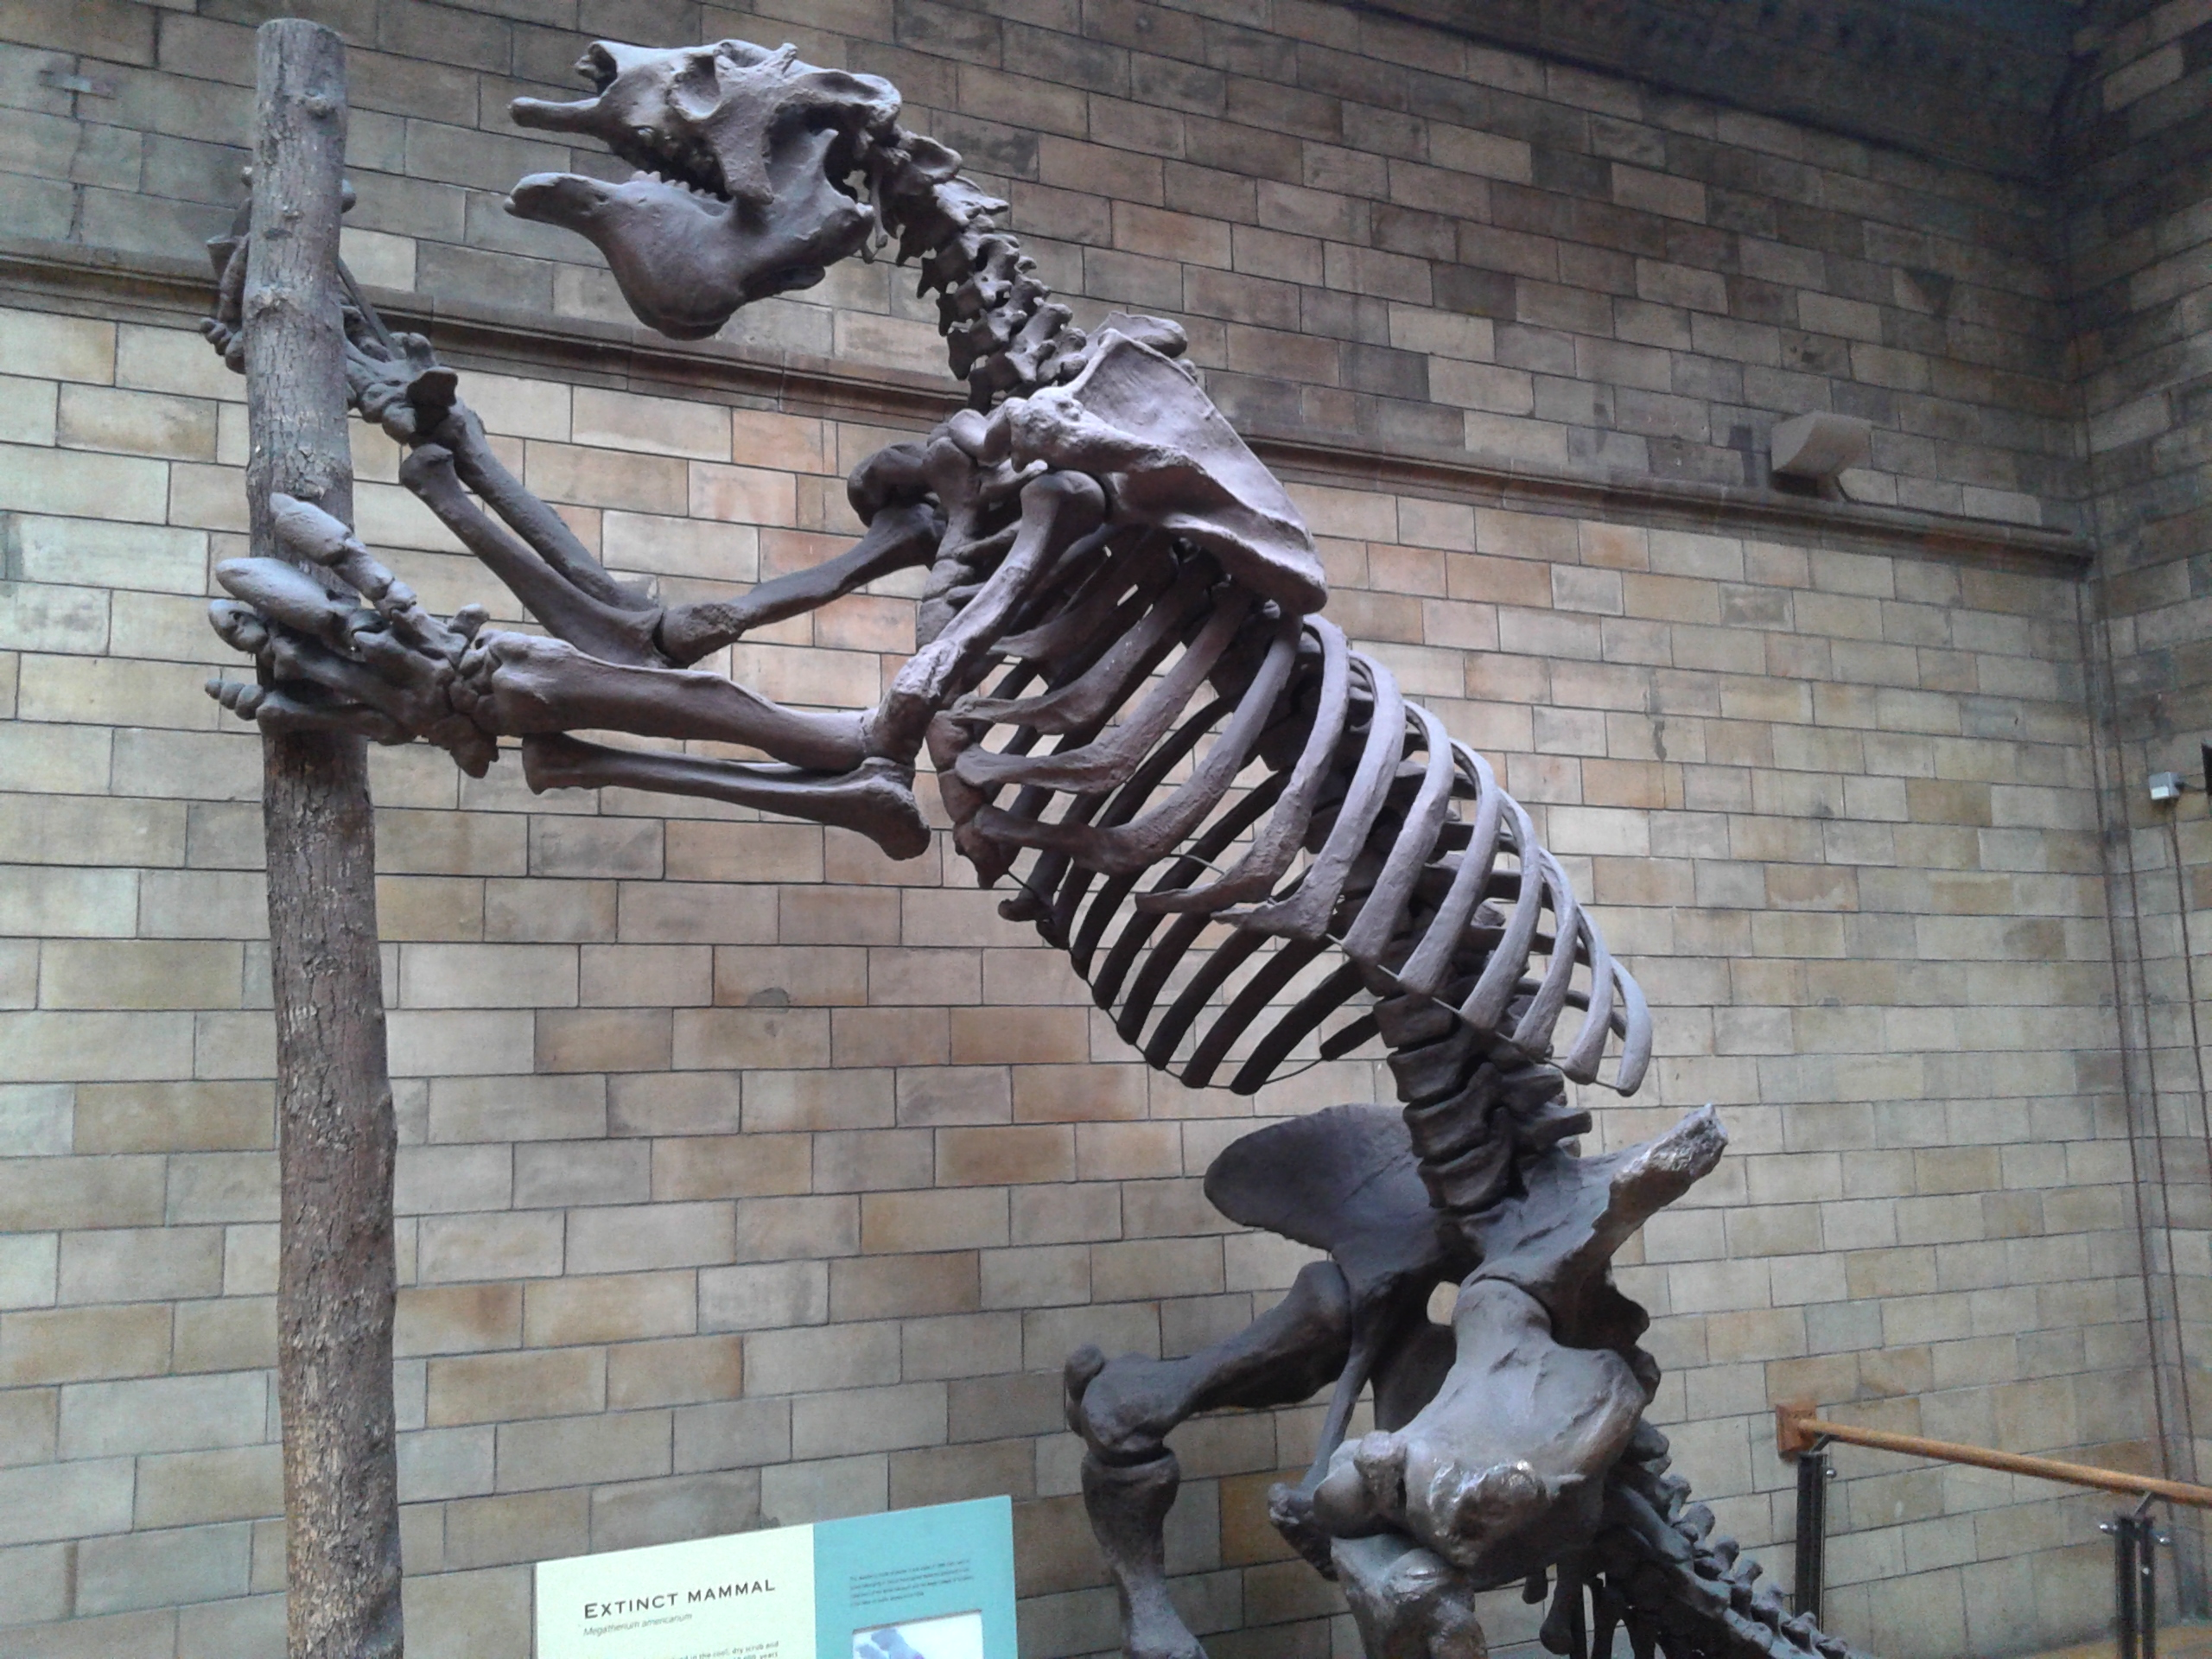

Slide 6
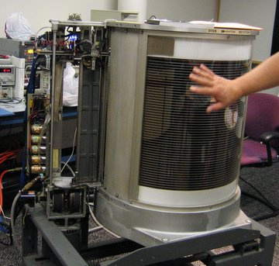
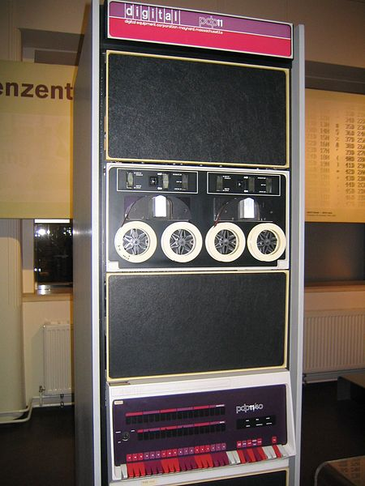
IBM 350 RAMAC
PDP DECtape
1956, 5 Mch, 8 Kch/s IO
1970, 144K 18_ bit words

Slide 7
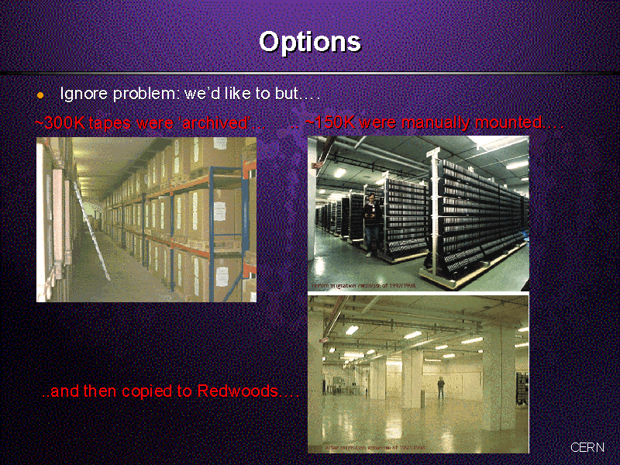
Lack of Storage – Lack of Space!

Slide 8

http://science.energy.gov/funding-opportunities/digital-data-management/
“The focus of this statement is sharing and preservation of digital research data”
All proposals submitted to the Office of Science (after 1 October 2014) for research funding must include a Data Management Plan (DMP) that addresses the following requirements:
DMPs should describe whether and how data generated in the course of the proposed research will be shared and preserved.
If the plan is not to share and/or preserve certain data, then the plan must explain the basis of the decision (for example, cost/benefit considerations, other parameters of feasibility, scientific appropriateness, or limitations discussed in #4).
At a minimum, DMPs must describe how data sharing and preservation will enable validation of results, or how results could be validated if data are not shared or preserved.

Slide 9

4C Roadmap Messages
A Collaboration to Clarify the Costs of Curation
Identify the value of digital assets and make choices
Demand and choose more efficient systems
Develop scalable services and infrastructure
Design digital curation as a sustainable service
Make funding dependent on costing digital assets across the whole lifecycle
Be collaborative and transparent to drive down costs

Slide 10
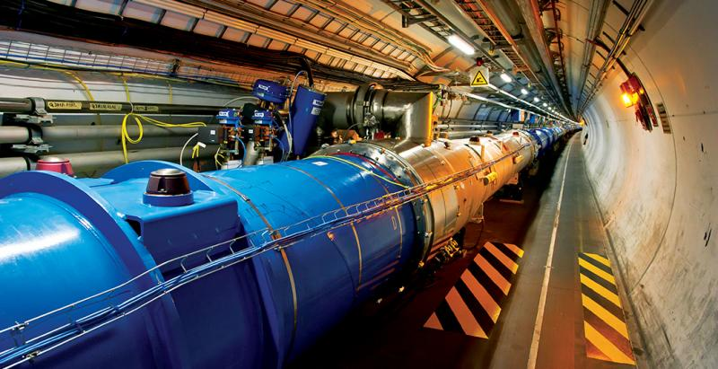
“Observations” (unrepeatable)
versus “measurements”
“Records” versus “data”
Choices & decisions:
Some (re-)uses of data are unforeseen!
No “one-size fits all”

Slide 11
Volume: 100PB + ~50PB/year
(+500PB/year from 2025)

Slide 12

Identify the value of digital assets and make choices
Significant volumes of HEP data are thrown away “at birth” – i.e. via very strict filters (aka triggers) B4 writing to storage
To 1st approximation ALL remaining data needs to be kept for a few decades
“Value” can be measured in a number of ways:
  Scientific publications / results;
  Educational / cultural impact;
  “Spin-offs” – e.g. superconductivity, ICT, vacuum technology.

Slide 13
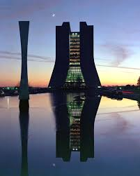
Balance sheet – Tevatron@FNAL
20 year investment in Tevatron ~ $4B
Students $4B
Magnets and MRI $5-10B ~ $50B total
Computing $40B
Very rough calculation – but confirms our gut feeling that investment in fundamental science pays off
I think there is an opportunity for someone to repeat this exercise more rigorously
cf. STFC study of SRS Impact
http://www.stfc.ac.uk/2428.aspx
}

Slide 14
Data: Outlook for HL-LHC
PB
We are here!
Very rough estimate of a new RAW data per year of running using a simple extrapolation of current data volume scaled by the output rates.
  To be added: derived data (ESD, AOD), simulation, user data…
At least 0.5 EB / year (x 10 years of data taking)

Slide 15
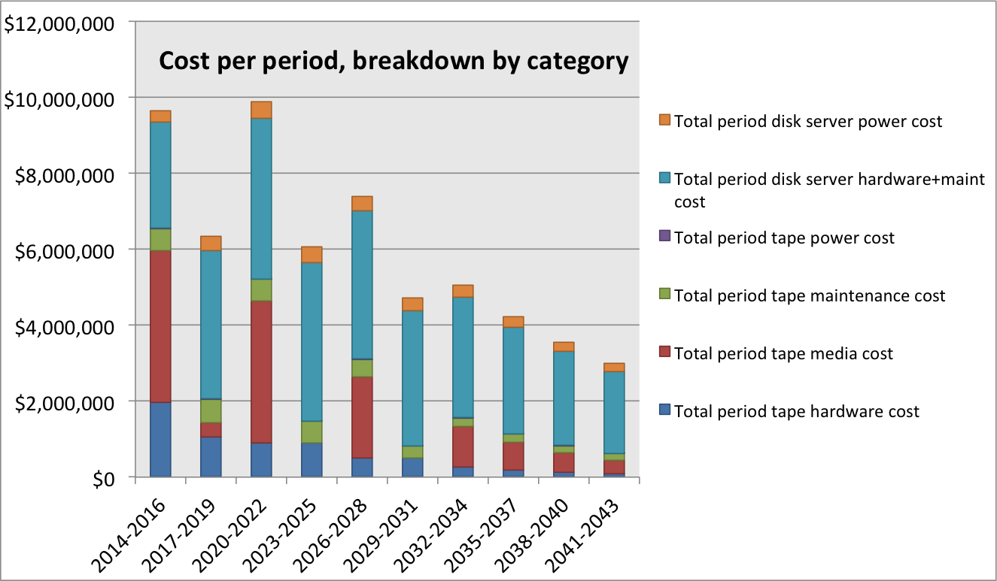
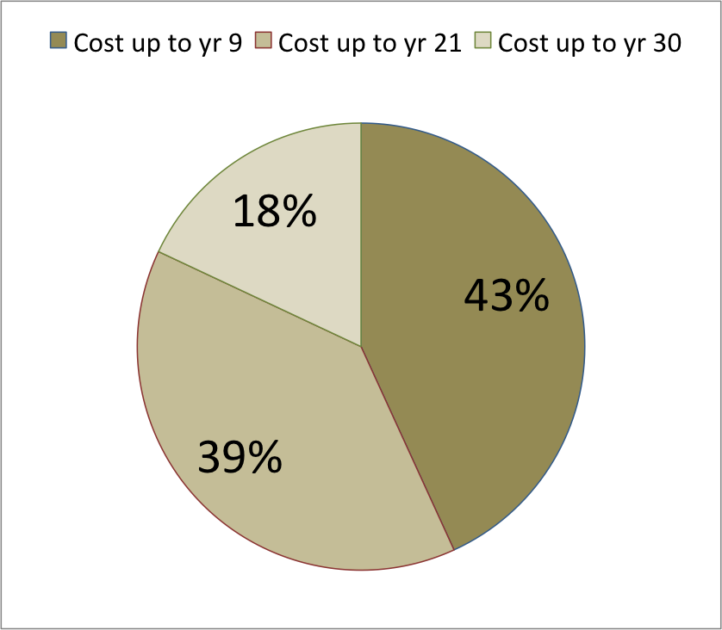
Approximation of (HL-)LHC Growth
Total cost: ~$59.9M
(~$2M / year)

Slide 16
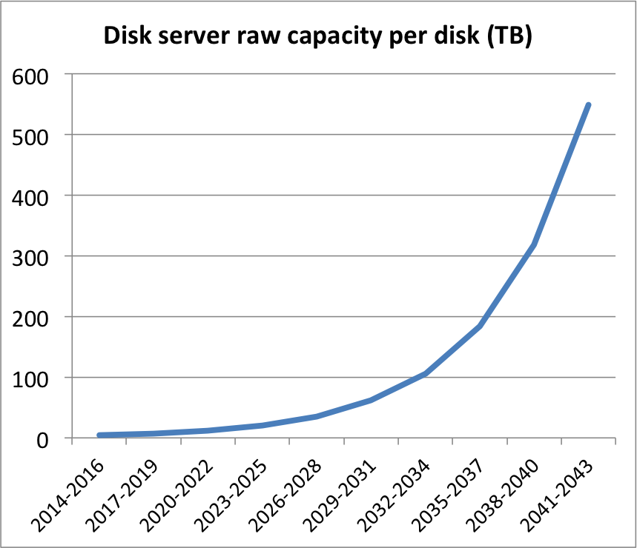
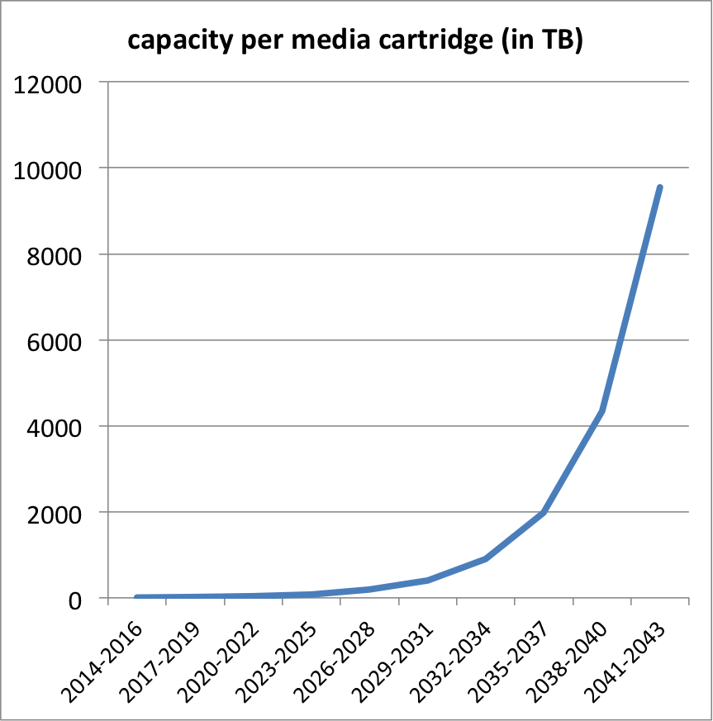
Storage Technology evolution
Assuming
  +20% yearly disk capacity per constant $
  +30% yearly tape capacity per constant $ (+20%/yr I/O increase)
2044: 550TB
2044: 9.5PB(!)
2034: 106TB
2034: 900TB
2014: 4TB
2024: 20TB
2014: 8TB
2024: 85TB

Slide 17
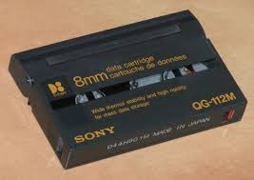
Long-Term Storage Examples
LEP: ~100TB = O(10) today’s cartridges (~$3K)
HERA: ~10PB = O(10) “2030” cartridges
LHC Run 1: ~100PB =O(10) “2040” cartridges
LHC total: ~10EB = O(??) ????

Slide 18

Data Preservation plans
The ALICE collaboration is committed to develop a long term program for Data Preservation to serve the triple purpose of
  preserving data, software and know-how inside the Collaboration,
  sharing data and associated software and documentation with the larger scientific community, and
  give access to reduced data sets and associated software and documentation to the general public for educational and outreach activities.

Slide 19
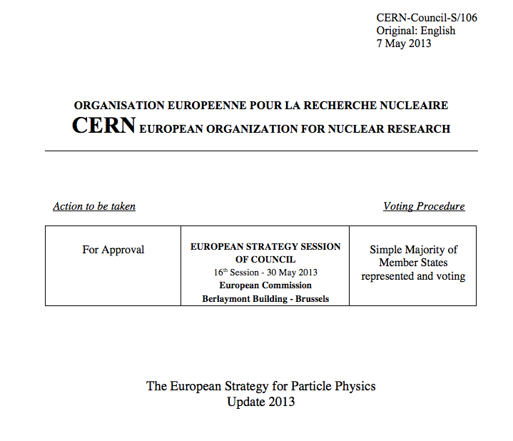
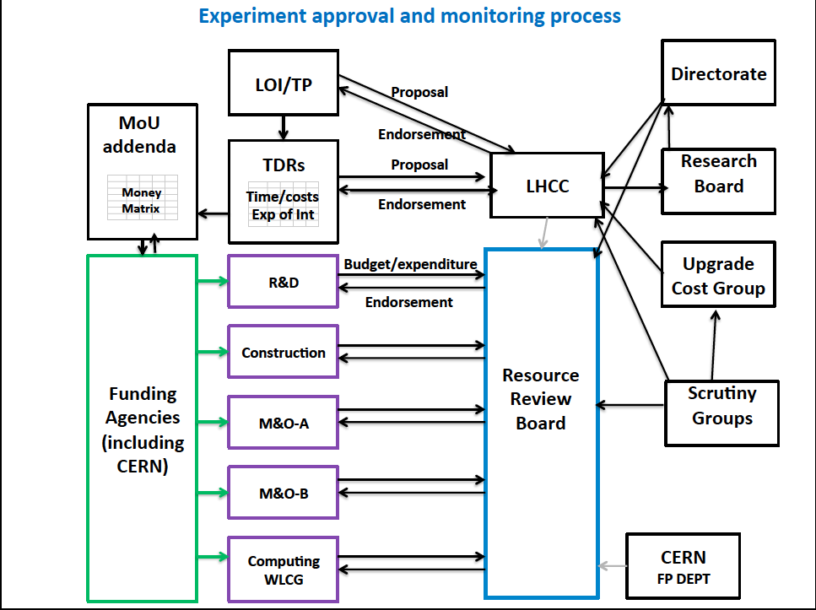
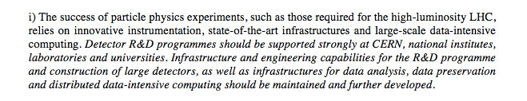
Sustainability – Funding

Slide 20
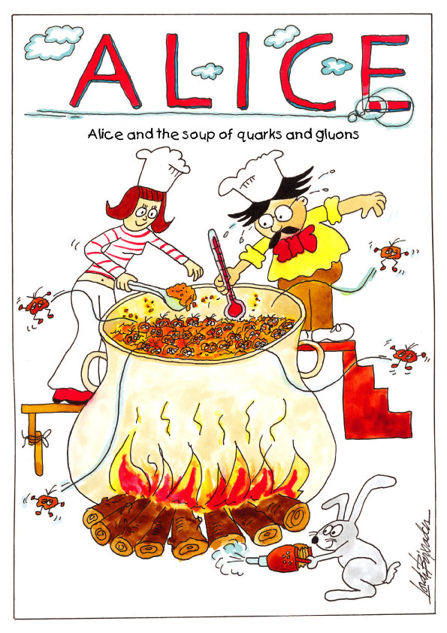
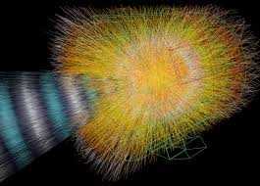
Data Preservation plans
The ALICE collaboration is committed to develop a long term program for Data Preservation to serve the triple purpose of
  preserving data, software and know-how inside the Collaboration,
  sharing data and associated software and documentation with the larger scientific community, and
  give access to reduced data sets and associated software and documentation to the general public for educational and outreach activities.
The goal is to require the reproducibility of analysis in such virtualized environments as a prerequisite for publishing results.

Slide 21
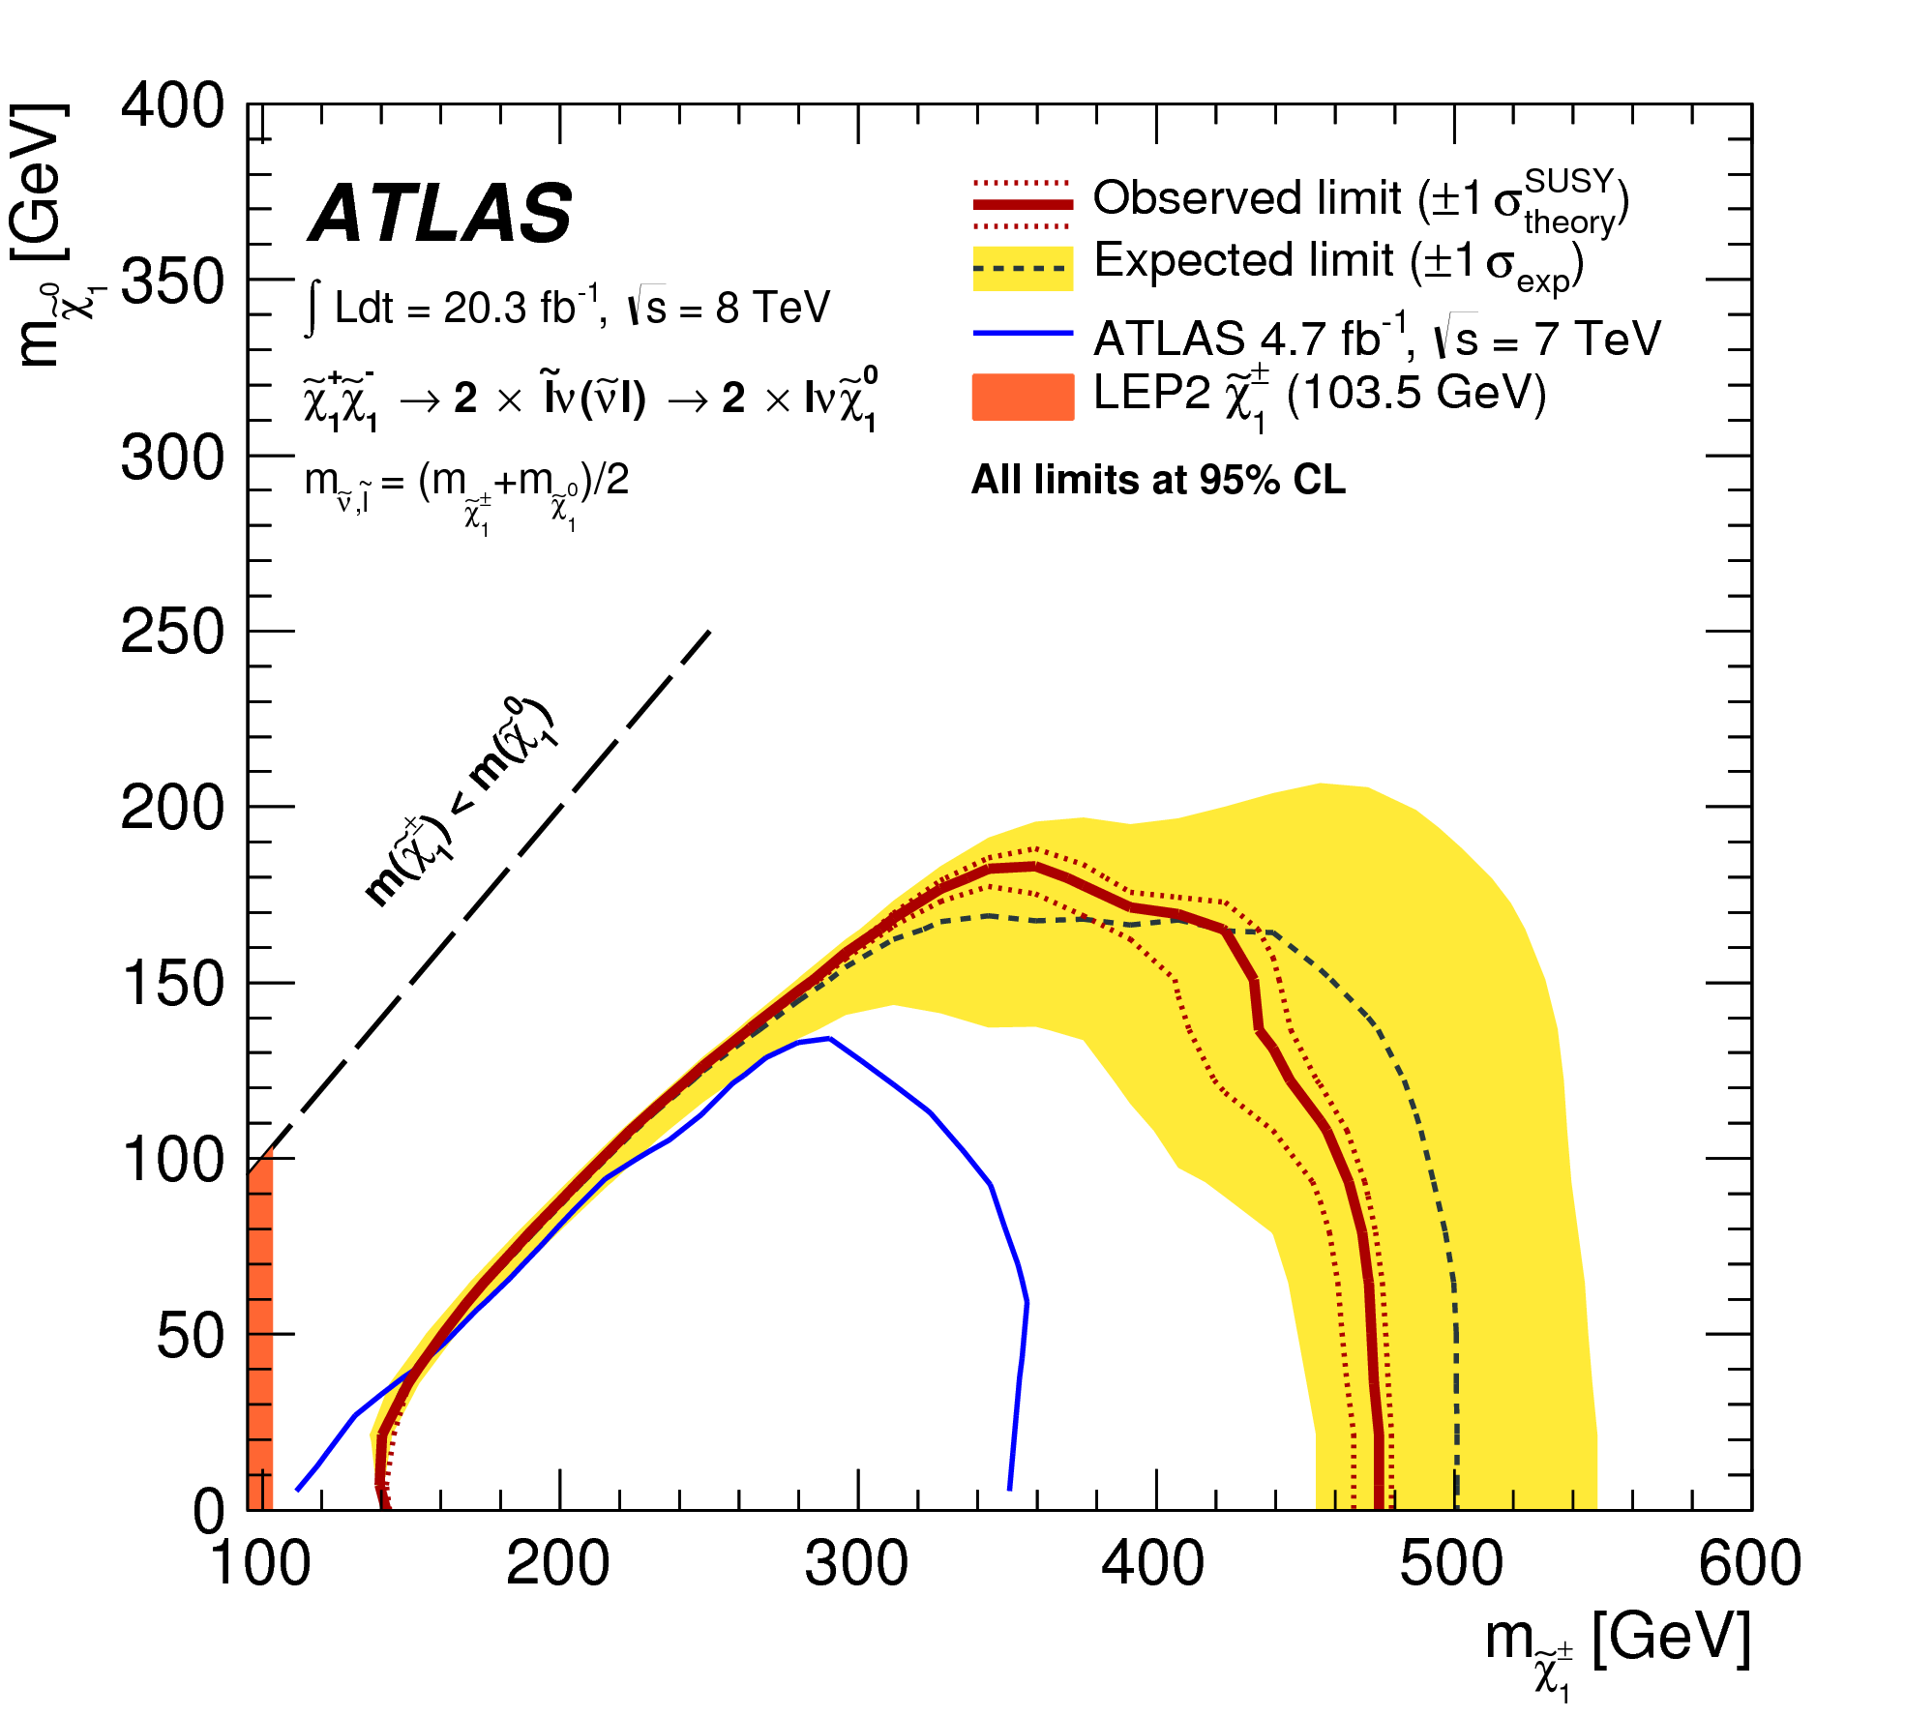

Slide 22
2020 Vision for LT DP in HEP
Long-term – e.g. FCC timescales: disruptive change
  By 2020, all archived data – e.g. that described in DPHEP Blueprint, including LHC data – easily findable, fully usable by designated communities with clear (Open) access policies and possibilities to annotate further
  Best practices, tools and services well run-in, fully documented and sustainable; built in common with other disciplines, based on standards
  DPHEP portal, through which data / tools accessed
    “HEP FAIRport”: Findable, Accessible, Interoperable, Re-usable
Agree with Funding Agencies clear targets & metrics

Slide 23
Implementing the Vision…
Together, we have reached the point where a generic, multi-disciplinary, scalable e-i/s for LTDP is achievable – and will hopefully be funded ☺
Built on standards, certified via agreed procedures, using the “Cream of DP services”, based on EUR100M investment in EU alone!
In parallel, Business Cases and Cost Models are increasingly understood, working closely with Projects, Communities and Funding Agencies

Slide 24
Summary (but not the end…)
Building on more than a decade of R&D and production deployment, together with de-facto and de-jure standards, a (general purpose) DP infrastructure could be setup
  There are many benefits of such an e-i/f – see for example 4C recommendations
Each discipline / community must understand what data it needs to preserve, for whom / what purpose and understand (justify) costs involved

Slide 25
4C Roadmap Messages
A Collaboration to Clarify the Costs of Curation
Identify the value of digital assets and make choices
Demand and choose more efficient systems
Develop scalable services and infrastructure
Design digital curation as a sustainable service
Make funding dependent on costing digital assets across the whole lifecycle
Be collaborative and transparent to drive down costs

Slide 26
The Golden Triangle
  Funding Agencies;
  Service Providers;
  User Communities.
  Agree up-front; meaningful metrics; on-going (live) data management plans
  Data Preservation / Curation / “Stewardship”

Slide 27
Outlook
With a sustainable, reliable, certified, distributed (for replication) DP infrastructure
.. Together with services supporting the Use Cases of different domains ...
We still have not solved all problems
For this, we need to go beyond Open Access, beyond Open Data, towards “Open Knowledge”

Slide 28
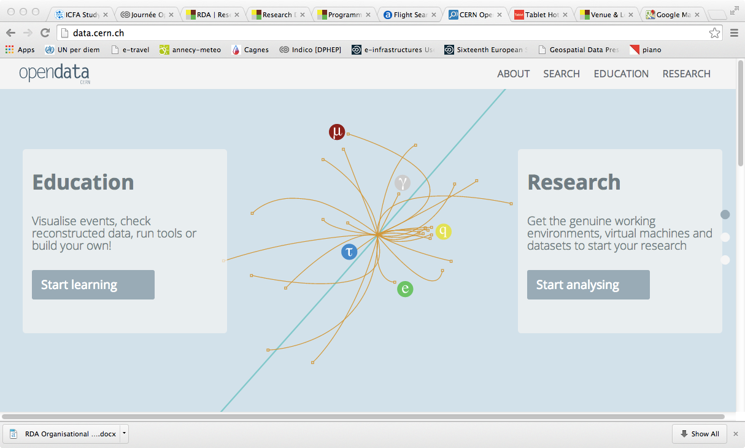

Slide 29
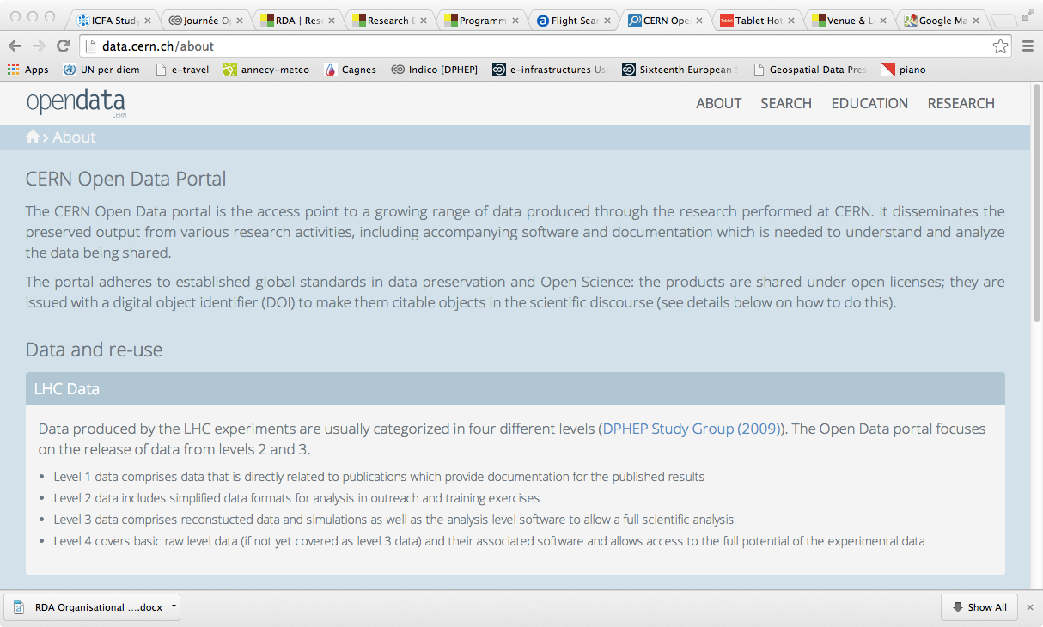

Slide 30
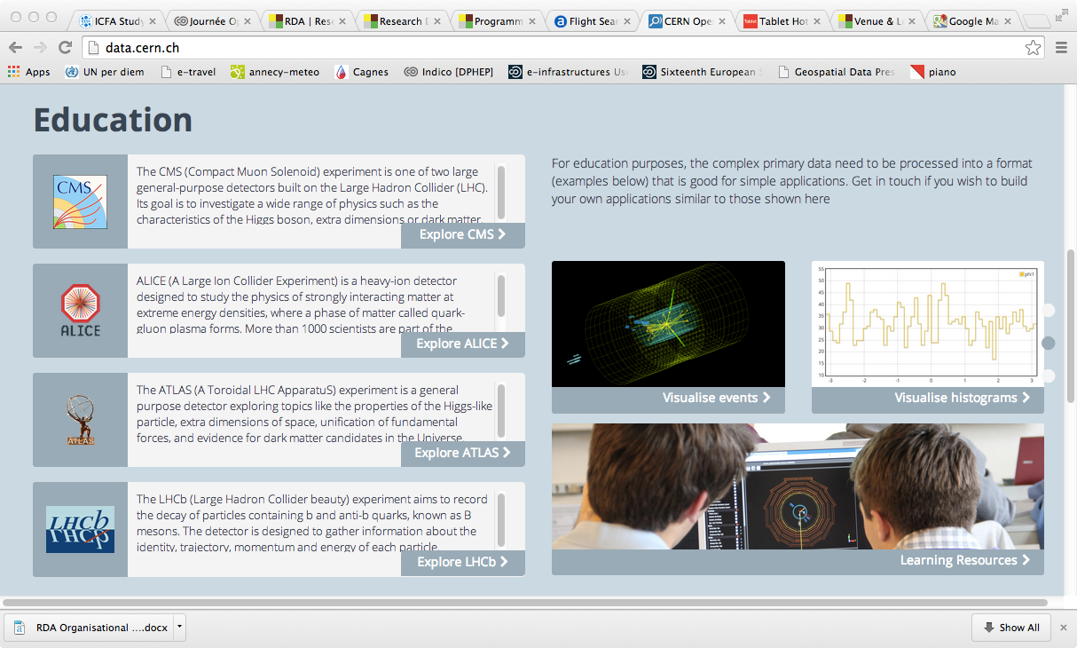

Slide 31
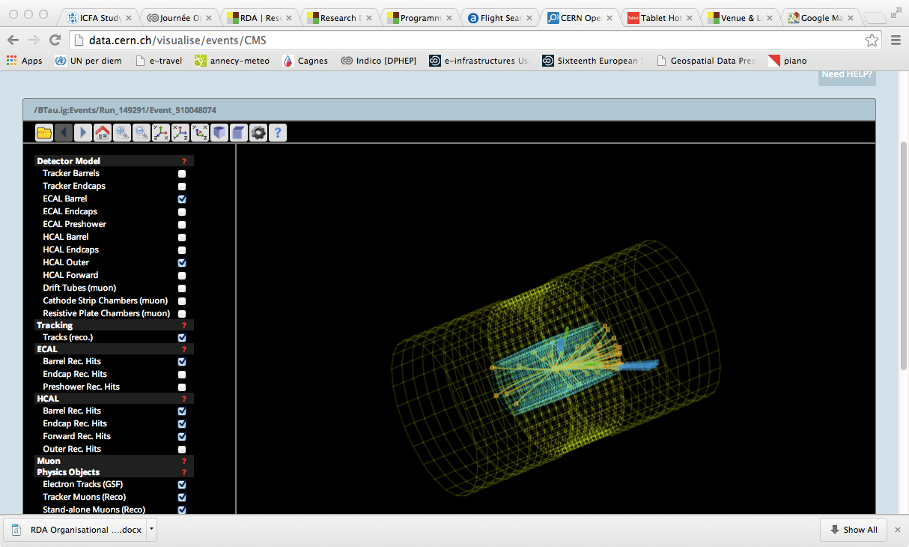

Slide 32
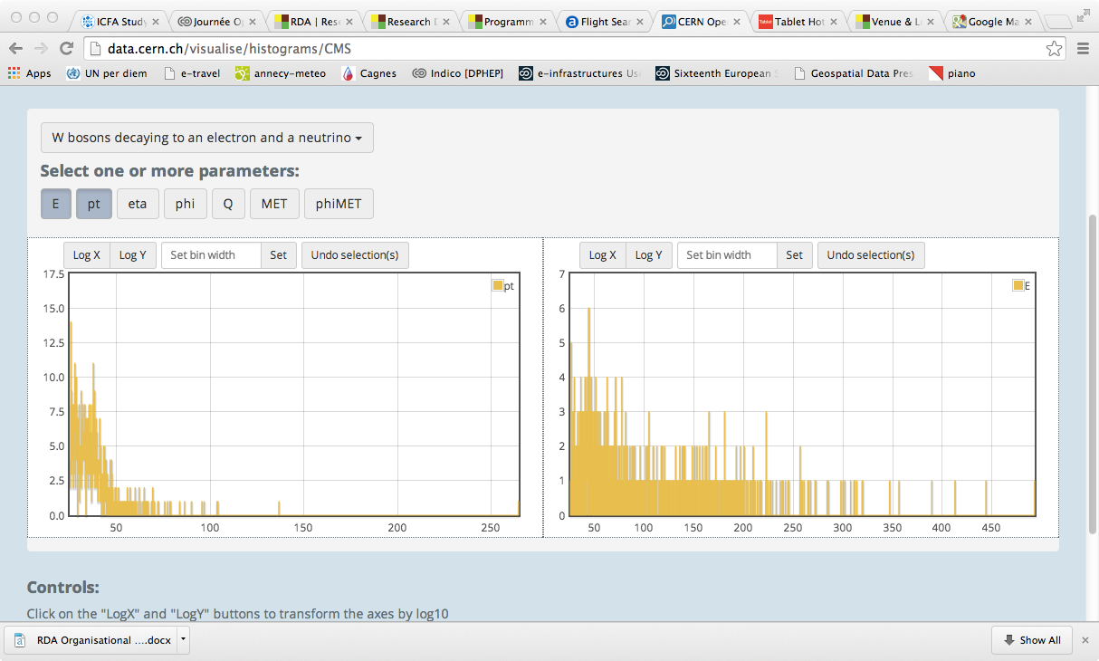

Slide 33
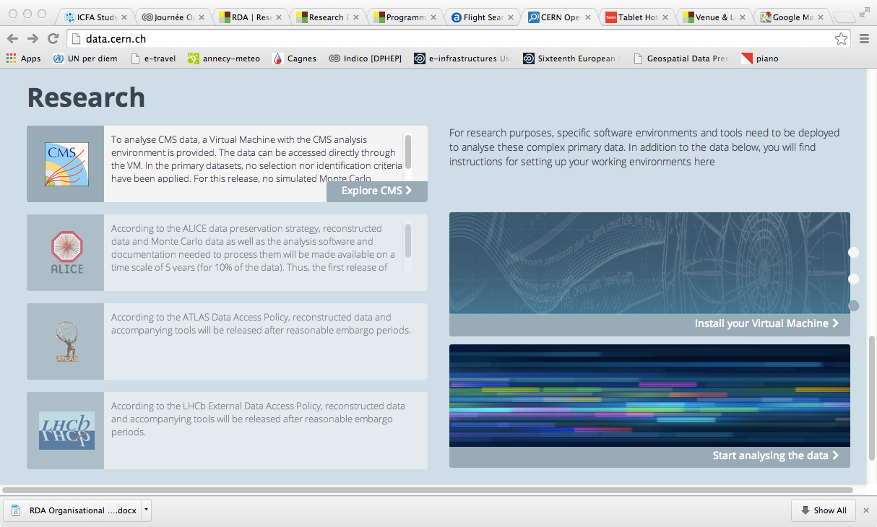

Slide 34
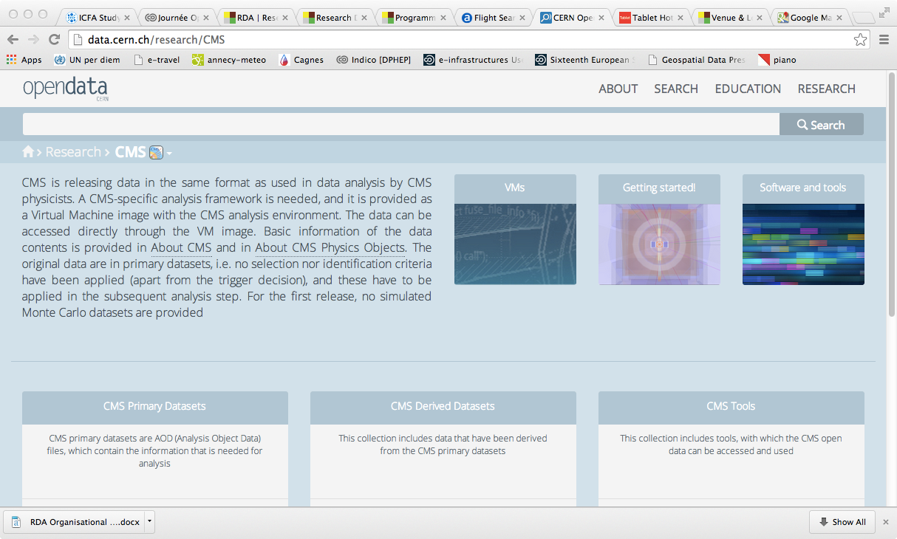

Slide 35


Slide 36
International Collaboration for Data Preservation and
Long Term Analysis in High Energy Physics

