Slide 1
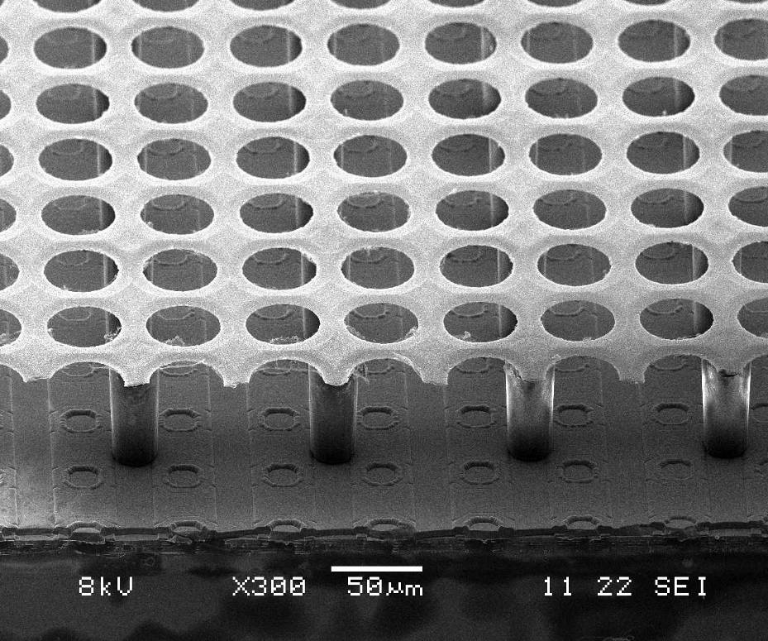
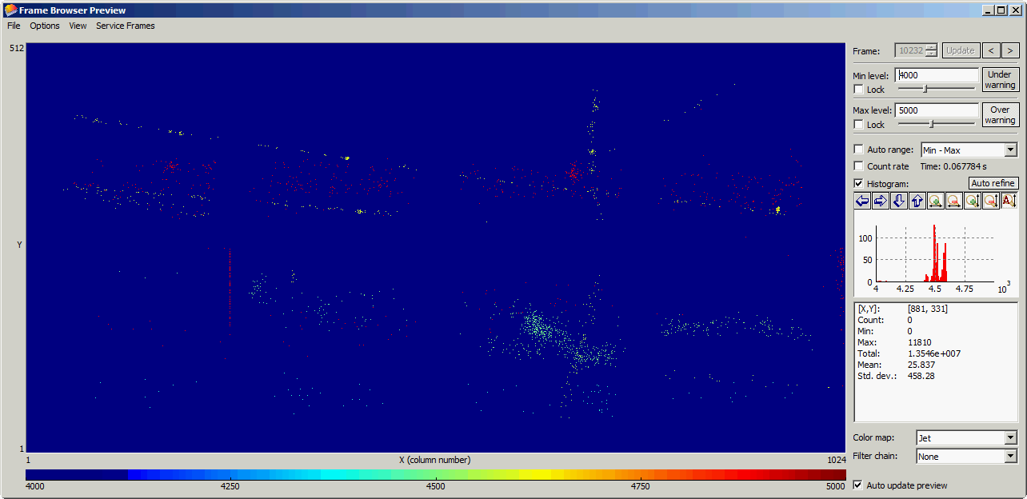
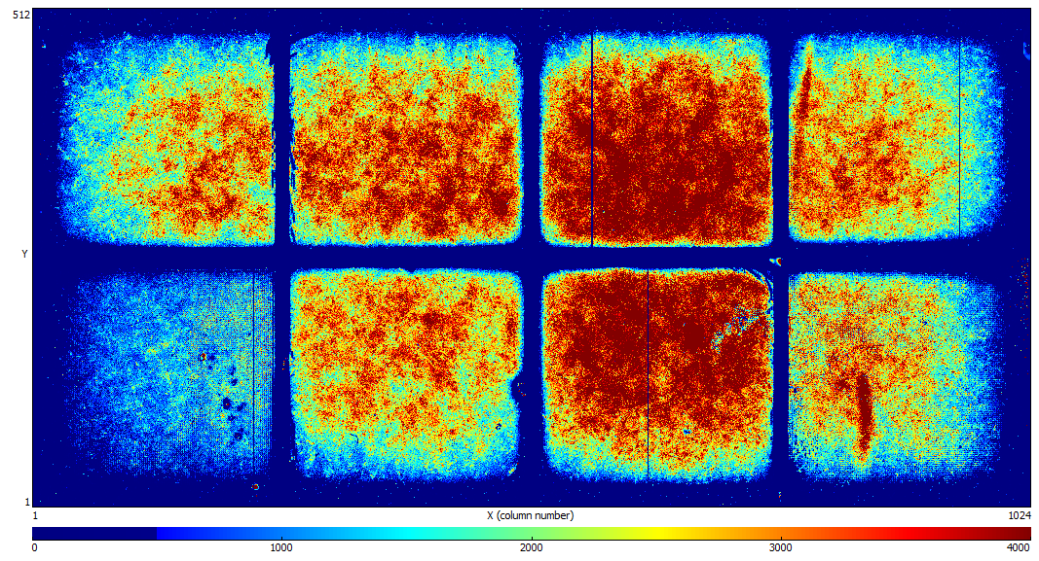
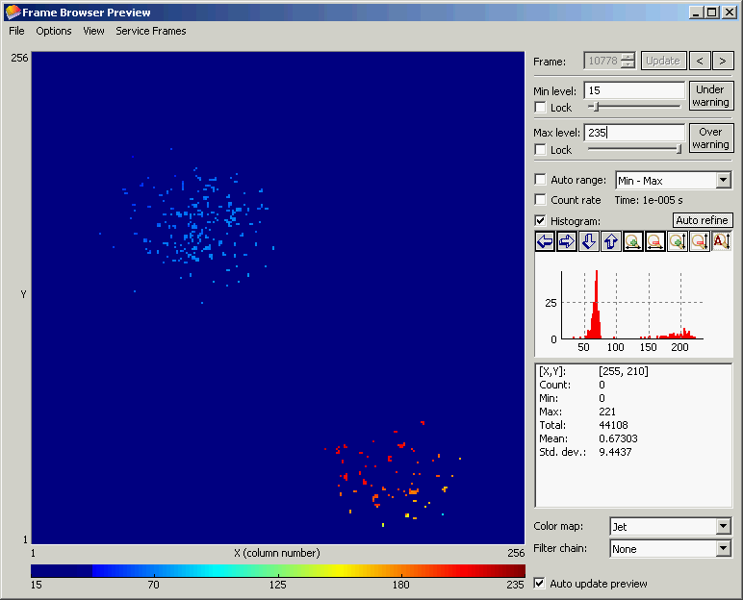

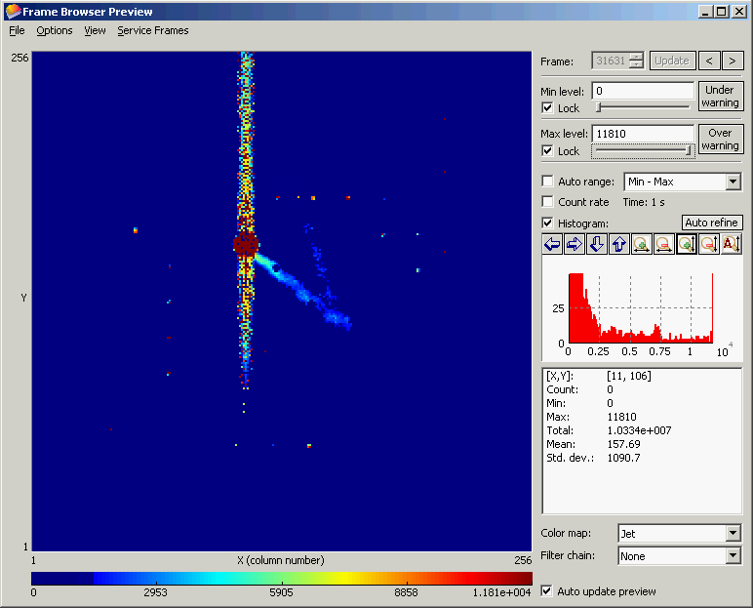
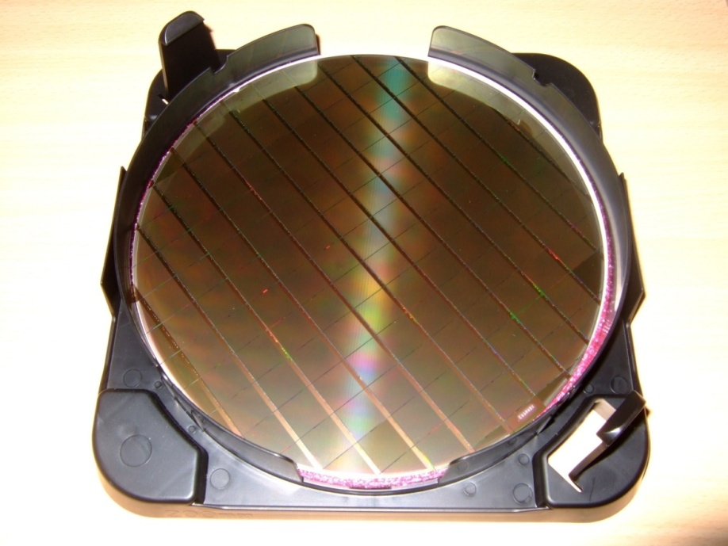
Ingrid
MPGD, RD51 and Pixel Readout for the ILC TPC
Maxim Titov
CEA Saclay, France
Pixel readout of the ILC TPC Project:
University of Bonn: Y. Bilevych, C. Brezina, K. Desch, J.
Kaminski, T. Krautscheid, C. Krieger, M. Lupberger
NIKHEF: Jan Timmermann
CEA Saclay: David Attie, Xavier Coppolani, Andrii
Chaus, Paul Colas, Maxim Titov
LAL Orsay (S. Barsuk)
Kyiv University (O. Bezshyyko group) – part of the RD51
collaboration together with LAL Orsay
French-Ukrainian Instrumentation Workshop, Paris, France, Oct. 1-3, 2014

Slide 2
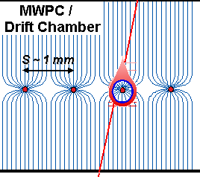
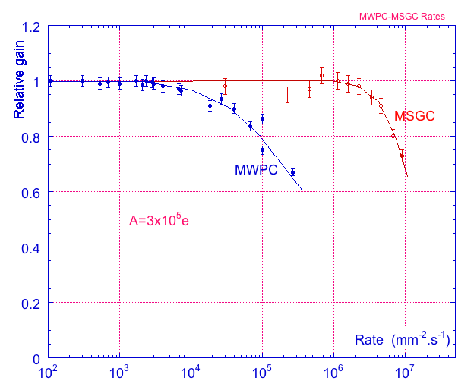
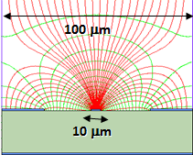
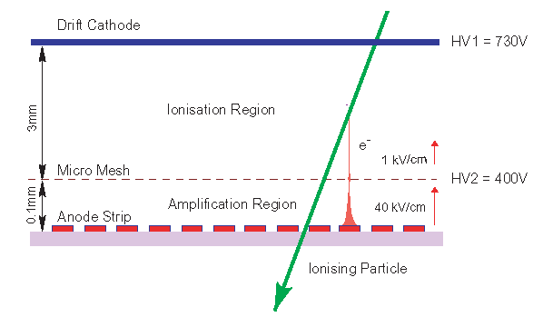
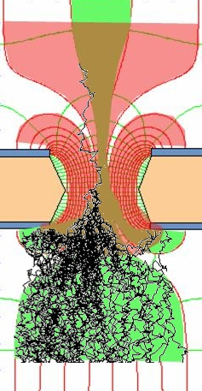
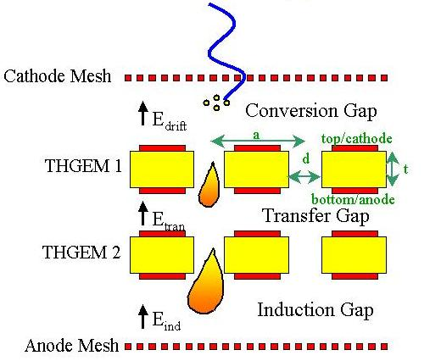
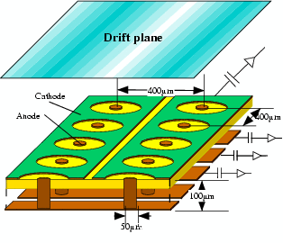
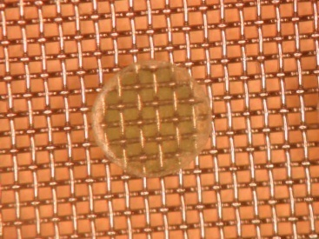

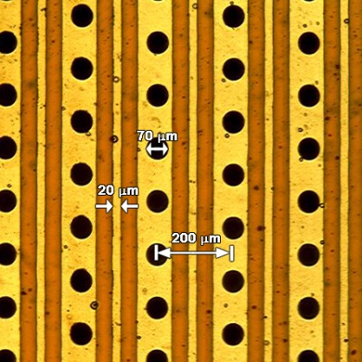
Micro-Pattern Gaseous Detector Technologies for Future Physics Projects
Micromegas
GEM
Thick-GEM, Hole-Type and RETGEM
MPDG with CMOS pixel ASICs (“InGrid”)
Micro-Pixel Chamber (μPIC)
Rate Capability:
MWPC vs MSGC
Micromegas
GEM
THGEM
MHSP
μPIC
Ions
40 %
60 %
Electrons
InGrid

Slide 3
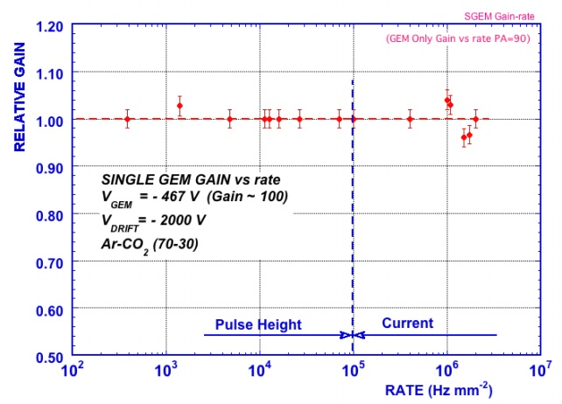
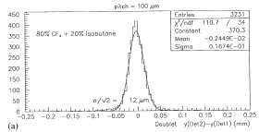
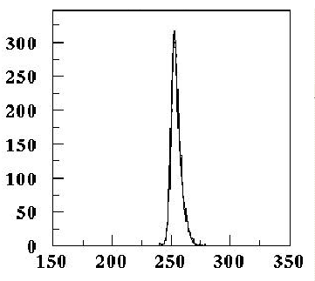
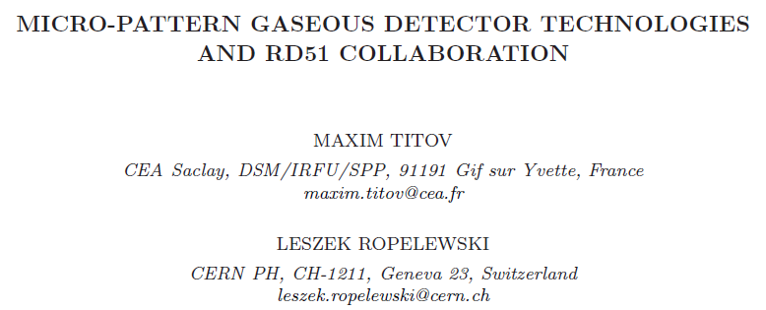
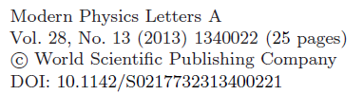

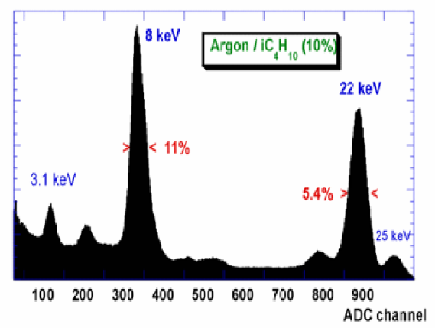
Why Micro-Pattern Gaseous Detectors are so attractive …
High Rate Capability
High Gain
High Space Resolution
Good Time Resolution
Good Energy Resolution
Excellent Radiation
Hardness
Ion Backflow Reduction
Photon Feedback
Reduction
GEM
2x10⁶ Hz/mm²
GEM
Micromegas
σ_{space} ~ 15-40 μm
GEM
σ _{time} ~ few ns
Micromegas
One of the recent reviews describing
the progress of the RD51 collaboration:

Slide 4
Historical Roadmap of the MPGD Technologies and RD51 Collaboration
MicroMEGAS (CEA Saclay, Y. Giomataris)
RD51
collaboration
MSGC (ILL, A. Oed)
GEM (CERN, F. Sauli)
RD28
1988
1996
1992
1997
2003
LEM (Periale)
THGEM(Chechik)
2008
1996
2000
2005
InGrid
μ-PIC (A. Ochi, T. Tanimori)
Capillary plate (Yamagata U., H. Sakurai)
Many of the Micro-Pattern Gaseous Detector Technologies were introduced before
the RD51 Collaboration was founded
With more techniques becoming available (or affordable), new detection concepts
are being introduced and the existing ones are substantially improved

Slide 5
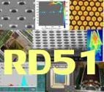
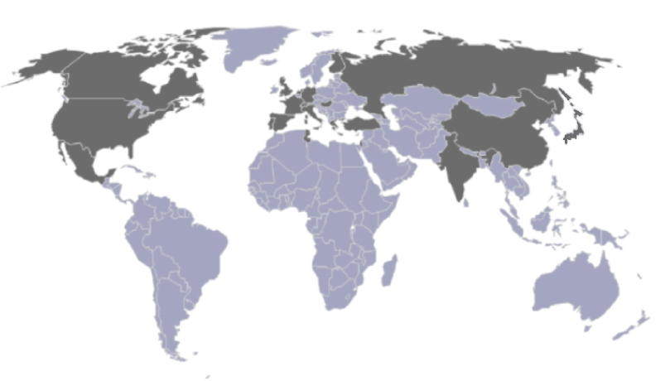
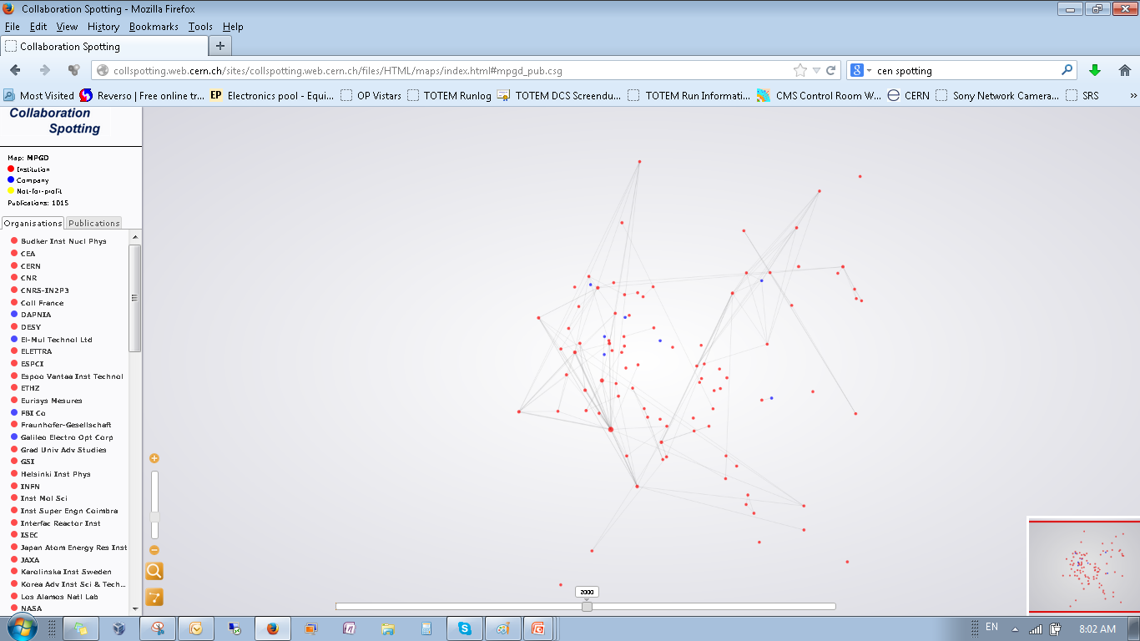
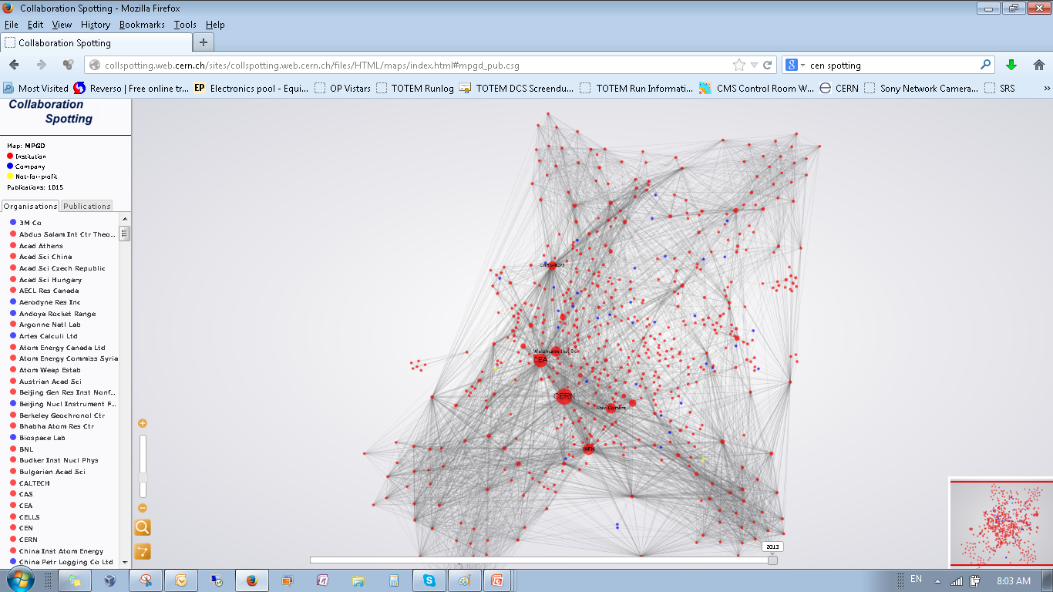
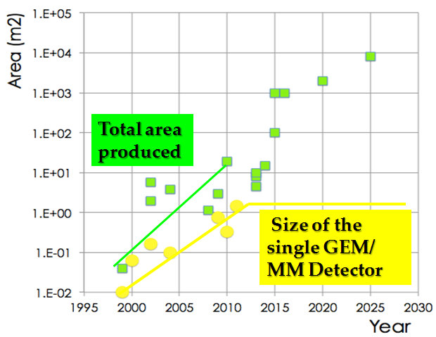
RD51 – Development of Micro-Pattern Gaseous Detector Technologies
The main objective is to advance MPGD technological development and associated electronic-readout systems, for applications in basic and applied research”
A fundamental boost is offered by RD51: from
isolate MPGD developers to a world-wide net
1998
2014
http://rd51-public.web.cern.ch/rd51-public
World-wide Collaboration for the
MPGD Developments →
RD51 (91 institute, > 500 people):
Large Scale R&D program to advance MPGD Technologies
Access to the MPGD “know- how”
Foster Industrial Production
Advances in photolithography →
Large Area MPGDs (~ m² unit size)

Slide 6
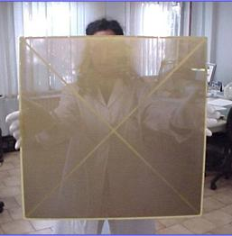

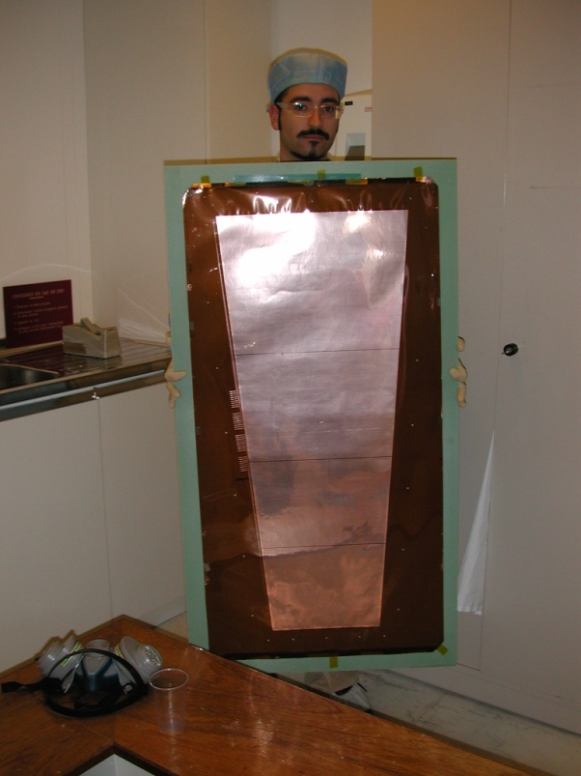
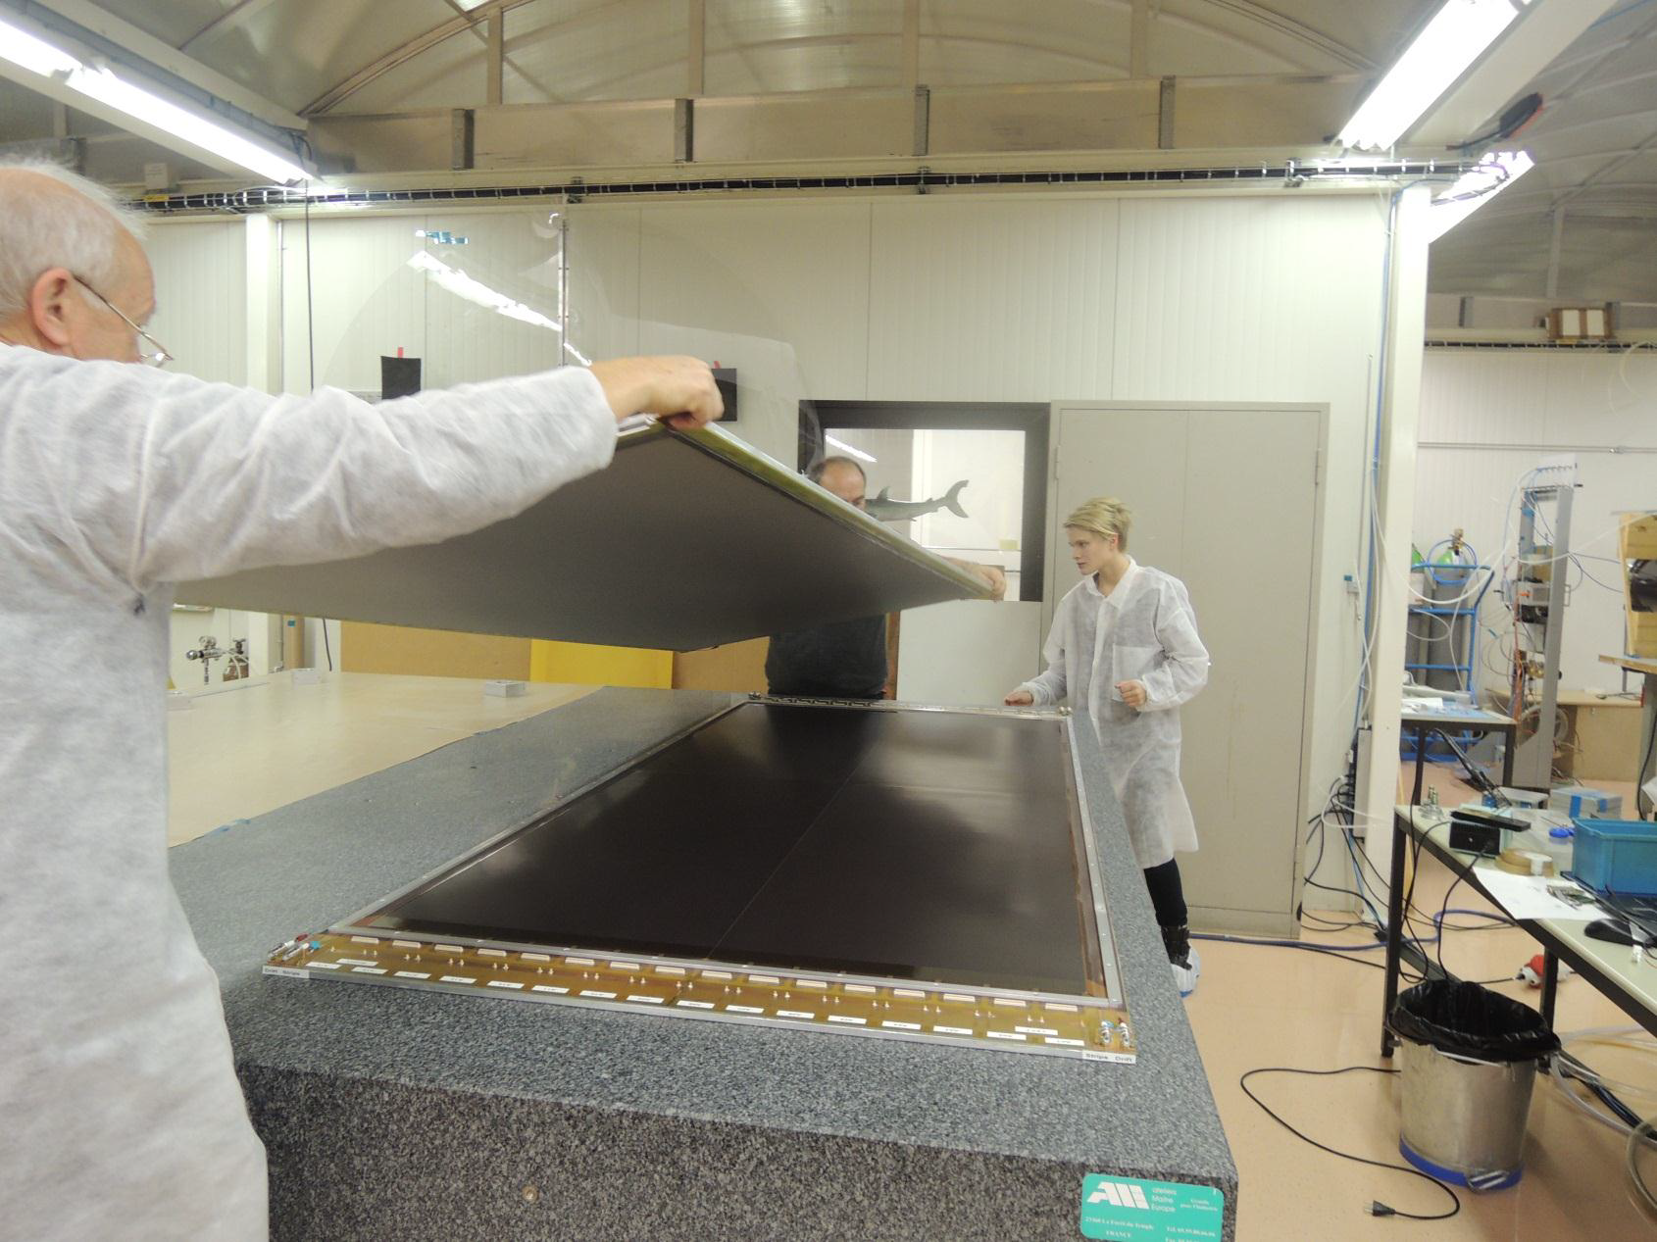
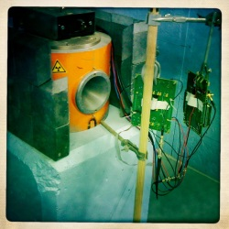
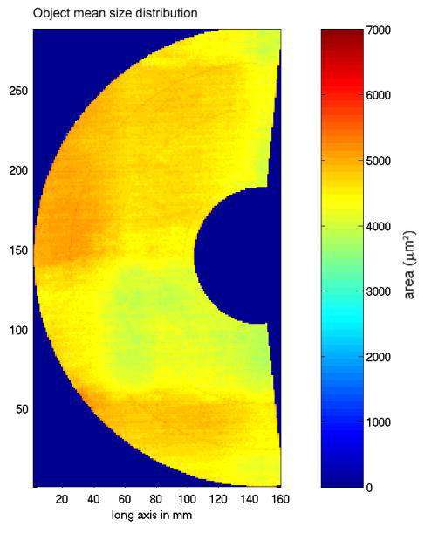
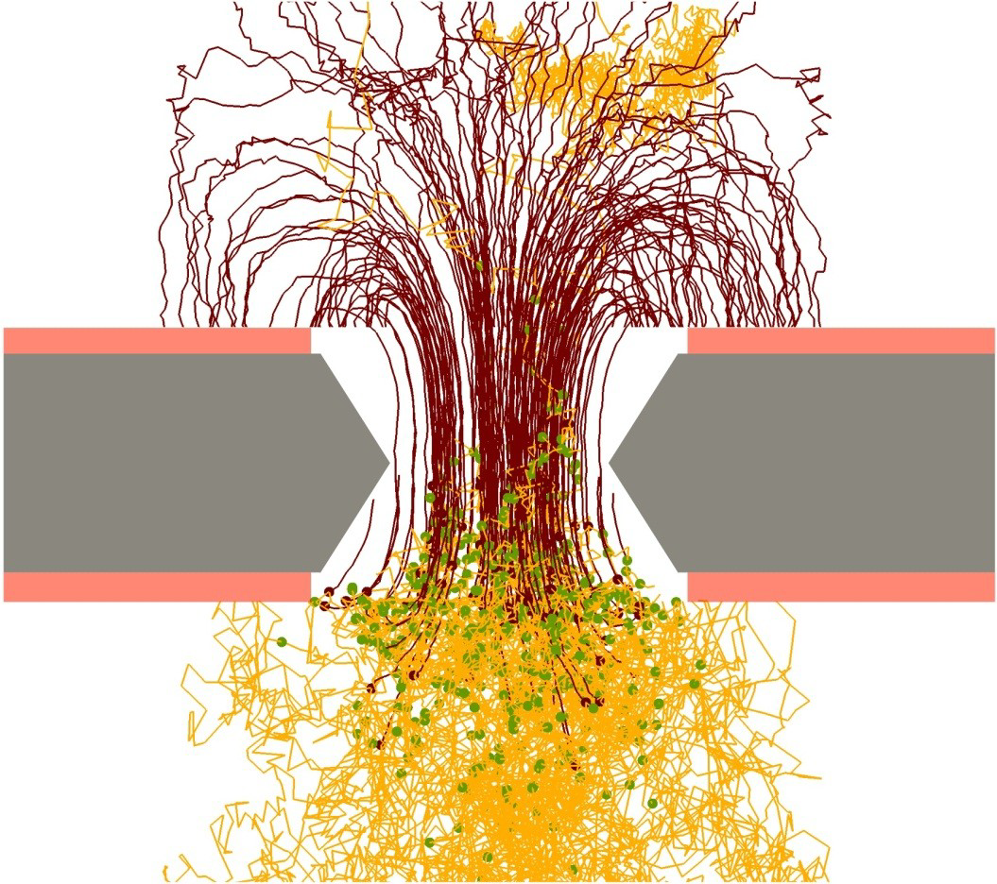
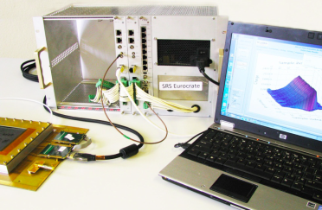
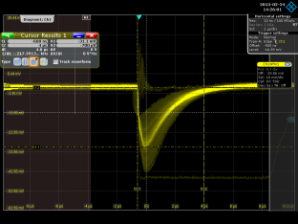
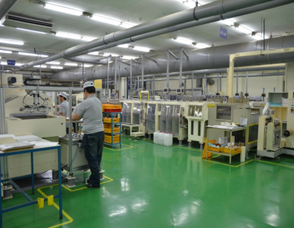
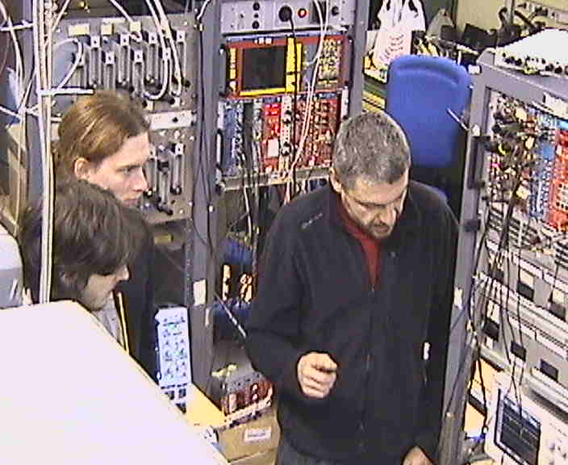
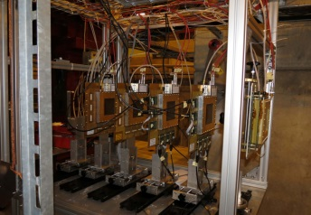
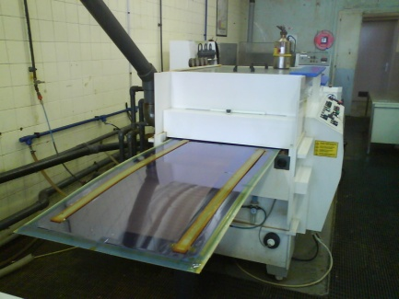
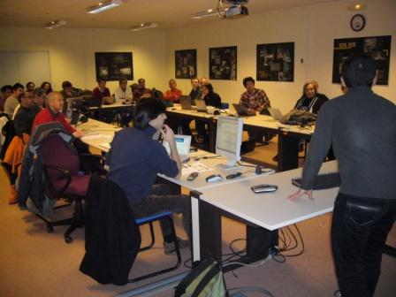
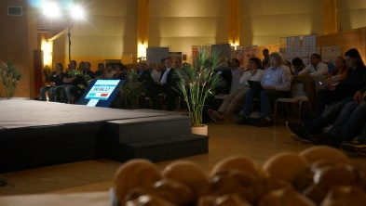
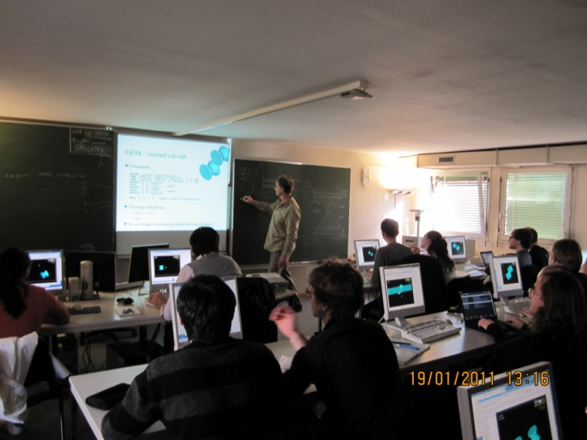
Future RD51 Collaboration Activities
Large Area Detectors
Assembly Optimization
RD51 Common Projects
Generic R&D, QA
Long Term Stability
WG2:
WG1:
WG5:
Software Tools and
Simulations
MPGD Electronics
RD51
WG4:
WG3/NEW WG:
WG7:
WG6:
Conferences / Schools
Academia-Industry
Matching Events
CERN MPGD
Workshop,
Quality Control
and Industrialization
RD51 Common
Test Beam and Lab Facilities

Slide 7
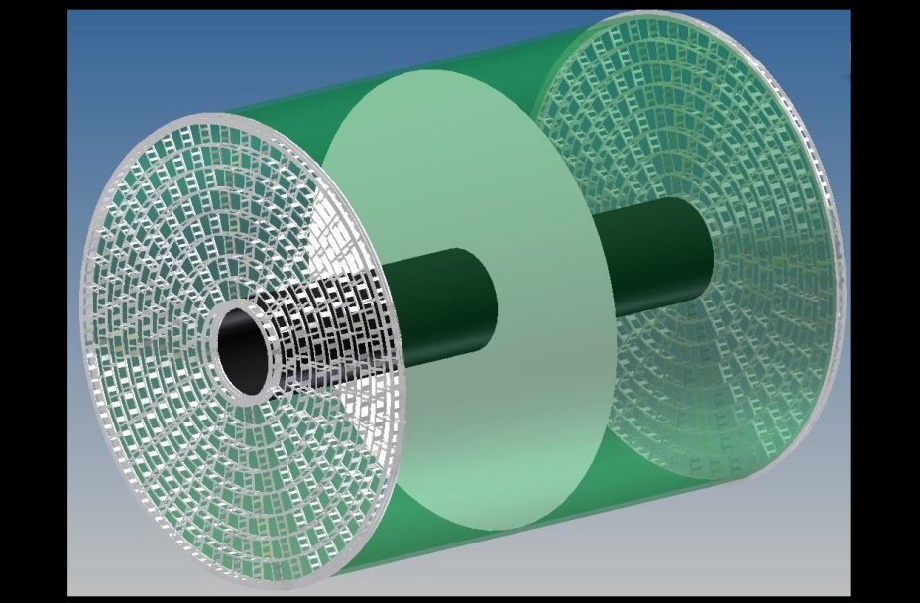
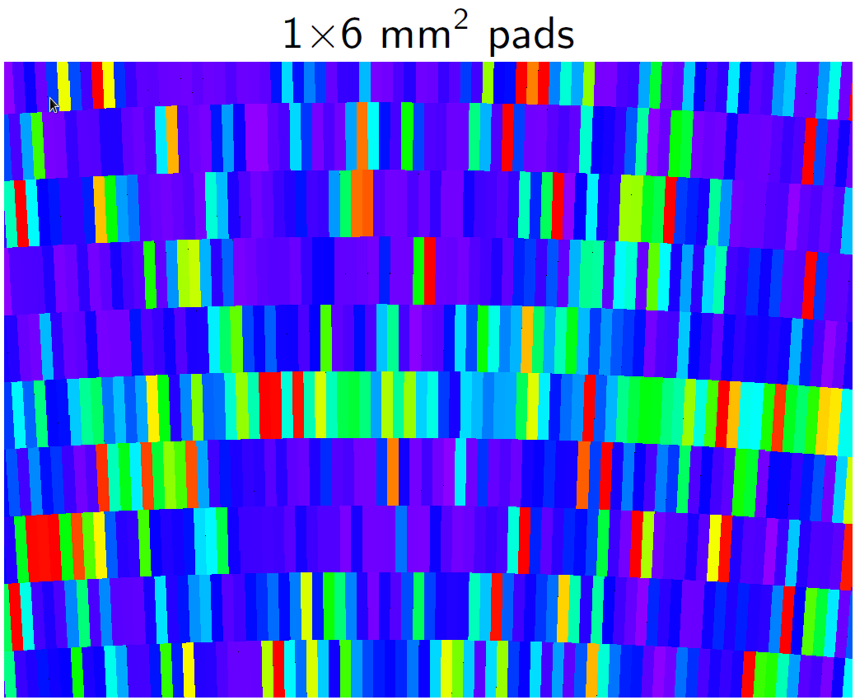
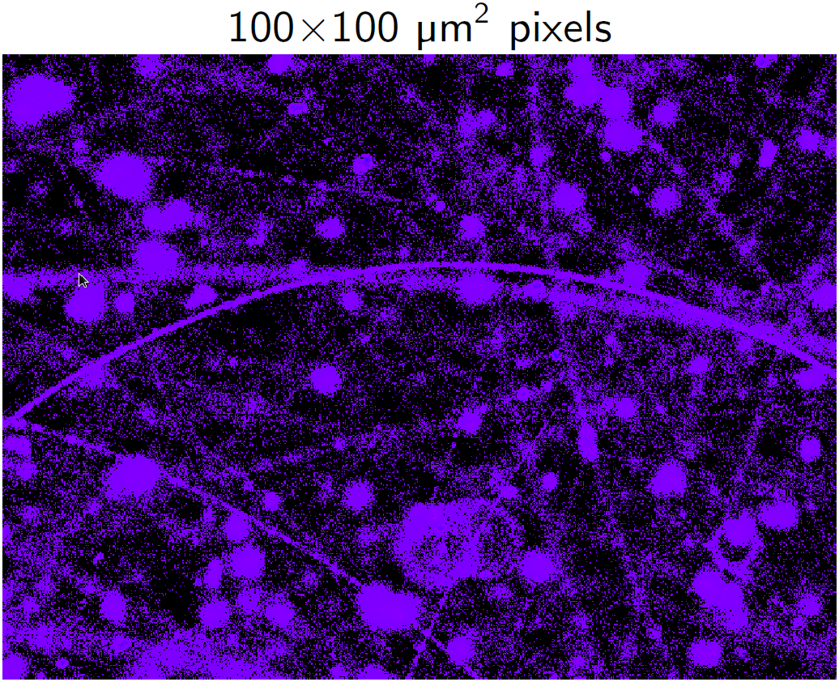
Pixel Readout for Time Projection Chamber at the ILC or CLIC
MPGDs are foreseen as TPC readout for ILC
or CLIC (size of endcaps of ~ 10 m²):
Standard pads (1x 6 mm²): 8 rows of detector
modules (17×23 cm2); 240 modules per endcap
Pixel (55x 55μm²): ~100-120 chips per module
→ 25000-30000 per endcap
Potential advantages of pixel TPC (55x 55μm²):
→ very good point + momentum resolution
→ dE/dx via cluster counting
→ frontend electronics automatically integrated (‘active endplate’)
Potential concerns:
→ diffusion will limit resolution (gas!):
how small is necessary?
→ cost ?
→stable operation possible ?
Demonstrate operability of the concept;
Measure & understand (details of) charge cloud
Backgrounds in
CLIC TPC requires
very small pixels
(< 1x1 mm²)
CLIC TPC
Simulation
(M. Killenberg)

Slide 8
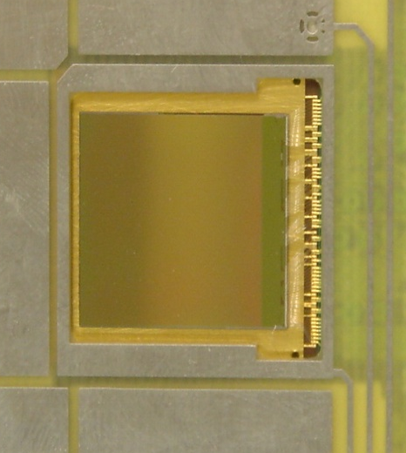
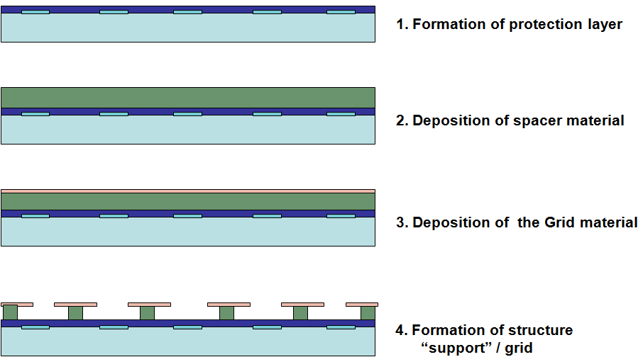
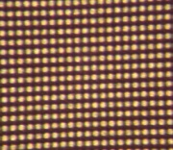
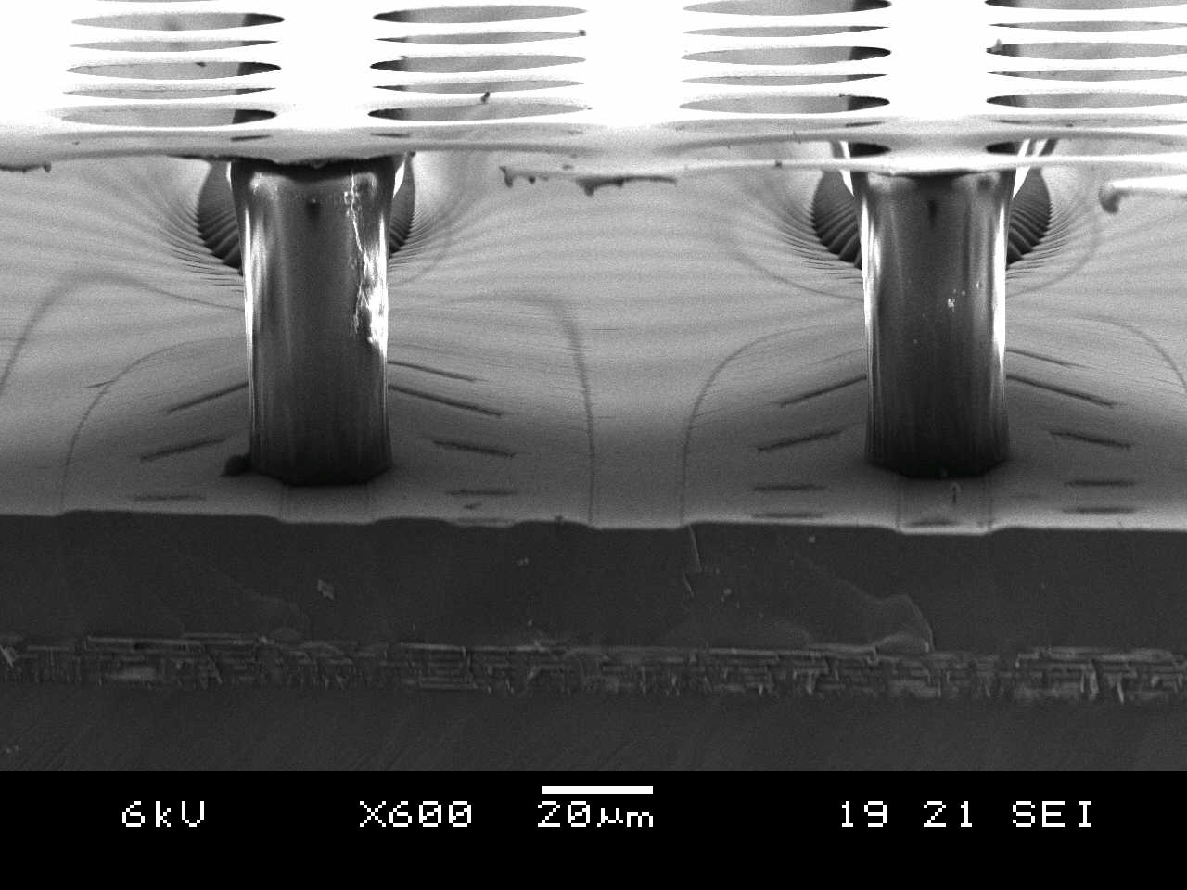

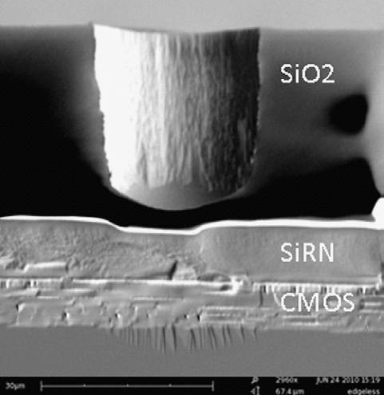
Integrated Electronics: Pixel Readout of Micro-Pattern Gas Detectors
3D Gaseous Pixel Detector → 2D (CMOS pixel chip readout) x 1D (drift time)
Through POST-PROCESSING INTEGRATE
MICROMEGAS directly on top of CMOS chip
Bump bond pads for Si-pixel Detectors - Timepix or Medipix2 (256 × 256 pixels of size 55 × 55 μm2) serve as charge collection pads.
(e.g. Si3N4)
(e.g. SU8)
Each pixel can be set to:
● TOT ≈ integrated charge
● TIME = Time between hit and shutter end
“InGrid” Concept:
50 - 80 μm
Protection Layer (few μm)

Slide 9

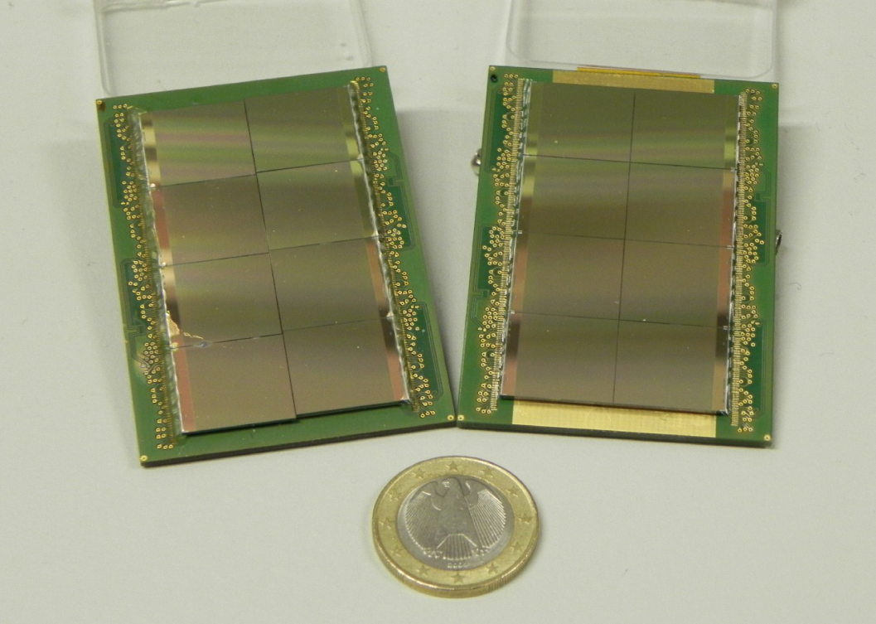


Going to Larger Areas: “Octopuce” Modules based on the 2 x 4 Timepix ASICs
Saclay
3 GEM
InGrid
“Octopuce”
/ InGrid
Bonn
2010: Saclay / NIKHEF “Octopuce” (InGrid): studies with X-Rays and at DESY e- beam
2012-2013 : 2 Saclay / NIKHEF “Octopuce”(InGrid): 1 - some issues with readout; 2 - OK
2013: 2 Bonn “Octoboards” (InGrid & 3-GEM): studies with RD51 SRS at DESY e- beam
Single point resolution vs
drift distance (Octopuce / InGrid):
Image from
Bonn/“Octoboard”
(5 GeV e-):
InGrid: each electron
avalanche
corresponds to
single pixel hit
4 Timepix ASICs
Bonn/ InGrid
Bonn/ InGrid

Slide 10




Octoboard
Kyiv University Simulations (autumn 2013 – spring 2014)
See O. Bezshyyko
presentation on Oct. 1
Periphery
Board
Mesh
HV contact
Bakelite
Metal on top
Anode plate PCB
Chip carrier PCB
O.Bezshyyko, 2-nd French-Ukrainian workshop on the instrumentation developments for HEP, October 1-3, Orsay

Slide 11




Saclay “Octopuce’s”: Study of Uniformity with X-Rays & Cosmics
Cosmics DATA:
Octopuce 3
Uniform irradiation with X-Rays
DATA:
Octopuce 1
Simulation
(Kyiv Univ.)
Single electron sensitivity ~ 100 % (in the central areas of the chips)
Work is ongoing to better understand & improve field distortions in-between and at the borders of “InGrid’s (based on simulation)
Electric field configuration
RD51-NOTE-
2013-002

Slide 12

Future Plans: Pixel Readout of MPGD - Proof-of-Principle of Si-TPC
Mid-term plan (3 years):
Develop and equip a full
LCTPC module (~100 chips)
with “InGrid”s, using
“Octopuce” module as
the basic building block
Pixel LC-TPC Consortium: Bonn, Saclay, NIKHEF, DESY, LAL, Kyiv University
Improved mass production of “InGrid”s (less dead area, higher yield, protection)
Minimize field distortions in the « Octopuce » plane; work on more realisitic cooling and power pulsing
Develop simulation chain to compare momentum resolution, double track resolution, dE/dx and pattern recognition to pad-based readout and to optimize the geometry
Experimental dE/dx study by cluster counting using InGrid at the LAL/PHIL facility

Slide 13






Trajectories in the field. Shielding [cm]
See O. Bezshyyko
presentation on Oct. 1
0Tl 1TL 4Tl
O.Bezshyyko, 2-nd French-Ukrainian workshop on the instrumentation developments for HEP, October 1-3, Orsay

Slide 14
Pixel Readout for LC TPC: Next Steps
Short-Term Plans:
Improve SU8-based « InGrid « structure (less dead area, higher yield, protection)
Better understand and improve field distortion issues at the « InGrid » plane
(in between chips and at the borders of the Octopuce);
Develop simulation chain to compare momentum resolution, double track resolution, dE/dx and pattern recognition to pad-based readout and to optimize the geometry (e.g. minimize the needed chip coverage)
Long-Term Plans:
Improved chip functionality → Timepix3 → transfer InGrid process to Timepix3
Adapted readout system → high-speed SRS readout for Timepix(3)(8 &100 chips);
Improved mass production of InGrids → in collaboration with IZM, Berlin
Work on more realistic cooling and power pulsing;
Develop a backside connection technology both for LV/data and for the HV;

Slide 15















Irfu – LAL – Kyiv Cooperation: Present and Future
Kyiv University made a major contributions towards optimization of geometry of large-area
“InGrid” Detectors (Garfield ++ simulations) within the ILCTPC-Pixel Collaboration:
Effect of gaps
between chips
Effect of geometry deviations
LAL/Kyiv U/IRFU/CERN
Cooperation on LEETECH
Platform / PHIL @ LAL:
Magnet (CERN) + Collimators
(Kyiv University)
Ultimate goal is to develop experimental setup with “InGrid” Detectors @ Kyiv
university (optimization of detector characteristics and educational setup)

Slide 16



Kyiv University in the Pixel Consortium: Present and Future
See O. Bezshyyko presentation on Oct. 1
1. Simulation of geometry for 100 chip module (96=12х8)
2. Development of test platform for Micromegas detector at the Nuclear Physics Department Kyiv University (in Ukraine)
?
Power supply
PC
Gas supply system
Detector setup
DAQ - ADC
Gas storage
O.Bezshyyko, 2-nd French-Ukrainian workshop on the instrumentation developments for HEP, October 1-3, Orsay

