Slide 1
LEETECH
experimental platform
Oleg Bezshyyko
O.Bezshyyko, 2-nd French-Ukrainian workshop on the instrumentation developments for HEP, October 1-3, Orsay

Slide 2
Outline
LEETECH facility at PHIL
Goals and applications
Simulations in GEANT4 (I stage, II stage)
Design and production (in Kyiv University, TSNUK) of vacuum chamber and collimator system (mechanical part and electronics)
Design and production of Dipole Magnet (in CERN)
Status
O.Bezshyyko, 2-nd French-Ukrainian workshop on the instrumentation developments for HEP, October 1-3, Orsay

Slide 3


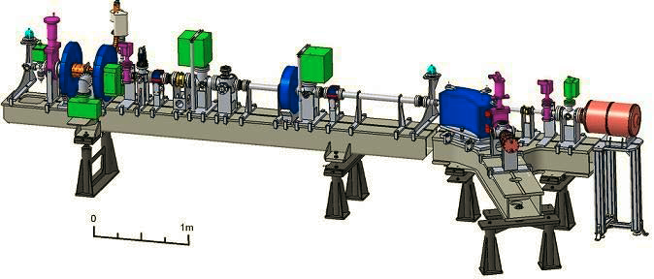
PHIL - PHoto-Injecteur au LAL
LEETECH – Low Energy Electron Technology –
facility at the PHIL to obtain quasi monochromatic electrons of variable low energy
Collaboration with: LAL (PHIL, general management and many other…); CERN (dipole magnet), Kiev U - TSNUK (collimators, vacuum chamber, simulation), IRFU (gas system, setup calibration)
O.Bezshyyko, 2-nd French-Ukrainian workshop on the instrumentation developments for HEP, October 1-3, Orsay

Slide 4
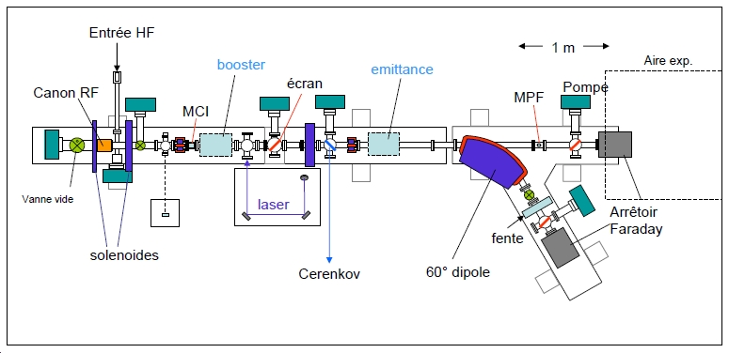
Goals and applications
Using of electrons provided by PHIL with momentum 5-8 MeV/c and (10⁸ now) 10⁹ particles per bunch, 5 bunches per second
Timing: laser pulse with 7 ps FWHM
PHIL
extension
Goal: obtain samples of “quasi-monochromatic” electrons:
with adjustable energy between 1 MeV (is desirable a few 100 keV) and 5 MeV
energy spread of better than 10 %
with adjustable intensity down to 10⁴ and less electrons per sample (ideal case is 1 electron on bunch)
Specific advantage – good time resolution (<300 ps)
O.Bezshyyko, 2-nd French-Ukrainian workshop on the instrumentation developments for HEP, October 1-3, Orsay

Slide 5
Goals and applications
Test bench:
Gaseous detectors tests, e.g. routine Micromegas/InGrid performance tests
to optimize the protection layer.
Generic R & D
Applications: LCTPC with Micromegas/InGrid option, CAST
Studies of the crystal properties and prototypes for UA9 project
FTOF: time-of-flight particle identification detector based on DIRC technique
Measurements of scintillators for SuperNEMO experiment
Tests of diamond sensors (profile monitor, tracking, …)
Physics measurements:
E.g. non-relativistic electron energy losses with Micromegas/TIMEPIX
Students hands-on:
All above + track reconstruction, gaseous detector edge effects
O.Bezshyyko, 2-nd French-Ukrainian workshop on the instrumentation developments for HEP, October 1-3, Orsay

Slide 6
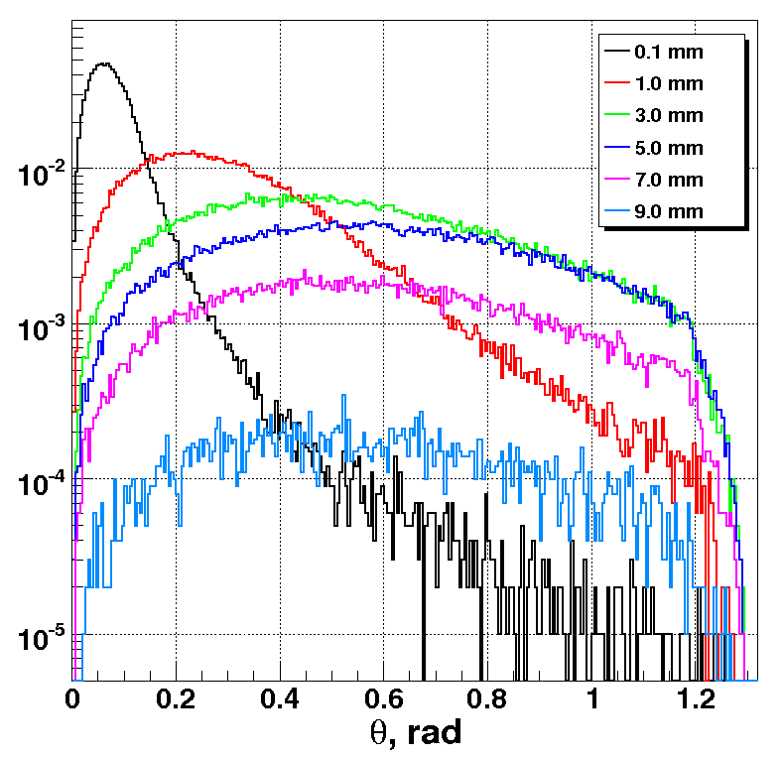
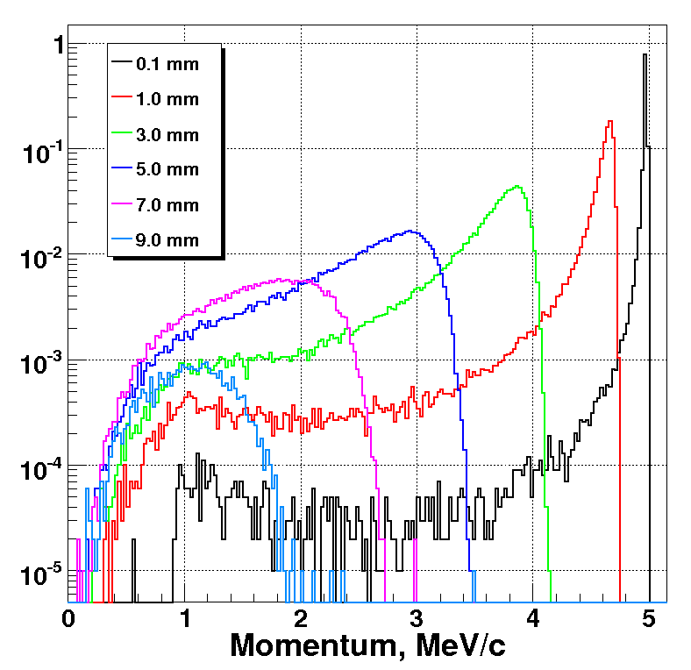
GEANT4 Simulations
Al Plug
L.Burmistrov (LAL)
Active participation of students: O.Fedorchuk, V. Krylov, M. Haranko
Use of electrons from PHIL
Reduce energy/intensity using Al plug
Beam vacuum
e⁻
Capture the electrons with the angle from the plateau
Initial flight direction of electrons
Different plug thickness favours different energy samples, so that it is advantageous to produce several plugs of different thickness
O.Bezshyyko, 2-nd French-Ukrainian workshop on the instrumentation developments for HEP, October 1-3, Orsay

Slide 7
Use electrons from PHIL
Al Plug
Collimator1
Reduce energy/intensity using Al plug
Beam vacuum
e⁻
Select optimal direction for electrons passing the plug with collimator 1
Select required energy by half-turn of electron in the magnetic field
Magnet
Vacuum
Magnet with adjustable field In range 100(50?)-2000 gauss
O.Bezshyyko, 2-nd French-Ukrainian workshop on the instrumentation developments for HEP, October 1-3, Orsay

Slide 8
Use electrons from PHIL
Al Plug
Collimator1
Detector to be tested
(Micromegas, …)
Reduce energy/intensity using Al plug
Beam vacuum
e⁻
Select unique direction for electrons passing the plug with collimator 1
Collimator2
Select required energy by half-turn of electron in the magnetic field (position of collimator 2 or field value)
Magnet with adjustable field
Adjust intensity/energy spread using collimator 2, positioned in front of tested detector
Vacuum
Electron counting at low fluxes: Micromegas to calibrate detector settings (magnetic field and collimator positions) or count electrons on individual bunch basis
O.Bezshyyko, 2-nd French-Ukrainian workshop on the instrumentation developments for HEP, October 1-3, Orsay

Slide 9
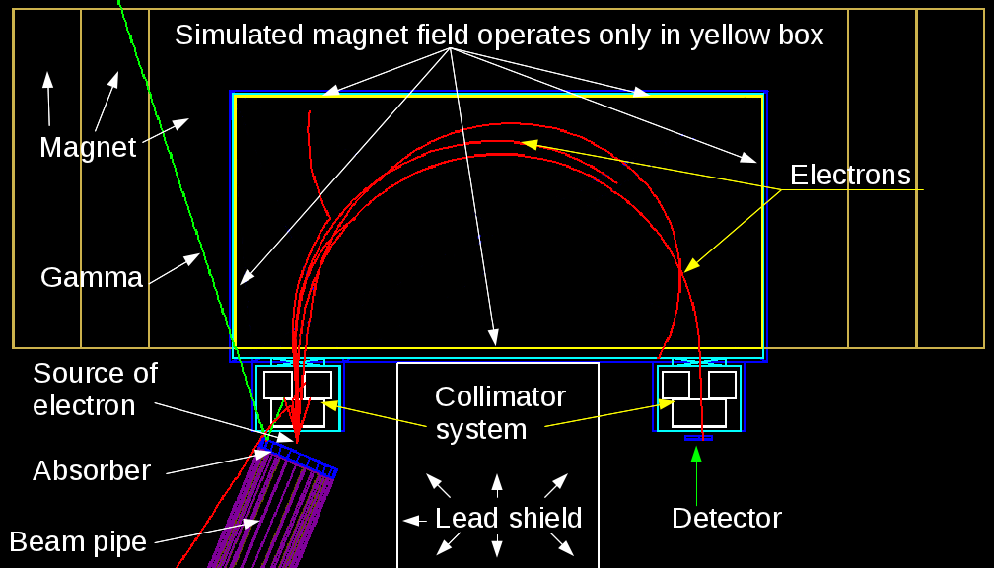
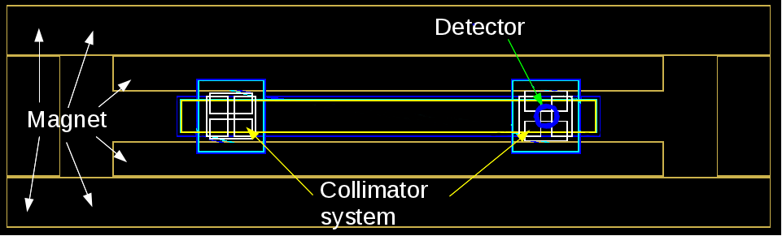
Simulations in GEANT4 (I stage), geometry
O.Bezshyyko, 2-nd French-Ukrainian workshop on the instrumentation developments for HEP, October 1-3, Orsay

Slide 10
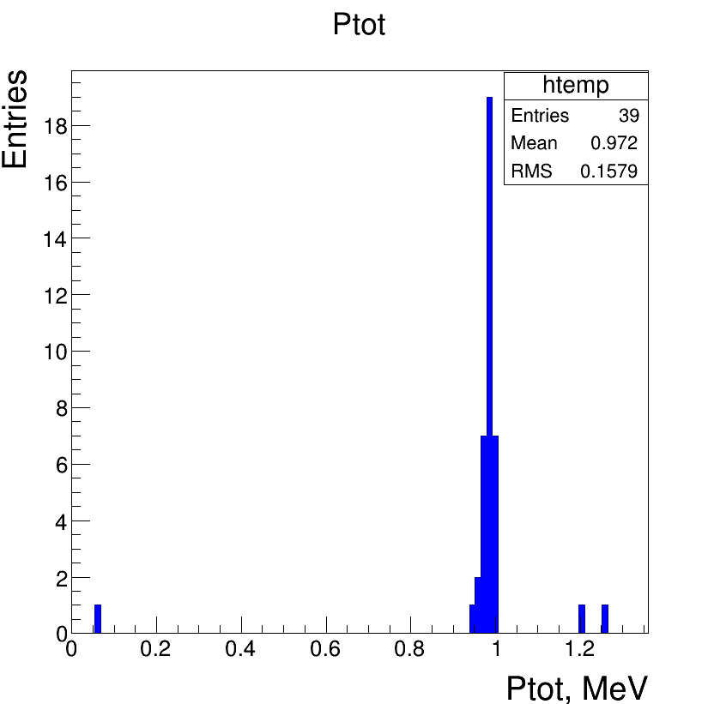
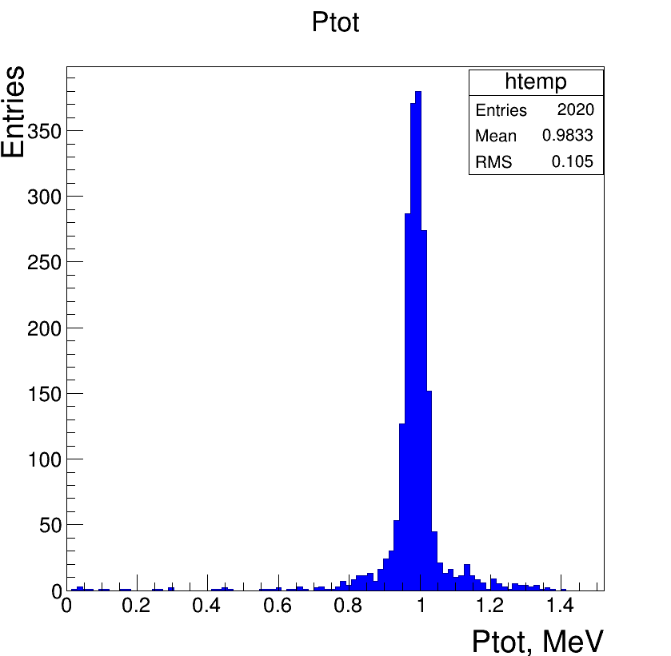
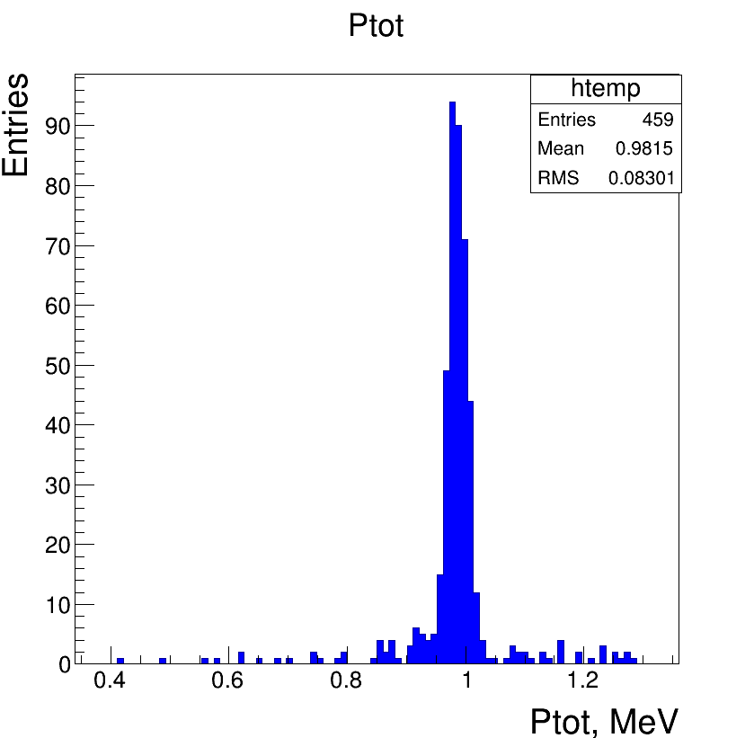
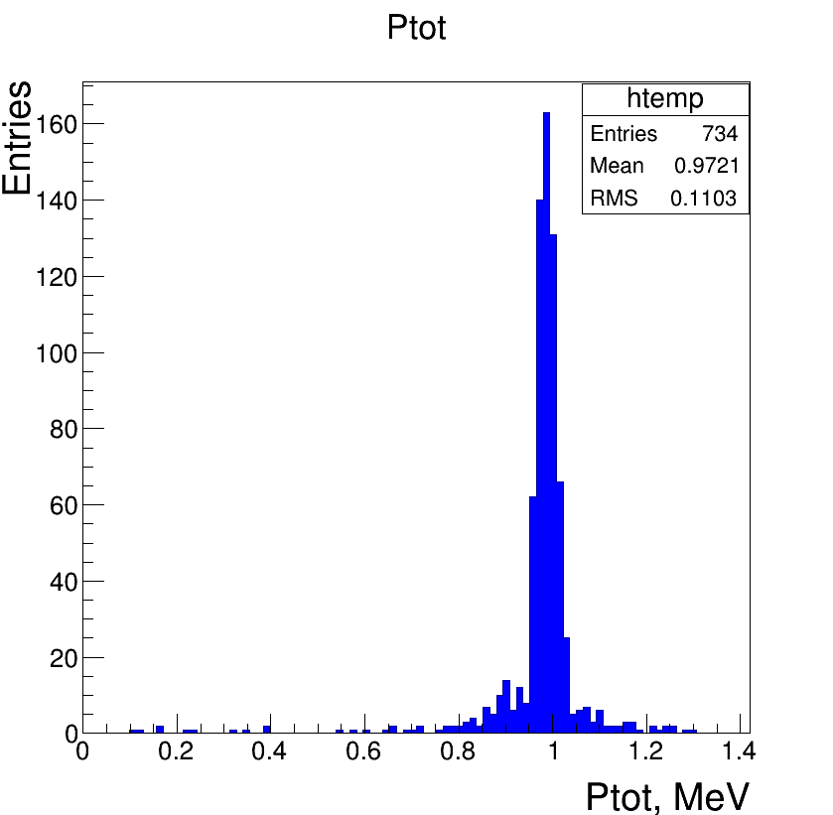
Simulations in GEANT4 (I stage), typical spectra
First collimator 0.2cm
Second collimator 0.6cm
First collimator 1cm
Second collimator 1.6cm
First collimator 0.4cm
Second collimator 1.2cm
First collimator 1cm
Second collimator 1cm
O.Bezshyyko, 2-nd French-Ukrainian workshop on the instrumentation developments for HEP, October 1-3, Orsay

Slide 11
Simulations in GEANT4 (I stage), time resolution
Collimators 0.8x1cm
Sigma 78ps
Collimators 0.4x0.8cm
Sigma 48ps
Real Settings
Collimators 1x1.4cm
Sigma 110ps
Collimators 1x1.4cm
Sigma 96ps
Gamma
O.Bezshyyko, 2-nd French-Ukrainian workshop on the instrumentation developments for HEP, October 1-3, Orsay

Slide 12
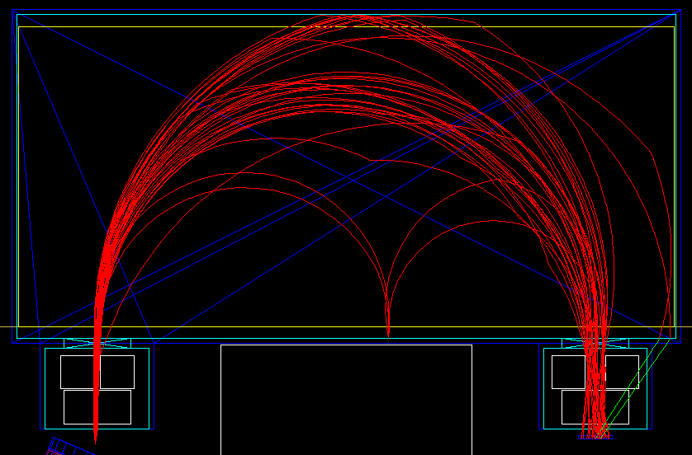
Source of the noise
This picture shows all tracks which hit the detector and with momentum less than 0.9 MeV and more than 1.1 MeV (image only for background particles).
2
4
1
3
O.Bezshyyko, 2-nd French-Ukrainian workshop on the instrumentation developments for HEP, October 1-3, Orsay

Slide 13
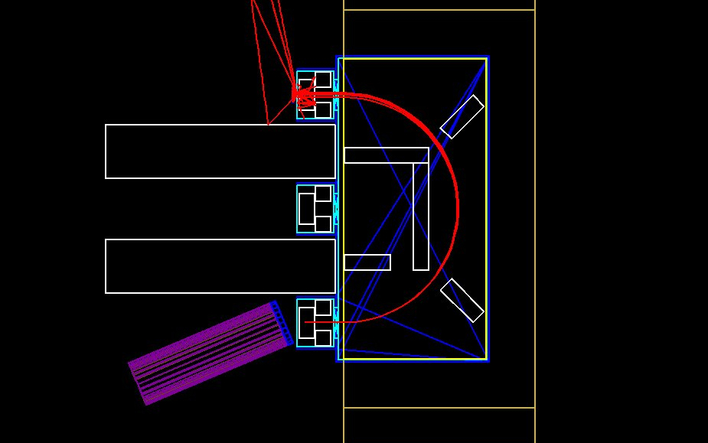
Simulations in GEANT4 (II stage), geometry
O.Bezshyyko, 2-nd French-Ukrainian workshop on the instrumentation developments for HEP, October 1-3, Orsay

Slide 14
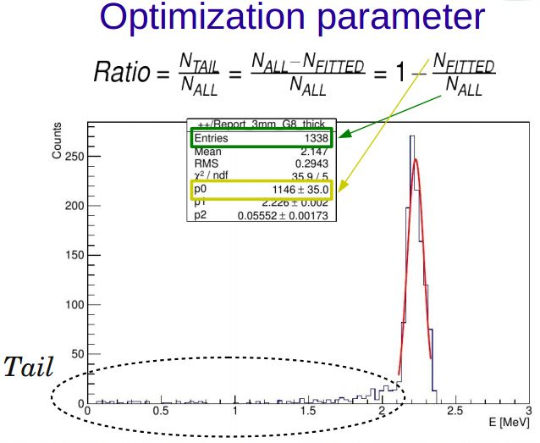
Simulations in GEANT4 (II stage), typical spectra
O.Bezshyyko, 2-nd French-Ukrainian workshop on the instrumentation developments for HEP, October 1-3, Orsay

Slide 15
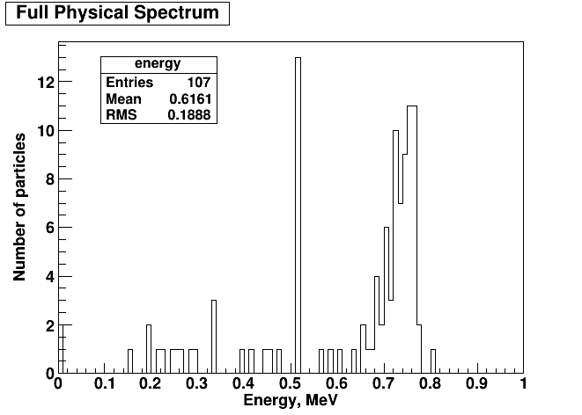
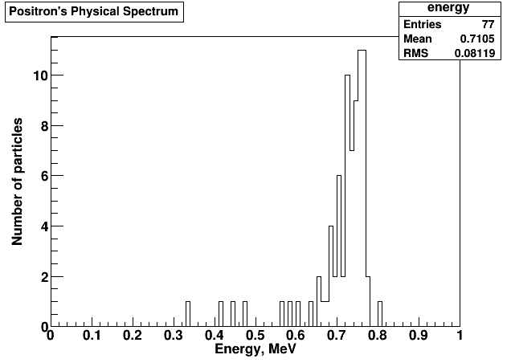
Simulations in GEANT4 (II stage),
Quasi-monoergetic positron source
Only one positron per 7000 of electrons (for 1.5 mm lead cup)
General Particle Source technique had been used to create distributions (in GEANT4 ) - to simulate 10 billion of electron events, we need to run only 1.42 million of positrons (for 1.5 mm cup).
Resulting spectrum at the detector.
1.5 mm lead cup
Resulting spectrum at the detector
(only positrons). 1.5 mm cup
O.Bezshyyko, 2-nd French-Ukrainian workshop on the instrumentation developments for HEP, October 1-3, Orsay

Slide 16
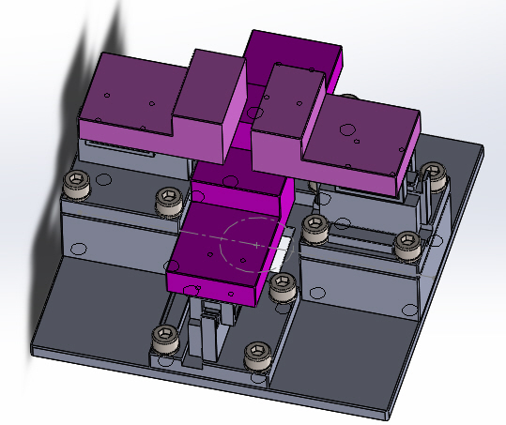
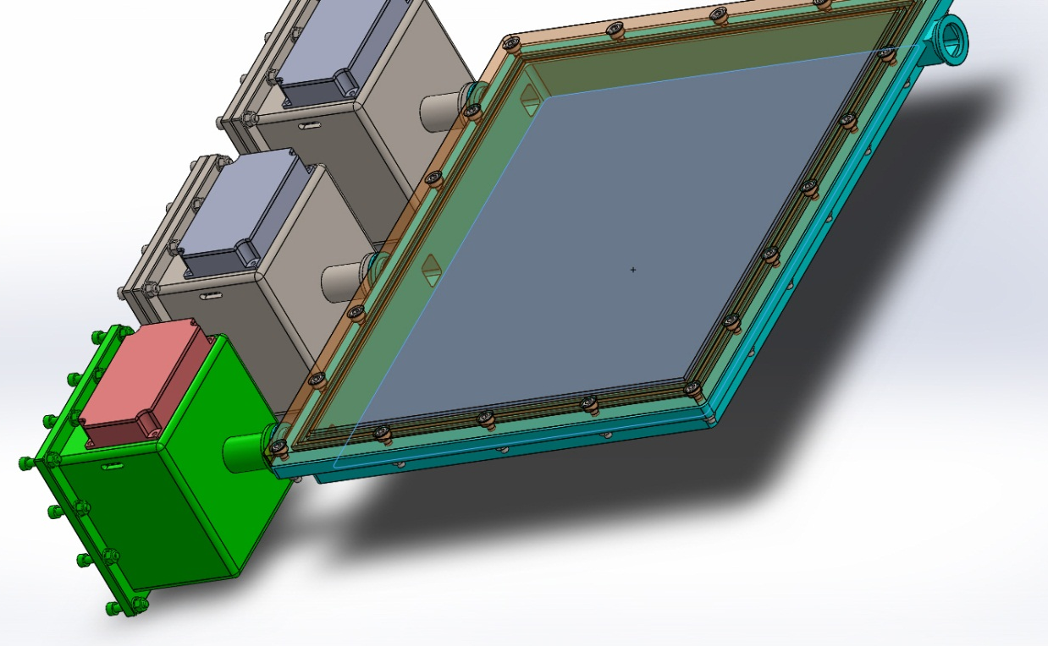
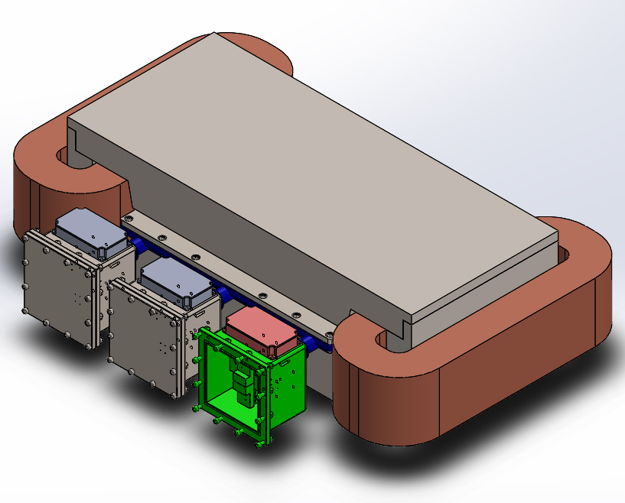
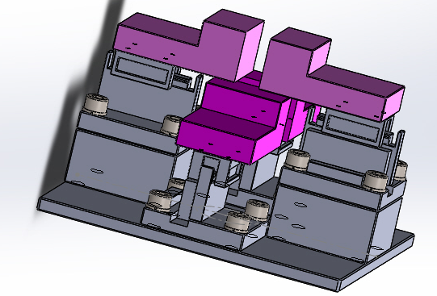
Engineering design of the system (mechanical part )
O.Bezshyyko, 2-nd French-Ukrainian workshop on the instrumentation developments for HEP, October 1-3, Orsay

Slide 17
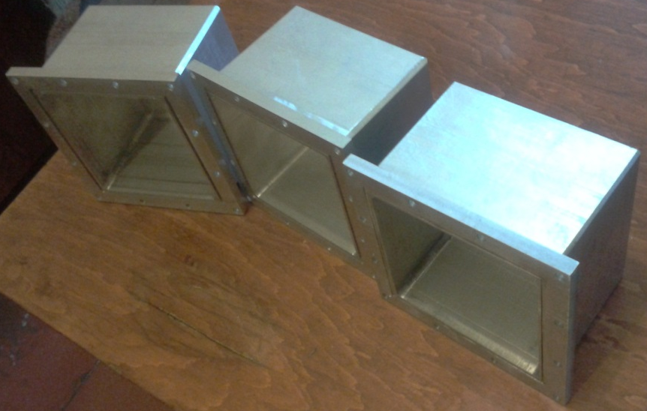
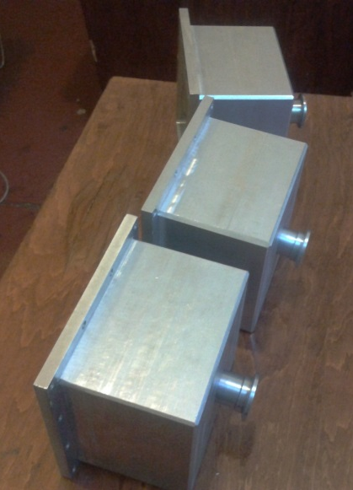
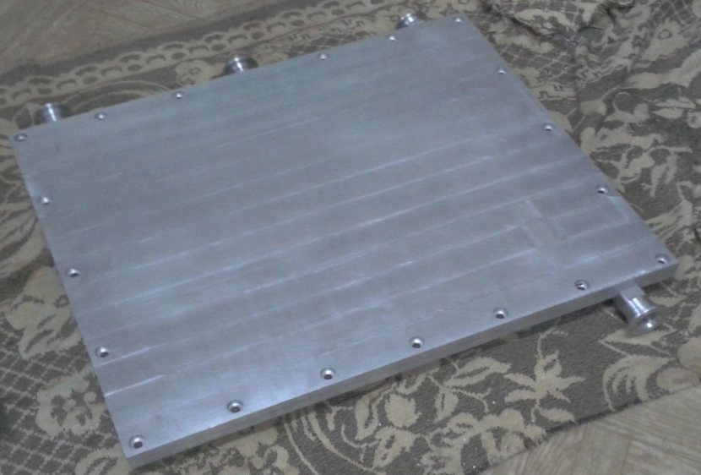
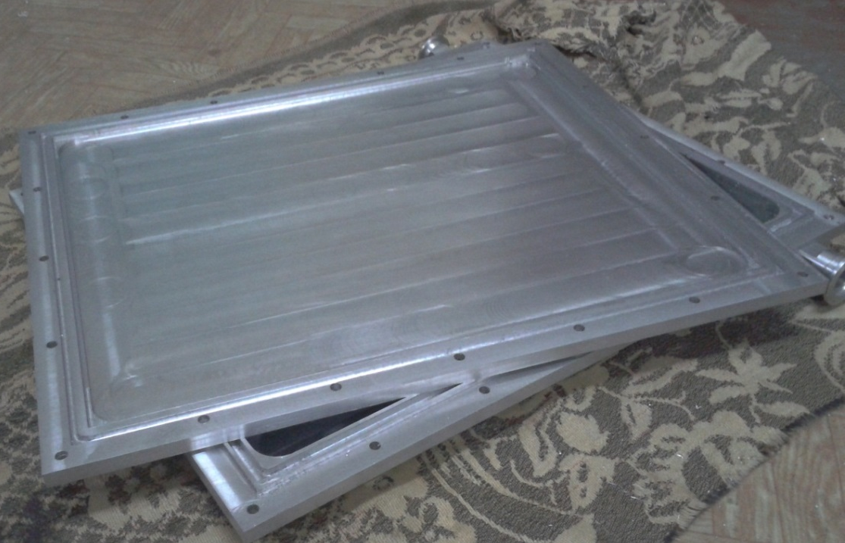
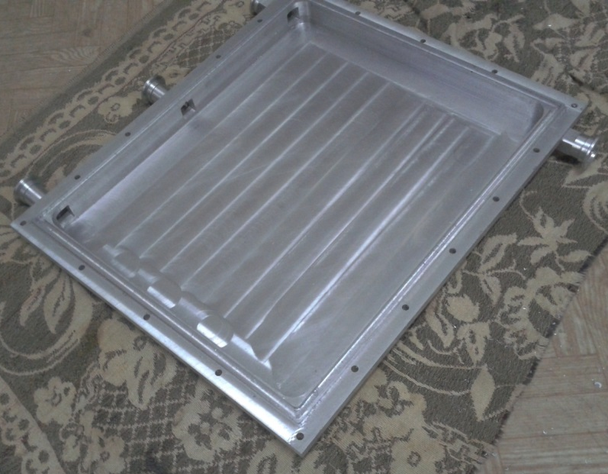
Manufacturing of vacuum chamber and 3 boxes for collimators
O.Bezshyyko, 2-nd French-Ukrainian workshop on the instrumentation developments for HEP, October 1-3, Orsay

Slide 18
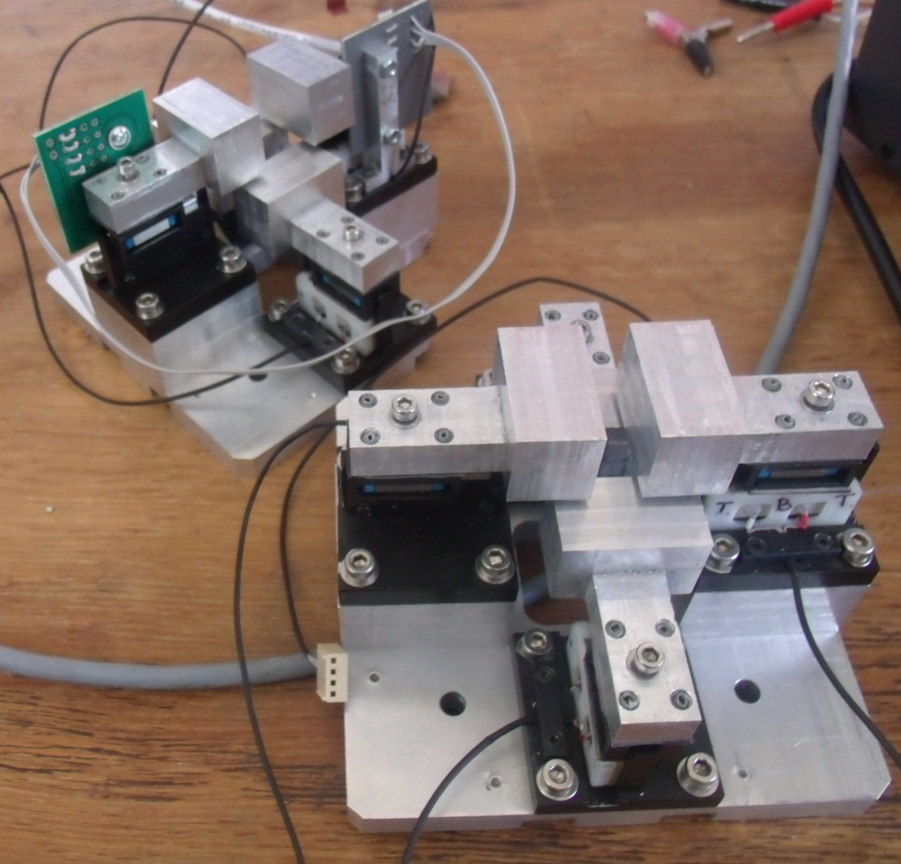
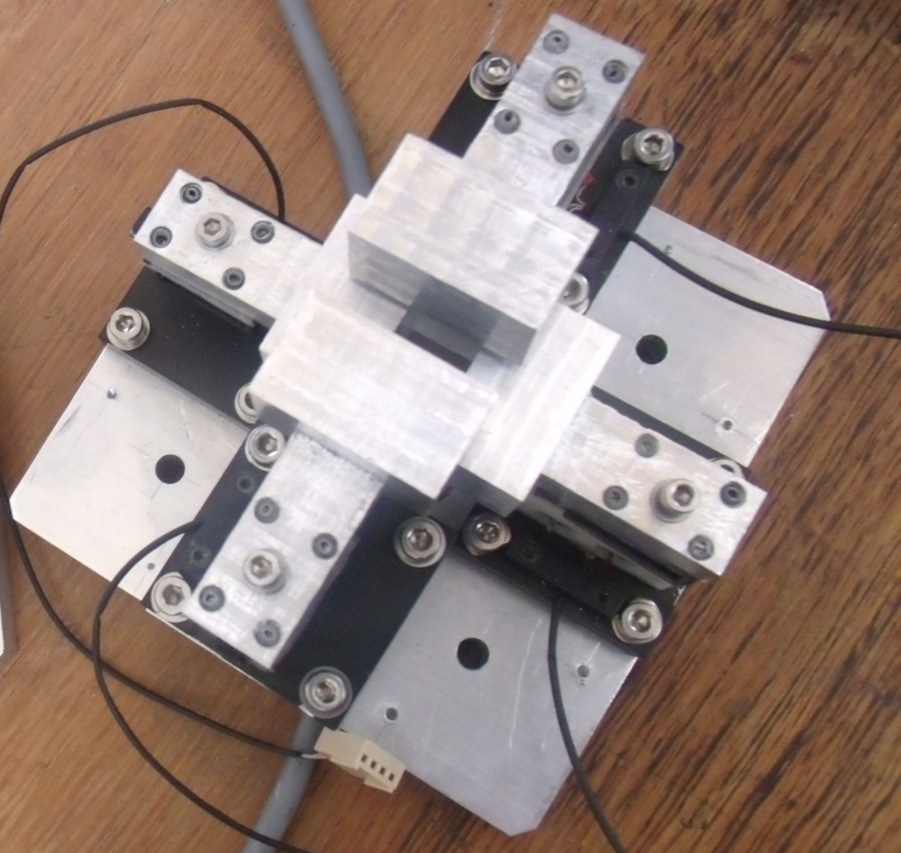
Collimator systems
Three similar collimator systems with piezomotors were produced and verified
O.Bezshyyko, 2-nd French-Ukrainian workshop on the instrumentation developments for HEP, October 1-3, Orsay

Slide 19

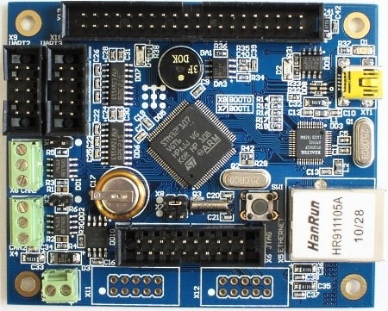
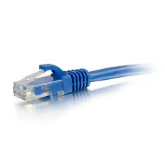
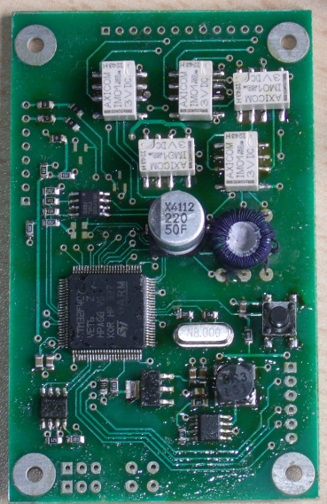
Control electronics for collimator system
Active participation of students: V. Krylov, T. Patlatiuk
Master Board
Ethernet
Computer
CAN bus
interface
Feedback
3 Slave Boards
CAN
CAN
O.Bezshyyko, 2-nd French-Ukrainian workshop on the instrumentation developments for HEP, October 1-3, Orsay

Slide 20
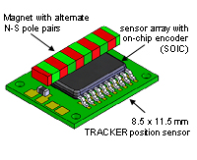
Feedback
Hall effect position sensor
A specific magnet strip needs to be placed above the chip
Characteristics
Coordinate value is stored in 12-bit register
This register value becomes to zero every 2mm.
Resolution: 2mm/2¹² = 0,488 um
Access interface: I²C
O.Bezshyyko, 2-nd French-Ukrainian workshop on the instrumentation developments for HEP, October 1-3, Orsay

Slide 21
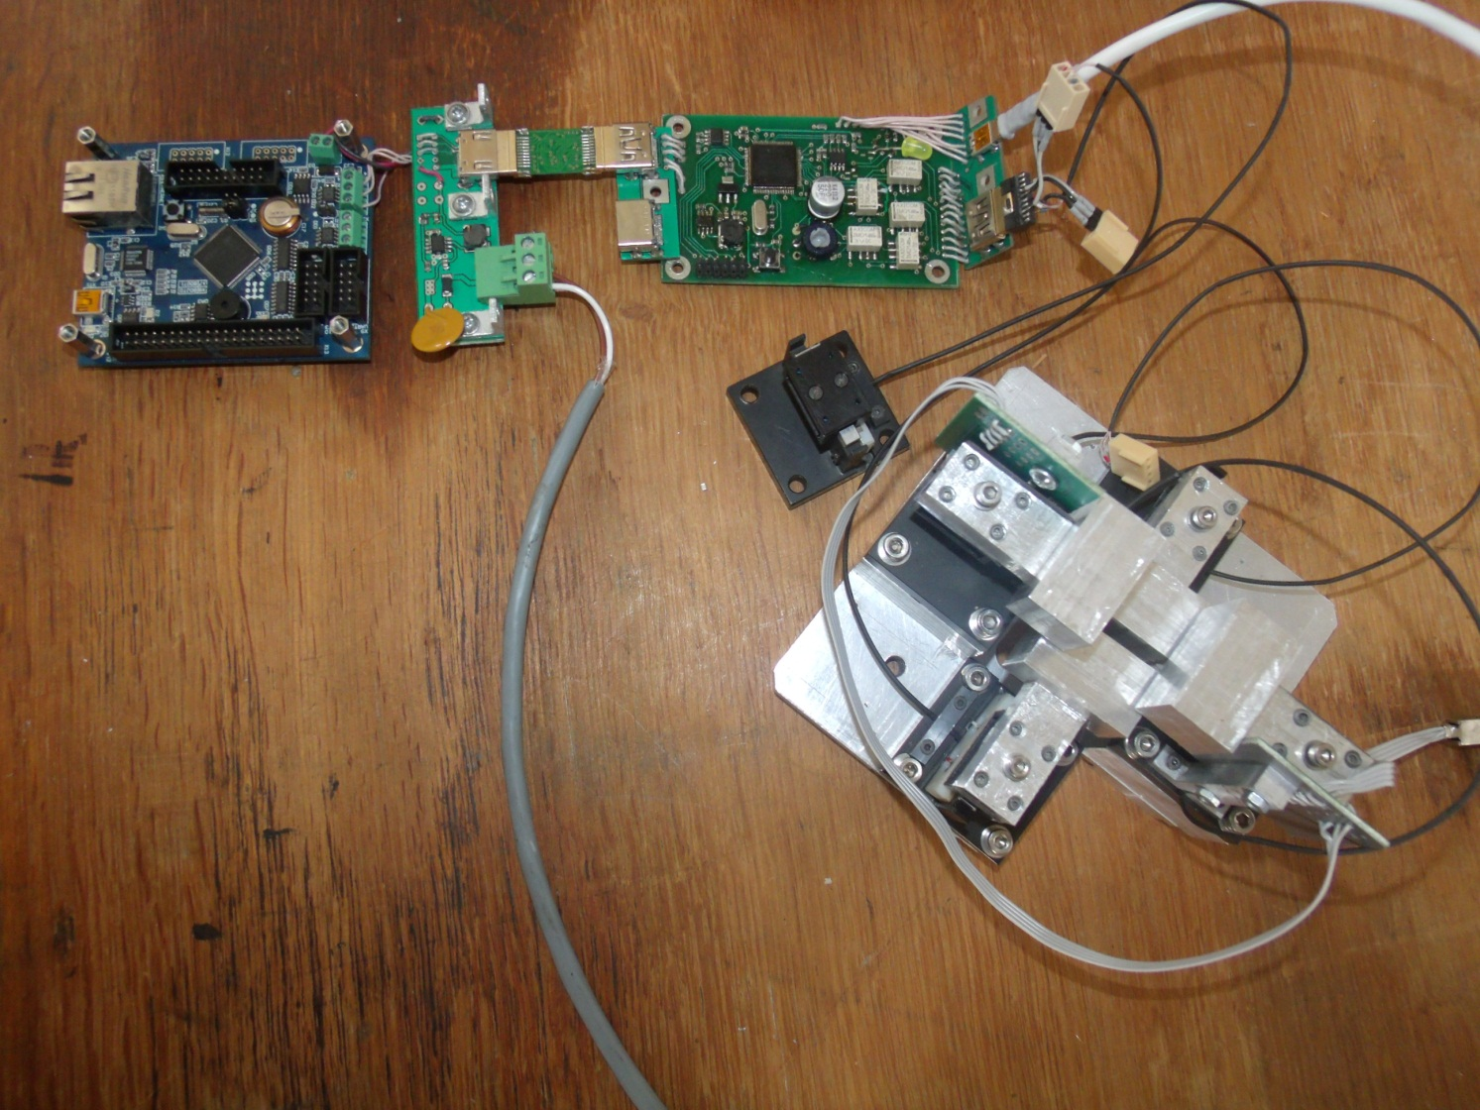
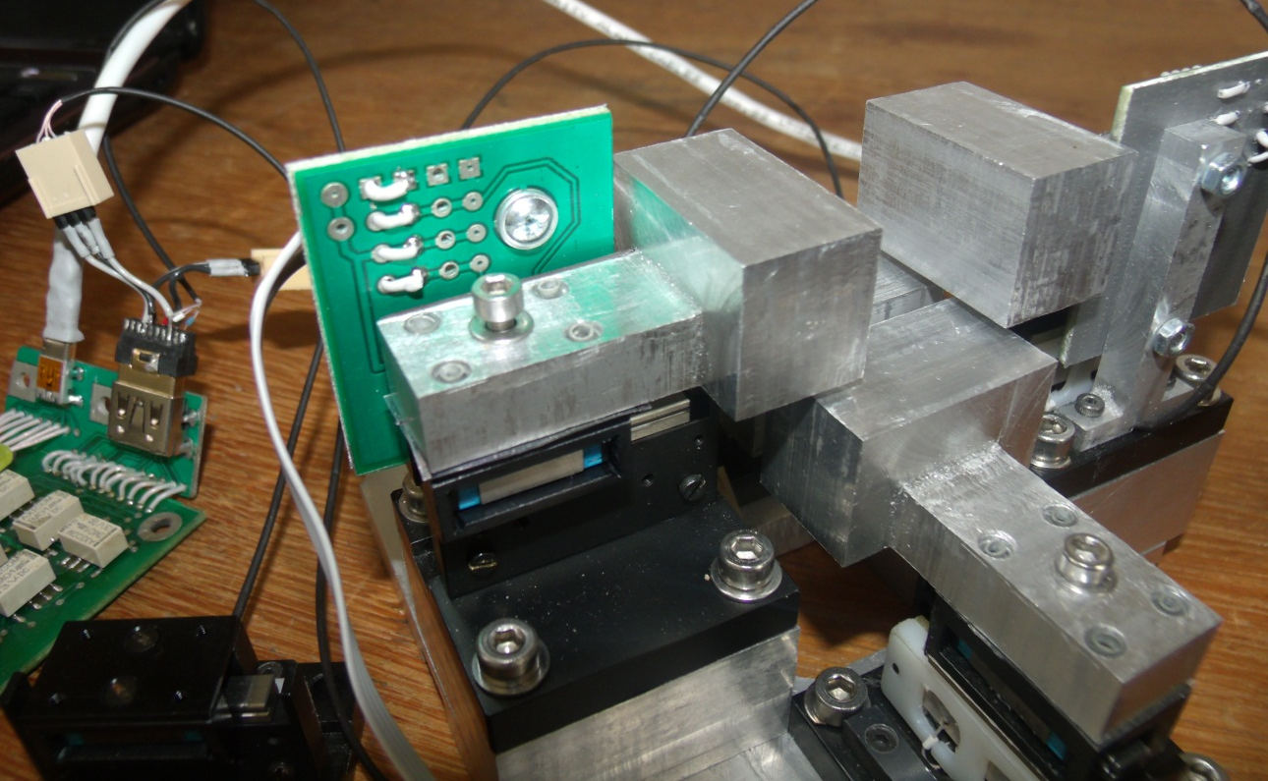
    Test assembly
O.Bezshyyko, 2-nd French-Ukrainian workshop on the instrumentation developments for HEP, October 1-3, Orsay

Slide 22
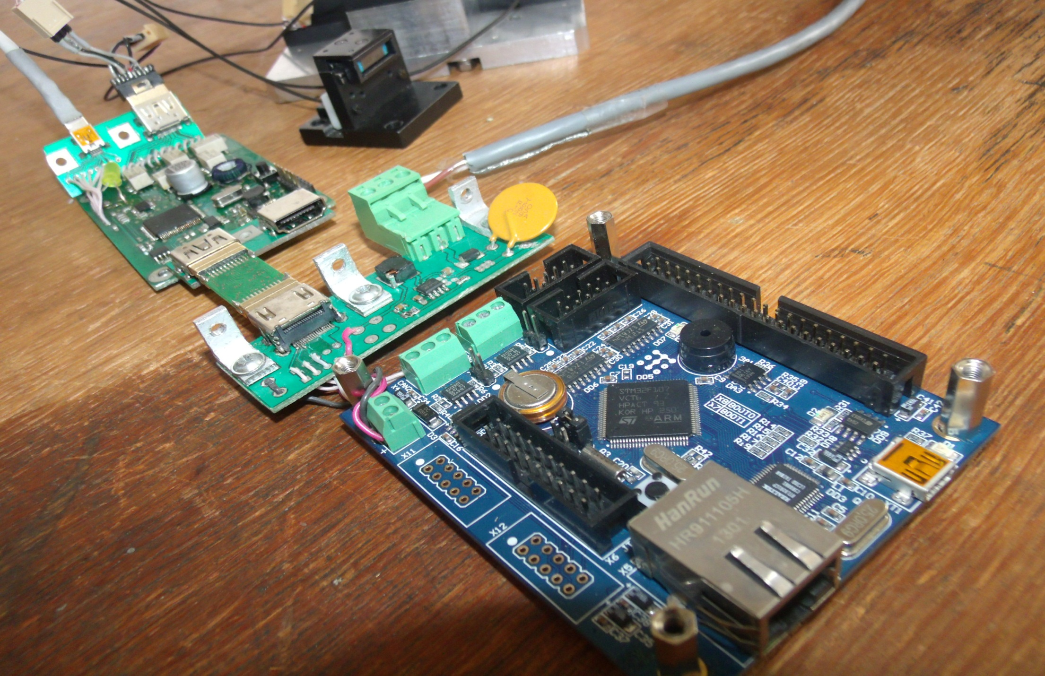
    Test assembly
Test collimator motor
Auxiliary board
Slave
board
HDMI
connector
Master board
O.Bezshyyko, 2-nd French-Ukrainian workshop on the instrumentation developments for HEP, October 1-3, Orsay

Slide 23
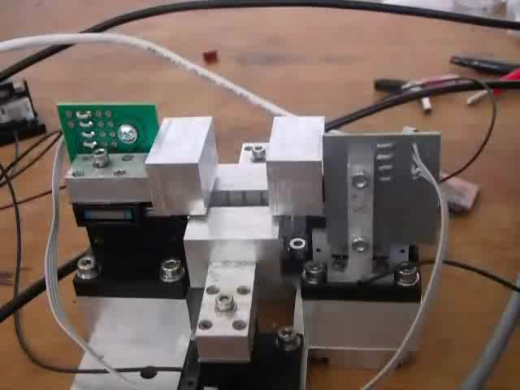

Slide 24
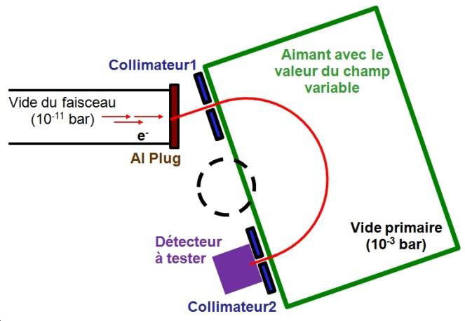
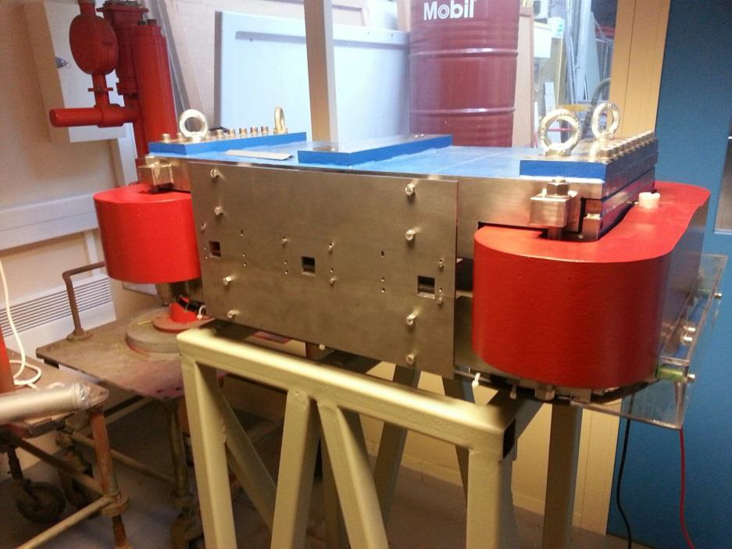
Dipole magnet
produced at CERN, and delivered to LAL
O.Bezshyyko, 2-nd French-Ukrainian workshop on the instrumentation developments for HEP, October 1-3, Orsay

Slide 25
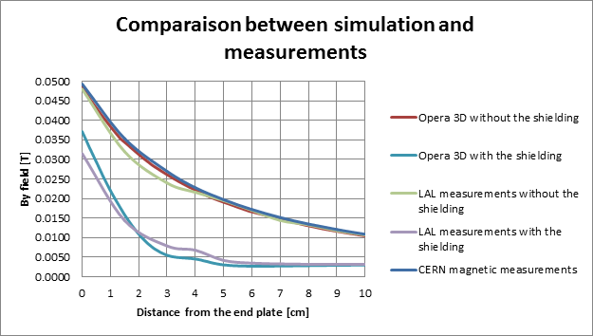
Dipole magnet
O.Bezshyyko, 2-nd French-Ukrainian workshop on the instrumentation developments for HEP, October 1-3, Orsay

Slide 26
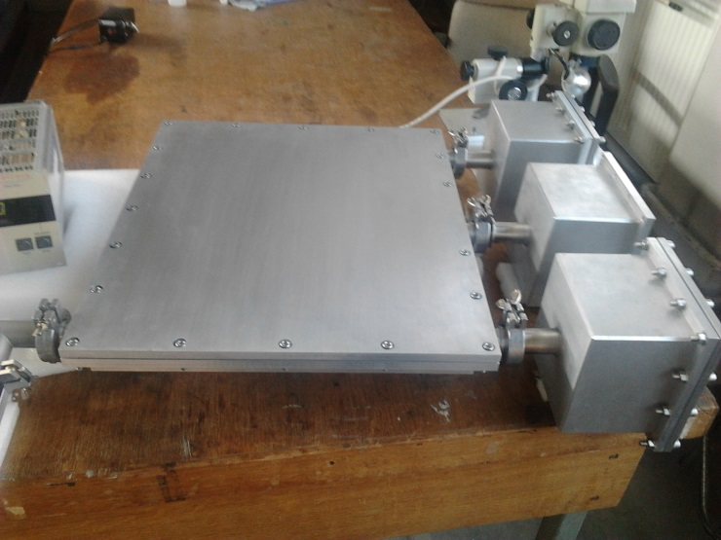

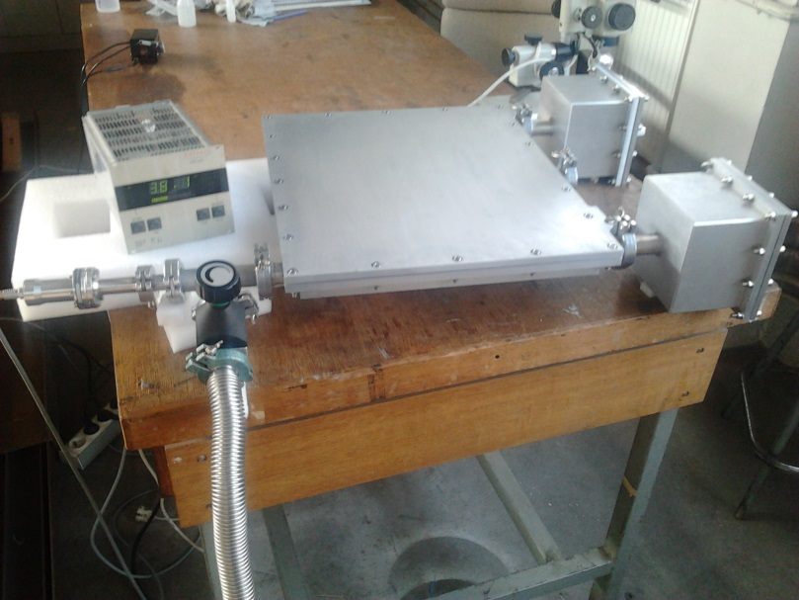
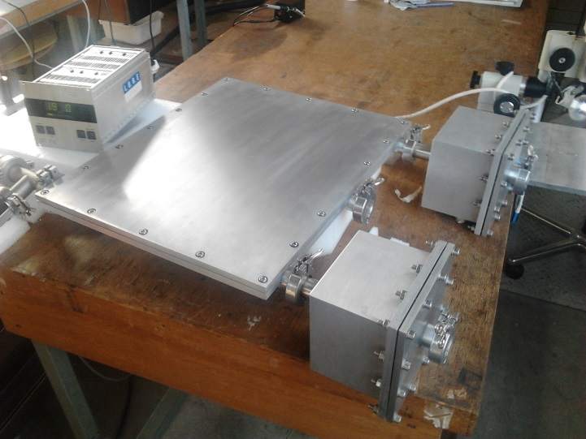
Status
Magnet, vacuum chamber and three collimator subsystems are produced and delivered to LAL. Electronic, mechanical, vacuum tests of these components are performed and now tests of all LEETECH system are starting at the PHIL facility
O.Bezshyyko, 2-nd French-Ukrainian workshop on the instrumentation developments for HEP, October 1-3, Orsay

Slide 27

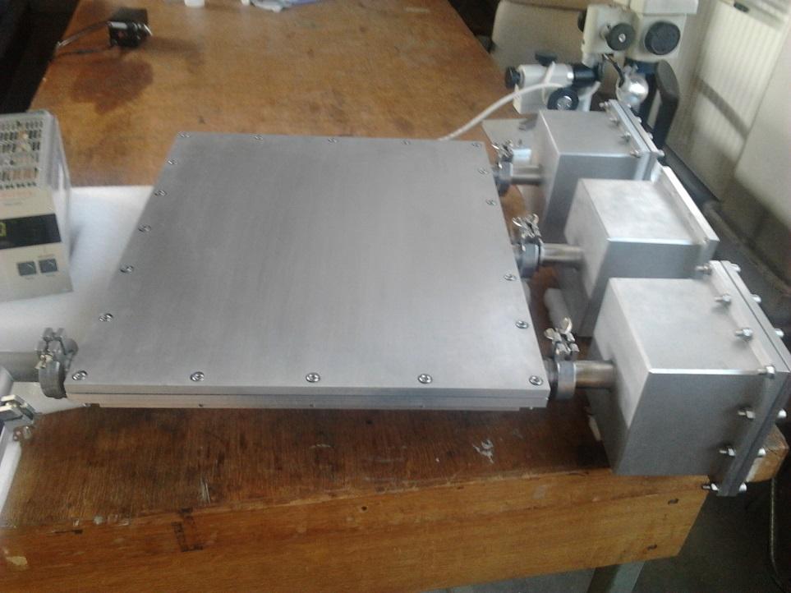

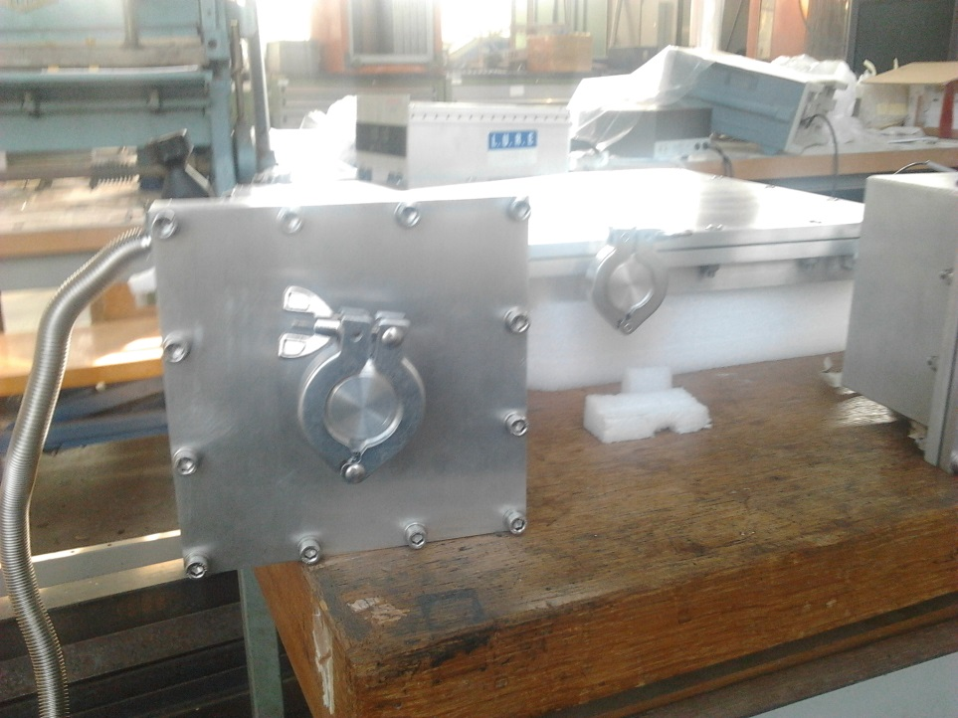
Vacuum chamber and collimators were produced in Kyiv University (TSNUK, Ukraine), delivered to LAL and have tested here
O.Bezshyyko, 2-nd French-Ukrainian workshop on the instrumentation developments for HEP, October 1-3, Orsay

Slide 28
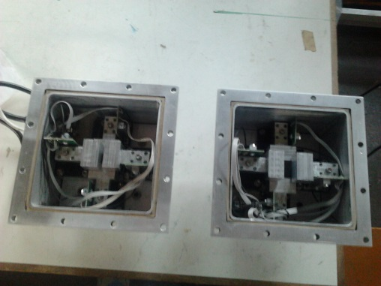
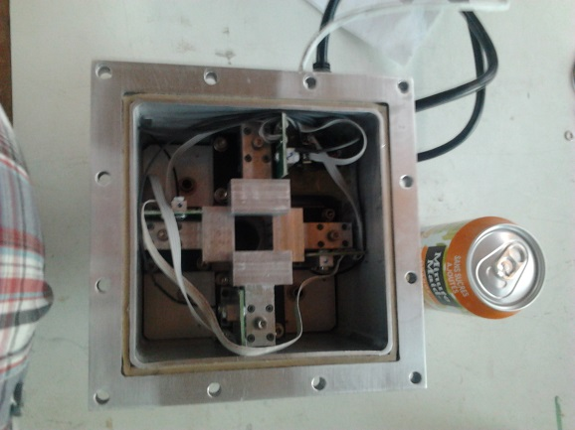
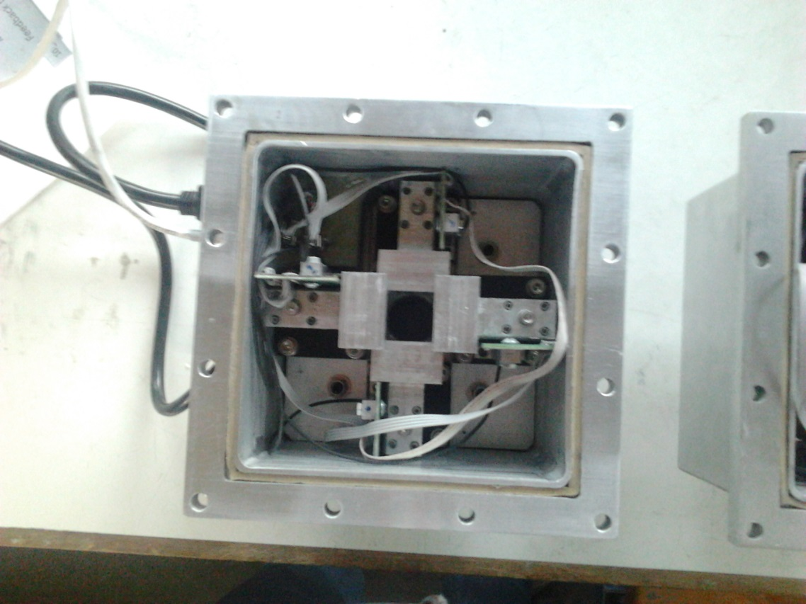
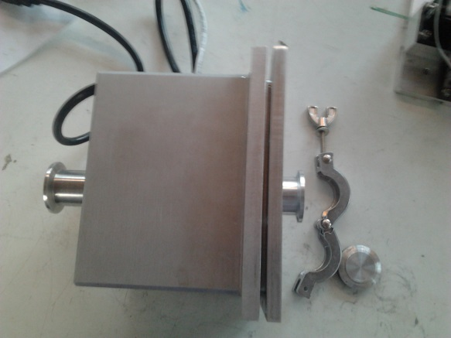
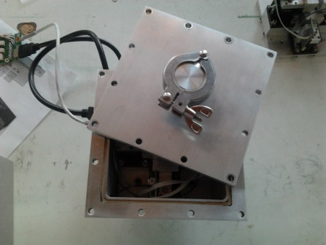
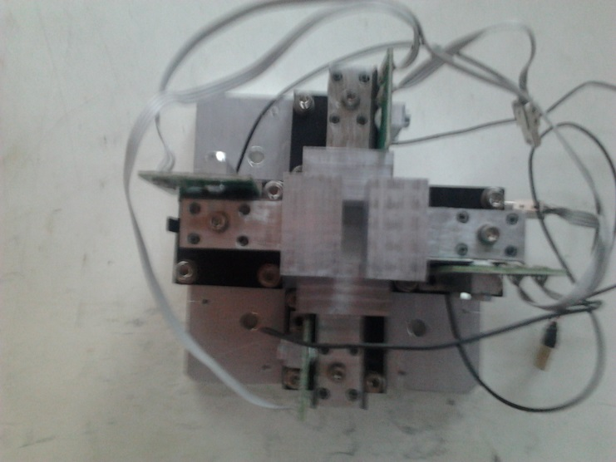
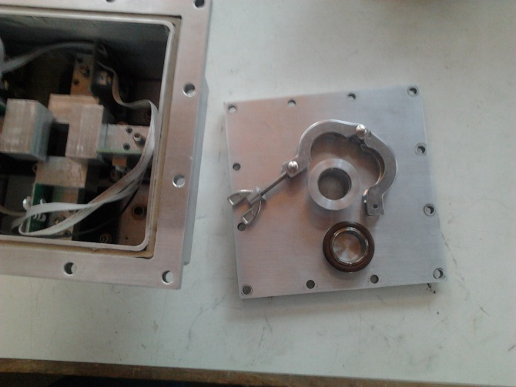
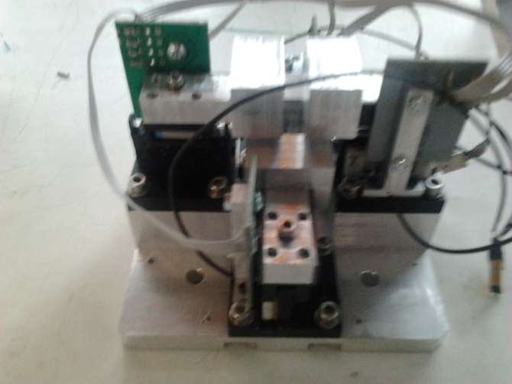
Vacuum chamber and collimators were produced in Kyiv University (TSNUK, Ukraine), delivered to LAL and have tested here
O.Bezshyyko, 2-nd French-Ukrainian workshop on the instrumentation developments for HEP, October 1-3, Orsay

Slide 29




O.Bezshyyko, 2-nd French-Ukrainian workshop on the instrumentation developments for HEP, October 1-3, Orsay

Slide 30
Conclusions
Tasks for LEETECH facility at PHIL and its general design were considered
Simulation of LEETECH facility in GEANT4 was performed
Design and production (in Kyiv University) of vacuum chamber and collimator system (mechanical part and electronics) was carried out
Design and production of Dipole Magnet (in CERN) was carried out
All LEETECH components were delivered in LAL and tested here
Testing of whole system and studies at the PHIL in the schedule
O.Bezshyyko, 2-nd French-Ukrainian workshop on the instrumentation developments for HEP, October 1-3, Orsay

