Slide 1
Diamond Detector Development and Tests
V. Kubytskyi, S. Liu, P. Bambade, F. Bogard, J. Cayla, N. Fuster Martinez, I. Khvastunov, H. Monard, C. Sylvia, T. Tauchi,
N. Terunuma, T. Vinatier
French-Ukrainian workshop, 1 October, 2014

Slide 2
Our Goals
Mastering the diamond detectors: physics, instrumentation, electronics
Development of application oriented diamond detectors
Using this devices at accelerator facilities

Slide 3
Outline
Diamond as particle detector
Tests with diamond detector
Modeling of signal collection

Slide 4
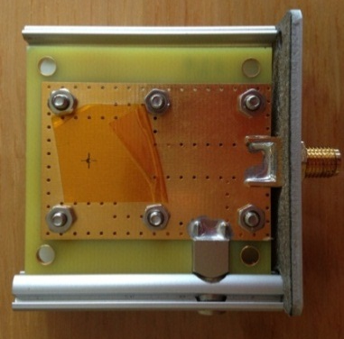
Diamond as particle detector
Depending on the applications in addition: fast low noise electronics charge amplifier,
current amplifier, attenuators, power supply, oscilloscope etc.
SPICE simulation for optimal parameters of the electrical circuit for given application

Slide 5
Physical properties of CVD diamond
Property Diamond Silicon
Density (g m⁻³) Band gap (eV) Resistivity (Ω cm) Breakdown voltage (V cm ⁻¹) Electron mobility (cm³ V⁻¹ s⁻¹) Hole mobility (cm³ V⁻¹ s⁻¹) Saturation velocity (μm ns⁻¹) Dielectric constant Neutron transmutation cross-section(mb) Energy per e-h pair (eV) Atomic number Av.min.ionizing signal per 100 μm (e) | 3.5 5.5 >10¹² 10⁷ 1900 2300 141 (e⁻) 96(hole) 5.6 3.2 13 6 3600 | 2.32 1.1 10⁵ 10³ 1500 500 100 11.7 80 3.6 14 8000
ADVANTAGES
• Large band-gap⇒ low leakage current
• High breakdown field
• High mobility⇒ fast charge collection
• Large thermal conductivity
• High binding energy⇒ Radiation hardness
Fast pulse ⇒ several ns
High dynamic range
Charge generated by 1 MIP for 500 µm diamond (with 100% CCE): 2.88 fC

Slide 6
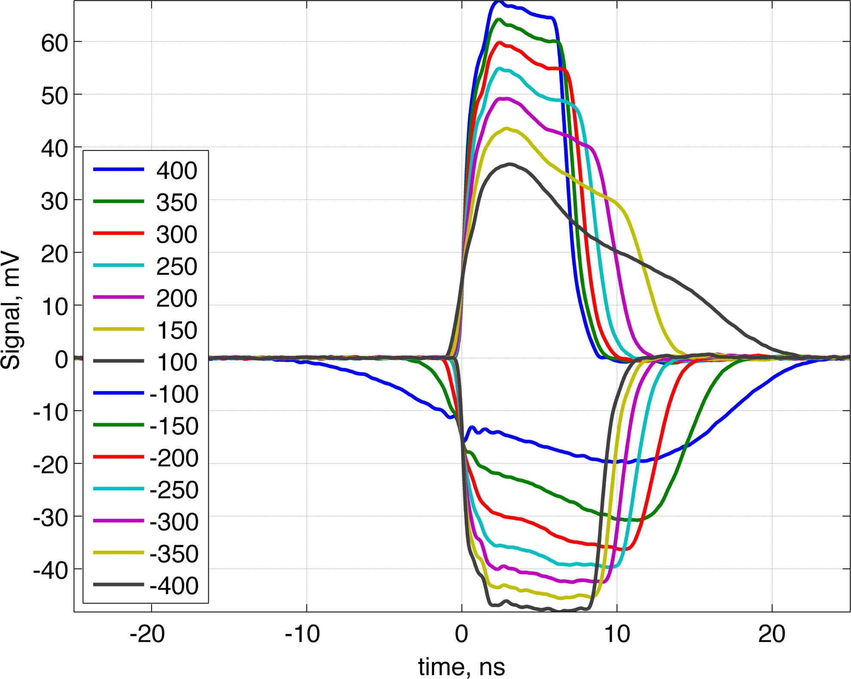
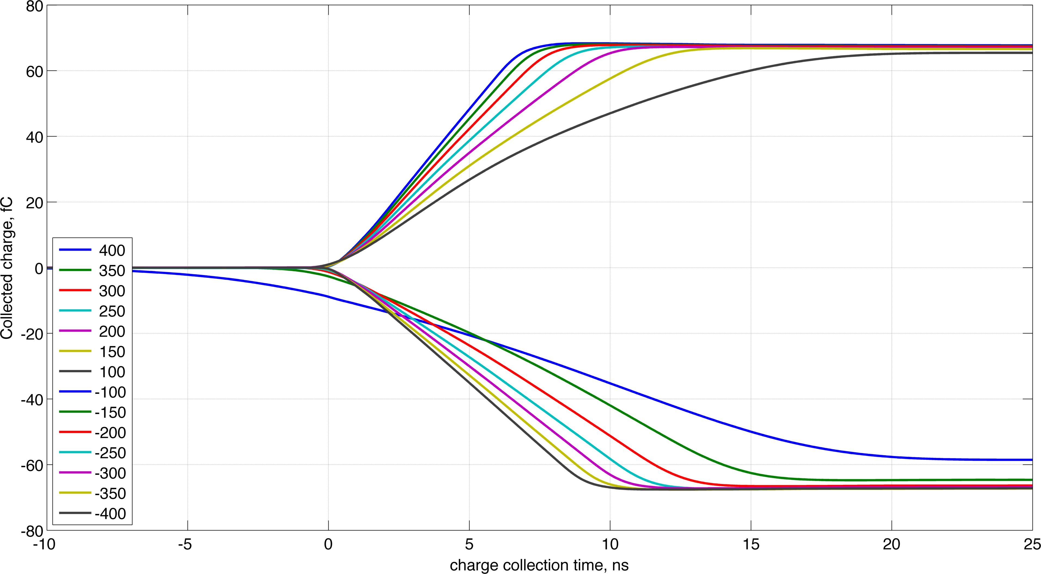
Calibration: Tests with well known
Radioactive Sources
+ current amplifier
Signal: Shockley-Ramo theorem
²⁴¹Am alpha source: Eα = 5.4 MeV
Allows to obtain diamond characteristics by Transient Current Technique.

Slide 7
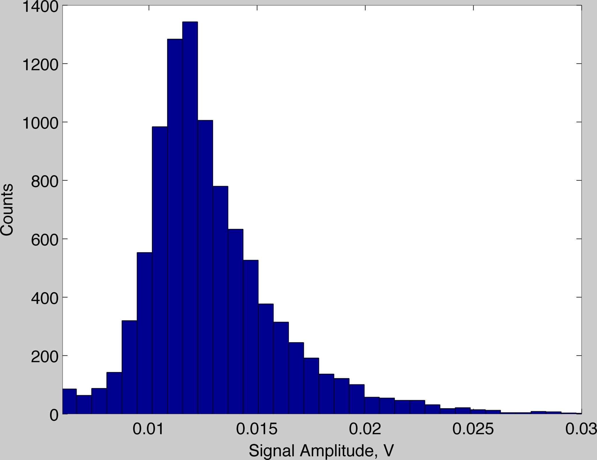
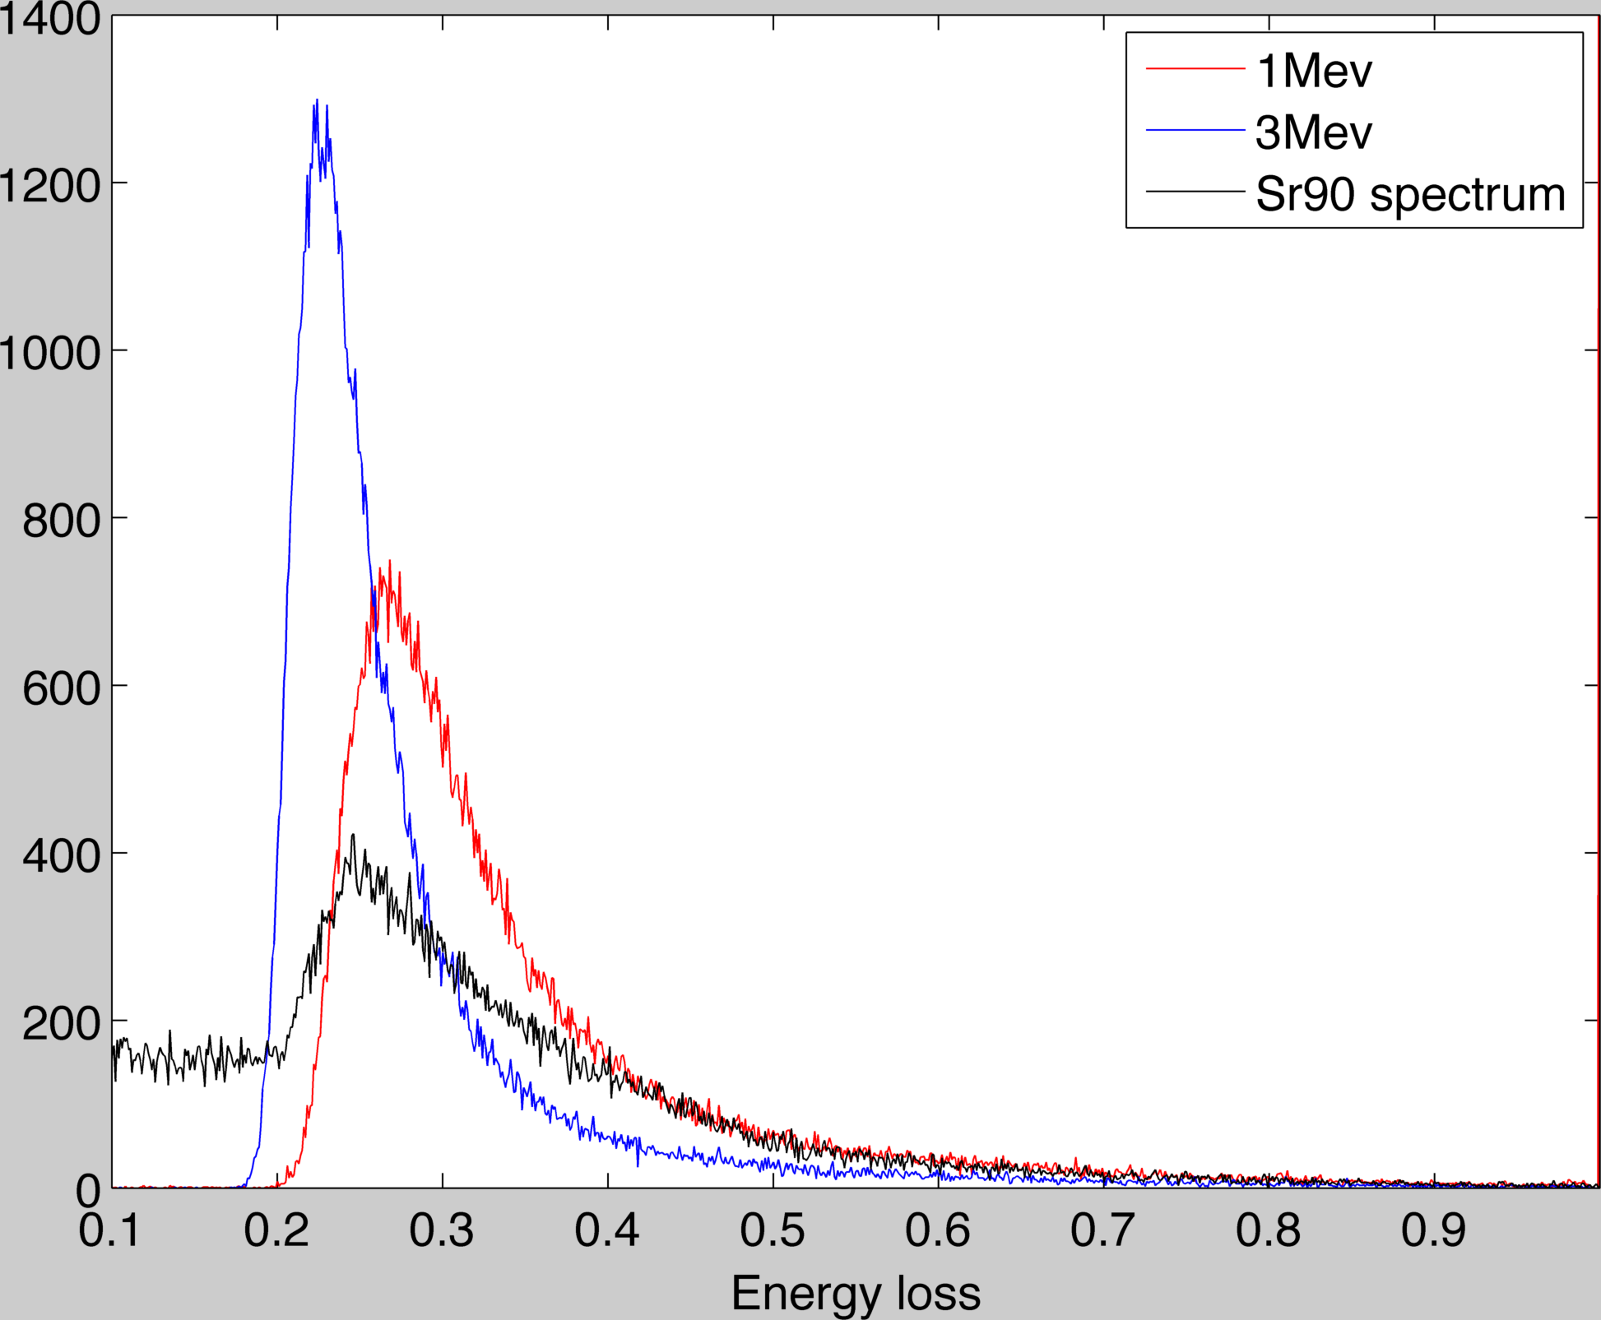
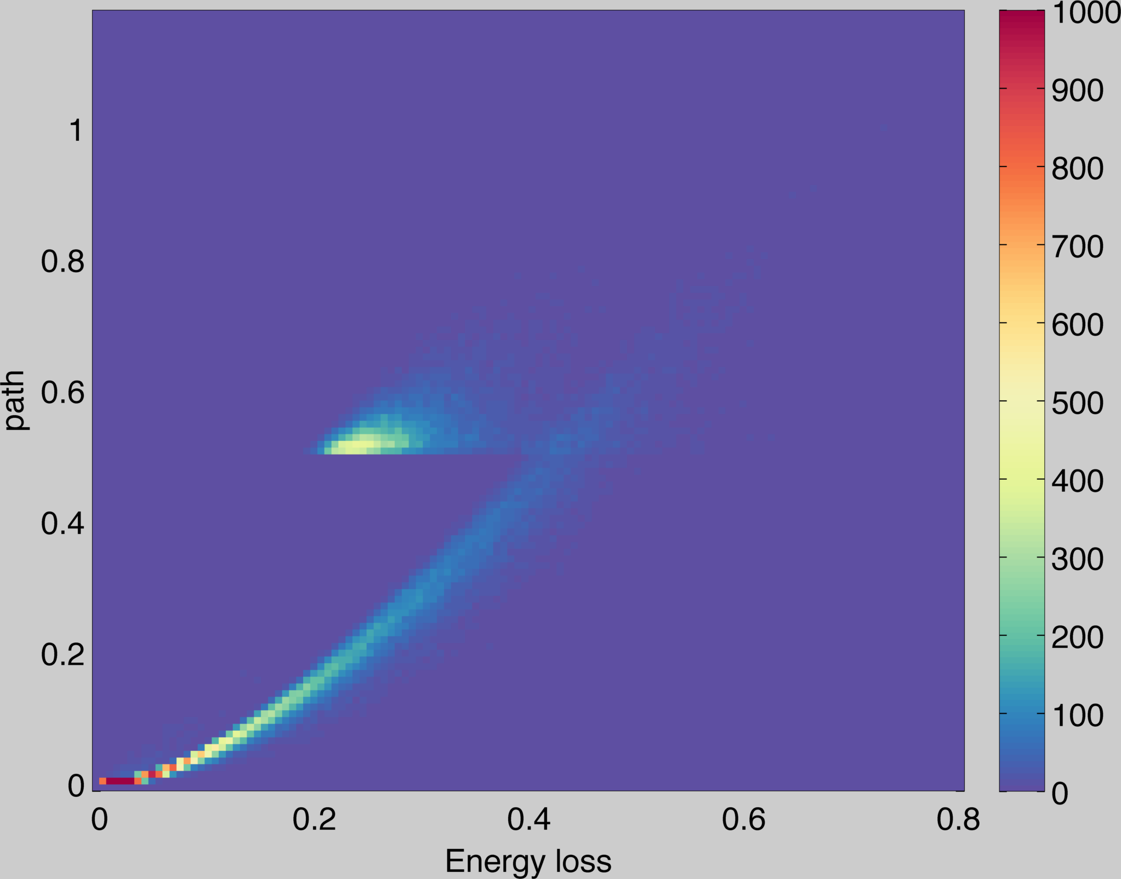
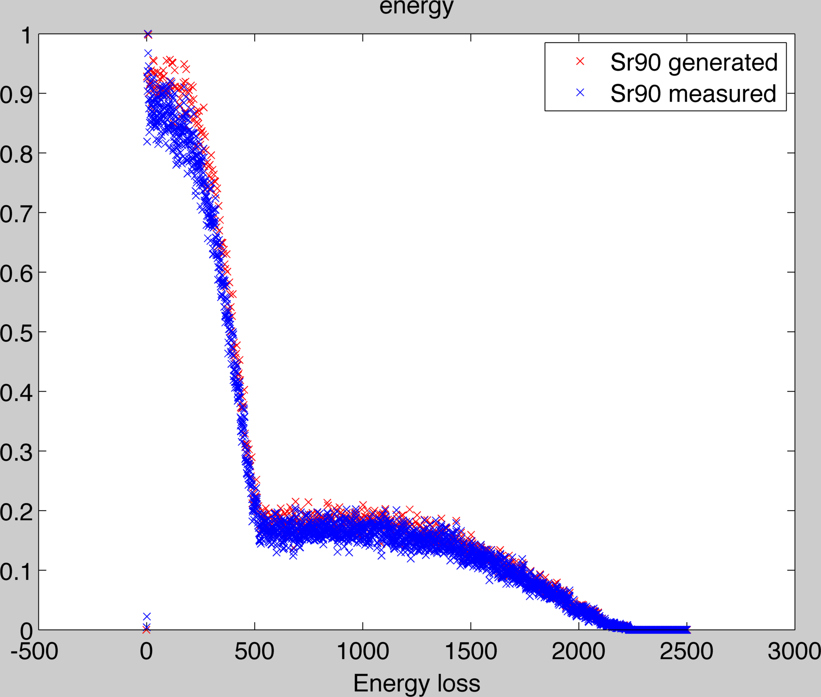
+charge amplifier(4mV/fC)
0.55 MeV
2.27 MeV
Geant4 diamond simulation.
Sr90 spectrum

Slide 8
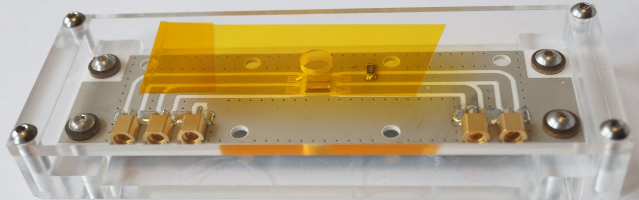
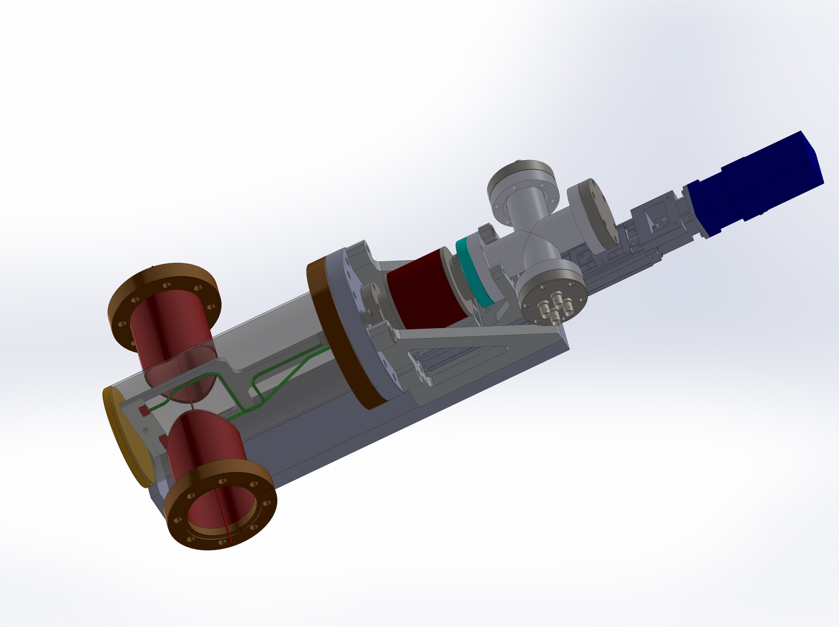
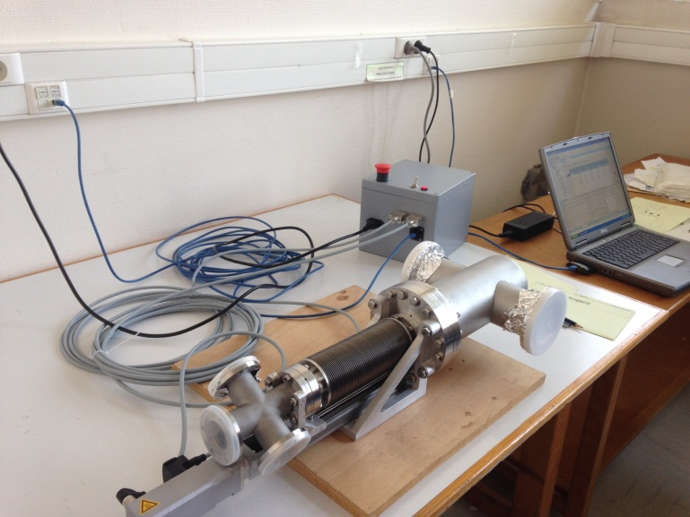
Applications: PHIL beam monitor
In Vacuum Diamond Detector
CH1
CH3
HV
CH4
CH2
The same setup will be used at ATF2 for investigation of beam halo

Slide 9
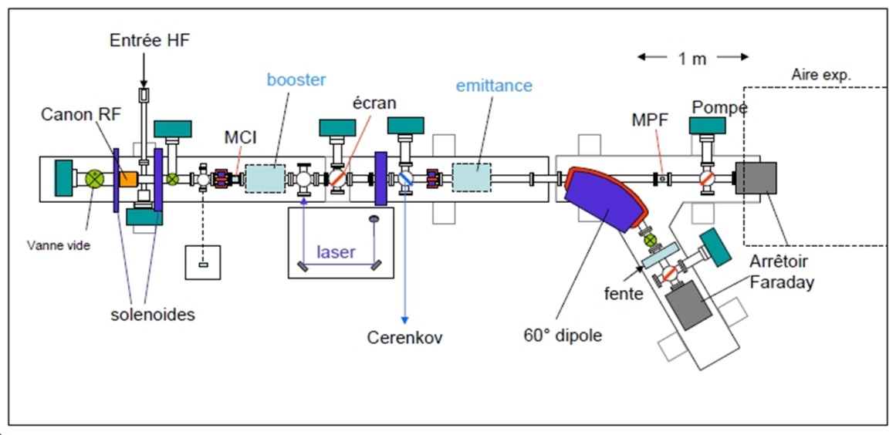
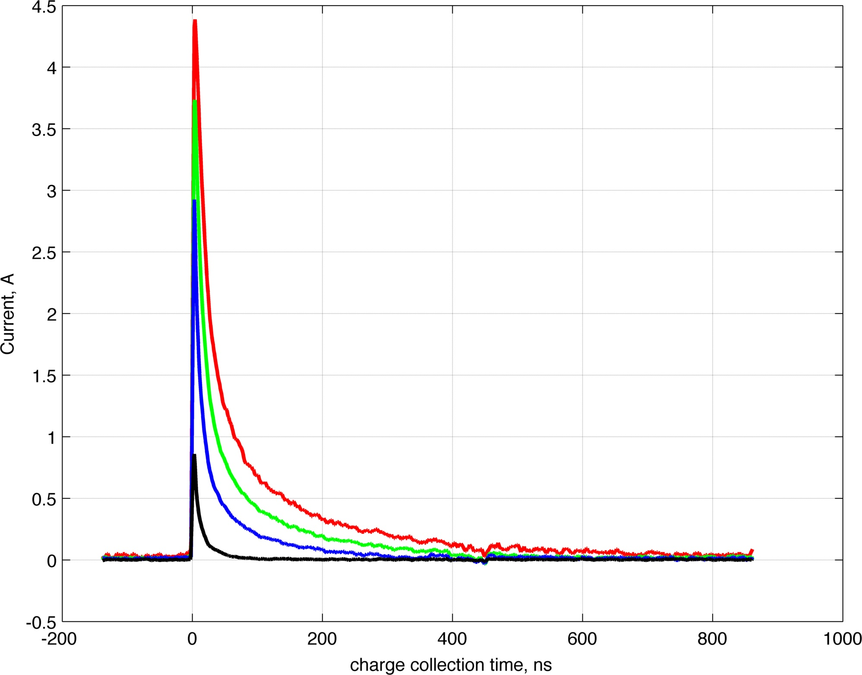
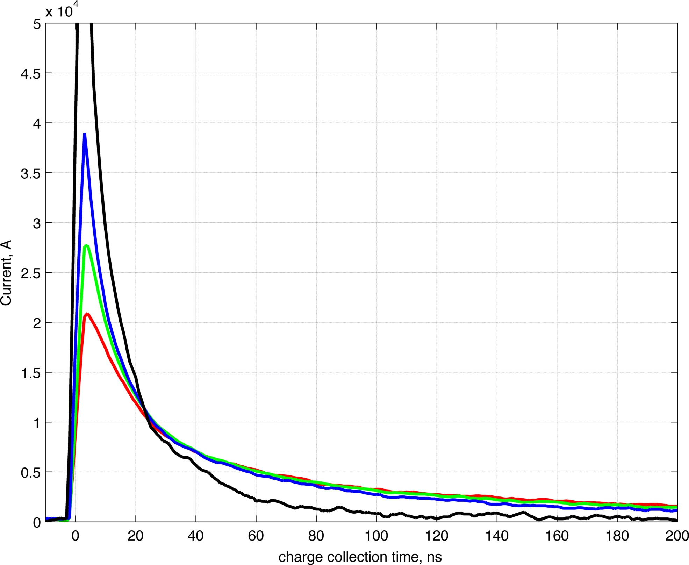
PHIL Facility
PHIL Electron Beam Parameters
Charge: 1pC-500 pC/bunch (1 bunch per RF pulse) ;
Duration of Charge: 7 ps FWHM;
Charge Stablility: < 2%;
Beam Energy: 3 to 5MeV;
Minimum Dispersion: < 1%;
Increase of incident charge slow down charge collection
Normalized on collected charge
Different characteristic times

Slide 10
Modeling of charge collection in 1D
Drift-diffusion equations.
where
Generation, recombination terms can be added here
Poisson equation in this case can be solved analytically:
Numerical solution of drift-diffusion eqns. -> time evolution of charge densities inside the diamond

Slide 11
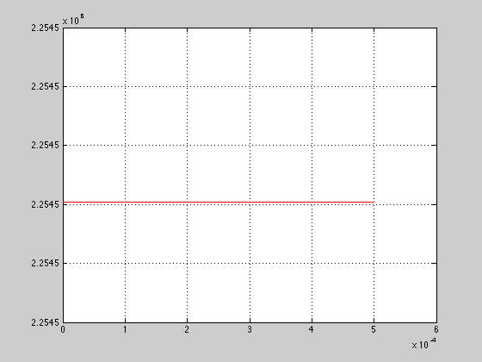
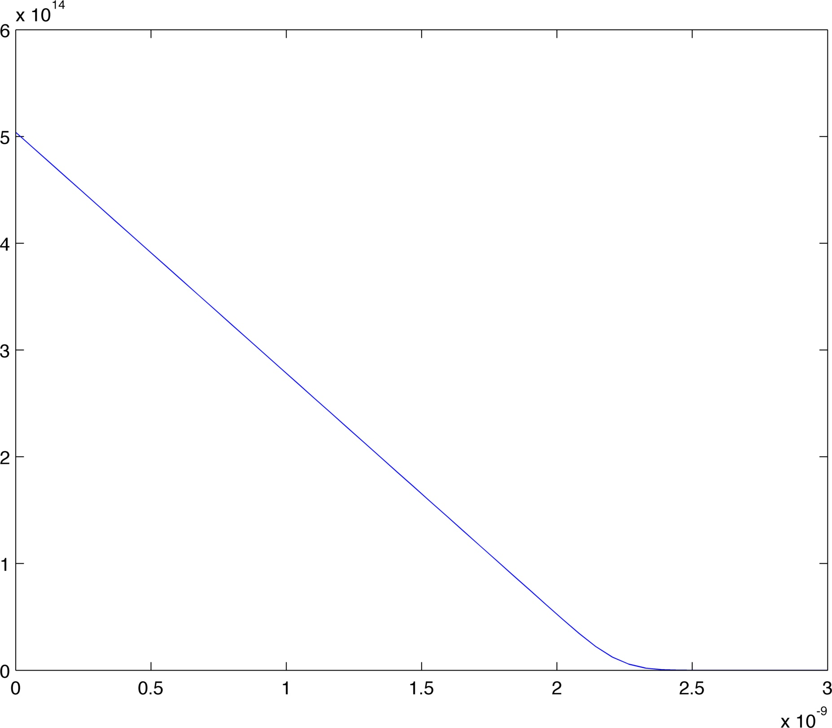
Modeling Charge collection 1 MIP( created~18000e-h pairs)
Collected charge as a function of time
electrons
holes
High Voltage

Slide 12
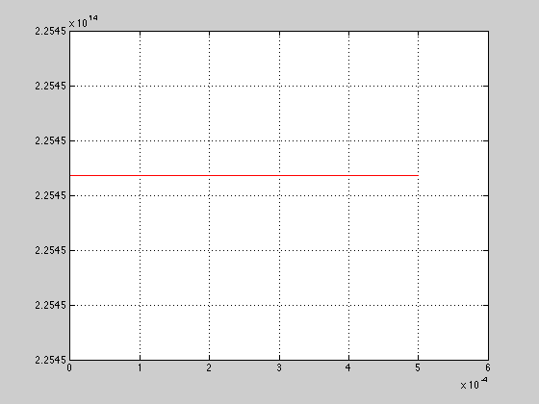
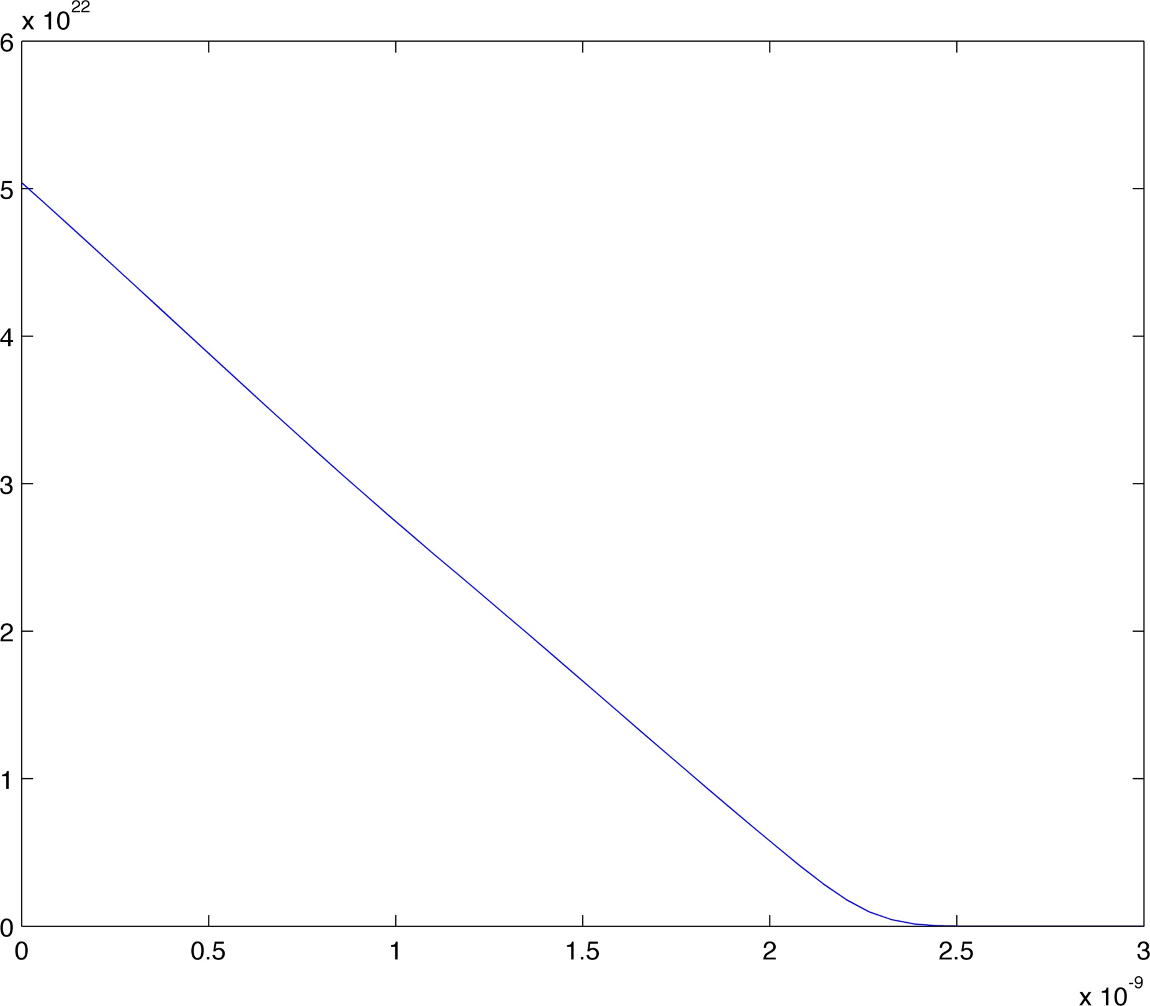
Nmip ~10^5
Typical for beam halo
Collected charge as a function of time

Slide 13
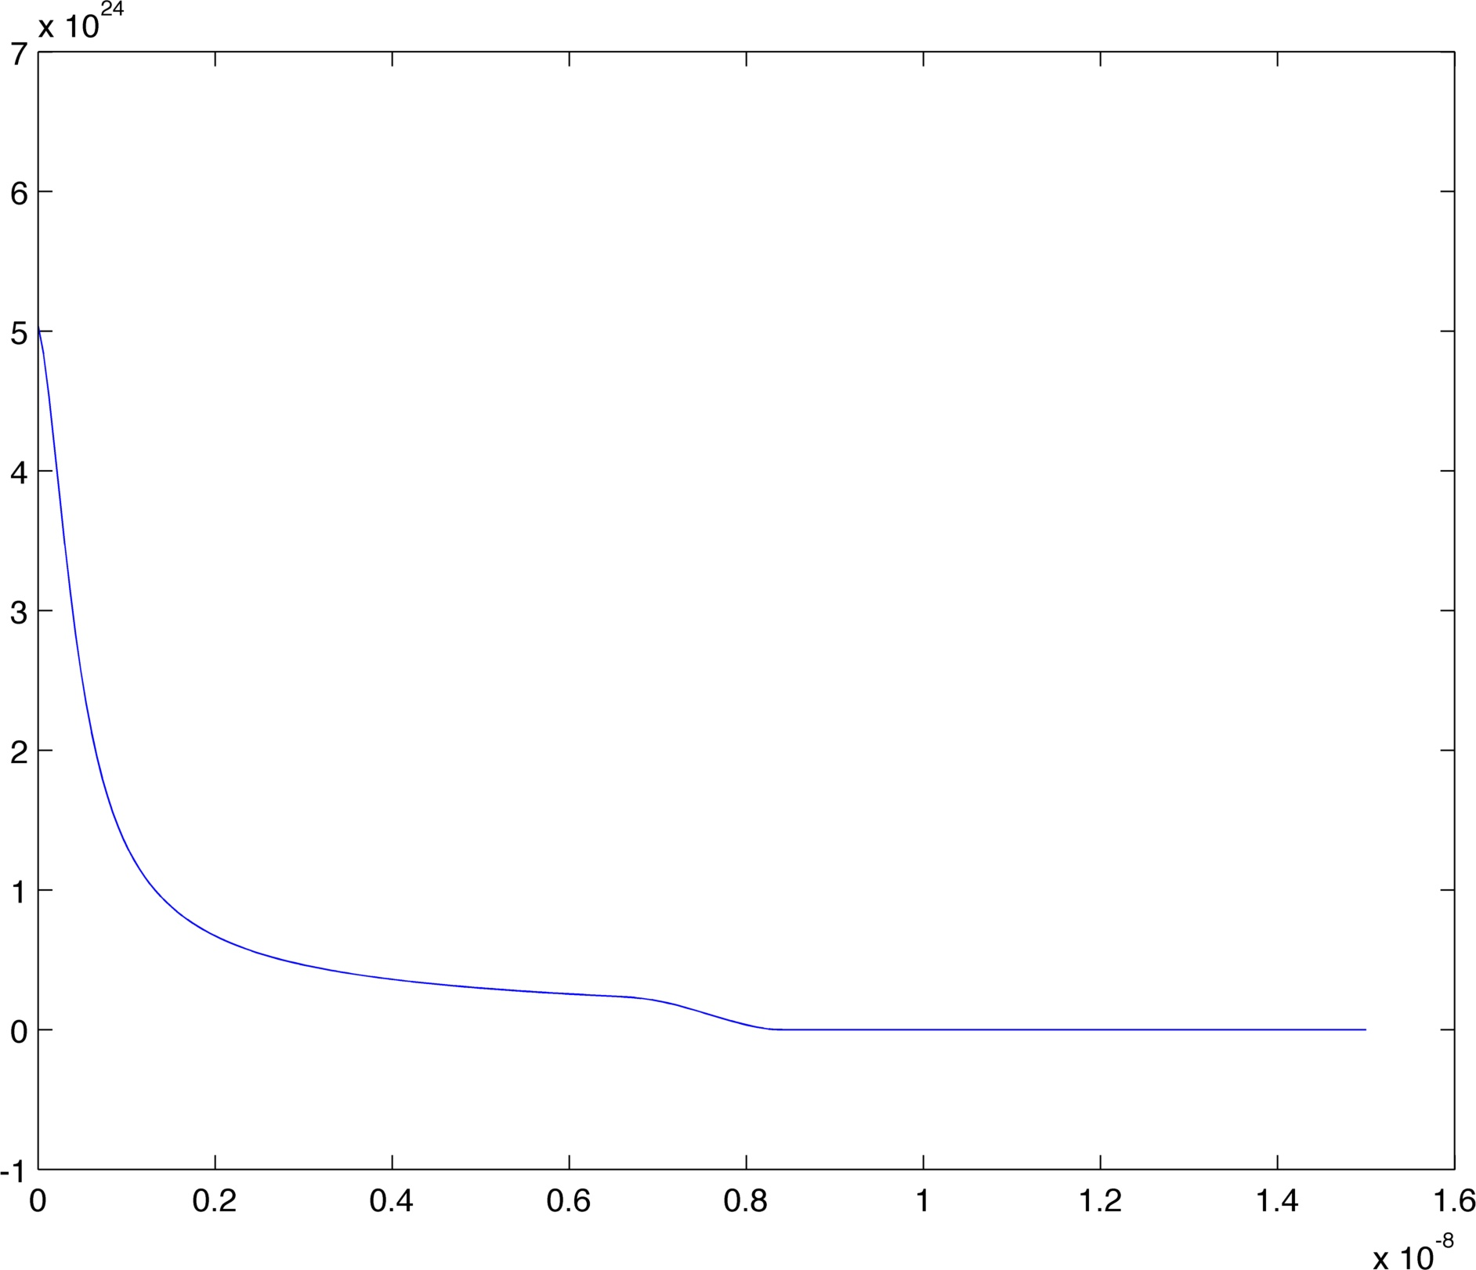
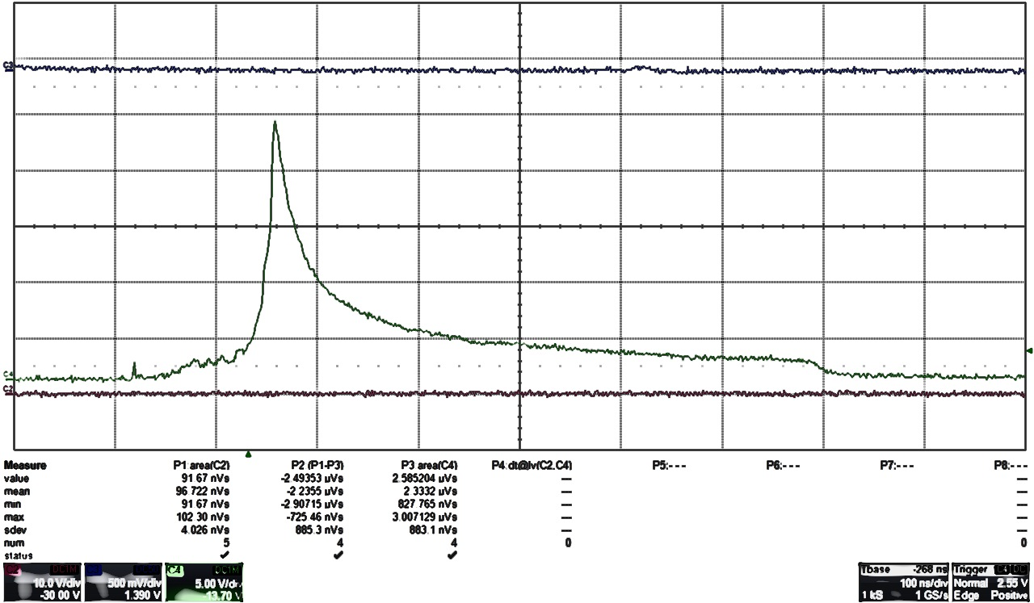
Nmip 1
Nmip ~10^8
Slowing down due to space charge
Looks similar
PHIL tests
Peak when charge densities
are separated in space

Slide 14
Future plans
We need:
-Fast, low noise charge amplifier (in case of Belle2 application 4 ns);
-understand ways of optimization of the detector; modeling
-characterize multistrip diamond detector in UHV

