Slide 1
Taras Shevchenko National University of Kyiv
Micromegas simulations for ILCTPC
Oleg Bezshyyko
O.Bezshyyko, 2-nd French-Ukrainian workshop on the instrumentation developments for HEP, October 1-3, Orsay

Slide 2
In cooperation with:
CEA Saclay, Irfu/SPP, France
LAL, Orsay, France
University of Bonn, Germany
Nikhef, Netherlands
DESY, Germany
O.Bezshyyko, 2-nd French-Ukrainian workshop on the instrumentation developments for HEP, October 1-3, Orsay

Slide 3
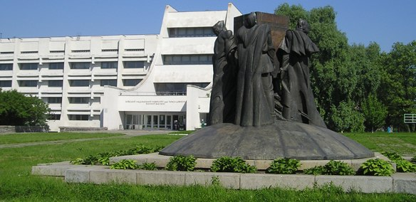
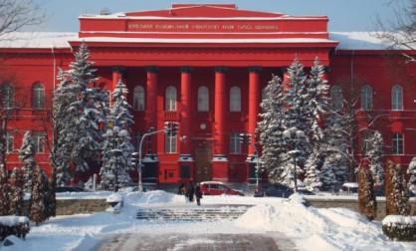
Taras Shevchenko National University of Kyiv
Nuclear Physics Department
(Head of Department – I.Kadenko)
Simulation direction - O.Bezshyyko and O. Fedorchuk
Test platform - O.Bezshyyko, V.Krylov, L.Golinka-Bezshyyko, D.Sukhonos…, other students :)
O.Bezshyyko, 2-nd French-Ukrainian workshop on the instrumentation developments for HEP, October 1-3, Orsay

Slide 4
Outlines
Tasks of LCTPC collaboration
Previous experience of Micromegas simulation
Simulation of Octoboard geometries
Plans
O.Bezshyyko, 2-nd French-Ukrainian workshop on the instrumentation developments for HEP, October 1-3, Orsay

Slide 5
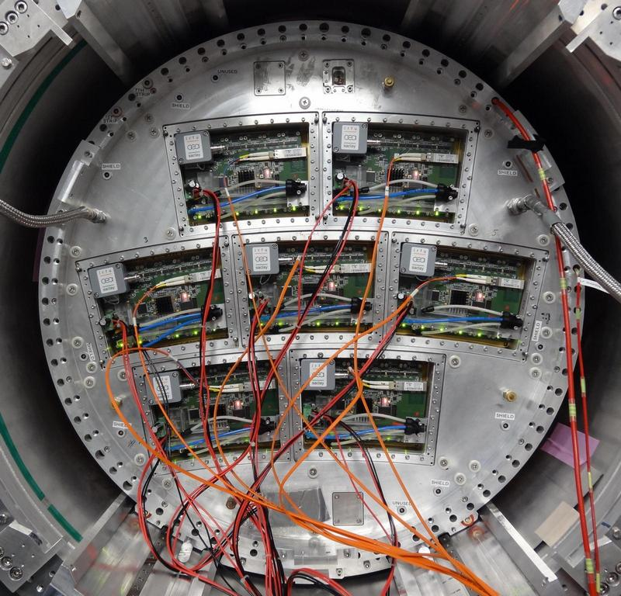
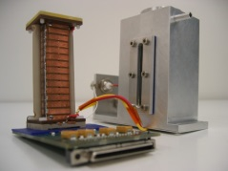
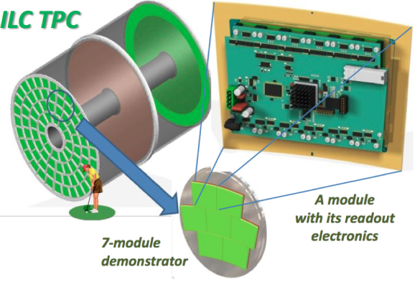
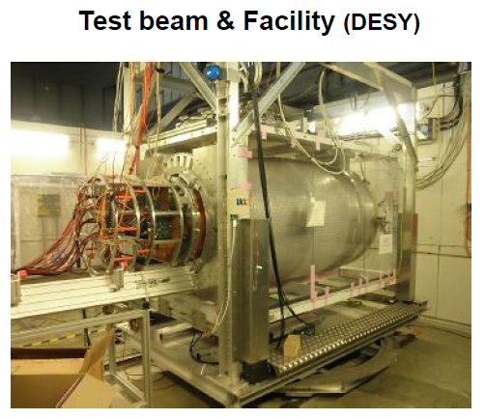
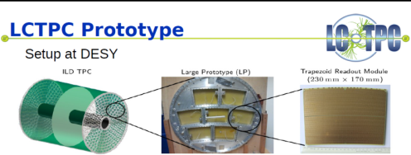
The LCTPC collaboration formed to join the international efforts to develop a high-performance Time Projection Chamber (TPC) for future Linear Collider
1
2
3
TPC R&D
ILC direction (Japan)
CLIC direction (possible option)
1. Small Prototypes - SP
2. Large Prototypes – LP
3. Design
http://irfu.cea.fr/ILC-TPC/
https://agenda.linearcollider.org/getFile.py/access?contribId=4&resId=0&materialId=slides&confId=6380
http://indico.ific.uv.es/indico/getFile.py/access?contribId=521&sessionId=29&resId=0&materialId=slides&confId=2025
O.Bezshyyko, 2-nd French-Ukrainian workshop on the instrumentation developments for HEP, October 1-3, Orsay

Slide 6
Time Projection Chamber (TPC): 2D/3D Drift Chamber
The Ultimate Wire (drift) Chamber
track of
charged
particle
E-field
(and B-field)
Wire plane
Wire Plane
+
Readout Pads
Pad plane
From Harry van der Graaf, NIKHEF, Amsterdam, TIME Workshop, Zürich, Oct 6, 2005

Slide 7
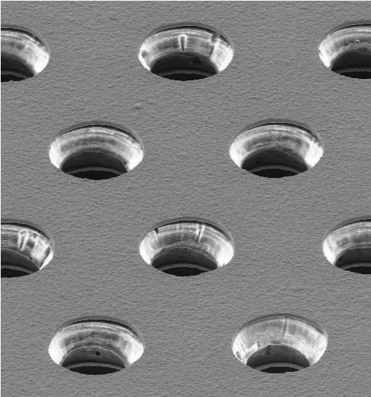
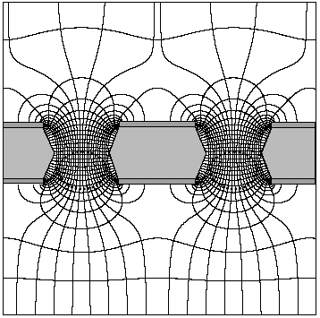
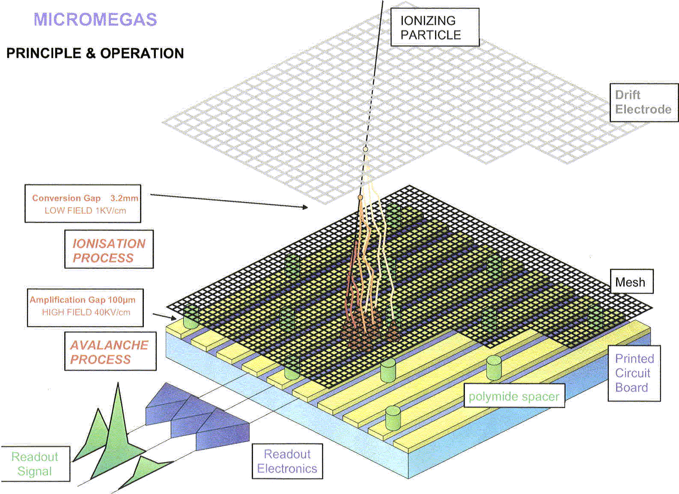
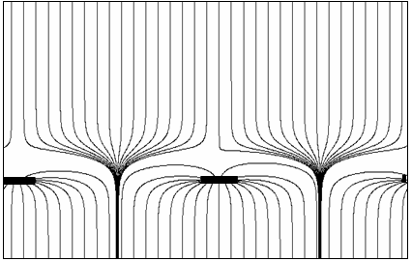
Micro Patterned Gaseous Detectors
High field created by Gas Gain Grids
Most popular: GEM & Micromegas
GEM
Micromegas
From Harry van der Graaf, NIKHEF, Amsterdam, TIME Workshop, Zürich, Oct 6, 2005

Slide 8
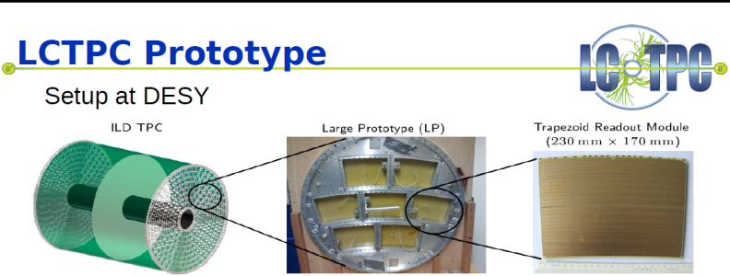
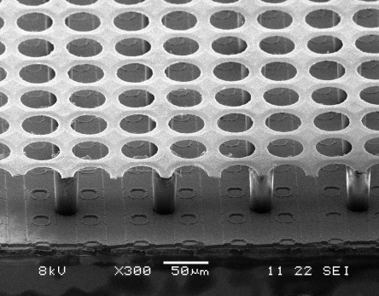
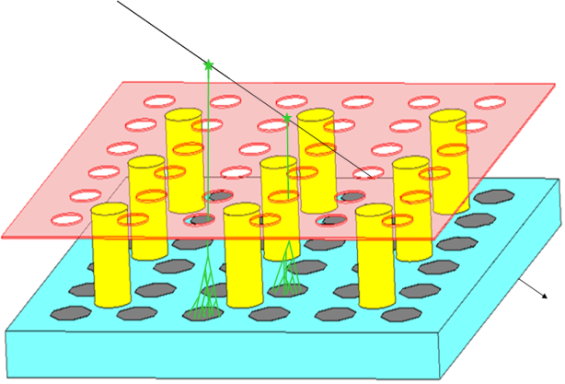
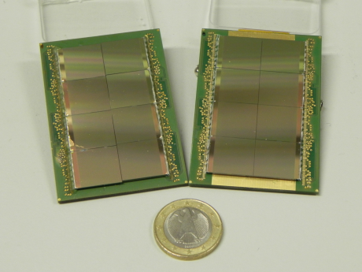
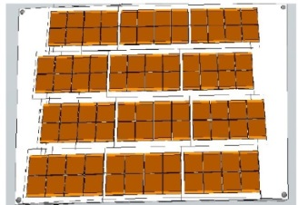
Options for a MPGD TPC (Astrid M¨unnich (DESY), Large Prototype TPC for the ILC, )
1. Multilayer GEM with the pads to readout the signal charges spread on the
pad plane by the diffusion.
2. Micromegas with pads and resistive-anode to spread the very narrow
charge on the pad plane.
Multilayer GEM with pixel readout.
Micromegas mesh with pixel readout
“InGrid” Concept:
Grid
Supporting pillar
Pixel pad
CMOS chip
O.Bezshyyko, 2-nd French-Ukrainian workshop on the instrumentation developments for HEP, October 1-3, Orsay

Slide 9
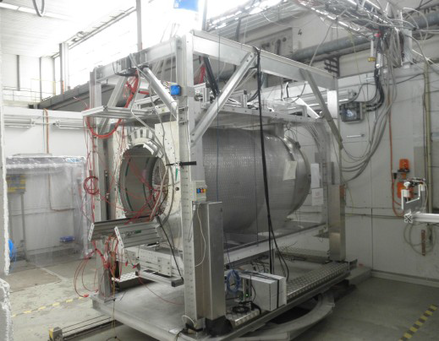
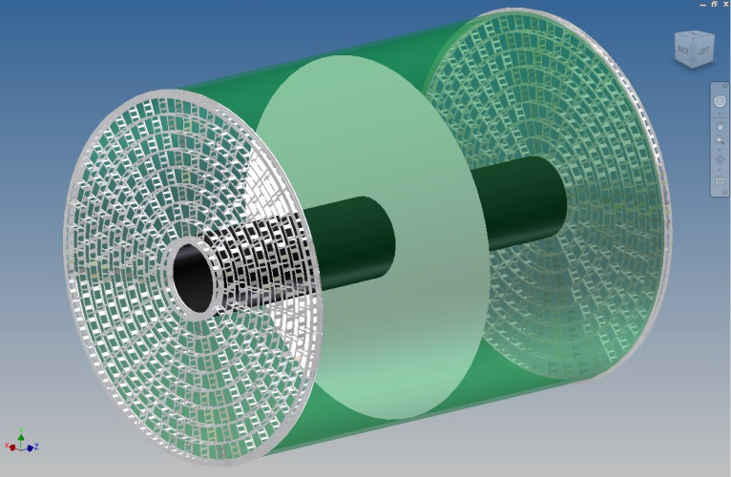
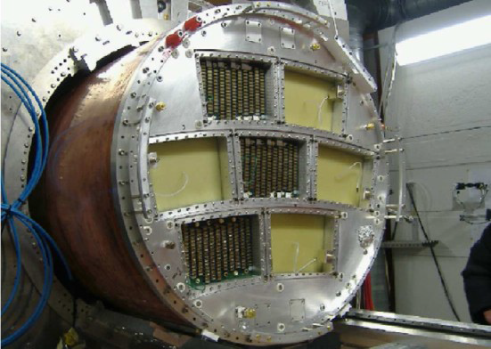
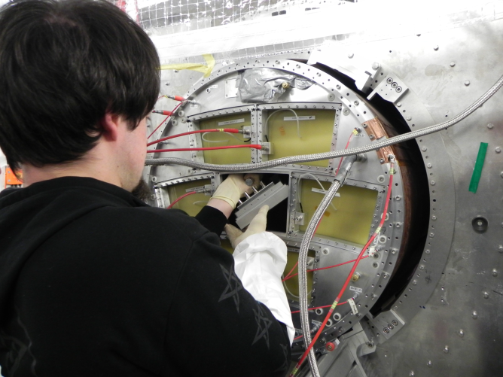
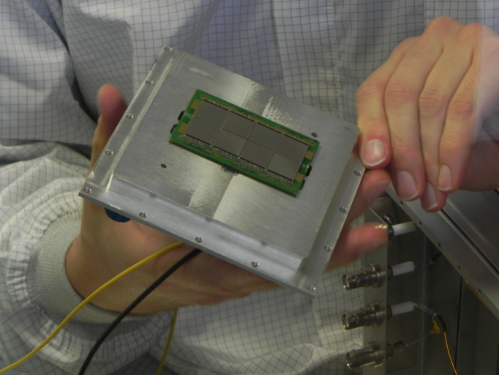
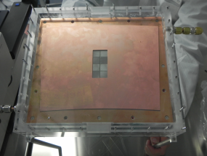
Setup at DESY
Michael Lupberger DPG Mainz 2014
O.Bezshyyko, 2-nd French-Ukrainian workshop on the instrumentation developments for HEP, October 1-3, Orsay

Slide 10
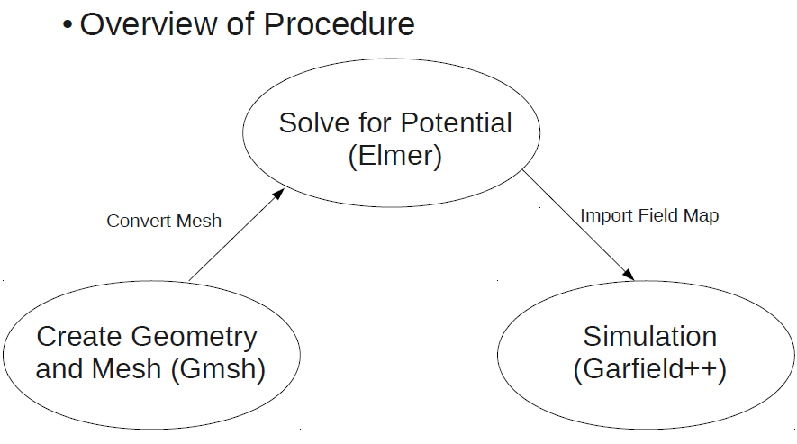
Garfield++
EM simulation software
COMSOL Multiphysics
http://www.comsol.com/comsol-multiphysics
CST STUDIO SUITE
https://www.cst.com/Products/CSTS2
ANSYS
http://www.ansys.com
Elmer+Gmsh
http://www.csc.fi/english/pages/elmer
O.Bezshyyko, 2-nd French-Ukrainian workshop on the instrumentation developments for HEP, October 1-3, Orsay

Slide 11
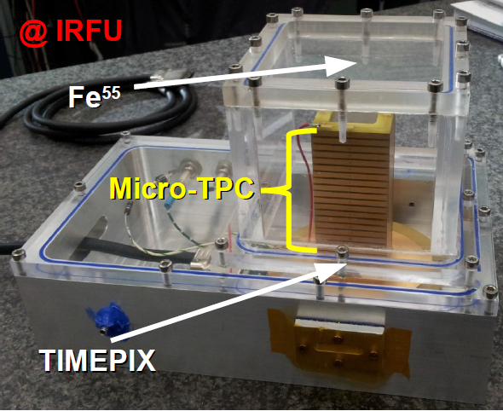
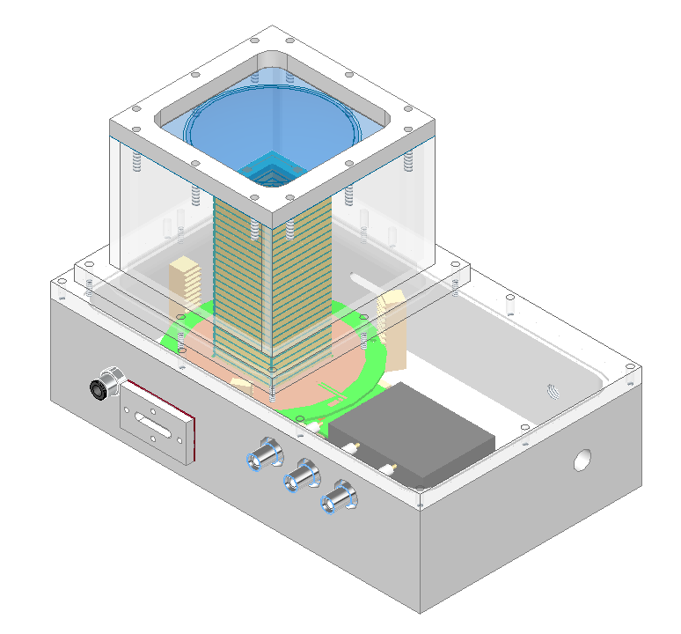
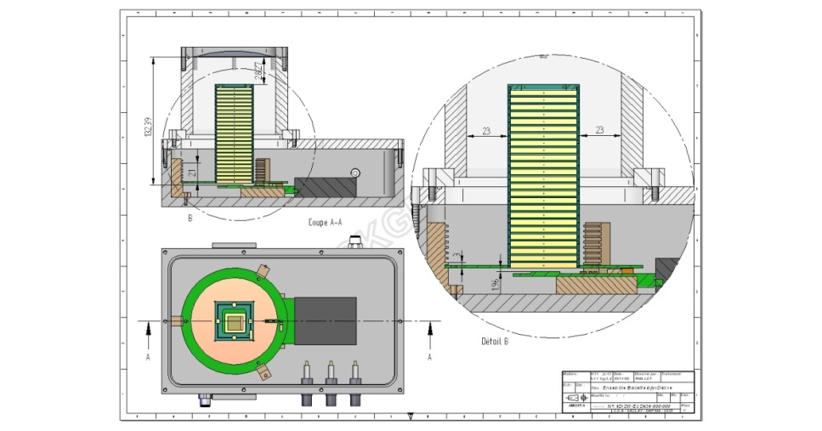
Micro TPC IRFU (simulations)
(december 2012 – summer 2013)
O.Bezshyyko, 2-nd French-Ukrainian workshop on the instrumentation developments for HEP, October 1-3, Orsay

Slide 12
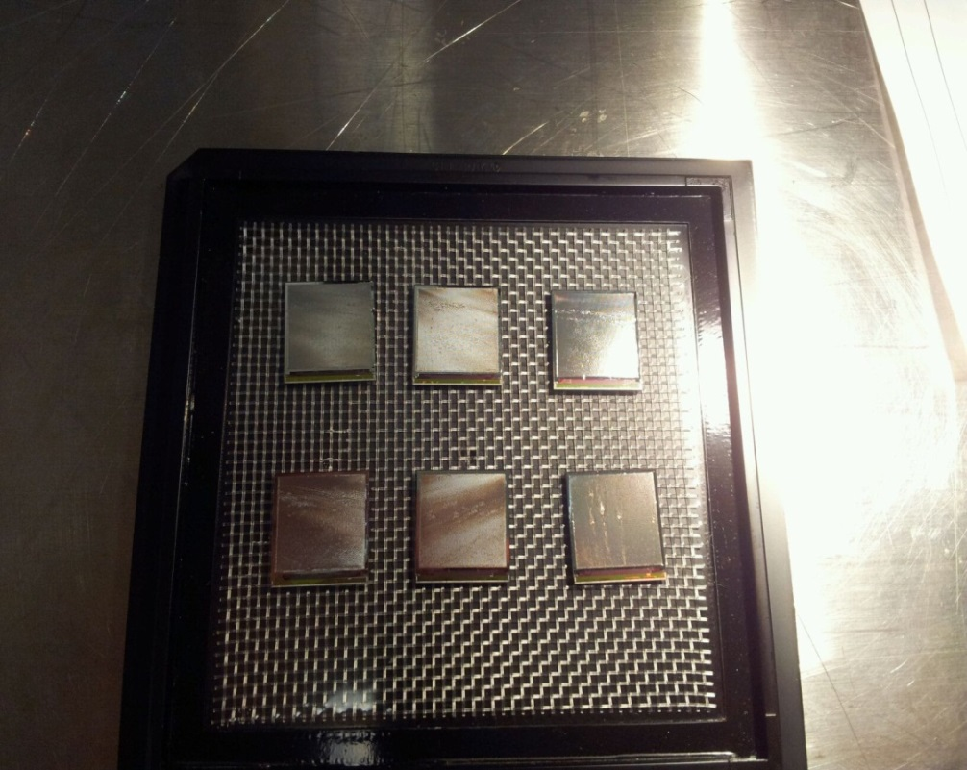
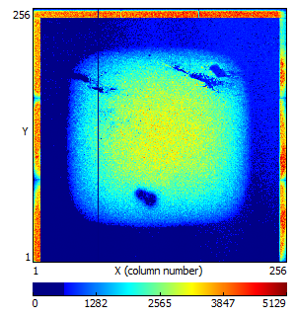
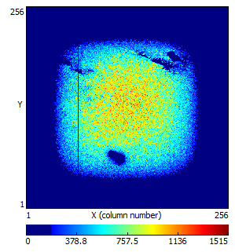
Studies of new IZM-3 InGrids in the Saclay micro-TPC
2011: Major Step Forward → InGrid Production on a wafer level
2013: 3rd IZM production run to post-process Timepix chips on a wafer level
Received 6 IZM-3 InGrids in Saclay (earlier studies
with IZM-3 InGrids have been performed in Bonn,
NIKHEF)
From A. Chaus, D. Attie, P. Colas, M. Titov presentation
One InGrid is tested →
in general, good behavior
Guard ring problem
in micro-TPC
Some noise and/or
discharges
Some local grid
issues

Slide 13
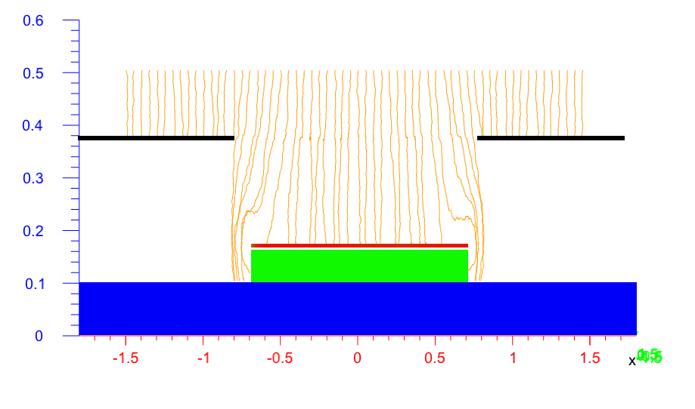
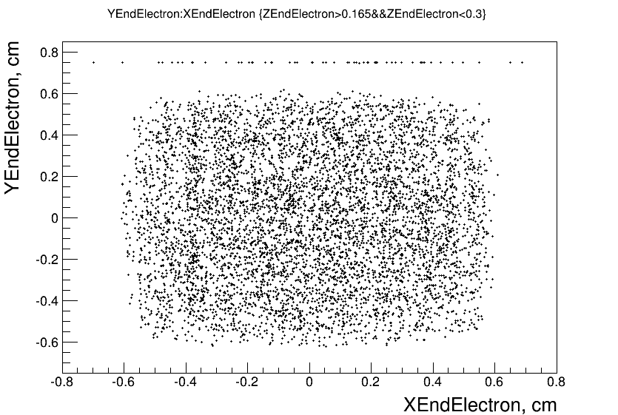
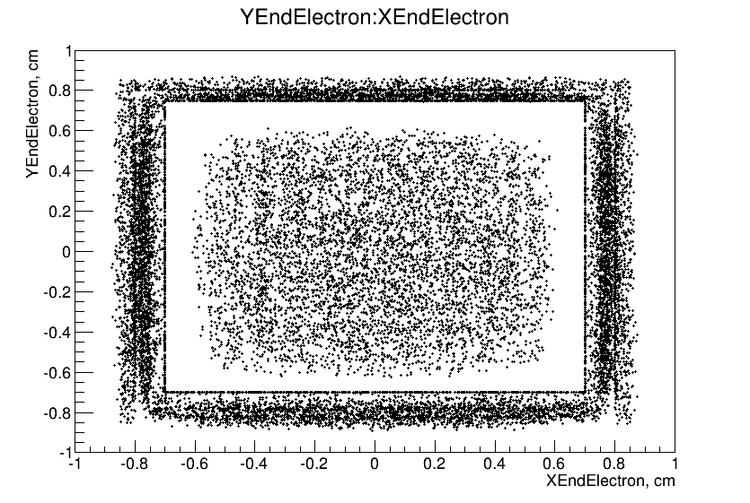
Micro TPC - IRFU (simulations)
(december 2012 - summer 2013)
Upper electrode – Uupe=-2800V
First strip – Ufs=-800V
Mesh – Um=-350V
Guard ring – Us=-350V
O.Bezshyyko, 2-nd French-Ukrainian workshop on the instrumentation developments for HEP, October 1-3, Orsay

Slide 14
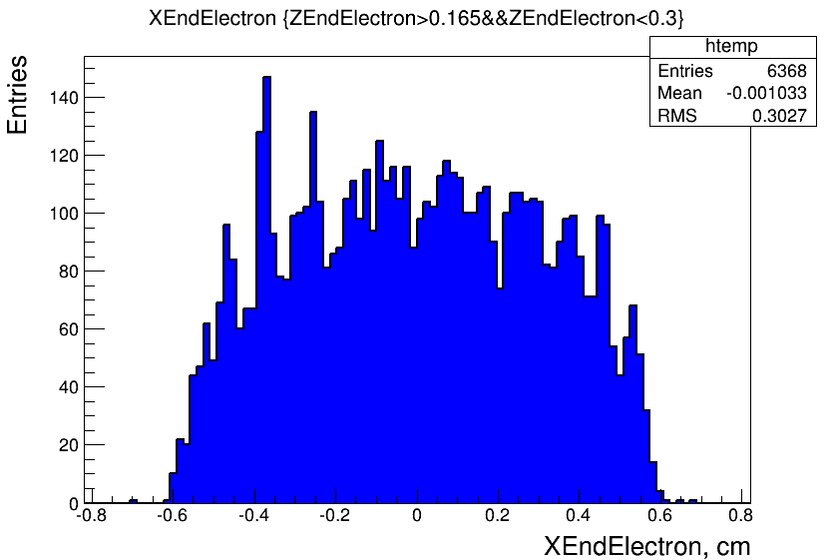
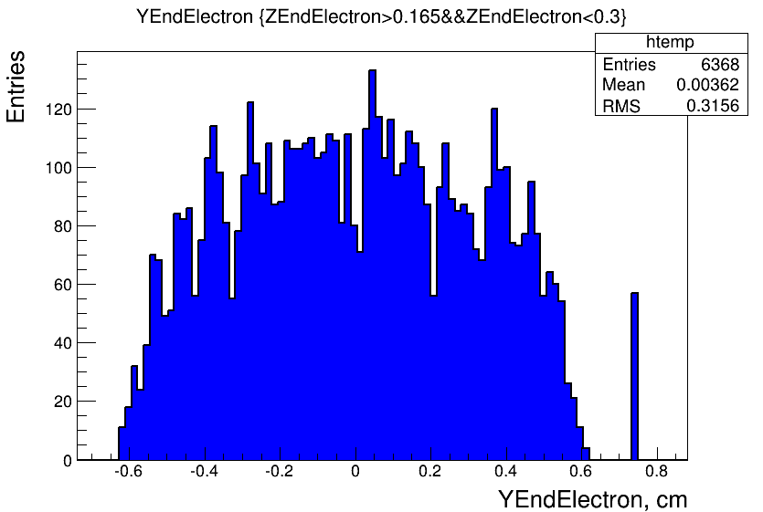
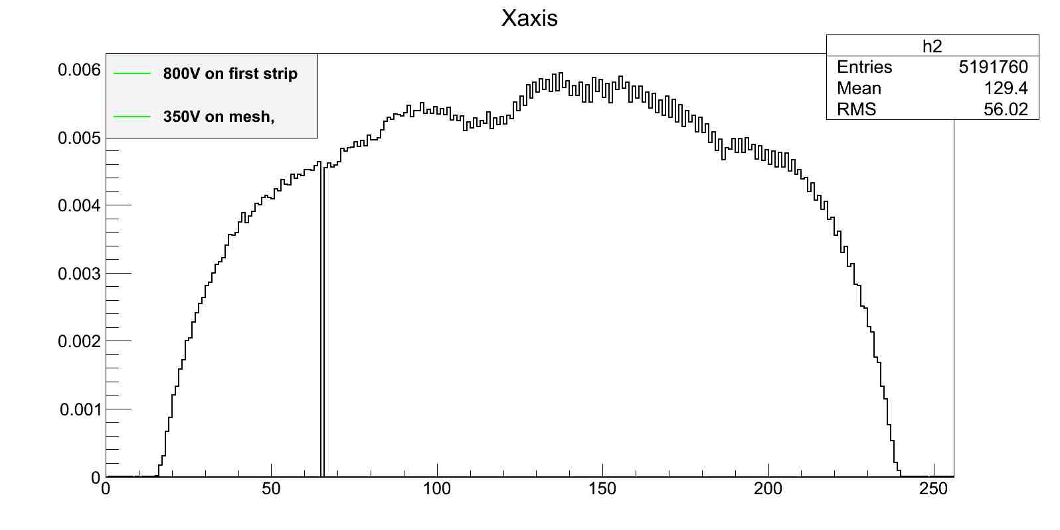
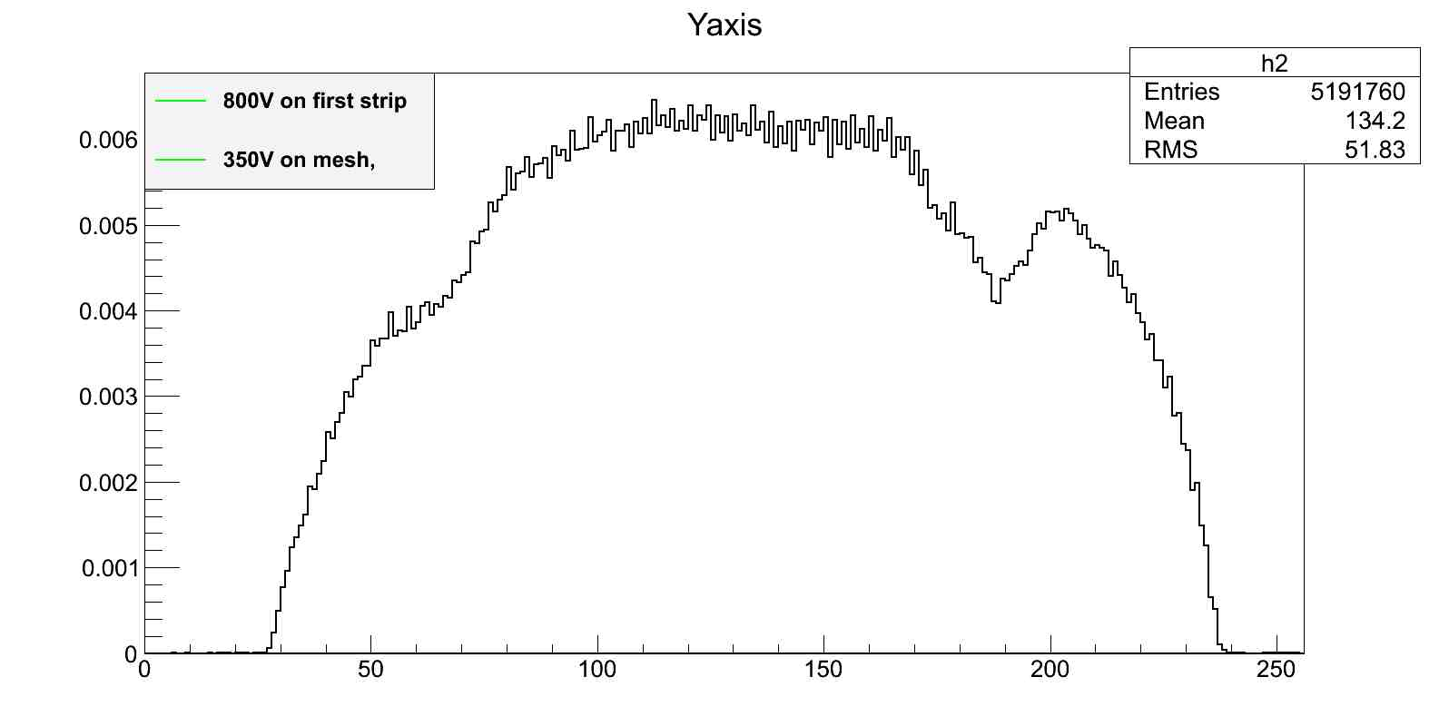
Micro TPC (simulations)
(december 2012 - summer 2013)
First strip – Ufs=-800V
Upper electrode – Uupe=-2800V
Mesh – Um=-350V
Guard ring – Us=-350V
First strip – Ufs=-800V
O.Bezshyyko, 2-nd French-Ukrainian workshop on the instrumentation developments for HEP, October 1-3, Orsay

Slide 15
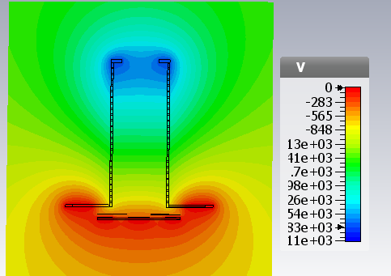
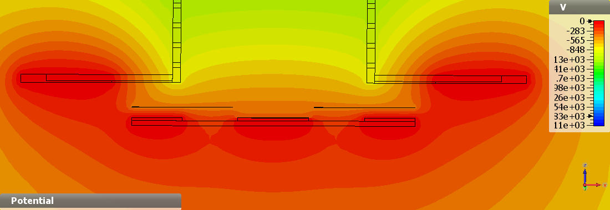
Micro TPC - IRFU (simulations)
(december 2012 - summer 2013)
(optimal Us for better field uniformity)
Upper electrode – Uupe=-2800V
First strip – Ufs=-800V
Mesh – Um=-350V
Guard ring – Us=-430V
better field uniformity
O.Bezshyyko, 2-nd French-Ukrainian workshop on the instrumentation developments for HEP, October 1-3, Orsay

Slide 16
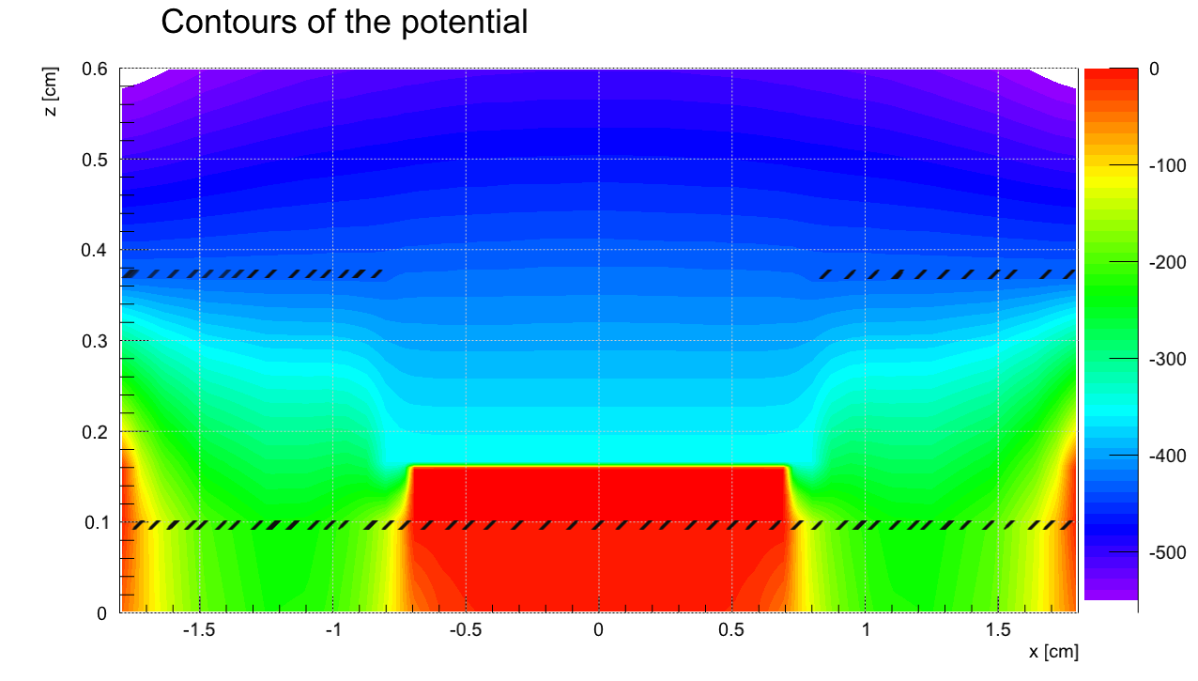
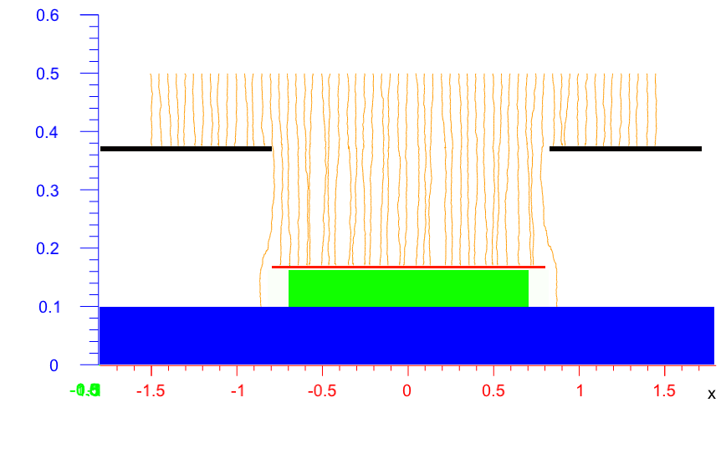
Micro TPC - IRFU (simulations)
(december 2012 - summer 2013)
(addition of mesh “wings” (edges 1 mm) -
attempt to obtain uniform field near mesh edges)
Upper electrode – Uupe=-2800V
First strip – Ufs=-800V
Mesh – Um=-350V
Guard ring – Us=-430V
Conclusion:
Very good result but question about constructive restrictions
1 mm
X axis
O.Bezshyyko, 2-nd French-Ukrainian workshop on the instrumentation developments for HEP, October 1-3, Orsay

Slide 17
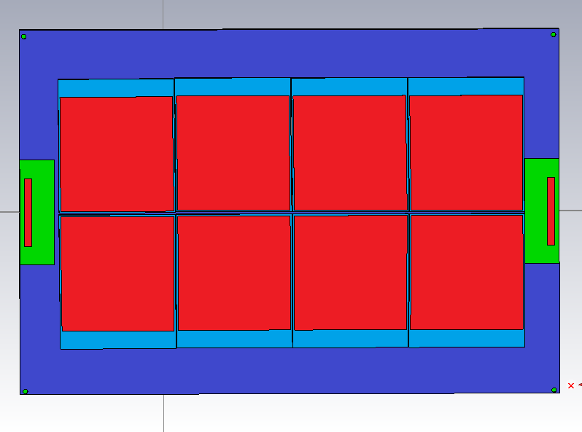
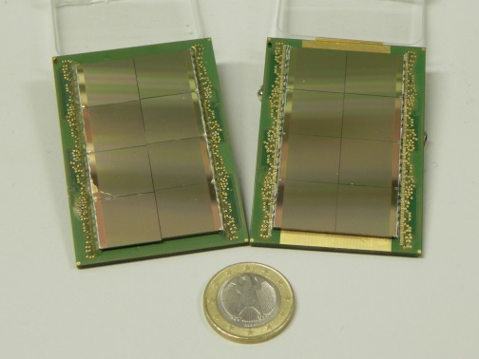
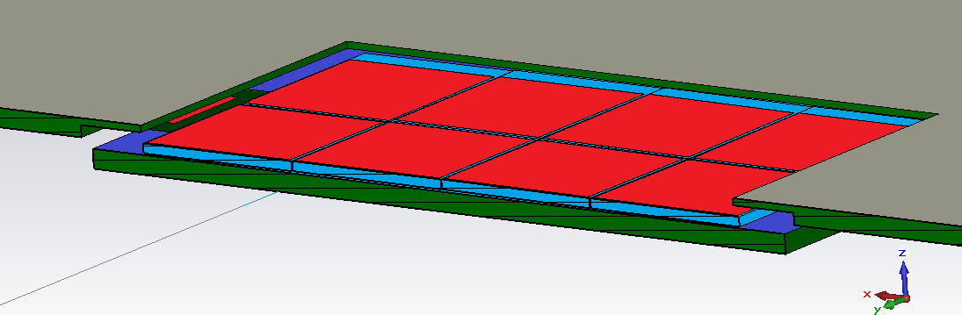
Octoboard - University of Bonn Simulations (autumn 2013 – spring 2014)
Periphery
Board
Mesh
HV contact
Bakelite
Metal on top
Anode plate PCB
Chip carrier PCB
O.Bezshyyko, 2-nd French-Ukrainian workshop on the instrumentation developments for HEP, October 1-3, Orsay

Slide 18
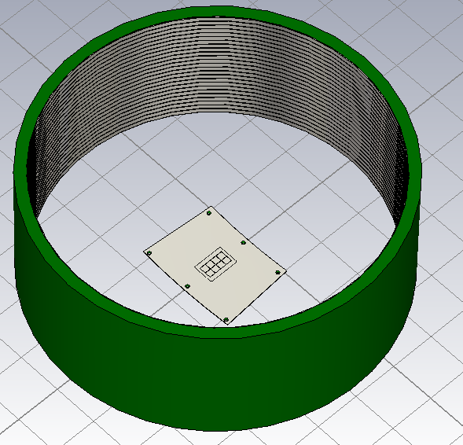
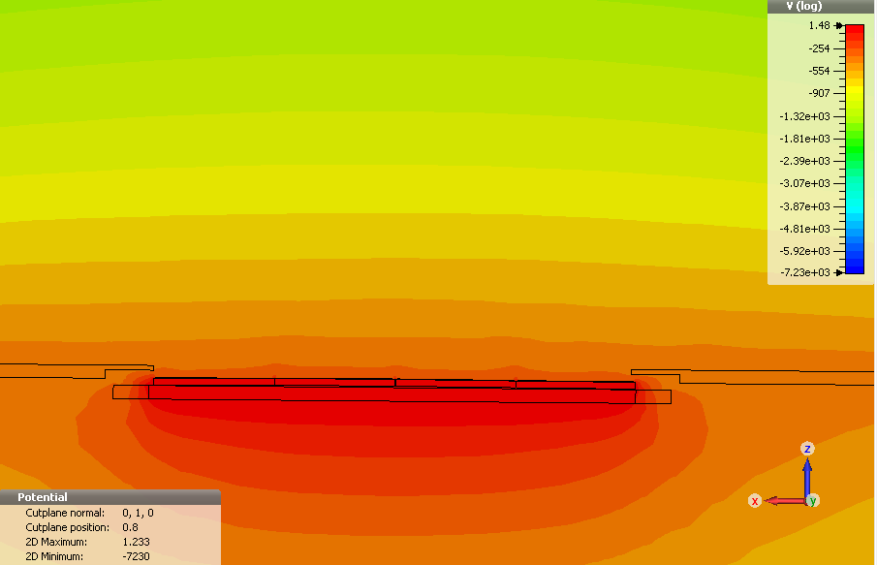
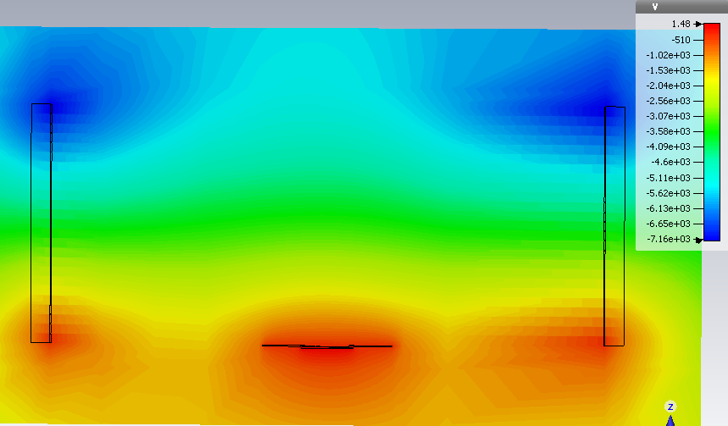
Field cage in CST
CST simulations
The field near the octoboard is
sufficiently uniform
O.Bezshyyko, 2-nd French-Ukrainian workshop on the instrumentation developments for HEP, October 1-3, Orsay

Slide 19
Chip geometry
Periphery is extension
of chip without mesh
Mesh
Outermost hole of mesh
that serve as reference
point for positioning of
the chips towards to each other.
Dike
Periphery
Dice
O.Bezshyyko, 2-nd French-Ukrainian workshop on the instrumentation developments for HEP, October 1-3, Orsay

Slide 20
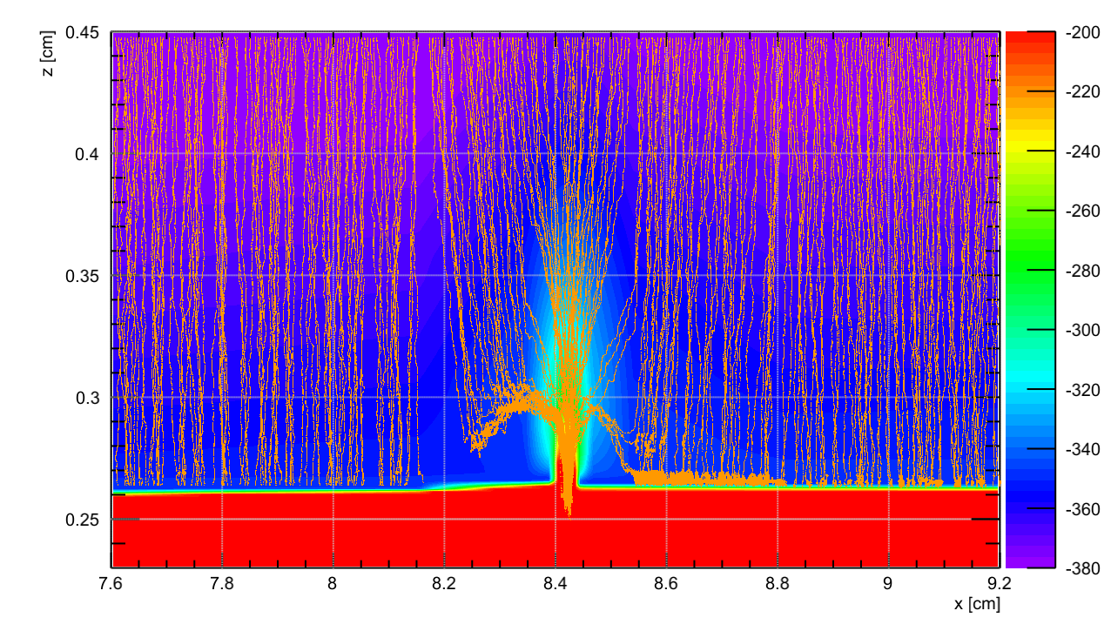
Distortion of voltage and electron path (using "A Garﬁeld++ interface for CST TM“, K.Zenker, LC Notes. LC-TOOL-2013-022, 8p.(http://www-ﬂc.desy.de/lcnotes/))
Voltage distribution
near the gap
Gap absorbs electrons
O.Bezshyyko, 2-nd French-Ukrainian workshop on the instrumentation developments for HEP, October 1-3, Orsay

Slide 21
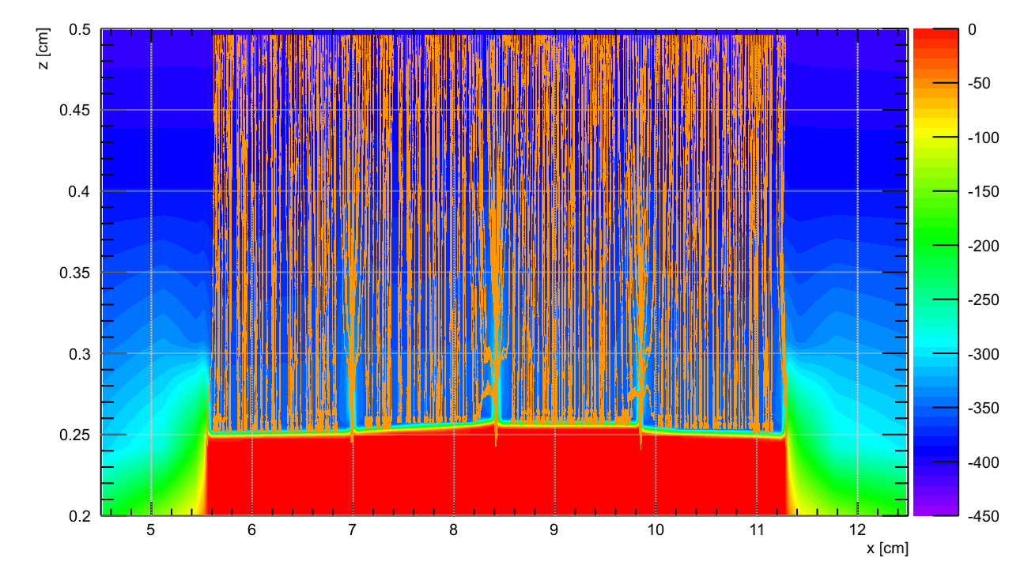
Distortion of voltage and electron path
Voltage distribution
Tracks of drifting
electrons
O.Bezshyyko, 2-nd French-Ukrainian workshop on the instrumentation developments for HEP, October 1-3, Orsay

Slide 22
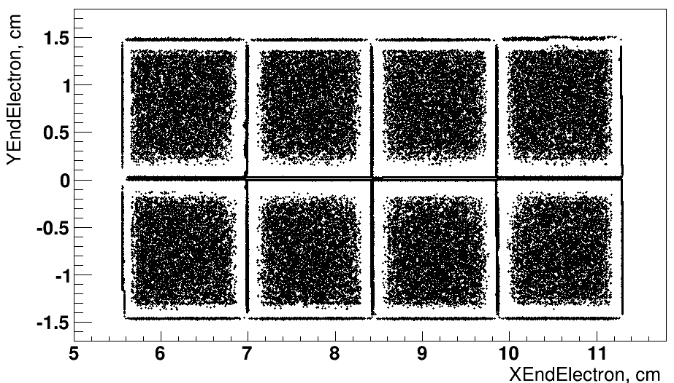
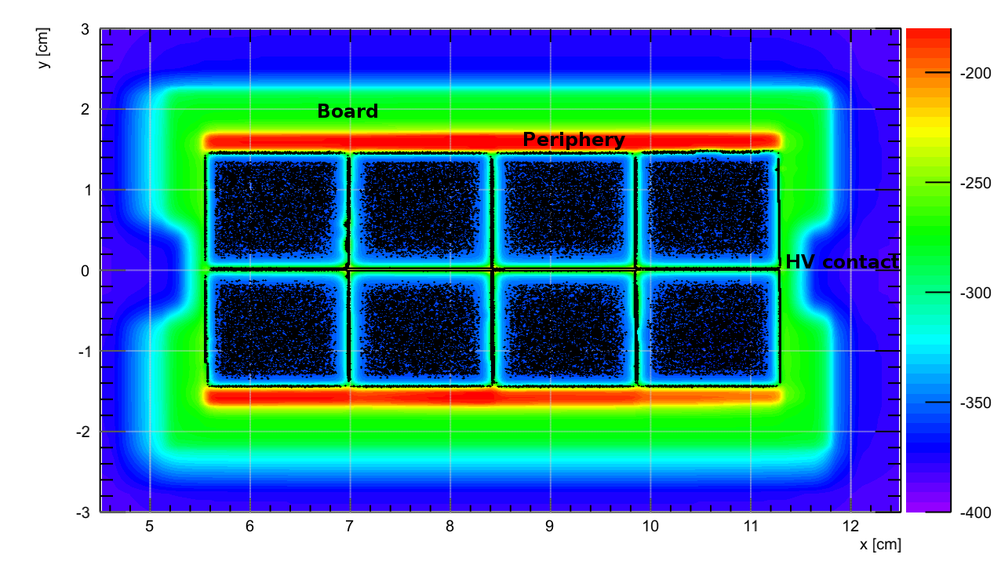
Sensitive area
Periphery
Board
Mesh
HV
Bakelite
Dead area
O.Bezshyyko, 2-nd French-Ukrainian workshop on the instrumentation developments for HEP, October 1-3, Orsay

Slide 23
Shifting of chips in the simulation
Chips are slightly tilted and shifted towards each other.
Z shifting
gap
Example of vertical shifting
Example of horizontal shifting
O.Bezshyyko, 2-nd French-Ukrainian workshop on the instrumentation developments for HEP, October 1-3, Orsay

Slide 24
Distorted field
CST
Garfield++
Top chip
Bottom chip
Top chip
Garfield++
Top chip
Increasing of chips z shifting
Bottom chip
Bottom chip
O.Bezshyyko, 2-nd French-Ukrainian workshop on the instrumentation developments for HEP, October 1-3, Orsay

Slide 25
Maximum Z shifting in
real octoboard - not more
than 188 um. This
responds to 300 um
increasing of dead
distance comparing
to not shifted chips.
0 cm
1 cm
X coordinate
0.5 cm
1.5 cm
2 cm
2.5 cm
3 cm
O.Bezshyyko, 2-nd French-Ukrainian workshop on the instrumentation developments for HEP, October 1-3, Orsay

Slide 26
Combining of several volumes
Two ways of
meshing
We want to combine two ways of meshing to
increase level of detalization using the experience
obtained by our young student Yurii Pyadyk (under supervising of Klaus Zenker, Ralf Diener)
during summer practice 2013 in DESY.
O.Bezshyyko, 2-nd French-Ukrainian workshop on the instrumentation developments for HEP, October 1-3, Orsay

Slide 27
"SLIT STRIP“ SHIELDING
Report at LCTPC-pixel meeting (13 March 2014)
https://agenda.linearcollider.org/conferenceDisplay.py?confId=6340
?
O.Bezshyyko, 2-nd French-Ukrainian workshop on the instrumentation developments for HEP, October 1-3, Orsay

Slide 28
Geometry
“slit strip“ shielding
Box with increased precision
O.Bezshyyko, 2-nd French-Ukrainian workshop on the instrumentation developments for HEP, October 1-3, Orsay

Slide 29
Relative position
1100 um
550 um
100 um
650 um
First holes
300 um
300 um
200 um
300 um
Dice
Dike
O.Bezshyyko, 2-nd French-Ukrainian workshop on the instrumentation developments for HEP, October 1-3, Orsay

Slide 30
Fields
O.Bezshyyko, 2-nd French-Ukrainian workshop on the instrumentation developments for HEP, October 1-3, Orsay

Slide 31
Without shielding, B = 4 T
Wings
O.Bezshyyko, 2-nd French-Ukrainian workshop on the instrumentation developments for HEP, October 1-3, Orsay

Slide 32
Trajectories in the field [cm]
0T 1T 4T
O.Bezshyyko, 2-nd French-Ukrainian workshop on the instrumentation developments for HEP, October 1-3, Orsay

Slide 33
Trajectories in the field. Without shielding [cm]
0Tl 1TL 4Tl
O.Bezshyyko, 2-nd French-Ukrainian workshop on the instrumentation developments for HEP, October 1-3, Orsay

Slide 34
Trajectories in the field. Shielding [cm]
0Tl 1TL 4Tl
O.Bezshyyko, 2-nd French-Ukrainian workshop on the instrumentation developments for HEP, October 1-3, Orsay

Slide 35
Plans
1. Simulation of geometry for 100 chip module (96=12х8)
2. Development of test platform for Micromegas detector at the Nuclear Physics Department Kyiv University (in Ukraine)
?
Power supply
PC
Gas supply system
Detector setup
DAQ - ADC
Gas storage
O.Bezshyyko, 2-nd French-Ukrainian workshop on the instrumentation developments for HEP, October 1-3, Orsay

Slide 36
Conclusions
Simulations of Octoboard module were performed (electric fields and trajectories of drifting electrons)
Dependencies of geometry inaccuracies were studied
Essential influence of thin slits (gaps) between chips is shown
Simple method to mitigate this harmful influence is proposed
Future plans are considered
O.Bezshyyko, 2-nd French-Ukrainian workshop on the instrumentation developments for HEP, October 1-3, Orsay

Slide 37
O.Bezshyyko, 2-nd French-Ukrainian workshop on the instrumentation developments for HEP, October 1-3, Orsay

Slide 38
to Maxim Titov
and Sergey Barsuk
for the strong support
O.Bezshyyko, 2-nd French-Ukrainian workshop on the instrumentation developments for HEP, October 1-3, Orsay

