Slide 1
CHANNELING 2014 COMPTE-RENDU
R.CHEHAB

Slide 2
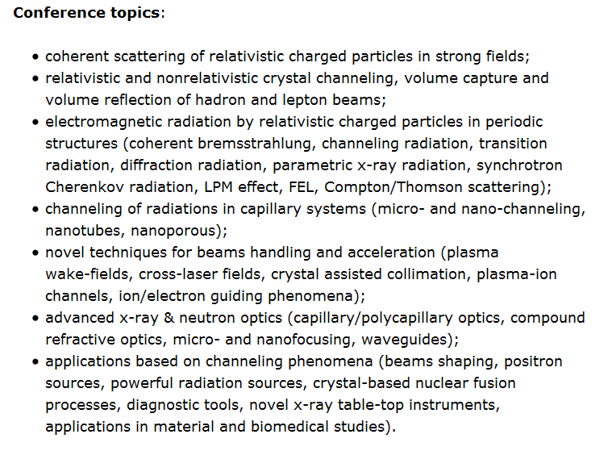
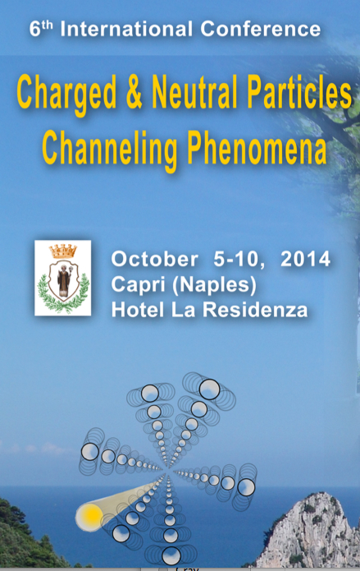
CHANNELING 2014

Slide 3
CHANNELING 2014
PLAN
*1) Presentation of the hybrid source of positrons with granular
converter
*2) Some topics presented at the workshop
* Crystal undulator
* Bent crystals for beam collimation
* Parametric X ray radiation (PXR)
* Capillary optics

Slide 4
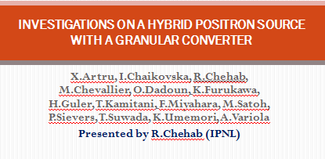
CHANNELING 2014

Slide 5
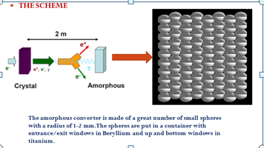
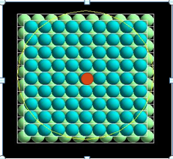
CHANNELING 2014
The hybrid positron source is based on a crystal-radiator providing a large number of photons and an amorphous converter at some distance; in between a sweeping magnet to take off charged particles. The granular converters have been built at LAL by Filip RUDNYCKY
Exit face with central sphere

Slide 6
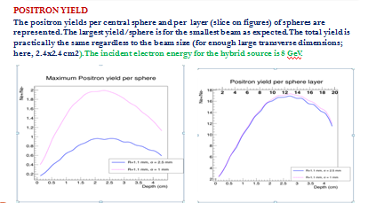
CHANNELING 2014
POSITRON YIELD IN CENTRAL SPHERE AND INTEGRATED OVER LAYERS

Slide 7
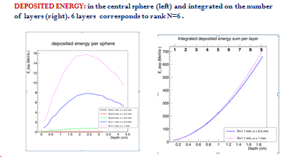
CHANNELING 2014
DEPOSITED ENERGY IN CENTRAL SPHERE AND INTEGRATED OVER THE LAYERS

Slide 8
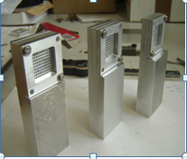
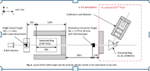
CHANNELING 2014
4 granular converters have been built at LAL (P.Rudnycky) with 2, 4, 6 and 8 layers of W spheres. The sphere radius is 1.1 mm. Entrance and exit windows are Al grids with 1.8 mm diameter holes to allow the positioning (glue) of thermocouples. These converters are already at KEK and will be tested in the beginning of next year. Temperature rise as yield will be measured.
Granular converters built at LAL (F.Rudnycky)

Slide 9
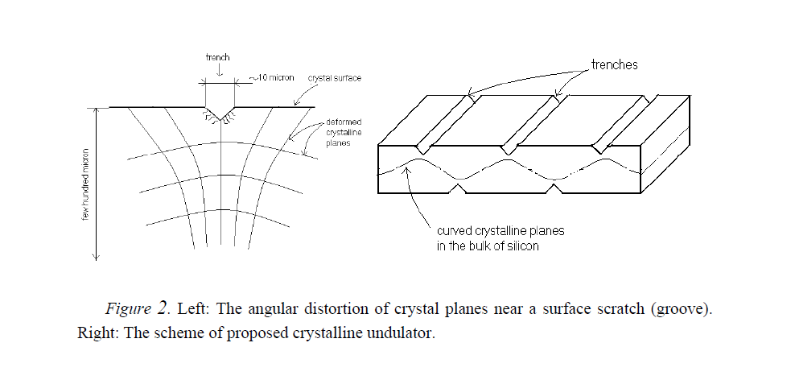
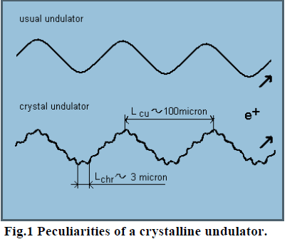
CHANNELING 2014
2-OTHER TOPICS
2-1 CRYSTAL UNDULATOR; realized by a modulation of the crystal planes: such modulation is obtained by ultrasound techniques, periodic surface strains,..On the left figure we show a crystal with micro-scratches. The technique was tested successfully with a 70 GeV p beam at Protvino. The crystal has 10 periods and 5 mm thickness; amplitude of the sinusoid is 100 Å.
There is another method to bend the crystal planes: growing strained crystal layers: Si_Ge…(next page)
We show on the figure on the right the periods of modulation and channeling in the case of a positron beam. Typical case
Here, λ_{u} > λ (channeling)

Slide 10

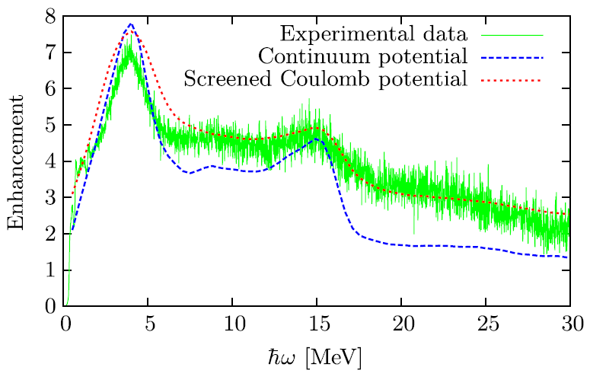
CHANNELING 2014
Crystalline undulators (U.Uggerhoj)
The enhancement represents the ratio of the total radiation spectrum to the Bethe-Heitler spectrum. The left peaks ➔ channeling, whereas the right peaks➔ undulator motion
Recall: λ_{u} < λ_{ch} (here)

Slide 11
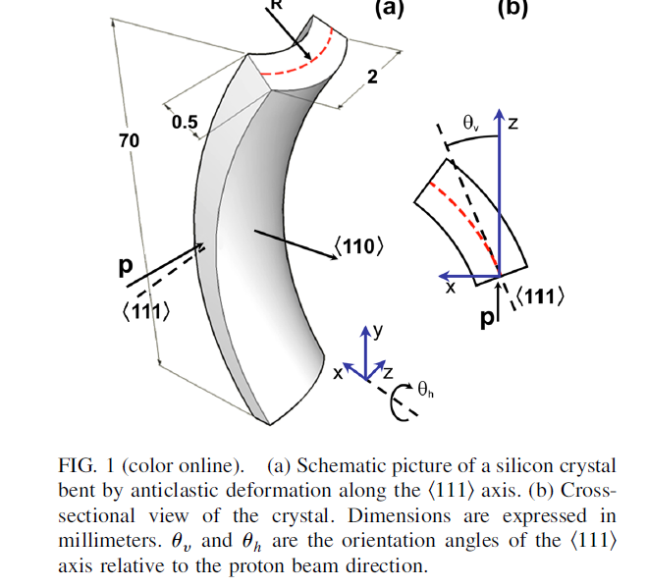
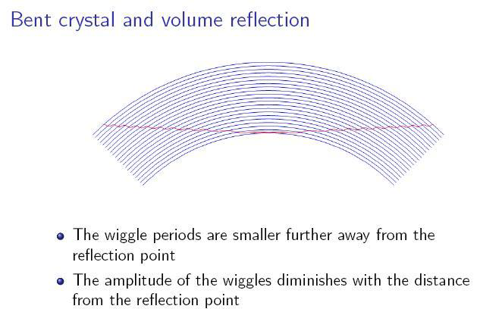
CHANNELING 2014
2-2-BENT CRYSTALS: bending of the atomic planes. The particles –proton, for example- are channeled in the bent planes. Bending is obtained by mechanical means. Another way to deflect the particles is the volume reflection : particles are reflected by the atomic planes.
PARTICLE COLLIMATION: in order to sweep off the beam halo, crystals are much more efficient that classical magnets due to the strong fields. Experiments were undertaken successfully at FNAL, Protvino, CERN with Si crystals. Application to LHC is considered. An experiment: UA9 ( on which LAL collaborates) is under way since 2009.

Slide 12
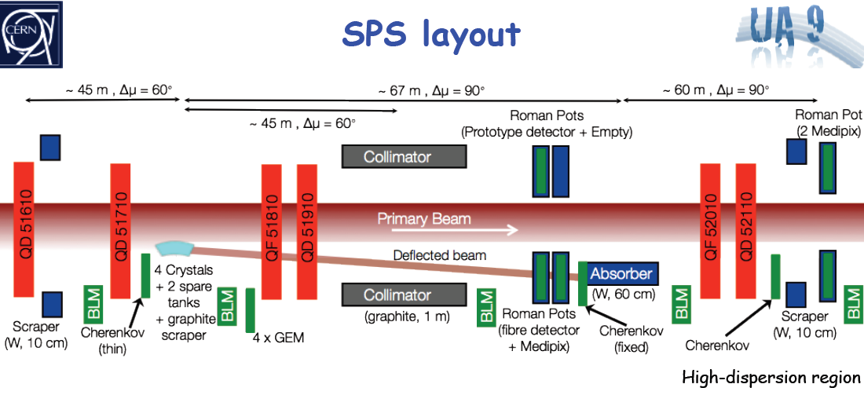
CHANNELING 2014
BENT CRYSTALS: APPLICATION TO BEAM COLLIMATION ➔ TEST @ CERN➔ UA9
To sweep off the halo particles surrounding the beam core and which produce losses in the accelerator , a multi-stage collimation system is considered.

Slide 13
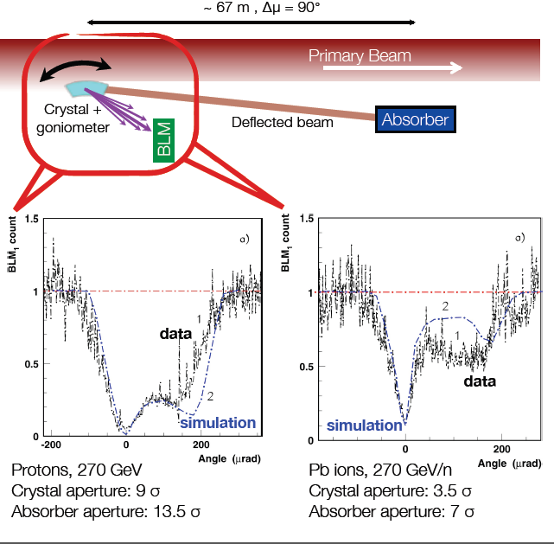
CHANNELING 2014
Bent crystals
Use of crystals as primary collimators allows a significant reduction of the beam losses detected in the BLM (Beam Loss Monitor)
On the figure, the measured and simulated beam losses. The “0” angle corresponds to alignment to the crystal plane.
The critical angle @ 270 GeV is 12.2 μrad
Channeling
Volume reflection

Slide 14
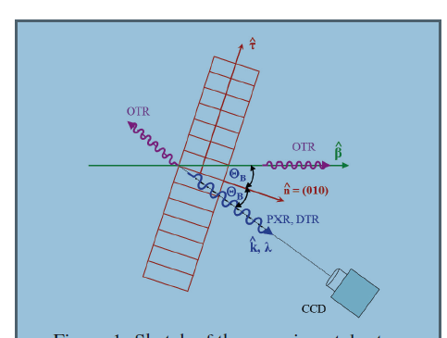
CHANNELING 2014
2-3 PXR Parametric X RAY can be understood
as the diffraction of the photon cloud
(FWW approx.) representing the Coulomb field
of the particle on the crystal planes. It can be
used for beam diagnostics as shown in Mainz
(G.Kube et al.)

Slide 15
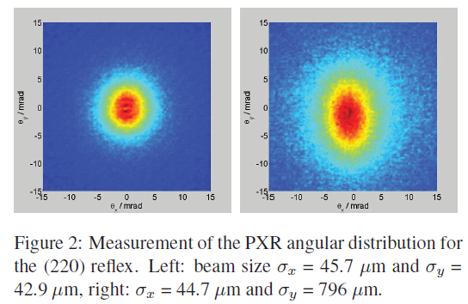
CHANNELING 2014
PXR: angular distribution of the beam is depending on its size
A.Schagin (KIPT & Belgorod) proprosed the use of PXR to control the beam characteristics (angular distribution) for bent crystals as for crystals used for other purposes (ex: e+ targets) ➔ this conference
G.Kube et al. (Mainz)

Slide 16
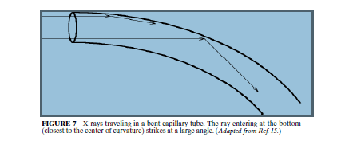
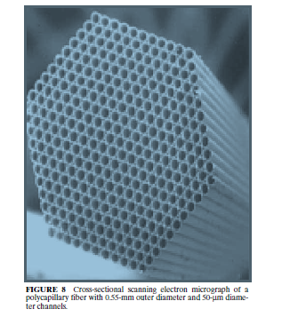
CHANNELING 2014
2-4 CAPILLARY OPTICS (X RAYS)
This technique was, first (?), proposed by
M.Kumakhov, who described for the first
time the channeling radiation.
Transport of X rays in capillary tube ➔
Reflection and bending at less than the
critical angle w.r.t. tangent to the glass
tube.
* Polycapillary tubes

Slide 17
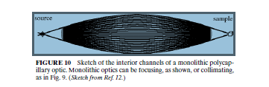
CHANNELING 2014
POLYCAPILLARY TUBES: APPLICATIONS
Transport and focusing of X rays: small spots of
several 100 nm to some nm are feasible. Very useful
to have a good resolution , for example, when
studying the morphology of a sample.
As an example of application➔ the detection
of the soft X rays from TOKAMAK at Cadarache.
A report (D.Mazon/CEA) at the conference on
the use of polycapillaries to detect soft X rays
(1 keV to 10 keV) with a transmission efficiency
about 30 %. (tests at CELIA/Bordeaux)
This kind of information is useful for
controlling the plasma stability in Tokamak
at ITER.

Slide 18
CHANNELING 2014
SUMMARY & CONCLUSIONS
The CHANNELING workshop, held every 2 years, in Italy and organized by LNF-INFN
has about hundred participants: the main topics concern channeling and radiations in crystals Other applications, like polycapillaries, took some importance since the beginning. An oral contribution on e+ sources using channeling has been given.
This talk has shown few topics. The oral contributions of the workshop are available on the workshop site: www.lnf.infn.it/conference/channeling2014/ from October 27.

