Slide 1
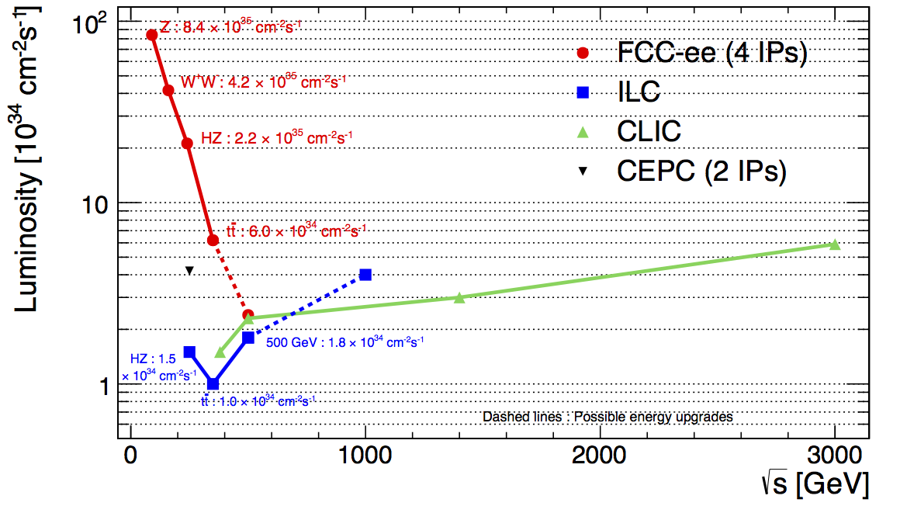
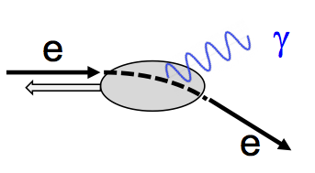
Future
e⁺e⁻
colliders
√s (GeV) Main physics goals
90 Z-pole precision EW measurements beyond LEP, SLC
160 WW precision physics (mass at threshold)
250 H precision physics (HZ)
~350 H (HZ, Hνν) and top (mass, couplings) precision physics
500-3000 ttH, HH (self-couplings), direct searches for new physics
Linear:
Larger √s reach
Low repetition rate
→ L from nm size beams
→ large beamstrahlung
→ larger E-spread
Long. polarization easier
Circular:
√s limited by SR ~ E⁴_{beam}/R
Large number of circulating bunches → high L (increases at lower √s as less SR → spare RF power used to
accelerate more bunches). Note: need top-up injection ring to compensate fast L burn-off (lifetime ~ 30’)
Several interaction regions possible
Precise E-beam measurement from resonant depolarization

Slide 2
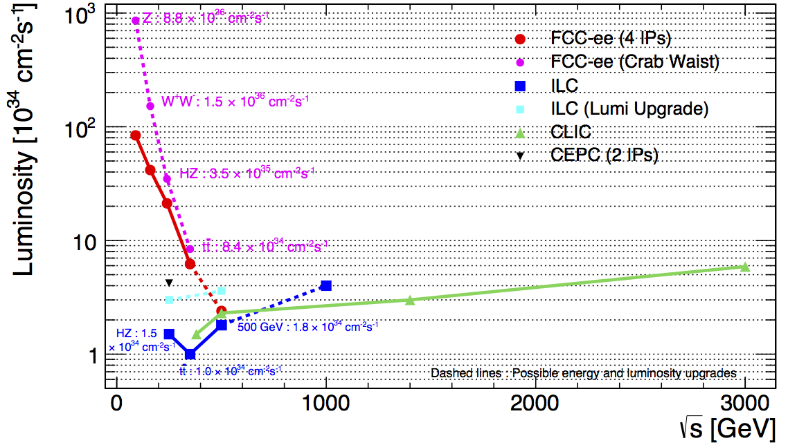
FCC-ee with crab waist scheme
ILC most recent operating scenario:
start at √s ~ 500 GeV, then √s ~ 350, 250 GeV
L upgrade: 1312→ 2625 bunches per pulse
E upgrade to 1 TeV
CLIC most recent operating scenario:
start at √s ~ 380 GeV then move to the TeV region

Slide 3
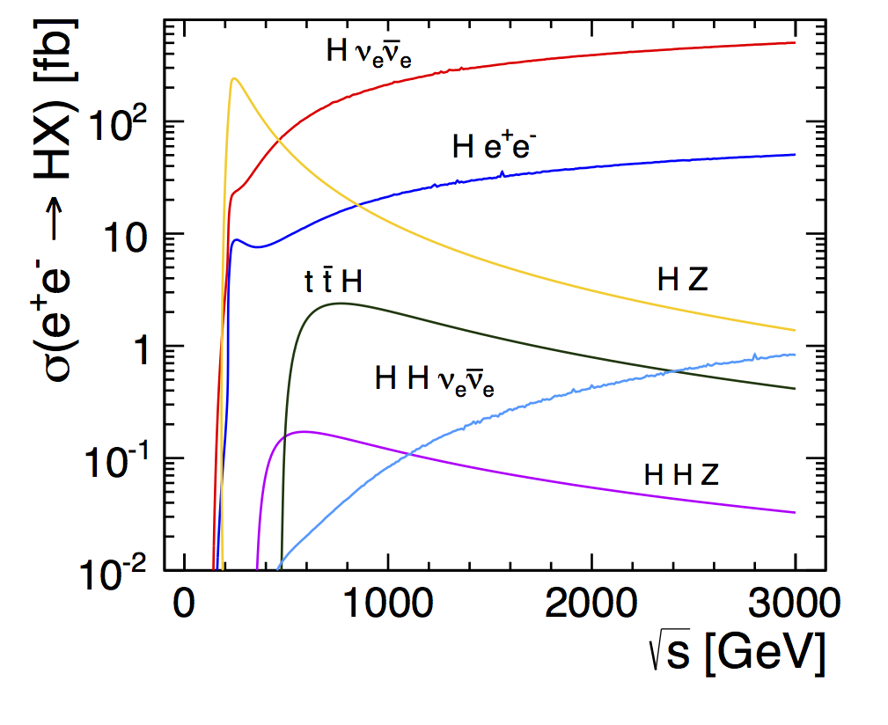
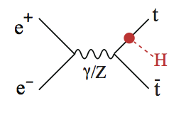
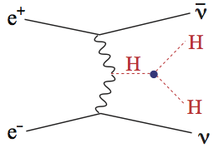

Slide 4
Projected integrated luminosities for current operating scenarios
Integrated luminosities (ab⁻¹)
√s 90 ~240 350-380 500 1.4 3 70 100 Total # of # H events
at √s>240 GeV years at production
FCC-ee 90^{(*)} 10 3 13 ~7-15 2 M
CepC 5 5 ~10 1 M
ILC 2 0.2 4 6.2 ~20 1.6 M
CLIC 0.5 1.5 2 4 ~20 1.5 M
SppC 30 30 ~10 30 B
FCC-hh 40 40 ~25 40 B
GeV
TeV
(*) 4x10¹² Z
2 experiments assumed for CepC, SppC and FCC-hh, 2-4 for FCC-ee
L upgrade assumed for ILC and crab waist option for FCC-ee
FCC-ee run at 160 GeV not included
Note:
Scenarios (revised after H discovery) will evolve based also on future LHC results
Different definitions of “year” across projects: assumed physics data-taking time varies over 0.5-1.6x10⁷ s/year
Note: LHC 2012: 0.6x10⁷ s of machine operation in physics with stable beams
pp colliders: usable H events are ~ 10% of total cross-section due to large backgrounds
H studies are only one of several physics goals

Slide 5
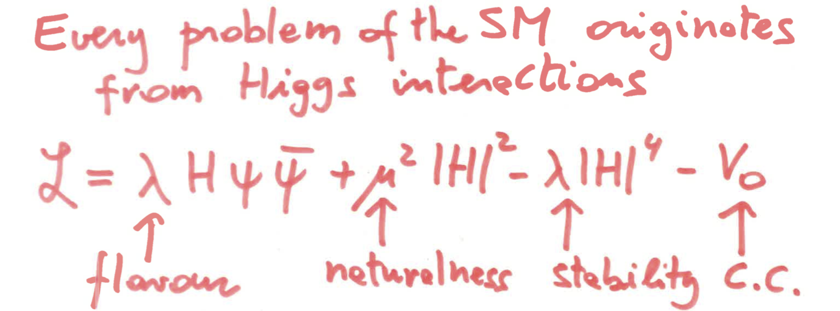
The H boson is not just … “yet another particle”
Profoundly different from all elementary particles discovered so far
Related to the most obscure sector of SM
Linked to some of the deepest structural questions (flavour, naturalness, vacuum, ...)
Its discovery opens new paths of exploration, and a very broad and challenging experimental programme
G.F. Giudice
Precision measurements of couplings
(as many generations as possible, loops, …)
Forbidden and rare decays (e.g. H→ τμ)
→ flavour structure and source of fermion masses
H potential (HH production, self-couplings):
→ EWSB mechanism (strong dynamics ?)
→ EW phase transition → baryogenesis ?
Exotic decays (e.g. H→ E_{T}^{miss}) → new physics ?
Other H properties (width, CP, …)
Searches for additional H bosons
…
Impact of new physics on couplings:
→ 0.1-1% exp. precision needed
Δκ/κ ~ 5%/Λ²_{NP} (Λ_{NP} in TeV)

Slide 6
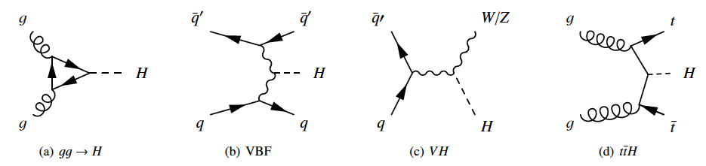
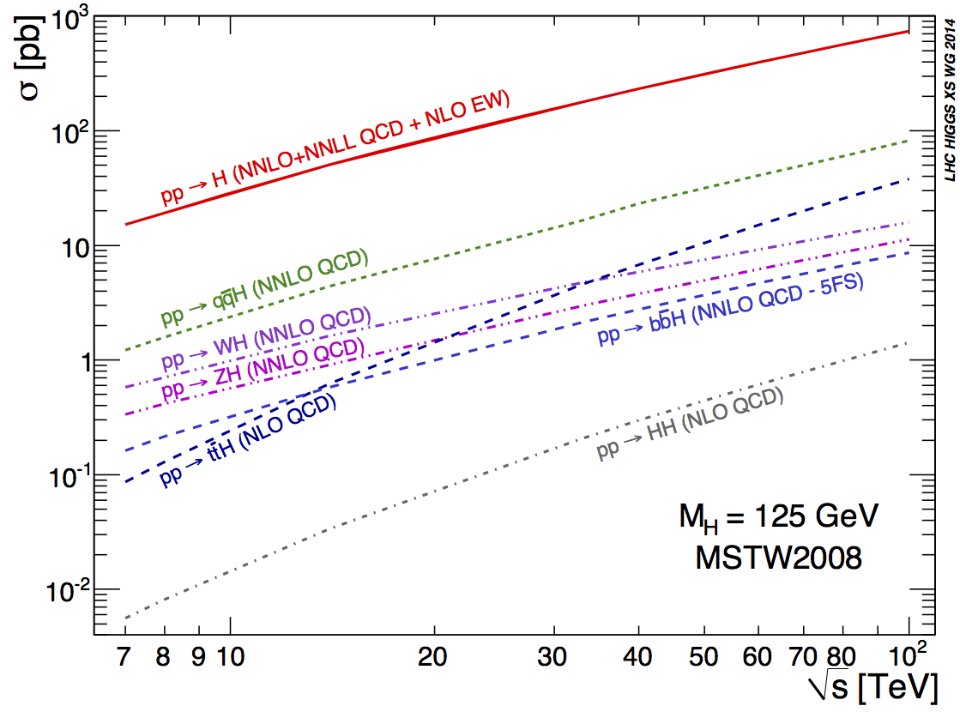
e⁺e⁻ colliders
pp colliders
High energy, huge cross-sections
optimal for (clean) rare decays and
heavy final states (ttH, HH)
Huge backgrounds → not all channels
accessible
Model-dep. coupling measurements:
Γ_{H} and σ (H) from SM
Low backgrounds → all decay modes
(hadronic, invisible, exotic) accessible
Model-indep. coupling measurements:
σ(HZ) and Γ_{H} from data (ZH → μμ/qq+X
recoil, Hvv →bbvv)
ttH and HH require √s ≥ 500 GeV

Slide 7
Coupling LHC CepC FCC-ee ILC CLIC FCC-hh
√s (TeV)→ 14 0.24 0.24 +0.35 0.25+0.5 0.38+1.4+3 100
L (fb⁻¹) → 3000(1 expt) 5000 13000 6000 4000 40000
K_{W} 2-5 1.2 0.19 0.4 0.9
K_{Z} 2-4 0.26 0.15 0.3 0.8
K_{g} 3-5 1.5 0.8 1.0 1.2
K_{γ} 2-5 4.7 1.5 3.4 3.2 < 1
K_{μ} ~8 8.6 6.2 9.2 5.6 ~ 2
K_{c} -- 1.7 0.7 1.2 1.1
K_{τ} 2-5 1.4 0.5 0.9 1.5
K_{b} 4-7 1.3 0.4 0.7 0.9
K_{Zγ} 10-12 n.a. n.a. n.a. n.a.
Γ_{h} n.a. 2.8 1% 1.8 3.4
BR_{invis} <10 <0.28 <0.19% <0.29 <1%
K_{t} 7-10 -- 13% ind. tt scan 6.3 <4 ~ 1 ?
K_{HH} ? 35% from K_{Z} 20% from K_{Z} 27 11 5-10
model-dep model-dep
Units
are %
Few preliminary
estimates available
SppC : similar reach
from K_{γ}/K_{Z}, using
K_{Z} from FCC-ee
rare decays → pp
competitive/better
from ttH/ttZ,
using ttZ and H
BR from FCC-ee
LHC: ~20% today → ~ 10% by 2023 (14 TeV, 300 fb⁻¹) → ~ 5% HL-LHC
HL-LHC: -- first direct observation of couplings to 2nd generation (H→ μμ)
-- model-independent ratios of couplings to 2-5%
Best precision (few 0.1%) at FCC-ee (luminosity !), except for heavy states (ttH and HH) where high energy needed → linear colliders, high-E pp colliders
Complementarity/synergies between ee and pp
Theory uncertainties (presently few percent e.g. on BR) need to be improved to
match expected superb experimental precision

Slide 8
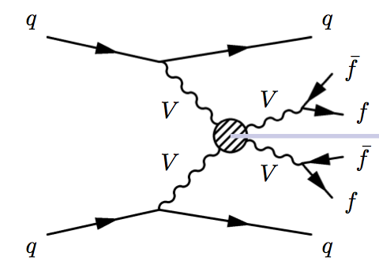
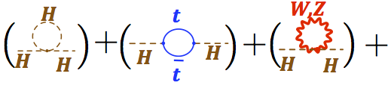

Few
examples.
Preliminary
estimates
Adressing other “structural issues”: a 100 TeV pp collider as an example
Conclusive elucidation of EWSB mechanism:
probe SM in regime where EW symmetry is restored (√ŝ >> v=246 GeV)
Without H: V_{L}V_{L} scattering violates unitarity at m_{VV} ~TeV
H regularizes the theory fully → a crucial “closure test” of the SM
Else: new physics shows up: anomalous quartic couplings (VVVV, VVhh)
and/or new heavy resonances
100 TeV pp: direct discovery potential of new resonances in the O(10 TeV) range
Naturalness:
If no new physics at end of LHC → ~ 1% fine-tuning
100 TeV pp: direct sensitivity to stops and other
top partners up to O(10) TeV → fine-tuning pushed to 10⁻⁴
(Distinguished) theorist 1: “Never seen 10⁻⁴ level of tuning in particle physics: qualitatively new, mortal blow to naturalness”. (Distinguished) theorist 2: “Naturalness is a fake problem”
ΔM_{H}² ~
…
~ Λ²
Nature of EW phase transition:
if first order (faster than in SM) could give rise to baryogenesis → need modification of
the H potential, e.g. by adding a scalar singlet:
→ this (difficult) model can be constrained from precise
measurements of HZ coupling at e⁺e⁻ and H self-coupling
at 100 TeV pp, and direct searches for new (invisible) particles at 100 TeV pp.
CepC-SppC http://cepc.ihep.ac.cn/preCDR/volume.html; see also Curtin et al., arXiv:1409.0005v4

Slide 9
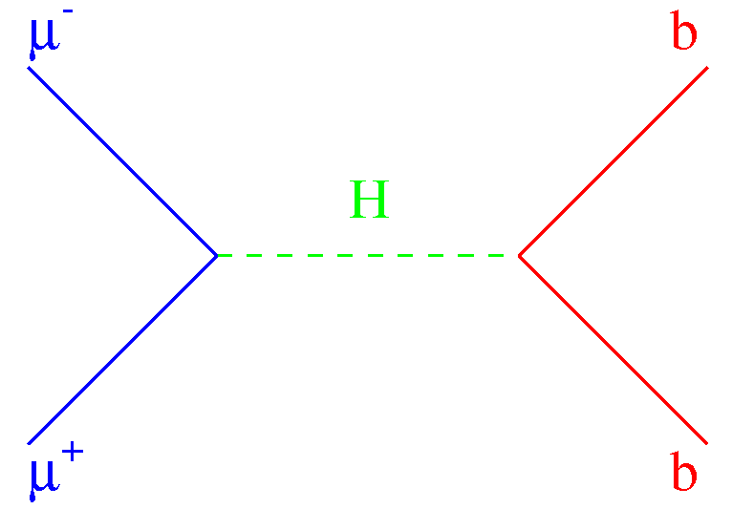
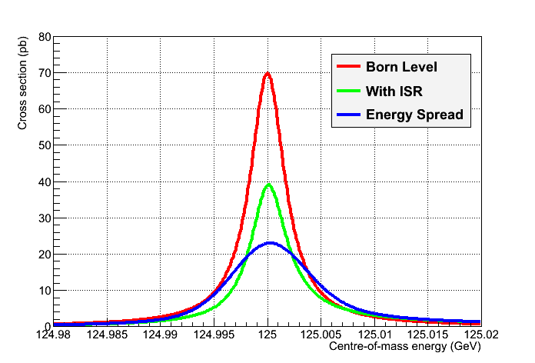
What about
Muon Colliders ?
Synergies
with neutrino
factories
Main advantage compared to e⁺e⁻ colliders: m_{μ} ~ 200 m_{e}
→ negligible SR → can reach multi-TeV with (compact !) circular colliders:
300 m ring for √s = 125 GeV, 4.5 km for √s = 3 TeV
→ negligible beamstrahlung → much smaller E spread
Main challenge: produce high-intensity, low E-spread beams:
m_{μ} ~ 200 m_{e} → SR damping does not work → novel cooling methods (dE/dx based) needed
to reach beam energy spread of ~ 3x10⁻⁵ (for precise line shape studies) and high L
τ_{μ} ~ 2.2 μs → production, collection, cooling, acceleration, collisions within ~ ms
σ (μμ → H) ~ 20 pb (s-channel resonant production) → H factory
Beam spread of ~ 3x10⁻⁵ would allow Γ_{H}
measurement from line shape to 5% (0.2 MeV)
→ resolve (possible) resonances
σ (μ⁺μ⁻→ H)
~40000 x
σ (e⁺e⁻→ H)
However, with currently projected L (~10³²):
~ 20000 H/year → not competitive with
e⁺e⁻ colliders for coupling measurements
(except Hμμ ~ 1%)
More R&D needed to demonstrated feasibility, in particular cooling:
linear systems (MICE at RAL), rings (recently re-ignited by C.Rubbia)

Slide 10
Hard, challenging work for everybody to make the “impossible” possible !
Accelerator R&D (few examples …):
High-field, accelerator-quality Nb₃Sn superconducting magnets ready for massive industrial production starting mid-end next decade. Continue to push HTS for
farther-term future.
Normal- and super-conducting high-Q RF cavities reaching higher field at lower cost
(great progress recently in SCRF)
Higher-efficiency RF power sources
Novel ideas to reach GV/m acceleration gradients, allowing factor ~10 shorter Linacs:
e.g. laser- and beam-driven plasma wakefield acceleration (FACET@SLAC, BELLA@LBNL,
AWAKE@CERN, LAOLA@DESY, FLAME@LNF)
MW-class proton sources and high-power targets for longer-term opportunities
(muon colliders, … )
Detectors (few examples …):
ultra-light, ultra-fast, ultra-granular, rad-hard, low-power Si trackers
10⁸ channel imaging calorimeters (power consumption and cooling at high-rate machines,..)
big-volume 5-6 T magnets (~2 x magnetic length and bore of ATLAS and CMS,
~50 GJ stored energy) to reach momentum resolutions of ~10% for p~20 TeV muons
Theory: improved theoretical calculations (higher-order EW and QCD corrections) needed
to match present and future experimental precision on EW observables, Higgs production
and branching ratios. Work together with experiments on model-independent analyses
in framework of Effective Field Theory

