Slide 1




Nouvelles aproches (et nouveaux besoins) en radiothérapie
Yolanda Prezado
Nouvelles approaches in Radiotherapy (NARA)
Laboratoire Imagerie et Modélisation pour
la Neurobiologie et la Cancérologie
Campus d’Orsay, France
prezado@imnc.in2p3.fr

Slide 2
Radiotherapy (RT)
Medical use of ionizing radiation for treatment of cancer and some other types of benign lesions, like arterious-venous malformations.
Example of a rapid technological transfer
  1895: Roentgen discovers X-rays
  1895: First RT treatment (recurrent breast cancer, Grubbe, Chicago)
  1896: Stomach cancer treatment (Freund, Viena).

Slide 3
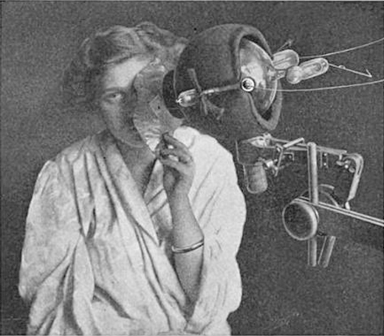
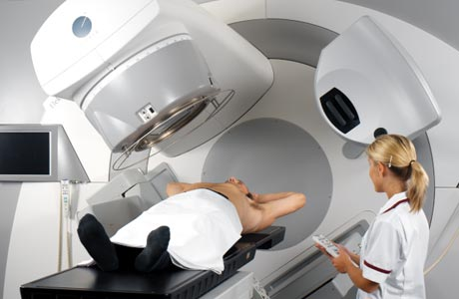
Radiotherapy (RT)
One of the most important methods of cancer treatment. At least 50 % of all cancer patients will receive radiotherapy at some stage during the course of their illness (Delanay et al., 2005).
Despite a rapid development in the last decades there is a still a great need of research and development.

Slide 4
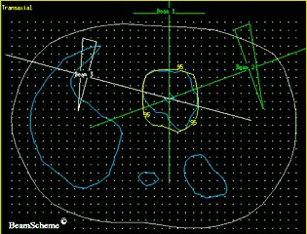
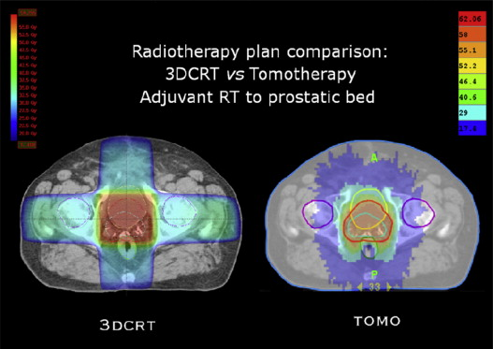
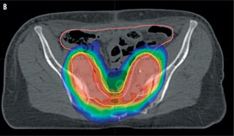
In the last decades
2D radiotherapy
3D conformal radiotherapy
Intensity modulated RT

Slide 5
External radiotherapy
Medical lineal accelerators (RF)
Mainly 6 and 18 MV photons. Other particles e, p, ¹²C
“Large field sizes”: several squared cm
Homogenous dose distributions
Dose rates around 2 Gy/min
Temporal fractionation of the dose
Most common scheme
2 Gy/session, 5 session per week, 5-6 weeks

Slide 6
The basis of Radiotherapy
RT limited by the tolerance doses of normal tissues

Slide 7
The basis of Radiotherapy
Tumor control
probability
Some radioresistant tumors
Some pediatric cancers
Tumors close to a sensitive structure
Normal tissue
complication
probability
Probability
Dose

Slide 8
Some strategies to improve RT outcome
To enhance tumor radiosensitivity
To develop novel approaches allowing increasing
the normal tissue resistance

Slide 9
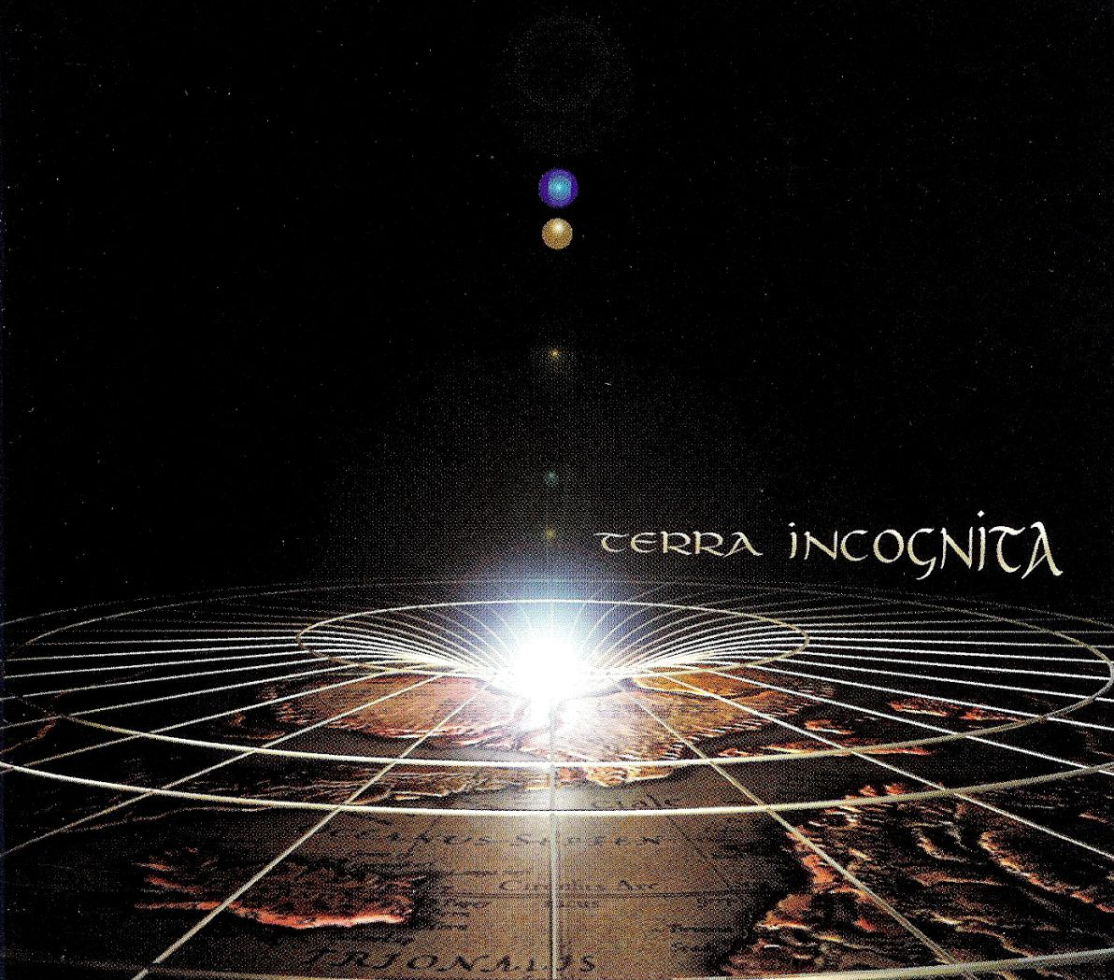
Radiotherapy: modeling biological response
LINACS → MV photons/e- (95%)-protons-hadrons (5%)
2 Gy/session, 1 session per day, 5 days/week
Dose rate~ 2 Gy/min
Field sizes > cm²
Homogeneous dose distributions
Temporal
fractionation
Standard RT
Spatial
fractionation
Biological
response

Slide 10

Radiotherapy: modeling biological response
Tumor control
probability
Normal tissue
complication
probability
Physical dose
Biological dose
Biological effect of the radiation
Type of radiation
Beam energy
Delivery mode: dose rate, spatial
and temporal distributions, etc.
Tumor type
Tumor microenviroment
Genetics
Physical parameters
of irradiation
Biological factors

Slide 11
Radiotherapy: modeling biological response
Tumor control
probability
Normal tissue
complication
probability
Physical dose
Biological dose
Biological effect of the radiation
Type of radiation
Beam energy
Delivery mode: dose rate, spatial
and temporal distributions, etc.
Tumor type
Tumor microenviroment
Genetics
Physical parameters
of irradiation
Biological factors

Slide 12
Radiotherapy: modeling biological response
LINACS → MV photons/e- (95%)-protons-hadrons (5%)
2 Gy/session, 1 session per day, 5 days/week
Dose rate~ 2 Gy/min
Field sizes > cm²
Homogeneous dose distributions
Temporal
fractionation
Standard RT
Spatial
fractionation
Biological
response

Slide 13
Temporal fractionation of the dose
Dividing a dose into several fractions spares normal tissues
– Repair of sublethal damage between dose fractions
– Repopulation of cells
• Dividing a dose into several fractions increases damage to the tumor
– Reoxygenation of tumor environment
– Reassortment of cells into radiosensitive phases of the cell cycle
• Prolongation of treatment reduces early reactions
• However, excessive prolongation allows surviving tumor cells to proliferate

Slide 14
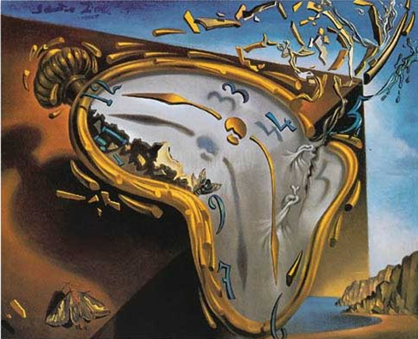
Temporal fractionation of the dose
Common scheme 2 Gy/session, 1 session/days, 5 days week, 5-6 weeks
Other schemes explored
Hypofractionation (higher doses-less days)
benefit for some prostate, breast, lung cancers
Hyperfractionation (lower doses, twice per day, more days)
advantageous for some head-and-neck and cervical squamous cell cancers
Continuous hyperfractionated accelerated radiation therapy (three small sessions per day)
used to treat lung cancer

Slide 15

Temporal fractionation of the dose
Common scheme 2 Gy/session, 1 session/days, 5 days week, 5-6 weeks
Other schemes explored
Hypofractionation (higher doses-less days)
benefit for some prostate, breast, lung cancers
Hyperfractionation (lower doses, twice per day, more days)
advantageous for some head-and-neck and cervical squamous cell cancers
Continuous hyperfractionated accelerated radiation therapy (three small sessions per day)
used to treat lung cancer
TIME MATTERS

Slide 16
Radiotherapy: modeling biological response
Tumor control
probability
Normal tissue
complication
probability
Physical dose
Biological dose
Biological effect of the radiation
Type of radiation
Beam energy
Delivery mode: dose rate, spatial
and temporal distributions, etc.
Tumor type
Tumor microenviroment
Genetics
Physical parameters
of irradiation
Biological factors

Slide 17
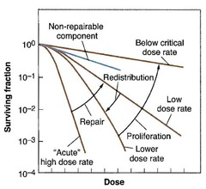
Dose rate
Common dose rates in external RT 2 Gy/min -- Most modern machines 18 Gy/min
In general dose rate cells killing (time to repair)
However, in some cases (low dose rates) there is an inverse dose rate effect, which is thought to be due to redistribution and cells piling up in the radiosensitive G2 cell cycle check point.
No evaluations performed at very high dose rates.

Slide 18
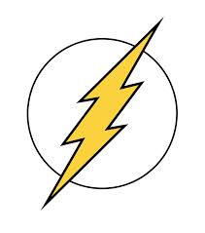
Dose rate
FLASH irradiation the dose is given in short pulses (< 500 ms) at ultrahigh dose rate (> 40 Gy/s)
Differential effect tumor-healthy tissues
  Tumor control equivalent to conventional RT
  Significantly reduces side effects in normal tissues
Ex. complete lack of acute pneumonitis and late lung fibrosis after
bilateral thorax irradiation of C57BL/6J mice with FLASH at doses
known to trigger the development of pulmonary fibrosis in 100%
of animals after conventional RT.
Favaudon et al. 2014

Slide 19
Radiotherapy: modeling biological response
Temporal
fractionation
Standard RT
Spatial
fractionation
Biological
response

Slide 20
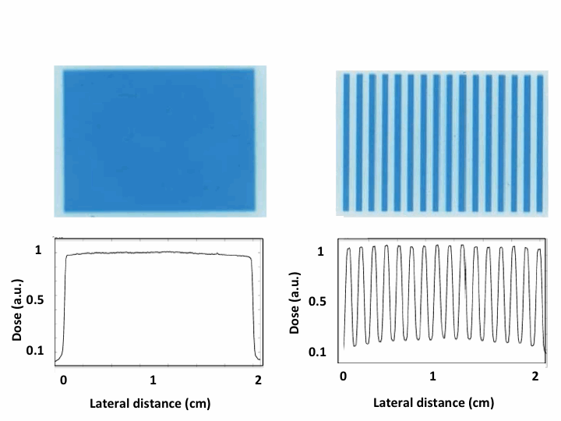
Spatial fractionation of the dose
Conventional
RT
Spatially fractionated
RT

Slide 21
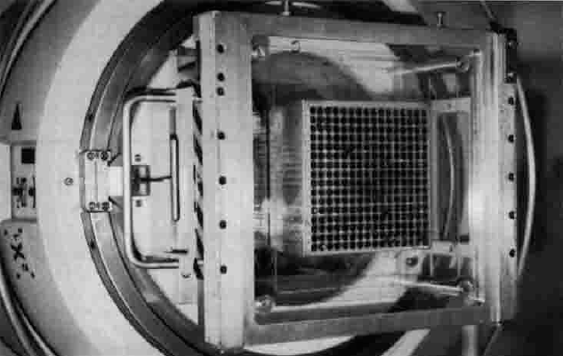
RT techniques based on a spatial fractionation of the dose
GRID Therapy (few hospitals in the world)
1909 Alban Kohler used a “perforated screen” (grid)→ effect similar to treatment with small pencil beams.
Widely used in the 1950s as a way to reach tumors deep in the body with kilovoltage beams.
From the 70s GRID therapy with megavoltage radiation beams → palliation of selected, massive and bulky tumors
Improved response to RT and may possibly have cell killing effects outside the directly irradiated area
Beam sizes > 1 cm²
PVDR from 2 to 5

Slide 22
Radiotherapy: modeling biological response
Tumor control
probability
Normal tissue
complication
probability
Physical dose
Biological dose
Biological effect of the radiation
Type of radiation
Beam energy
Delivery mode: dose rate, spatial
and temporal distributions, field
size, etc.
Tumor type
Tumor microenviroment
Genetics
Physical parameters
of irradiation
Biological factors

Slide 23
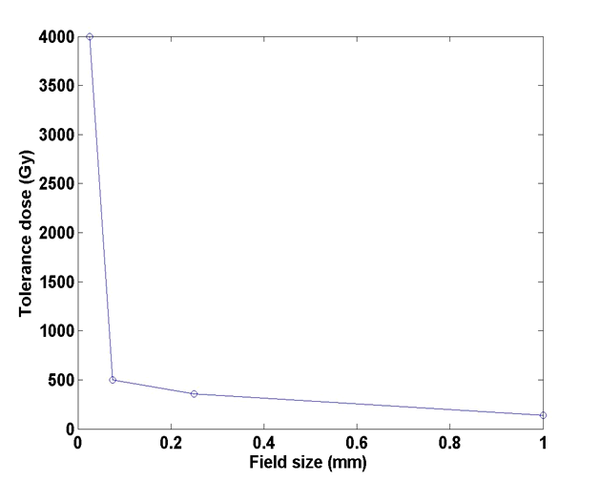
Field size
Dose-volume effect: the smaller the field size is, the higher the tolerance
Zeman et al., Science (1959)

Slide 24
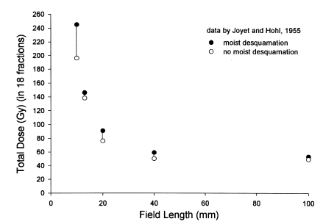
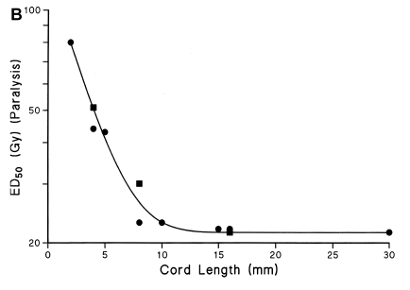
More recent examples with high energy photons
SKIN
SPINAL CORD
J.W. Hopewell, K.R. Trott / Radiotherapy and Oncology 56 (2000) 283-288
The stem-cell depletion hypothesis → for each organ exits a limiting critical volume, which can be repopulated by a single surviving stem cell and for which damage can be repaired by repopulation (Yaes & Kalend, 1988; Yaes et al, 1988).

Slide 25
Novel RT techniques based on “different” delivery modes
Combination
very small field sizes (< 1mm²) + Spatial fractionation of the dose
Dose-volume effects
Conventional RT
Zeman et al., Science (1959)

Slide 26
Novel RT techniques based on “different’’ dose delivery methods
Dose-volume effects→ exponential increase of healthy tissue tolerances
+
Spatial fractionation→ gain in healthy tissue recovery →increase of healthy tissue tolerances
Tumor Control
Probability
Normal Tissue
Complication
Probability

Slide 27
Novel RT techniques based on “different’’ dose delivery methods
Dose-volume effects→ exponential increase of healthy tissue tolerances
+
Spatial fractionation→ gain in healthy tissue recovery →increase of healthy tissue tolerances
Tumor Control
Probability
Normal Tissue
Complication
Probability

Slide 28
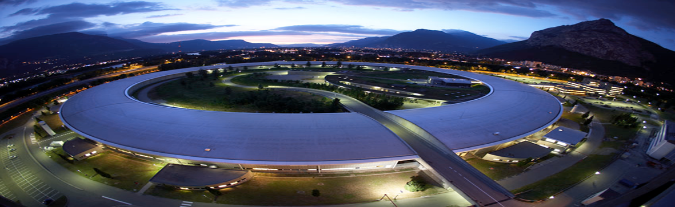
Synchrotron micro and minibeam radiation therapy
Submillimetric field sizes (25 to 700 µm)
Interbeam separation (400 to 3500 µm)
Dose profiles consist of a pattern of peaks and valleys
Kilovoltage beams

Slide 29
Minibeam Radiation therapy
High resistance of normal tissues
Doses as high as 100 Gy/session are still well-tolerated by the rat brain in comparison to 22 Gy in RT conventional
Prezado et al, submitted Rad. Reseach
A factor 3 increase in lifespan of glioma bearing rats
Prezado et al., J. Synchr. Rad. 2012

Slide 30
Biological effects not well understood
Cell migration seems to be the responsable for tissue reparaison
Differential effect normal-tumoral tissues
  Induction of denudation of tumor vessel endothelium, of a decrease in tumor blood volume as well as of tumor hypoxia.
  The bystander effect/cellular communication.
  A significant transcriptomic modulation for 30 genes in intracranial tumor tissue following spatial fractionation techniques, undetected in normal tissue→ mainly related to the regulation of cell cycle and to immune/inﬂammatory response.

Slide 31
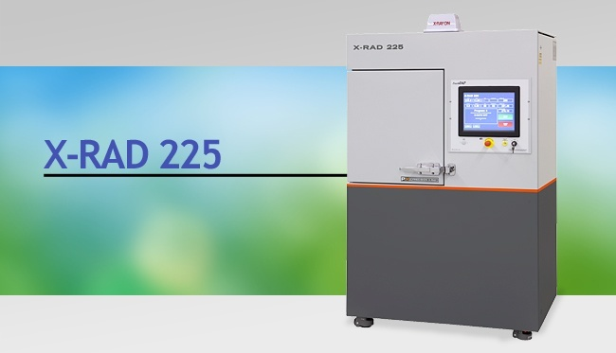
x-rays MBRT: possible transfer from synchrotrons to cost-effective equipment
IMNC + Campus d’Orsay + INSERM U836
Radiobiology platform (Institut Curie)
Synchrotron → low cost equipment
Feasibility evaluation: modification of the irradiator (patent)
Biological studies → understand the involved mechanisms (starting Autumn)

Slide 32
Radiotherapy: modeling biological response
Tumor control
probability
Normal tissue
complication
probability
Physical dose
Biological dose
Biological effect of the radiation
Type of radiation
Beam energy
Delivery mode: dose rate, spatial
and temporal distributions, field
size, etc.
Tumor type
Tumor microenviroment
Genetics
Physical parameters
of irradiation
Biological factors

Slide 33
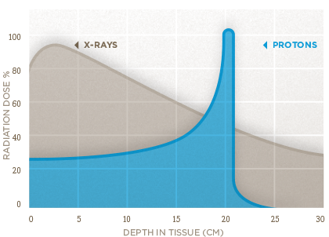
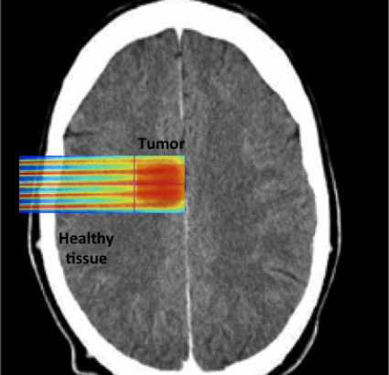
Proton minibeam radiation therapy
+
In a recent work: Monte Carlo proof of concept suggested
a possible way to generate minibeams of protons and
highlithted advantages of this approach [Prezado 2013] :
Spatial fractionation in healthy tissue
Homogeneous distribution at the Bragg peak location

Slide 34
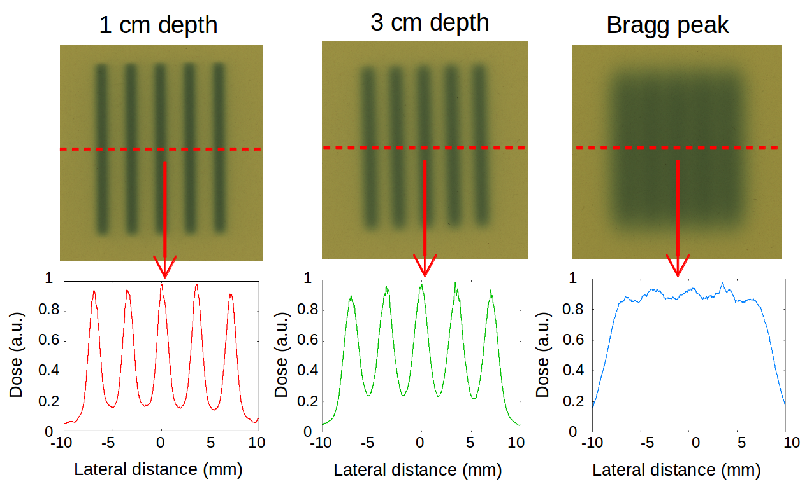
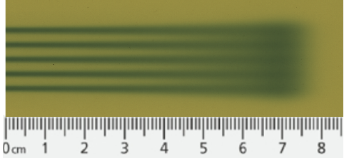
Implementation at the Proton Therapy Center Orsay
Spatial fractionation of the dose in the normal tissue beyond the Bragg peak
Quasi-homogeneous dose distribution at the Bragg peak location due to multiple Coulomb scattering in depth

Slide 35
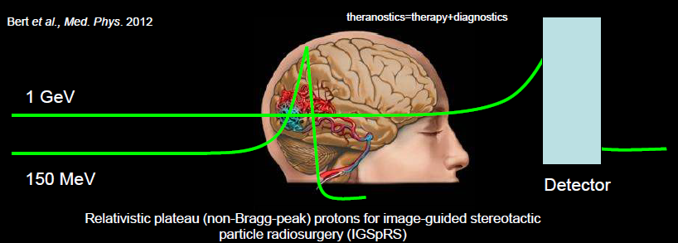
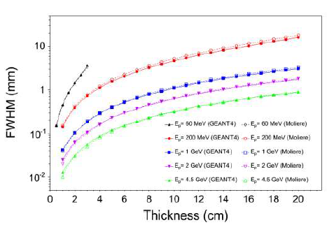
Relativistic proton radiosurgery & theragnostics
Beam energies > 1 GeV
→Reduced lateral scattering
→Ideal candidate for remote scalpel
Durante et al 2012

Slide 36
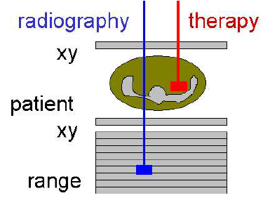
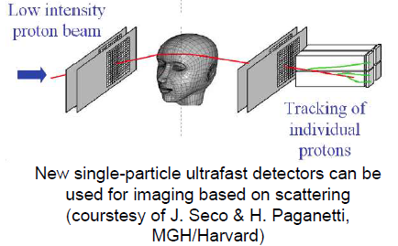
Relativistic proton radiosurgery & theragnostics
Theragnostic= Therapy + Imaging
Varentsov et al., Phys. Med. 2012

Slide 37
Potential renewed use of very heavy ions for therapy
Very heavy ions (Ne or heavier) used in the past, very effective for the treatment of hypoxic/resistant tumors (Castro 1994)
However abandoned due to important side effects in normal tissues
C. Peucelle et al, submitted Med. Phys.

Slide 38
Very heavy electrons for therapy
E ~300 MeV At hospitals E ~ 2 – 25 MeV
Potential clinical advantages that can be investigated:
-Lateral electromagnetic scanning could have certain clinical advantages that are not possible by using photon beams. This can be advantageous for image-guided energy- and intensity modulated radiation therapy
- a possible gain in relative biological effectiveness (RBE) might be observed.

Slide 39
High energy electron grid therapy: colaboration with LAL
2D dose distributions
For a human head 250-300 MeV are required
View of the grid
Martinez & Prezado, Med. Phys. 2015
Technical implementation– colaboration with LAL

Slide 40
Reflexion on posible technological needs to optimize the techniques
X-rays MBRT low cost machine with small divergence and higher flux
pMBRT magnetic collimation to be studied. Higher flux, smaller emittance needed. Necessity of new set of quadrupole magnets?
Very high energy pMBRT: is there any place to perform biological experiments?
Very high energy electron grid therapy—design of an adequate machine
In all cases, cheaper and more compact equipment.

Slide 41
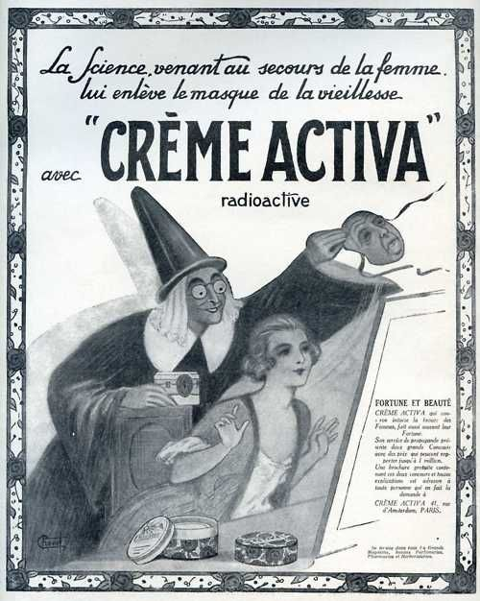
Conclusions
We are still far away from having found the optimum way to use ionizing radiation for therapy
Some relevant radiobiological effects/mechanisms only recently explored
Physics paramaters of the irradiation can be used to model the biological response – to improve treatment outcome
Advancements in radiotherapy require a interdisciplinary approach

Slide 42
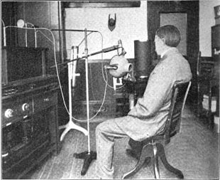
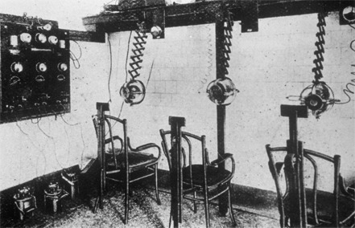

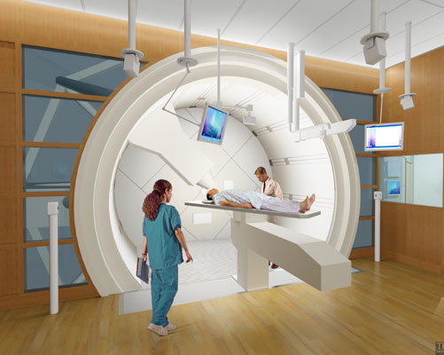
Thank you for your attention
prezado@imnc.in2p3.fr

