Slide 1
Modeling of diamond sensor signal formation in extreme conditions
V. Kubytskyi, S. Liu, P. Bambade, F. Bogard, D. Jehanno,
C. Sylvia, P. Cornebise, T. Tauchi, N. Terunuma

Slide 2
Outline
Introduction to DS
Modeling of charge collection
Results for 1-10⁹ Mips
Conclusions

Slide 3
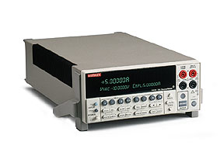
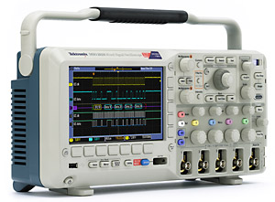
1.1 What is diamond sensor?
Introduction to DS
Diamond
1 MIP≈36 in 1 μm
1 MIP≈36 in 1 μm
1 MIP≈36 in 1 μm
High Voltage
400 V
Reading side
0 V
E = V/d
d=500μm
How many particle we detected???

Slide 4
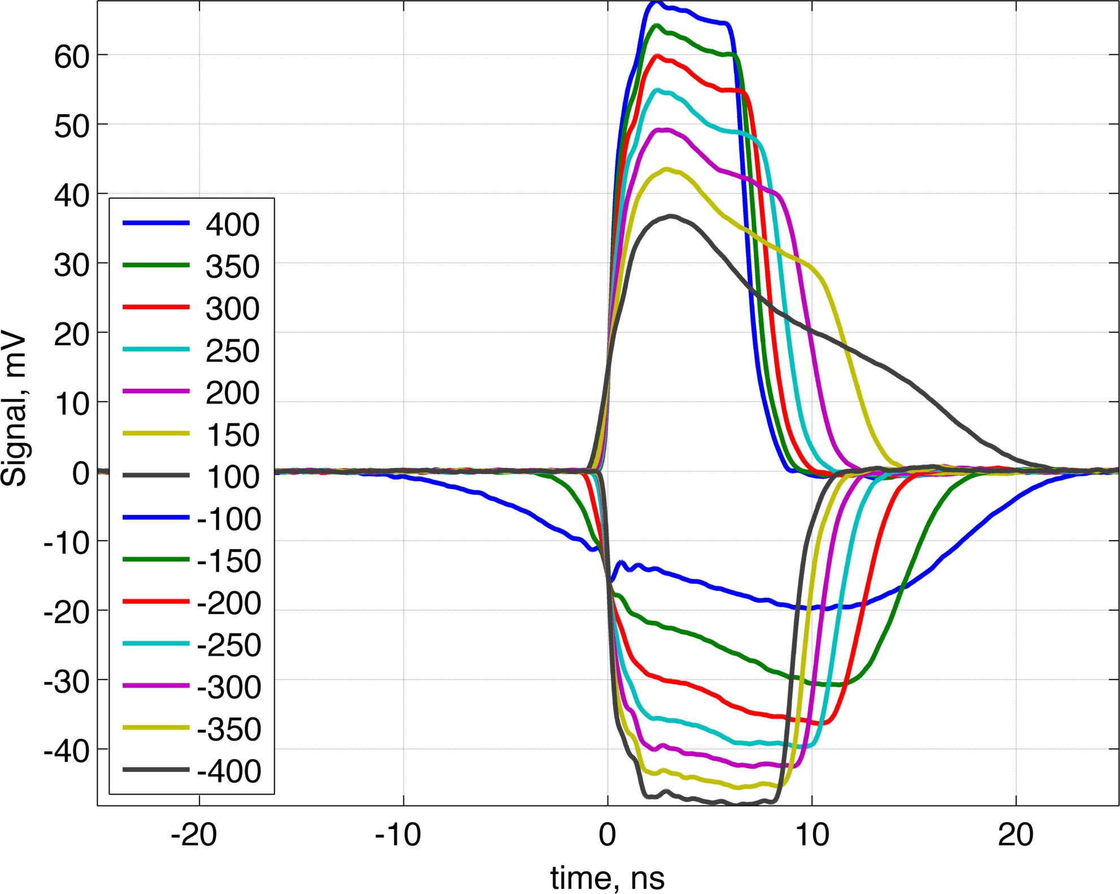
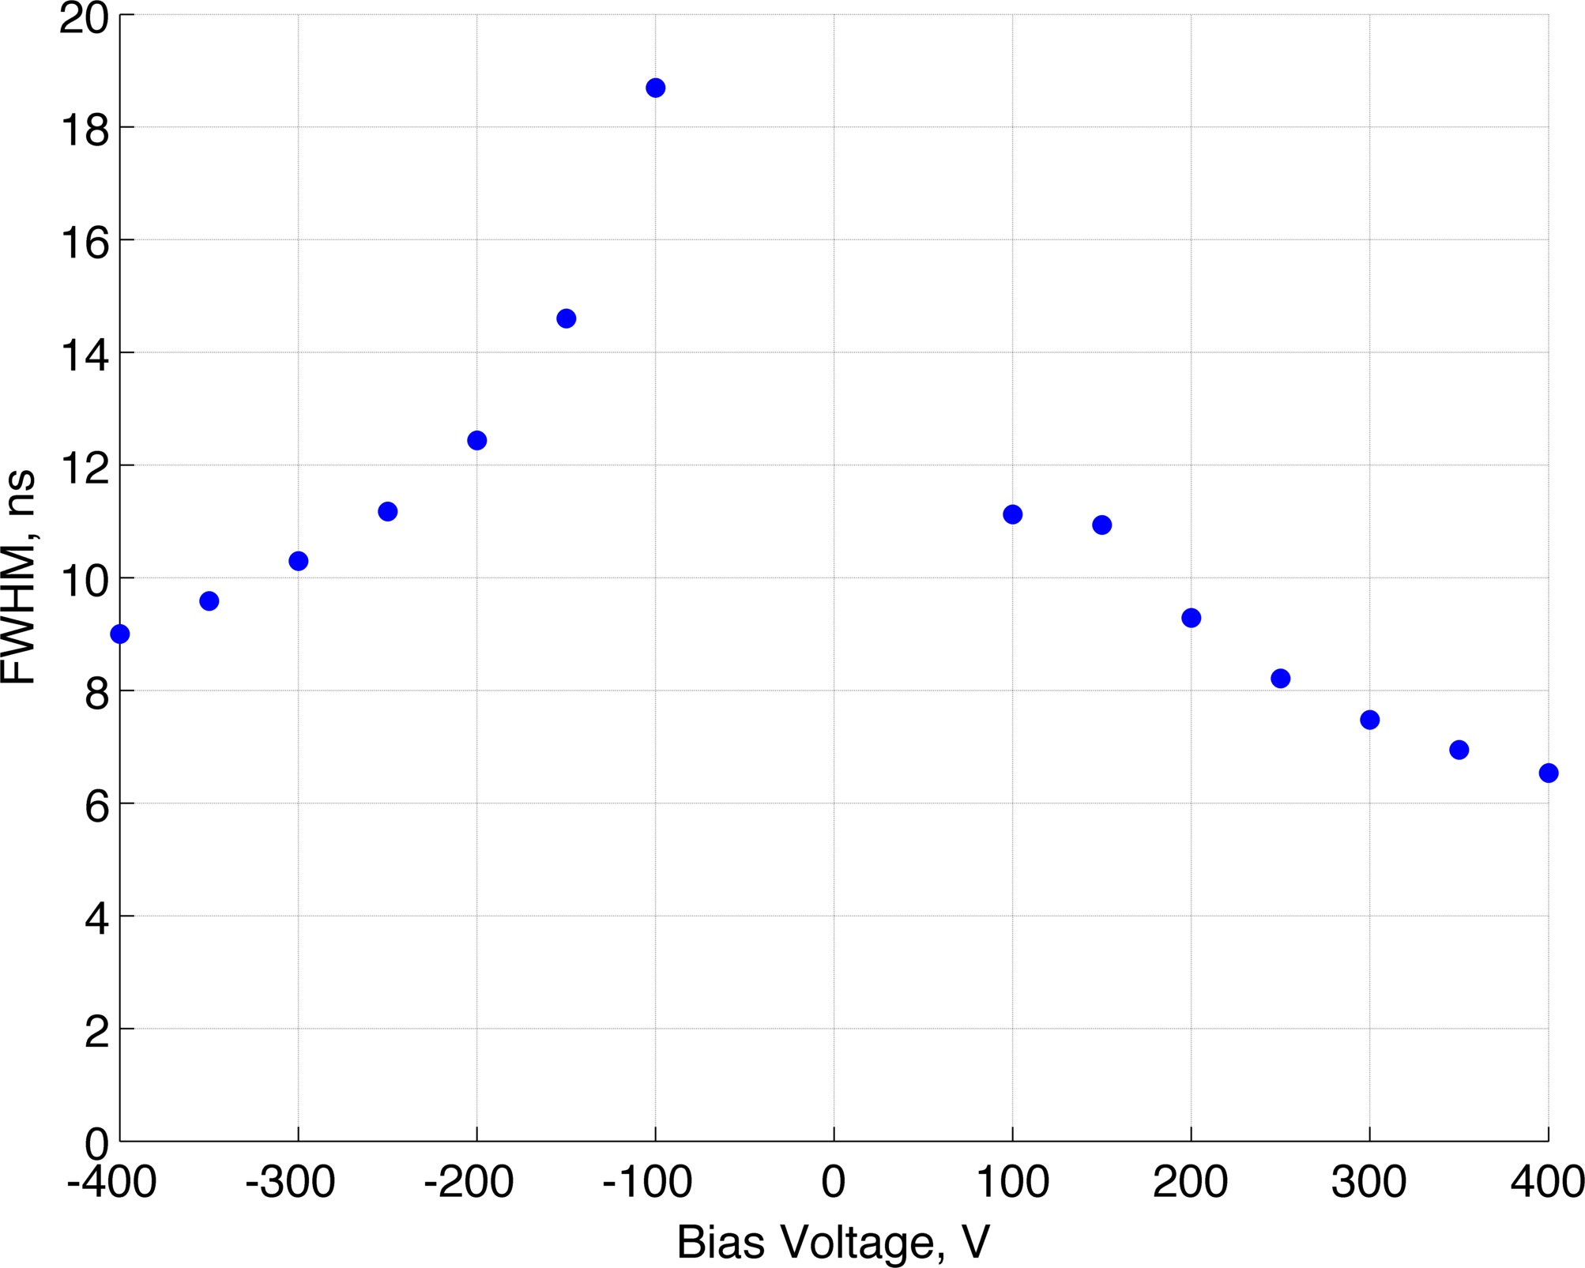
1.2 Calibration of the sensor
Introduction to DS
²⁴¹Am alpha source: Eα = 5.4 MeV
²⁴¹Am alpha source: Eα = 5.4 MeV
+ current amplifier (40dB)
Allows to obtain diamond characteristics
by Transient Current Technique.
Velocity saturation

Slide 5
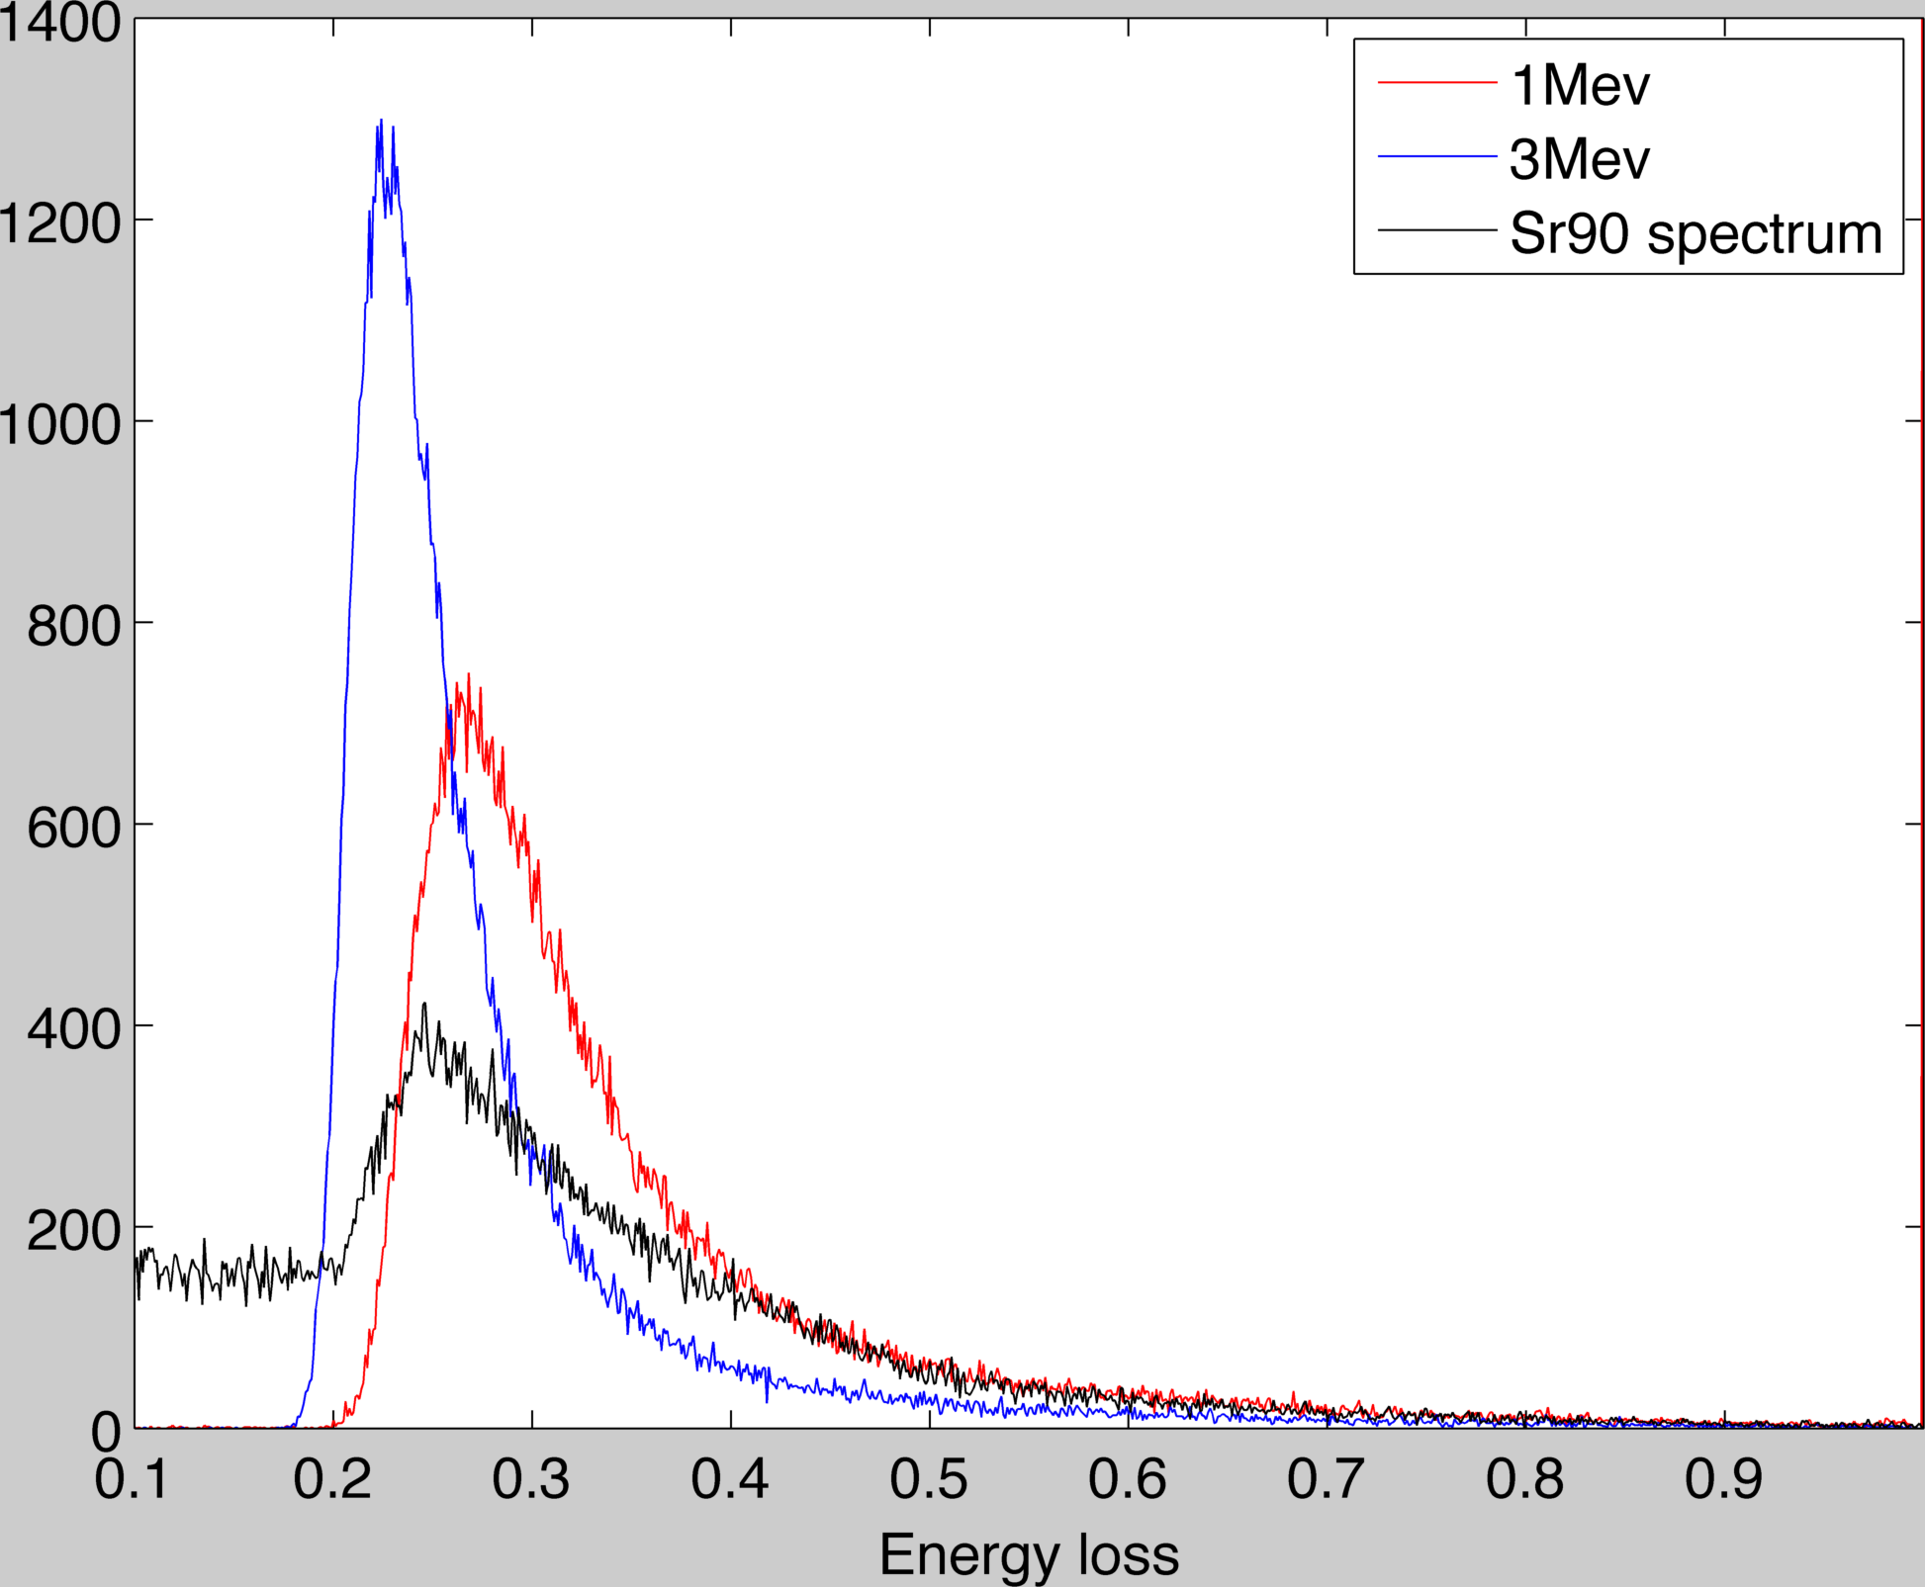
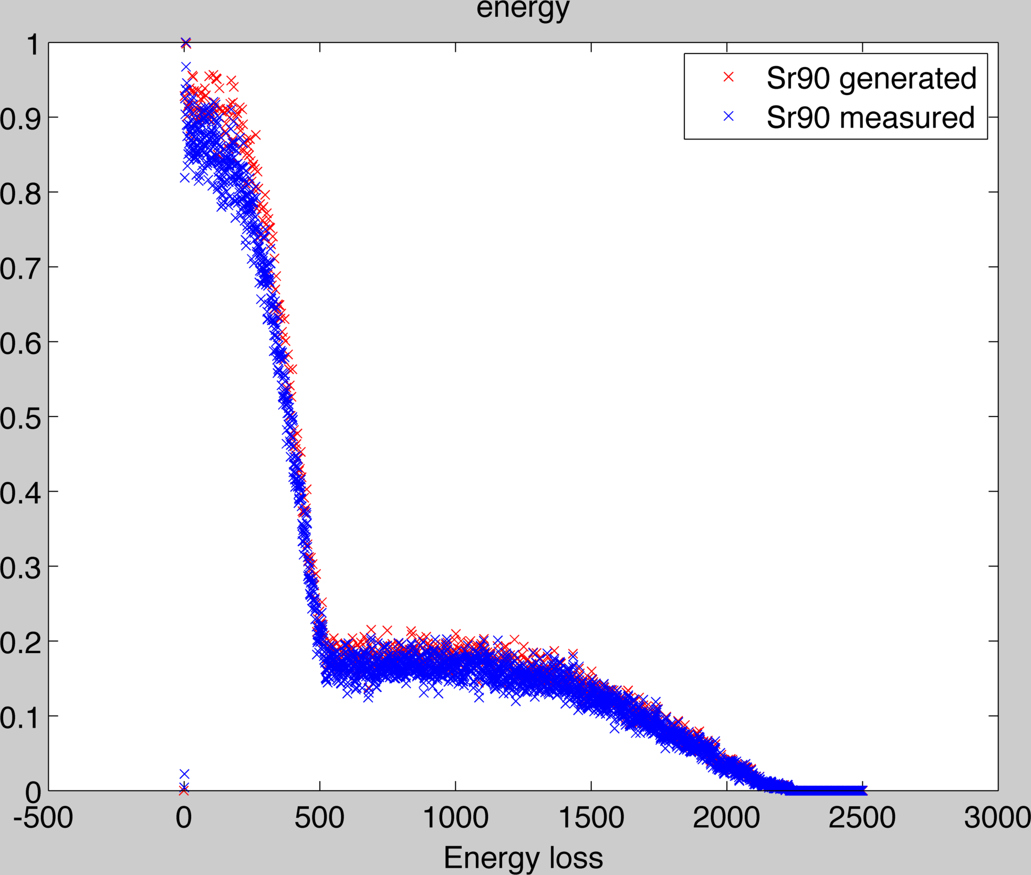
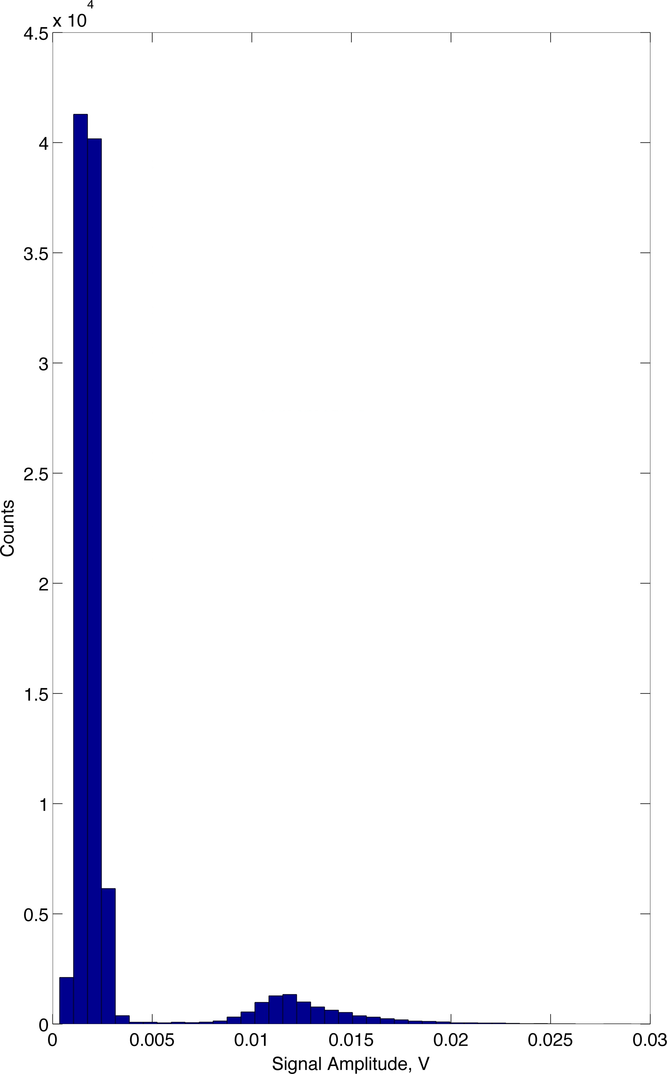
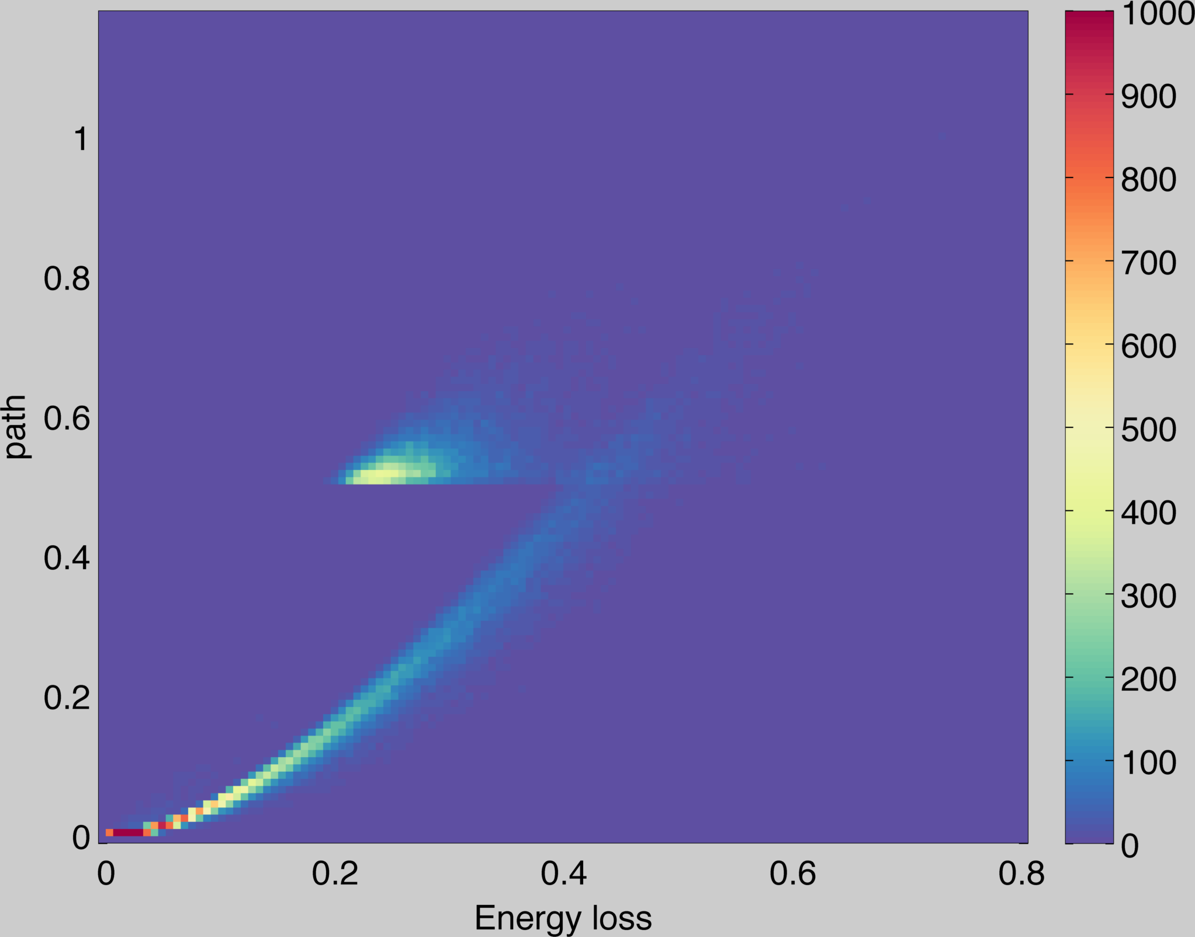
1.2 Calibration of the sensor
Introduction to DS
Geant4 diamond simulation.
0.55 MeV
2.27 MeV
+ charge amplifier(4mV/fC)
Noise
Sr90 spectrum
Signal from 1 MIP

Slide 6
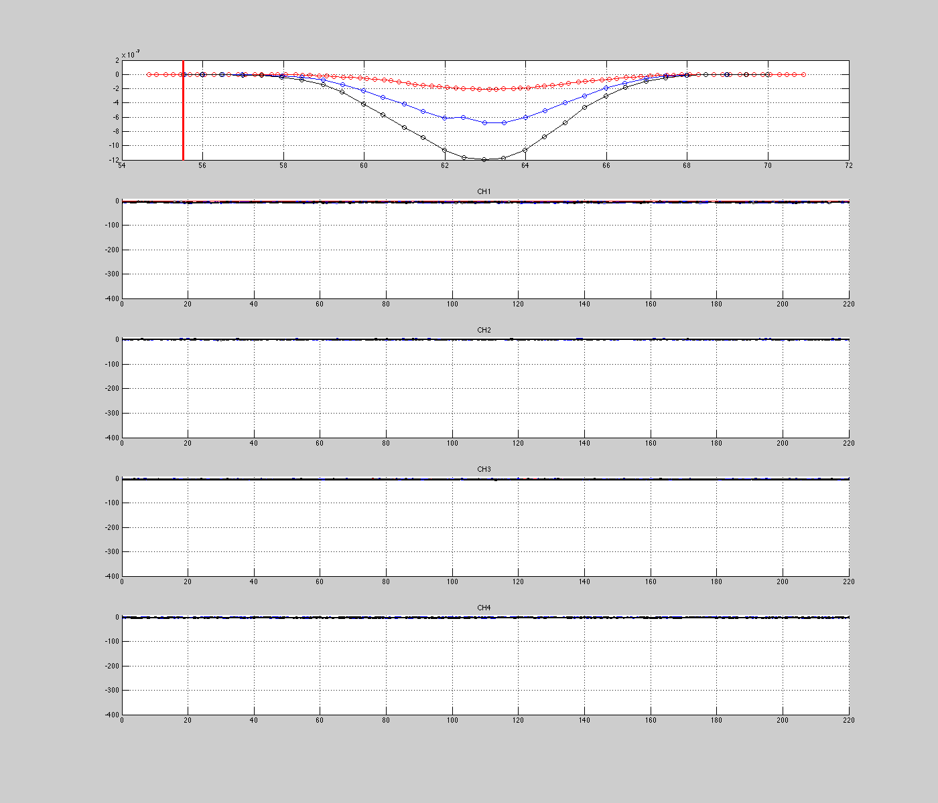
1.3 Signals measured at ATF2
Introduction to DS
Total charge in the diamond
50 V
200 V
400 V
10 waveforms at each position
ch1
Ch1
BEAM
ch2
Ch2
Ch3
ch3
Ch4
ch4

Slide 7
1.4 Motivation for modeling
Introduction to DS
Correct calibration of our detector for maximum dynamic range
Understanding of processes during charge collection
Optimization of our DS for given application

Slide 8
2. Modeling of charge collection in 1D
Time = 0
Time = 1
Time = K
Motion of electrons and holes in external electric field create current on electrode.
Parameters:
-number of incident particles
-biased voltage
-diamond thickness
Variables:
Material parameters
(Pomorski et al.)
Mobilities
μ_{e} = 1300..3100 [cm²/Vs]
μ_{h} = 2300 [cm²/Vs]
Saturation velosities
v_sat_e = 1.9*10⁷ [cm/s]
v_sat_h = 1.4*10⁷ [cm/s]
Lifetimes
τ_{e} = 300 ns
τ_{h} = 300 ns

Slide 9
2.1 Current induced on the electrode
More generally: Shockley-Ramo theorem,
works for many electrodes configuration
x₀
q
q₂
q₁
ν
D
V_{b}
D
If charge is moving:
Same result

Slide 10
2.2 Modeling of charge collection in 1D
Standard approach in semiconductor device modeling is solution of
Drift-diffusion equations.
Variables:
+ initial conditions (concentrations proportional to Nmip)
+ appropriate boundary conditions
We use Scharfetter-Gummel Discretization:
Solving for each time moment (by Runge-Kutta method) gives the evolution
of charge densities

Slide 11
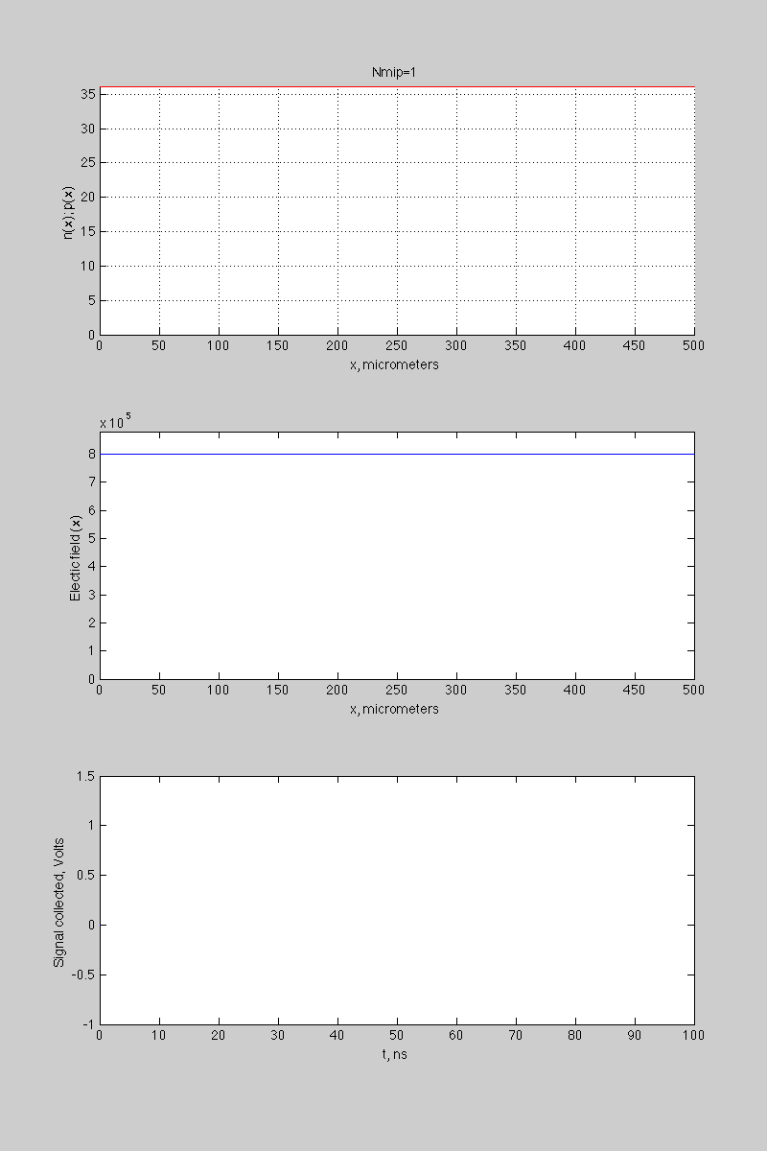
2.3 Examples
Nmip=1
Nmip=1e6

Slide 12
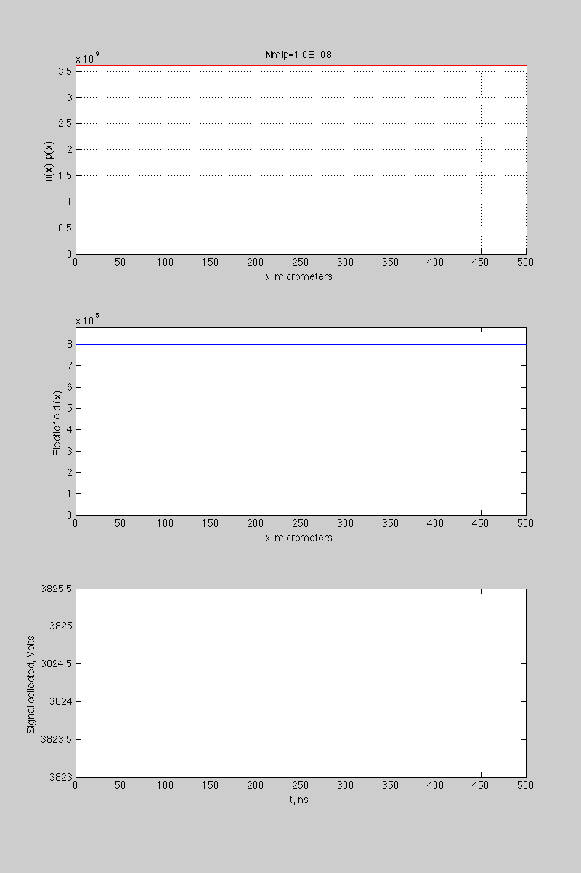
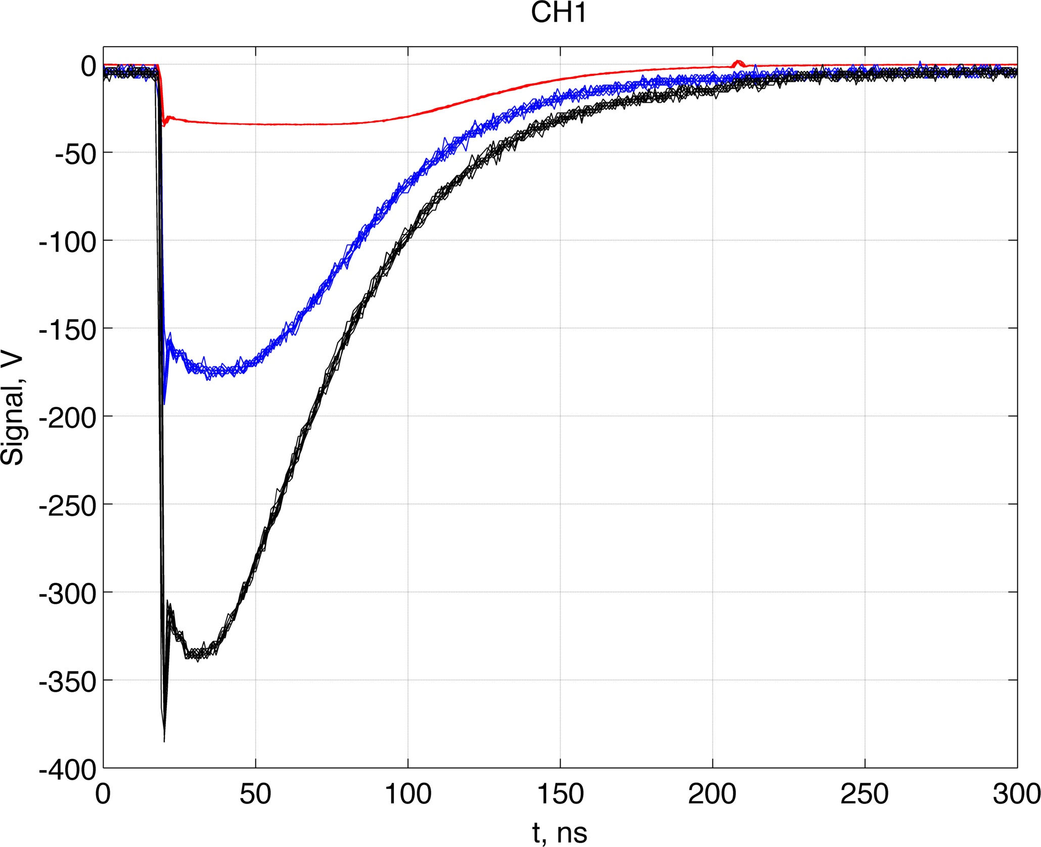
More particles
Nmip=1e8
50 V
200 V
400 V
Real waveforms
Wrong!

Slide 13
2.4 Taking into account the voltage drop
V_{read}
V₀
_{400V}
50 Ohm
For Nmip 1-1e5 V_{read} << V₀
D
For Nmip=1e6 and V₀=400V V_{read} =25 V
Which is not the case when signal is large, and system behaves self-consistently:
-large I -> large V_{read}->small V->slow collection (small I ) and inverse
-small I -> small V_{read}->large V->fast collection (large I )
We solve this equation at each time step to find settled regime
This significantly slows down the modeling speed

Slide 14
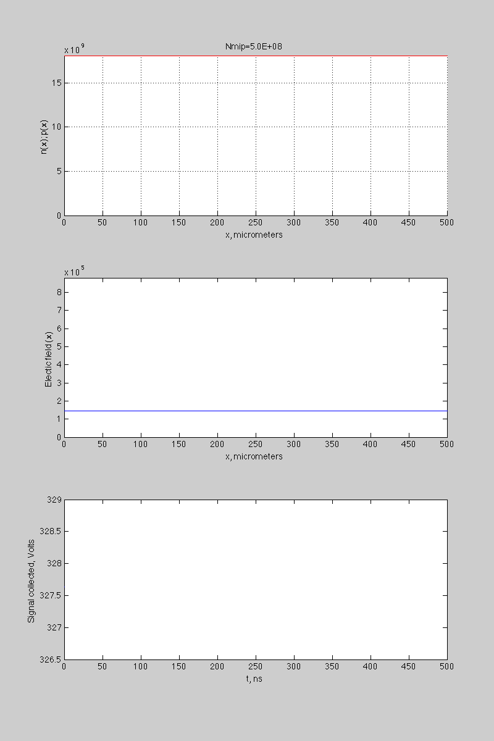
3. Results
Nmip=1e8
Nmip=5e8

Slide 15
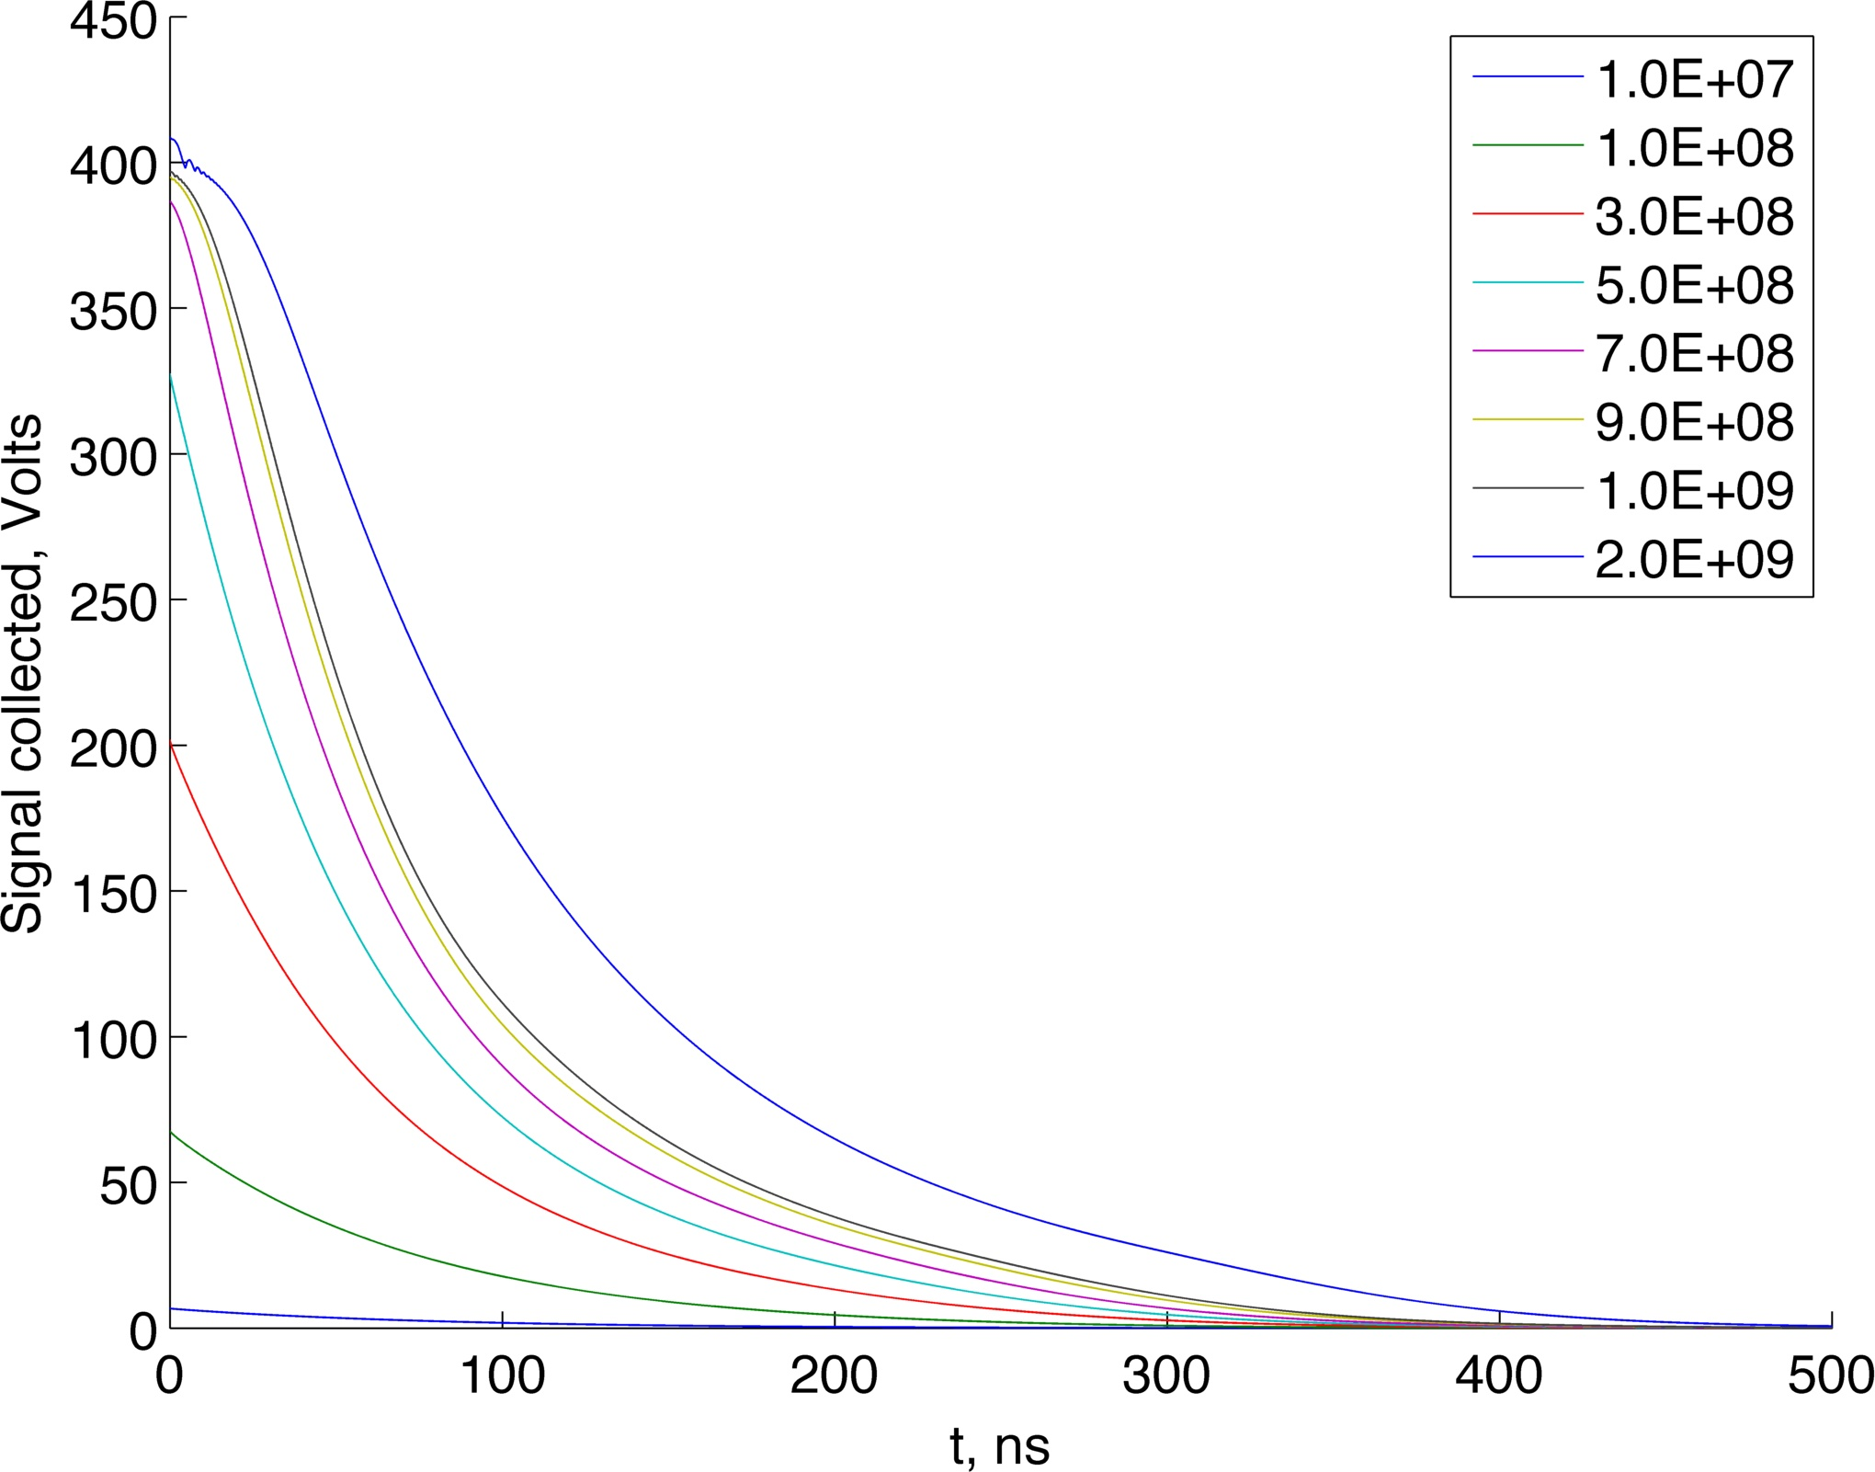
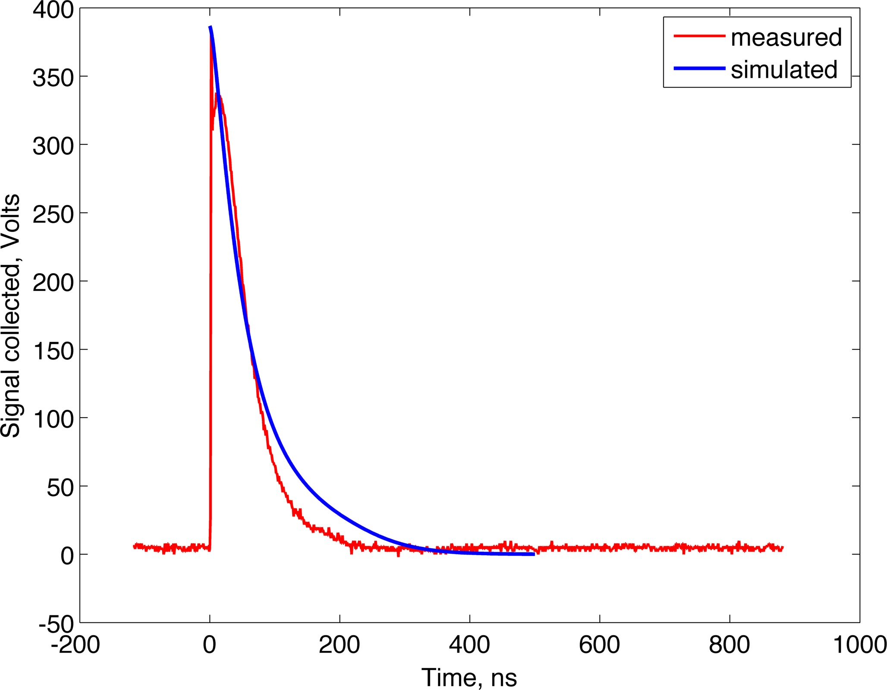
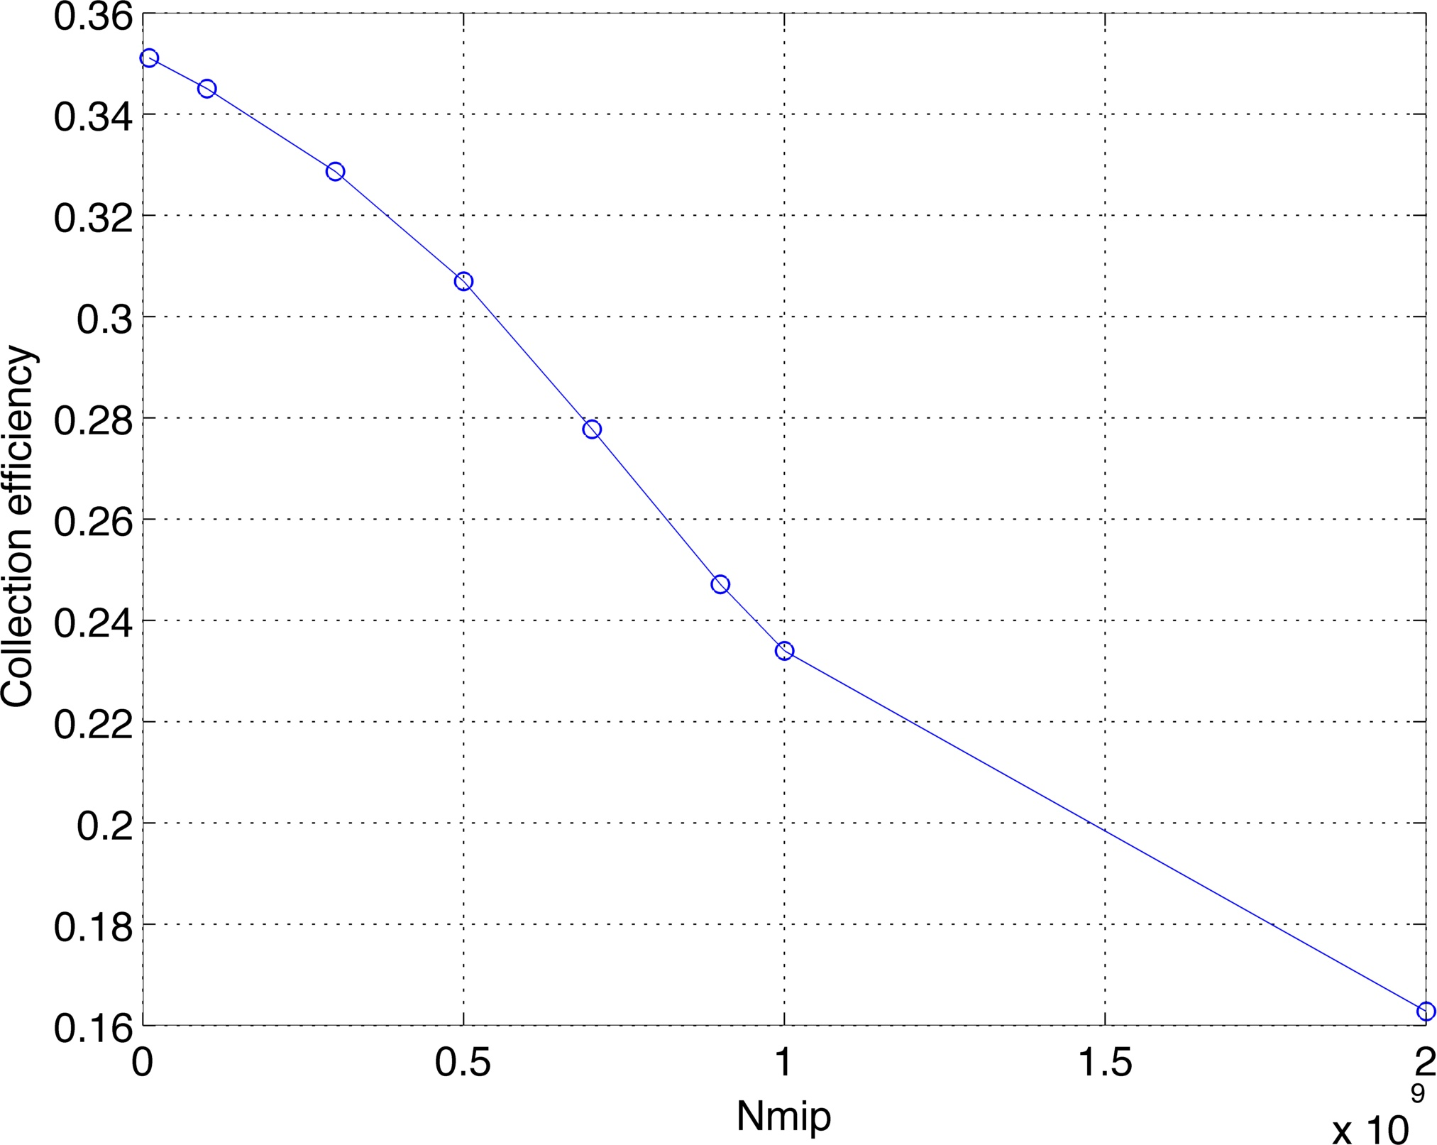
3. Results
Nmip=1e9

Slide 16
Role of material parameters

Slide 17
Conclusions
We developed a 1D model of diamond sensor which takes to account: space-charge effects, voltage drop,….
Up to 1e6 Mips the charge collection is in linear regime; for larger intensities charge collection is non-linear.
Allows to determine the proper calibration of our DS.
Can be easily extended for taking to account energy distribution of incident particles; extension to 2D case is complicated
…

Slide 18
Backup

Slide 19
Physical properties of CVD diamond
Property Diamond Silicon
Density (g m⁻³) Band gap (eV) Resistivity (Ω cm) Breakdown voltage (V cm ⁻¹) Electron mobility (cm³ V⁻¹ s⁻¹) Hole mobility (cm³ V⁻¹ s⁻¹) Saturation velocity (μm ns⁻¹) Dielectric constant Neutron transmutation cross-section(mb) Energy per e-h pair (eV) Atomic number Av.min.ionizing signal per 100 μm (e) | 3.5 5.5 >10¹² 10⁷ 1900 2300 141 (e⁻) 96(hole) 5.6 3.2 13 6 3600 | 2.32 1.1 10⁵ 10³ 1500 500 100 11.7 80 3.6 14 8000
ADVANTAGES
• Large band-gap⇒ low leakage current
• High breakdown field
• High mobility⇒ fast charge collection
• Large thermal conductivity
• High binding energy⇒ Radiation hardness
Fast pulse ⇒ several ns
High dynamic range
Charge generated by 1 MIP for 500 µm diamond (with 100% CCE): 2.88 fC

Slide 20
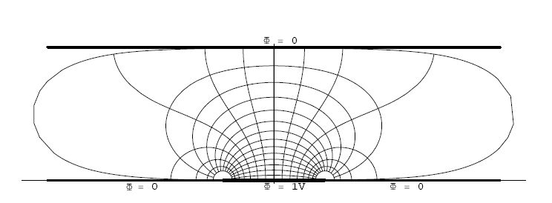
Weighting Field for a Strip in a Parallel Plate Geometry
D
w
Weighting Field:

Slide 21
Weighting Field for a Strip in a Parallel Plate Geometry
v
D
w
I(t,x) = -e₀*Ez[x,D-v*t]*v
When all charges have arrived at the electrodes the induced charge is equal to the total charge that has arrived at the electrode.
If the electronics ‘integration time’ ~ ‘peaking time’ ~ ‘shaping time’ is larger than the time it takes the electron to pass the induction gap, the readout strips that don’t receive any charge show zero signal.
If the electronics ‘integration time’ ~ ‘peaking time’ ~ ‘shaping time’ is smaller than than the time it takes the electron to pass the induction gap, the readout strips that don’t receive any charge show a signal different from zero that is strictly bipolar.

Slide 22
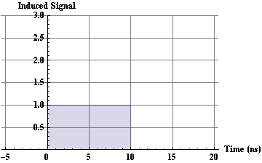
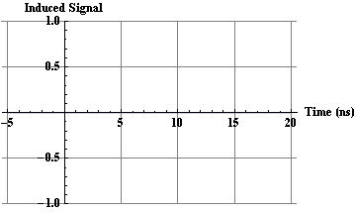
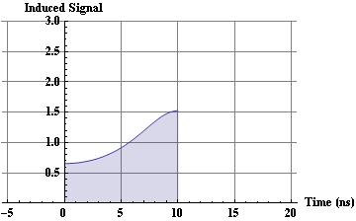
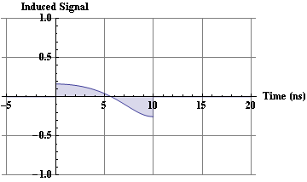
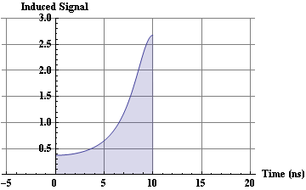
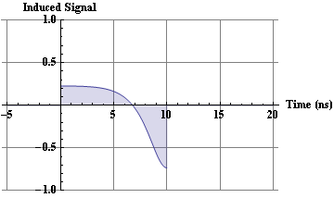
GEM Signals, Induced Currents
v
D = 1mm
Central Strip
First Neighbour
w
W >> D
W=D
W=D/2

Slide 23
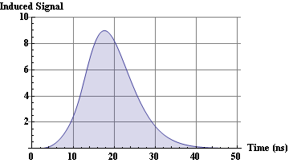
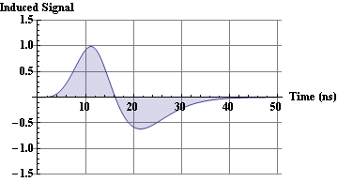
GEM Signals
v
D = 1mm
Central Strip
First Neighbour
w
W=D/2
W=D/2 (D=1mm, w=0.5mm)
Connecting an amplifier with Peaking Time = 10ns
→ 10% crosstalk !
In case the electronics peaking time is
smaller or of similar size as the time the electron takes to pass the induction gap, there is a sizable signal on the neighboring strips that do not even receive charges.
Central Strip
First Neighbor
W=D/2

