Slide 1
The Hard X-ray Modulation Telescope Mission
HUO Zhuoxi
Tsinghua Centre for Astrophysics
huozx@tsinghua.edu.cn
31st, Mar 2015, LAL

Slide 2
Outlines
Introduction on the HXMT mission
Science objectives: AGN, BH binaries, CXB, GXB, etc.
Detectors
Observations: scanning observations, pointed observations
Current status
Imaging and data analysis
Various imagers [image in, image out] in X-ray astronomy
HXMT image reconstruction: events in, image out
Signal/background discrimination & background estimation
Backgrounds modelling
Available measurements
Current strategies
Possible improvements?

Slide 3
Introduction on the HXMT mission

Slide 4
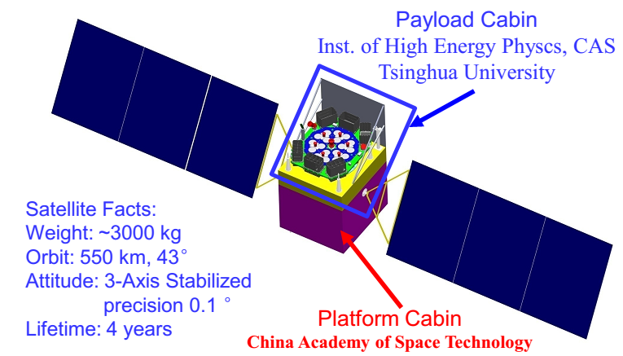
The Hard X-ray Modulation Telescope Mission
HXMT is a planned Chinese space telescope mission.
Planned observations: all-sky survey, deep scanning of selected regions, pointed observations.
Science objectives:
Detect various types of active galactic nuclei (AGNs). Expected outcomes: Unbiased survey, statistics on AGN; dust properties, unification theory of AGN.
Study temporal variation of X-ray objects such as black hole binaries, especially the quasi-periodical oscillation (QPO) phenomena as well as the cyclotron resonance and magnetic field of neutron stars. Expected to discriminate the magnetar model and the fallback disk model on neutron stars.
Monitor X-ray transients, e.g., Gamma-ray bursts (GRBs), soft Gamma-ray repeaters (SGRs), Anomalous X-ray transients (AXPs), etc. Anything new would be interesting enough.
Opportunistic scientific outcomes:
Cosmic X-ray background in the hard X-ray band. Unresolved AGNs.
Galactic X-ray background in the hard X-ray band.
Fermi bubbles under 1 MeV
…

Slide 5
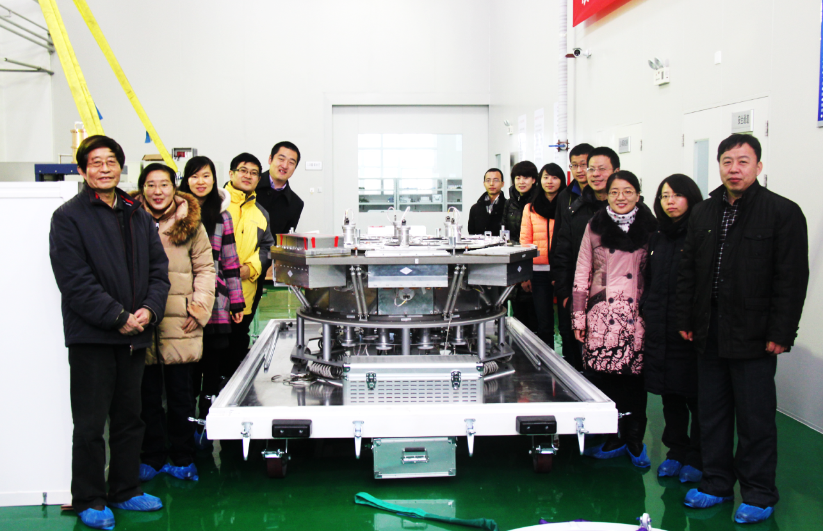
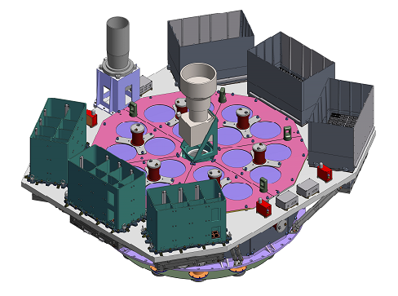
Satellite payloads summary
High energy telescope (HE):
20 – 250 keV;
18 Collimated scintillator detectors;
FOV: $5.7°×5.7°$ (FWHM);
Detection area: $5100 cm^{2}$.
Time resolution: $25 μs$
Energy resolution: 19%@60keV
Medium energy telescope (ME):
5 – 30 keV;
Detection area: $952 cm^{2}$.
Low energy telescope (LE):
1 – 15 keV;
Detection area: $384 cm^{2}$.
Space environment monitor (SEM)
HXMT Payload, 2012. Dec.
ME
LE
HE
HXMT Ground Application System:
Institute of High Energy Physics, CAS
Tsinghua University (Beijing)
Beijing Normal University

Slide 6
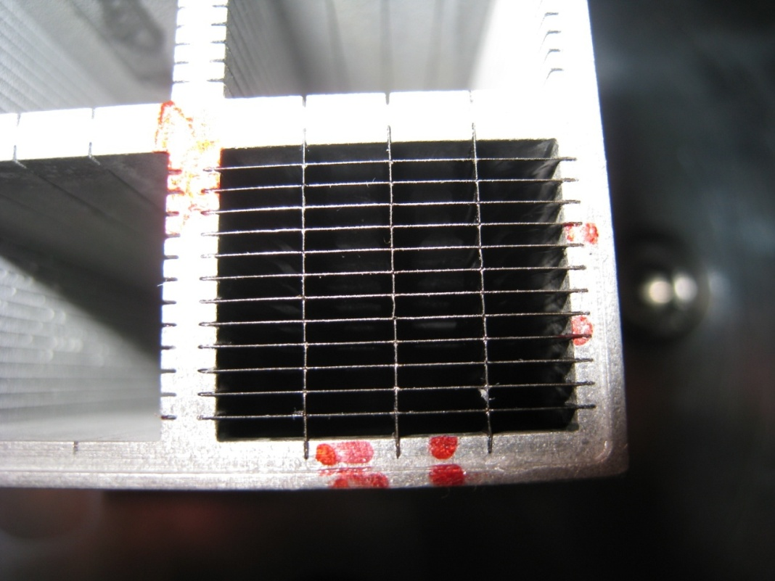
Collimated detectors
HE, ME and LE all consist of groups of collimated detectors.
HE:
18 collimated scintillator detectors
3 detectors share a read-out electronics
2 types of field of views: $5.7°×5.7°$ & $1.1°×5.7°$
3 types of positioning: $−60°$, $0°$, and $60°$
ME:
54 collimated Si-PIN detectors, 1728 pixels
FoVs: $4°×4°$ & $1°×4°$
Positioning: $−60°$, $0°$, and $60°$
LE:
24 collimated swept charge devices
FoVs: $4°×6°$ & $1.6°×6°$
Positioning: $−60°$, $0°$, and $60°$
A collimator, which is an opaque tube, “narrows” the beam of incident X-ray photons.

Slide 7
Observations
Scanning observations:
All-sky survey: fixed pointing to the earth; 0.5 year -> full coverage
Deep scan of selected small regions, e.g., the Galactic center
Pointed observations

Slide 8
Current status
Payloads system and satellite system:
Flight model phase (final phase)
Ground system (40+ software packages):
Scientific operation branch: finishing
Data preprocessing & quick-look branch: implementing
Data product generation & calibration branch: implementing
Data archiving & publication branch: implementing
Science support branch: deploying & accepting
Survey data analysis
Image reconstruction
Background estimation
Science simulator
Scheduled launch: 2016

Slide 9
Imaging and Data Analysis

Slide 10
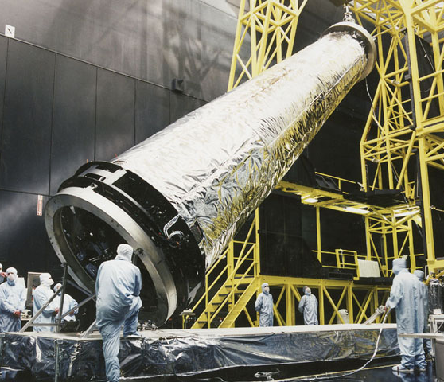
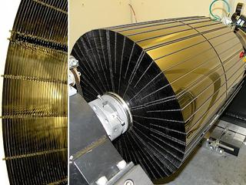
Various imagers in X-ray astronomy
Imagers: image (2D distribution of the object intensity) in, image (2D distribution of count rates) out
Wolter type I (grazing) telescope, for soft X-ray (usually <10keV)
Chandra X-ray Observatory, NASA
NuSTAR, NASA

Slide 11
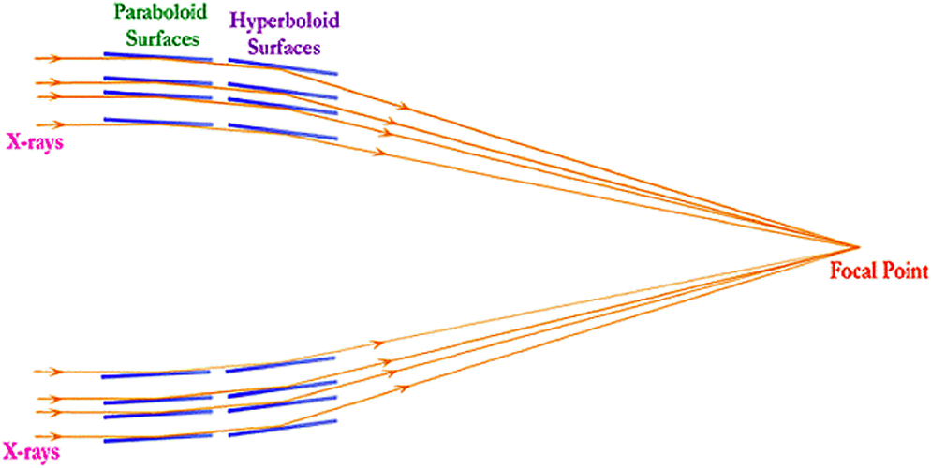
Various imagers in X-ray astronomy
Imagers: image (2D distribution of the object intensity) in, image (2D distribution of count rates) out
X-rays from point source are parallel
Parallel X-rays hit reflecting surfaces at very small angles
Parallel X-rays are “twisted” by reflecting surfaces gradually, so that they focus at one point, to form the image of the point source.
Optics of a grazing telescope
(Illustration by Paul Gorenstein, 2012)

Slide 12
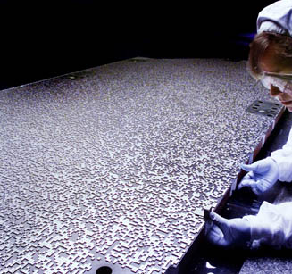
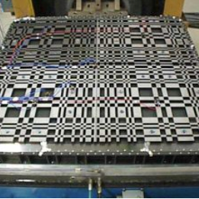
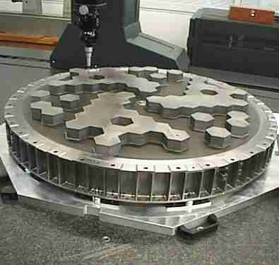
Various imagers in X-ray astronomy
Imagers: image (2D distribution of the object intensity) in, image (2D distribution of count rates) out
Coded mask imagers, for hard X-ray and soft Gamma-ray
Swift BAT, randomly coded
INTEGRAL IBIS, MURA coded
INTEGRAL SPI

Slide 13
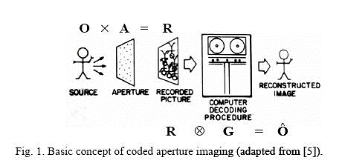
Various imagers in X-ray astronomy
Imagers: image (2D distribution of the object intensity) in, image (2D distribution of count rates) out
Pinhole camera: the smaller the hole, the sharper but dimmer the image
Enlarge the aperture by increasing the number of pinholes: both resolution and area (sensitivity)
Coding: record uniformly or randomly overlapped images
Decoding: correlating with coding matrix
Carron I. Nuit Blanche Blog. Igor Carron, 2008 Jan. Available from: http://nuit-blanche.blogspot.com/.

Slide 14
HXMT’s position-insensitive detectors
1D events
stream
2D image
(Huo et al., 2014)
$ω\left(t\right)$ is the status vector of the detector, as a function of time
$x$ is coordinate vector in celestial coordinate system
$d\left(ω\right)$ is the observed data, as a function of $ω$
$f\left(t,x\right)$ is the temporal-spatial distribution of the object intensity
$p\left(ω,x\right)$ is the response of the detector to a unit source at $x$ while its status vector is $ω$
Temporal-spatial modulation equation,
i.e., a time-dependent, spatial-variant, convolution.

Slide 15
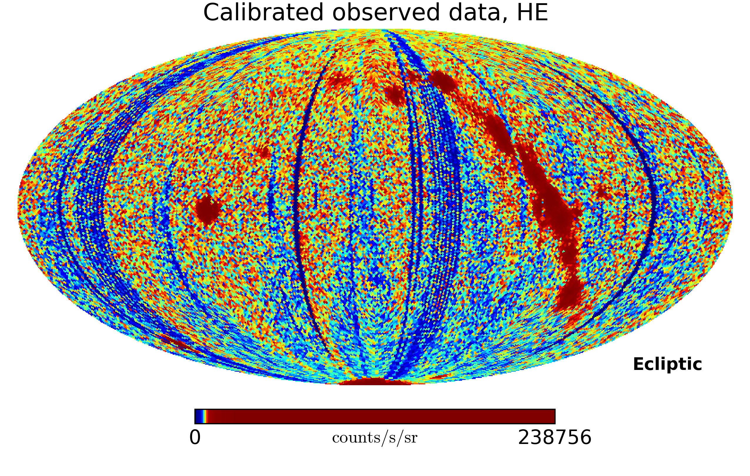
HXMT image reconstruction: events remapping
ToA of event
Interpolation with ACS nodes of events
Incident direction of event

Slide 16
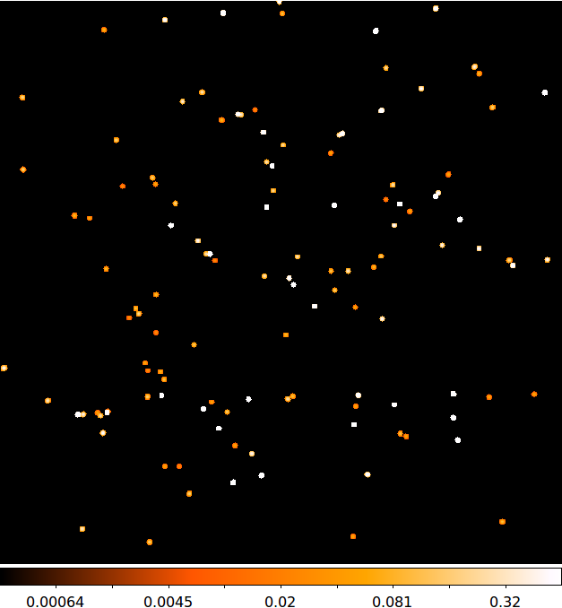
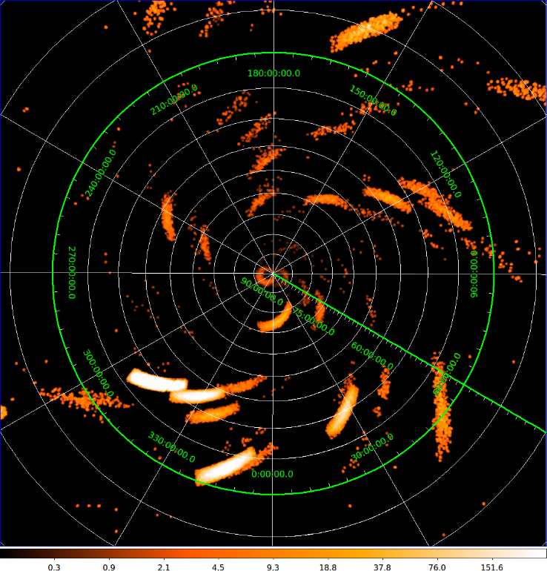
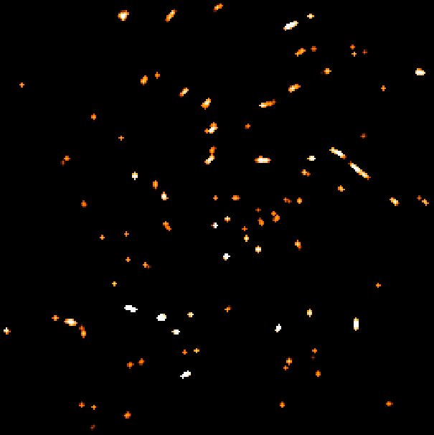
HXMT image reconstruction: deconvolution
Accelerated direct demodulation method:
Physical constrained, to increase stability and convergence.
Accelerated fixed-point iteration based on vector-extrapolation.
Adaptive clustering, to reduce the computational complexity brought by spatial-variance.
(Huo & Zhou, 2013; Huo & Zhang, in prep.)
Object (true image)
scan
Observed data
deconv
Reconst. image

Slide 17
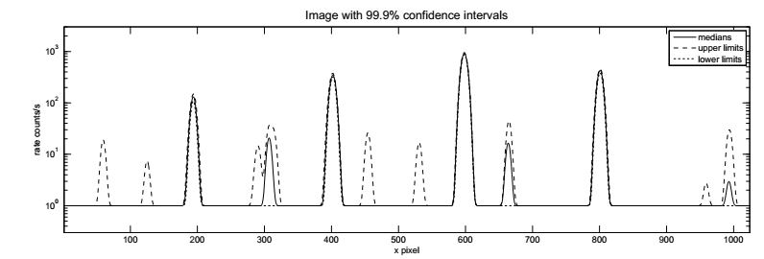
HXMT image reconstruction: background estimation
Uncertainty on background propagates to reconstructed image
Example I: General 1D image reconstruction with estimated background constraint
Upper limits (pixel-wise)
Lower limits
Medians
Effects (mainly on AGN survey):
Sensitivity to faint sources
Fake structures (amplified noise)

Slide 18
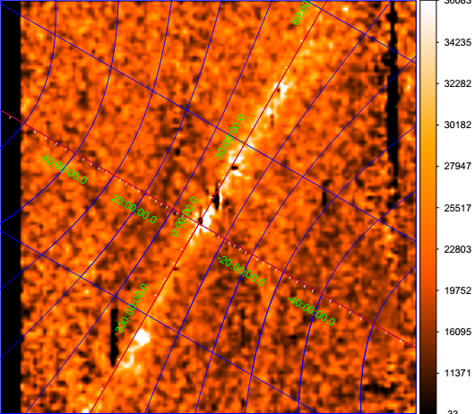
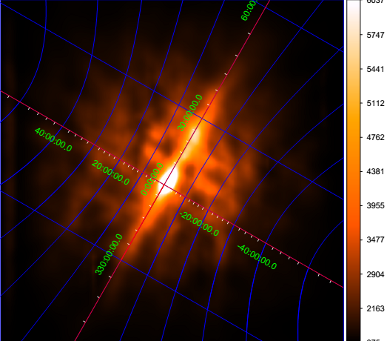
HXMT image reconstruction: background estimation
Example II: Galactic diffuse X-ray background reconstruction
Effects: morphology, energy, and energy spectrum
GXB with other backgrounds
Reconstructed GXB
Residuals!

Slide 19
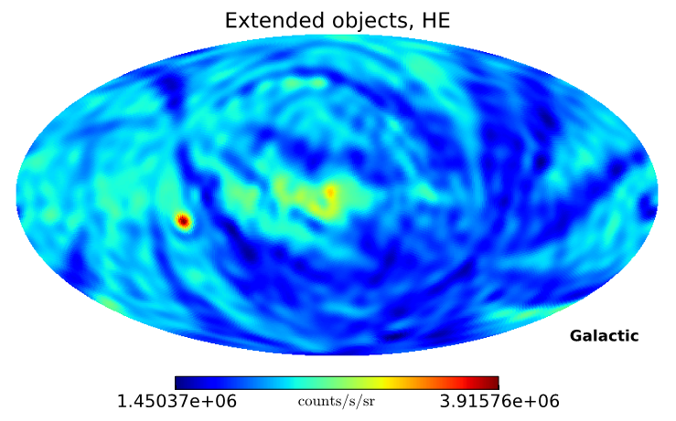
HXMT image reconstruction: background estimation
Example III: Cosmic diffuse X-ray background reconstruction
Crab pulsa
Galactic structures
SAA proton
Effects: energy spectrum, power spectrum

Slide 20
Signal/background discrimination & background estimation

Slide 21
HXMT payloads background Background is vital in image reconstruction
Origins:
Cosmic ray particles, e.g., $γ$, $p^{+}$, $e^{−}$, $e^{+}$, ${He}^{2+}$
Albedo photons, neutrons (reflected by the atmosphere)
Accidental events, e.g., solar flares, intensive proton events from solar activities or geomagnetic activities
South Atlantic Anomaly (SAA) protons
Mechanisms:
Aperture background mainly cosmic X-ray photons and other diffuse X-ray photons that will not blocked by the anti-coincidence detectors (ACD) shield
Leaked background Gamma-ray photons and charged particles that penetrate the ACD shield (e.g., during coincidence time interval of ACD shield, or during the dead time of the main detector)
Delayed background mainly decayed particles that detected by the main detector after anti-coincidence time interval ends, e.g.,
Materials of payloads were exited by trapped protons when passing SAA, secondary particles emitted continuously even after the satellite left SAA.

Slide 22
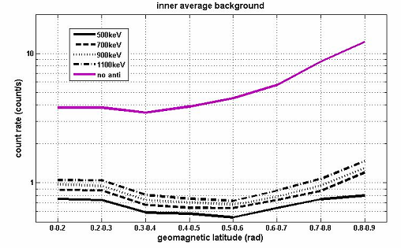
HXMT shields To reduce background online
Satellite panels (passive shielding)
ACDs (active shielding)
Collimator (passive shielding)
Main detector
Field of view
w/o ACD
w/ ACD
X-axis: geomagnetic latitude
Y-axis: background rate
(Lu 2013)

Slide 23
Delayed background Background we can’t eliminate
3 factors:
< 90 min: background rate varies with geomagnetic latitude.
Long-term: background rate bursts while passing SAA
Background rate variation modulated by particle transport process in satellite and payloads materials

Slide 24
Background modelling To “capture” and estimate background offline
Cosmic diffuse X-ray background
Intensity distribution: Earth blocking; isotropic
Energy spectrum: broken power law
Albedo photon: [CR + atmosphere] -> meson -> decay; electronic bremsstrahlung
Intensity depends on zenith angle & atmosphere depth
Energy spectrum: PL
Albedo neutron [measured by various low-orbit neutron probes]
Intensity depends on zenith angle
Energy spectrum: PL
Primary CR particles [measured by AMS]
Energy spectra: solar activity and geomagnetic field stiffness corrected PL models
Factors:
Environment background
Solar activity
Geomagnetic field
Attitude of the spacecraft

Slide 25
Signal/background discrimination
Current approach: online anti-coincidence detector shield Adjustable parameters:
anti-coincidence time interval
Increase: lower background rate (higher background rejecting rate), and loss on signal (lower signal accepting rate)
Decrease: lower background rejecting rate and higher signal accepting rate
ACD energy threshold
Fortunately, we can download all the events from the satellite…
With main detector information: pulse width, energy channel, ToA
ACD flags
Attitude control system (ACS) module information -> exposure to CR, solar activities and geomagnetic activities
Space environment monitor (SEM) -> real-time measurement on ambient background level
Open question: an offline, but better discrimination approach?

Slide 26
Background estimation
Current approach:
Environment background: SEM, providing input to offline simulations
Aperture background: solving measurement equations, since there are detectors with different apertures onboard at each energy band.
Leaked background and delayed background:
Prediction based on offline simulations
For HE: a dedicated blocked detector measures non-aperture background only
Open questions:
Drawbacks of the current approach?
Possible improvements or alternatives?
Feedback to signal/background discrimination, environment background input, to implement a closed-loop estimation

Slide 27
Summary

Slide 28
Summary
HXMT is the first planned Chinese space telescope mission.
It will perform an all-sky survey at 1 keV – 250 keV (hard X-ray) band, a series of deep scans on small regions, and pointed observations.
It’s expected that various types of AGNs will be detected, short-scale time-varying X-ray objects will be studied and X-ray transients such as AXP, SGR will be monitored by this telescope.
HXMT images are reconstructed from the observed data with offline data analysis.
All events with as mush attributes as possible are downloaded from the satellite before reconstruction.
Background discrimination and estimation are vital to image reconstruction hence the science objectives of this mission.
HXMT background
mainly arises from the environment, e.g., primary CR particles, albedo photons & neutrons, solar and geomagnetic activities induced events, etc.
Anti-coincidence detectors shield most of the charged particles.
Due to the particle transport process occurs in the satellite and payloads material there is delayed background that can not be shielded.
By the current design and implementation
Signal/background discrimination relies on online ACD shielding and flagging.
Time-varying background rate is predicted by offline simulation or measured by dedicated detector.

Slide 29
About my visit here…
Research interests：
Alternative signal/background discrimination based on multivariate analysis, starting from the TMVA package, hopefully could finish with a dedicated offline software trigger for HXMT, to improve on both signal acceptance and background rejection.
Closed-loop background estimation based on Kalman filtering.
I’m also working on image reconstruction/denoising/processing algorithms, fast large-scale linear equation system solver based on machine learning, GPGPU computing, etc.
Dr. HUO Zhuoxi
E-Mail: huozx [at] tsinghua.edu.cn
Office: Rm. 200, Building 208

