Slide 1
Influence des états de surfaces des miroirs sur la génération de rayons gamma
Dans le cadre d’ELI-NP-GBS

Slide 2
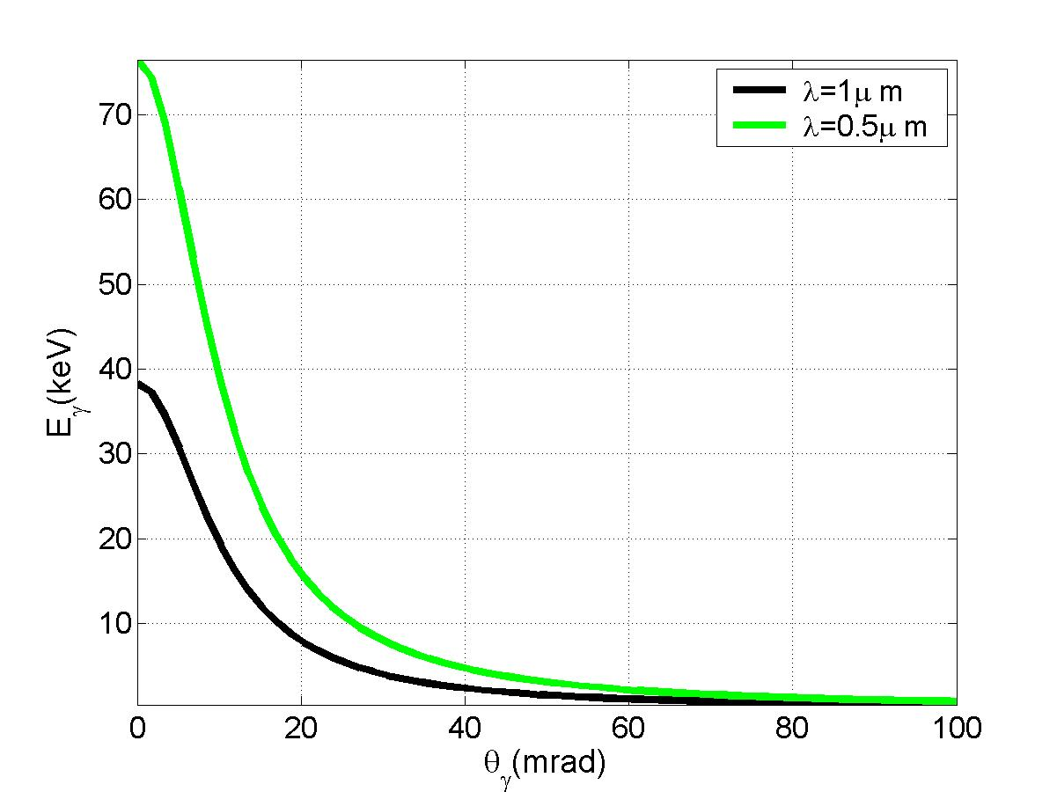
Production of the gamma-beam
Compton Scattering
Gamma-ray production
Collimation
Energies selection
+
E_{L}
Laser
gamma : E_{γ} = f(θ)
Electron
E_{e}
ϕ
θ
(scattered electron)
E_{e} = 50 MeV
E_{γ} (keV)
θ (mrad)

Slide 3
Configuration of the gamma-ray beam source
2 High power Lasers (3.5ps @515 nm, 100Hz, 200mJ)
= State of the Art
LINAC multi-bunch at 100Hz
(space, cost and tunability)
e⁻
photons
Laser Beam Circulator (recirculateur)
(efficiency, “robustness”)
gammas
Gamma-beam specifications:
Energies γ (E_{γ}) : 0.2 – 19.5 MeV
Bandwidth (ΔE/E) : <0.5%
Spectral density (flux - TASD): >5000 γ/(s.eV)
Linear polarization: >95%

Slide 4
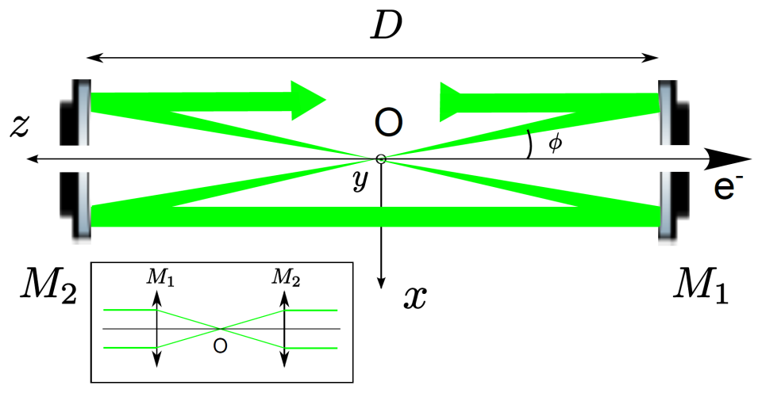
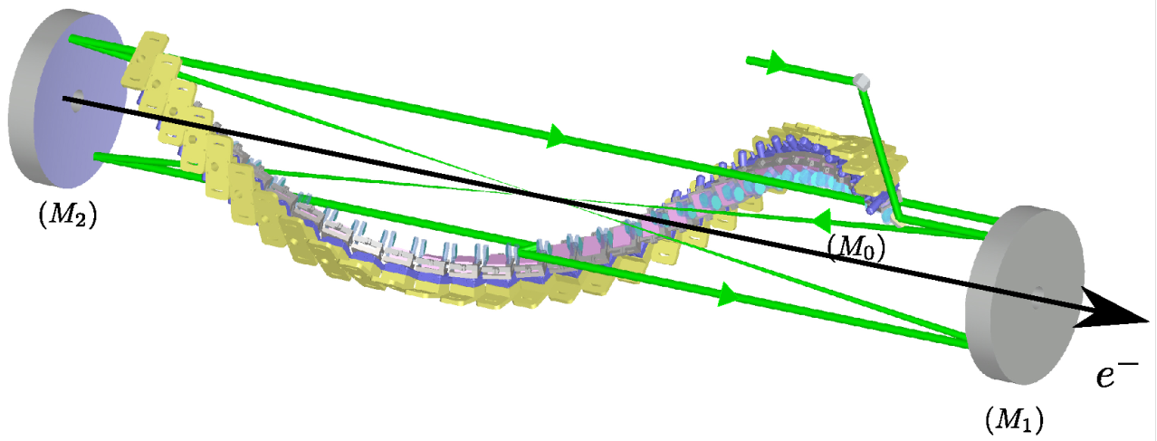
Optical system: laser beam circulator (LBC)
Circulator principle
Parameters = optimized on the gamma-ray flux
2 high-grade quality parabolic mirrors
Aberration free
Mirror-pair system (MPS) per pass
Synchronization
Optical plan switching
Constant incident angle = small bandwidth
Laser power = state of the art
Angle of incidence (φ = 7.54°)
Waist size (ω₀ = 28.3μm)
Number of passes = 32 passes
30 cm
2.4 m

Slide 5
Beam profile inside the Laser Beam Circulator (LBC)
Beam profile modification come from:
Alignment (negligible)
Input beam (considered perfect)
Surface defects

Slide 6
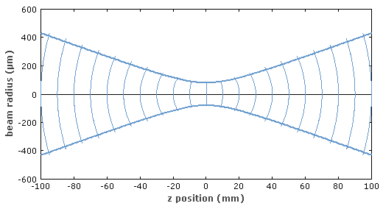
Gaussian Beam from laser
Cavity
Modelock

Slide 7
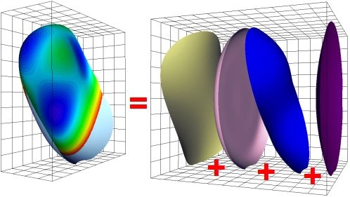
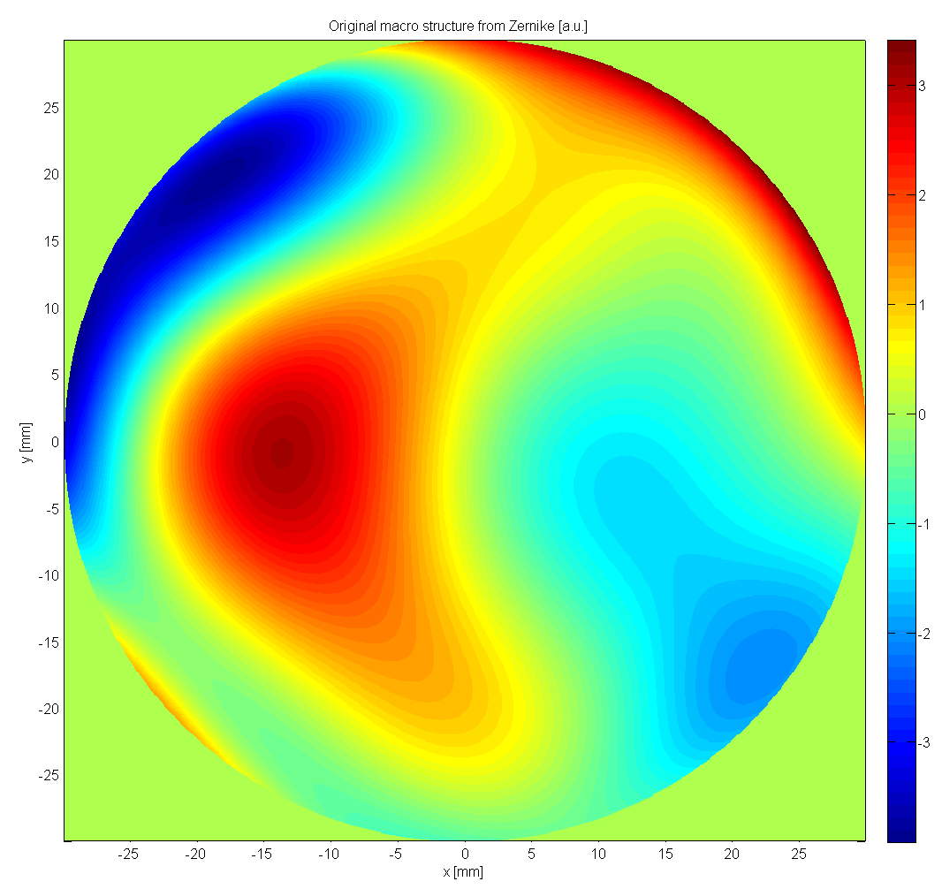
Zernike decomposition
Orthonormal base

Slide 8
Optical quality and beam profile
Surface deformations
IP beam profile
Simulated with proven method (same as Virgo)
Parabolic mirrors
MPS mirrors
Difficult to relate surface quality to gamma-ray flux
Price of optics !
Good
Bad
System with nonlinear behavior
=> everything have to be simulated
Good
Bad

Slide 9
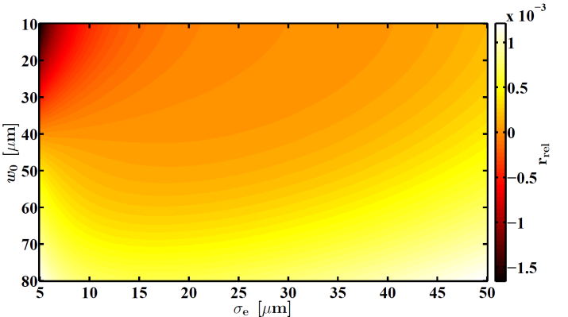
Time Average Spectral Density (TASD) calculation
TASD = N_{γ}/(s.eV) = gamma-ray flux in defined bandwidth
Where: ΔE_{γ} the gamma-ray linewidth, σ the Compton cross-section and
L the luminosity ➔ Spatio-temporal overlap
Constant
For two Gaussian beam with no divergence
For any laser intensity beam profile
If I_{l} Gaussian
Relative error on
no divergence approximation

Slide 10
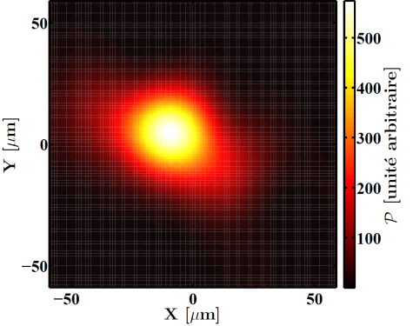
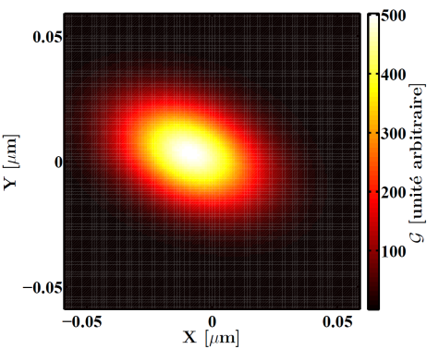
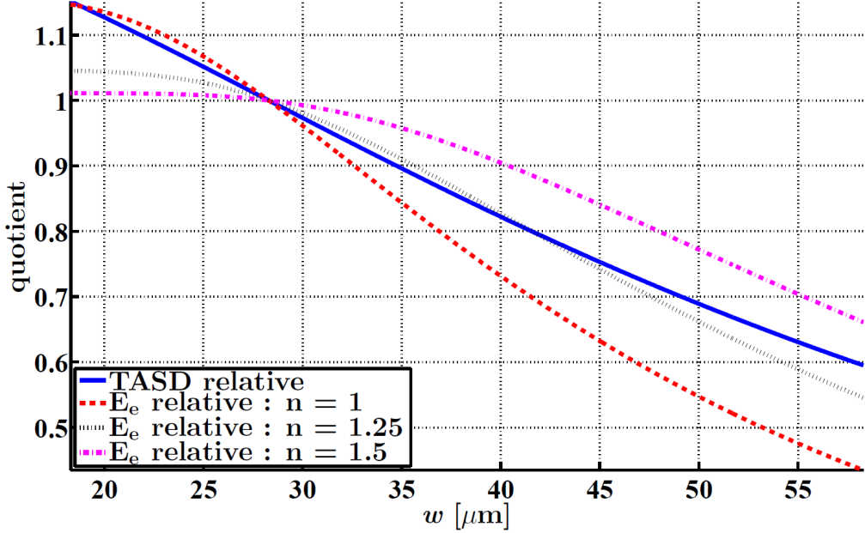
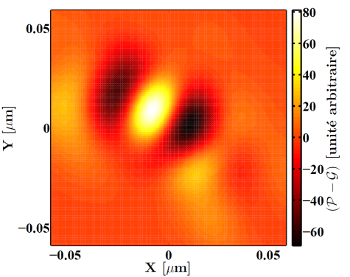
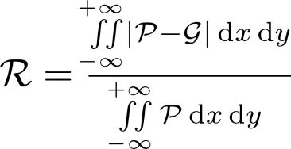
Qualitative estimators
Residual Gaussian beam profil (R)
Encercled energy (E_{e})
P
G
E_{e} = P/G, where (r = n*w₀)
r

Slide 11
Power Spectral Density
sample
PSD = |TF|^2
Direct space =>
Frequency space

Slide 12
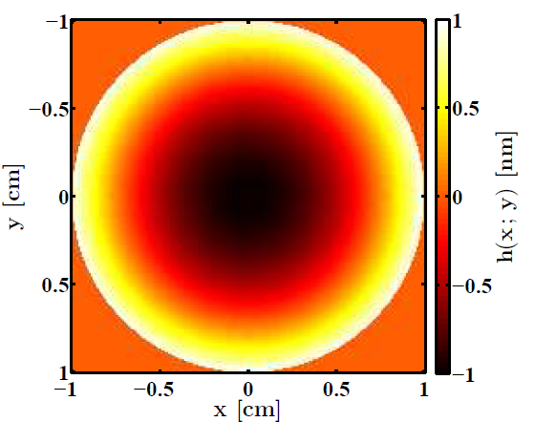
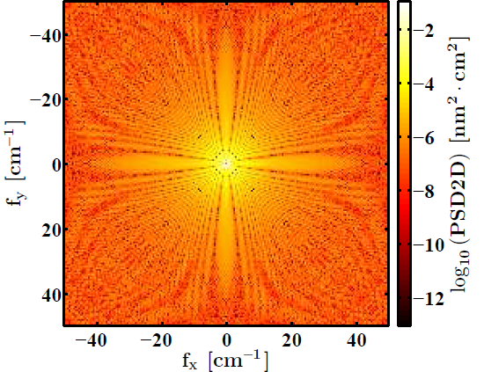
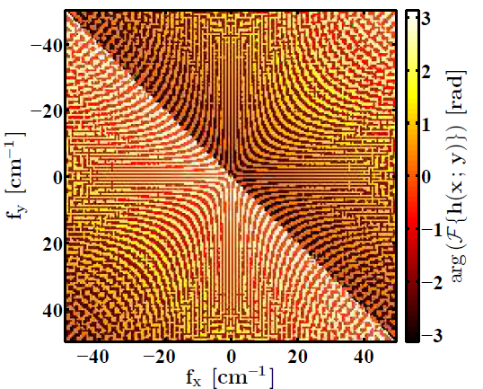
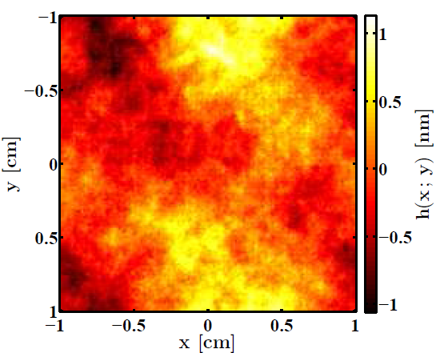
Macro-structure VS micro-structure
Initial maps: Focus
PSD in 2D
Reconstruction with
Random phase
Phase of the FFT
Simulated maps
➔ PSD not enough to define surface defects

Slide 13
Surface defects
=
Surface defects
Zernike
PSD
+
Surface defects are Polisher dependant
Polishers have process to compensate macro + micro structures
Macro-structure
Micro-structure

Slide 14
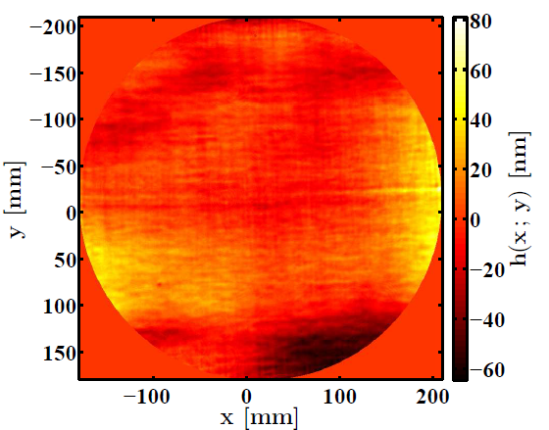
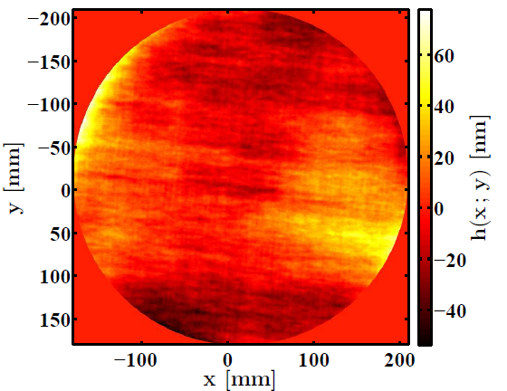
Surface defects simulation
Measured surface defects
Simulated surface defects
GOOD agreements
When using both the micro- and macro-structures

Slide 15
Simulation chain
Accurate propagation code:
BSP
FFT
slow
Results:
Beam profile at the IP
Beam position at the IP
Surface defects map for considered mirrors
Code V
Matlab
Matlab
Long and difficult chain ➔ Code V limits reach
Estimators + TASD

Slide 16
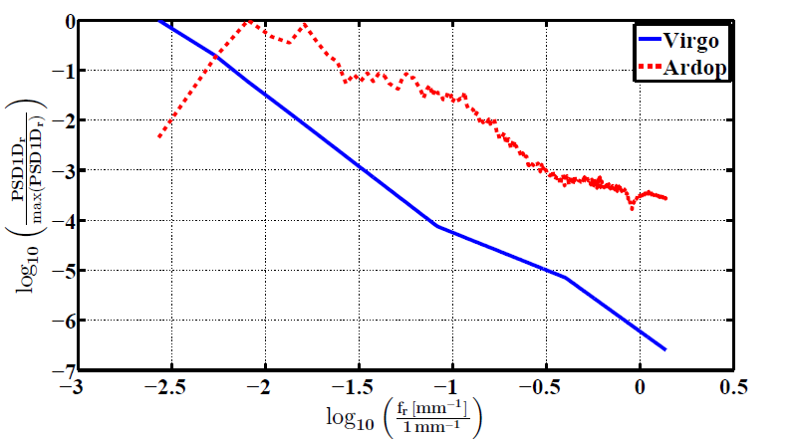
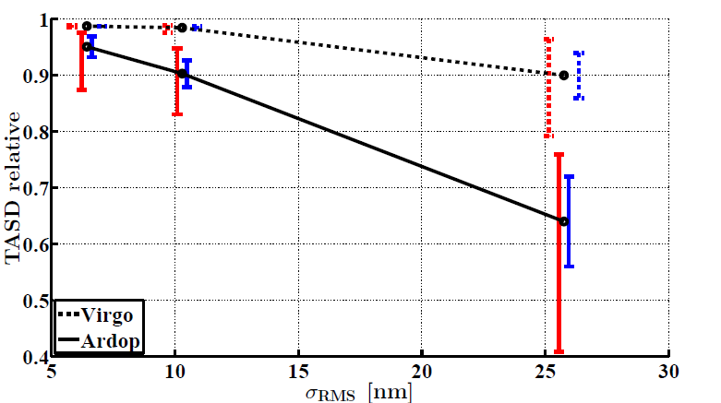
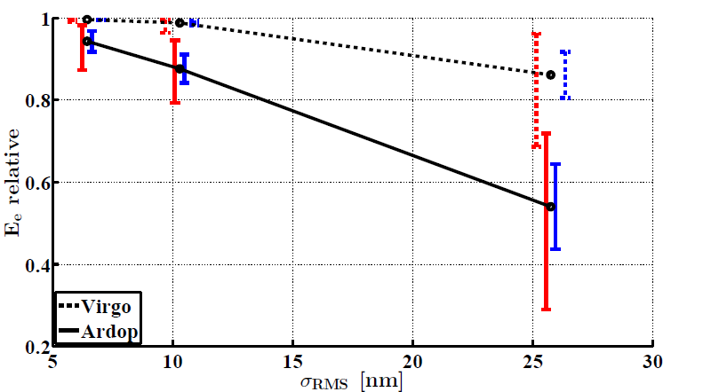
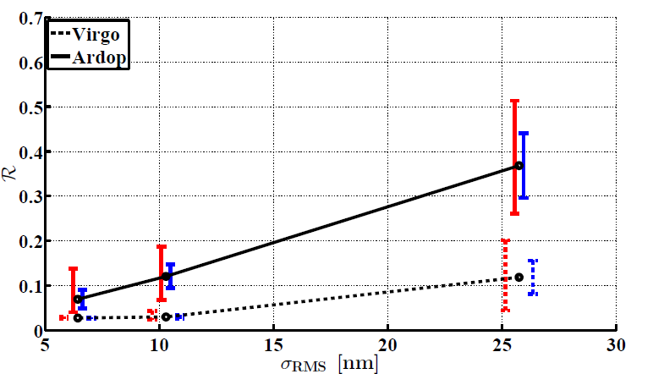
Results on parabolic reflectors
requiered
PSD used

Slide 17
Micro- and macro-strutures influence on beam profile for MPS mirrors
Macro-stucture only
Micro-stucture only
Same RMS at λ/100 ≈ 5nm, between (0-1 mm⁻¹)
Higher influence of the macro-structure
(opposite of parabolic mirrors)

Slide 18
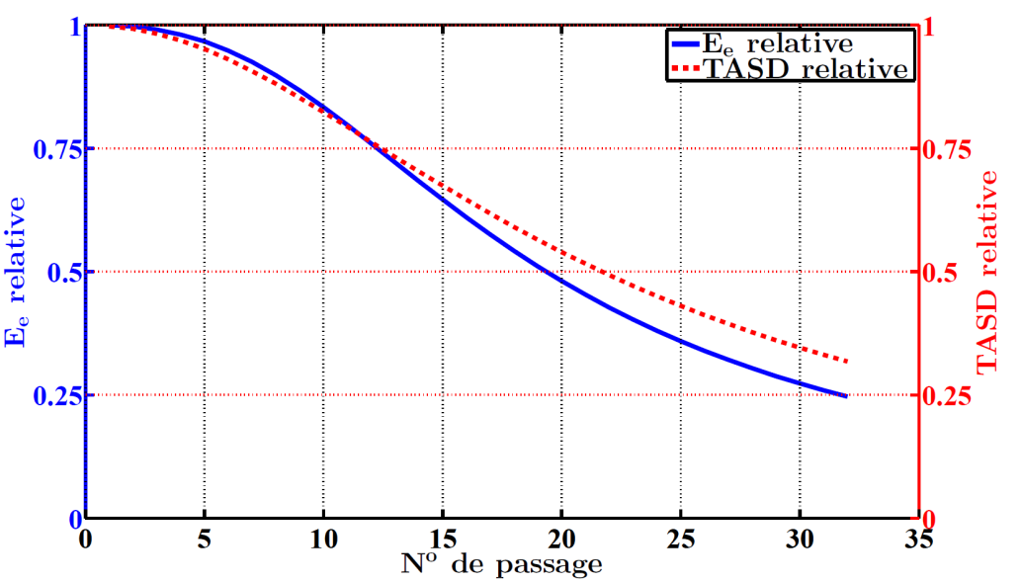
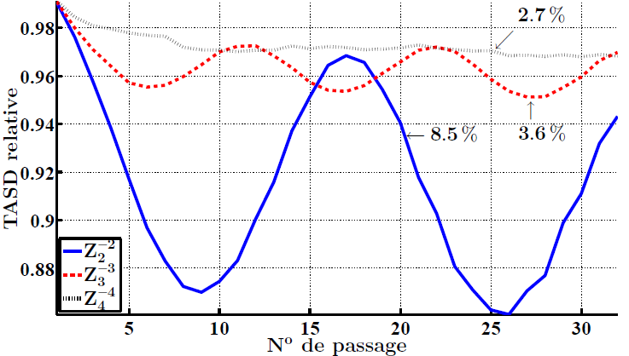
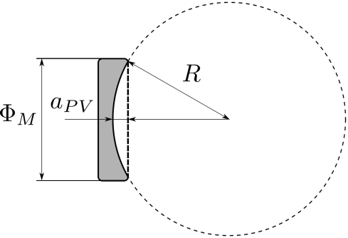
Fast calculation with constant defect
ABCD matrix can be used
PV = λ/20 ≈ 26nm for MPS only
➔ Accumulation effects
Focus PV = λ/100 ≈ 5nm for MPS only
➔ over State of the Art

Slide 19
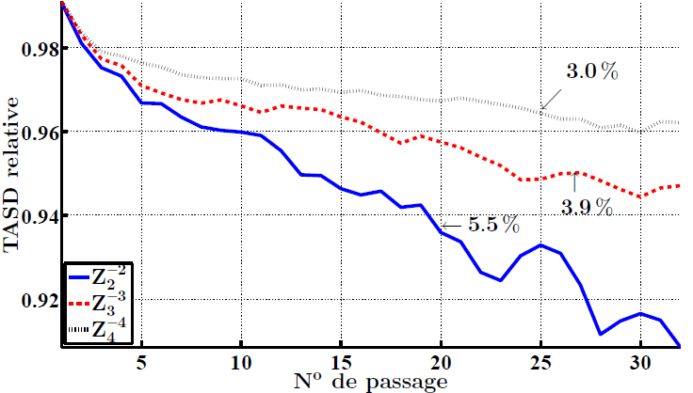
Randomization effect

Slide 20
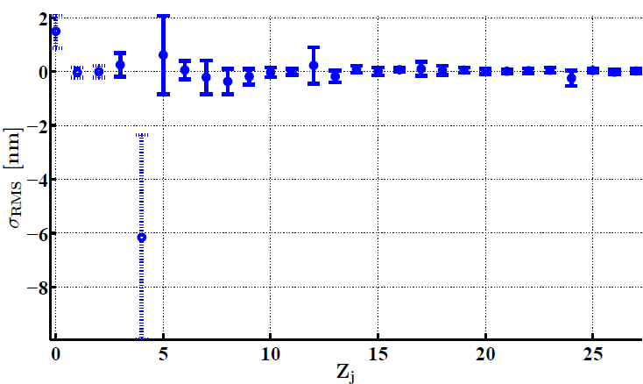
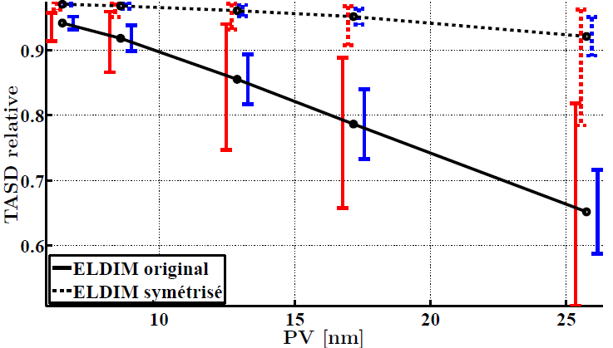
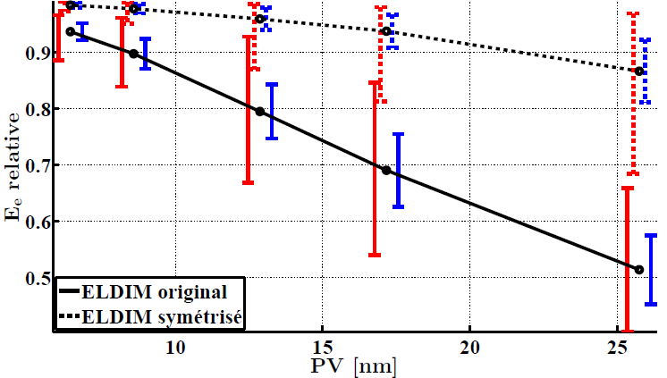
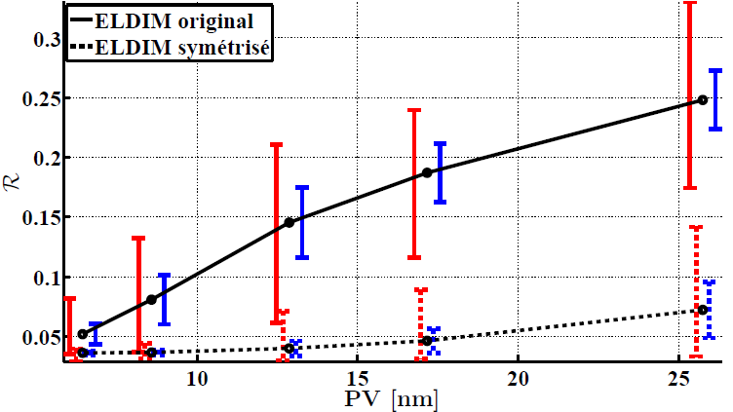
Results on MPS mirrors
requiered
Zernike used
State of the Art

Slide 21
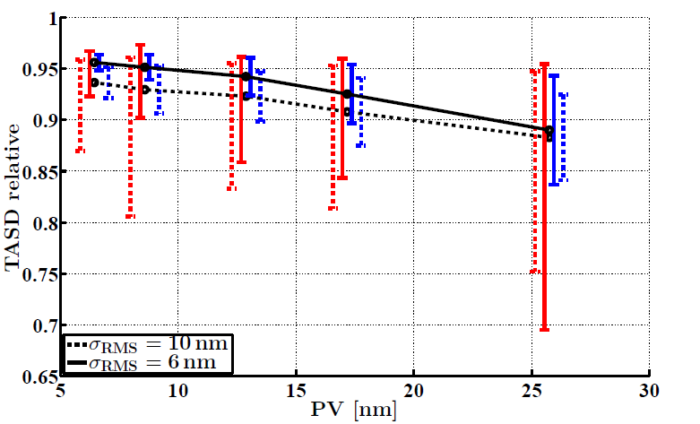
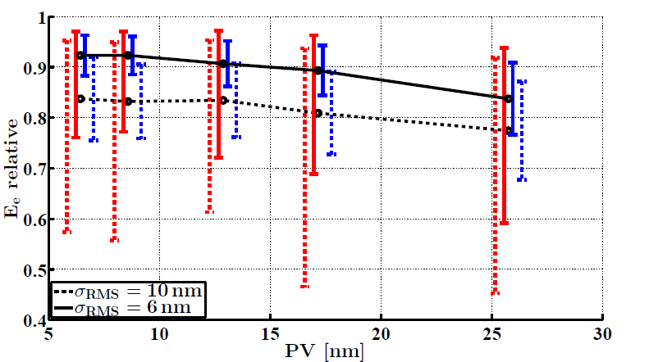
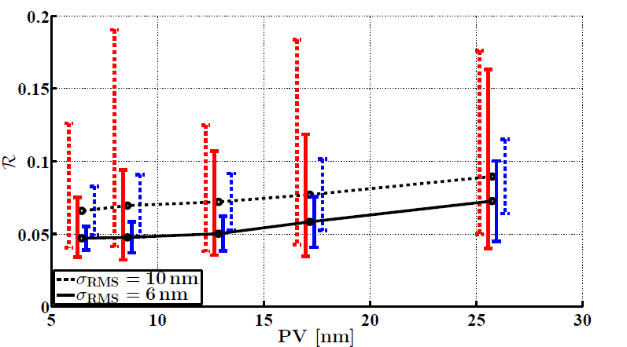
Overall results (all mirrors considered)
requiered

Slide 22
Thank you for your attention

