Slide 1
Designing of e⁻ Beam Test Facility at ThomX
Andrii Pastushenko

Slide 2
Outline
ThomX project
Re-matching of TL
ThomX upgrade: e⁻BThX

Slide 3
ThomX project
ThomX is a light source based on CBS (Compton Back Scattering).
Machine is designed to fulfill two goals:
  Maximize the average X-ray flux
  Provide a compact, reliable and tunable source which can operate in museums, hospitals, etc.
Includes injector, collector ring, laser and Fabry-Perot resonator as shown on Fig.1.
Fig.1.Schematic diagram of ThomX experiment

Slide 4
ThomX machine layout
We are interested only in beam dynamic along the machine. Whole machine can be divided into 3 parts:
TL (transfer line) – we understand one that starts at the end of linac
Collector ring
Extraction line
Electron part of the machine include:
Dipole magnets to steer the beam along the beampipe.
Quadrupole magnets to control beam transverse spread.
Sextupoles to correct chromaticity

Slide 5
ThomX machine: elements overview
Dipole magnets
Quadrupole magnets
Magnet type | Dipole | Injection dipole | Septum
Number | 4 + 8 | 2 | 1
Bending angle | 45° | 9.69° | 4.59°
Bending length | 0.276 m | 0.2 m | 0.126 m
Gap | 40 mm
Pole faces rotation angles, φ_{b}/φ_{e} | 0°/0° | 0°/9,69° | 0°/4.59°
Fringe field integral | 0.348 | 0 | 0
Magnet type | Quadrupole
Number | 7 + 24 + 2
Strength | -18 ÷ 18 T/m
Length | 0.15 m
Gap | 41 mm
Sextupole magnets
Magnet type | Quadrupole
Number | 6
Strength | -0.124*10⁸ ÷ 0.124*10⁸ T/m
Length | 60 mm
Gap | 42 mm

Slide 6
ThomX machine layout: ring
Ring parameters | value
Circumference | 16.8m
Nominal energy | 50 MeV
Betatron tunes, n_{x}/n_{z} | 3.17/1.74
Beta max, β_{x}/β_{z} | 11/11 m
Bunch storing time | 20 ns
Beam is injected and extracted using fast injection method. For this purpose 2 kickers and septum is installed in the ring.
Proper extraction is important here because of big experimental noise!

Slide 7
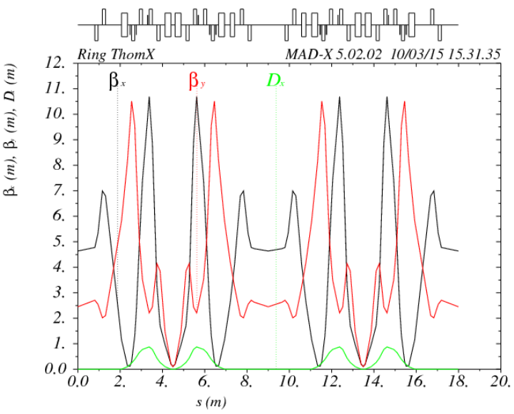
Re-matching of TL
Starting point for this calculations is injection point or middle of the septum.
Inside the ring we search for a periodical solution.
Values obtained here we use as the final condition for TL as well as initial for extraction line.
IP
Fig.2.Twiss parameters for the ring calculated in MadX

Slide 8
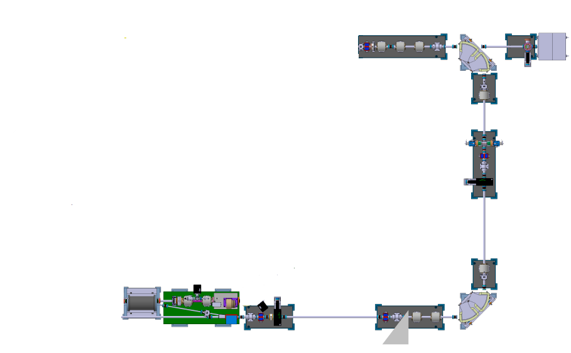
Re-matching of TL
From linac
TL parameters | value
Length | 13.5m
Nominal energy | 50 MeV
Phase advance, n_{x}/n_{z} | 4.48/0.6
Beta max, β_{x}/β_{z} | 39/74 m

Slide 9
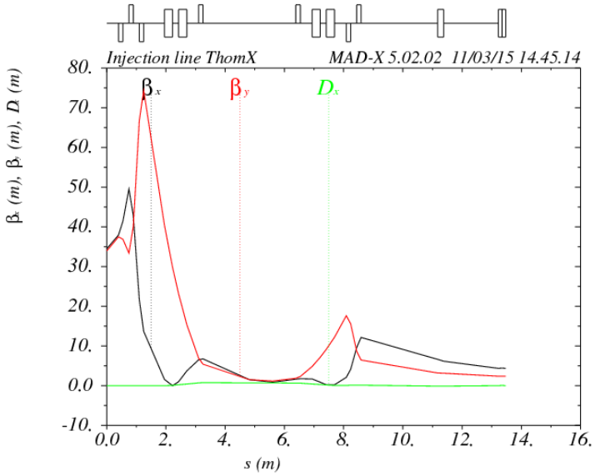
Re-matching of TL
Initial conditions for TL is values at the exit of the linac and are following:
β_{x} = β_{z} = 34 m
α_{x} = α_{z} = - 4.2
The ring and TL are matched to have equal beta and alpha functions at septum position using Madx. This values are obtained from previous calculations and are following:
β_{x} = 4.64
β_{z} = 2.45
α_{x} ~ 0
α_{z} ~ 0
Fig.4.Twiss parameters for the TL calculated in Madx

Slide 10
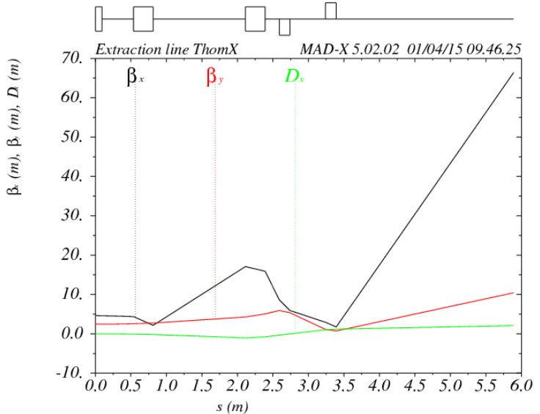
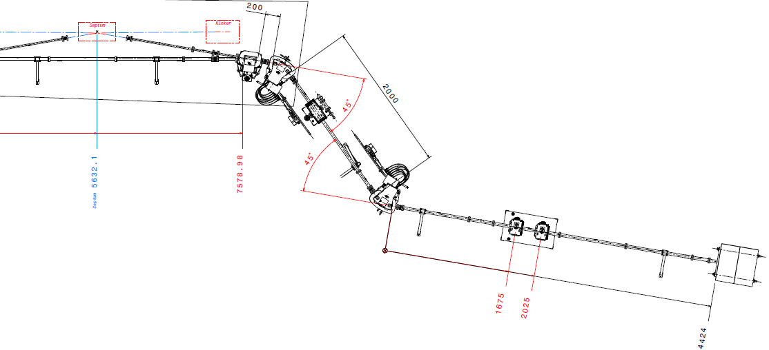
ThomX machine layout: extraction

Slide 11
ThomX machine upgrade: e⁻BThX
There is growing interest for use of electron beams in the energy range of few tens of MeV up to hundreds of MeVs.
Biomedical:
New radiotherapy approaches
This large multiplicity range requires a large flexibility of the beam parameters in this kind of Beam Test Facilities and many different diagnostics devices.
e⁻ line
Other
Detector developments
Space:
multipactor
Electron Beam Test Facility at ThomX (e⁻BThX)

Slide 12
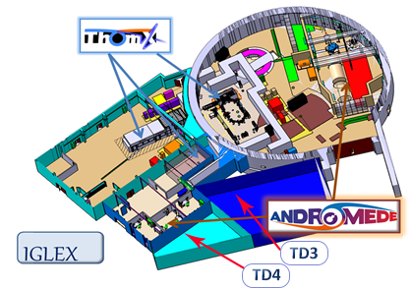
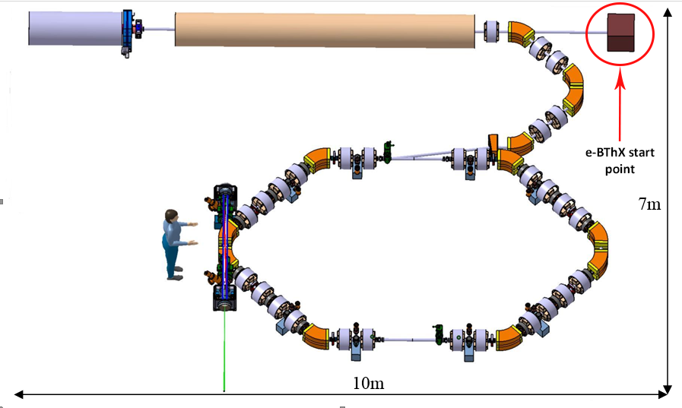
ThomX upgrade: e⁻BThX
e⁻BThX is supposed to start at the end of a straight section of TL after injection from linac as shown on Fig.4
Fig.5.Experimantal halls
The beam will be transported until the halls TD3 and TD4 as shown on Fig.5.
Fig.4.Red cyrcle indicate where the e⁻BThX starts

Slide 13
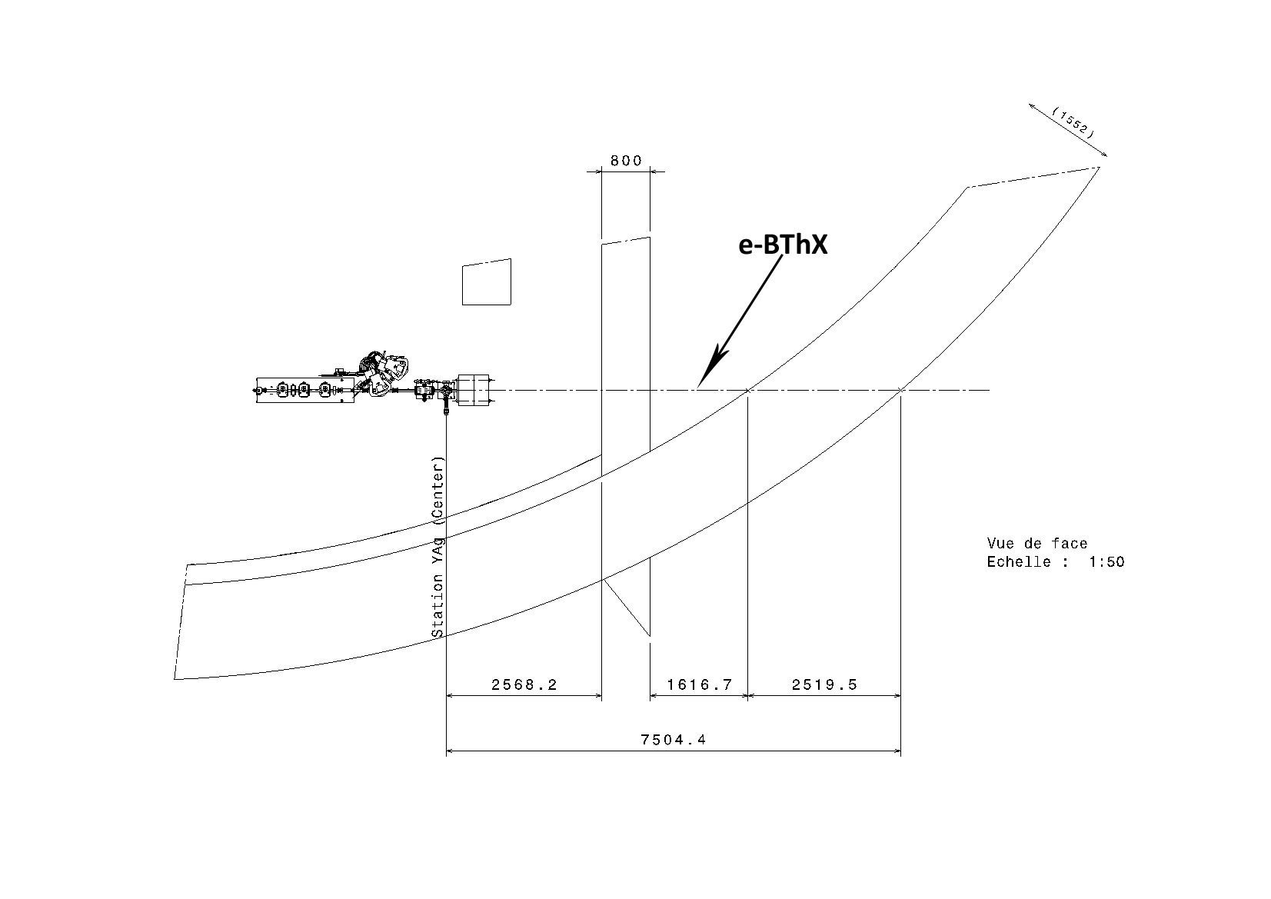
ThomX upgrade: e⁻BThX
In this case avoiding any beam losses while transferring beam through shielding walls is crucial.
Two e-beam experimental lines are being proposed, the first one will be a spectrometer line and the second one a multidisciplinary line.
We will concentrate on optics calculations after exit of the TL and before entering the experimental halls, on that part that is shown on Fig.6.
Fig.6.The beam transfer line from exit of the linac until the entrance of experimental halls TD3 and TD4

Slide 14



ThomX upgrade: e⁻BThX
For this part of the line we have limits on beta function values because of the size of beam pipe. Limits are following:
β_{x} < 70 m
β_{z} < 30 m
The beam pipe goes through 2 walls we do not much possibilities to place focusing elements there. One of the solution is to place them before and after the walls.
We consider 3 options:
1) triplet and doublet:
1) two triplets:
1) two doublets:
Existing triplet
Forbidden area
In the calculations we take the same quads as in ThomX machine.

Slide 15
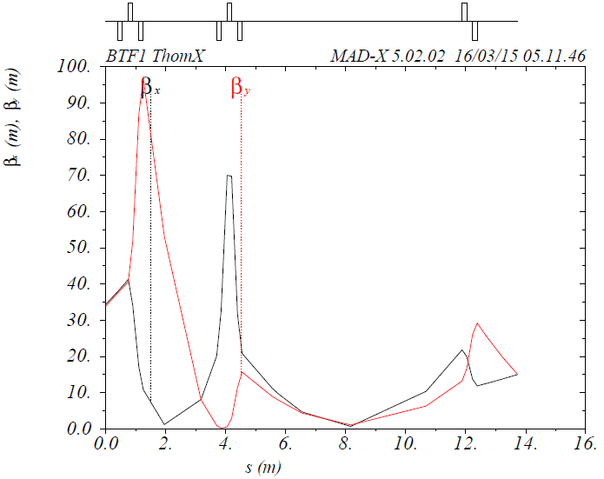
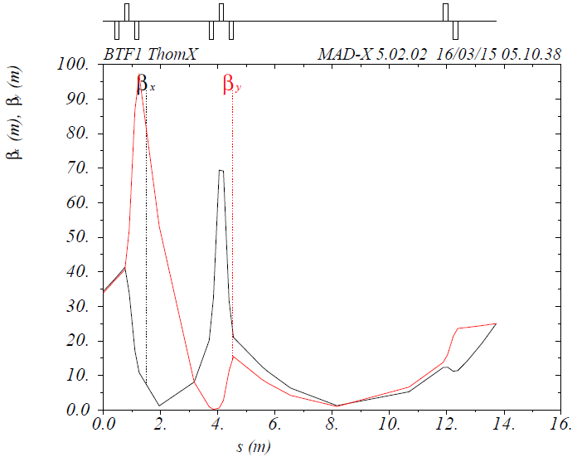
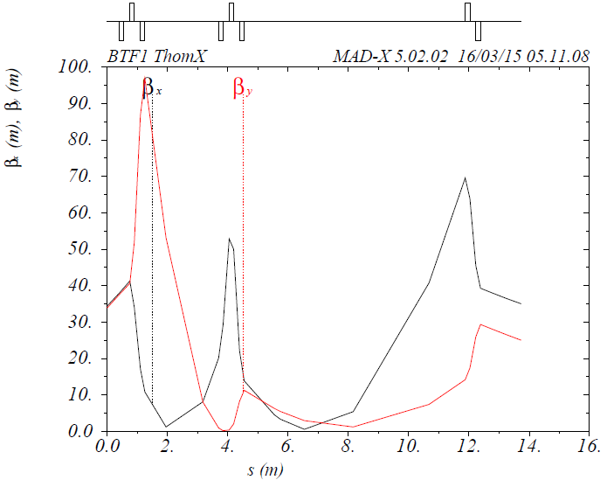
ThomX upgrade: e⁻BThX
1)First option – quads triplet and doublet
Some of the Madx output plots with different final conditions
For this option, iteration over final conditions was mad to see if such configuration fulfill all requirements.

Slide 16
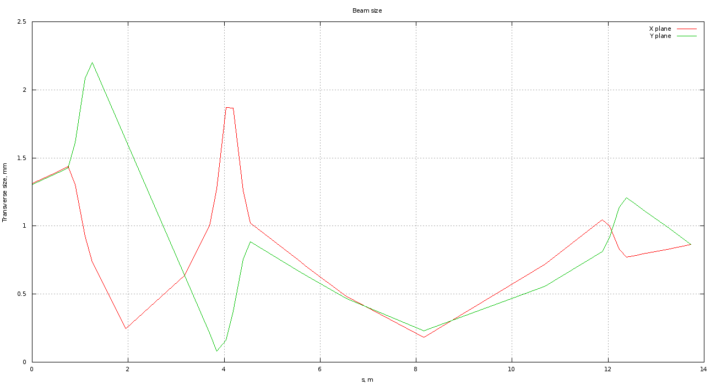
ThomX upgrade: e⁻BThX
1) triplet and doublet
Beam envelope for the final conditions betx/bety = 15/15 m
Vertical plane
Horizontal plane

Slide 17
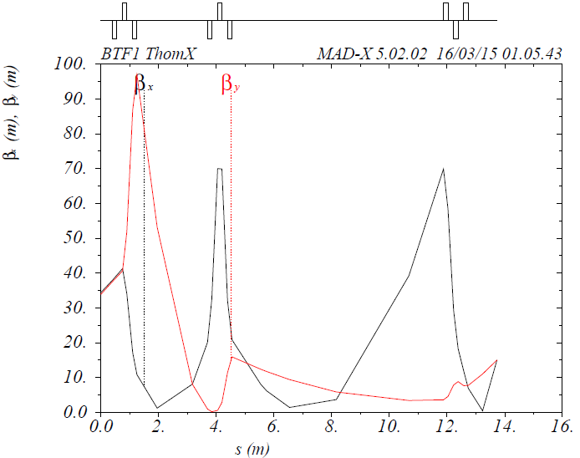


ThomX upgrade: e⁻BThX
2) Two quadrupoles triplets
Some MadX output for triplet-triplet configuration for different final conditions
On the plots we see that this configuration is not as good as previous one but fulfills all requirements

Slide 18
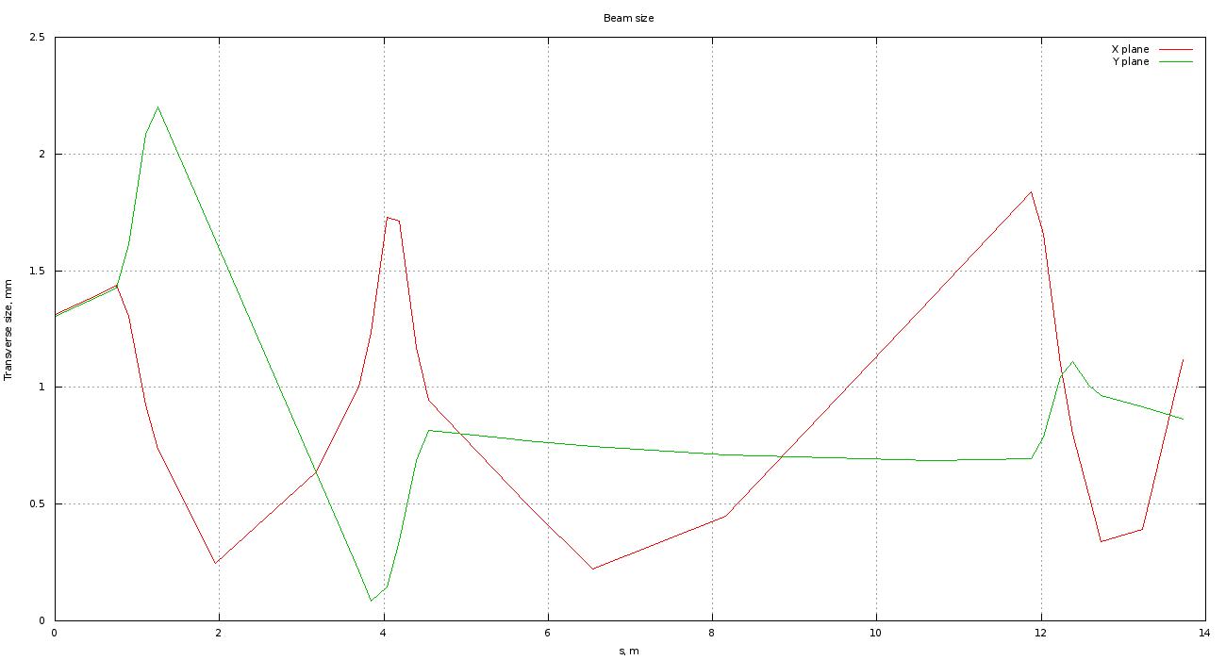
ThomX upgrade: e⁻BThX
2) Two quadrupoles triplets
Beam envelope sample for final betx/bety = 25/15 m:
Maximum beam size is:
2.2 mm - x plane
1.8 mm - z plane
Vertical plane
Horizontal plane

Slide 19
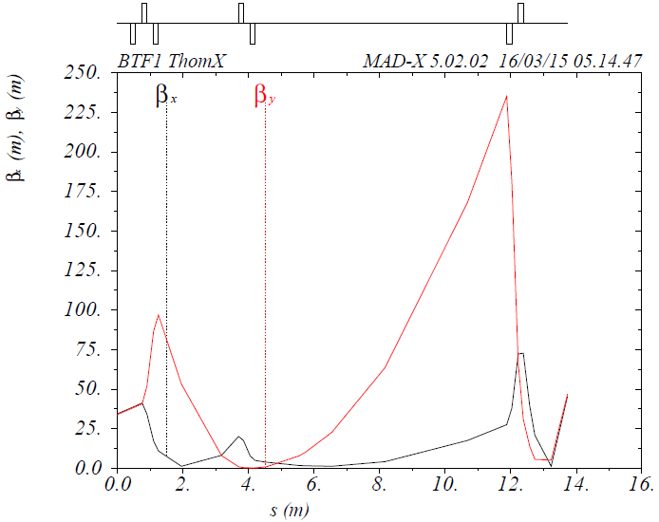
ThomX upgrade: e⁻BThX
3)Two quadrupole doublets
As we see on this plot, 2 doublets is not enough to fulfill all constraints we defined, so we cant use it.

