Slide 1


FCC summary report
23-27 March 2015
Washington

Slide 2
Motivation
European Strategy for Particle Physics 2013:
  “…to propose an ambitious post-LHC accelerator project….., CERN should undertake design studies for accelerator projects in a global context,…with emphasis on proton-proton and electron-positron high-energy frontier machines..…”
US P5 recommendation 2014:
  ”….A very high-energy proton-proton collider is the most powerful tool for direct discovery of new particles and interactions under any scenario of physics results that can be acquired in the P5 time window….”

Slide 3
Goal of FCC Study
Conceptual Design Report
By end 2018
In time for next
European Strategy Update

Slide 4
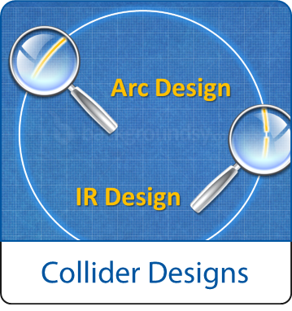
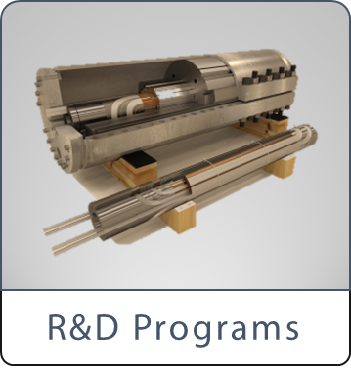
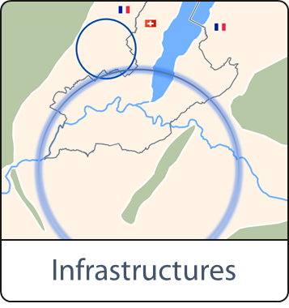
Scope: Accelerator & Infrastructure
FCC-hh: 100 TeV pp collider as long-term goal
→ defines infrastructure needs
FCC-ee: e⁺e⁻ collider, potential intermediate step
FCC-he: integration aspects of pe collisions
Push key technologies
in dedicated R&D programmes e.g.
16 Tesla magnets for 100 TeV pp in 100 km
SRF technologies and RF power sources
Tunnel infrastructure in Geneva area, linked to CERN accelerator complex
Site-specific, requested by European strategy

Slide 5

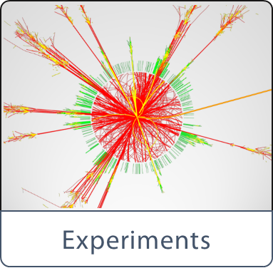
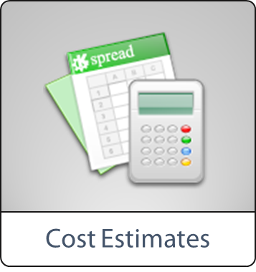
Scope: Physics & Experiments
Elaborate and document
- Physics opportunities
- Discovery potentials
Experiment concepts for hh, ee and he
Machine Detector Interface studies
Concepts for worldwide data services
Overall cost model
Cost scenarios for collider options
Including infrastructure and injectors
Implementation and governance models

Slide 6
CERN Circular Colliders + FCC
1980
1985
1990
1995
2000
2005
2010
2015
2020
2025
2030
2035
20 years
Constr.
Physics
LEP
Design
Proto
Construction
Physics
LHC
Design
Construction
Physics
HL-LHC
Future Collider
Design
Proto
Construction
Physics

Slide 7



Study time line towards CDR
2014 |  |  |  | 2015 |  |  |  | 2016 |  |  |  | 2017 |  |  |  | 2018
Q1 | Q2 | Q3 | Q4 | Q1 | Q2 | Q3 | Q4 | Q1 | Q2 | Q3 | Q4 | Q1 | Q2 | Q3 | Q4 | Q1 | Q2 | Q3 | Q4
Study plan, scope definition
Explore options
“weak interaction”
conceptual study of baseline “strong interact.”
FCC Week 2015:
work towards baseline
FCC Week 17 & Review
Cost model, LHC results
→ study re-scoping?
FCC Week 2016
Progress review
Elaboration,
consolidation
FCC Week 2018
→ contents of CDR
Report
CDR ready

Slide 8
Focus on Study-Phase 2
2014 |  |  |  | 2015 |  |  |  | 2016 |  |  |  | 2017 |  |  |  | 2018
Q1 | Q2 | Q3 | Q4 | Q1 | Q2 | Q3 | Q4 | Q1 | Q2 | Q3 | Q4 | Q1 | Q2 | Q3 | Q4 | Q1 | Q2 | Q3 | Q4
FCC Week 2015: work towards baseline
conceptual study of baseline “strong interact.”
FCC Week 2016
Progress review
Converge on solid and agreed baseline scenarios
Launch technology R&D at international level
Assure coherence between study branches
CDR ready

Slide 9
Key Parameters FCC-hh
Parameter | FCC-hh | LHC
Energy [TeV] | 100 c.m. | 14 c.m.
Dipole field [T] | 16 | 8.33
# IP | 2 main, +2 | 4
Luminosity/IP_{main} [cm⁻²s⁻¹] | 5 - 25 x 10³⁴ | 1 x 10³⁴
Stored energy/beam [GJ] | 8.4 | 0.39
Synchrotron rad. [W/m/aperture] | 28.4 | 0.17
Bunch spacing [ns] | 25 (5) | 25

Slide 10
Key Parameters FCC-ee
Parameter | FCC-ee |  |  | LEP2
Energy/beam [GeV] | 45 | 120 | 175 | 105
Bunches/beam | 13000- 60000 | 500- 1400 | 51- 98 | 4
Beam current [mA] | 1450 | 30 | 6.6 | 3
Luminosity/IP x 10³⁴ cm⁻²s⁻¹ | 21 - 280 | 5 - 11 | 1.5 - 2.6 | 0.0012
Energy loss/turn [GeV] | 0.03 | 1.67 | 7.55 | 3.34
Synchrotron Power [MW] | 100 |  |  | 22
RF Voltage [GV] | 0.3-2.5 | 3.6-5.5 | 11 | 3.5
Dependency: crab-waist vs. baseline optics and 2 vs. 4 IPs

Slide 11
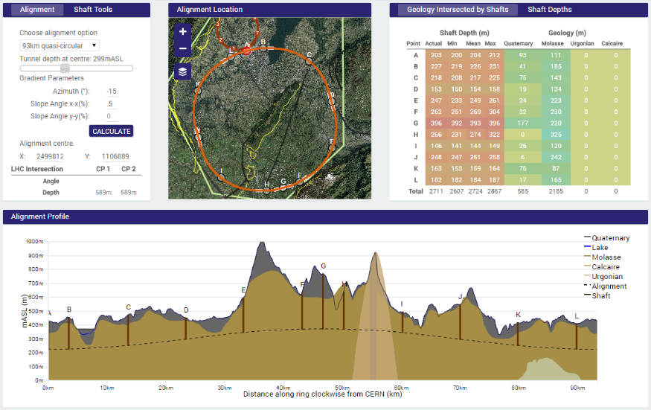
Geology Studies – Example 93 km
90 – 100 km fits geological situation well,
better than a smaller ring size
LHC suitable as potential injector

Slide 12
Push Technologies
?
WHY

Slide 13
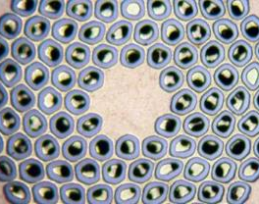
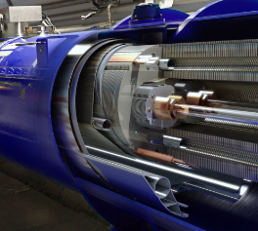
Key Technology R&D - HFM
Nb₃Sn
16 T
Conductor R&D
Magnet Design
Increase critical current density
Obtain high quantities at
required quality
Material Processing
Reduce cost
Develop 16T short models
Field quality and aperture
Optimum coil geometry
Manufacturing aspects
Cost optimisation

Slide 14
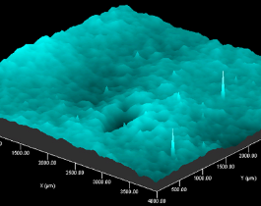
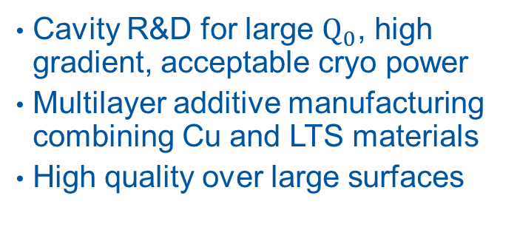
Key Technology R&D - RF
Beyond
Nb
Efficiency
Superconducting RF
Power Conversion
Cavity R&D for large $Q_{0}$, high gradient, acceptable cryo power
Multilayer additive manufacturing combining Cu and LTS materials
High quality over large surfaces
Push Klystrons far beyond 70% efficiency
Increase power range of
solid-state amplifiers
High reliability for high multiplicity

Slide 15
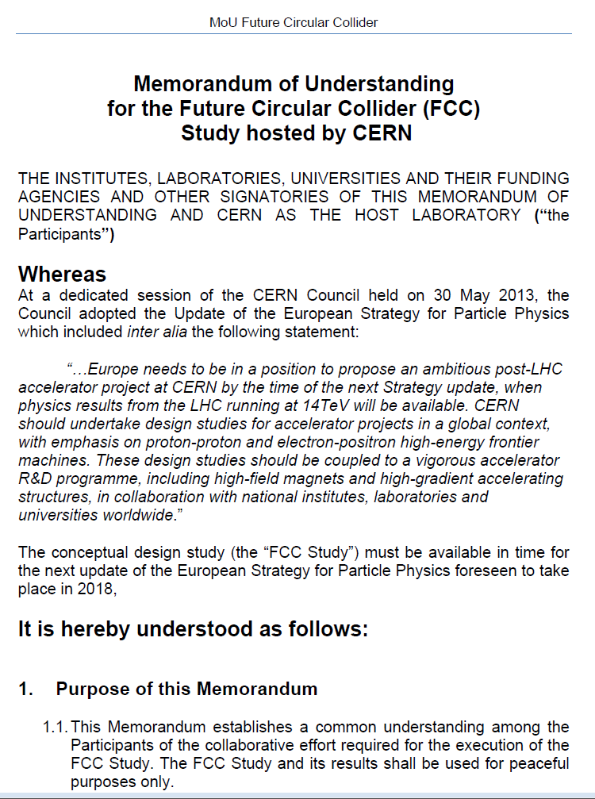
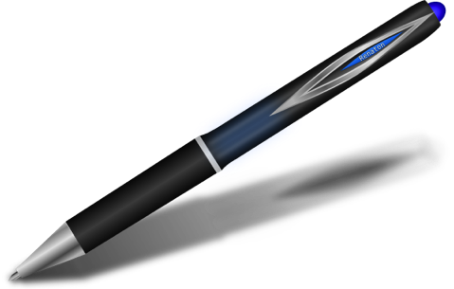
The FCC Collaboration
A consortium of partners based on a
Memorandum Of Understanding (MoU)
Working together on a
best effort basis
Self governed
Incremental & open to
academia and industry
Specific contributions detailed in Addendum

Slide 16
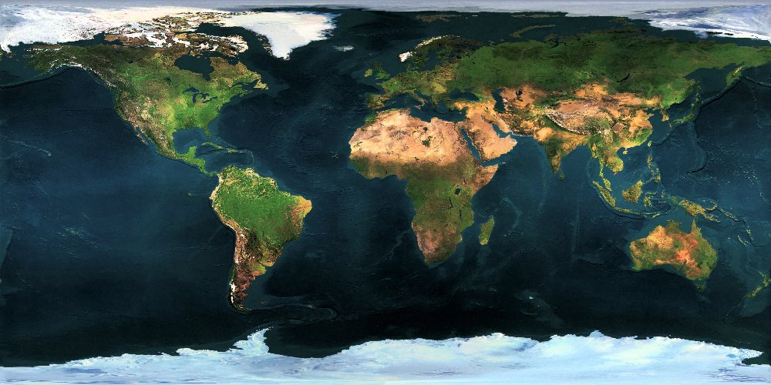




















Collaboration Status
51 institutes
19 countries
EC participation

Slide 17
Study Coordination Group
Study Lead
Hadron Collider
Physics & Experiments
Lepton Collider
Physics & Experiments
ep Physics, Experiment, IP Integration
M. Benedikt
F. Zimmermann
A. Ball, F. Gianotti, M. Mangano
A. Blondel,
J. Ellis, C. Grojean,
P. Janot
M. Klein,
O. Bruning
Hadron Injectors
Hadron Collider
Lepton Injectors
Lepton Collider
B. Goddard
D. Schulte,
M. Syphers
Y. Papaphilippou
F. Zimmermann,
J. Wenninger,
U. Wienands
Accelerator Technologies R&D
Special
Technologies
Infrastructures & Operation
Costing &
Planning
L. Bottura,
E. Jensen, L. Tavian
JM. Jimenez
P. Lebrun,
P. Collier
P. Lebrun,
F. Sonnemann
Further enlargement of coordination group and study teams with international partners

Slide 18

A key to New Physics

Slide 19
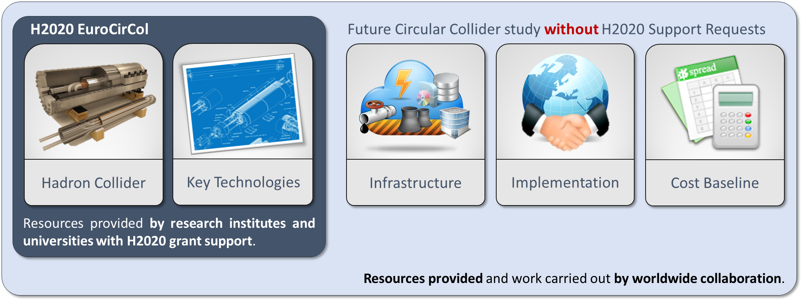
EuroCirCol EU Horizon 2020 Grant
EC contributes with funding to FCC-hh study
Core aspects of hadron collider design: arc & IR optics design
Feasibility study of key technologies: 16 T magnet program, cryogenic beam vacuum system

Slide 20
EuroCirCol Consortium + Associates
CERN | IEIO
TUT | Finland
CEA | France
CNRS | France
KIT | Germany
TUD | Germany
INFN | Italy
UT | Netherlands
ALBA | Spain
CIEMAT | Spain
STFC | United Kingdom
UNILIV | United Kingdom
UOXF | United Kingdom
KEK | Japan
EPFL | Switzerland
UNIGE | Switzerland
NHFML-FSU | USA
BNL | USA
FNAL | USA
LBNL | USA
Japan
KEK
Finland
TUT
United Kingdom
STFC, UNILIV, UOXF
Netherlands
UT
Germany
KIT, TUD
France
CEA, CNRS
CERN
Switzerland
EPFL, UNIGE
Italy
INFN
Spain
ALBA, CIEMAT
Consortium Beneficiaries, signing the Grant Agreement

Slide 21
Study Setup
Carried out by global collaboration
Universities, laboratories & industry worldwide
Hosted by CERN
Geographically
Balanced
Topically
Complementary
Worldwide
Excellence

Slide 22
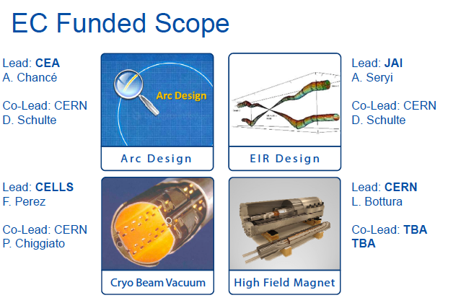

Slide 23
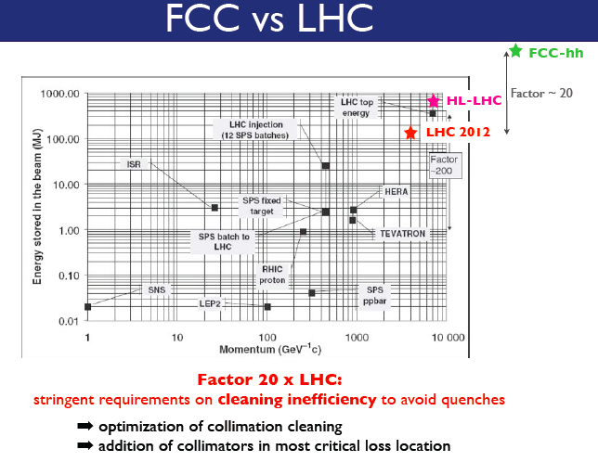

Slide 24
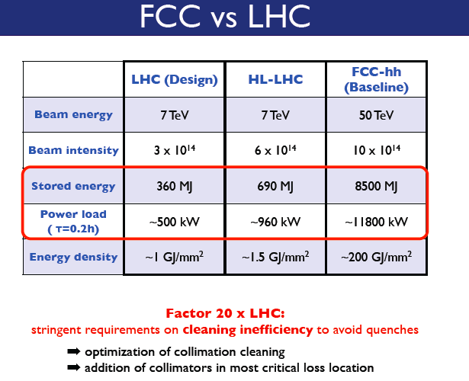

Slide 25
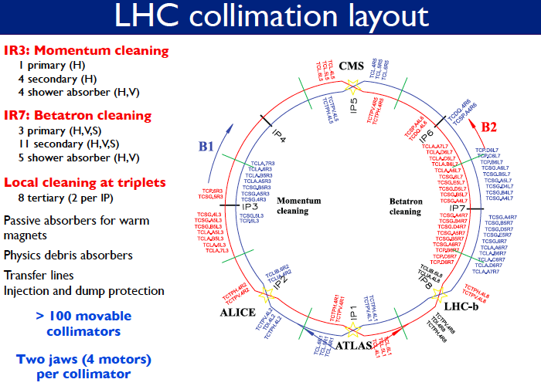

Slide 26
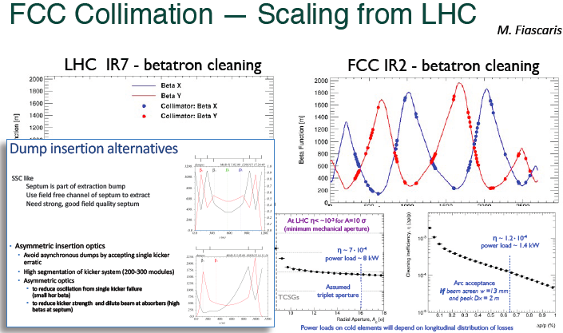

Slide 27
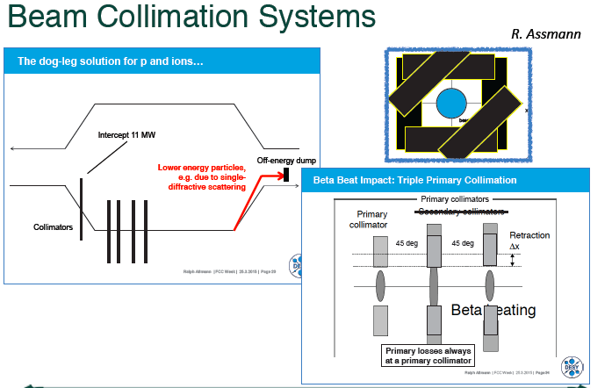

Slide 28
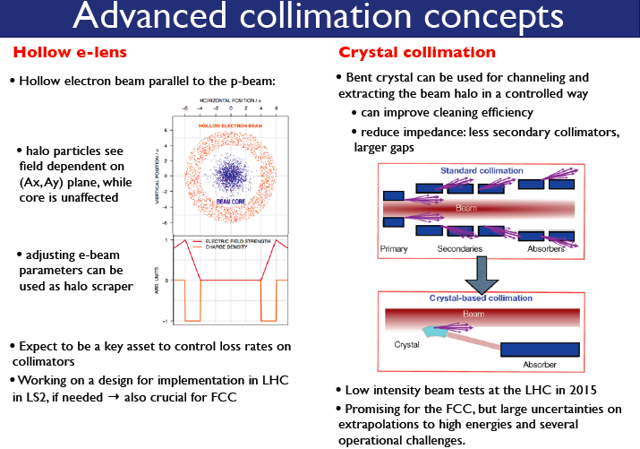

Slide 29
More interesting that I was waiting.
A lot of activity is starting and now it is time to go on board….
EuroCirCol Kick-off meeting 2-4 June 2015

