Slide 1
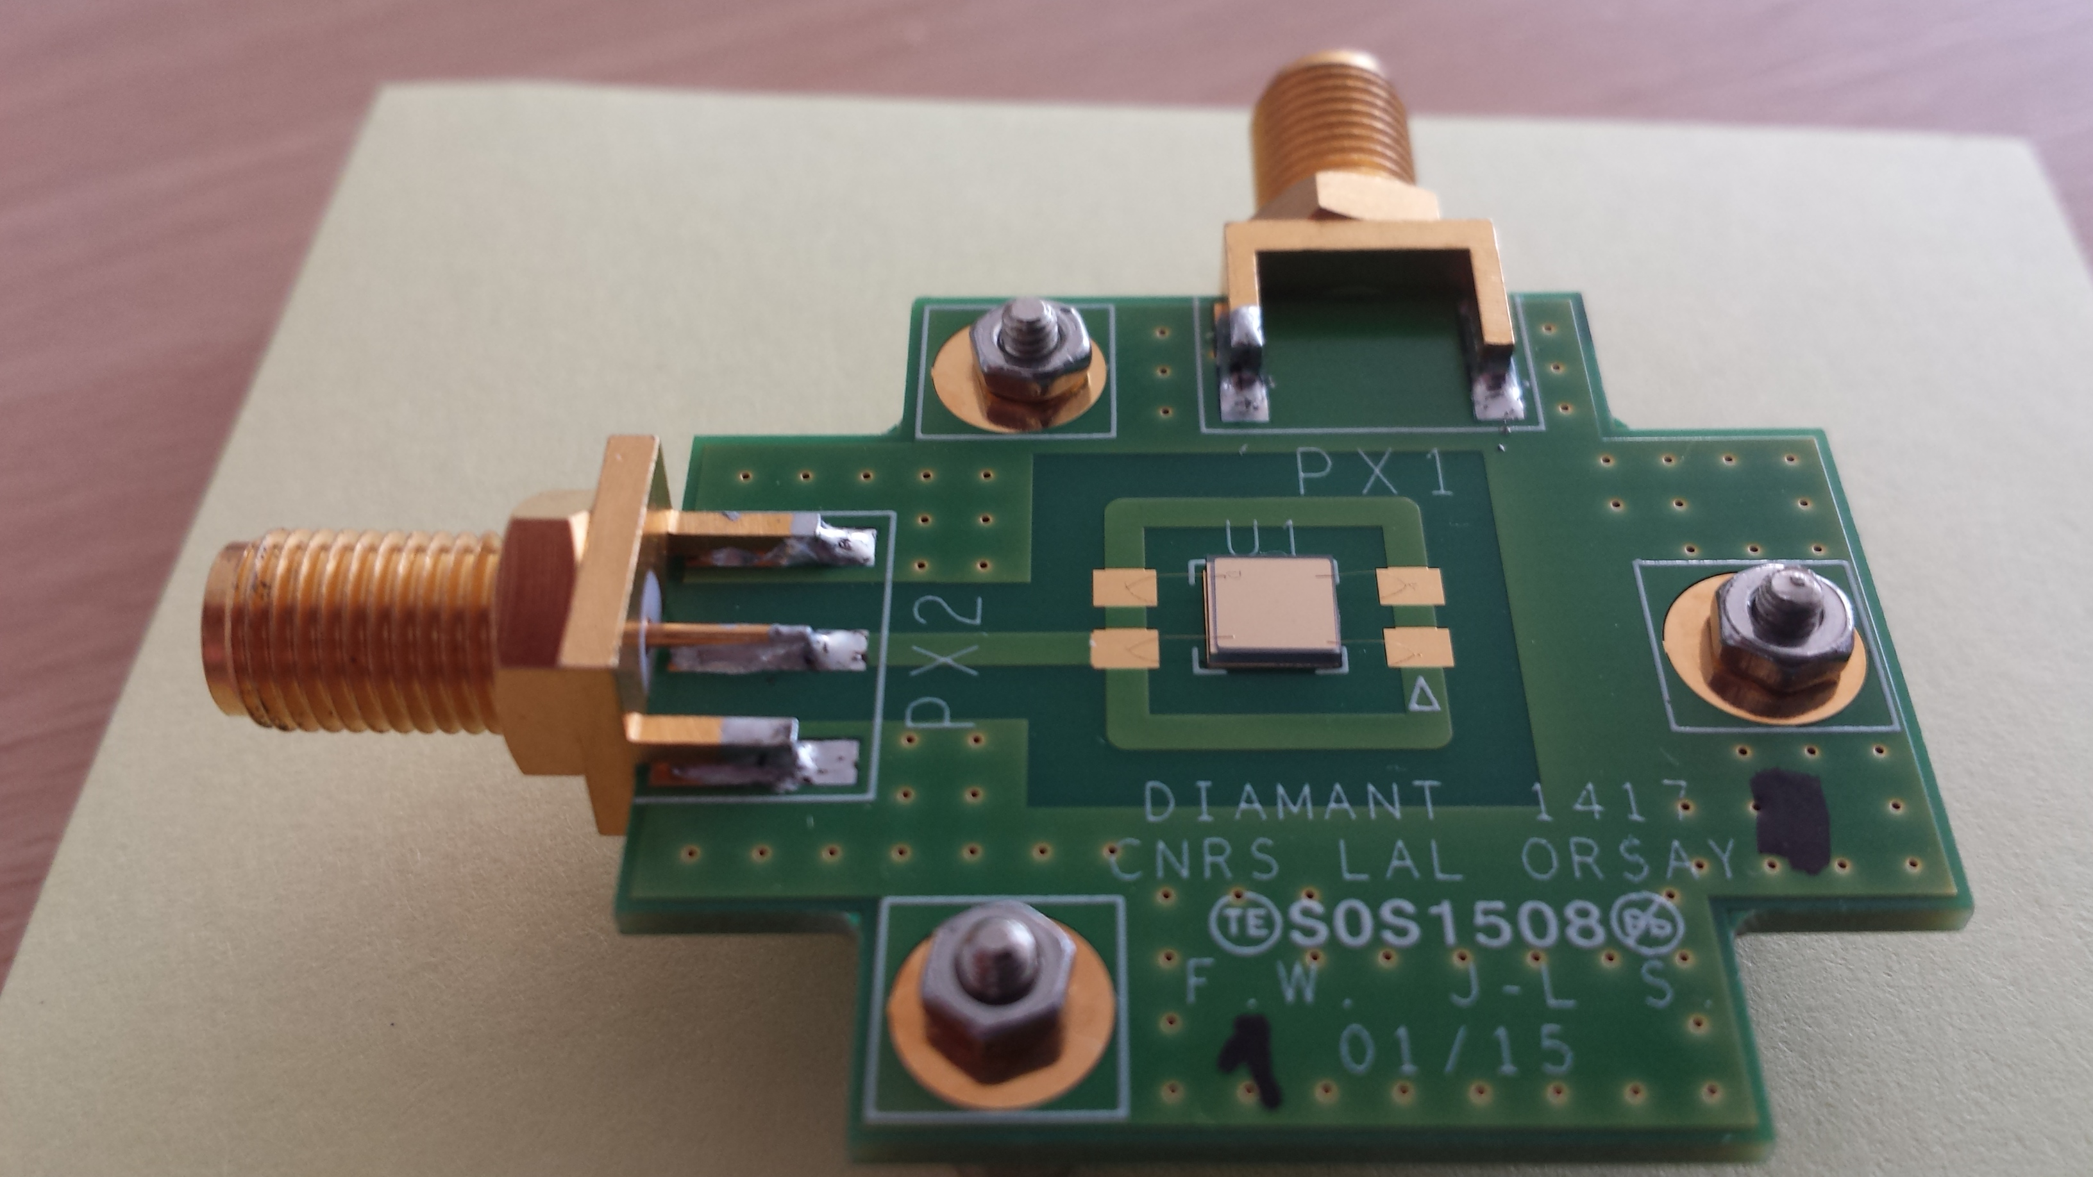
Diamond sensor made in LAL
500μm diamond with Ti/Pt/Au metallization
HV
Front side
Signal
V.Kubytskyi, P. Bambade, F. Bogard, F. Wicek + help and useful discussions from LAL colleagues

Slide 2
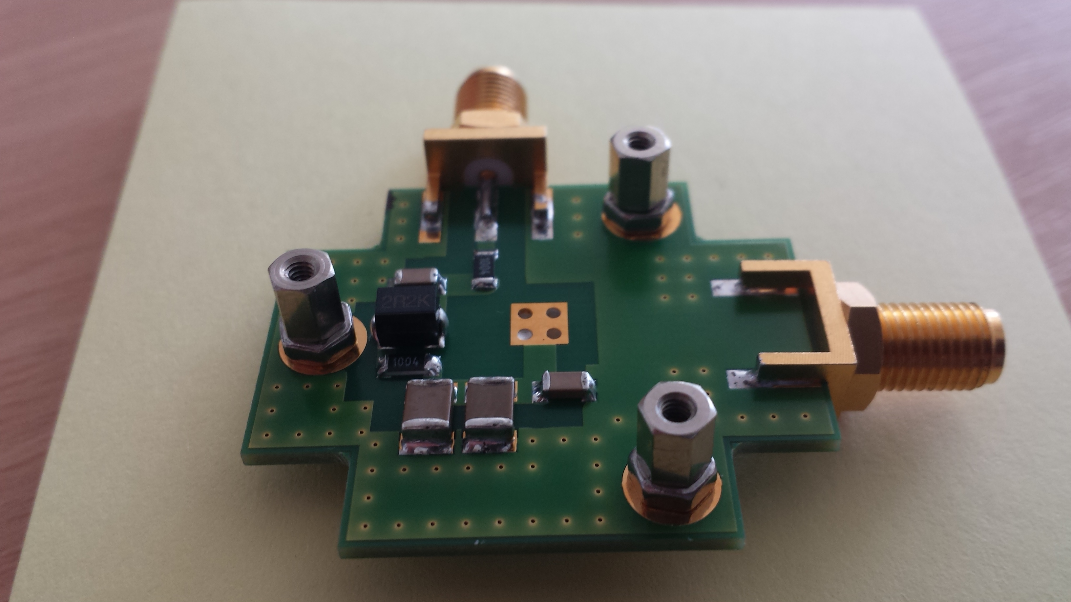
Back side
HV
Signal

Slide 3
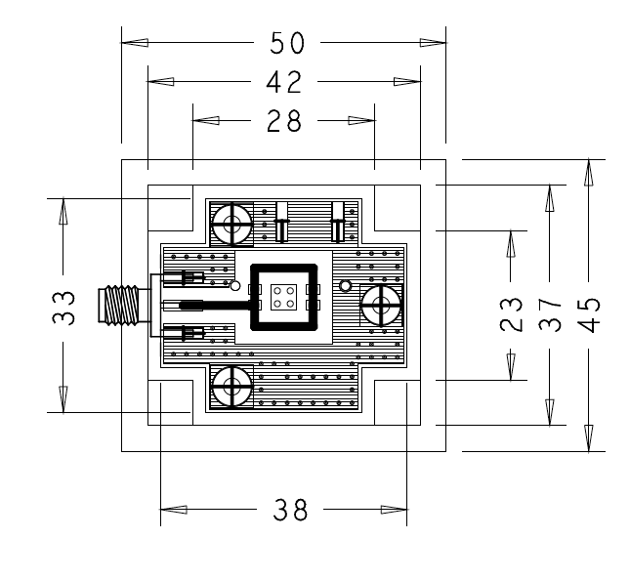
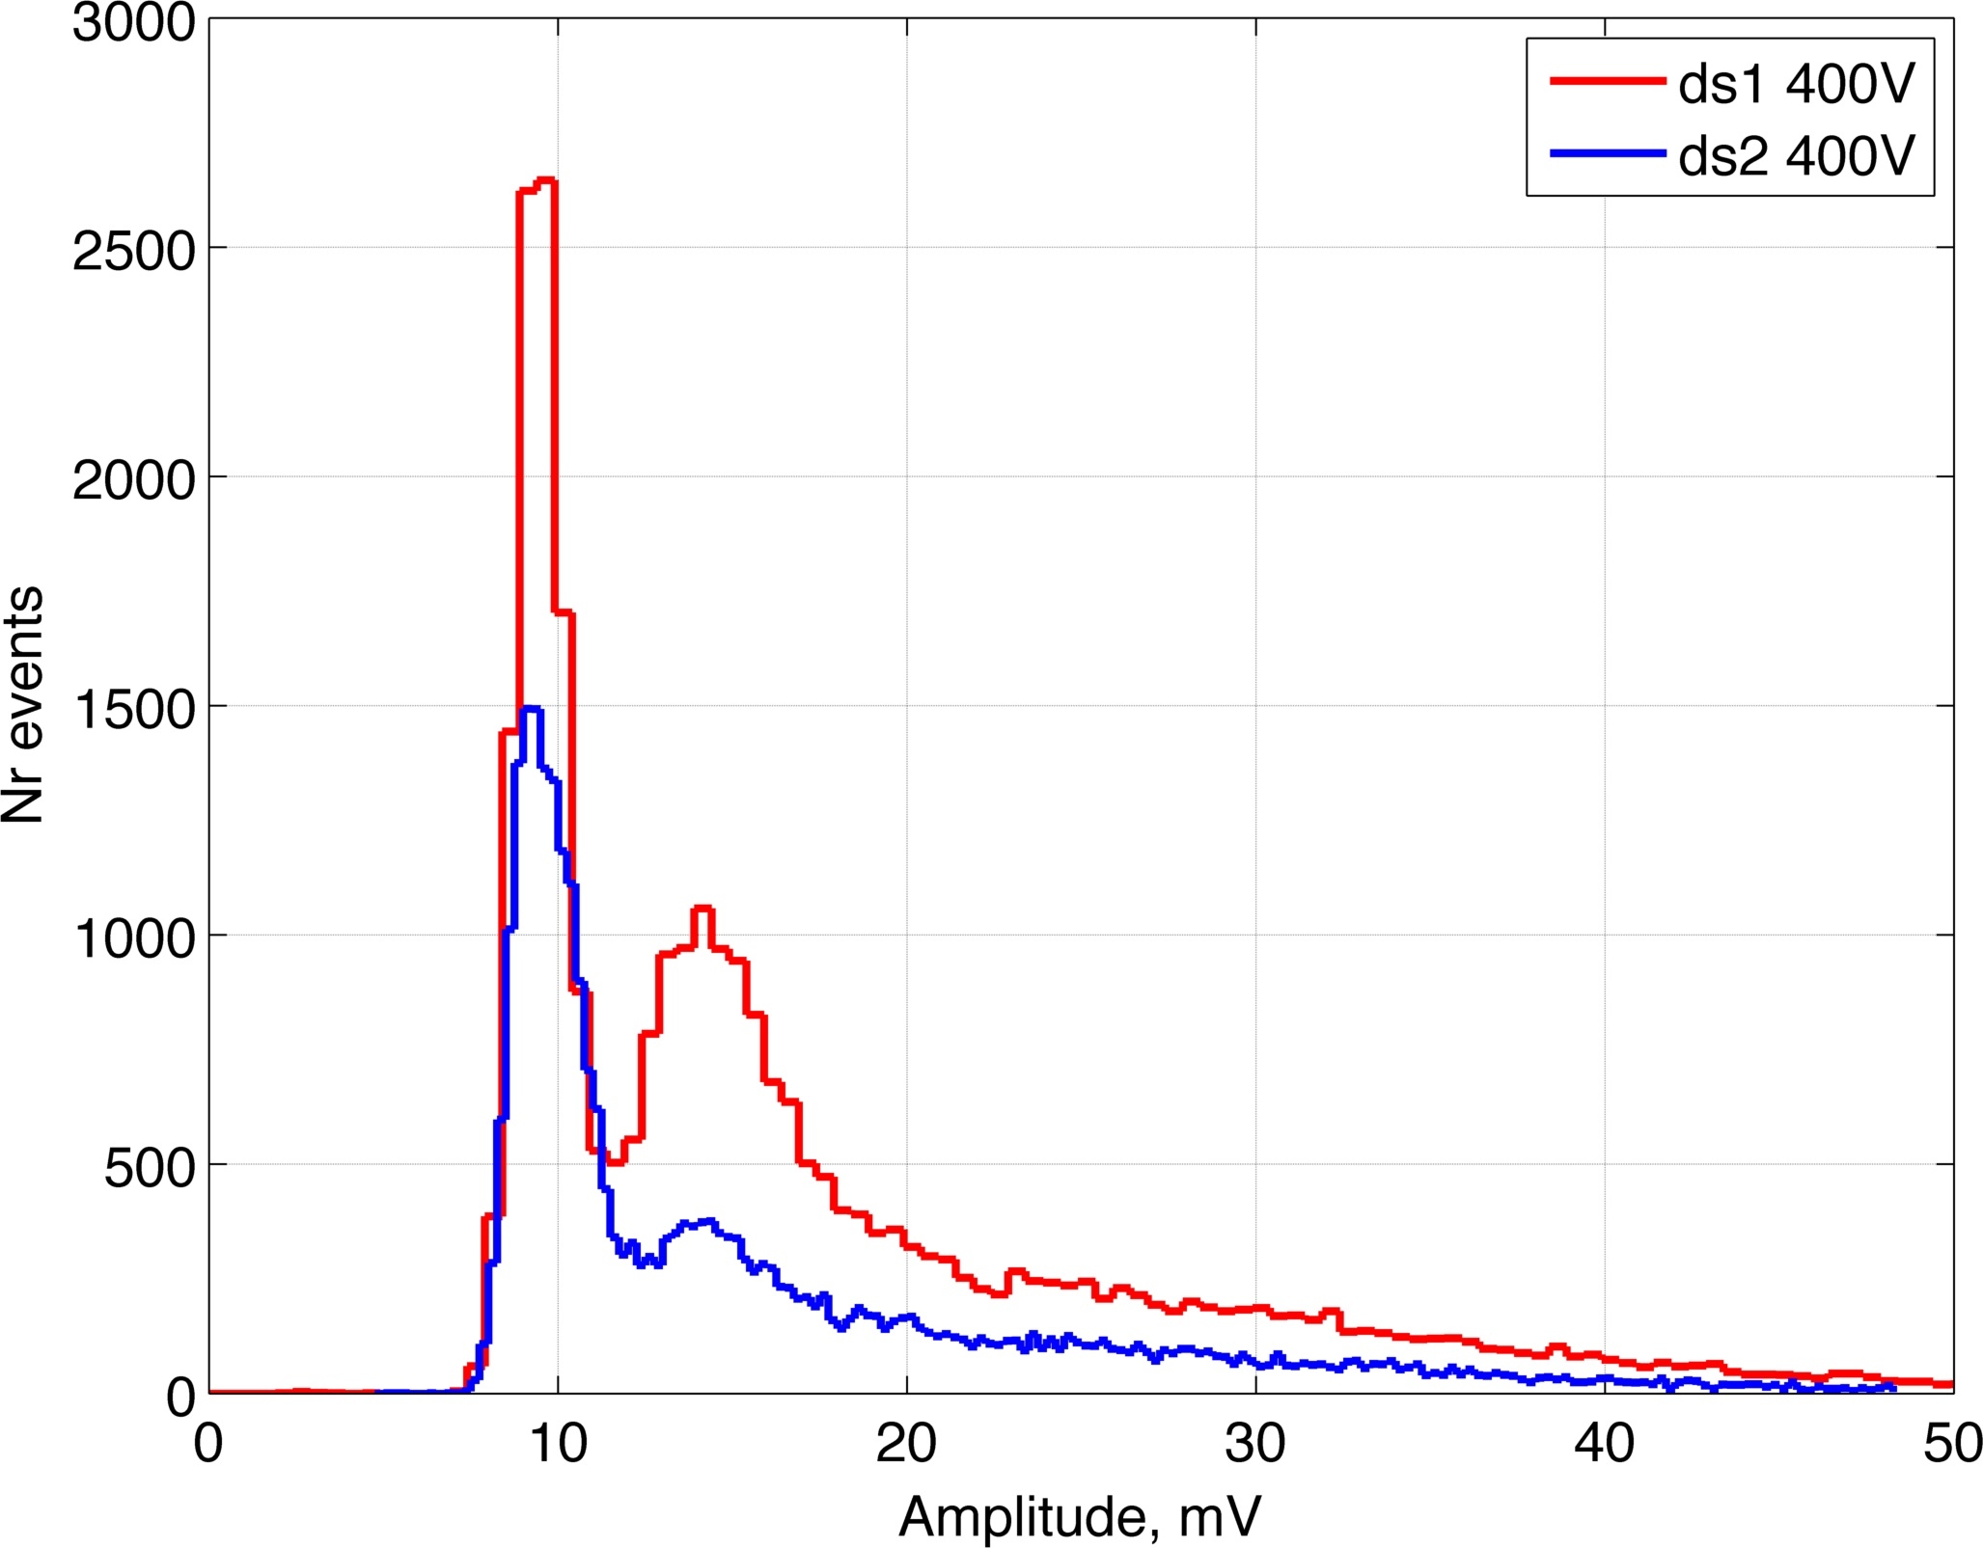
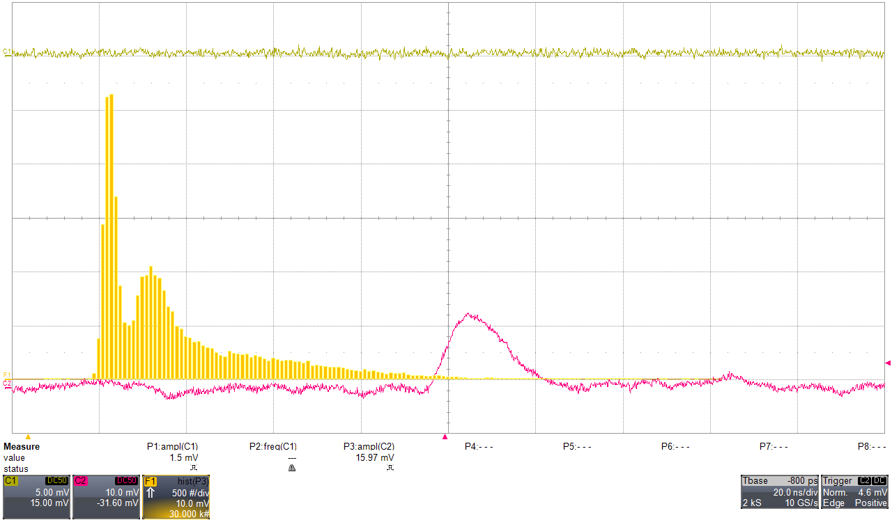
First meeting 08.01.2015
Metallization was done before at GSI
Design of PCB, fabrication, soldering components, mechanical and electrical tests
Gluing diamond to PCB and then bonding at IEF
First measurement 14.04.2015
noise
Signal with charge amplifier
Signal Sr90

