Slide 1
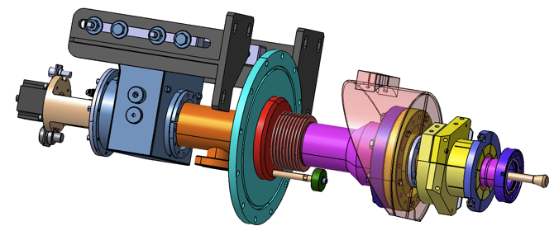
XFEL couplers production overview
Talk @ DEPACC
Hayg GULER

Slide 2
Outline
General introduction
Production and monitoring at companies
Coupler preparation
RF conditioning procedure
Different Issues
Current status

Slide 3
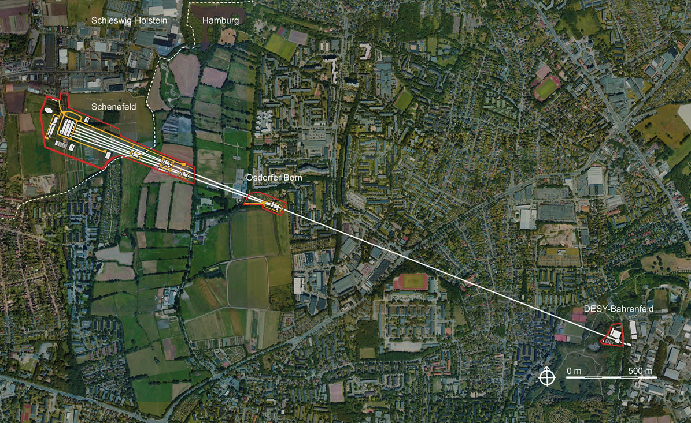
Introduction
1.3 Km e- cold linac reaching up to 17GeV

Slide 4
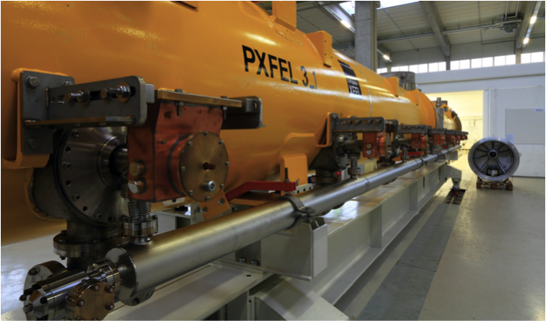
Introduction
Linac composed of 100 Cryomodules, equipped with 8 couplers each → 800 Couplers needed

Slide 5
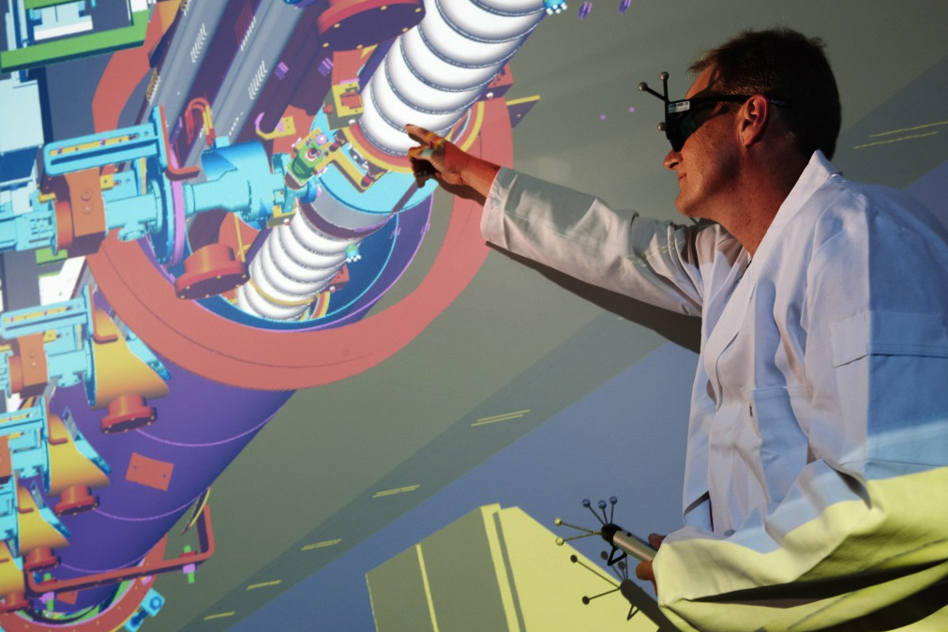
Introduction
Notes:
Vision générale → Vue de dessous du cryomodule : La partie froide du coupleur est fixée à la cavité supra.
Parler de la supra vs la zone a temperatue ambiante.

Slide 6
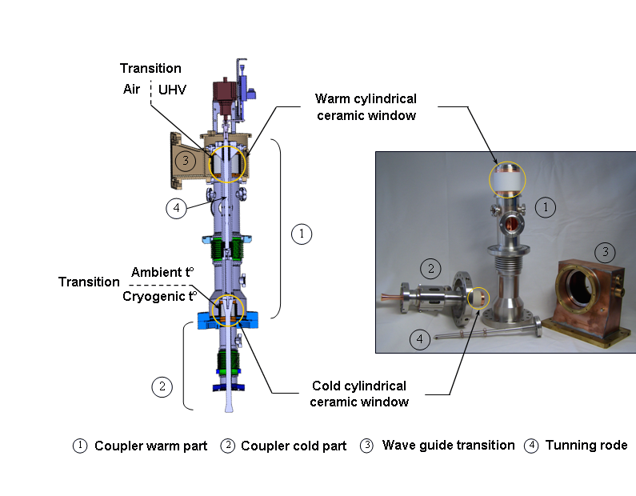
Functions
Introduction : functions of an RF coupler
Transfer the power to the cavity field and to the beam
has to match the impedance of the klystron to the beam loaded cavity
provide a vacuum barrier for the beam vacuum
do not contaminate the accelerator vacuum bridge the gap between room and cryogenic temperature
Notes:
Un coupleur XFEL doit remplire 3 fonctions :
Transmission de la RF entre une source vers les cavités supra
Séparation thermique : entre milieur a temperature cryogenique et milieur a temperature ambiante
Transition vide ultra vs vide (double separation via les ceramiques pour eviter que le vide froids se deteriorent)
assurer un couplage électrique (variable) avec les cavités via son antenne introduite au niveau du tube de faisceau à l’entrée du résonateur
Conducteur interne polarisable ?
Partie chaude
Partie froide
Une transition guide d’onde

Slide 7
The principal actors in the project

Slide 8





Production monitoring at companies
Brazing, Copper plating
TiN Coating, Welding
RF Conditioning
Cryogenic modules
Installation on tunnel

Slide 9
Production monitoring at companies
Companies
  Thales
    Assemblement des pairs (Brasage)
    Cuivrage des parties des coupleurs
    Implications dans la station de conditionnement
  RI
    Pose colleret cuivre aux ceramiques
    TIN Coating sur les ceramiques
    Soudure par faisceau d’e- : associe antenne partie haute de la ceramique + partie basse du coupleur froid
    Lavage des coupleurs : bain ultrasonique + détergent (Ticopure)
    Comptage des particules (propreté des coupleurs)
    RGA + Leak test
    Test de déplacement de l’antenne

Slide 10
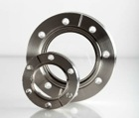
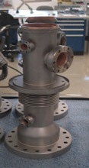
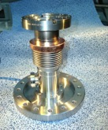

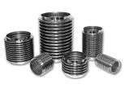
Production monitoring at companies
Thales
At Thales site:
1st step: parts assemblies by brazing:
2nd step: RF Surfaces copper plating of the assembled parts:
Notes:
Brasage céramique/cuivre

Slide 11
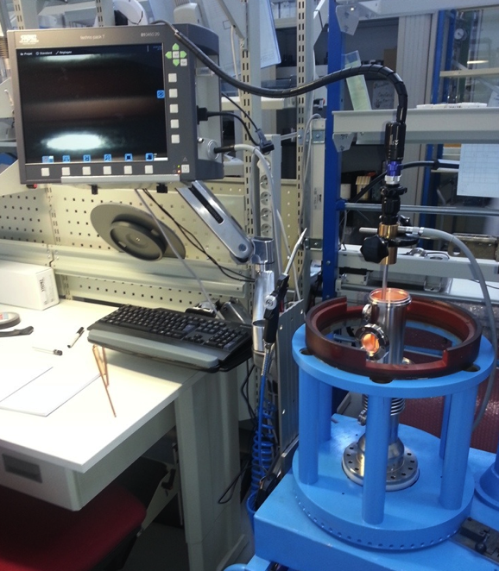
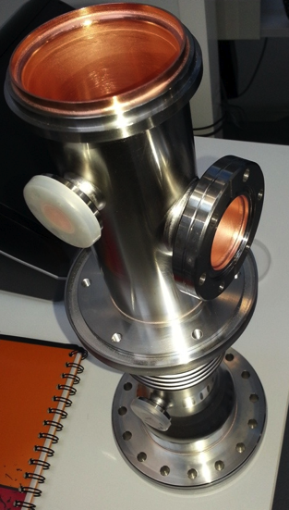
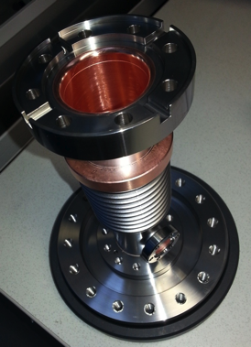
Production monitoring at companies
Thales : inspections
Weekly inspection meetings organized at Thales-Thonon to control parts copper plating quality
Cold part
Warm part

Slide 12

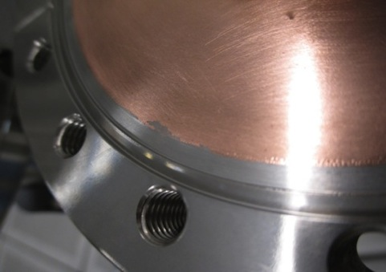

Production monitoring at companies
List of possible defects to reject coupler part
Inspection criteria document
x 40
… with derogation
x 30
… After particle removal
x 22
… with derogation

Slide 13

Inspection criteria
Main reasons of coupler rejection at the final inspection:
Copper plating defects (mainly during ramp up phase and before production stabilization):
→ Solved: process improvement, setting acceptance criteria (defects classification by types, dimensions and number. Agreement in corrective actions and tests.
Pitting
Blister
Copper peel off
X 20
X 30
Circular spots
X 22
Copper particle

Slide 14
Production monitoring at companies
RI (Köln)
At RI site:
Notes:
TIN Coating pour diminuer les coeficients d’emission secondaire, pour diminuer la formation de multipactors.

Slide 15
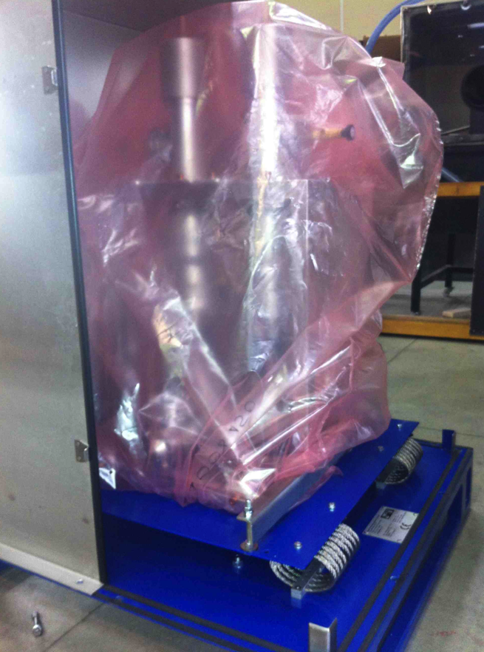

Production monitoring at companies
RI→LAL
Shipment to LAL

Slide 16
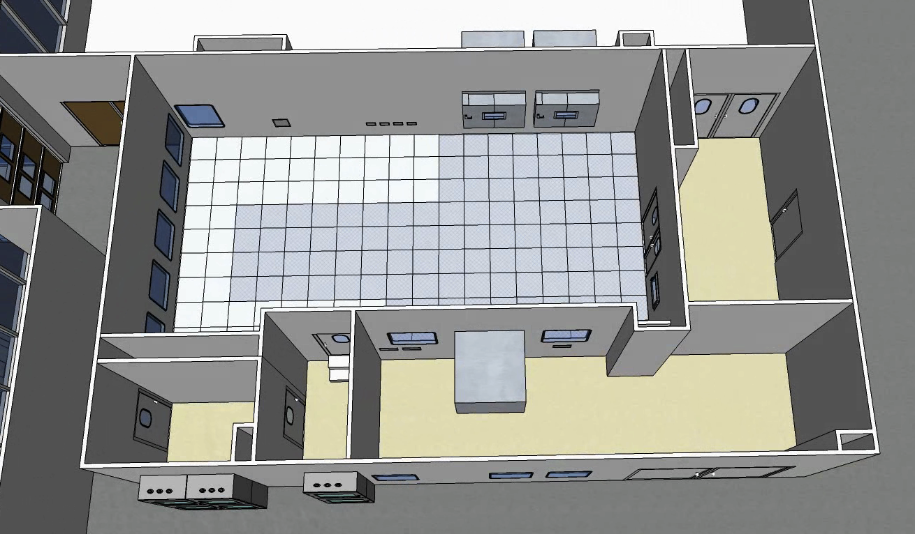
Couplers preparation and RF conditioning at LAL
ISO 5 clean room
ISO 7 clean room
Changing room
Airlock staff
Control room

Slide 17
Liste des controls au LAL
Etat des temoins de chocs + absence de degradation des boites de transport
Presence des (sous) ensembles, integrites sacs de transport
Aspect general des coupleurs, conformite des etats de surface
Proprete des coupleurs
Gravage des parties et sous parties
Tests de fuite → Toute une procedure bien detaillee

Slide 18
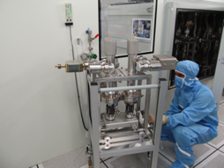
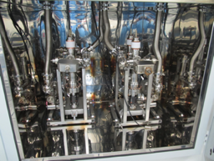
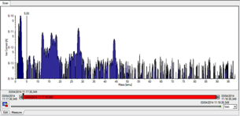
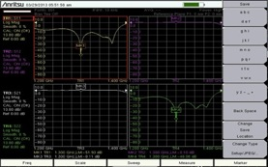
Couplers preparation and RF conditioning at LAL
List of actions to prepare RF conditioning
RGA spectrum recording
Leak test after reception
75h baking cycle at 130°C
Antenna tuning
Actuators assembly
Capacitors assembly
WGBs assembly

Slide 19
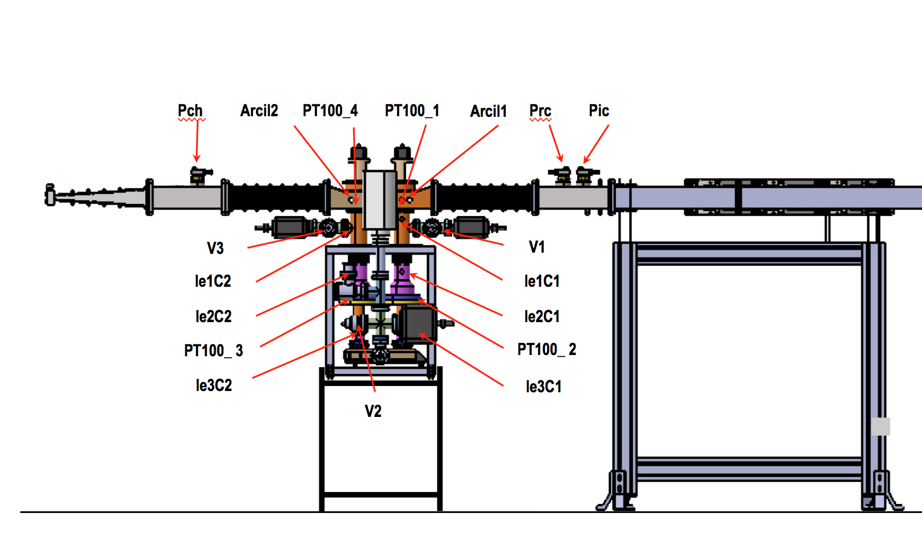
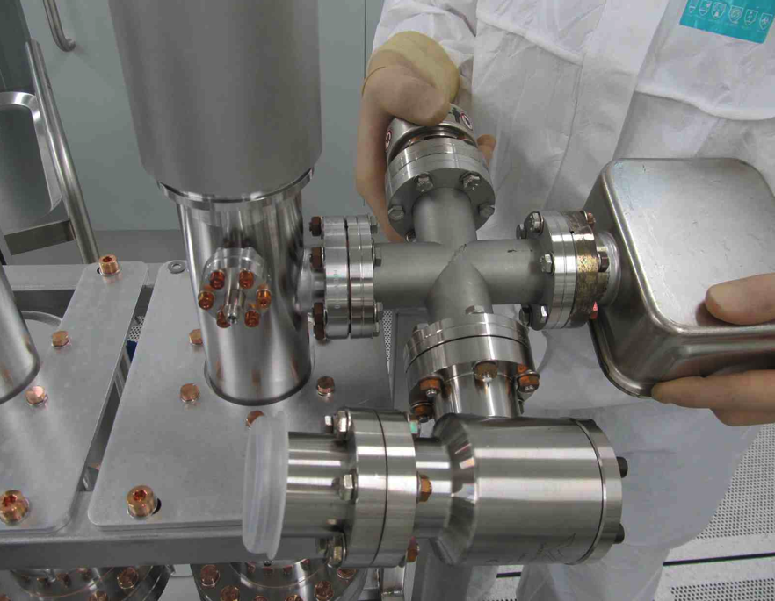
Couplers preparation and RF conditioning at LAL
Coupler on RF test bench : list of diagnostics
Notes:
Vision schematique des coupleurs sur banc de conditionnement.
Sont visibles la liste des diagnostiques : pickups, vides, niveaux de puissance incident et reflechie.
Voir quels detecteurs sont utilises pour mesurer les puissances (diode ?)

Slide 20
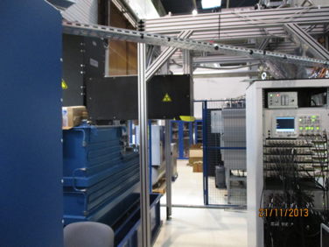
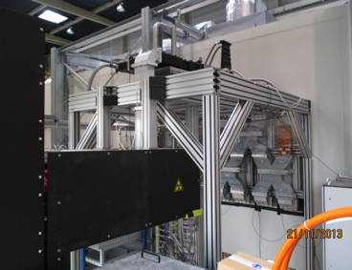
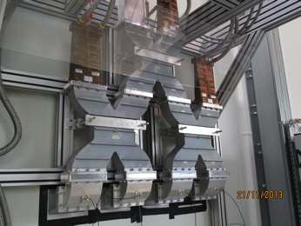
Couplers preparation and RF conditioning at LAL
RF station at LAL

Slide 21
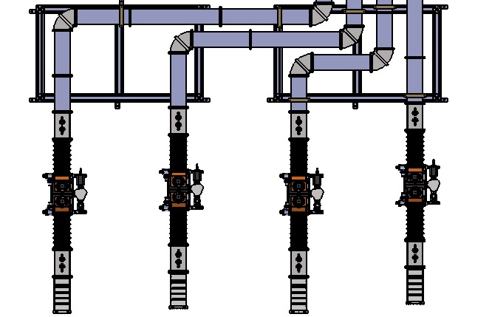
Couplers preparation and RF conditioning at LAL
Split power into 4 conditioning lines
PicC
PicB
PicA
PicD
PrcC
PrcA
PrcD
PrcB
Arcil1D
Arcil1C
Arcil1B
V1A
Arcil1A
V1D
V1C
V1B
V2D
V2C
V2B
V2A
Arcil2D
V3C
Arcil2C
Arcil2B
V3A
Arcil2A
V3D
V3B
PchC
PchB
PchA
PchD
Ligne D
Ligne C
Ligne B
Ligne A
Notes:
Discussion sur les detecteurs d’arc
Discussion sur l’utilite d’itiliser les SF6 comme gaz dans les guides d’onde

Slide 22
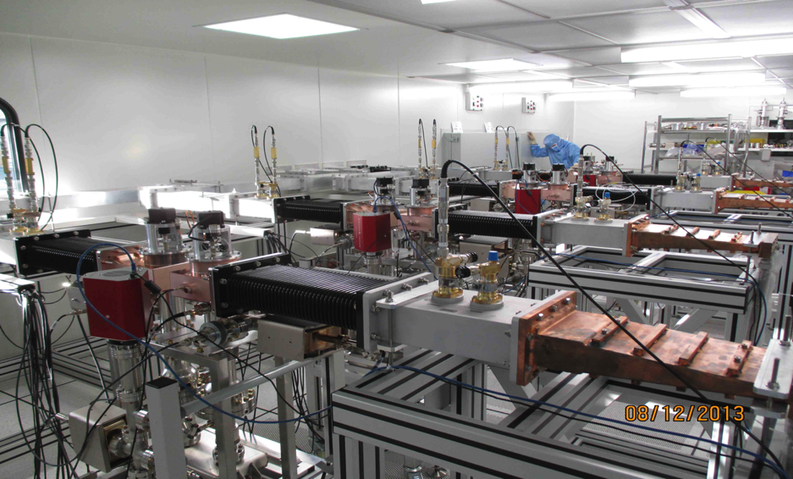
Couplers preparation and RF conditioning at LAL
LAL cleaned room with 4 coupler lines

Slide 23
RF conditioning process

Slide 24

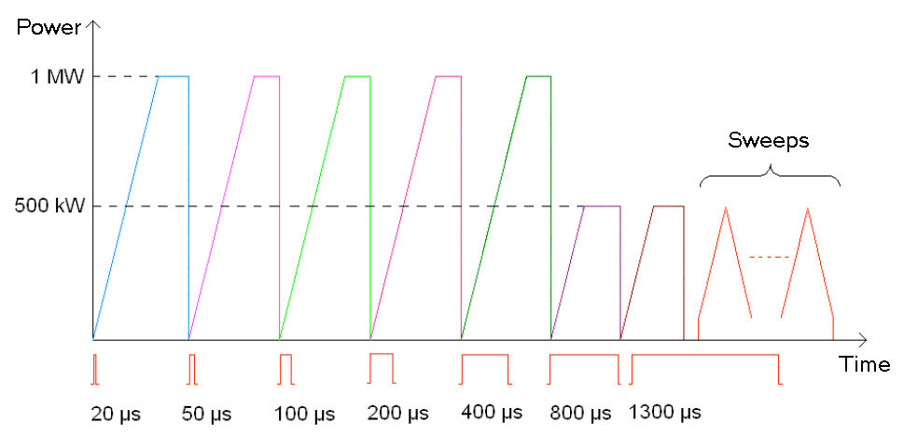
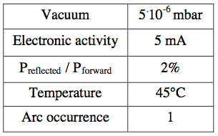
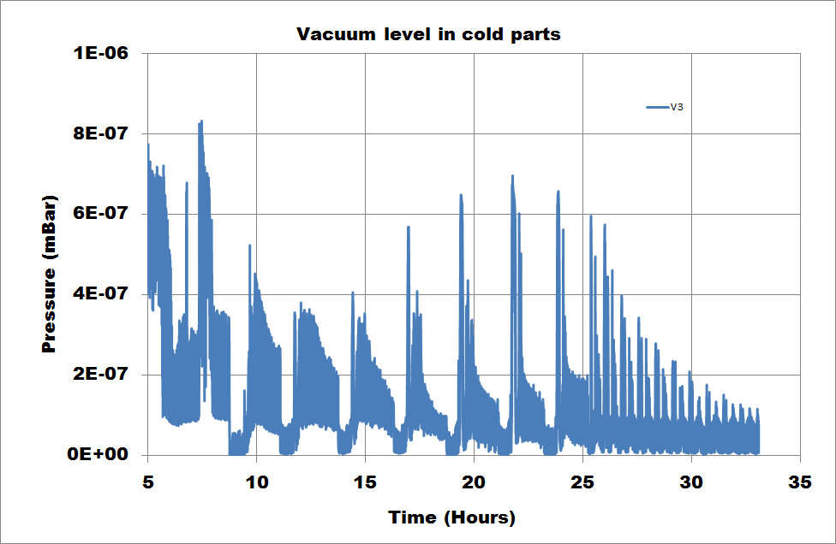
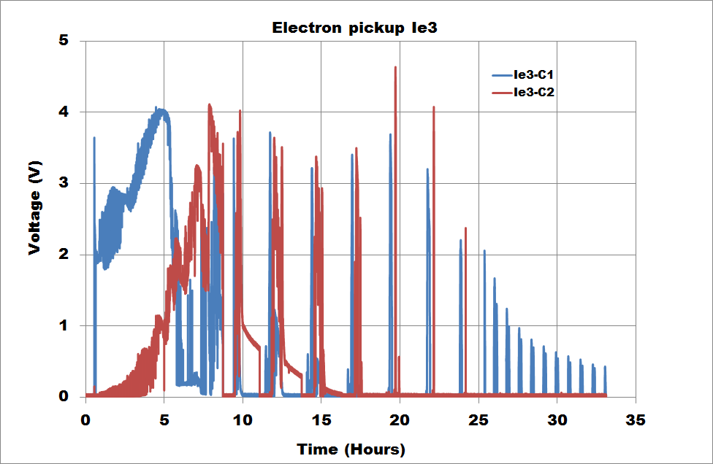
Couplers preparation and RF conditioning at LAL
RF conditioning sequences scheme
Algorithm :
While Vacuum < SV1
P += 0.1dB
Wait 15s
If Vacuum > SV1
P -= 0.1 dB
if Vacuum > SV2
P -= 0.4dB
End of conditioning :
Vacuum < 10-7 mBar
Pickup < few mA

Slide 25
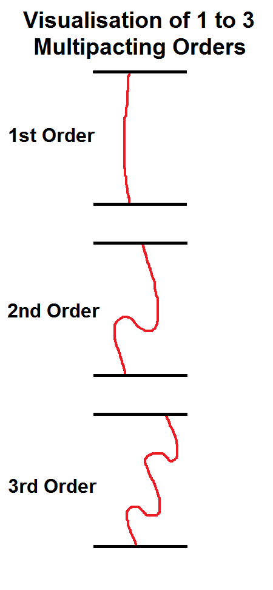
Multipacting (MP) in the coupler vacuum
Resonant multipaction of electrons caused by
electron trajectories (1 point or 2 point) determined by RF field and geometry
Secondary electrons emission (SEC) > 1
Order = travelling time over RF periods
  Low = more stable
  Low = more difficult to condition
→ Multipacting power level scales with :
(Frequency x diameter ) ⁴
→ Diameter is limited (excitation of TEM modes)

Slide 26
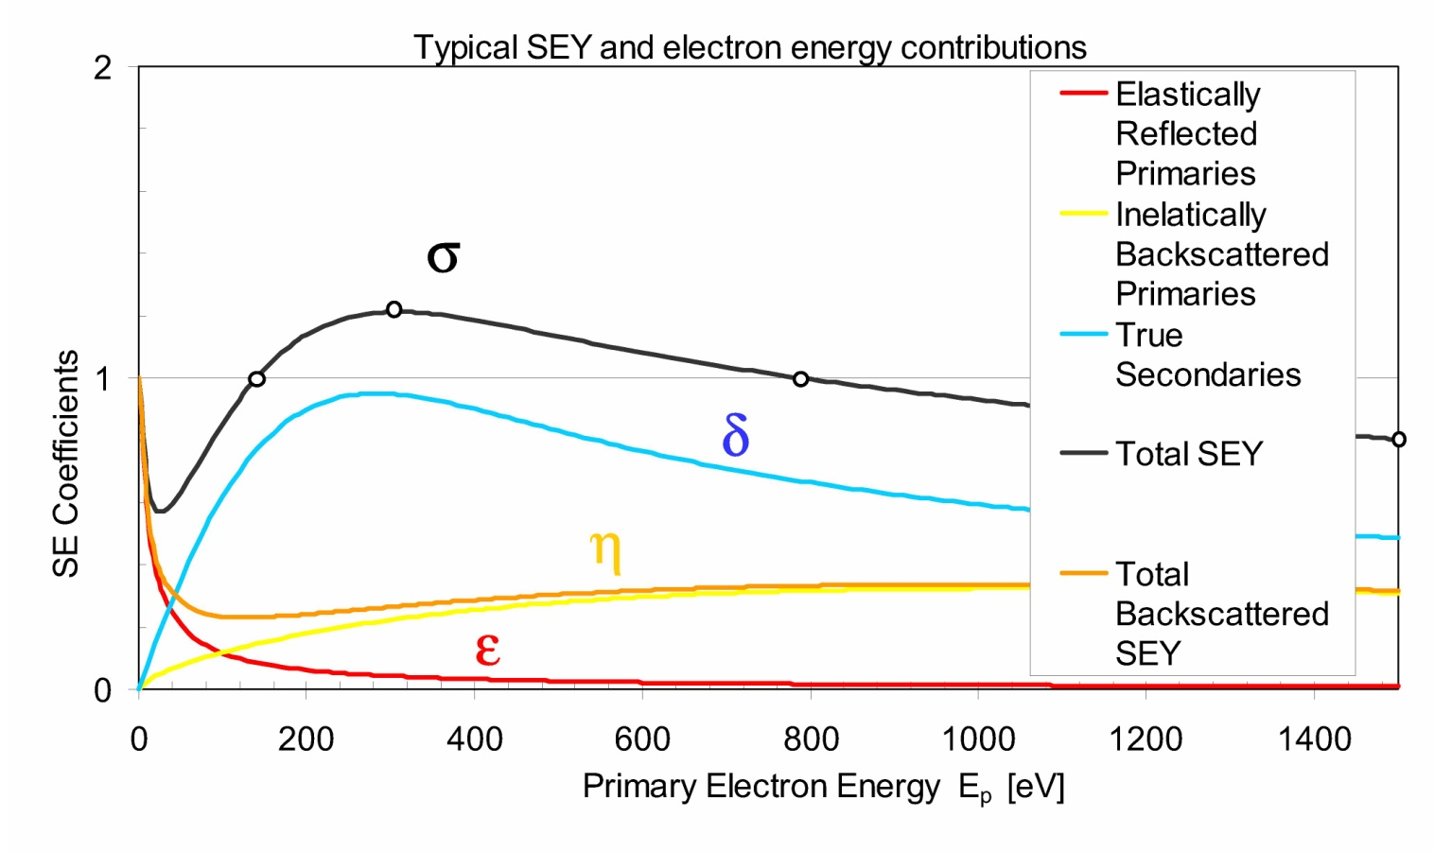
Secondary Electron Yield
Secondary Emission Yield
For multipactor to occur each electron striking the surface must generate more than one secondary on average.
The ratio of primary to secondary electrons is given by the secondary emission yield (SEY).
SEY is strongly dependant on impact energy and only gives an SEY>1 for a finite range of low energies

Slide 27
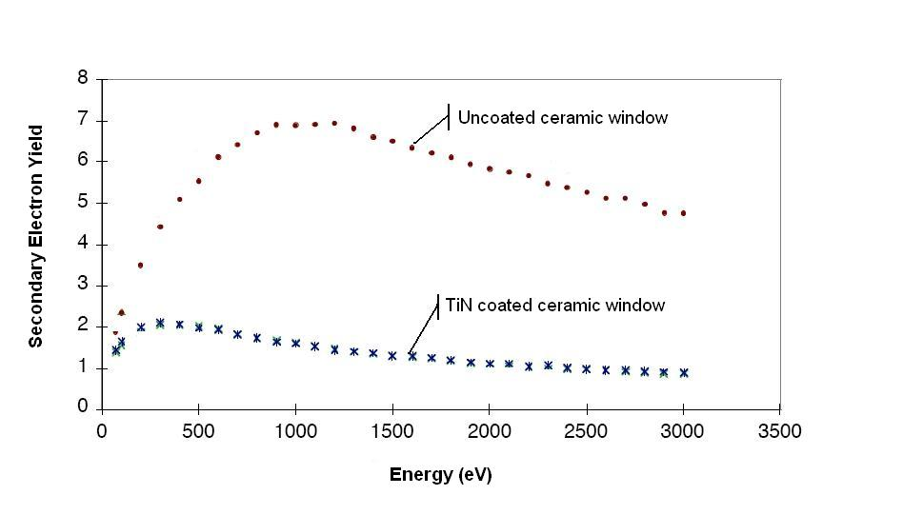
Multipactor phenomenon
Damages caused in ceramic windows
TiN coating on ceramics
Creation of damaging arcs,
Surface overheating that may lead to surface evaporation,
Load mismatch causing dangerous power reflection to the RF source.
→ Necessity of suppression, or at least limitation of this effect

Slide 28
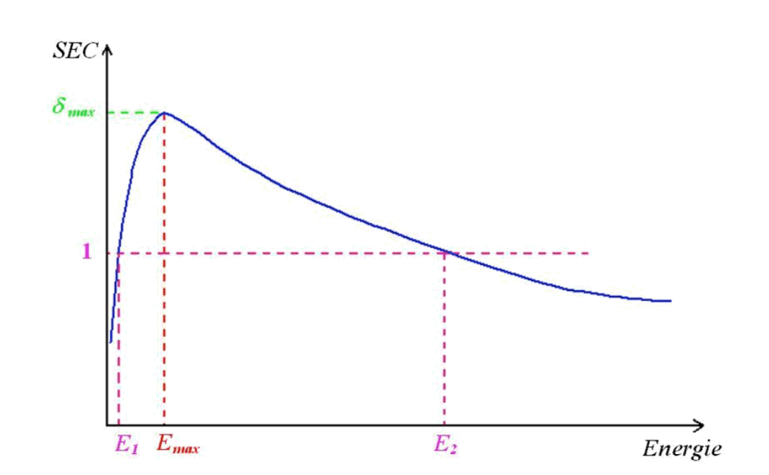
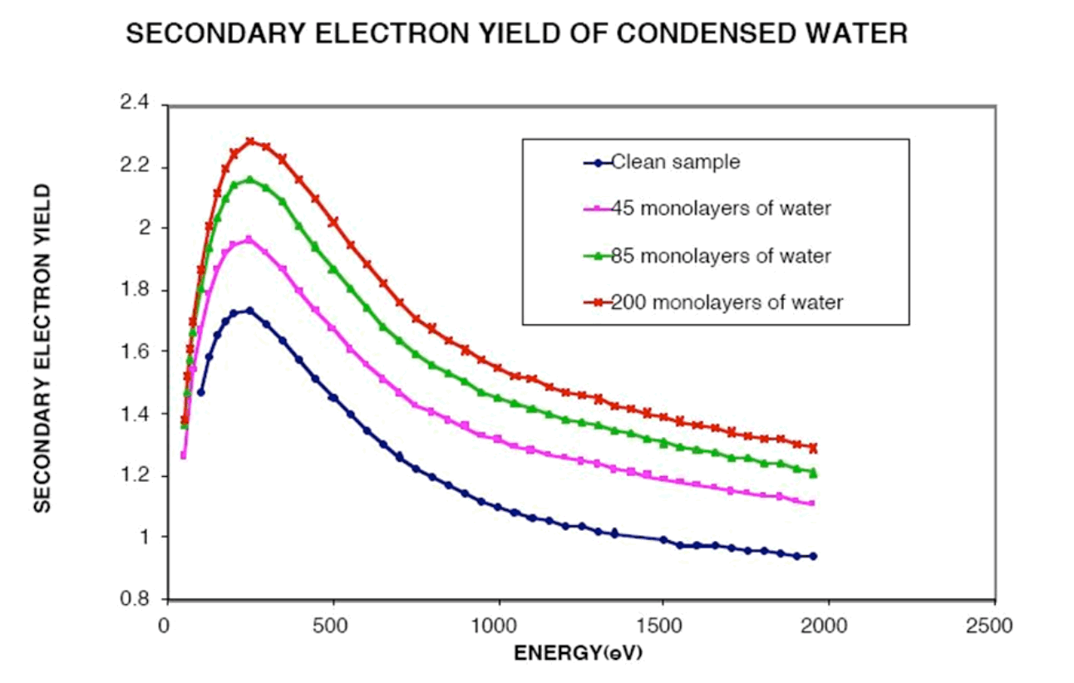
Secondary electrons emission
Standard curve
SEY for different water content
→ importance of baking : during in situ baking, the surfaces will release their water content

Slide 30
RF conditioning DATA

Slide 31
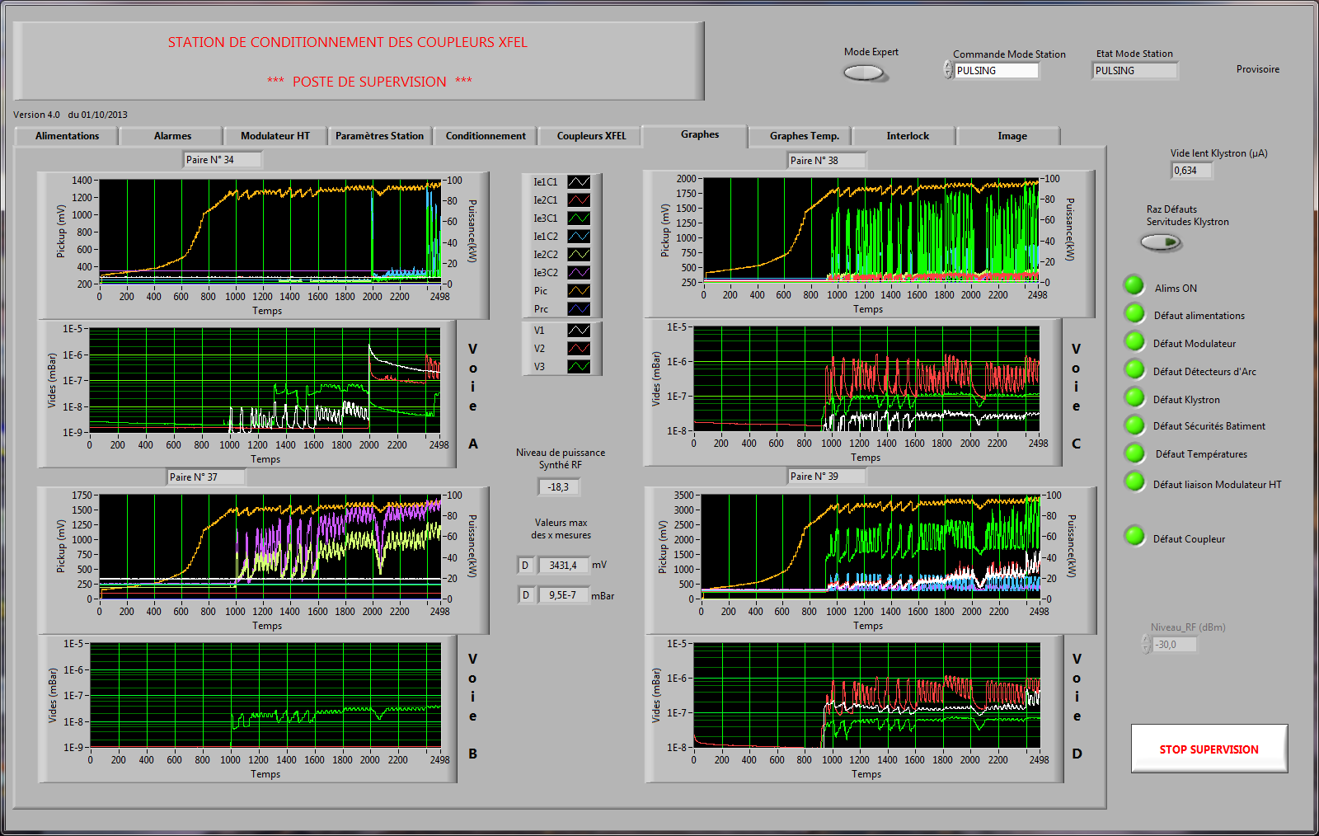
Couplers preparation and RF conditioning at LAL
RF conditioning software

Slide 32
XFEL conditioning data
Database : SQL
  All conditioning data each 10 seconds
  All interlock data
  All coupler/Pair information
Database → provide information to DESY
From sql to ROOT files
  Easy to analyze

Slide 33
RGA during RF conditioning
outgassing of all UHV-components has to be free of hydrocarbons
the leak-free system reaches a total pressure below 10⁻⁷ mbar
the sum of the partial pressures of masses from mass 45 on to at least mass 100 is less than 10⁻³ of the total pressure.
→ 100s to produce one full spectrum
→ Difficult to correlate to pickups and vacuum

Slide 34
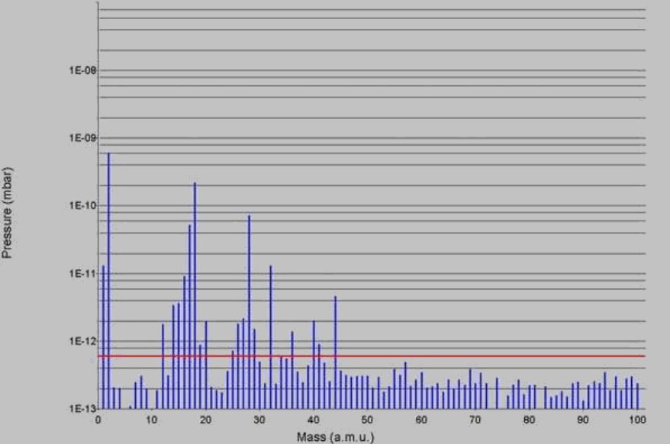
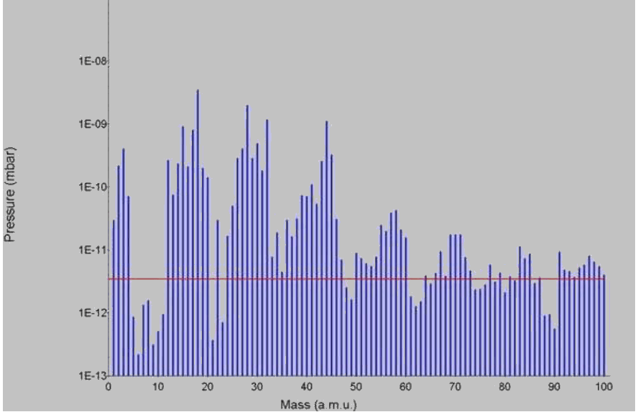
RGA examples
No hydrocarbon
Presence of hydrocarbon

Slide 35
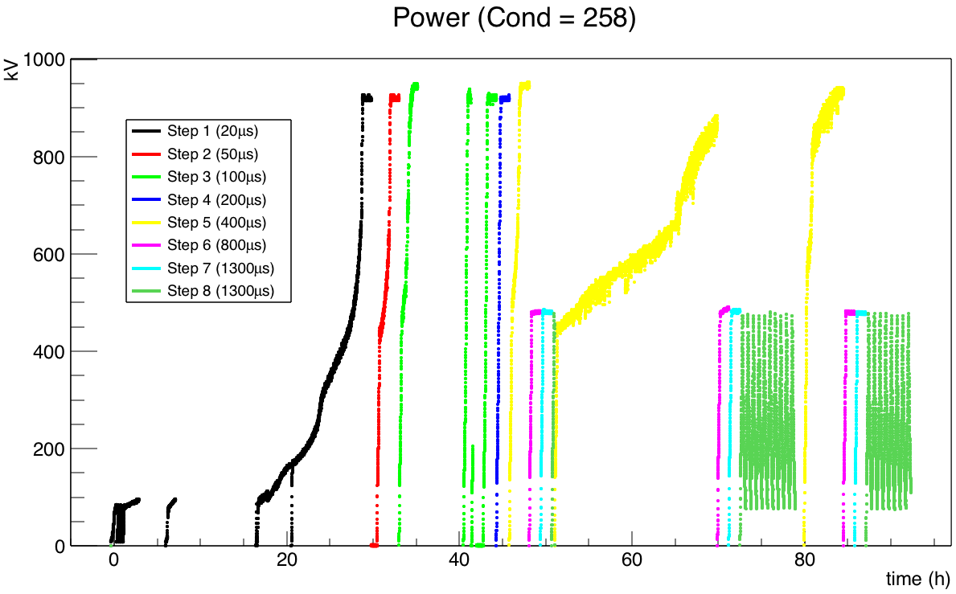
Couplers preparation and RF conditioning at LAL
RF conditioning DATA : Power sequences

Slide 36
Cold Pickups vs Power for each step

Slide 37
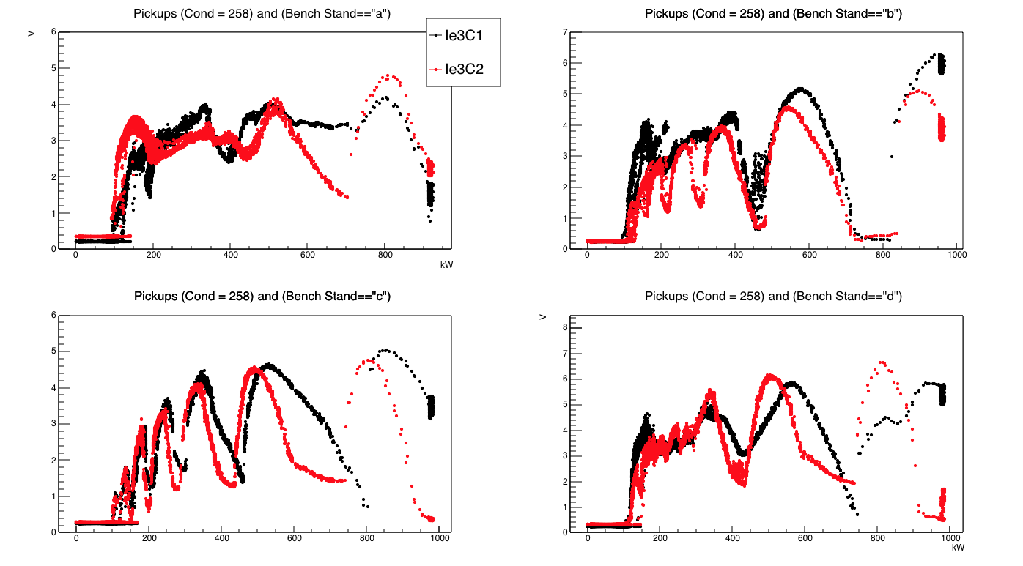
Pickups vs Power Cond 258 step 1

Slide 38
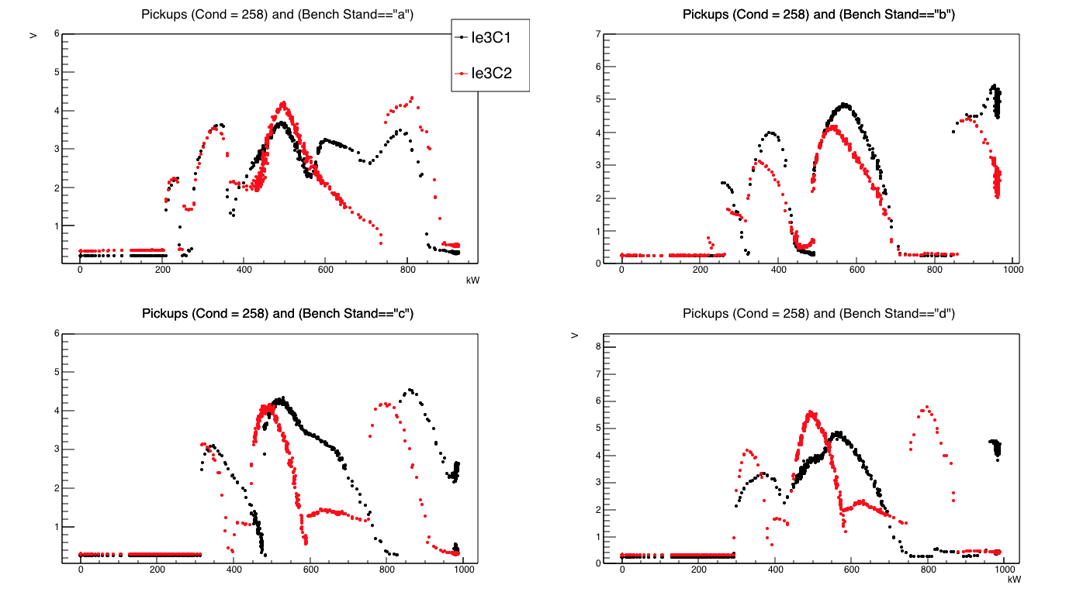
Pickups vs Power Cond 258 step 2

Slide 39
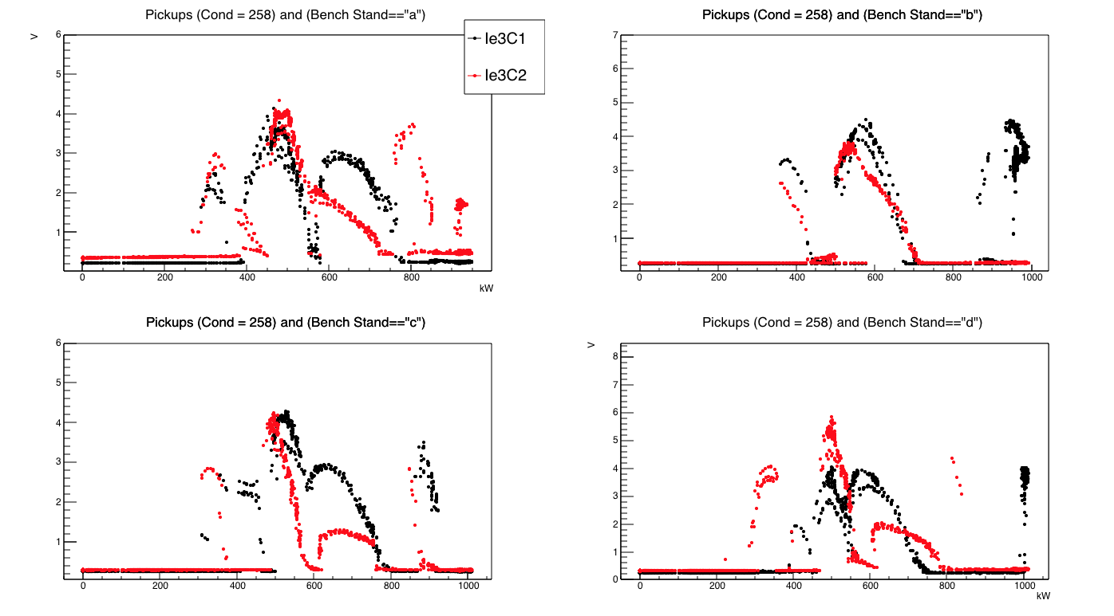
Pickups vs Power Cond 258 step 3

Slide 40
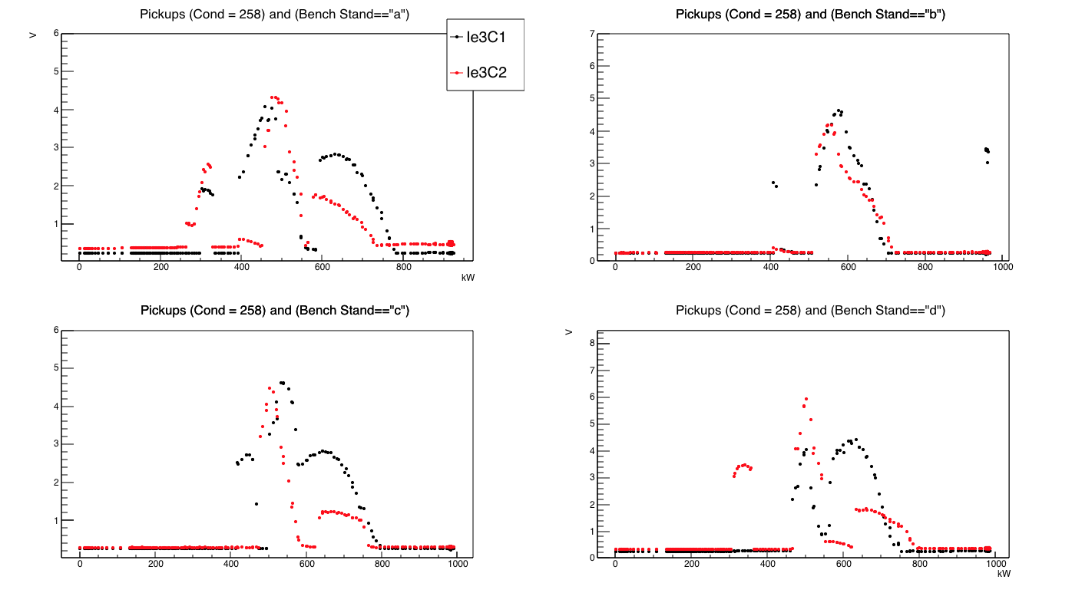
Pickups vs Power Cond 258 step 4

Slide 41
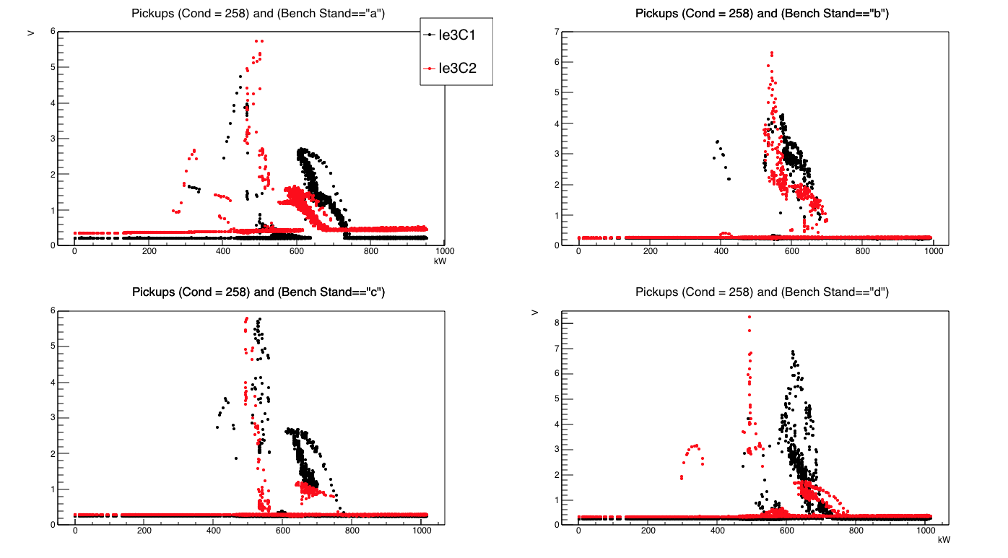
Pickups vs Power Cond 258 step 5

Slide 42
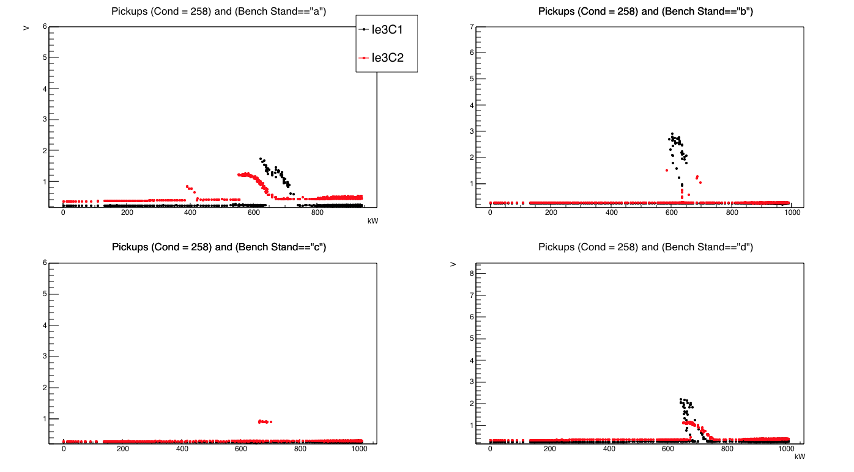
Pickups vs Power Cond 258 step 5(2)

Slide 43
Warm Pickups vs Power for each step

Slide 44
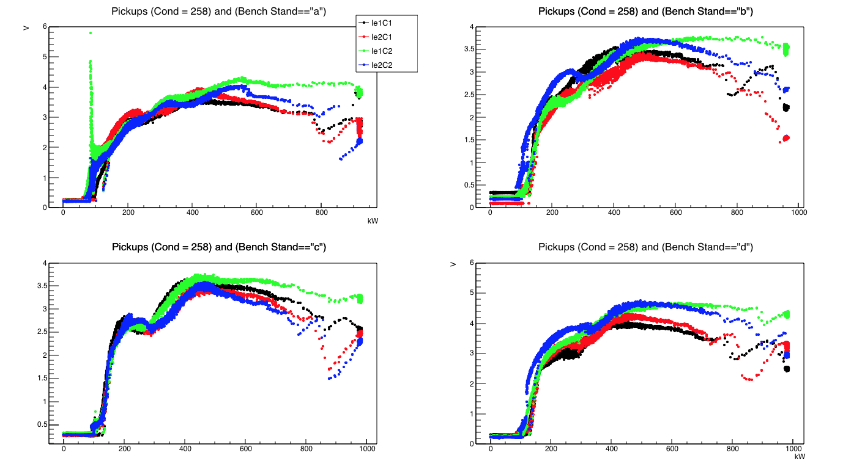
Pickups vs Power Cond 258 step 1

Slide 45
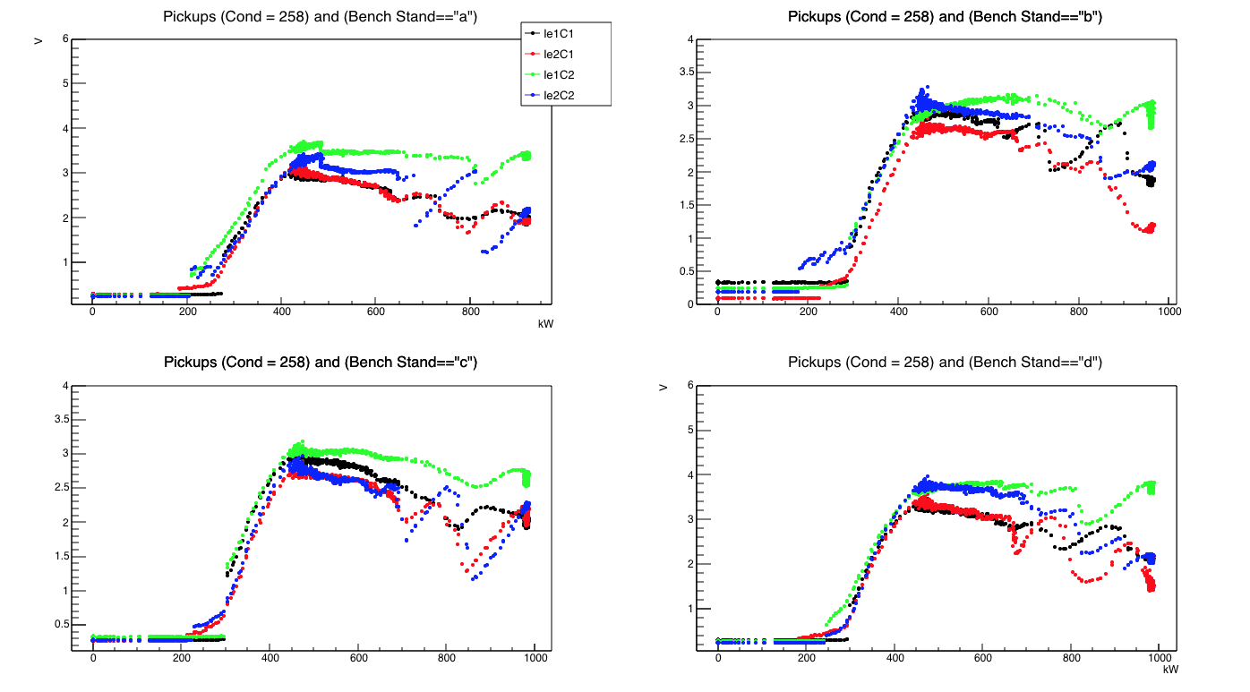
Pickups vs Power Cond 258 step 2

Slide 46
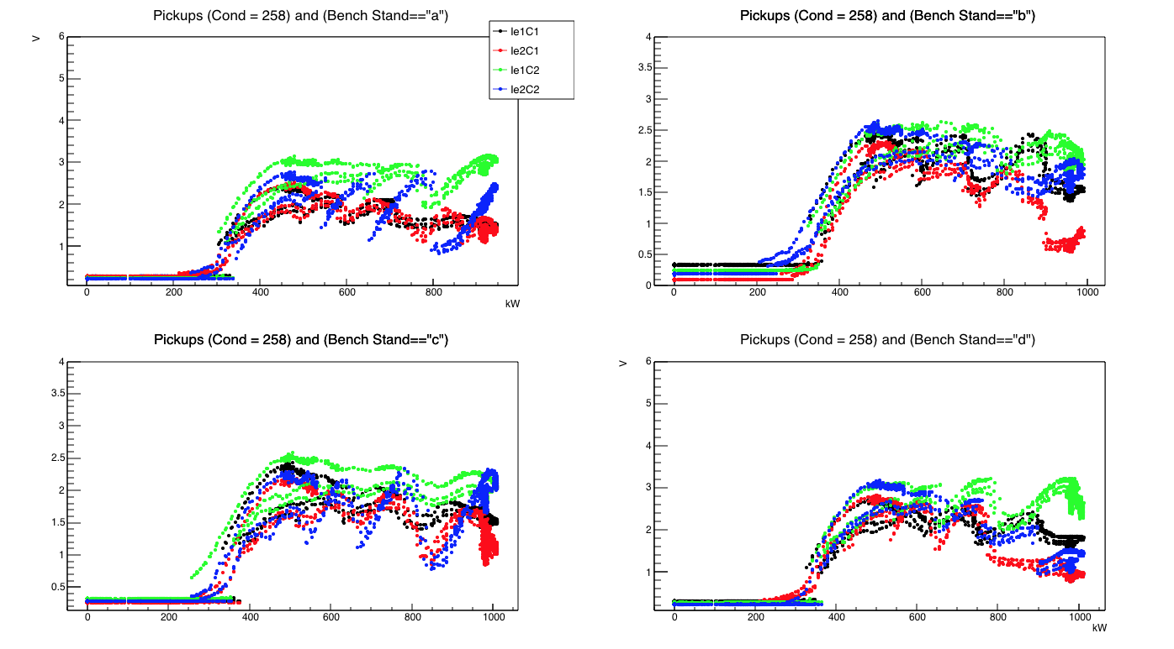
Pickups vs Power Cond 258 step 3

Slide 47
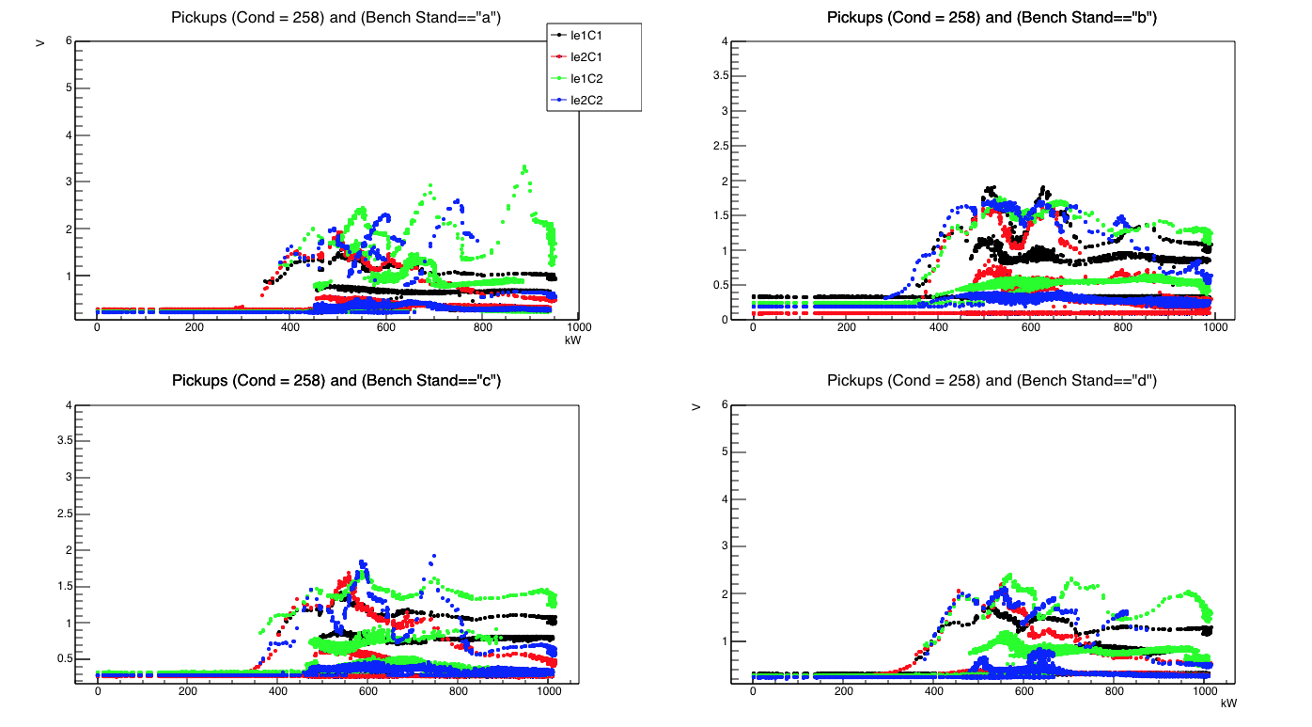
Pickups vs Power Cond 258 step 4

Slide 48
Pickups vs Power Cond 258 step 5

Slide 49
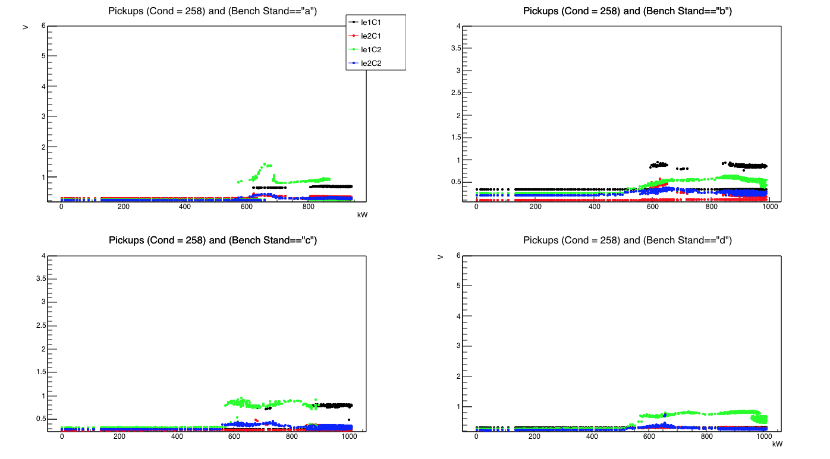
Pickups vs Power Cond 258 step 5(2)

Slide 50
Conditioning effect on pickups
Pickups appearing at low power (<200kW) disappear quite fast
Stable multipactor @ 300, 500 and 800 kW hold until nearly the whole conditioning
  But their intensity decreases
  Picks are more “resistant” for the cold parts and also marked/visible (narrow)

Slide 51
Warm Vacuum vs Power for each step

Slide 52

Vacuum vs Power Cond 258 step 1

Slide 53

Vacuum vs Power Cond 258 step 2

Slide 54

Vacuum vs Power Cond 258 step 3

Slide 55

Vacuum vs Power Cond 258 step 4

Slide 56

Vacuum vs Power Cond 258 step 5

Slide 57

Vacuum vs Power Cond 258 step 5(2)

Slide 58

Vacuum vs Power Cond 258 step 7(2)

Slide 59

Vacuum vs Power Cond 258 step 8(2)

Slide 60
Cold Vacuum vs Power for each step

Slide 61

Vacuum vs Power Cond 258 step 1

Slide 62

Vacuum vs Power Cond 258 step 2

Slide 63

Vacuum vs Power Cond 258 step 3

Slide 64

Vacuum vs Power Cond 258 step 4

Slide 65

Vacuum vs Power Cond 258 step 5

Slide 66

Vacuum vs Power Cond 258 step 5(2)

Slide 67

Vacuum vs Power Cond 258 step 7(2)

Slide 68

Vacuum vs Power Cond 258 step 8(2)

Slide 69
Conditioning efficiency on vacuum levels
High vacuum levels at low power disappear after the first conditioning steps
Vacuum levels around the multipactor area (300 to 800 kW) stay high until the last steps.
  The second turn into the 5th step makes most of the job to decrease the vacuum levels
  Mainly due to the SV1 threshold at < 10⁷mbar (more than 6x lower than standard value).

Slide 70
Overview : pickups and vacuum levels variations during conditioning

Slide 71

Vacuum vs Time Cond 258

Slide 72

Pickups(warm) vs Time Cond 258

Slide 73

Pickups (cold)vs Time Cond 258

Slide 74

Vacuum vs Time Cond 258 step 8(2)

Slide 75

Pickups vs Time Cond 258 step 8(2)

Slide 76

Conditioning duration : needs and reality
Needs: 8 couplers/Week
Baking : 3 ½ days
Remote control
RF conditioning : up to >100h
Increase baking temperature
RF station stabilized
RF conditioning:
< 40h
Possibility : 12 couplers/week

Slide 77


Slide 78
First CPI pairs → Comparison with THRI pairs

Slide 79

Second RF processing (Conditioning 303)
Bench B : CPI-005
Bench C :CPI-006
Bench D:THRI-210
RF conditioning after a second baking. Limiting pair was CPI-006 (warm vacuum)
140 hours to reach the 6th step … still long remaining process (to achieve the good conditions in the end : Vacuum < 10-7 mBar and low pickup level.)

Slide 80
First conclusions
Takes too long to be processed
  Usual process : baking + RF processing in less than 1 week
  Here : more than 200hours with only 6 steps …
    2 steps remains + steps with more drastic conditions on vacuum levels to
    Limiting CPI-006 removed from bench …
    SV1 increased to 7 or 8x10-7 mbar to help the power increase
    To accelerate the conditioning, duration between 2 consecutive power level was changed from 15 seconds to more (> 100 s), method which worked for “bad” THRI couplers
  An RF processing with pairs similar to CPI-5 or CPI-6 should take more than 2 weeks …

Slide 81

Pickups levels vs Power (Step1)

Slide 82

Pickups levels vs Power (Step2)

Slide 83

Pickups levels vs Power (Step3)

Slide 84

Pickups levels vs Power (Step4)

Slide 85

Pickups levels vs Power (Step5)

Slide 86

Pickups levels vs Power (Step6)

Slide 87

Comparison with THRI pairs

Slide 88
Conclusions concerning multipacting zones
CPI and THRI pairs stable multipactors seem to happen at the same powers
This is reassuring to see that they have the same behavior than the THRI couplers
The main issue is the time needed to decrease the vacuum and current levels

Slide 89


Last CPI pair RF conditioned step1

Slide 90


Step6

Slide 91
Remaining issues
Leak on push road bellow observed for some pairs
  Still under investigations
  More systematic tests to be done at company for early detection
    To prevent finding during tests on cryomodule
For some pairs : dark layers on cold ceramics
  Still under investigations
  Many tests already to remove (no success so far)
  Appear on both CPI and THRI pairs

Slide 92






ISSUES
Dark stain in the cold ceramics
→ Not yet solved, investigations are on going.

Slide 93

Dark stains on cold ceramics

Slide 94

RF conditioning data to find “strange behavior”
Large vacuum levels in associated warm vacuum. The vacuum level seems independent on the RF power. The correlation with electronic activity is also very poor.

Slide 95

RF conditioning data to find “strange behavior”
Current activity seems “normal”. The process which makes the large vacuum seems not understood and seems not strongly depends on the electronic activity.

Slide 96

RF conditioning data to find “strange behavior”

Slide 97


→ Shipment to IRFU n and RF conditioning at LAL

Slide 98
Production status and projections

Slide 99

Status of coupler production:
XM56

Slide 100


Slide 101
Thanks for your attention.

