Slide 1

LHC commissioning and operation at 13 TeV:
status and plans
Séminaire LAL
Frédérick Bordry
26th February 2016

Slide 2
LHC (Large Hadron Collider)
14 TeV proton-proton accelerator-collider built in the LEP tunnel
Lead-Lead (Lead-proton) collisions
1983 : First studies for the LHC project
1988 : First magnet model (feasibility)
: Approval of the LHC by the CERN Council
1996-1999 : Series production industrialisation
1998 : Declaration of Public Utility & Start of civil engineering
1998-2000 : Placement of the main production contracts
2004 : Start of the LHC installation
2005-2007 : Magnets Installation in the tunnel
2006-2008 : Hardware commissioning
2008-2009 : Beam commissioning and repair
2010-2035: Physics exploitation

Slide 3
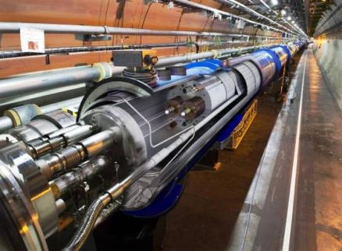
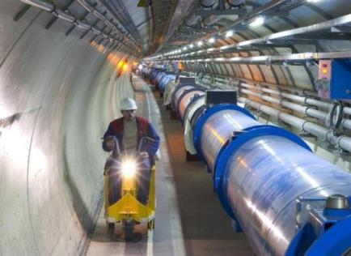
LHC:
technological challenges
The specifications of many systems were over the state of the art.
Long R&D programs with many institutes and industries worldwide.
The highest field accelerator magnets: 8.3 T (1232 dipole magnets of 15 m)
The largest superconducting magnet system (~10’000 magnets)
The largest 1.9 K cryogenics installation (superfluid helium, 150 tons of LHe to cool down 37’000 tons)
Ultra-high cryogenic vacuum for the particle beams (10⁻¹³ atm, ten times lower than on the Moon)
The highest currents controlled with high precision (up to 13 kA)
The highest precision ever demanded from the power converters (ppm level)
A sophisticated and ultra-reliable magnet quench protection system
(Energy stored in the magnet system: ~10 Gjoule, in the beams > 700 MJ)

Slide 4
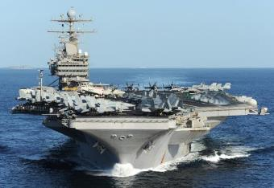

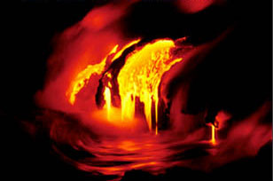
Energy management challenges
Energy stored in the magnet system: ∼10 GJoule
10 GJoule ≅ 55 km/h
10 GJoule ≅ flying 700 km/h
560 tons
88’000 tons
Energy stored in the two beams: 720 MJ [ 6 10¹⁴ protons (1 ng of H+) at 7 TeV ]
700 MJ melt one ton of copper
700 MJoule dissipated in 88 μs
700.106 / 88.106 ≅ 8 TW
World Electrical Installed Capacity ≅ 3.8 TW
1 electron volt = 1,602× 10⁻¹⁹ joule
Notes:
4
Aircraft carrier

Slide 5
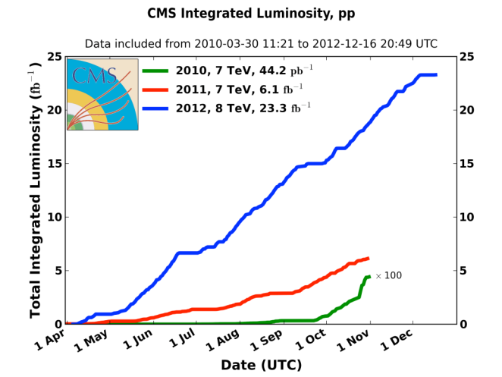
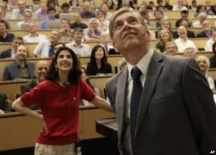
LHC 2010-2012: a rich harvest of collisions
Σ ∼30 fb⁻¹
∼ 2 10¹⁵ collisions
2010: 0.04 fb⁻¹
  7 TeV CoM
  Commissioning
  2011: 6.1 fb⁻¹
  7 TeV CoM
  … exploring limits
2012: 23.3 fb⁻¹
  8 TeV CoM
  … production
BEH boson announcement
3.5 TeV and 4 TeV in 2012
Up to 1380 bunches
with1.5 10¹¹ protons
Notes:
70 millions de millions de collisions = 1 femtobarn⁻¹

Slide 6
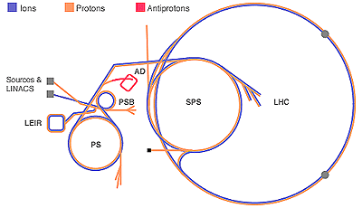
Long Shutdown LS1 from Feb. 2013 to Mar. 2015
2013
2014
2015
F
M
A
M
J
J
A
S
O
N
D
J
F
M
A
M
J
J
A
S
O
N
D
J
F
M
A
LHC
SPS
PS
PS Booster
beam to beam
available for works
Physics
Beam commissioning
Shutdown
Powering tests
Over 1 Million Hours Worked in the LHC Tunnel
Prepare the LHC for Operation at Nominal Energy
Consolidate and Upgrade the LHC and Injector performance
Major Maintenance Programme
  Safety First,
  Quality Second,
  Schedule Third.

Slide 7
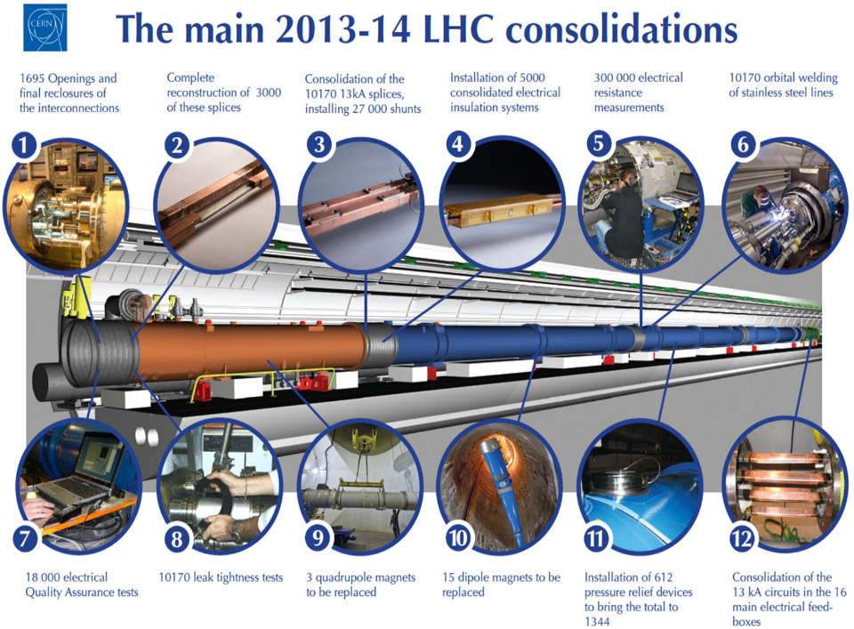
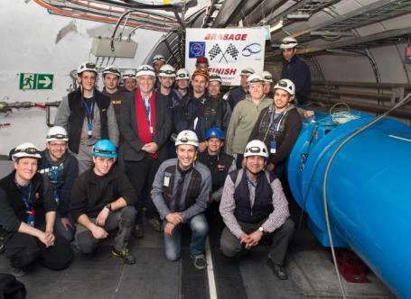
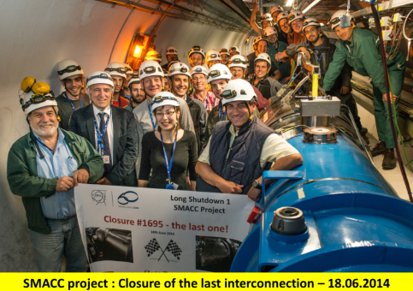
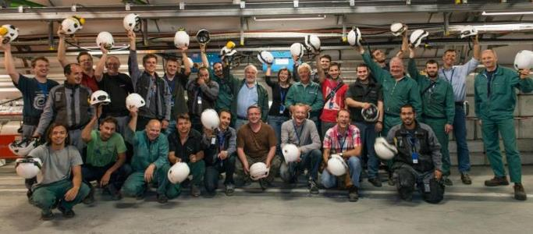

Slide 8
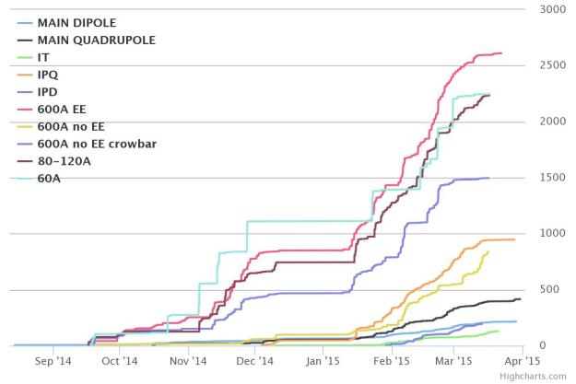
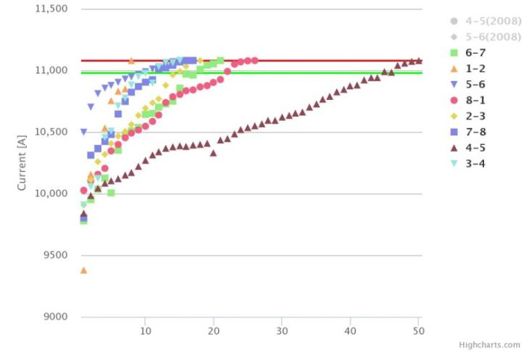
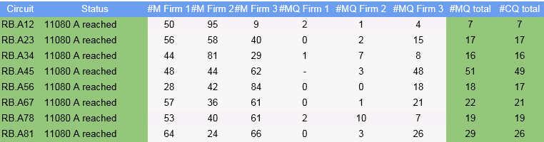
The LHC powering tests overview
Powering tests were completed at 8 am
on Friday 3rd April 2015
172 training quenches
∼600 secondary quenches
Only 1 quadrupole quench
Since September 15th 2014:
1566 superconducting circuits commissioned through execution and analysis of more than 10.000 test steps (~13.800 test steps including re-execution)

Slide 9
Dipole Training Campaign
Each Sector Trained to 6.55TeV (11080A)
(100 A above the operational field)
Sector | # Training quench | Flattop quenches
S12 | 7 | 0
S23 | 17 | 0
S34 | 15 | 1
S45 | 51 | 0
S56 | 18 | 3
S67 | 22 | 1
S78 | 19 | 3
S81 | 29 | 0
Total | 171 | 8
Large variation in number of training quenches per sector
Detailed Analysis in Progress!

Slide 10
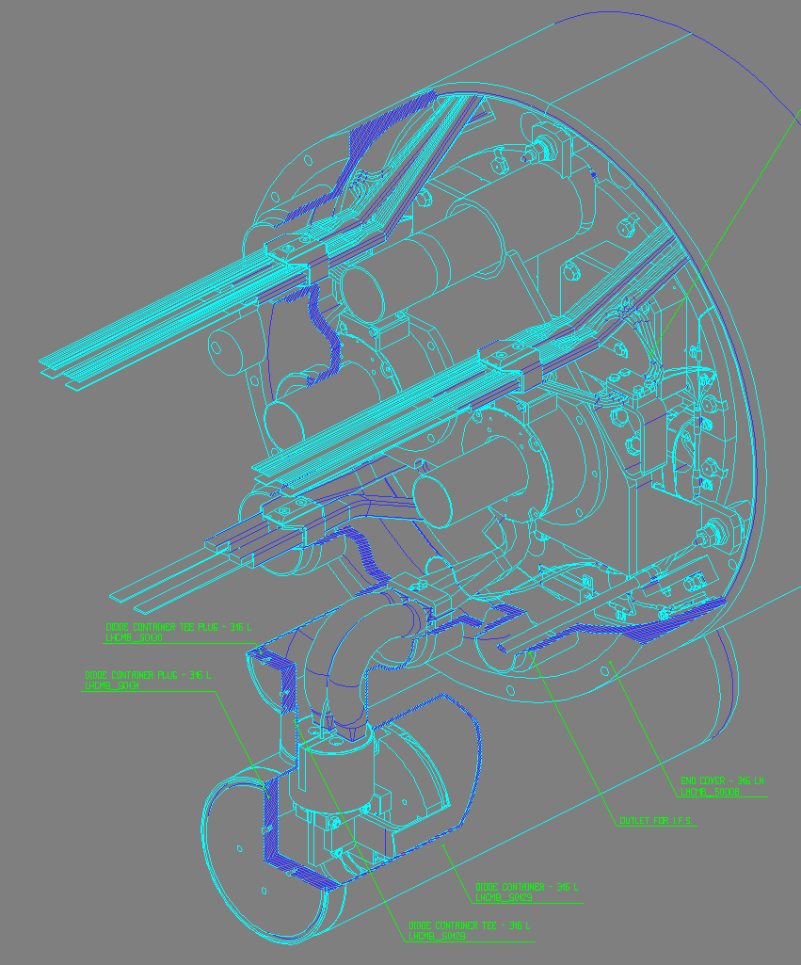
Not everything is plain sailing!
One example… sector 3-4
Metallic Debris
Earth Fault:
Connection side of main dipole magnet and bypass diode
The short is very likely caused by a small metallic debris, bridging the half moon with the diode tube.
Unfortunately can not see the debris in the affected magnet

Slide 11
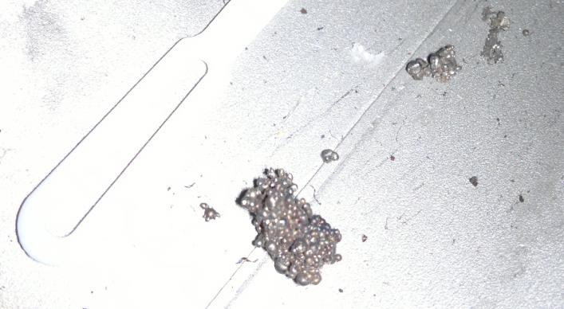
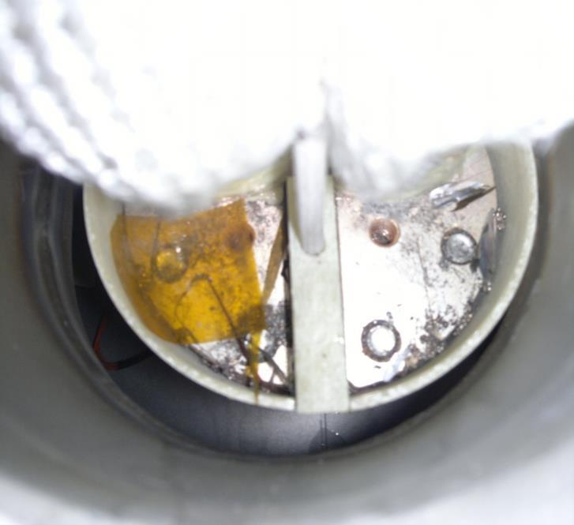
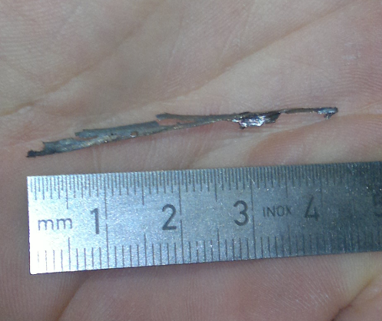
Metal chips and pieces found in the past
Top of the half moon

Slide 12
Three options were evaluated
X-ray of the
“half moon”
Try to blow away the debris with He flow
☺
☹
Try to vaporize the debris with an electrical discharge
Warm-up, open interconnect, and clean diode box
☹
☺
☺
Powering tests
All three options were evaluated, in terms of feasibility, duration, and risk.
Electrical Discharge Method Chosen

Slide 13
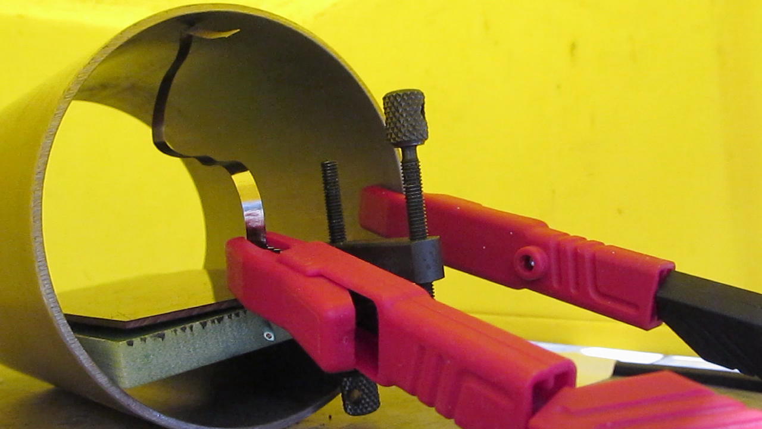
One week of intense preparation

Slide 14
Discharge Set-Up
OUTSIDE
INSIDE
IFS
Voltage reading by insulated probes (channels 2 & 4)
V-taps
MB.C19L4
1 HDS charged to
900 V (2.86 kJ)
1 Ω
Fault to GND
V
V
10 kΩ
I-taps
1 Ω
GND tap
Discharge Current
Current reading by transformer by a pulse transformer (channel 3)
Cryostat Wall
Courtesy Andrzej Siemko

Slide 15
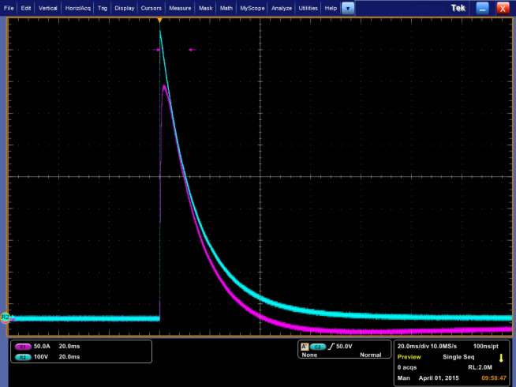
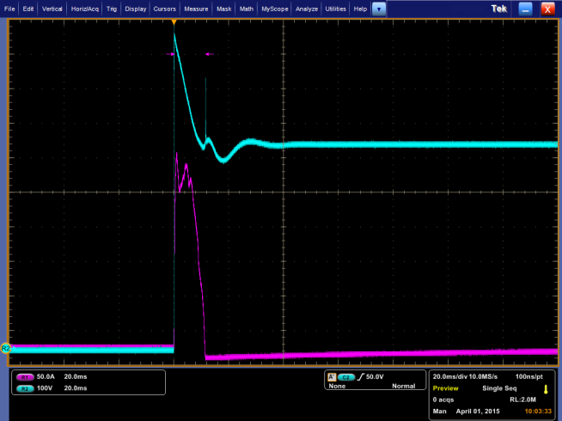
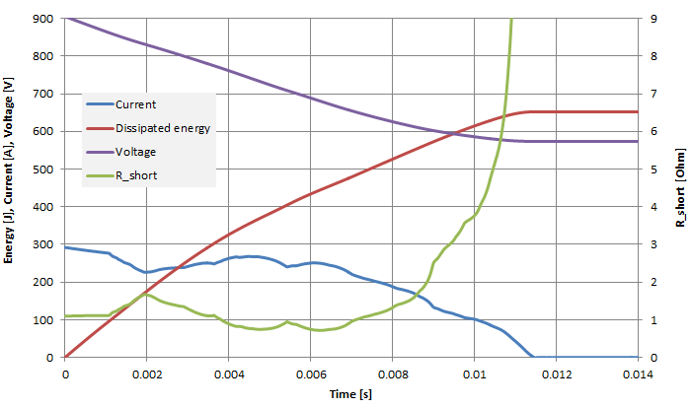
How it worked ?
and 11ms instead of 2 month
(10 days of thinking and preparation)
Dummy discharge
Burning discharge
Discharge stops at ~578V
Discharge time: ~11.5ms
Discharge voltage: 906V to 578V
Dissipated energy: ~1.5kJ
Balancing resistors: 2x1Ohm
Short resistance: ~1 Ohm
Energy dissipated in short: ~500J
Courtesy of J. Steckert, M. Dominguez and A. Verweij

Slide 16
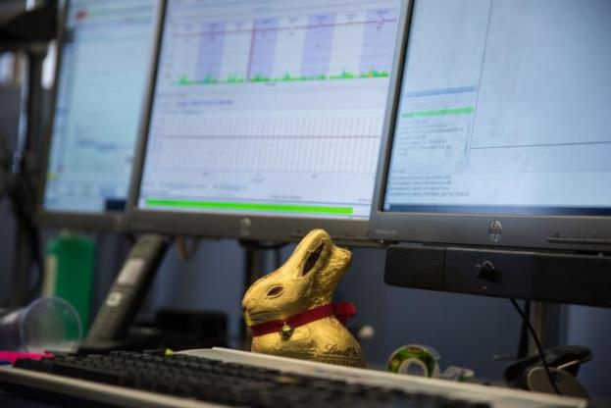
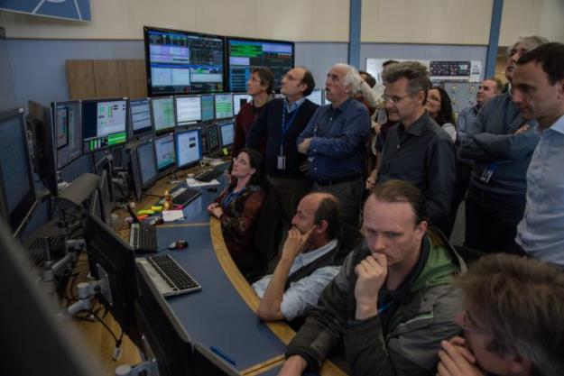
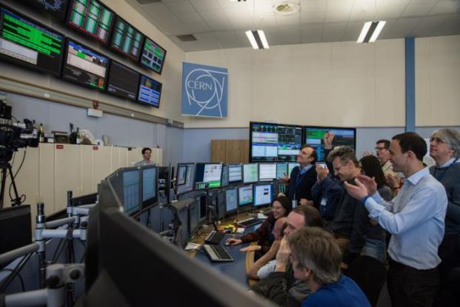
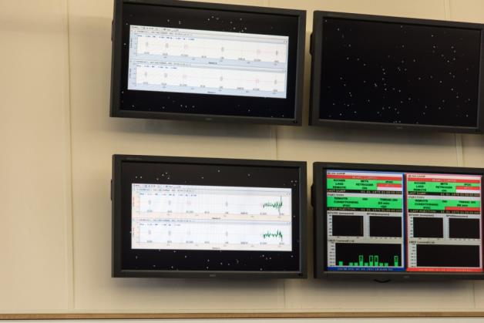
First circulating beams in LHC on Easter Sunday
5th April 2015

Slide 17
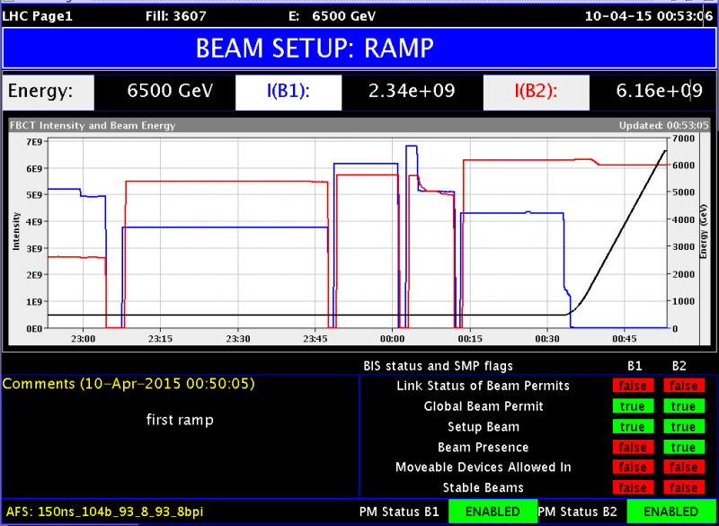
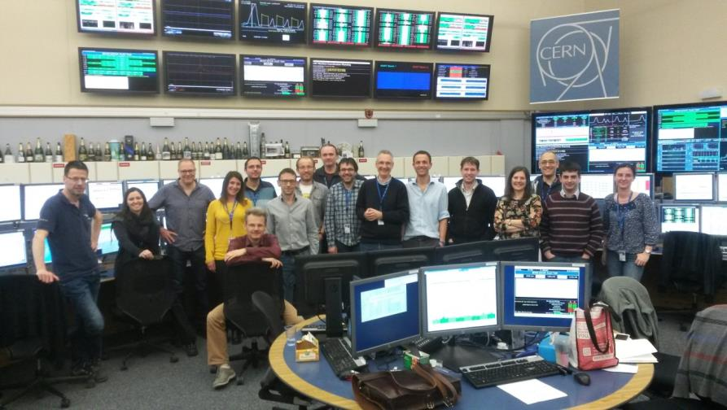
First beam at 6.5 TeV! (10th April)

Slide 18
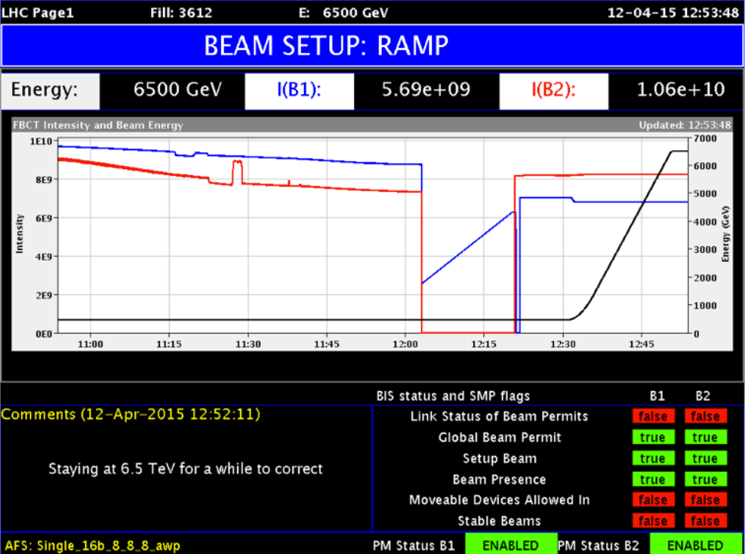
First beams at 6.5 TeV! (12th April)
First beam at 6.5 TeV! (10th April)

Slide 19
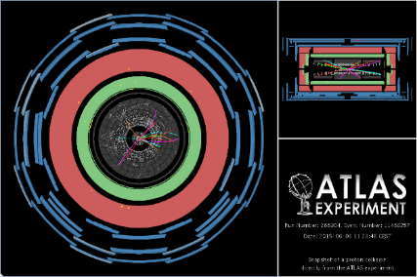
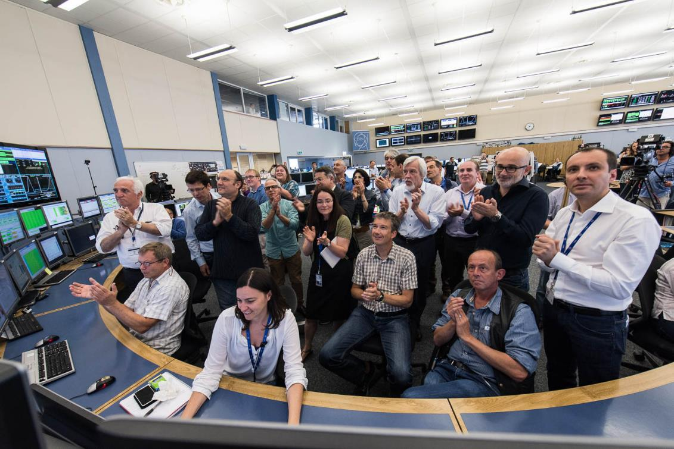
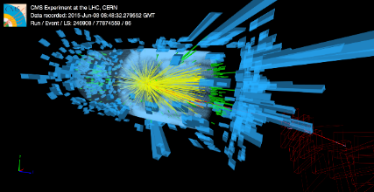
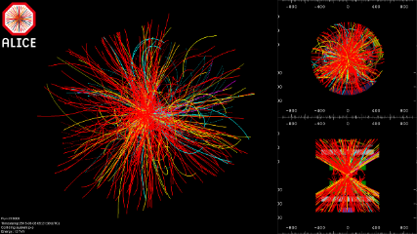
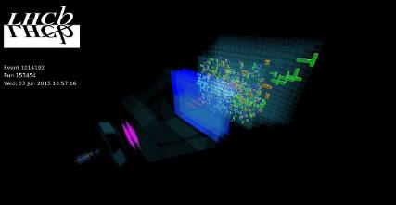
LHC experiments are back in business at a new record energy 13 TeV
3rd June 2015

Slide 20
Beam commissioning in two months ☺
13 TeV
A lot of lessons learnt and experience from Run 1
Excellent and improved system performance (LS1)
  Beam Instrumentation
  Transverse feedback
  RF
  Collimation
  Injection and beam dump systems
  Vacuum
  Machine protection
Improved software & analysis tools (LS1)
Magnetically reproducibility
Optically good, corrected to excellent
Behaving well at 6.5 TeV
  One additional training quench so far
Operationally well under control
  Injection, ramp, squeeze, de-squeeze
Terrific team work

Slide 21
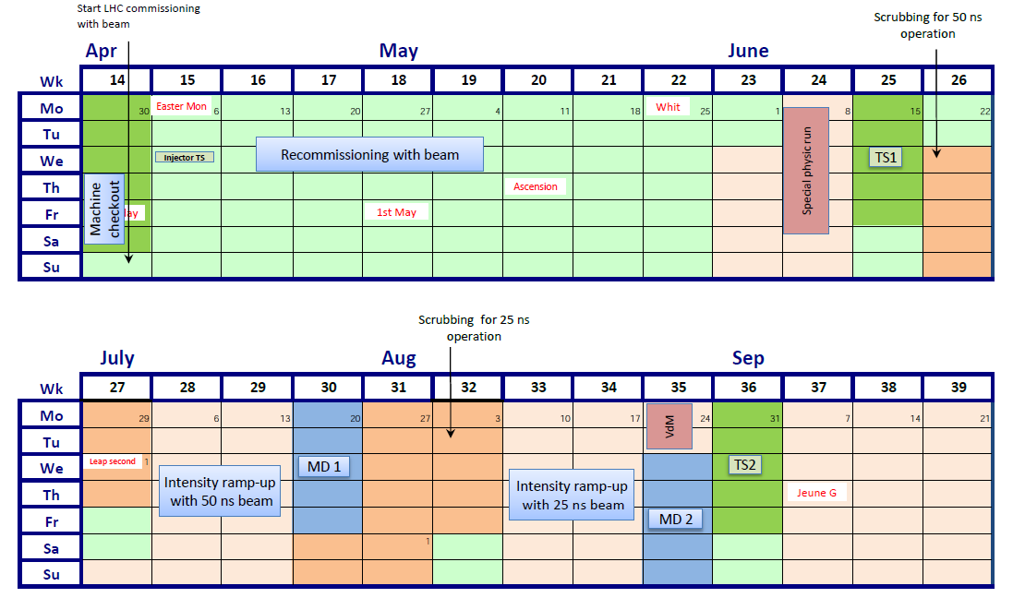
2015 Commissioning strategy
1
2
3
4
6
6
5
Low intensity commissioning – 8 weeks
First physics – low number of bunches, LHCf run
Electron cloud scrubbing for 50 ns (e-cloud)
Physics - intensity ramp-up with 50 ns
  Characterize high intensity operation (≈ repeat 4 TeV @ 6.5 TeV)
Electron cloud scrubbing for 25 ns (e-cloud)
Physics - ramp-up intensity for 25 ns operation

Slide 22
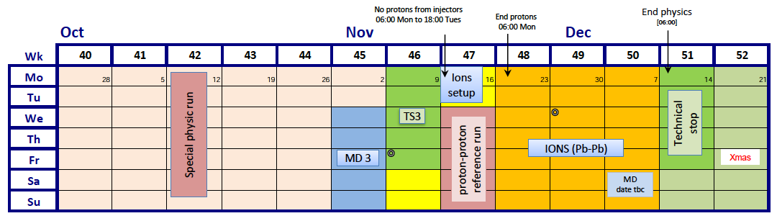
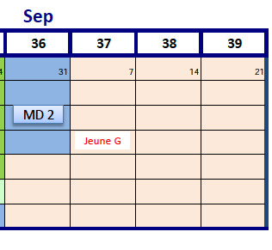



End of 2015: 25 ns physics run
889 b
1608 b
2041 b
1608 b
459 b
1033 b
745 b
1465 b
1177 b
1321 b
1825 b
Resume of the intensity ramp up after TS2
  First driven by machine protection validation
  Then driven by cryo system operation (> 1600 bunches)
Special physics run (90 m optics)
  back to lower beam intensity for commissioning and production → step down for 25 ns physics run
Ions run to conclude the year:
  Including intermediate energy run with proton at 2,51 TeV
October 28th,

Slide 23
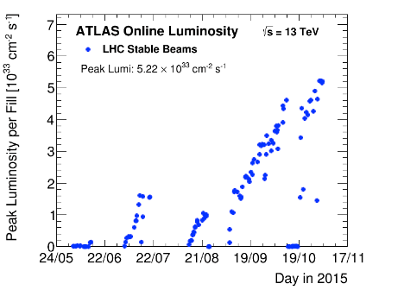
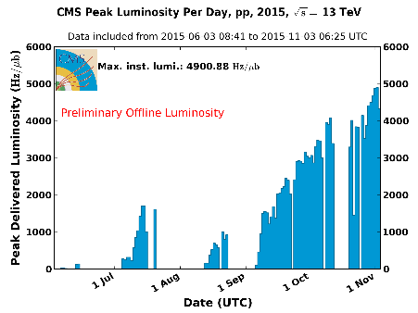
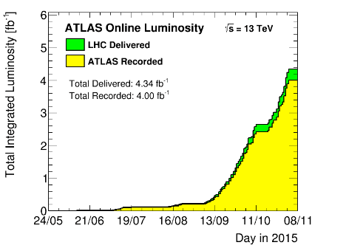
2015 LHC Luminosity
ATLAS
CMS
Peak
5 x 10³³ cm⁻¹ s⁻¹
Design 10³⁴ cm⁻¹ s⁻¹
Integrated

Slide 24
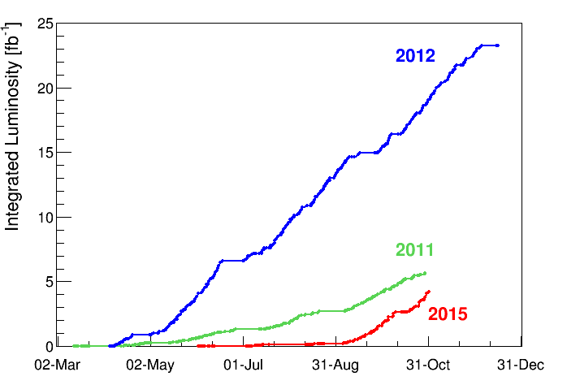
2015 LHC Integrated Luminosity
The initial projections of integrated luminosity for 2015 were ~ 8 fb⁻¹.
Achieved ~ 4.3 fb⁻¹.
Slope at the end of the run better than in 2011, and close to 2012 slope
(last week of operation > 1 fb⁻¹)
The main reasons for the lower value:
- Start-up delays (~ 4 weeks),
- Availability issues (radiation failures on the quench protection tunnel electronics; solved after TS2),
- Electron clouds mitigation

Slide 25
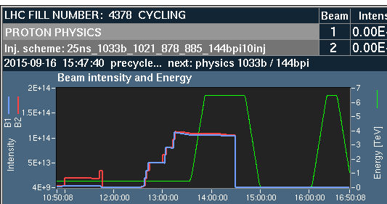
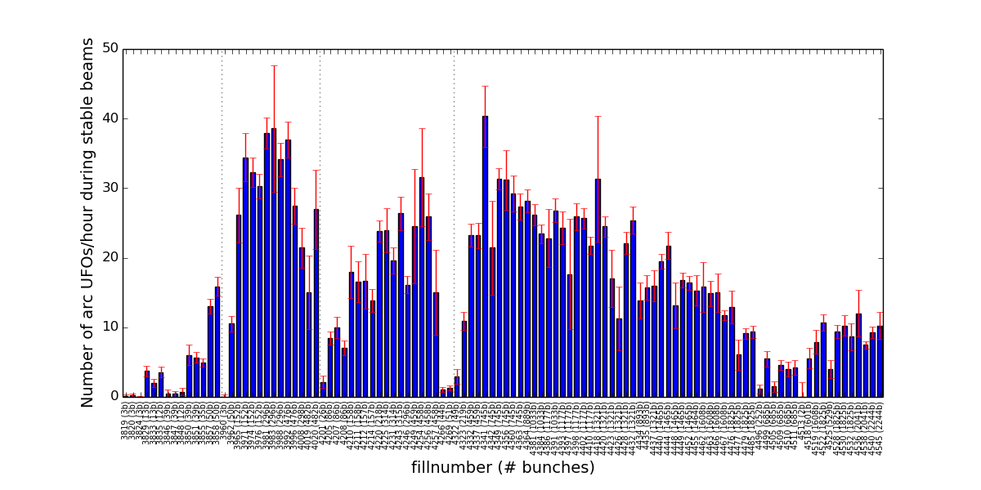
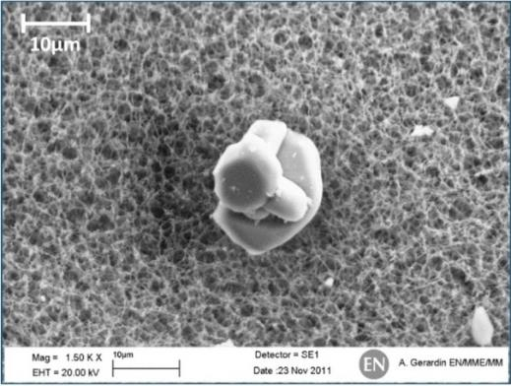
UFOs
There are with us, they are many of them, they are large !
UFO events observed quite often during operation at 6.5 TeV
25ns scrubbing
2015
1033 x 1033
UFO

Slide 26
UFOs
There are with us, they are many of them, they are large !
UFO events observed quite often during operation at 6.5 TeV
Conditioning is observed on the UFO rate in spite of the increasing number of bunches
BLM thresholds being optimize to find a good compromise between availability and quench protection
25ns scrubbing
2015

Slide 27
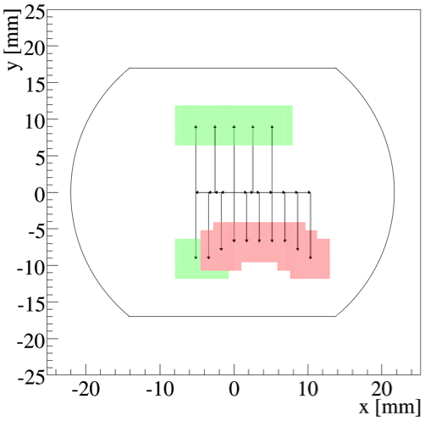
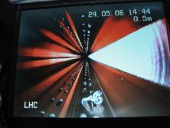
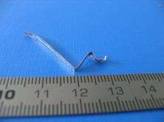
The bad ‘surprise’ : aperture restriction (ULO)
Aperture restriction:
A position with anomalous beam losses was located on beam 2 in the arc between LHCb and ATLAS only few days after commissioning.
Measured at injection and 6.5 TeV
An aperture restriction due to an was found by scanning the beam position.
Reference orbit is bumped by +1mm in V and -3mm in H at 15R8.
2015 not a limiting aperture for operation
Objects found in the past in the LHC vacuum chambers

Slide 28

The bad ‘surprise’ : aperture restriction (ULO)
Aperture restriction:
A position with anomalous beam losses was located on beam 2 in the arc between LHCb and ATLAS only few days after commissioning.
Measured at injection and 6.5 TeV
An aperture restriction due to an was found by scanning the beam position.
Reference orbit is bumped by +1mm in V and -3mm in H at 15R8.
2015 not a limiting aperture for operation
Opening the magnet to remove this object would take 2-3 months !
=> Not planned for YETS (Year End Technical Stop)

Slide 29
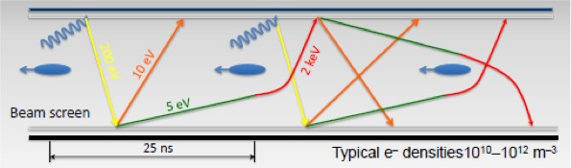
Some Limitations: e-cloud
Electron bombardment of a surface has been proven to reduce drastically the secondary electron yield (SEY) of a material. This technique, known as scrubbing, provides a mean to suppress electron cloud build-up.
Electron cloud significantly worse with 25 ns

Slide 30
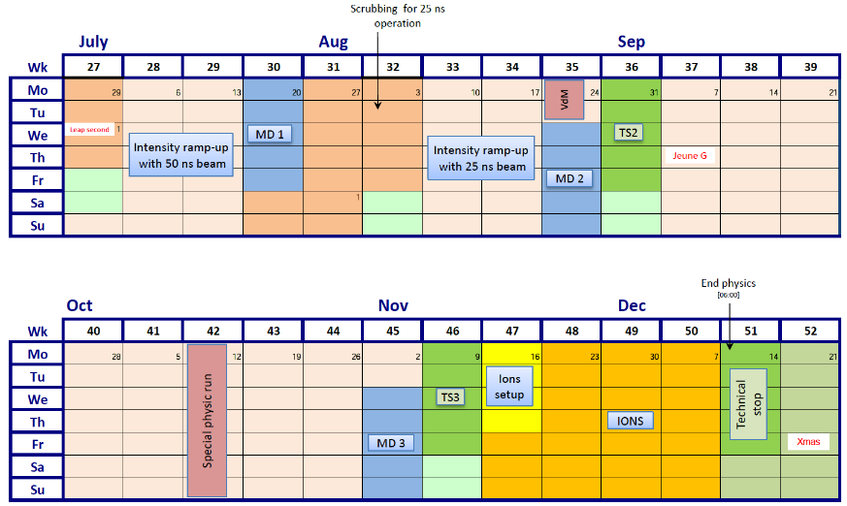
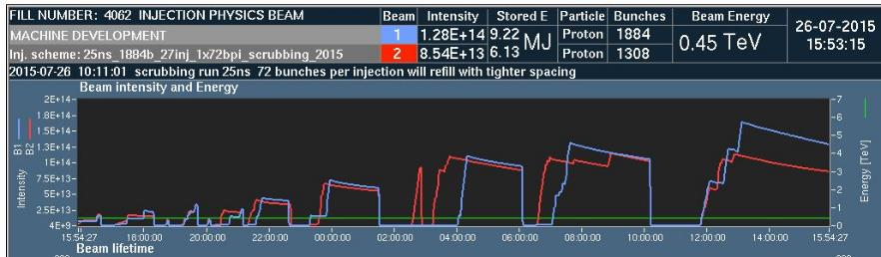
LHC 2015 – Q3/Q4

Slide 31
Scrubbing @ 25 ns bunch spacing
Two weeks of scrubbing with ~60% effective scrubbing time, excellent result considering that operating at the machine performance limits.
Observations confirmed the effectiveness of the Scrubbing process
  Clear improvement of beam quality thanks also to adapted machine settings.
    Decrease of proton losses, heat load on cryogenics
  Expected to keep scrubbing with physics fills by the electron cloud still present
Courtesy Miguel Jimenez and Gianluigi Arduini

Slide 32

Heat Load Evolution – E cloud
Scrubbing observed with physics fills at 6.5 TeV
  Hopefully gaining margin to further increase the number of bunches
  Scrubbing “memory” kept while running with 25 ns beams - deconditioning was observed after few weeks of low e-cloud operation
Dipoles of the instrumented half-cells

Slide 33


2015 LHC Machine availability
Statistics for 25 ns run from September 7 to November 3

Slide 34


LHC cryogenic availability
98,9 % per sector (8)

Slide 35



End of 2015: Lead-Lead physics run
- After TS3, restart for ions physics run
- Intermediate energy run with protons at 2.51 TeV :
  Full cycle commissioning: combined ramp
  and squeeze, optics, Machine protection validation....
  - Intensity ramp up: up to 1800 bunches per beam
- 3 weeks of Pb-Pb collisions:
  - Again full validation of a new cycle at 6.37 ZTeV: Alice pre-squeeze, squeeze, ALICE crossing reversal + IP shift....

Slide 36




Lead-Lead physics run: Summary
- Design peak lumi: 1×10²⁷ cm⁻²s⁻¹:
  ALICE leveled at design luminosity
  ATLAS/CMS already beyond (up to 3.5x10²⁷ cm⁻²s⁻¹ )
- Delivered luminosity(3 weeks of physics):
  Target for 2015 ions run :300 - 500 µb⁻¹
  ALICE 430 µb⁻¹ ; ATLAS/CMS ∼700/600 µb⁻¹

Slide 37


2016
2016 a production year

Slide 38

Proton-Proton Plans for 2016
Stable Safe Operations
  Don’t compromise on machine safety!
  Don’t do anything to compromise machine reproducibility
Electron Cloud under control
  Short dedicated scrubbing
  Continue during intensity ramp-up
6.5 TeV, 40-50 cm β*
  Keep an eye on availability
Nominal 25ns beam, 2748 bunches, 288 bpi
  May push later to shorter bunches & BCMS
Reasonable Good! Availability
  Sustained effort to trace faults
  Keep avoidable interruptions to production running to a minimum
Excellent Operational Efficiency
  Combined ramp/squeeze
  Work on injection process

Slide 39


LHC goal for Run 2 and 3
Integrated luminosity goal:
Run2: ∼100-120 fb⁻¹
∼ 300 fb⁻¹ before LS3
30 fb⁻¹
300 fb⁻¹

Slide 40
LHC roadmap: according to MTP 2016-2020
Physics
LS2 starting in 2019 => 24 months + 3 months BC
LS3 LHC: starting in 2024 => 30 months + 3 months BC
Injectors: in 2025 => 13 months + 3 months BC
Shutdown
Beam commissioning
Technical stop
Run 3
Run 2
HL-LHC Civil engineering
LS 2
LIU installation
PHASE 1
Run 4
Run 3
LS 3
Run 4
HL-LHC installation
PHASE 2
LS 4
LS 5
LS 4
Run 5
LS 5

Slide 41

The European Strategy for Particle Physics
Update 2013
Europe’s top priority should be the exploitation of the full potential of the LHC, including the high-luminosity upgrade of the machine and detectors with a view to collecting ten times more data than in the initial design, by around 2030. This upgrade programme will also provide further exciting opportunities for the study of flavour physics and the quark-gluon plasma.
HL-LHC from a study to a PROJECT
300 fb⁻¹ → 3000 fb⁻¹
including LHC injectors upgrade LIU (Linac 4, Booster 2GeV, PS and SPS upgrade)

Slide 42


Strategic Plan for U.S. Particle Physics
Particle Physics Project Prioritization Panel (P5) – May 2014

Slide 43
Goals and means of the LHC Injectors Upgrade: LIU project
Increase intensity/brightness in the injectors to match
HL-LHC requirements
Enable Linac4/PSB/PS/SPS to accelerate and manipulate higher intensity beams (efficient production, space charge & electron cloud mitigation, impedance reduction, feedbacks, etc.)
Upgrade the injectors of the ion chain (Linac3, LEIR, PS, SPS) to produce beam parameters at the LHC injection that can meet the luminosity goal
Increase injector reliability and lifetime to cover HL-LHC run (until ~2035) closely related to consolidation program
Upgrade/replace ageing equipment (power supplies, magnets, RF…)
Improve radioprotection measures (shielding, ventilation…)
Courtesy of Malika Meddahi

Slide 44


LS2 : (2019-2020), LHC Injector Upgrades (LIU)
LINAC4 – PS Booster:
  H⁻ injection and increase of PSB injection energy from 50 MeV to 160 MeV, to increase PSB space charge threshold
  New RF cavity system, new main power converters
  Increase of extraction energy from 1.4 GeV to 2 GeV
PS:
  Increase of injection energy from 1.4 GeV to 2 GeV to increase PS space charge threshold
  Transverse resonance compensation
  New RF Longitudinal feedback system
  New RF beam manipulation scheme to increase beam brightness
SPS
  Electron Cloud mitigation – strong feedback system, or coating of the vacuum system
  Impedance reduction, improved feedbacks
  Large-scale modification to the main RF system
These are only the main modifications and this list is far from exhaustive

Slide 45
Goal of High Luminosity LHC (HL-LHC):
The main objective of HiLumi LHC Design Study is to determine a hardware configuration and a set of beam parameters that will allow the LHC to reach the following targets:
Prepare machine for operation beyond 2025 and up to 2035-37
Devise beam parameters and operation scenarios for:
# enabling a total integrated luminosity of 3000 fb⁻¹
# implying an integrated luminosity of 250-300 fb⁻¹ per year,
# design for μ ∼ 140 (∼ 200) (➔ peak luminosity of 5 (7) 10³⁴ cm⁻² s⁻¹)
# design equipment for ‘ultimate’ performance of 7.5 10³⁴ cm⁻² s⁻¹
and 4000 fb⁻¹
=> Ten times the luminosity reach of first 10 years of LHC operation

Slide 46
LHC Upgrade Goals: Performance optimization
Luminosity recipe :
  1) maximize bunch intensities
  2) minimize the beam emittance
3) minimize beam size (constant beam power);
4) maximize number of bunches (beam power);
5) compensate for ‘F’;
6) Improve machine ‘Efficiency’
Injector complex
LIU ⬄ IBS
  triplet aperture
    25ns
Crab Cavities
minimize number of unscheduled beam aborts

Slide 47

The HL-LHC Project
New IR-quads Nb₃Sn (inner triplets)
  New 11 T Nb₃Sn (short) dipoles
  Collimation upgrade
  Cryogenics upgrade
  Crab Cavities
  Cold powering
  Machine protection
  …
Major intervention on more than 1.2 km of the LHC

Slide 48



Squeezing the beams: High Field SC Magnets
Quads for the inner triplet
Decision 2012 for low-β quads
Aperture ∅ 150 mm – 140 T/m
(B_{peak} ≈12.3 T)
operational field, designed for 13.5 T => Nb₃Sn technology
(LHC: 8 T, 70 mm )
 | β_{triplet} | Sigma triplet | β* | Sigma*
Nominal | ~4.5 km | 1.5 mm | 55 cm | 17 um
HL-LHC | ~20 km | 2.6 mm | 15 cm | 7 um

Slide 49


Quadrupoles of LARP
Courtesy: G. Ambrosio FNAL
and G. Sabbi , LBNL
3.3 m coils
90 mm aperture
LQS01a: 202 T/m at 1.9 K
LQS01b: 222 T/m at 4.6 K
227 T/m at 1.9 K
Target:
200 T/m gradient at 1.9 K
LQS02: 198 T/m at 4.6 K 150 A/s
208 T/m at 1.9 K 150 A/s
limited by one coil
LQS03: 208 T/m at 4.6 K
210 T/m at 1.9 K
1st quench: 86% s.s. limit

Slide 50

LS2 : collimators and 11T Dipole
X

Slide 51



11 T Magnet – Nb3Sn technology
Status on recent developments &tests at CERN
Courtesy of Frédéric Savary
Notes:
This slide shows the results of the 2nd single aperture model of the 11T dipole fabricated at CERN; it is MBHSP102
The training curve in light grey is the one of MBHSP101. In this model, 4 quenches shown in blue dots at the beginning of the training, all the quenches were located in coil 107. This model was dismounted to recover coil 106, and to assemble it with coil 108
The training curve in light grey includes a thermal cycle
The training curve of MBHSP102 is at 1.9 K
The nominal current is 11.85 kA. The test target is 12.5 kA for MBHSP102. It corresponds to a bore field of 11.74 T. Tomorrow we will try to push it to 12.80 kA, which corresponds to 12 T (worth recalling that the structural design is for 12 T)

Slide 52









In-kind contributions and collaborations
for design, prototypes, production and tests
Discussions are ongoing with other countries, e.g Canada,…
ATLAS
CMS
Q1-Q3 : R&D, Design, Prototypes and in-kind USA
D1 : R&D, Design, Prototypes and in-kind JP
MCBX : Design and Prototype ES
HO Correctors: Design and Prototypes IT
Q4 : Design and Prototype FR
CC : R&D, Design and in-kind USA
CC : R&D and Design UK

Slide 53


LHC roadmap: Goal of 3’000 fb⁻¹ by mid 2030ies
3000 fb⁻¹
Run 1
Run 2
Run 3
300 fb⁻¹
30 fb⁻¹
300
High Luminosity project (HL-LHC)

Slide 54

“to propose an ambitious post-LHC accelerator project at CERN by the time of the next Strategy update”
d) CERN should undertake design studies for accelerator projects in a global context,
d) CERN should undertake design studies for accelerator projects in a global context,
with emphasis on proton-proton and electron-positron high-energy frontier machines. These design studies should be coupled to a vigorous accelerator R&D programme, including high-field magnets and high-gradient accelerating structures, in collaboration with national institutes, laboratories and universities worldwide.
HGA
And also R&D on Proton-Driven Plasma
Wakefield Acceleration (AWAKE Expt at CERN)

Slide 55



CLIC Multi-TeV Linear Collider
Tunnel implementations (laser straight)
Central MDI & Interaction Region
Notes:
Main points:
After the work done for the CDR there are several key points that need to be addressed or improved in the coming years (mention the five points on the fly in)
Several of them, for example costing-power-physics-some technical developments, can and will be done in collaboration with similar work for the large ring

Slide 56

“to propose an ambitious post-LHC accelerator project at CERN by the time of the next Strategy update”
d) CERN should undertake design studies for accelerator projects in a global context,
d) CERN should undertake design studies for accelerator projects in a global context,
with emphasis on proton-proton and electron-positron high-energy frontier machines. These design studies should be coupled to a vigorous accelerator R&D programme, including high-field magnets and high-gradient accelerating structures, in collaboration with national institutes, laboratories and universities worldwide.
HGA
HFM
And also R&D on Proton-Driven Plasma
Wakefield Acceleration (AWAKE Expt at CERN)

Slide 57
Future Circular Collider
First studies on a new 80 km tunnel in the Geneva area
  42 TeV with 8.3 T using present LHC dipoles
  80 TeV with 16 T based
  on Nb₃Sn dipoles
  100 TeV with 20 T based
  on HTS dipoles
High Energy-LHC :33 TeV
with 20T magnets

Slide 58

Future Circular Collider Study - SCOPE
CDR and cost review for the next ESU (2018)
Forming an international collaboration to study:
pp-collider (FCC-hh)
defining infrastructure requirements
e⁺e⁻ collider (FCC-ee) as potential intermediate step
p-e (FCC-he) option
~16 T ⇒ 100 TeV pp in 100 km
~20 T ⇒ 100 TeV pp in 80 km
FCC: 80-100 km infrastructure in Geneva area

Slide 59






























Collaboration, February 2015
Collaboration Status (11/2015)
72 Institutes (research centers & universities)
European Commission
26 countries

Slide 60

Conclusions
LHC is operational at 13 TeV c.m. (> 4fb-1) and
with 25ns beams (2x2244 nominal bunches)
From 2016 : production mode at 13 TeV
  - 13TeV, machine scrubbed for 25 ns operation
  - β* = 40 cm in ATLAS and CMS
  - Rapid intensity ramp up should be possible
  Nominal design luminosity 1x10³⁴ cm⁻² s⁻¹ should be reached
  RUN 2 goal : 100 fb⁻¹ and
  to reach 300 fb⁻¹ at the end of RUN 3
  LHC Injector Upgrade (LIU => LS2)
  and High Luminosity LHC (HL-LHC =>LS3)
  well defined and now in construction phase
  Full exploitation of the LHC with optimised planning out to 2035.

Slide 61

Thanks for your attention

Slide 62





MB4001: a “CERN” magnet
Cold mass welding
Winding, collaring, yoking completely “in house”

Slide 63


MB4001: a “bonus” magnet
MB4001 on the test bench in SM-18
15.12.2015
Courtesy Luca Bottura

Slide 64


HL-LHC : Civil Engineering
Surface building @ P5

Slide 65



Integration: vibration, machine integration, double decker and more
Vibration studies and measurements
Machine lay-out
Double Decker: lay-out and service integration (for WP17)
Courtesy of P. Fessia

