Slide 1
LAB data and PAON4 new data
Qizhi Huang
17 Dec. 2015

Slide 2
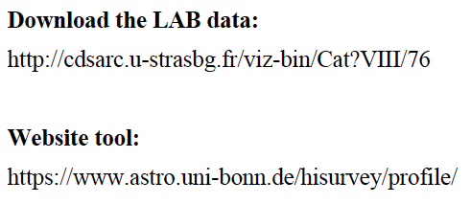
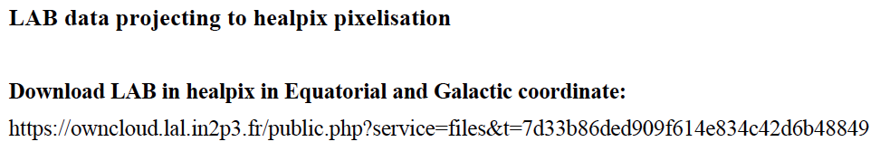
LAB data
https://owncloud.lal.in2p3.fr/public.php?service=files&t=7d33b86ded909f614e834c42d6b48849

Slide 3
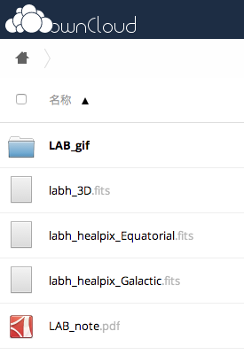
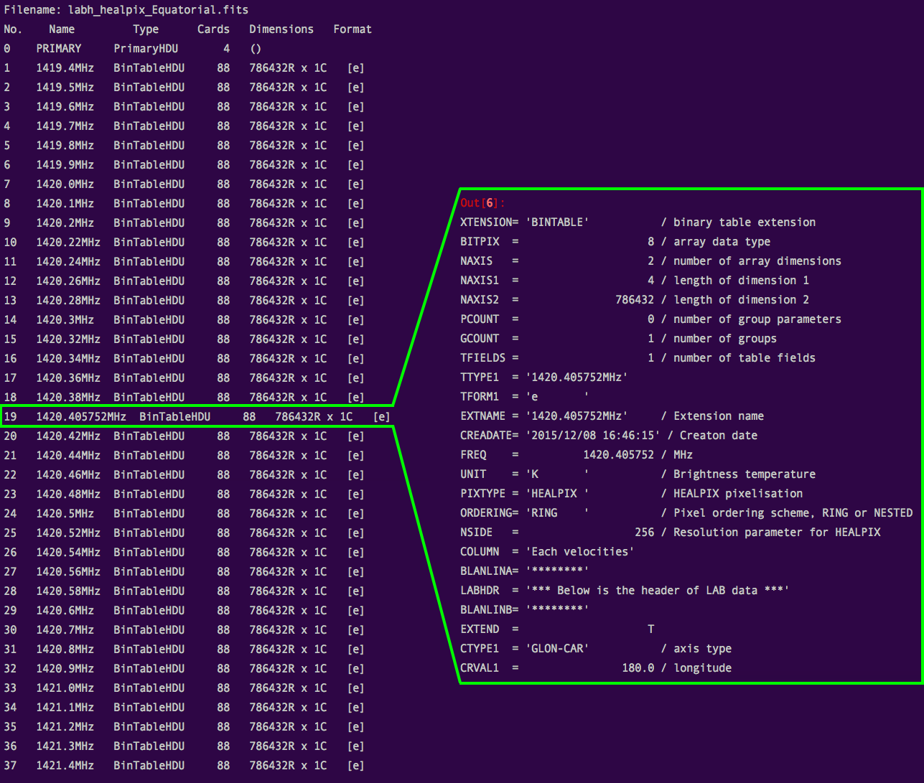
Header of FITS

Slide 4
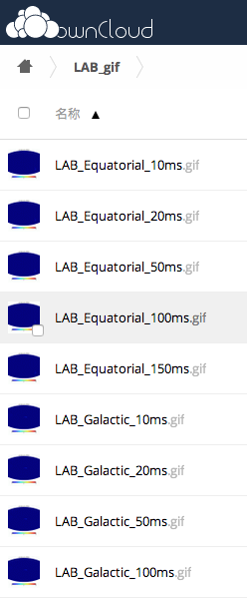
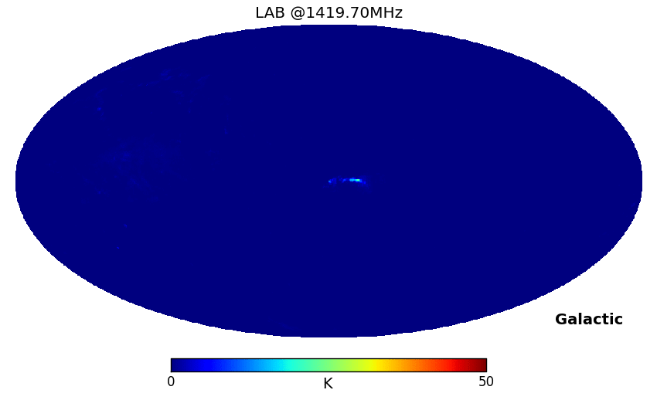

GIF image

Slide 5
PAON4 new data
CygA365S7dec15, Cy gA465S5dec15, CygA565S2dec15, CygA665S1dec15, CygA765S30nov15, CygA865S3dec15, CygA965S6dec15
Map produced from CygA665S1dec15
We can use the 7 data above to make a 7degree map

