Slide 1


High-Efficiency
Klystron Design for the CLIC Project
Antoine Mollard¹, Claude Marchand¹,
Franck Peauger¹, Juliette Plouin¹
Armel Beunas², Rodolphe Marchesin²
¹DRF/Irfu/SACM/Lisah
CEA Saclay
91191 Gif-sur-Yvette Cedex
²Thales Electron Devices
2 Rue Marcel Dassault
78140 Vélizy-Villacoublay
Journée des Doctorants Pheniics 2016| Mollard Antoine antoine.mollard@cea.fr

Slide 2
High-Efficiency Klystron Design for the CLIC Project
High-efficiency RF source design
Klystron principle
Kladistron (high-efficiency klystron) principle
TH2166 klystron and the kladistron prototype design
Cavities fabrication

Slide 3
High-efficiency RF source Design

Slide 4



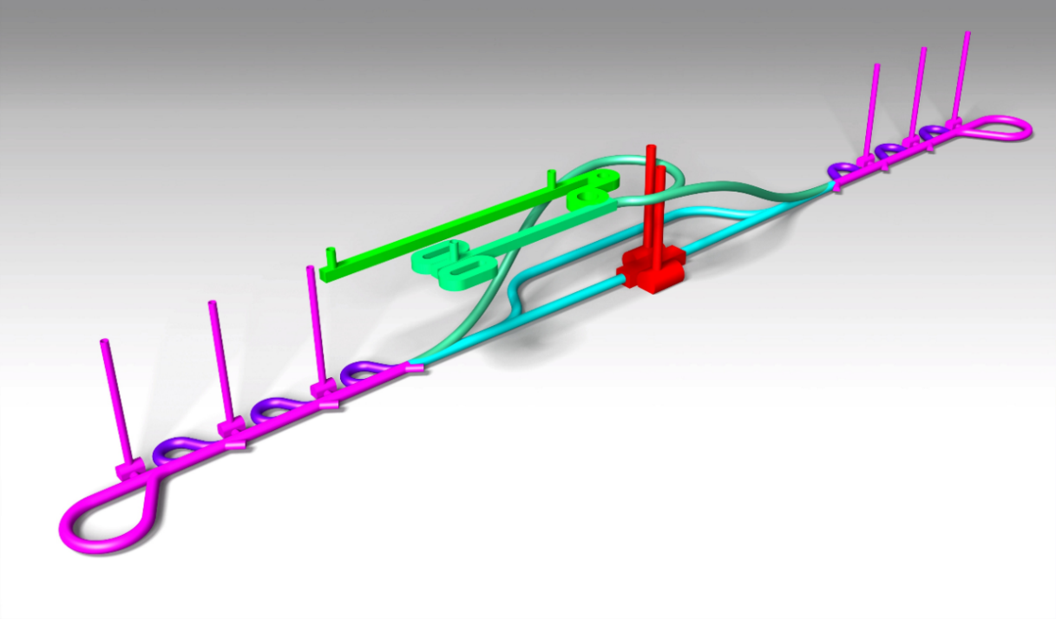
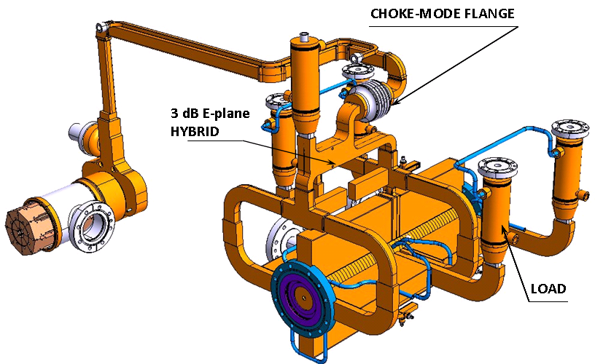
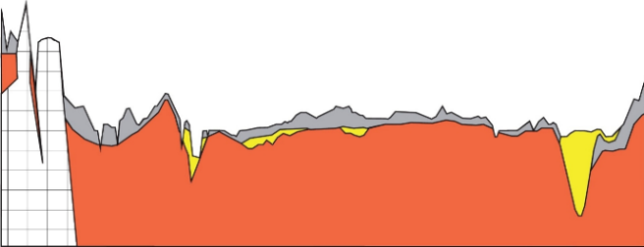
The CLIC project
CLIC : Compact LInear Collider
3TeV 50km-long electron/positon collider
CLIC accelerator is designed with several cavities (about 120000)
These cavities need conditioning on specific benches with high-power RF source (klystron).
e
-
e
+
I
N
J
E
C
T
I
O
N
D
E
S
C
E
N
T
T
U
N
N
E
L
I
N
J
E
C
T
I
O
N
D
E
S
C
E
N
T
T
U
N
N
E
L
C
O
M
B
I
N
E
R
R
I
N
G
S
D
R
I
V
E
B
E
A
M
I
N
J
E
C
T
O
R
m
B
Y
P
A
S
S
T
U
N
N
E
L
CLIC accelerator RF cell
0
I
N
T
E
R
A
C
T
I
O
N
R
E
G
I
O
N
D
R
I
V
E
B
E
A
M
L
O
O
P
S
0
1
M
A
I
N
B
E
A
M
I
N
J
E
C
T
O
R
H
RF Power (120 MW)
D
A
M
P
I
N
G
R
I
N
G
S
H
1
k
m
D
R
I
V
E
B
E
A
M
D
U
M
P
S
T
U
R
N
A
R
O
U
N
D
L
i
m
e
s
t
o
n
e
s
M
o
l
a
s
s
e
M
o
r
a
i
n
e
s
S
a
n
d
s
a
n
d
g
r
a
v
e
l
s
C
L
I
C
S
C
H
E
M
A
T
I
C
I
N
J
E
C
T
I
O
N
T
U
N
N
E
L
L
H
C
(
n
o
t
t
o
s
c
a
l
e
)
e
-
S
I
D
E
e
+
S
I
D
E
F
R
A
N
C
E
S
W
I
T
Z
E
R
L
A
N
D
A high-efficiency klystron would lead us to a cheaper solution.
Decelerated Drive Beam 100 A
Accelerated Main Beam 1 A

Slide 5



The high-efficiency klystron project
WP12 : Innovative RF Technologies
2013 - 2017
« In this sub-task, CEA will develop and search for innovative concepts of X band RF power sources and components. The objective is to propose affordable and reliable solutions for future testing capabilities for the CLIC accelerating structures. The task includes the design and the fabrication of prototype RF devices to demonstrate the feasibility of the new concepts proposed. »
Budget available to build a (small) part of the RF power source or component
Collaboration with THALES ELECTRON DEVICES :
PhD funding : 50% CEA/50% Thales (Contrat de Thèse CEA Industrie)
Co-supervisation :
Juliette Plouin/Franck Peauger/Claude Marchand @ CEA
Armel Beunas/Rodolphe Marchesin @ Thales
Collaboration with CERN : Igor Syratchev, Walter Wuensch…
MAGIC bought by CEA with “contribution exceptionnelle de la France au CERN”
☞ Activity fully oriented towards R&D

Slide 6
Klystron principle

Slide 7
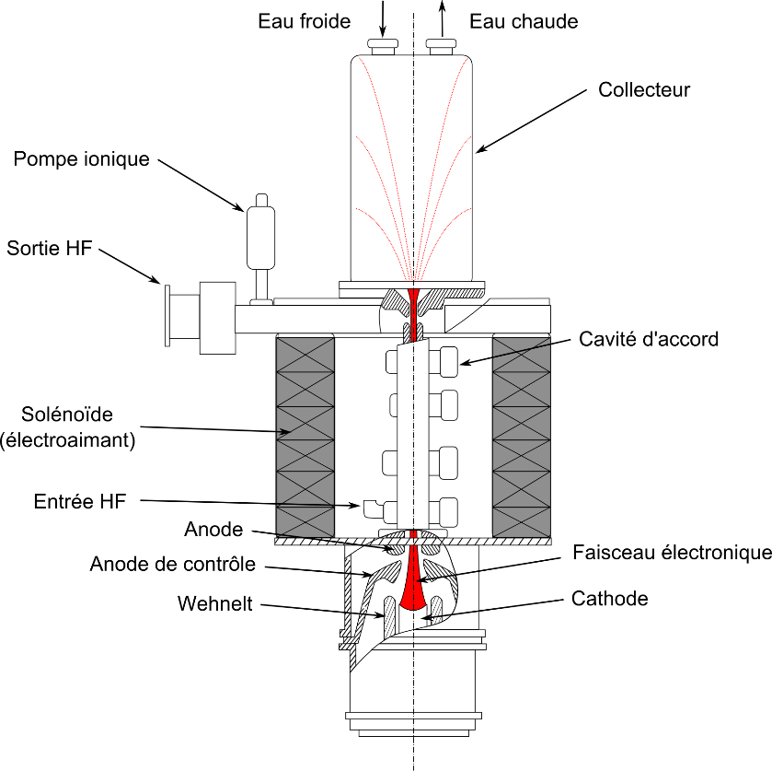
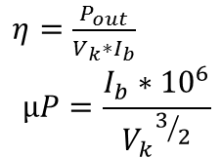
Klystron principle
Cold water
Hot water
Linear-beam vacuum device which is used as a narrow bandwidth amplifier for high radio frequencies (100 MHz-100GHz)
Creation of a stream of electrons by the electron gun (thermionic emission)
Confinement by an external magnetic field
Triggering of the beam modulation by the wave in the input cavity
Modulation of the beam into a set of electron bunches in the gain cavity/ies
Drifting of the electron bunches
Energy transfer between the bunches and the output antenna
Absorption of the lower energy electron beam by the collector
Klystron efficiency is the ratio of the output power to the electron gun supply power.
Collector
Ionic pump
7
RF output
6
Ps
Middle cavity
Solenoid
2
5
4
RF input
3
Pe
Control anode
Electron beam
Vk
Ib
1
$η=\frac{P_{out}}{V_{k}∗I_{b}}$
$$µP=\frac{I_{b}∗{10}^{6}}{{V_{k}}^{3/2}}$$

Slide 8
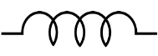
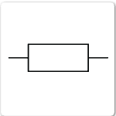

Beam/cavity interaction model
One can characterize beam/cavity interaction by a lumped circuit.
Circuit’s parameters are linked to the electromagnetic field and thus cavity’s dimensions and materials properties.
AJDisk and Klys2D are lumped circuits-based codes.
Electron beam

Slide 9
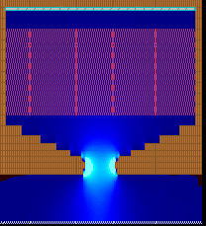
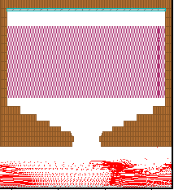

Klystron simulation codes used in this project
AJDisk
  SLAC 1D-code
  No magnetic field needed
  Klystron cavities characterized partly by lumped circuits (f, R/Q, Q0, Qext)
KLYS2D
  Thales Electron Devices (TED) 2D-code
  Magnetic field needed
  Klystron cavities characterized by lumped circuits (f, R/Q, Q0, Qext)
Magic2D
  ATK 2D-code
  Finite differential code
  Magnetic field needed
  Klystron cavities dimensions needed
Lumped circuit (resistor, shell, capacitor)
$$\vec{E_{z}}$$
Notes:
Electric field
Parameters computed with HFSS

Slide 10
Kladistron (high-efficiency klystron) principle

Slide 11
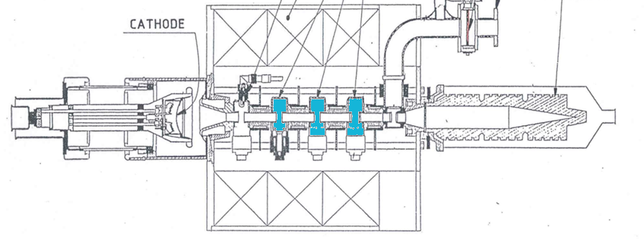
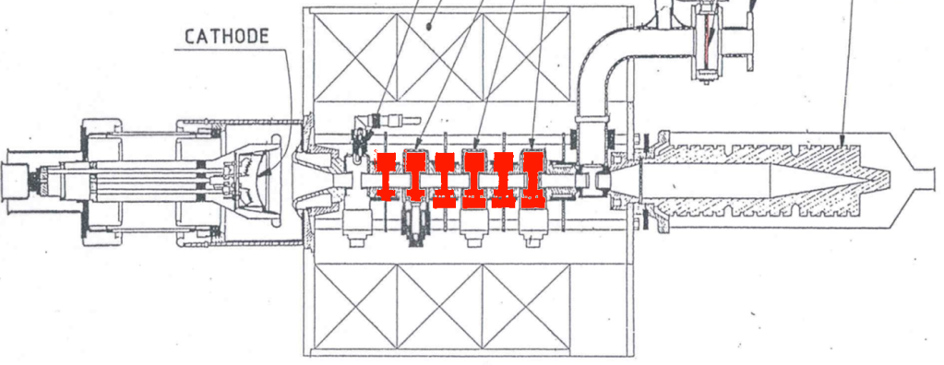



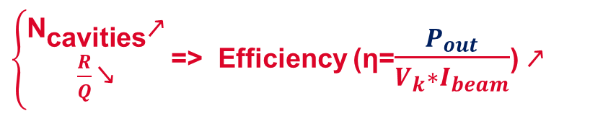

Kladistron
$$P_{out}$$
A Kladistron (Kl-adi(adiabatic)-stron) is a high-efficiency klystron with a large number of cavities (at least twice as many as in a classical klystron).
Inspired by Radio Frequency Quadrupole (RFQ), this architecture leads us to a smoother bunching and also a higher efficiency.
$$V_{k}$$
$\left\{\begin{aligned}{\text{N}}_{\text{cavities}}\text{↗} \\ \frac{R}{Q}\text{↘}\end{aligned}\right.$ => Efficiency (η=$\frac{P_{out}}{V_{k}∗I_{beam}}$) $\text{↗}$
$${P′}_{out}$$
$$V_{k}$$

Slide 12
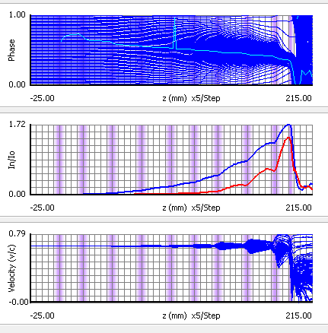
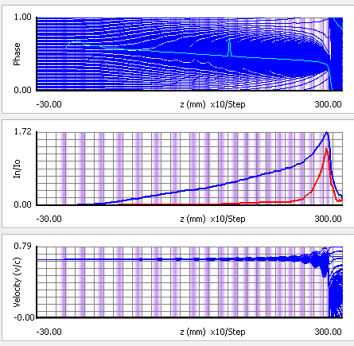
AJDisk 1D-simulations of a 12GHz-Kladistron
10 cavities – 12GHz
µP = 1.5 A.V^-3/2
Efficiency 67.2 %
Length 197 mm
20 cavities – 12GHz
µP = 1.5 A.V^-3/2
Efficiency 78 %
Length 285 mm
In the design proposed, the cavities are weakly coupled to the beam (low R/Q) and largely detuned to avoid strong bunching.

Slide 13
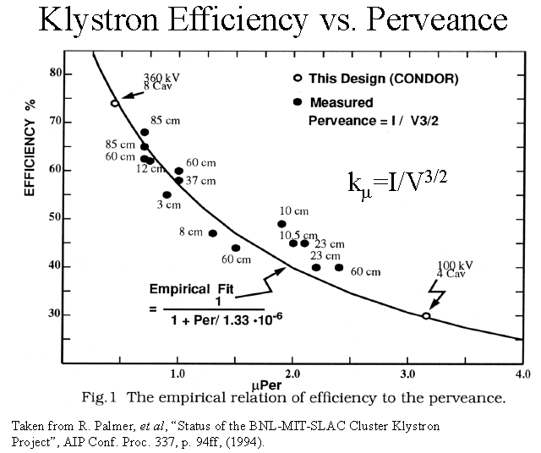
Kladistron and classical klystrons
12GHz
« KLADISTRON »
4.9GHz
« KLADISTRON »
(technical demonstration)

Slide 14
TH2166 klystron and the kladistron prototype design

Slide 15


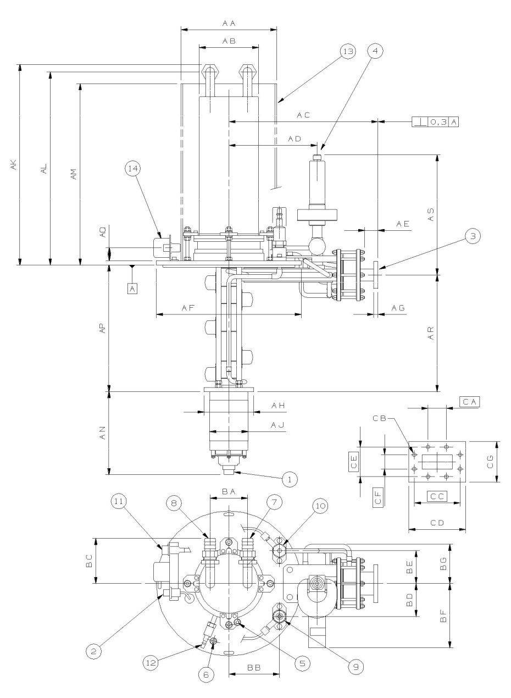
TH2166 Klystron
TH2166 front view
TH2166 klystron was designed by Thales electron devices (TED) for Mainz Microtron.
Features
Frequency | 4.9 GHz
Output power | 56 kW
Efficiency | 50%
Vk | 26 kV
µP | 1.066
Bmax | 0.27 T
Gain | >40 dB
Number of cavities | 6
Interaction line length | 233mm
233mm
This klystron will be modified to verify the kladistron principle.

Slide 16
TH2166 efficiency as a function of the input RF power
Codes validation
Our simulation results are close to tests results, with an efficiency spread of 2 points.

Slide 17
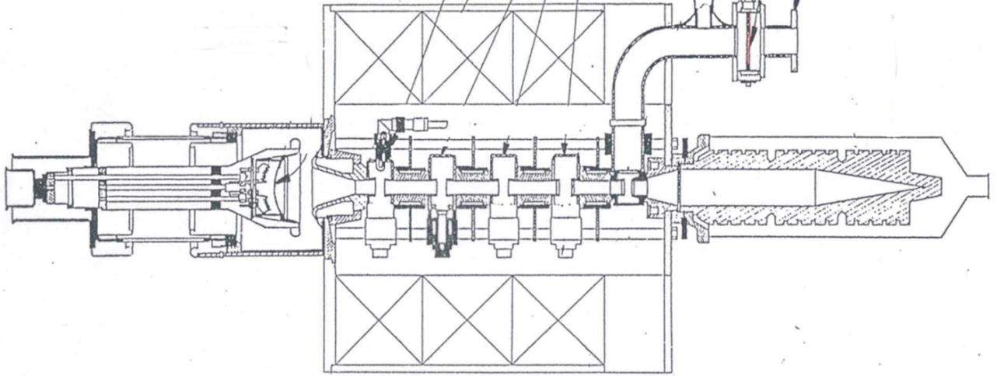
klystron TH2166 enhancement
Modification of the interaction line
TH2166 intermediate cavities
input cavity
output cavity and window
Thales TH2166 klystron
6 cavities
gun
collector
solenoid
Kladistron intermediate cavities
input cavity
output cavity and window
CEA TH2166 kladistron
16 cavities
gun
collector
Thales-provided elements
solenoid

Slide 18
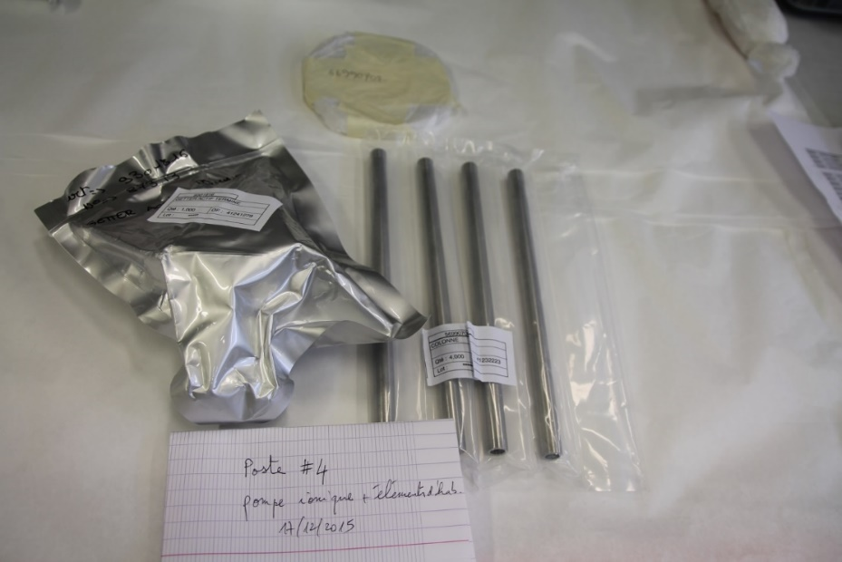
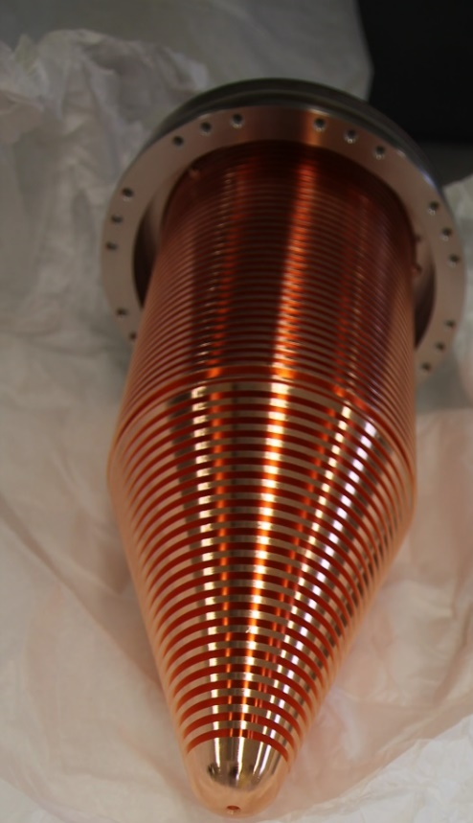
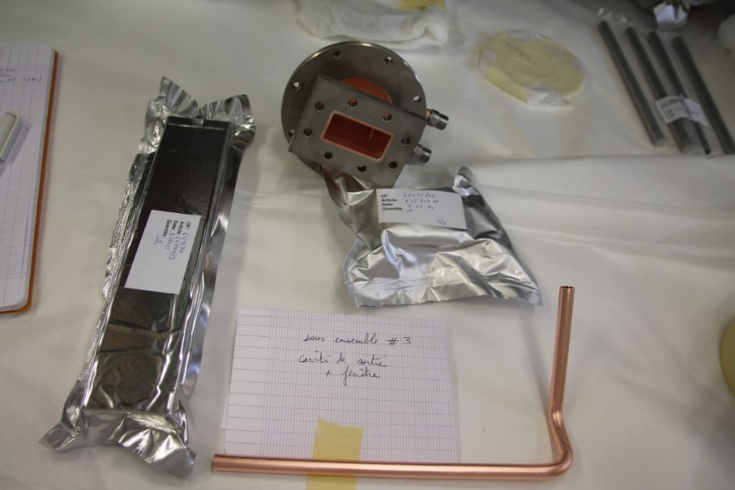
Thales-provided elements
Steel rods and Ionic pump
Wave guide,
Output cavity and
Output antenna
Collector
These elements have already been delivered.

Slide 19
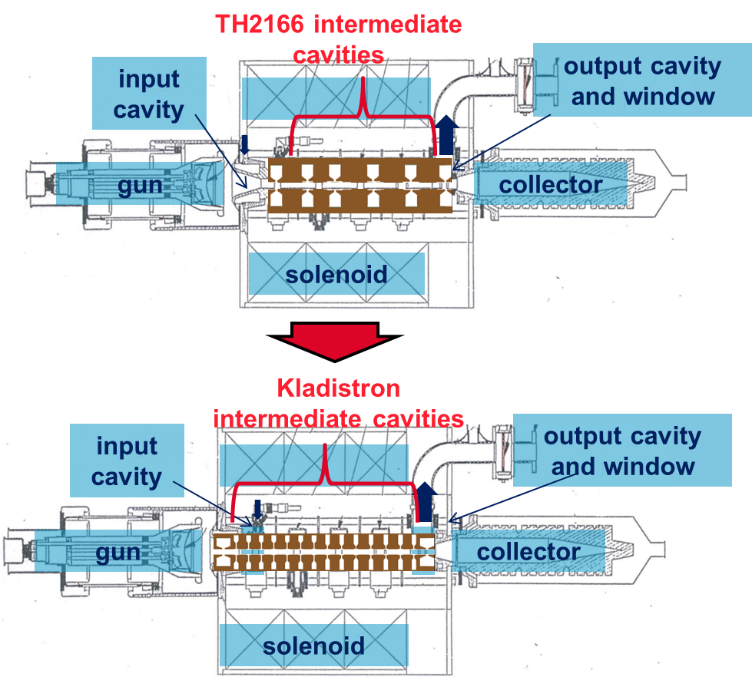
klystron TH2166 enhancement
Cavities preliminary design
The design we are looking for would let us :
Use the TH2166 klystron test and conditioning bench
➔ Total interaction line length of 233mm, same input and output cavities, same solenoid
Use the TH2166 klystron electron gun and collector
➔ Same microperveance of 1µA.V^(-3/2)
Check the kladistron principle
➔ More than 6 cavities
Avoid cavities coupling
➔ Drift space between cavities larger than 9mm
Avoid gain peaks
➔ Low R/Q and Q0 values

Slide 20
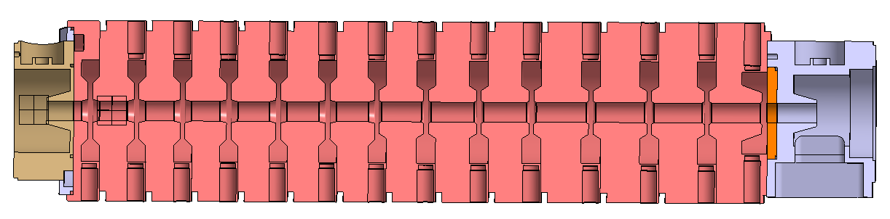
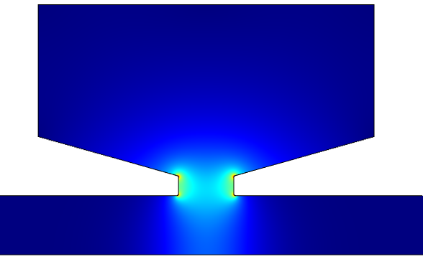
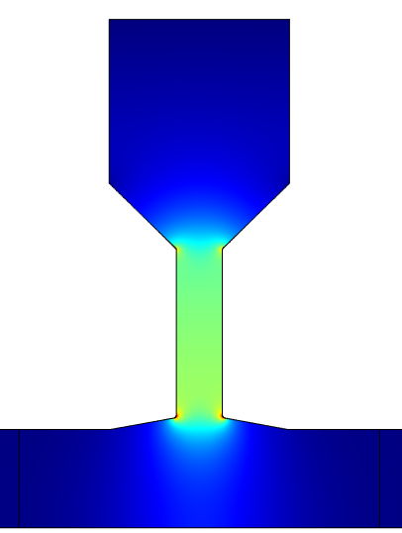
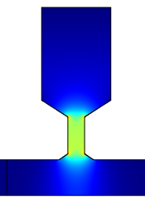
klystron TH2166 enhancement
Cavities preliminary design
Type 1
Type 2
Type 3
Type 1
TH2166 cavity shape
Low-coupling cavity shapes
Type 1
Type 2
Type 3
According to our COMSOL simulations, these low-coupling cavities are fit for smooth electron bunching. On the other hand, the strong electric fields and narrow cavities gap are responsible for multipactor phenomenon.

Slide 21
Th2166 Klystron and Kladistron Comparison
MAGIC2D Simulations
For the moment, our kladistron simulation results reach an efficiency of six points above TH2166 simulation results.

Slide 22
Cavities fabrication

Slide 23
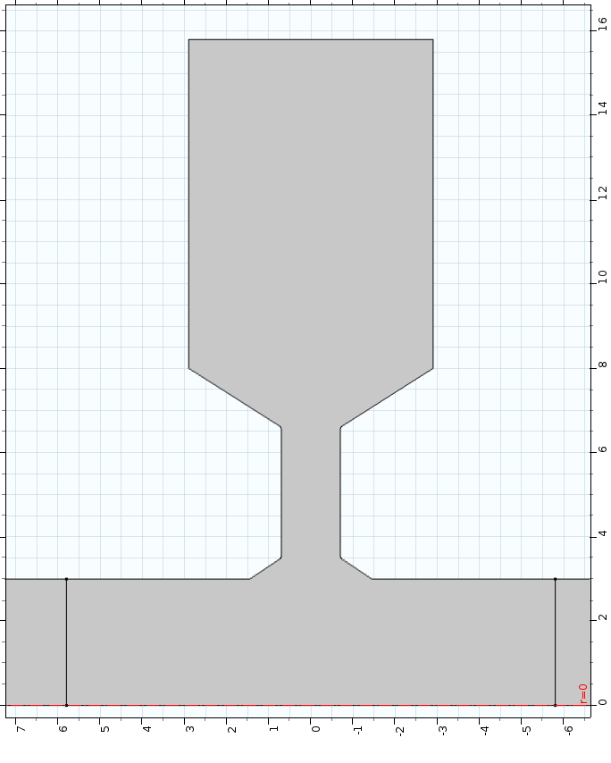
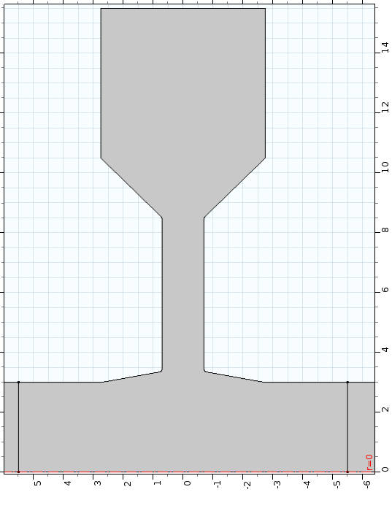
Frequency shift : a reliable tuning system is required
Zgap
Zgap
Type 2
Type 3
Δf/Δzgap ≈ 2.5MHz/µm

Slide 24
Frequency shift : a reliable tuning system is required
→Δzgap ≈ -4µm
For each computation we shift the frequency of one of the cavities.
Kladistron efficiency is sensitive to its cavities frequency shifts, especially at the end of the interaction line.

Slide 25
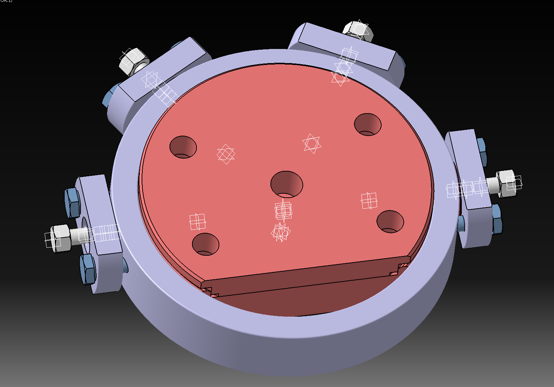
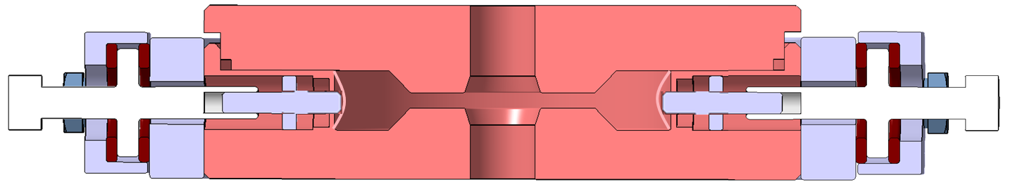
Cavities and tuning system preliminary design
Cooling system channels (4)
Beam drift tube
Copper
This preliminary design is under study and it is considering the surrounding of the cavities (cooling system, solenoid,…).
The tuning system is inspired by CLIC accelerating cavities design; a thigh copper membrane is misshaped to adjust cavities frequencies. This strain is controlled by an accurate screw thread.
Thread steel pin brazed on the membrane
Bronze bearing
Cavity
Beam drift tube
Misshaped membrane
Screw thread
Tuning system (x4 at 60°)

Slide 26
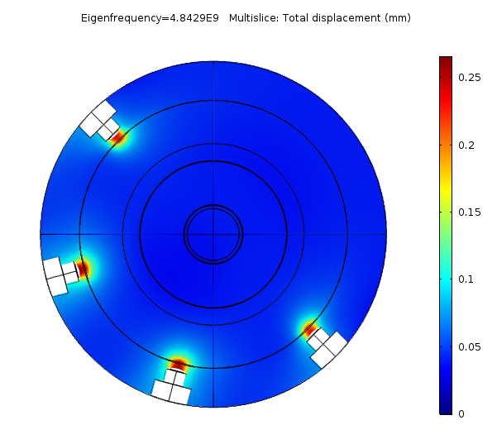
Tuning system preliminary design
COMSOL simulations
Displacement (mm) | Δf (for each tuning system) (MHz) | Δf (for 4 tuning systems) (MHz)
0.26 | 4.02 | 16.03

Slide 27
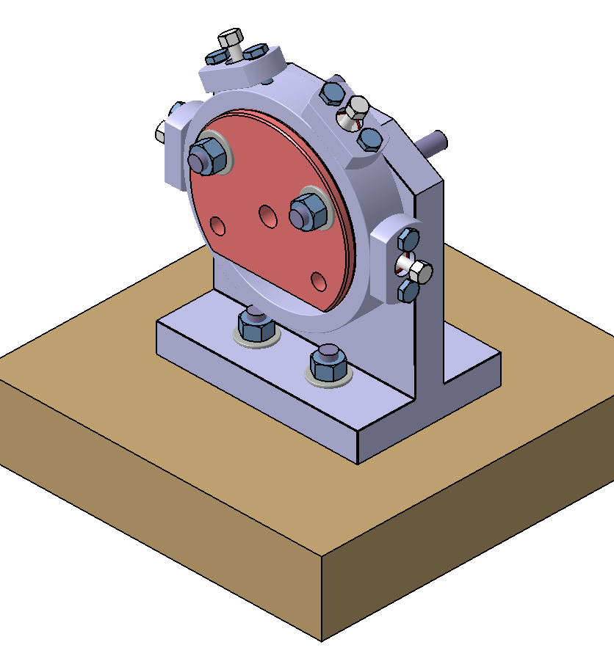
Next step : Prototype cavities to test
Type 2 and type 3 prototype cavities to be tested to validate tuning system (and tuning range & resolution) and brazing process.
Prototype test bench

Slide 28
Conclusion and outlook
TH2166 klystron study and codes validation
TH2166 kladistron preliminary design
TH2166 kladistron’s cavities design started
We will soon test two first prototype cavities
(June 2016)
Further multipactor studies
TH2166 Kladistron assembled and tested by the end of the year.

Slide 29
Thank you for your attention

Slide 30
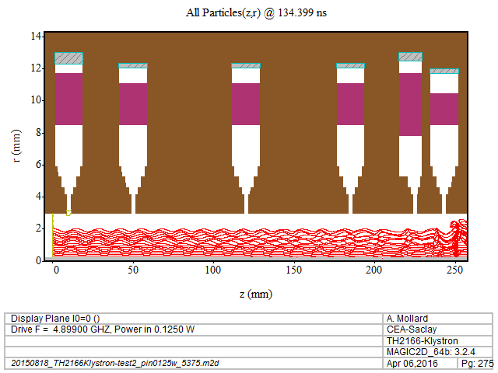
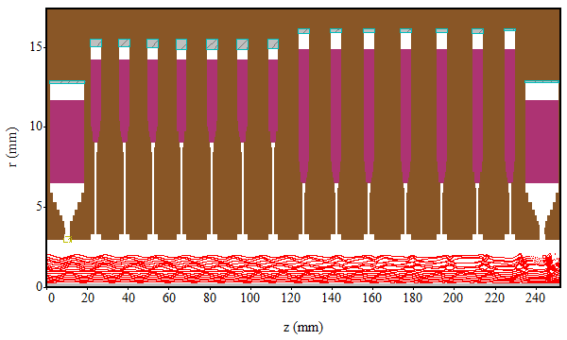
Th2166 Klystron and Kladistron Comparison
MAGIC2D Simulations
Electron bunching improvement.

Slide 31
Th2166 Klystron and Kladistron Comparison
MAGIC2D Simulations
Electron bunching improvement.

Slide 32
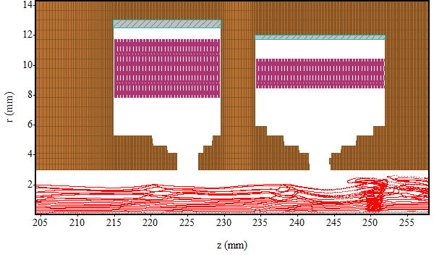
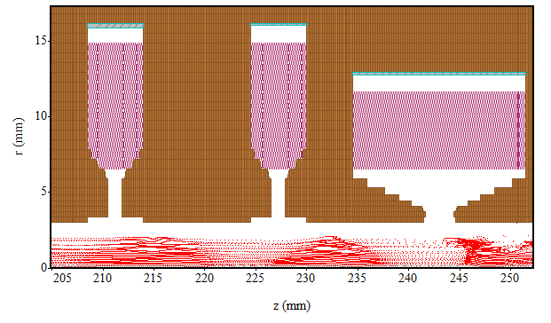
Th2166 Klystron and Kladistron Comparison
MAGIC2D Simulations
Electron bunching improvement.

Slide 33
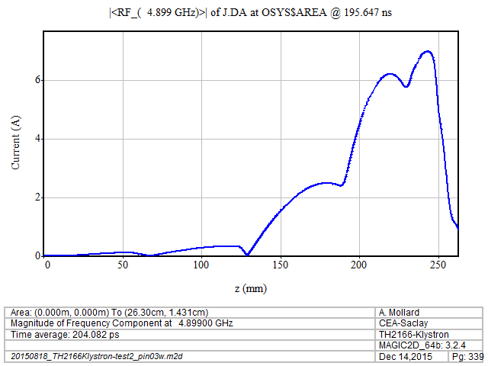
Th2166 Klystron and Kladistron Comparison
MAGIC2D Simulations
Beam current improvement.

