Slide 1
Experimental summary/conclusion of Higgs Hunting 2016
Marco Pieri
University of California San Diego
Higgs Hunting 2016
Paris, August 31st – September 2nd 2016

Slide 2
Outline
Introduction
SM-like Higgs measurements
BSM Higgs bosons and decays
Future perspectives
Summary and outlook

Slide 3
Disclaimers
I will not put emphasis on Run 1 results that were available since more than one year
We had quite some time to discuss them
Will report the many latest results based on 13 TeV data
We had very nice Young Scientist’s talks that I will not be able to cover
Apologies for the contributions I may miss or not well represent

Slide 4
Tevatron
Still carrying out precision measurements
New Tevatron top mass combined measurement updating 2014 result: M_{t}=174.30 ± 0.35 (stat) ± 0.54 (syst) GeV
Working on update of W mass
Continues to investigate on the excess reported in the measurement of tt A_{FB}
R. Hirosky

Slide 5
R. Hirosky

Slide 6
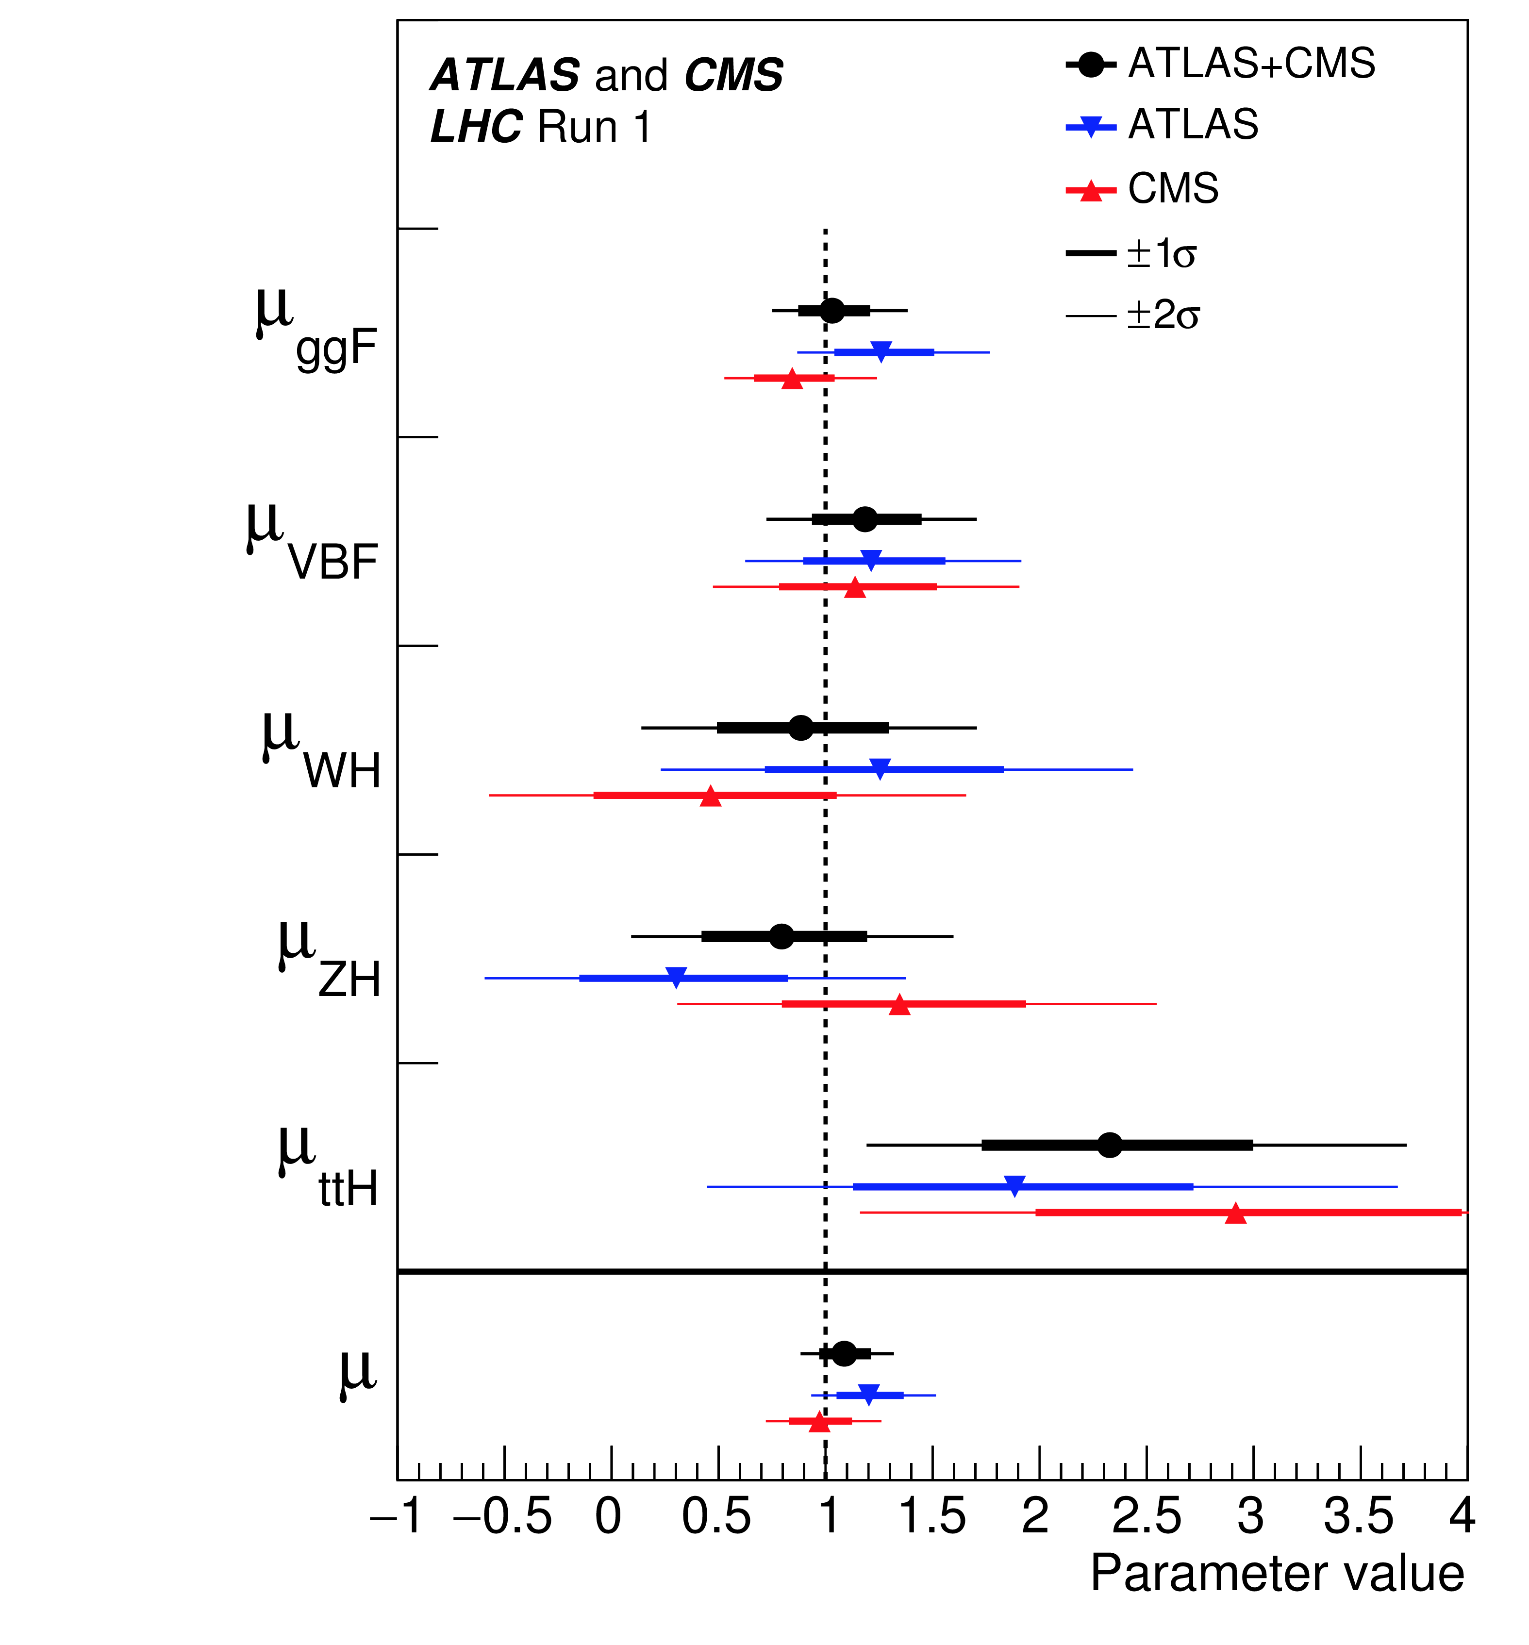
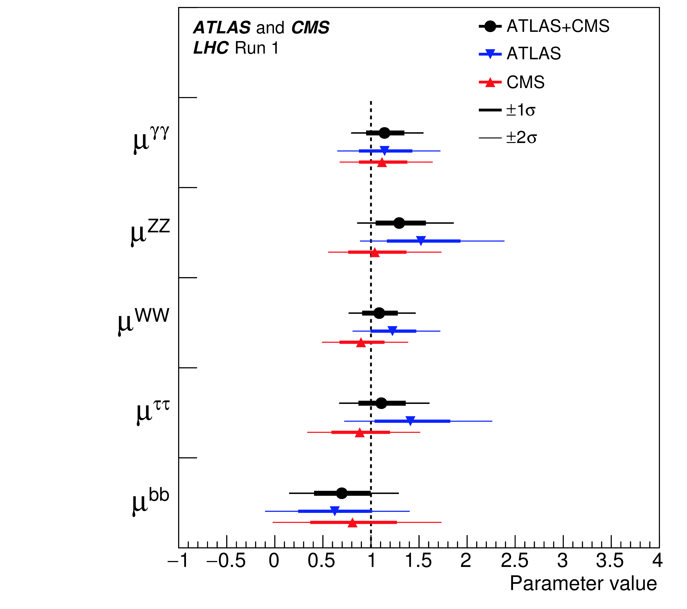
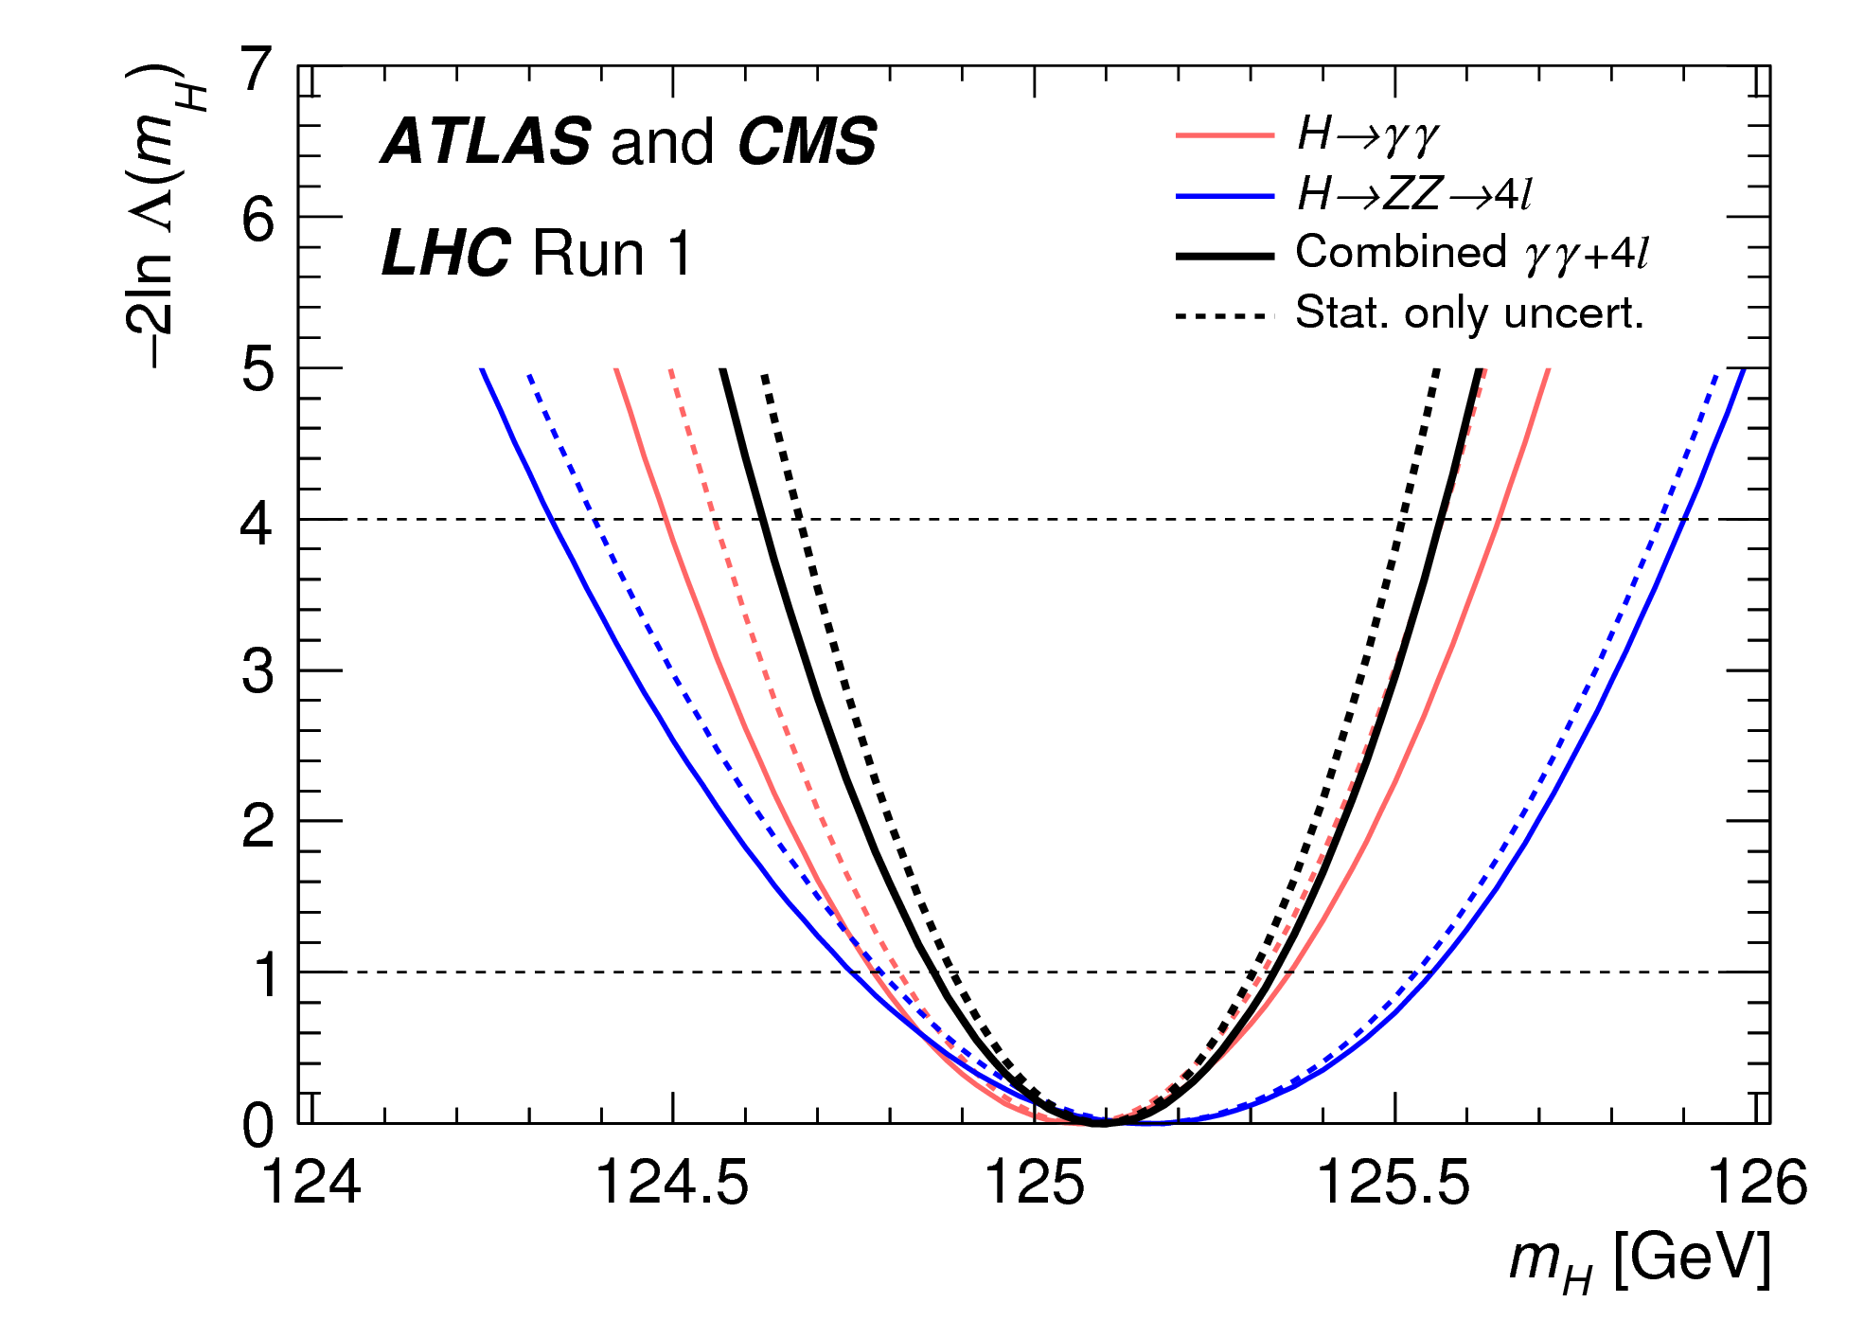
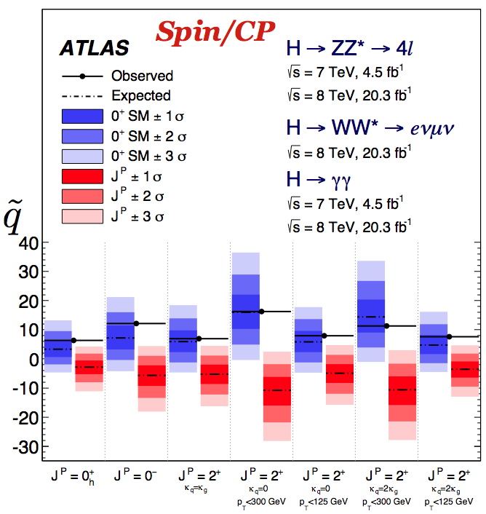
Run 1 Results
Only recall the combined ATLAS + CMS results here (talk of P. Francavilla): mass and couplings
Many more results from Run 1 on:
SM-like Higgs-CP studies
All measurements agree with the SM
BSM Higgs (additional Higgs bosons and decays)
Also no hints of any statistically significant excess

Slide 7
ATLAS + CMS final Run 1 results: mass
P. Francavilla
PRL 114 (2015) 191803

Slide 8
ATLAS + CMS final Run 1 results: couplings
JHEP 08 (2016) 045
P. Francavilla
With central values and covariance matrix it is possible to derive in an approximate way all other results

Slide 9
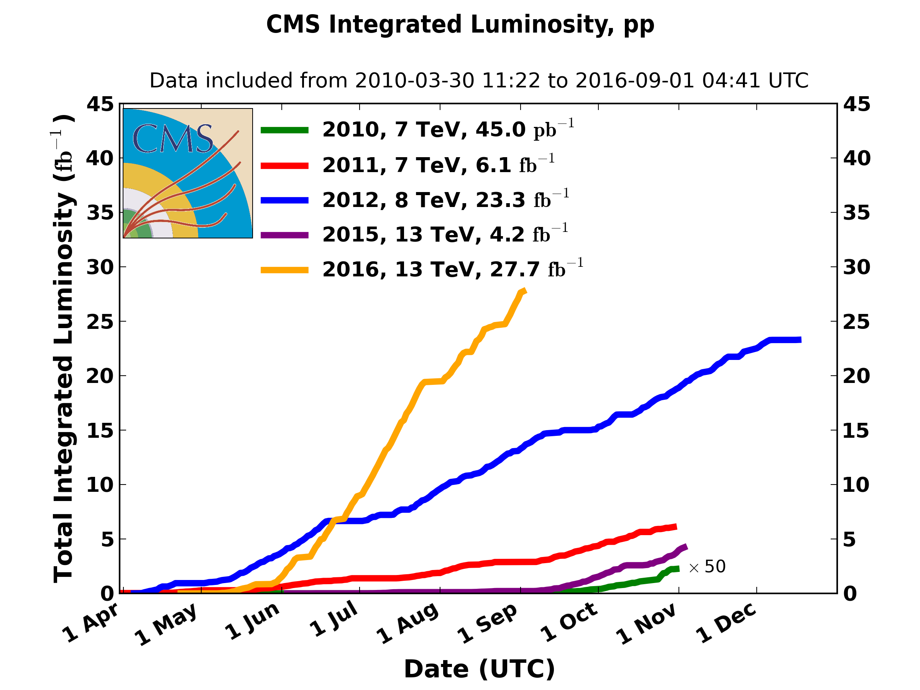
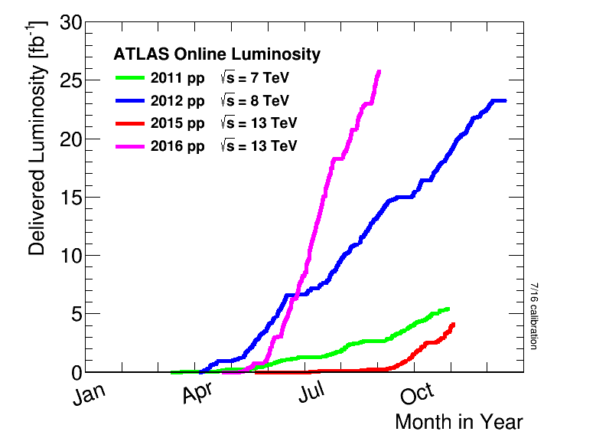
LHC is performing wonderfully in 2016
Instantaneous luminosity same or more than expected
Already delivered more than 25 fb⁻¹ per experiment
ATLAS
CMS
Max instantaneous luminosity 1.2-1.3 x 10³⁴ cm⁻²s⁻¹

Slide 10
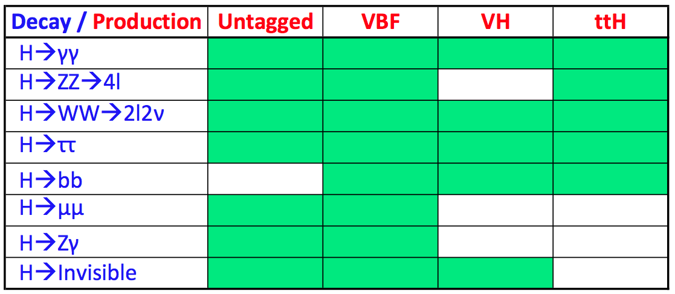
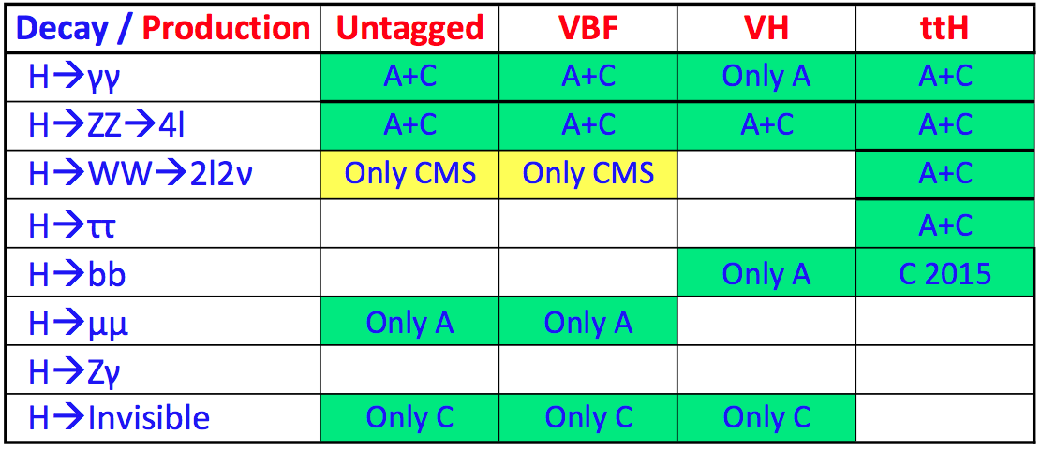
Status of main Higgs decay channels
Almost all results of Run 1 are published
Most of Run 2 results are preliminary and more work is needed to finalize them
Run 1: 7 – 8 TeV
Run 2: 13 TeV

Slide 11
Measurements
of the SM-like
Higgs boson

Slide 12
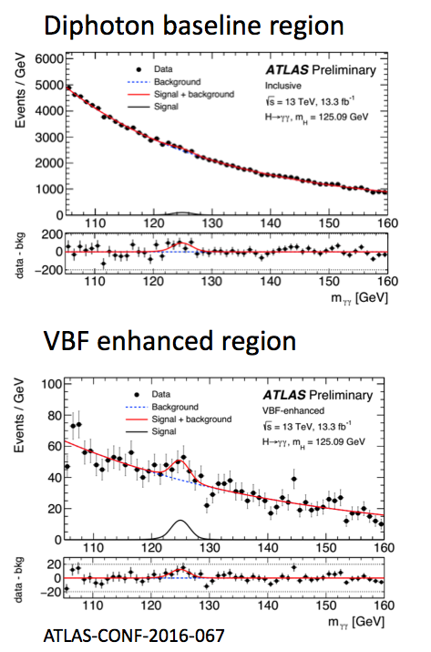
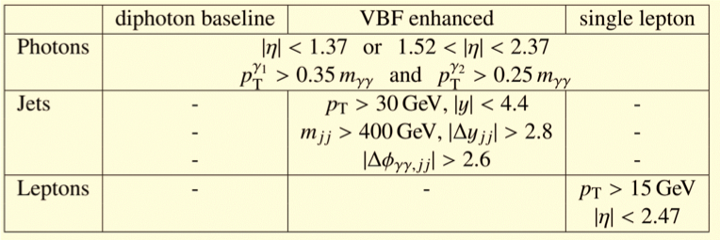
ATLAS H→γγ 13 TeV fiducial cross sections
Y. Wu

Slide 13
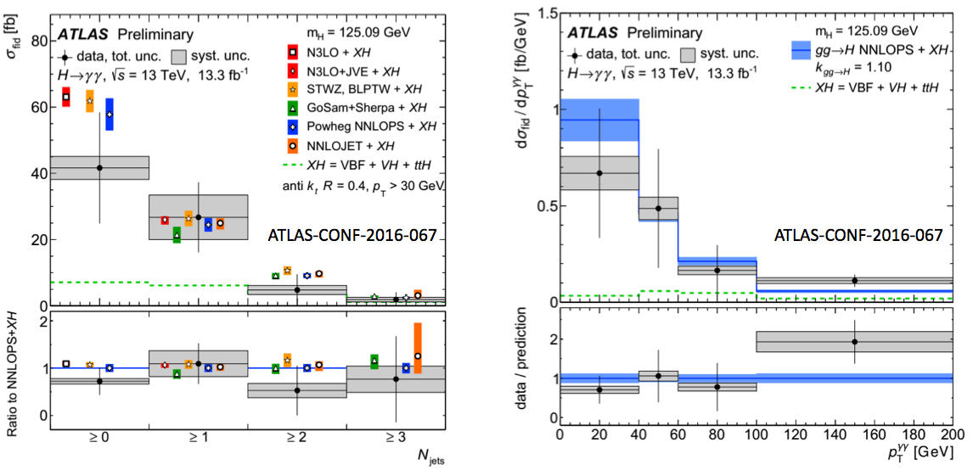
ATLAS H→γγ 13 TeV differential distributions
In diphoton baseline region
Y. Wu

Slide 14
ATLAS H→γγ 13 TeV signal strengths
Y. Wu

Slide 15
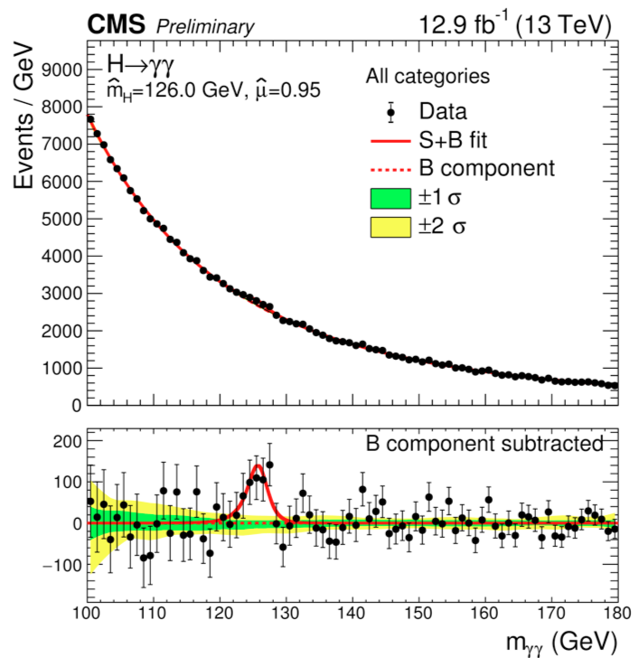
CMS H→γγ
A. Calderon,
L. Corpe

Slide 16
CMS H→γγ fiducial cross section
A. Calderon

Slide 17
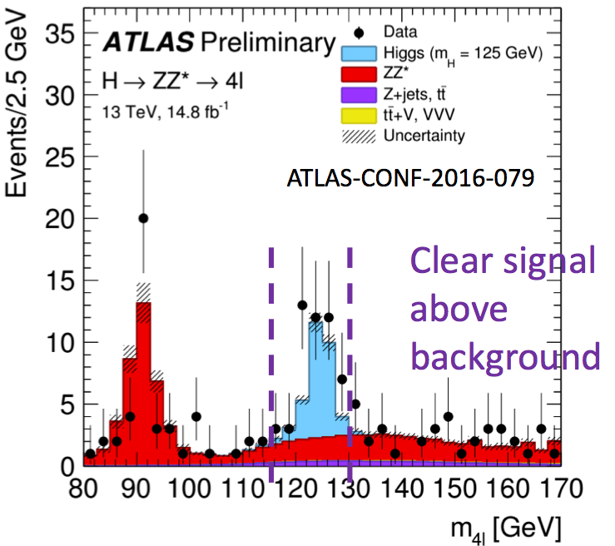
ATLAS H→ZZ→4l 13 TeV
Y. Wu

Slide 18
ATLAS H→ZZ→4l 13 TeV
Y. Wu
New analysis method compared to Run 1, fit BDT discriminant for events in the mass peak

Slide 19
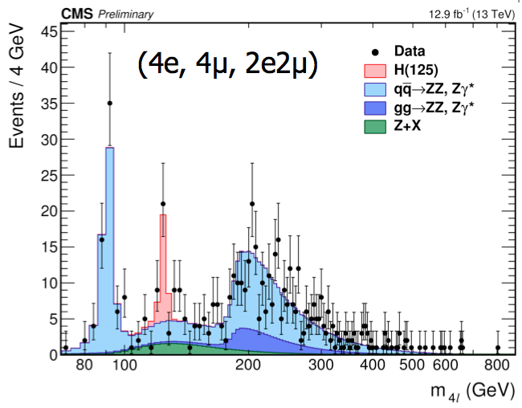
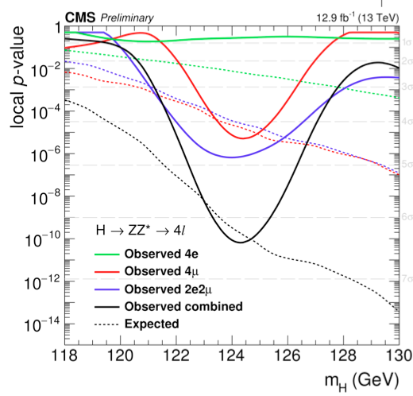
CMS H→ZZ→4l 13 TeV
A. Calderon
Similar analysis strategy as Run 1

Slide 20
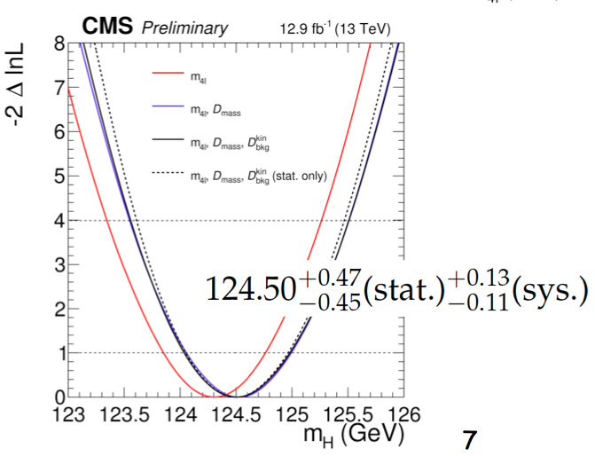
CMS H→ZZ→4l 13 TeV
First Higgs boson mass measurement at 13 TeV
A. Calderon

Slide 21
CMS H→ZZ→4l 13 TeV
A. Calderon

Slide 22
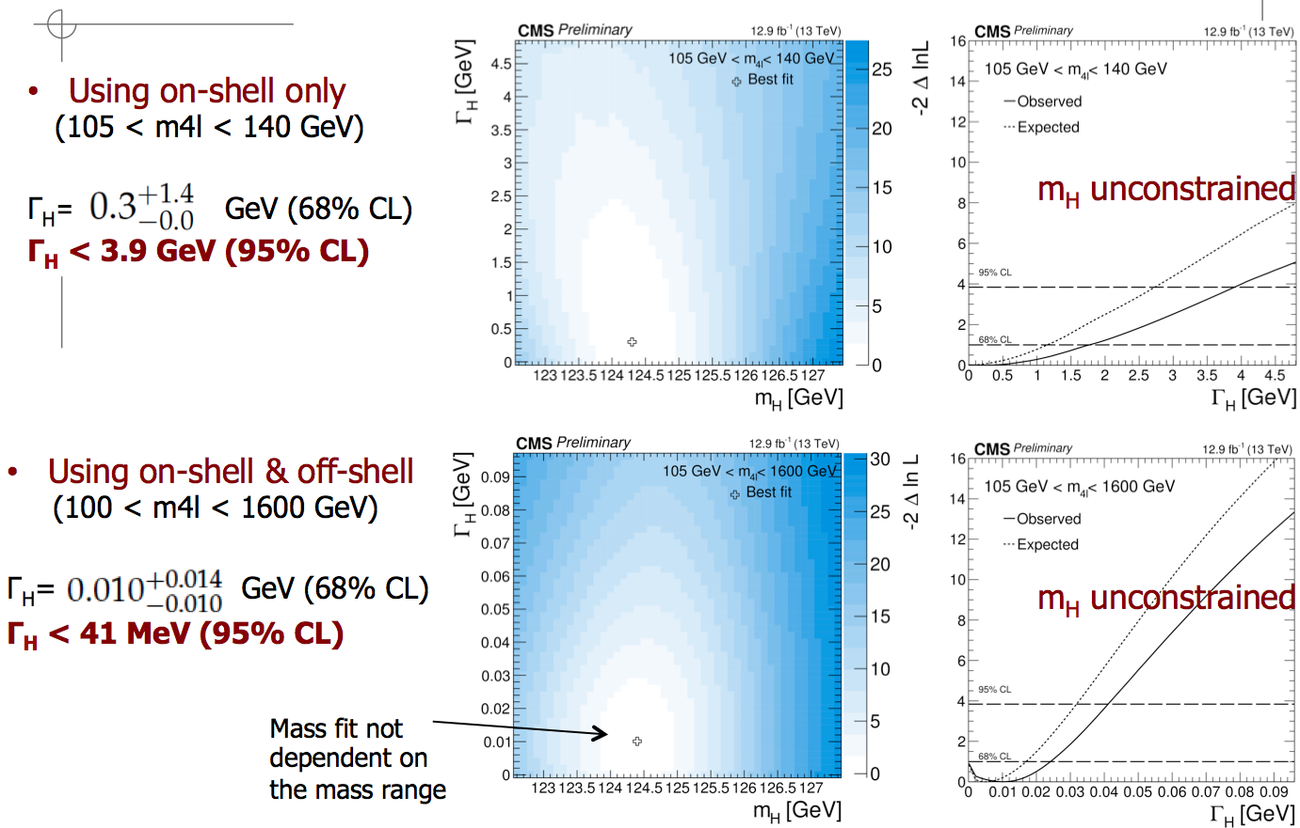
CMS H→ZZ→4l 13 TeV, width
A. Calderon, U. Sarica

Slide 23
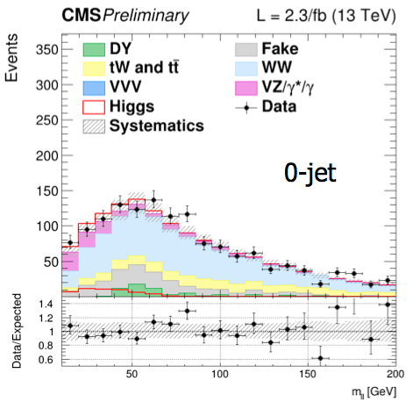
H→WW→2l2ν
Both experiments are working hard but analysis is more complicated than γγ and ZZ
ATLAS and CMS analysis on 2016 data are in progress
Only results from CMS based on 2015 data shown at Moriond eμ in the 0- and 1-jet channels
A. Calderon

Slide 24
ATLAS VH H→bb
E. Shabalina

Slide 25
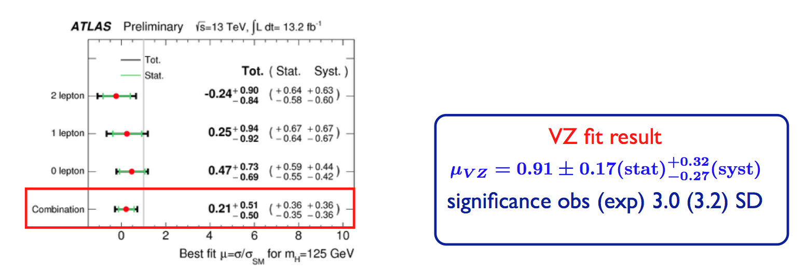
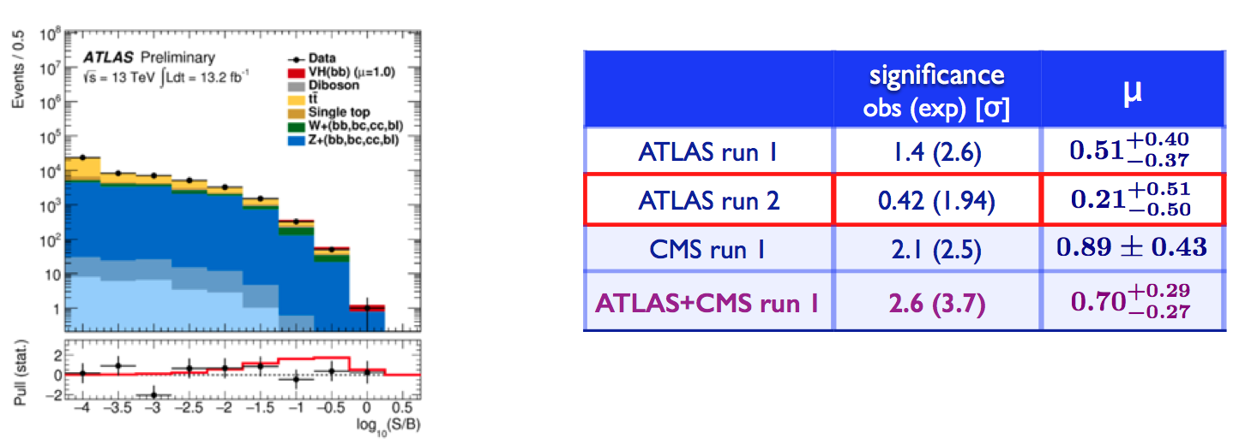
ATLAS VH H→bb results
E. Shabalina
Systematic uncertainties of similar
size as statistical ones

Slide 26
CMS VBF H→bb
A. Nayak
Analysis strategy is the same as in Run 1

Slide 27
ATLAS VBF H→bb (plus photon)
E. Shabalina

Slide 28
ATLAS ttH multi-lepton
Great interest in ttH because cross section increases at 13 TeV by a factor 4 (similar increase for main BGs)
E. Shabalina

Slide 29
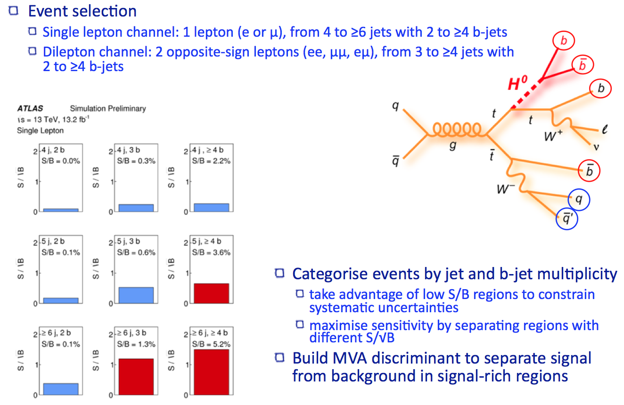
ATLAS ttH H→bb
E. Shabalina
aa

Slide 30
ATLAS ttH H→bb
aaa

Slide 31
ATLAS ttH combination
E. Shabalina

Slide 32
CMS ttH, H→γγ
A. Calderon

Slide 33
CMS ttH multi-lepton
A. Calderon

Slide 34
CMS ttH H→bb with 2015 data
A. Nayak
Summary of CMS results
 | ttH (H→bb) | ttH (H→γγ) | ttH multi-lepton
CMS | -2.0±1.8 | 1.9 | 2.0
+1.5
-1.2
+0.8
-0.7

Slide 35
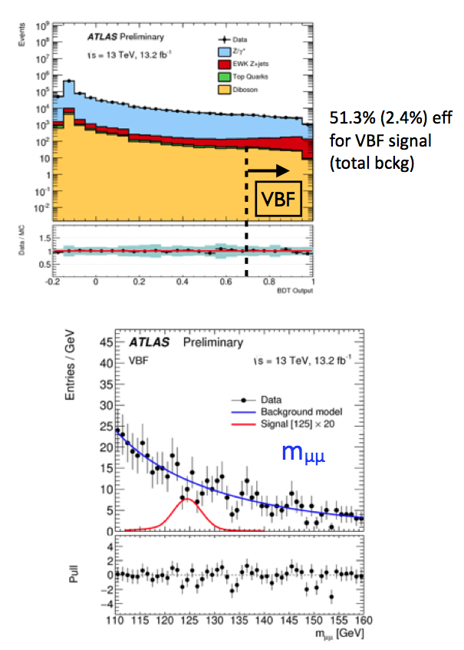
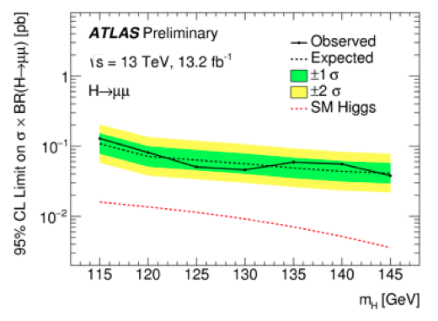
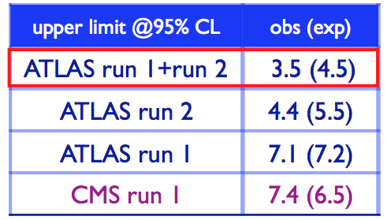
ATLAS H→μμ
E. Shabalina

Slide 36
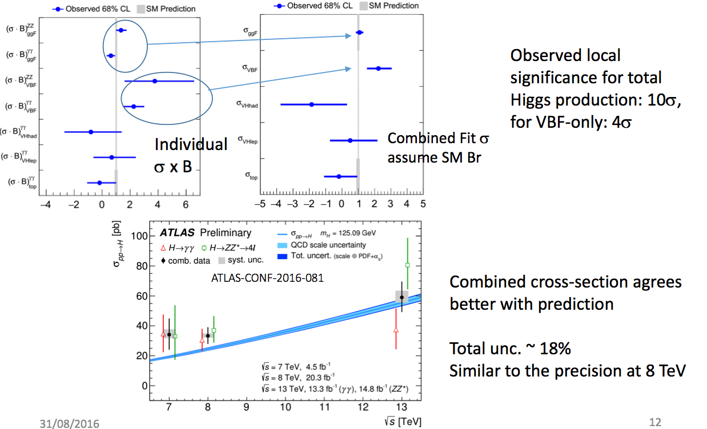
ATLAS γγ + ZZ combination
Y. Wu, D. Gillberg

Slide 37
ATLAS γγ + ZZ combination
F. Tackmann
First fits with simplified
template cross sections

Slide 38
BSM

Slide 39
Diphoton excess at 750 GeV
Lot of excitement and lots of work from both experiments during the first months of the year, until ICHEP
Some excess was observed in 2015 data
3.9 σ ATLAS at 750 GeV (3.4 at 734 GeV after reprocessing)
3.4 sigma at 750 GeV CMS (combined with 8 TeV)
Global significances below ~2 sigma
Mass was the same at Moriond
No excess seen in γγ in 13 fb⁻¹ of 2016 data and all related channels (e.g. Zγ) and limits derived
R. Covarelli, K. Grevtsov

Slide 40
Diphoton excess at 750 GeV

Slide 41
Diphoton excess at 750 GeV

Slide 42
BSM Higgs searches
Searches for BSM physics in the Higgs sector
BSM decays
Direct searches for additional Higgs boson
Higgs properties modifications (non SM couplings, CP studies, Higgs width) from SM-like Higgs bosons measurements

Slide 43
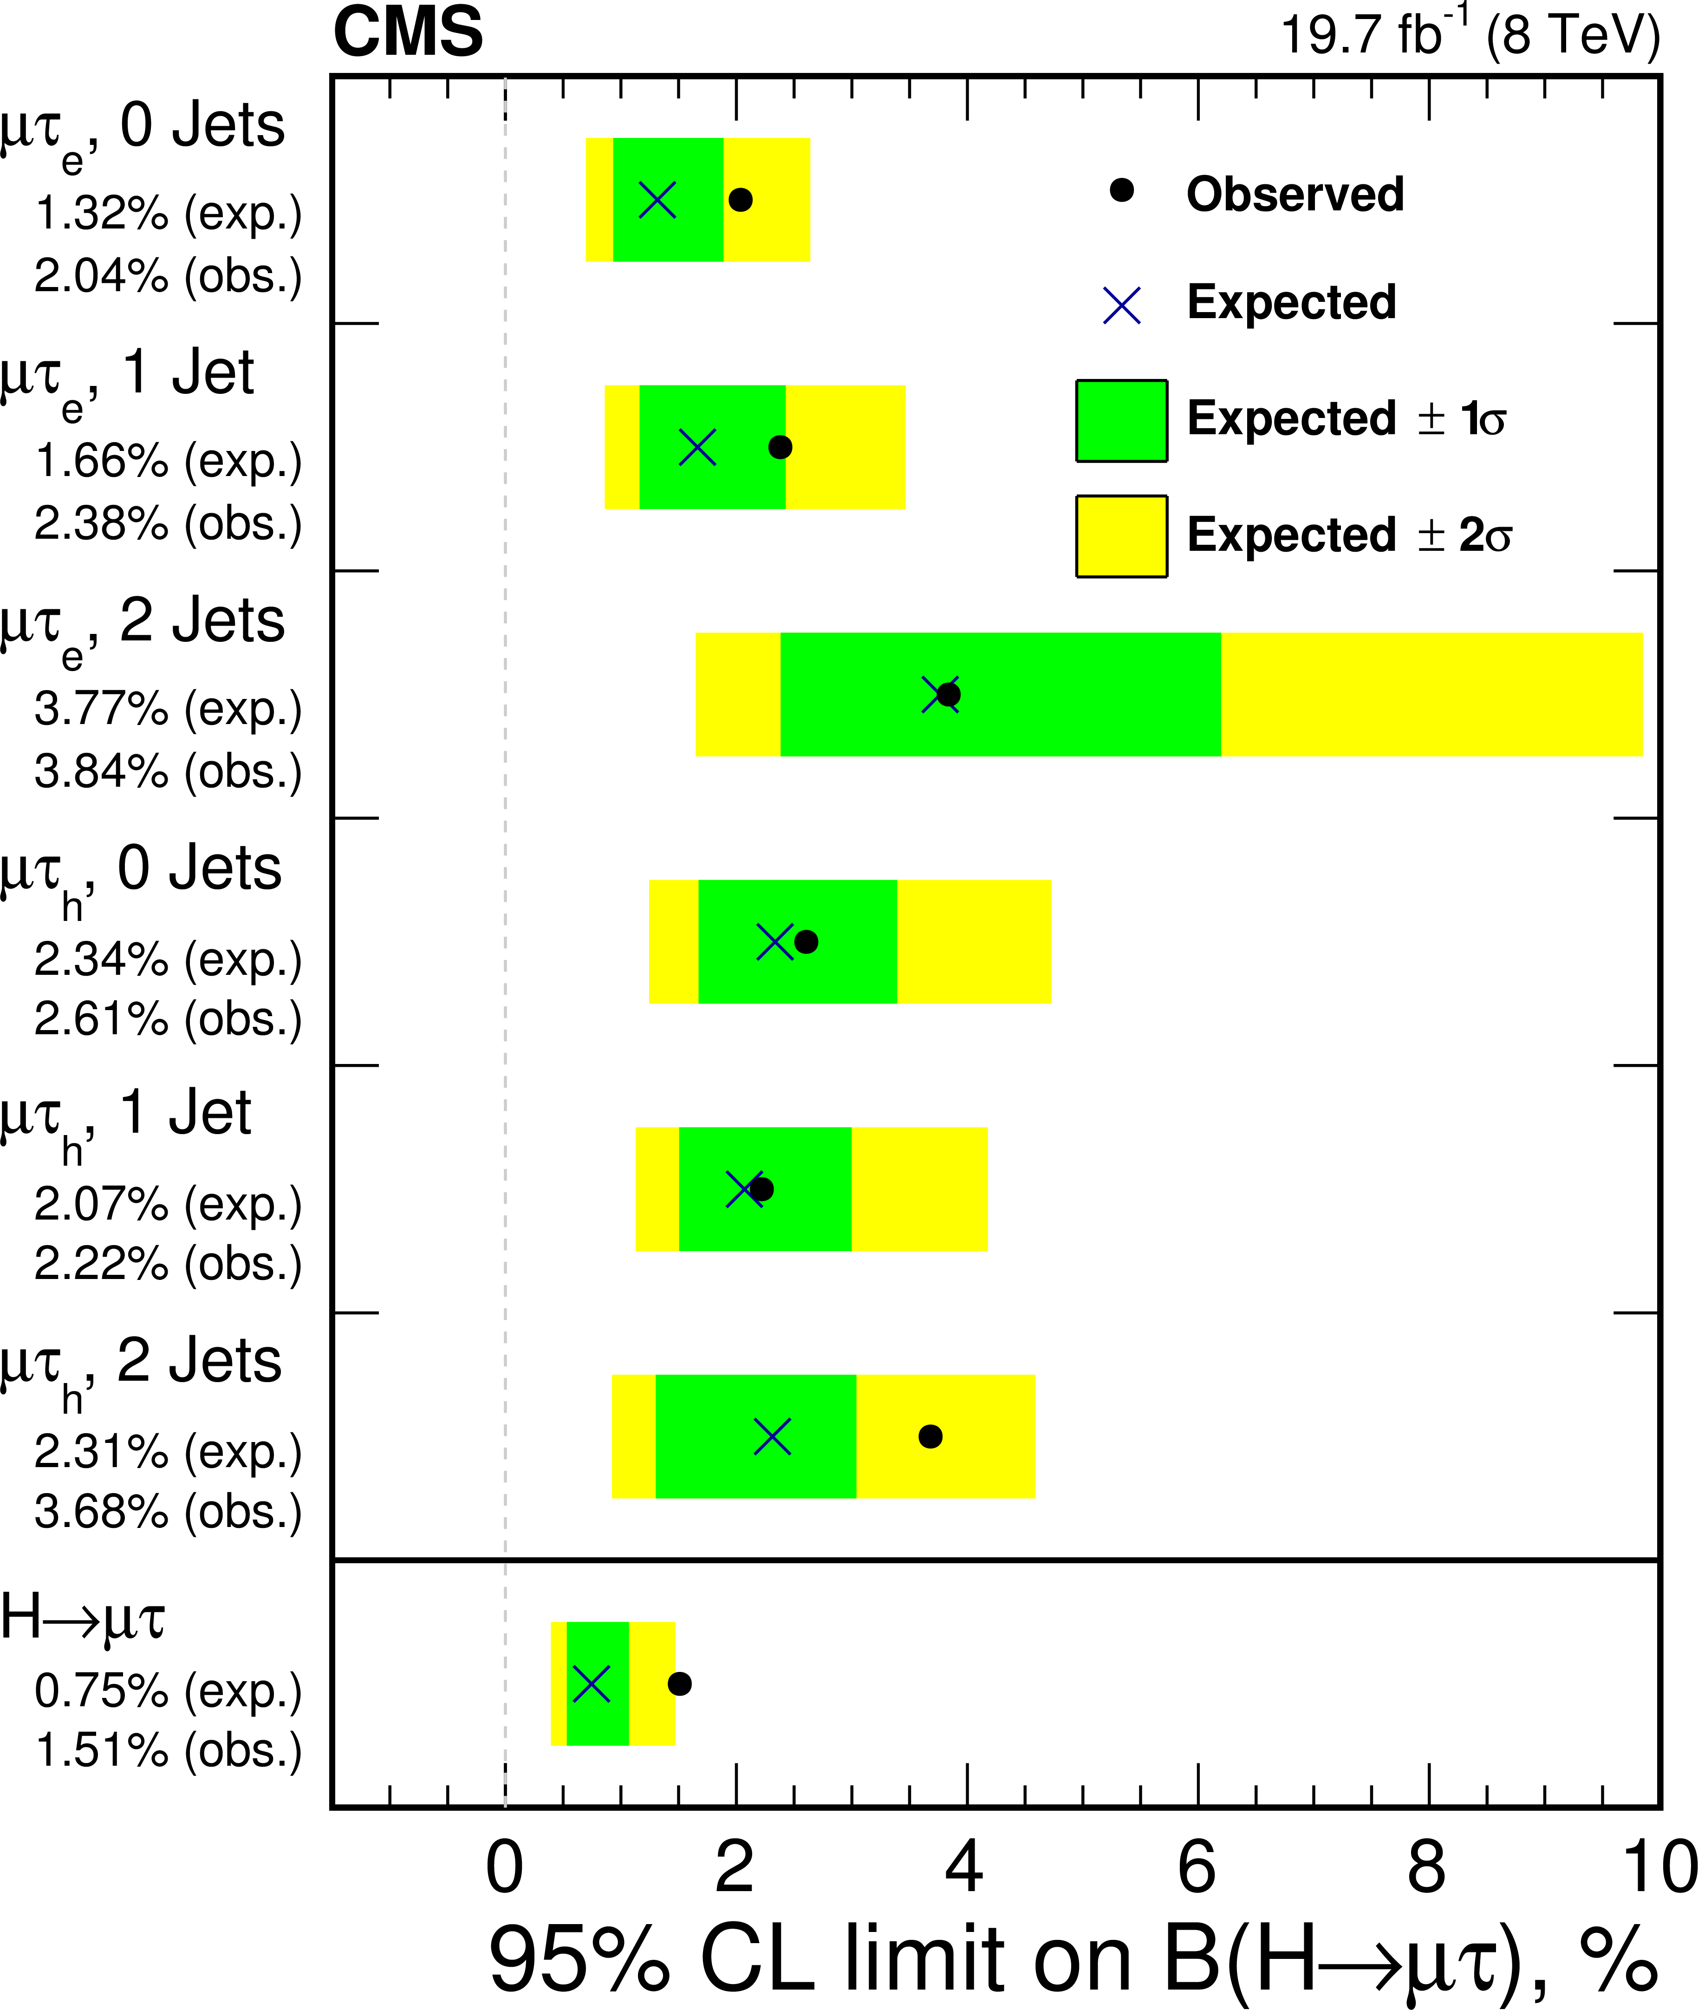
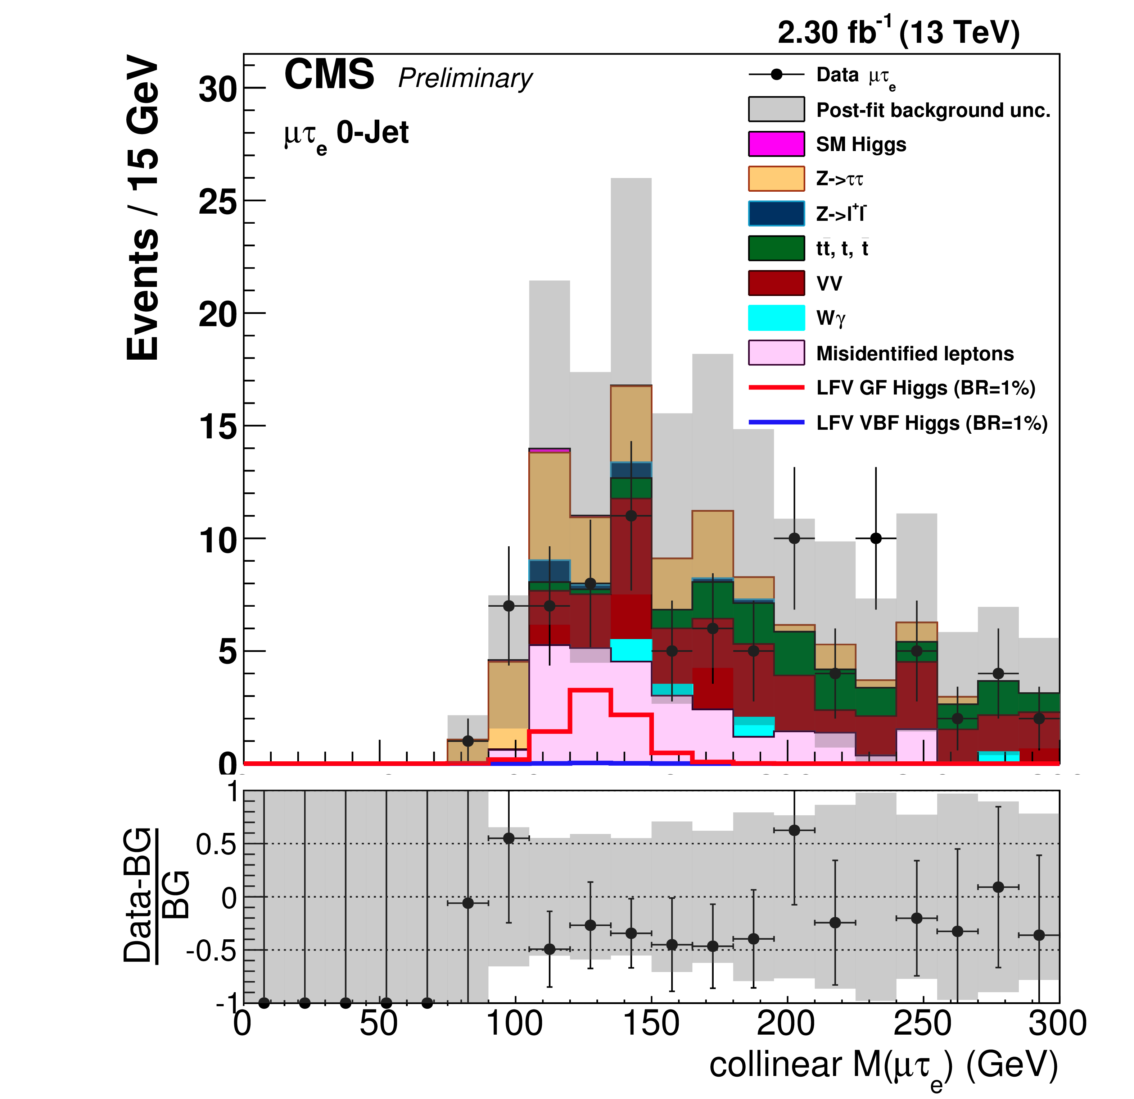
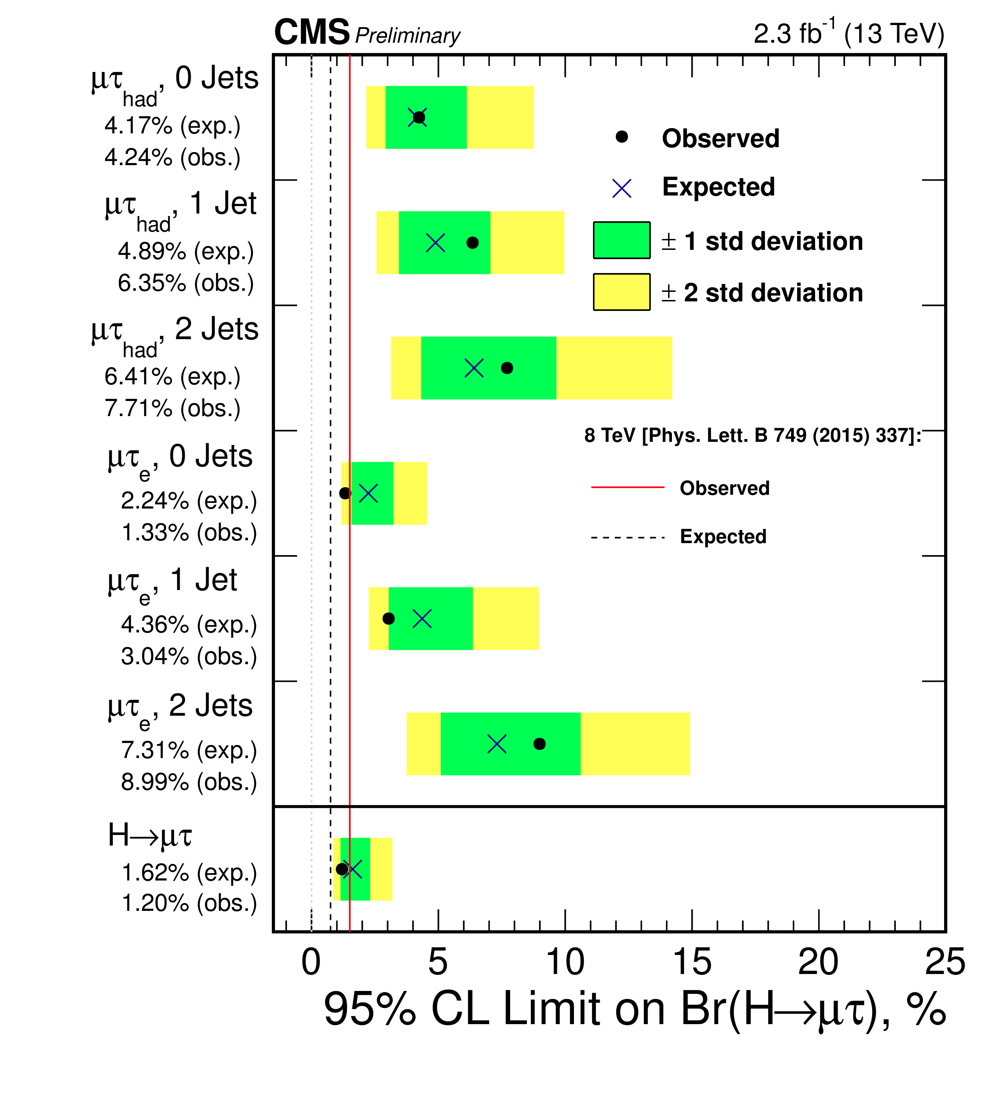
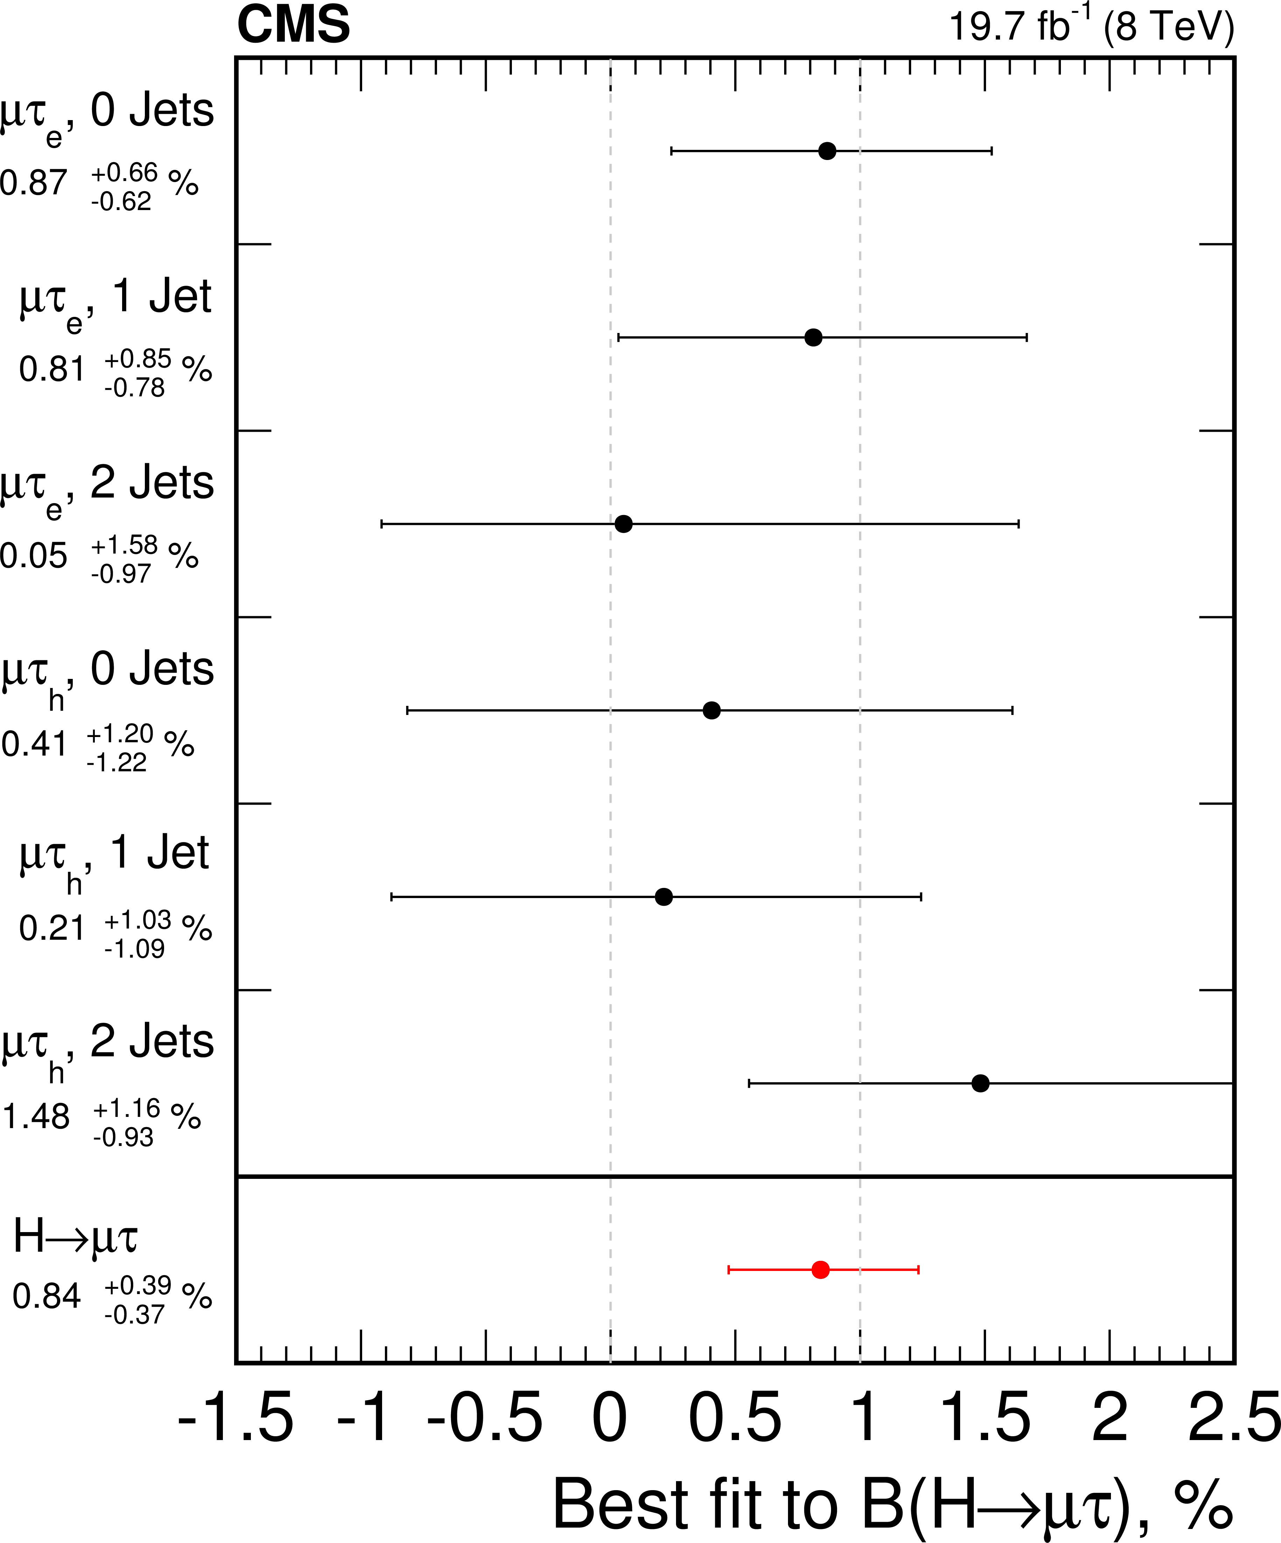
CMS LFV decays
Some small excess (~2.4σ) in H->μτ was reported by CMS in Run 1
As in Run 1 μτ_{e} and μτ_{h} are analyzed (2015 data only)
D. Taylor
13 TeV
No excess observed but previous excess not excluded yet

Slide 44
CMS Higgs invisible decays
D. Taylor
Combined: BR_{inv}<0.24 (0.23) at 95% CL

Slide 45
ATLAS Neutral Higgs searches: H/A→ττ
aa
L. Fiorini,
P. de Bruin
ATLAS also reported the results of the search of H/A->tt based on Run 1 data and taking into account the interference

Slide 46
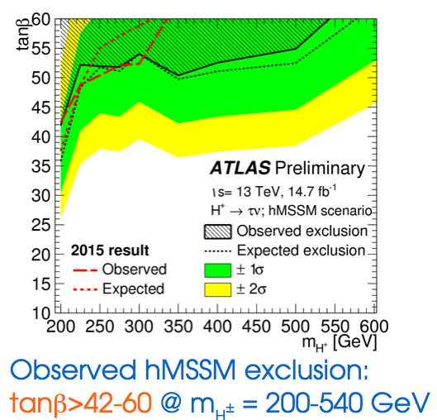
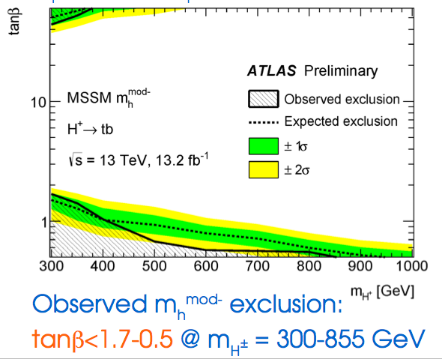
ATLAS Charged Higgs searches
H± -> τν
H± -> tb
L. Fiorini
No signal observed and improved exclusion limits obtained
Next for ATLAS and CMS will be to address the intermediate region
~160-180 GeV (calculations now available)

Slide 47
CMS H±→WZ
D. Taylor

Slide 48
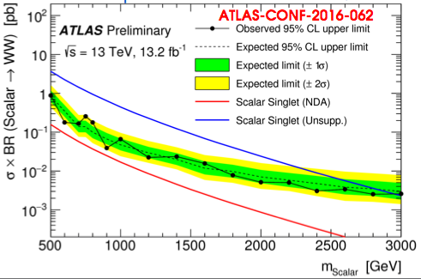
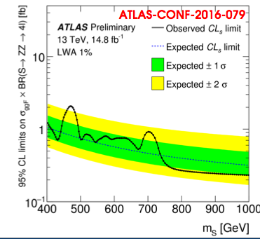
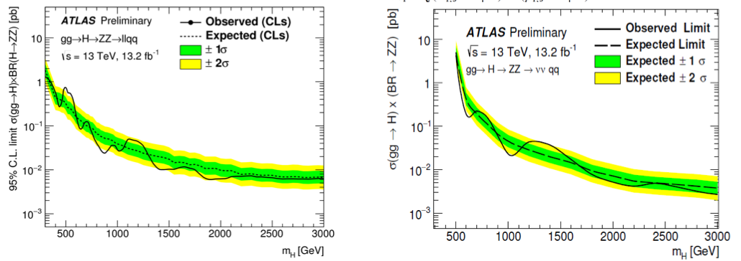
ATLAS: high mass searches
Largely exploit jet substructure in many different channels
Large improvements compared to Run 1
WW->lνqq
ZZ->4l
ZZ->llqq
ZZ->ννqq

Slide 49
ATLAS results on hh→bbbb
Combine resolved and unresolved exploiting IBL detector for b-tagging
29 x the SM, expected may be somewhat larger

Slide 50
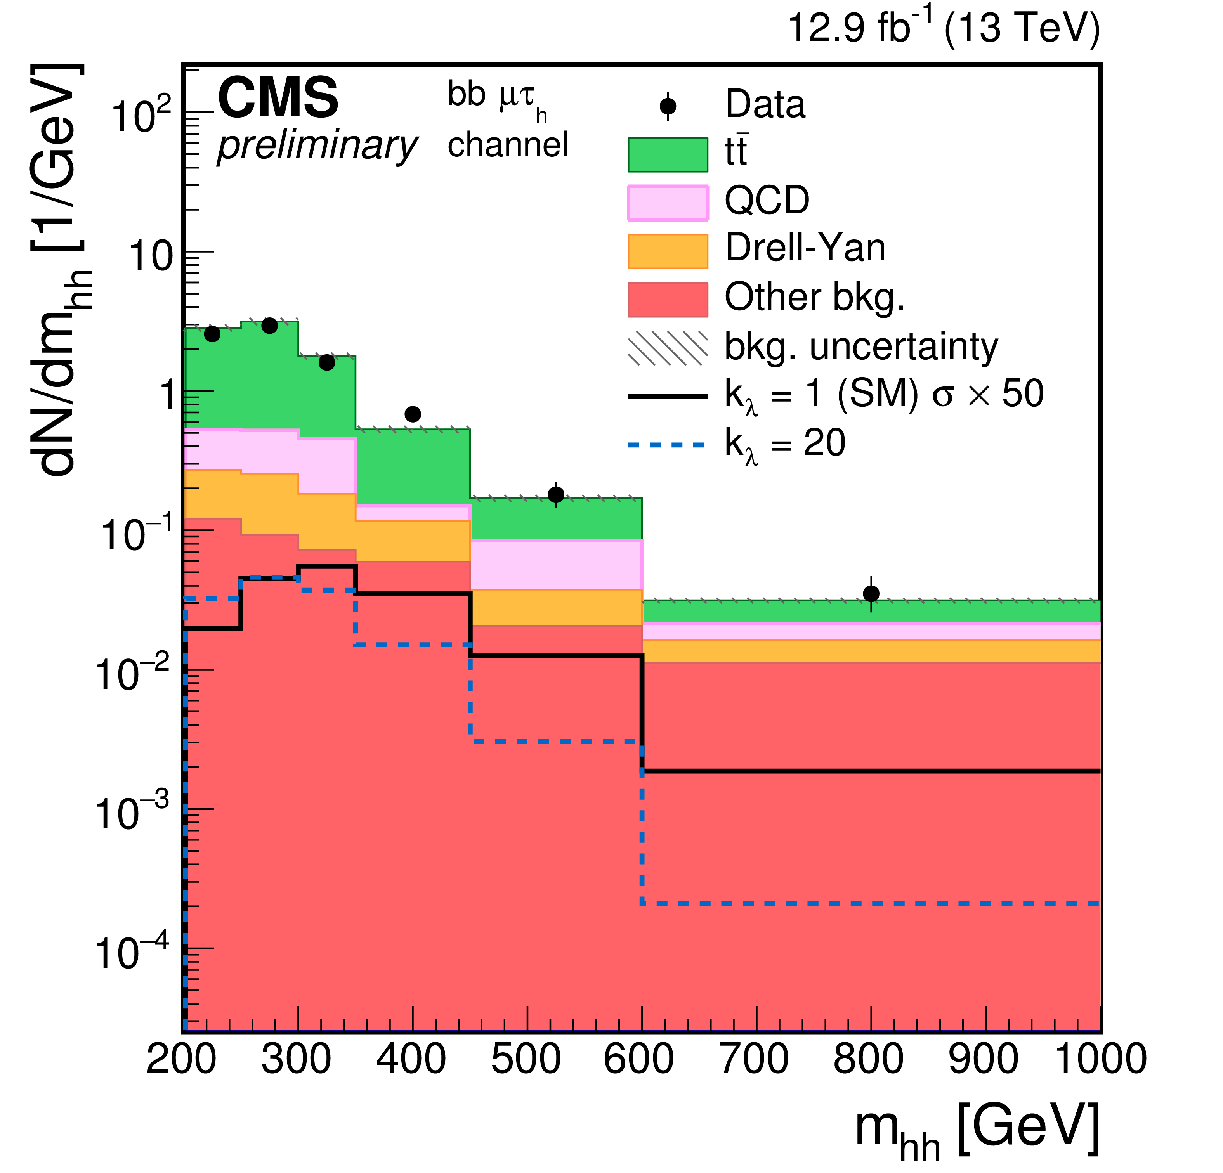
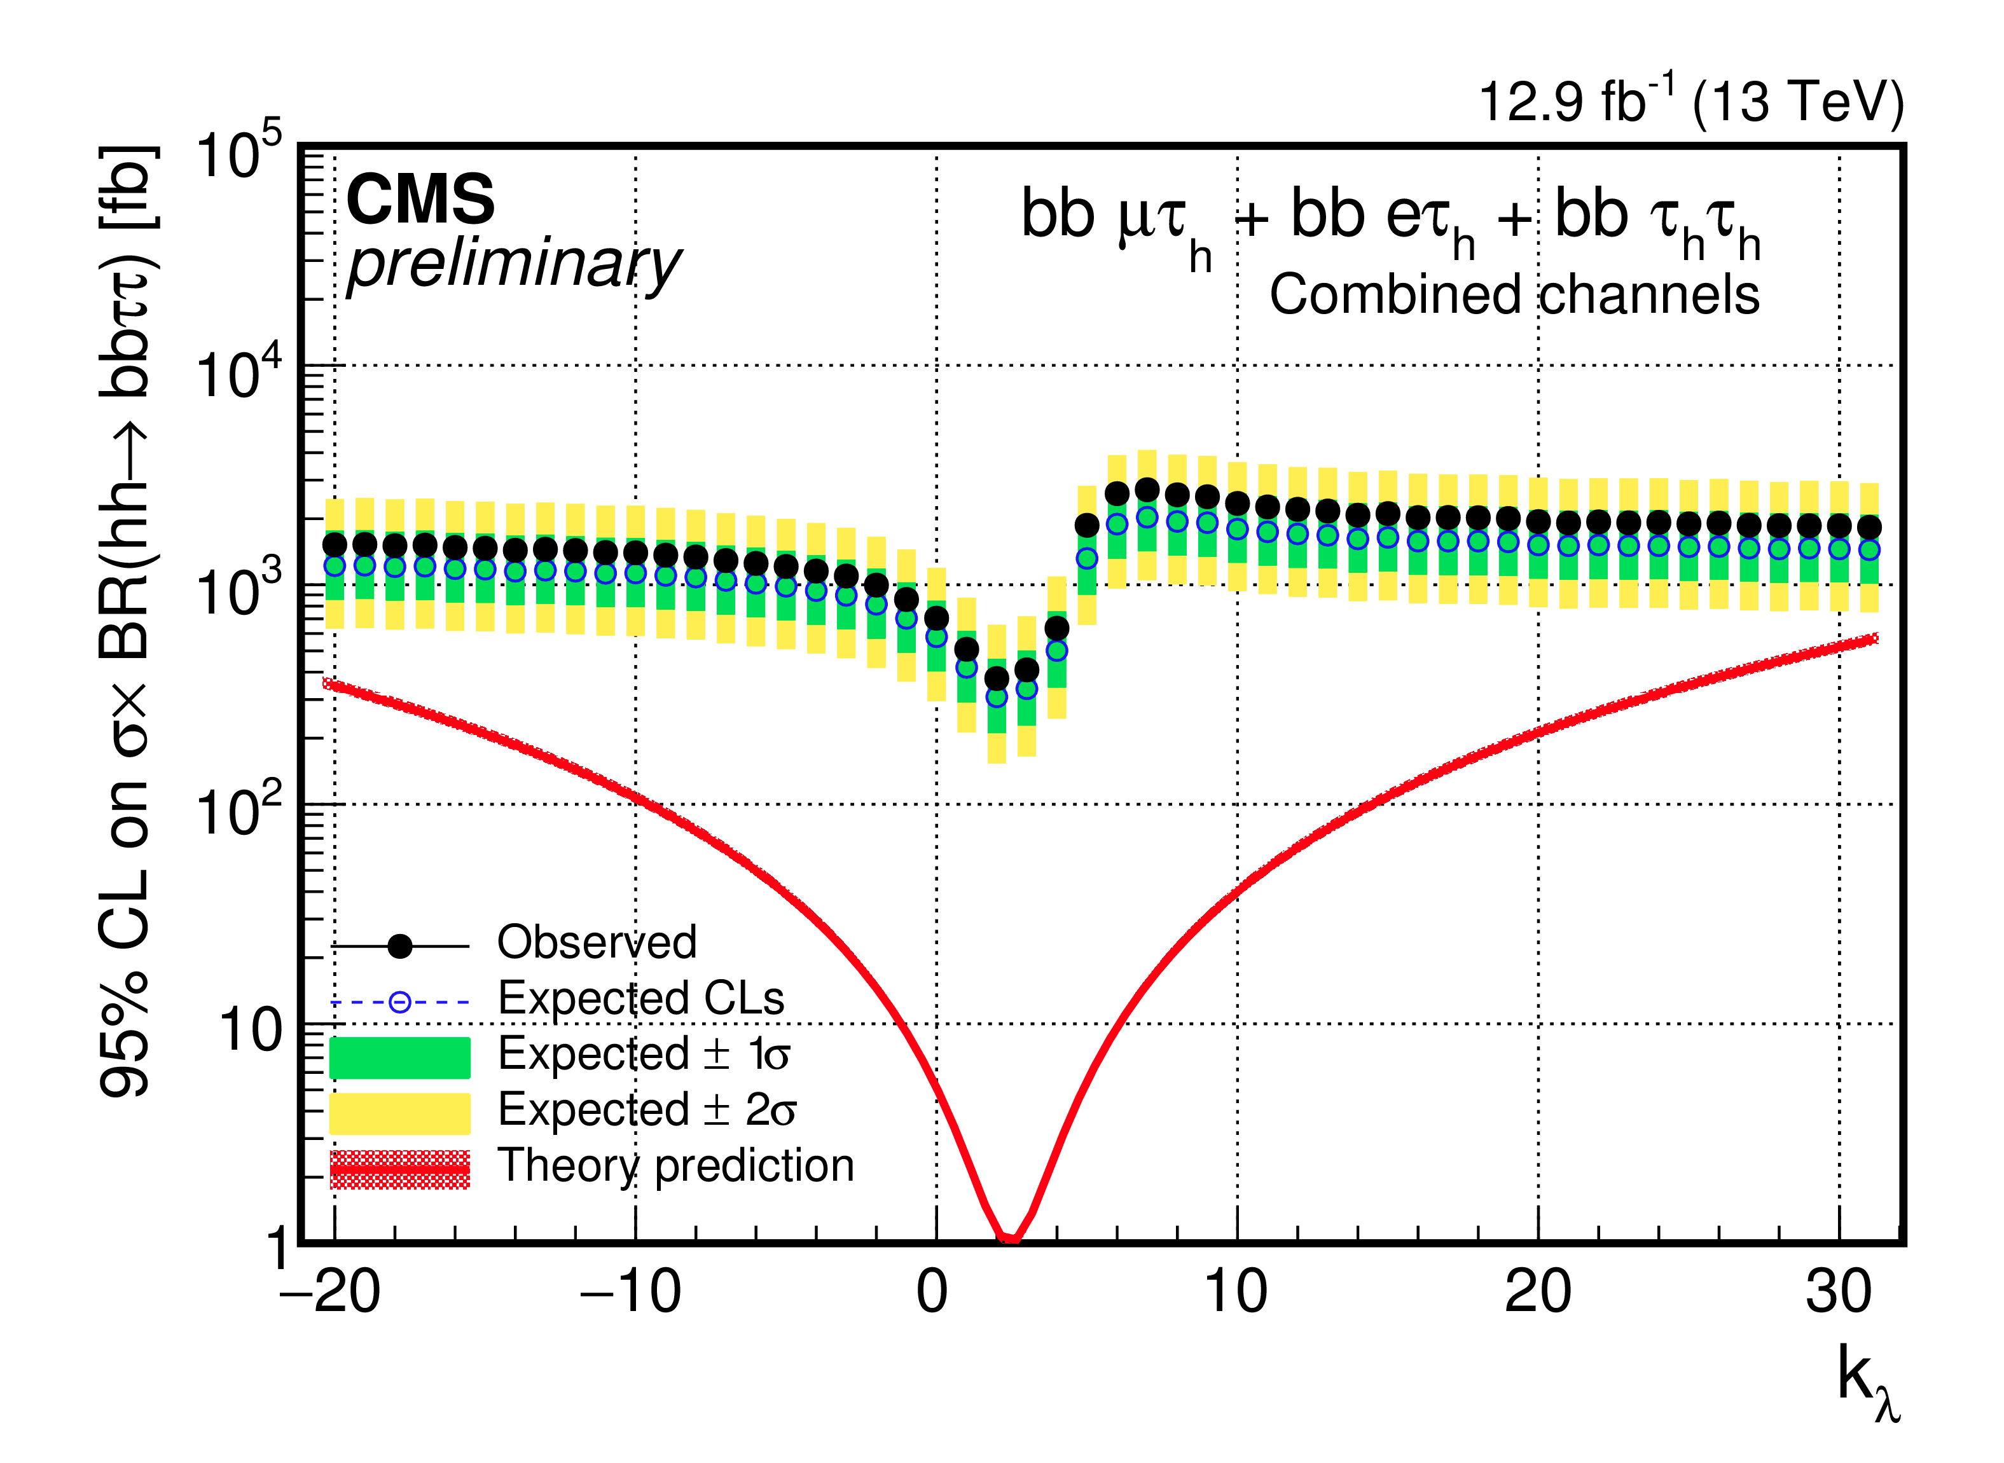
CMS double Higgs searches
Resonant and non-resonant searches have been performed at 13 TeV in different channels using 2015 data
bbττ has been updated with the full statistics before ICHEP
95% CL upper limits as function of the anomalous
triliear couplings (~200 x the SM)

Slide 51
In summary, still
no deviations from SM expectations

Slide 52
Future

Slide 53
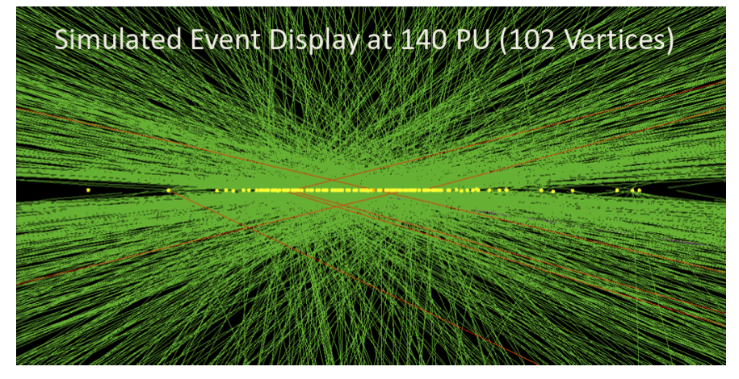
Future prospects
D. Gillberg, D. Sperka
Higher PU, up to 140 interactions
Per beam crossing and more

Slide 54
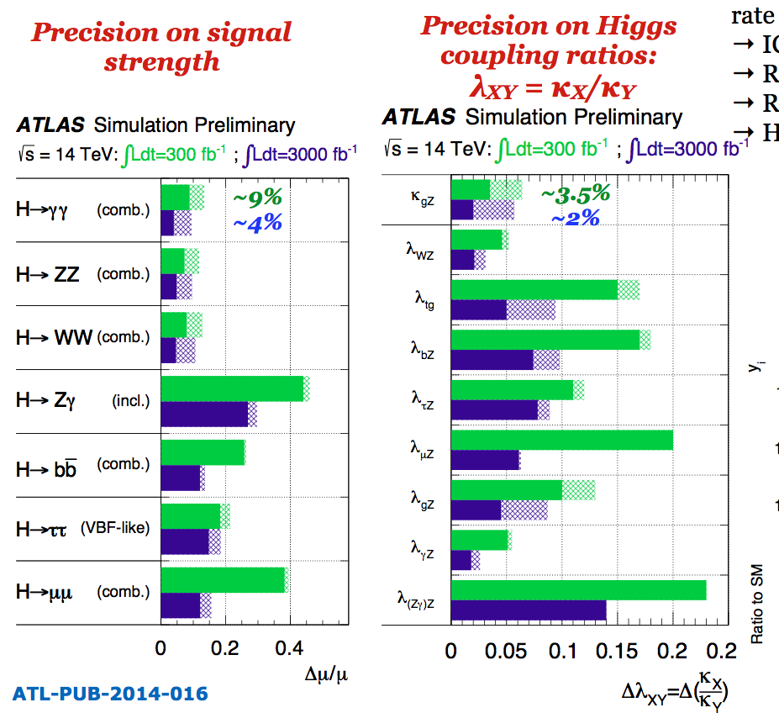
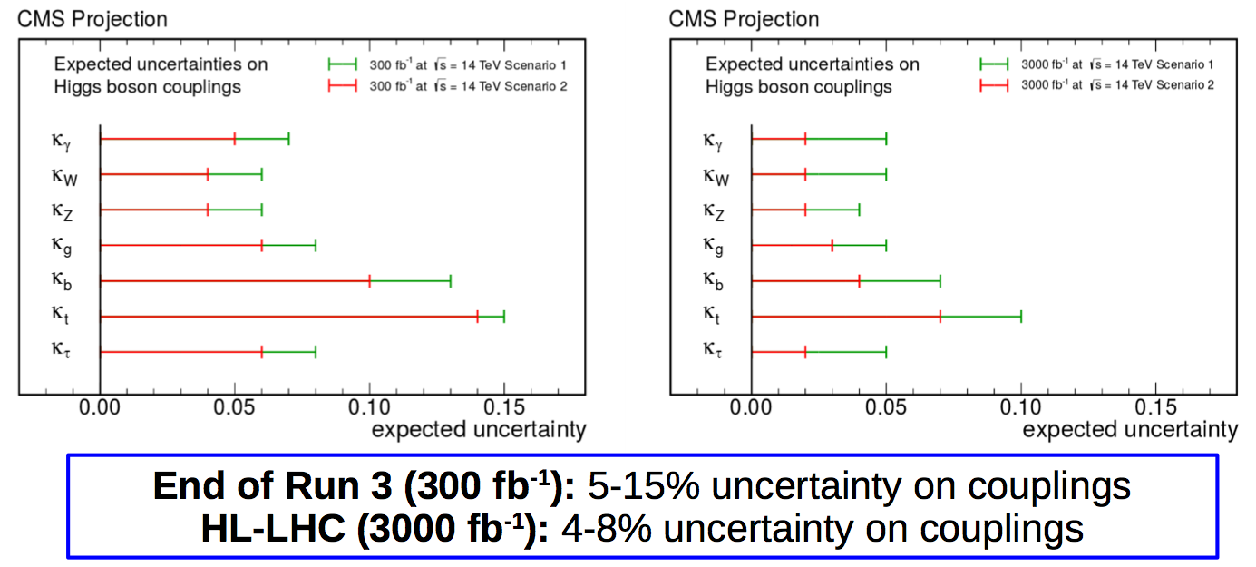
Signal strength and couplings projections
Based on 8 TeV analyses, next iteration will surely be more accurate
With Yellow Report 4 the LHCHXSWG has already improved the theory uncertainties by a factor 2
Important to also make projections on some ratios that have reduced theory errors, lumi error and others…

Slide 55
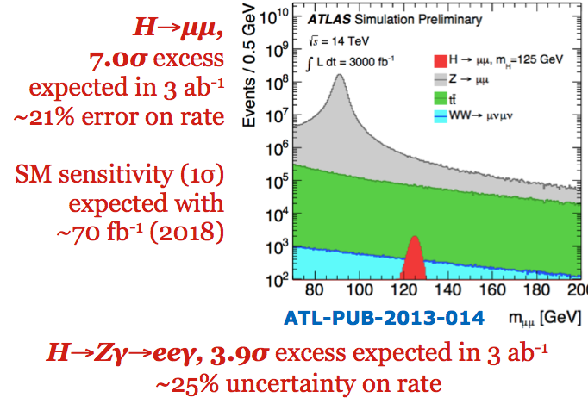
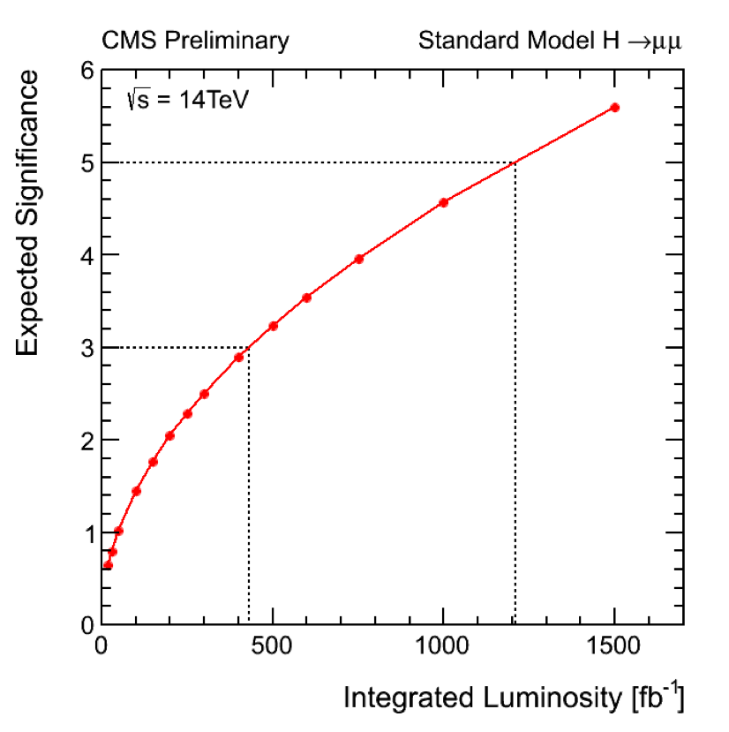
H→μμ and rare decays
H→μμ is the most promising channel to test the Higgs couplings to the second generation fermions
D. Gillberg, D. Sperka
CMS: significance as
function of IntL Similar conclusion
ATLAS H→μμ and H→Zγ

Slide 56
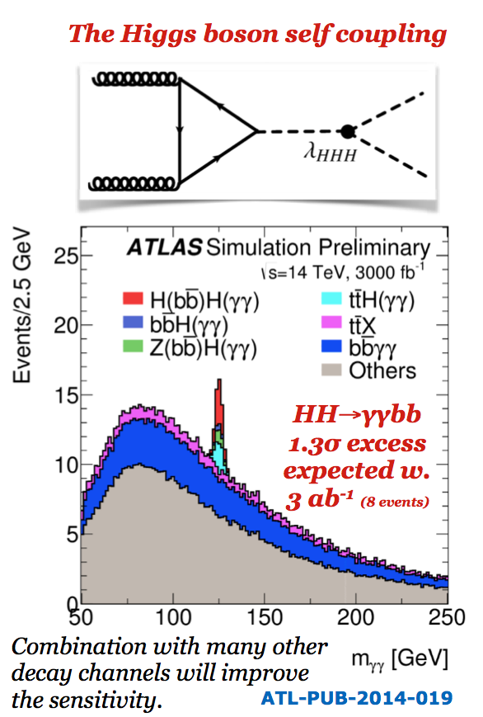
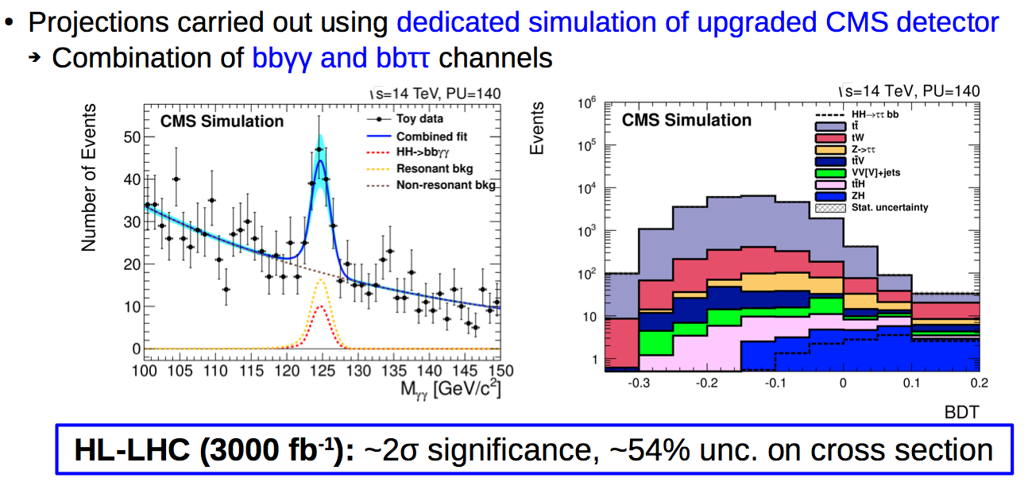
Double Higgs production
ATLAS, simple cut and
count analysis, can be improved
CMS uses bbγγ and bbττ

Slide 57
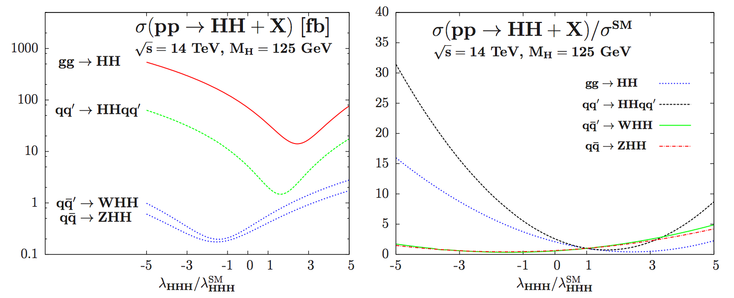
Final reach for Higgs self coupling
We currently estimate 1.5-2 σ per experiment at the end of HL-LHC, more channels, improvements in the analysis…
Generic statements that we may reach 3σ with 3 ab⁻¹
A complete analysis should be made at some point to clarify the issue
But note that the sensitivity is expressed for double Higgs production, NOT for triple Higgs coupling
Still we will be sensitive to large deviations
arXiv:1212.5581 [hep-ph]

Slide 58
Summary
and
Outlook

Slide 59
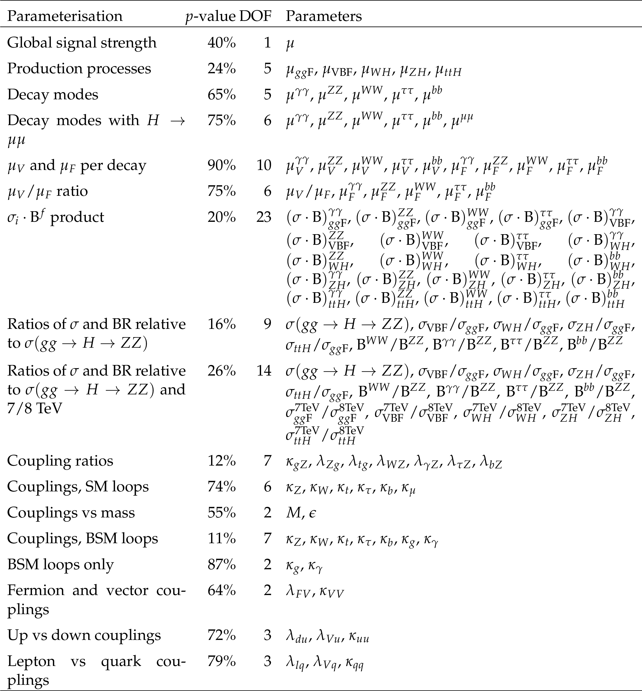
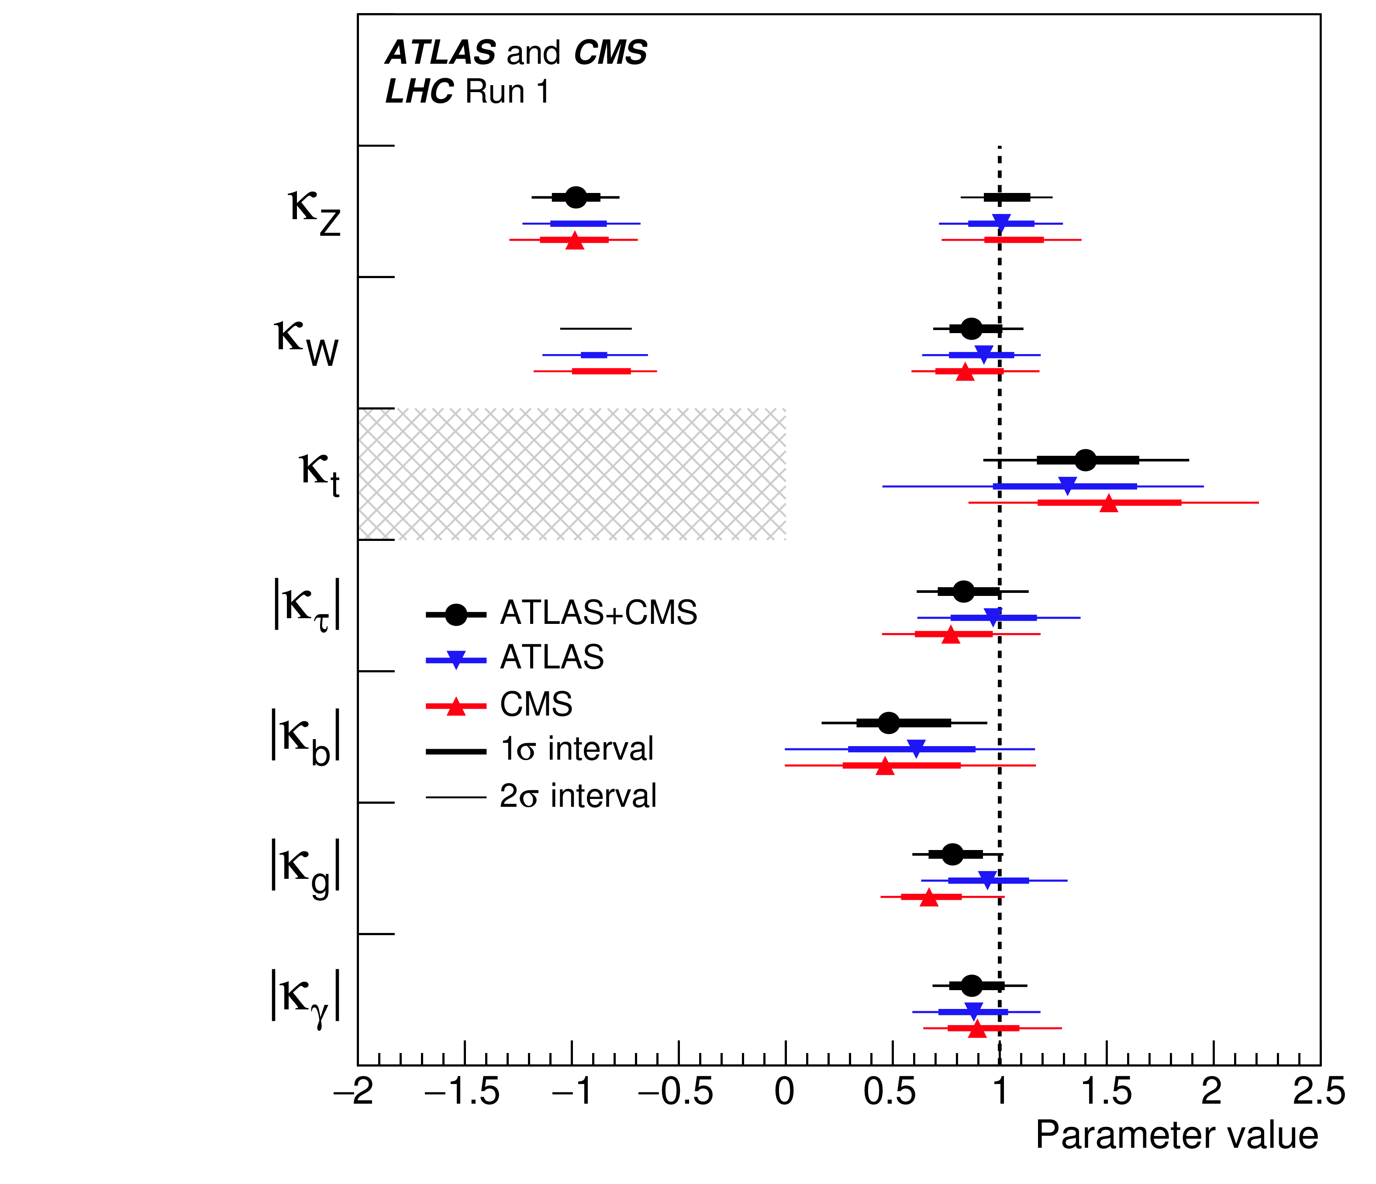
What to keep an eye on
Largest discrepancies observed (only at the 10% level and fully compatible with statistics) were in ttH and H->bb
Analyses of Run 2 data for now seem to go in the same direction
Interesting NMSSM model proposed by C. Wagner and collaborators with stop quarks in the gluon fusion loop would account for it
p-values of combined ATLAS+CMS fits

Slide 60
Summary
Thanks to the excellent performance of the LHC, ATLAS and CMS are collecting a lot of data and analyzing them promptly
Lots of measurements and searches have been reported by ATLAS and CMS
New interpretations are starting to be carried out (simplified template cross sections)
Fiducial and differential measurements will become more important with higher statistics
No significant deviations observed (yet)

Slide 61
Outlook
Higgs boson properties are among the most interesting measurements at the LHC
After discovering the Higgs boson, we should measure its properties as well as we can
Precise measurements may reveal BSM physics:
SM extensions, dark matter, …
Keep searching for BSM effects in the Higgs sector
BSM decays, additional Higgs bosons
It may take longer that we are used to, in some cases precision physics takes time
in many cases systematic uncertainties will start to dominate soon (did not happen in Run 1)
theory community will play a major role in the understanding of signal and backgrounds
I believe that we have a very exciting experimental program ahead of us

