Slide 1




Equipe PRAE
LAL-IPNO-IMNC

Slide 2
Outline
General Description: Scientific and Technical
Resources: teams, associated partnerships and budget
Status and Perspectives
IN2P3 Perspectives

Slide 3
PRAE – General description
PRAE : Platform for Research and Applications with Electrons
Responsable scientifique national: Sergey BARSUK (LAL)
Responsables scientifiques locaux: Eric VOUTIER (IPNO): ProRad
Yolanda PREZADO (IMNC): Radiotherapy
Bernard GENOLINI (IPNO): Detectors R&D
Angelès FAUS-GOLFE (LAL): Accelerator & beam instrumentation
Responsable technique: Patricia DUCHESNE (IPNO)
PRAE: The multi-disciplinary site based on the high-performance electron beam with the energy of 70 MeV (intermediate PRAE version) and 140 MeV (designed PRAE version). Infrastructure and PRAE design allows an upgrade to 300 MeV.
Mutually linked axes of PRAE:
Axis 4 – Accelerator: Construction of the machine (direct line + two deviated lines) to service other axes with the beam of required performance; accelerator R&D; training.
Axis 1 – Nuclear physics/nucleon structure: proton charge radius; training.
Axis 2 – Radiotherapy: new approaches in radiotherapy; promising for IMRT (Intensity Modulated Radiation Therapy), radiobiology studies.
Axis 3 – Instrumentation R&D: versatile instrumentation platform; training.
Transversal project.
Strong complementary expertise of the IMNC, IPN and LAL groups proposing the project.
Re-use of the unique site of the former Linear Accelerator and its infrastructure.
  .
2. Radiotherapy
3. Detector R&D
Nuclear physics:
nucleon structure
4. Accelerator
PRAE
Notes:
3
Groupe Evaluation AERES 13-14 janvier 2011

Slide 4
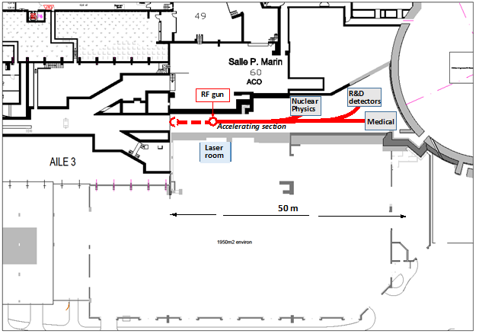
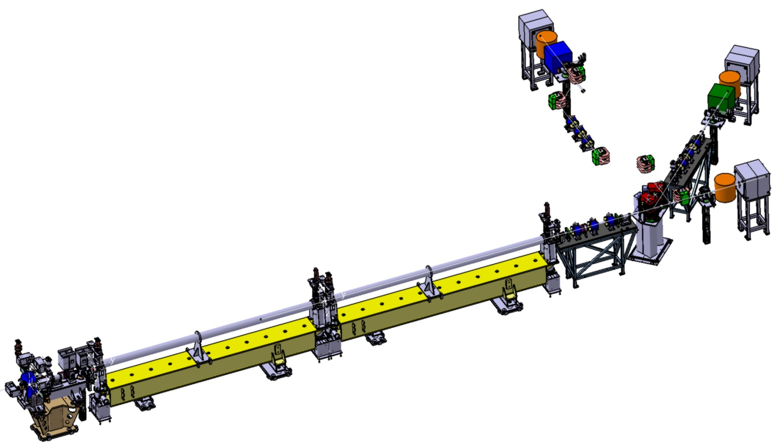
PRAE – General description
ProRad
Instrumentation
3.47 m
4,8 m
Radiotherapy
HG S-band Linac 25 MV/m
RF gun 5 MeV
Notes:
4
Groupe Evaluation AERES 13-14 janvier 2011

Slide 5
Outline
General Description: Scientific and Technical
Resources: teams, associated partnerships and budget
Status and Perspectives
IN2P3 Perspectives

Slide 6
PRAE – Teams
Organisation :
4 mutually linked project axes:
Project Coordinator
PA1: Nuclear Physics (IPNO)
Eric Voutier
PA4: Accelerator and beam instrumentation R&D (LAL, IPNO)
Angeles Faus-Golfe
PA3: Detector R&D (LAL, IPNO, IMNC)
Bernard Genolini
PA2: Radiotherapy (IMNC, IPNO, LAL)
Yolanda Prezado
Technical Coordinator
Main links between the project axes:
Accélérateurs
Physique Nucleaire
Radiothérapie
R&D détecteurs
LASERIX
Definition of practical work packages and identification of possible bottlenecks started in the working groups
Notes:
6
Groupe Evaluation AERES 13-14 janvier 2011

Slide 7
PRAE – Teams
Proposed to create Operations group (project leader – technical coordinator – project axes responsibles) and Steering committee (laboratories directors, representative of IN2P3, representative(s) of P2IO – Samuel Wallon, external experts)
Project Coordinator
Sergey BARSUK
Technical Coordinator
Patricia DUCHESNE
Scientific Coordinators
PA1 : Radiotherapy Yolanda PREZADO
PA2 : Subatomic Physics Eric VOUTIER
PA3 : Detectors R&D Bernard GENOLINI
PA4 : Accelerators and Beam Angeles FAUS-GOLFE
Instrumentation R&D
ACCELERATORS
Angeles FAUS-GOLFE
INFRASTRUCTURES
Marc LANGLET
RADIOPROTECTION & SECURITY
EXPERIMENTS
-
RF GUN
Mohamed EL KHALDI
RF LINAC
Mohamed EL KHALDI ELECTRONICS (LLRF)
Mohamed EL KHALDI
HPRF
Maher OMEICH
MECHANICS
Alexandre GONIN
Denis DOUILLET
BEAM INSTRUMENTATION
Patrick AUSSET
MECHANICS
Sébastien BLIVET
IMPLEMENTATION
Alexandre GONIN
Patricia DUCHESNE
RADIOPROTECTION & SECURITY
Patricia BERTHO
Sébastien WURTH
PA1
IRRADIATION CHAMBER
Sébastien BLIVET
SCANNING DIPOLE
Cynthia VALLERAND
Samuel MEYRONEINC
DEFINITION OF NEEDS
Marc LANGLET
Patricia DUCHESNE
ASN PROCEDURE
Patricia BERTHO
Sébastien WURTH
Jean François LE DU
INTEGRATION
Alexandre GONIN
Denis DOUILLET
BEAM PIPES
Alexandre GONIN
Denis DOUILLET
BEAM DUMPS
Alexandre GONIN
Denis DOUILLET
PA2
SUPPORT STRUCTURE
Kevin PRESSARD
REACTION CHAMBER
Christine LE GAILLARD
ENERGY MEASUREMENT
Dominique Marchand
Luc Perrot
MECHANICS
Sébastien Blivet
MASTER WORK
Marc LANGLET
Patricia BERTHO
Patricia DUCHESNE
In Progress
BEAM LINES
Angelès FAUS-GOLFE
MECHANICS
Alexandre GONIN
Denis DOUILLET
MAGNETS
Cynthia VALLERAND
Patricia DUCHESNE
VACUUM
Bruno MERCIER
PA3
SPECTROMETRE
Sergey BARSUK
Giulia HULL
CONTROL SYSTEM
Hayg GULER
Notes:
7
Groupe Evaluation AERES 13-14 janvier 2011

Slide 8
PRAE – Teams
Contribution of participants:
FTE |  | 2016 | 2017 | 2018 | 2019
PA1: Nuclear Physics | IPNO | 1.55 | 3.35 | 3.5 | 2.75
PA2: Radiotherapy | IMNC | 0.1 | 0.1 | 0.9 | 1.05
 | LAL | 1.2 | 1.2 | 0.25 | 0.2
 | IPNO | 0.05 | 0.15 | 0.05 | 0.05
PA3: Detectors R&D | IPNO | 0.85 | 1.5 | 1.05 | 0.55
 | LAL | 0.75 | 1.45 | 1.3 | 0.7
PA4: Accelerator * | LAL | 2.4 | 2.75 | 2.95 | 2.85
 | IPNO | 0.5 | 0.65 | 0.8 | 0.65
Total |  | 7.4 | 11.2 | 10.8 | 8.8
* : included mechanics CDD 100% during 4 years
More:
Technical coordinator (0.5 FTE)
Infrastructure responsible: definition of needs, master work (?FTE)
Security & radioprotection: ASN procedure (?FTE)
Optics and beam dynamics (?FTE PhD)
other CDD ?
Notes:
8
Groupe Evaluation AERES 13-14 janvier 2011

Slide 9
PRAE – Associated partnerships
Associated partnerships:
The project will benefit from existing partnerships or those being established.
Synergy with the ALTO, PHIL, THOMX, … technological solutions: possible complementary production of cavities from the industrial partners; expertise, common production runs, shared equipment.
Collaboration with TE-MNC Technical department of CERN: e.g. LEETECH spectrometer (also contribution from P2IO).
Possible collaboration with the RF CLIC group at CERN.
Collaboration with Ukrainian groups via LIA IDEATE.
Possible collaboration on the RF technologies (PMB, …).
Interest for full-scale participation in PRAE by CPO. Contribution to instrumentation of axis 2; and to axis 4
Interest to formally join the PRAE effort by CSNSM. Contribution to DAQ instrumentation for axes 1 and 3, expertise in DCOD (NARVAL + ENX), integration of the slow control (ENX), user interface, online track processing: trigger, enhanced analysis.
Agreement with SLAC is being discussed. Contribution via recuperation of some accelerator components.
Interest from the Laserix group as a user and contributor. Minor modification of the machine design to host Laserix electron-laser interaction program, 10 days per year. Contribution with laser and laser service.
Associated partnerships, news:
Notes:
9
Groupe Evaluation AERES 13-14 janvier 2011

Slide 10
PRAE – Budget
Total contribution via request P2IO (phase 1 concerned) : 814 kE.
PostDoc P2IO (3 years) + PostDoc CNRS (1 year)
Equipment 514 kE (P2IO) + 100 kE (complementary contribution by IPNO and LAL).
Other sources of financing the project: the SESAME project submitted to the IdF region.
Infrastructure ensured via contributions by the participating laboratories.
Notes:
10
Groupe Evaluation AERES 13-14 janvier 2011

Slide 11
Outline
General Description: Scientific and Technical
Resources: teams, associated partnerships and budget
Status and Perspectives
IN2P3 Perspectives

Slide 12
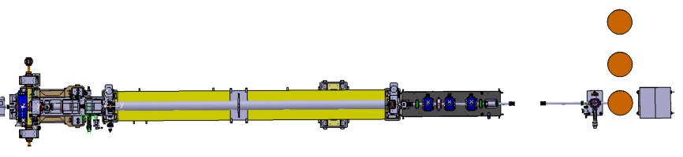
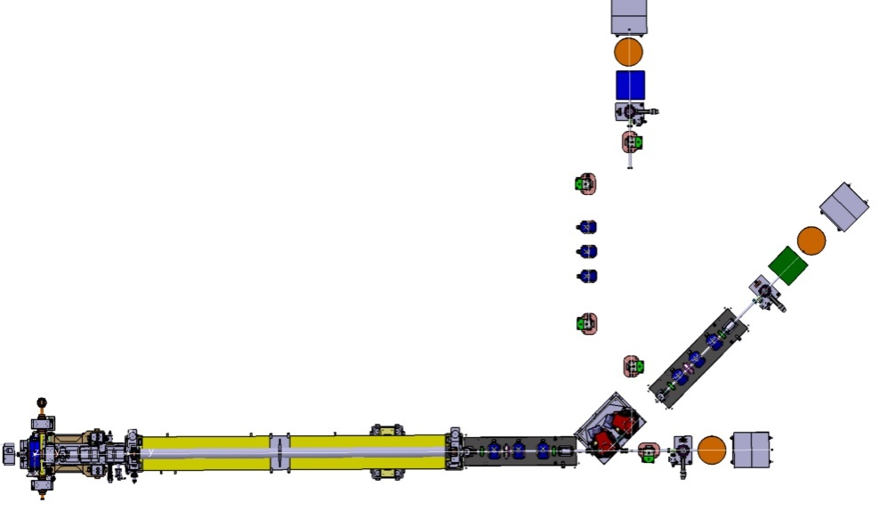
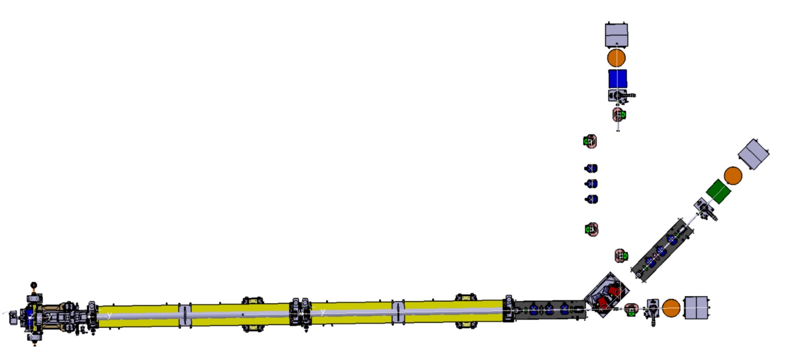
PRAE – Status & Perspectives
Three phases of PRAE construction
Phase 1: 2 nC electron bunches at 50 Hz, accelerated to 50-70 MeV, direct PRAE beam line
ProRad
Phase 2: two deviated lines; scanning dipole for Radiotherapy; spectrometer for Instrumentation; magnetic chicane for ProRad.
Instrumentation
Radiotherapy
ProRad
Phase 3: 140 MeV
Instrumentation
Radiotherapy

Slide 13
PRAE – Status & Perspectives
Three phases of PRAE construction
PRAE Phase 1 (Essential contribution by P2IO.)
  Accelerator: 2 nC electron bunches at 50 Hz, accelerated to 50-70 MeV, direct PRAE beam line.
  Nuclear physics/nucleon structure: optimization of the setup using simulation and tests; tests of the target for the complete ProRad instrument; measurement of the electric form factor of the proton.
  Radiotherapy: validation of the PRAE setup, dosimetry campaign, using goniometer.
  Detector R&D: calibration and commissioning of the setup. First use by instrumentation groups.
  Numerous tests and validations possible with the existing PHIL, ALTO, … facilities.
  Edition of Technical Design Report.
PRAE Phase 2
  Accelerator: direct (radiotherapy platform) and two deviated beam lines (nuclear physics and detector R&D)
  Nuclear physics/nucleon structure: nominal ProRad experiment operation.
  Radiotherapy: PRAE setup, dosimetry campaign, validation using scanning dipole.
  Detector R&D: spectrometer; routine use by instrumentation groups.
PRAE Phase 3
  Accelerator: new accelerator section, maximum planned energy 140 MeV reached.
  Nuclear physics/nucleon structure: complementary ProRad measurements; program extension.
  Radiotherapy: dosimetry, small animals measurements.
  Detector R&D: routine use by instrumentation groups.

Slide 14
PRAE – Status & Perspectives
Planning: phase 1, e-beam 70 MeV, direct line
Year | 2016 | 2017 |  | 2018 |  | 2019 |  | 2020
Semester | 2 | 1 | 2 | 1 | 2 | 1 | 2
Design, components procuring
Component tests at PHIL-10 MeV
Component tests at PHIL-30 MeV
Validation of axis setups at PHIL
Infrastructure at PRAE
Installation at PRAE
PRAE commissioning, 70 MeV
TDR chapters ready
Provide within 12 months from the filing folder and ASN authorization .
Implementation Study and definition of the needs for infrastructure work must start now
Problem of availability of contributors because of ongoing projects ( ThomX , operating platforms , ...).
PRAE operational :
PRAE v1

Slide 15
PRAE – Status & Perspectives
Phases 2 and 3: e-beam 70 and 140 MeV, direct + 2 deviated lines
Year | 2016 | 2017 | 2018 | 2019 | 2020 | 2021 | 2022 | 2023 | 2024 | 2025
Phase 1
Phase 2, 70 MeV, 3 lines
Design, components procuring
Construction
Commissioning
Phase 3, 140 MeV, 3 lines
Design, components procuring
Construction
Commissioning
PRAE operational :
PRAE v1
Development PRAE v2-3

Slide 16
Outline
General Description: Scientific and Technical
Resources: teams, associated partnerships and budget
Status and Perspectives
IN2P3 Perspectives

Slide 17
PRAE – IN2P3 Perspectives
PRAE is a unique innovative and attractive multi-disciplinary project for science, R&D and applications based on complementary IMNC – IPN – LAL expertise, in the heart of the IN2P3.
Construction of the multi-disciplinary PRAE site – Subatomic physics, Radiotherapy, Instrumentation R&D and Accelerator – is centered around the new high-performance electron accelerator and involves 3 major IN2P3 laboratories
Participating IN2P3 laboratories commit expertise, manpower, infrastructure and complementary funding to complete the core of the PRAE project. Unique former Linear Accelerator protected zone will be reused. IN2P3 has supported strongly the SESAME request, awaiting results…
New original and competitive scientific program, impact expected at the regional and national level. Federation of the key scientific communities of IN2P3 around PRAE, opening to larger scientific community, industry, and education.

Slide 18
PRAE
BACKUP
Notes:
18
Groupe Evaluation AERES 13-14 janvier 2011

Slide 19
Former site of linear accelerator at LAL
RF gun
R&D
detectors
Nuclear
Physics
Accelerating section
Medical
Laser
room
50 m
Classification waved now !

Slide 20
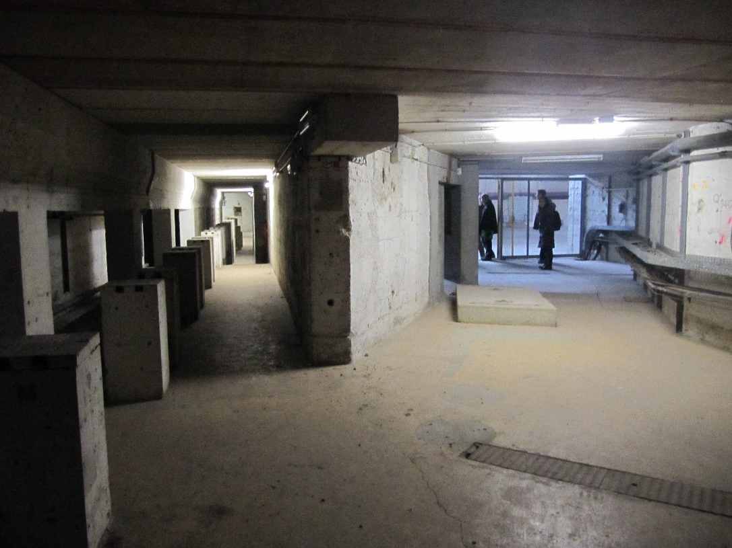
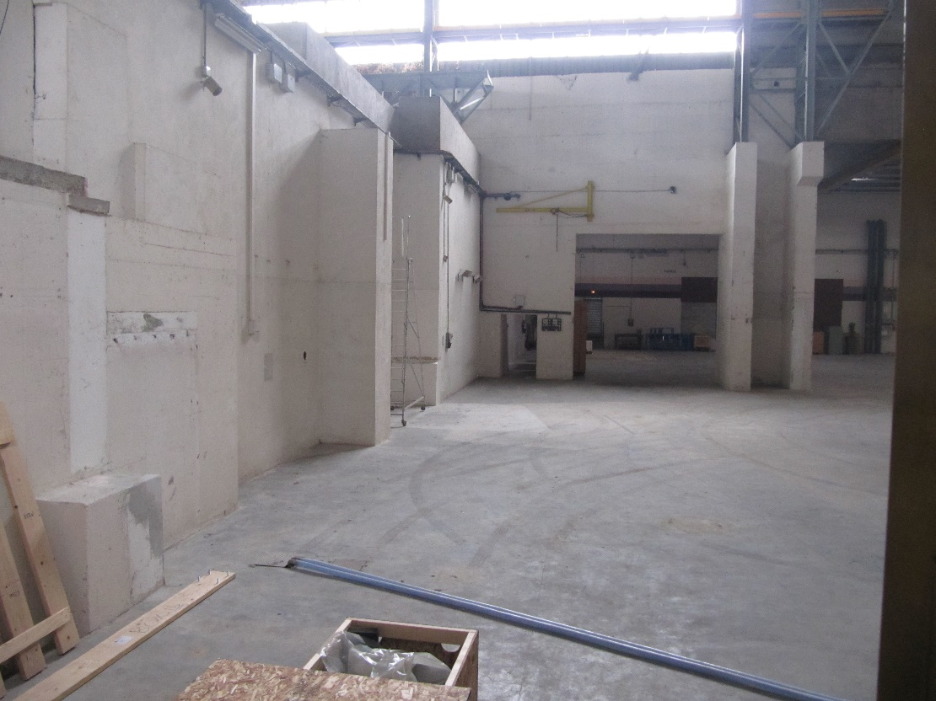
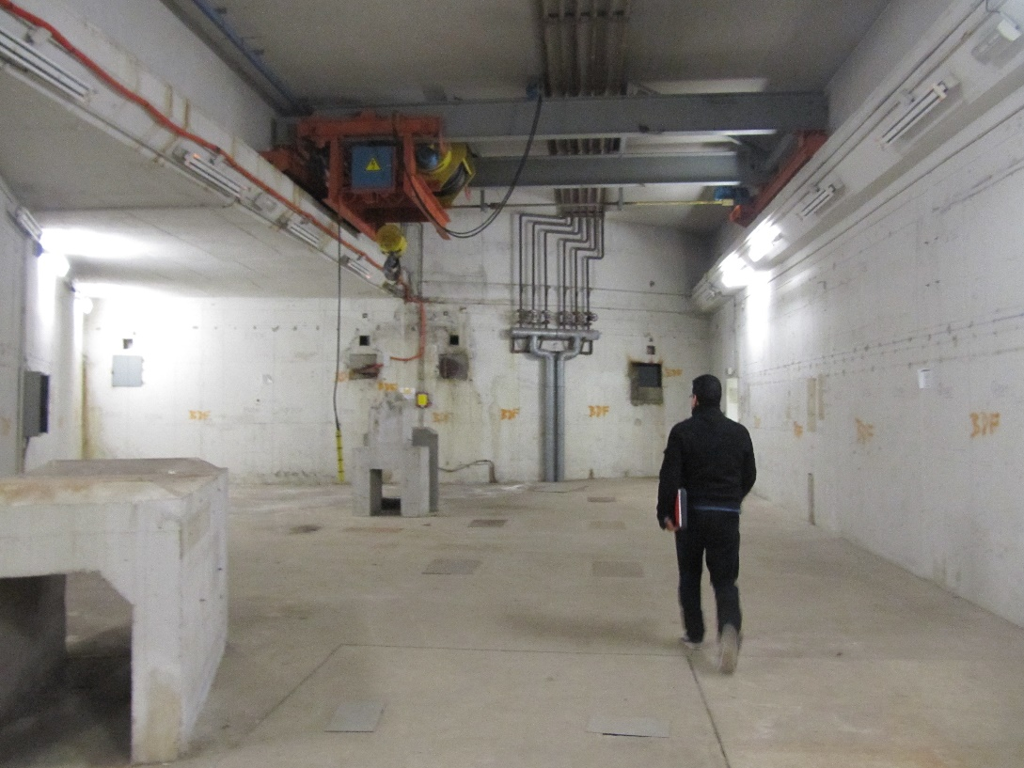
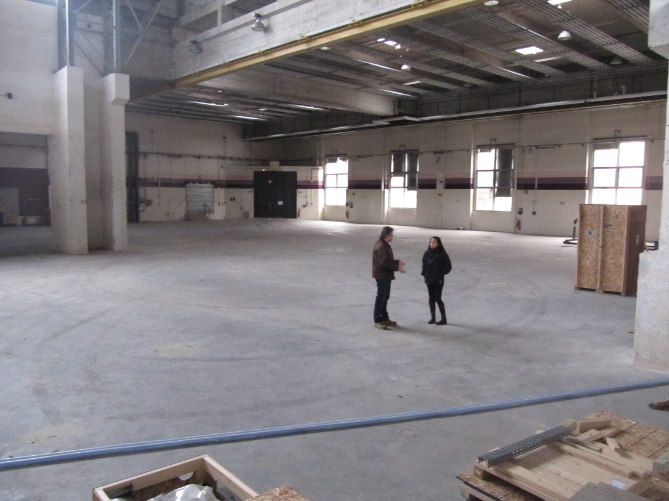
Former site of linear accelerator at LAL
Beam line
Laser hut
Experimental hall
Access path

Slide 21
Axis 4: accelerator construction and related R&D
Coordinator: Angeles Faus-Golfe (LAL)
  Principle goal : core accelerator construction / application
  Other studies : R&D high-gradient RF, large intensity dynamic range BPMs, R&D on other accelerator applications
  Training of engineers and technical staff; Students’ hands-on

Slide 22

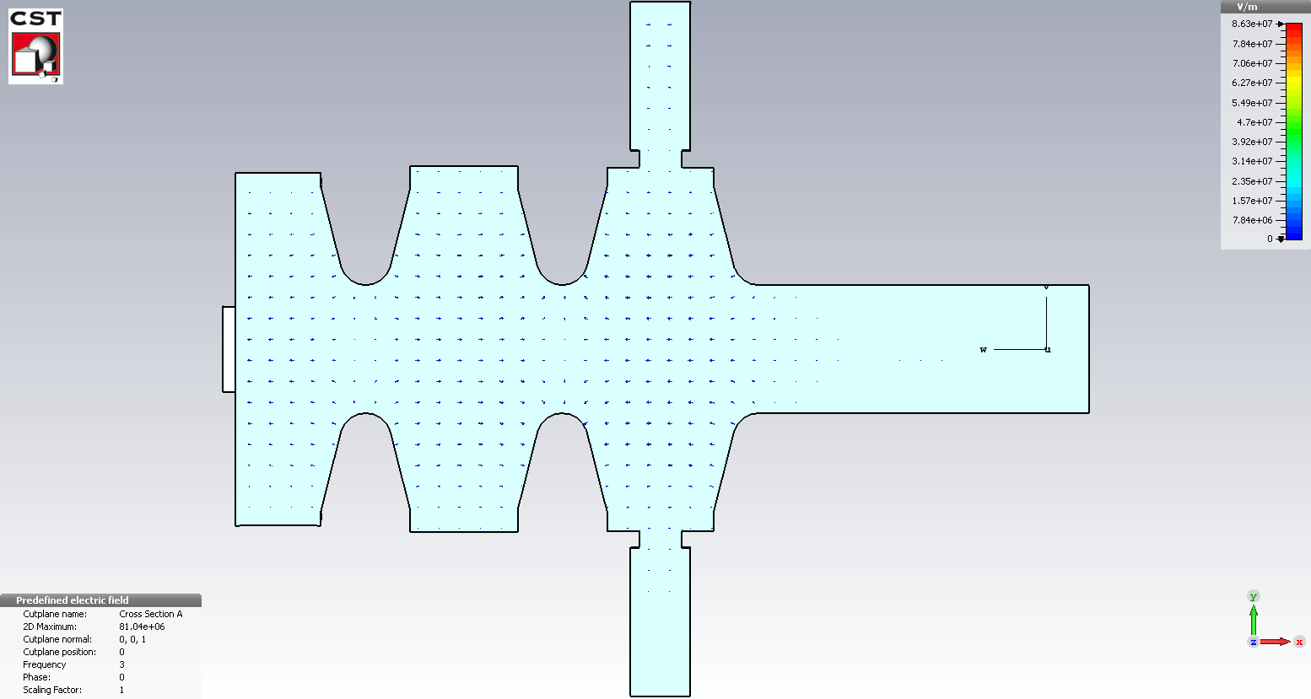

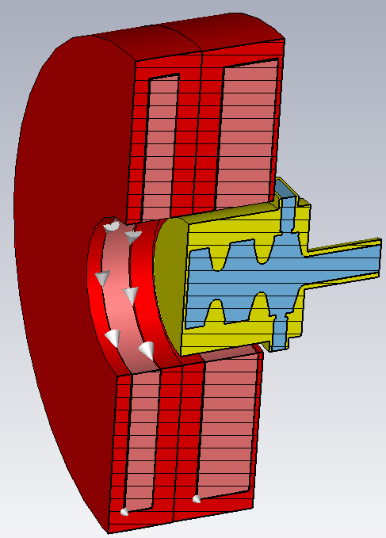
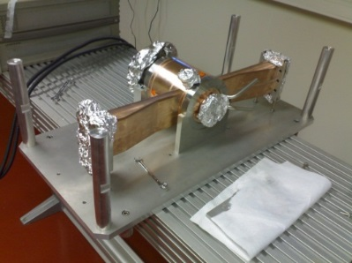
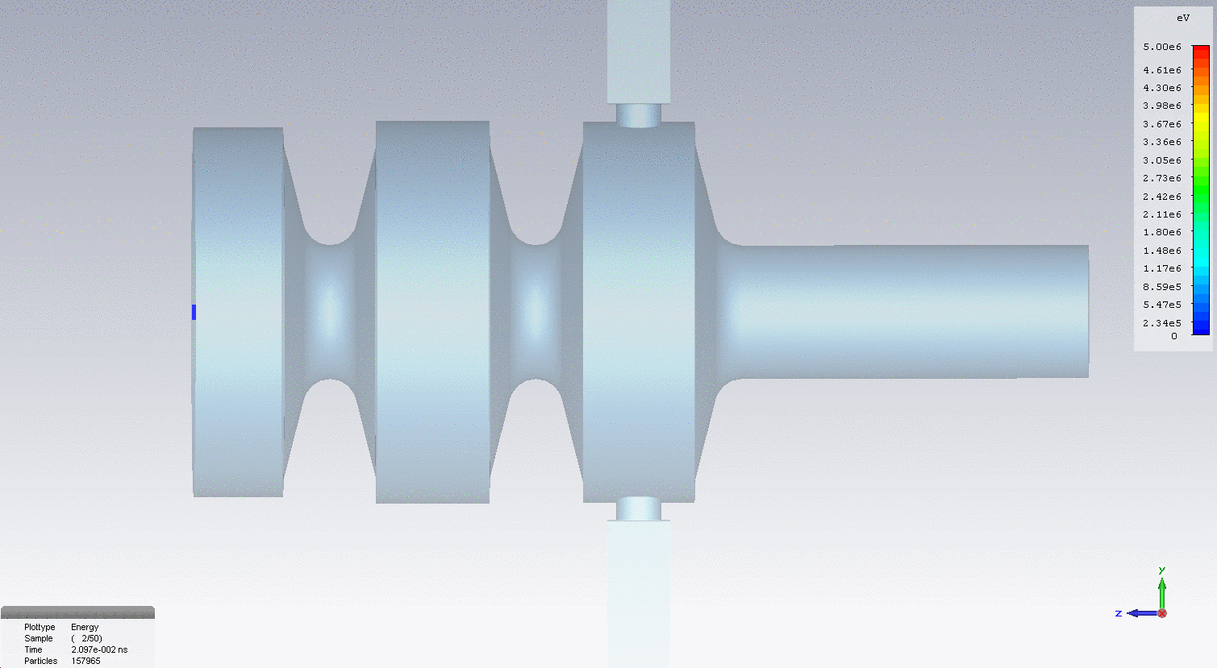
Example: expertise on RF gun
Accelerating gradient (TM₀₁₀ _ π mode ): 80 MV/m at P_{in}=5 MW
Photoinjector specification
RF power (5 MW)
Operation frequency | 2998,55 MHz (30°C, in vacuum)
Charge | 1 nC
Laser wavelength, pulse energy | 266 nm, 100 µJ
RF Gun Q and Rs | 14400, 49 MΩ/m
RF Gun accelerating gradient | 80 MV/m @ 5 MW
Normalized emittance (rms ) | 4.4 π mm mrad
Energy spread | 0.4 %
Bunch length (rms) | 5 ps
Photocathode
Coupling slot compensating the Field distortion
Short circuit
Gun with its coils (CST)
RF gun designed and produced at LAL
CST-Particle in cells, simulation results: Mohamed
20 cm
Energy gain = 5 MeV for Pin =5 MW
Bucking coil
Focusing coil

Slide 23
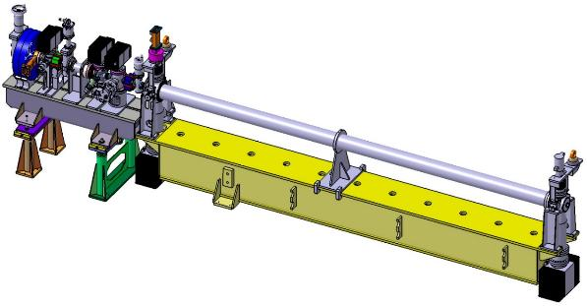
High-gradient research collaboration, LAL - PMB company
The PRAE accelerator will profit from the high-gradient S-band accelerating structure development of the HGAS project (“CIFFRE” project, collaboration with industry):
Development of high-gradient S-band TW accelerating structure (HGAS)
Project Responsible: Dr. Mohamed El Khaldi,
duration: 2014 - 2018 (4 years)
Direct application of high-gradient compact S-band electron LINAC for PRAE
PMB_LAL Accelerating section
(HGAS)
RF Gun
HGAS Technical specification:
4,8 m
Structure | Disk-loaded
Operation mode or phase advance | 2π/3
Operation Frequency | 2998,55 MHz (30°C, in vacuum)
Accelerator type | Quasi constant gradient, travelling wave
Accelerating Field for an input peak power of 22 MW | 25 MV/m (peak value)
Energy gain for an input peak power of 22 MW | 65 MeV (only HGAS)
Quality factor Q | > 14000
Number of cells | 94 + 2 coupler cells
Flange to flange length | 3,47 m

Slide 24
High-gradient accelerating structure development: challenges
The major obstacle to achieve higher gradients is RF breakdown, limiting working power and producing irreversible surface damage.
Breakdown limit depends on the RF circuit, structure geometry, and RF frequency. Also a function of the input power, pulse width, surface electric and magnetic fields and modified Poynting vector.
Improvements achievable via
  RF design optimization: optimization of the cell shape in order to maximize RF efficiency and minimize surface fields and modified pointing vector at very high accelerating gradients;
  Fabrication process optimization: precision machining, cleaning, brazing, …
  New materials: Copper Alloys, Tungsten, Molybdenum, … in critical areas
Prototypes have been designed and are under fabrication by PMB: investigate all possible issues (RF, mechanical) and improve the machining of cells and brazing processes.
M. EL Khaldi, L. Garolfi,“RF DESIGN OF A HIGH GRADIENT S-BAND TRAVELLING WAVE ACCELERATING STRUCTURE FOR THOMX LINAC”, Proceedings of IPAC2015, Richmond, VA, USA

Slide 25
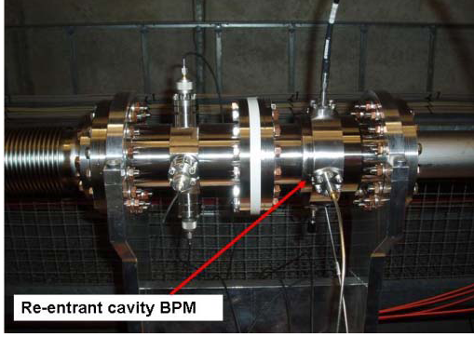
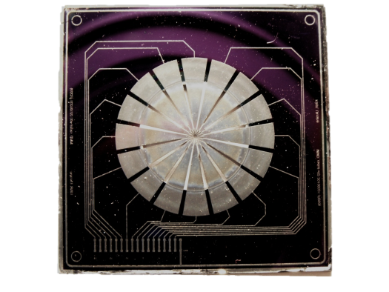
Beam instrumentation: other issues and challenges
Phase 1, BPMs: large intensity range required (2 nC - 10 pC), studies to make a technology choice
Re-entrant cavity type (CALIFE-CTF3; 5 µm resolution in a ±5 mm dynamic range)
Microstrip Metal Foil Monitors (MMD; LIA IDEATE, prototype for PHIL test)
MMD: 16 sectors, 1 μm thick
New high-performance electron accelerator will be constructed for PRAE applications.
Successful construction will be ensured by the expertise of participating laboratories.

Slide 26
Axis 1: nuclear physics / nucleon structure
Coordinator: Eric Voutier (IPN)
  Principle experiment : proton charge radius measurement, 30-70 MeV
  Students’ hands-on

Slide 27
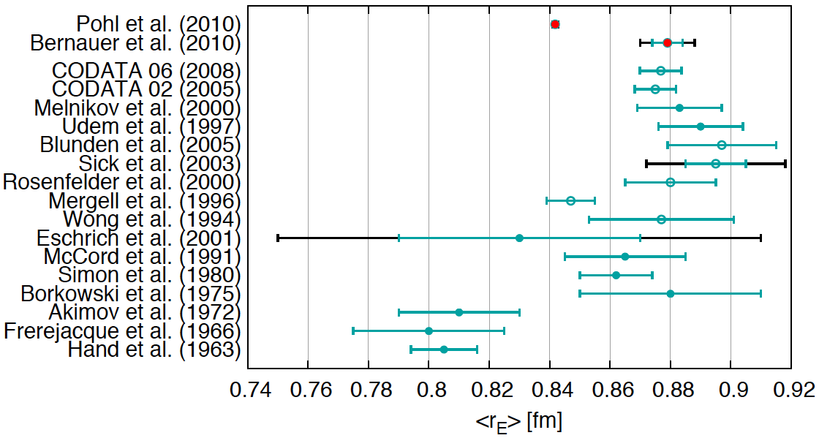
Proton charge radius puzzle
Determination of the proton charge radius from
muonic hydrogen Lamb shift
significantly differs from that using
electronic hydrogen Lamb shift and electron scattering.
Search for explanations from experimental issues, theory, … :
Underestimated uncertainties / Bad radius determination / Lepton non-universality / New force/particles / Novel hadronic physics / … → no consensus.
More data / different experiment needed !
Courtesy of M. Distler
7σ

Slide 28
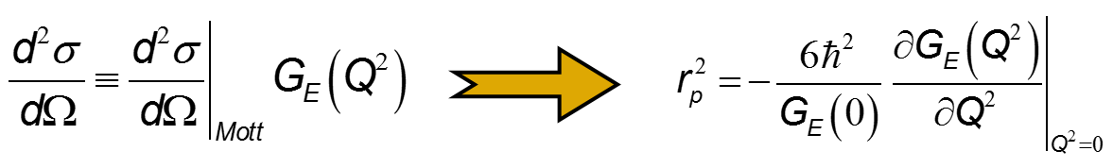
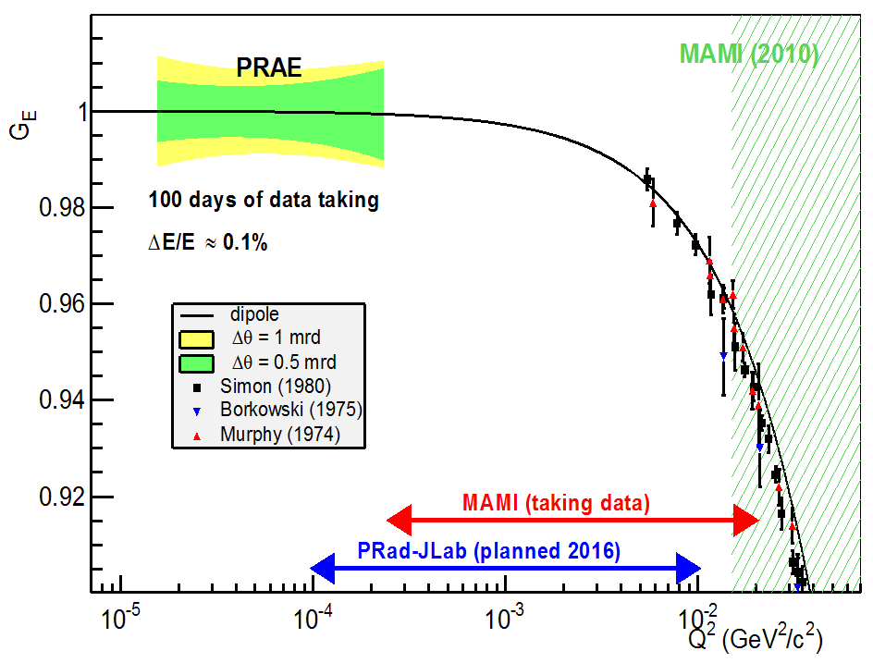
ProRad experiment at PRAE
The ProRad experiment at PRAE aims at accurate measurements (≤1%) of
the electric form factor of the proton G_{E}(Q²) at very low four-momentum transfer Q².
Measurements in the unexplored Q²-range 1.5×10⁻⁵ – 3×10⁻⁴ (GeV/c²)² will constrain the Q²-dependence of G_{E} and the extrapolation to zero important for the determination of the proton charge radius.
Any deviation from 1 would indicate genuine novel effects.

Slide 29
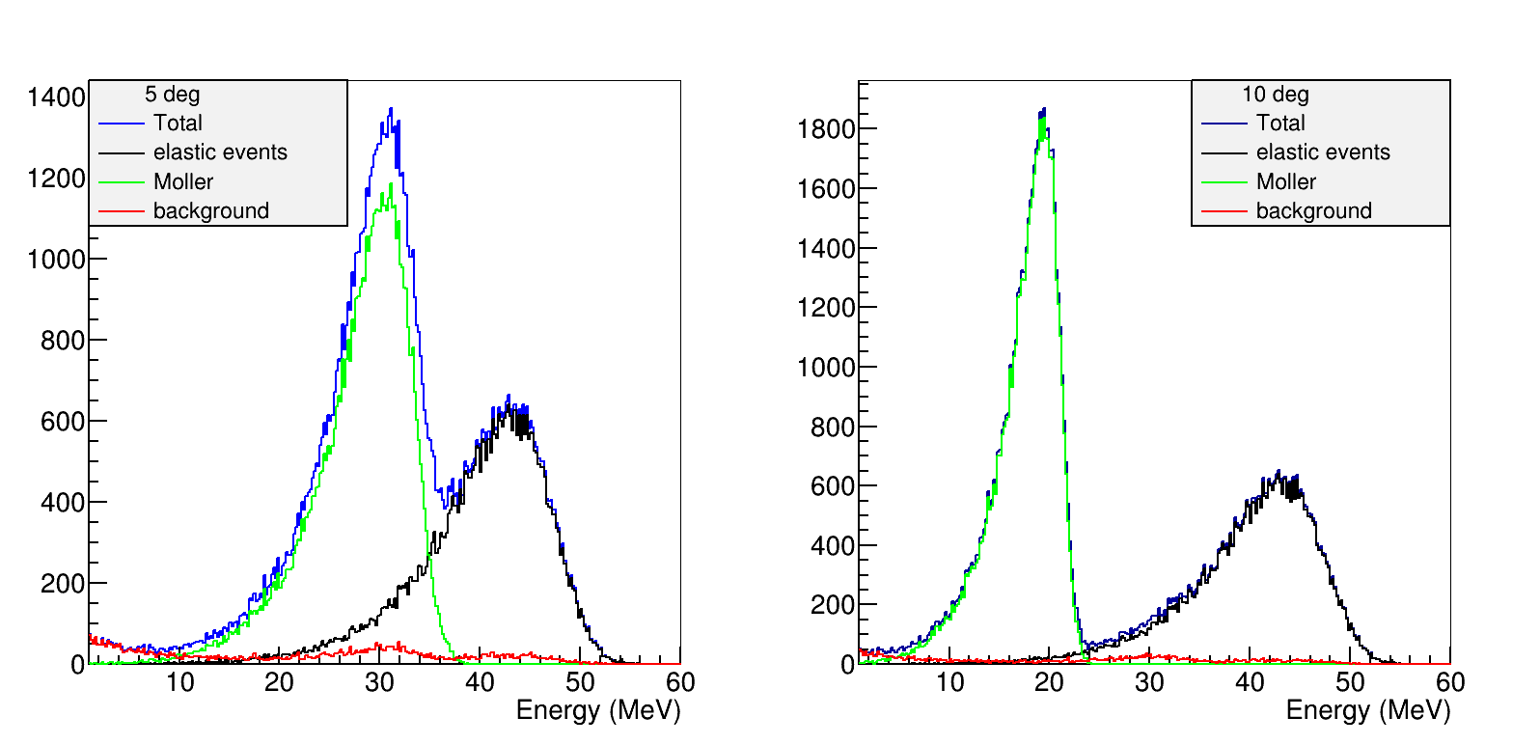
ProRad: experimental technique
Measurements of the ep elastic scattering between 5° and 15° (5 angle points) at 3 different beam energies, and in absence of any magnetic field and tracking system.
The energy deposit spectra in calorimeter allow separation between elastic and Møller electrons
Absolute normalization from simultaneous measurement of ep elastic and ee Møller within the same detector using scattered electron kinematic separation.
Precise beam: ΔE/E = 10⁻³, σ_{x,y} < 0.5 mm, Δθ < 1 mrad

Slide 30
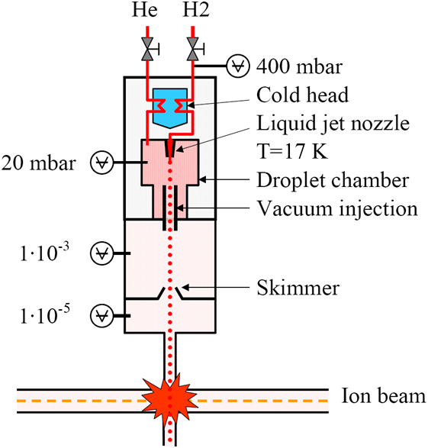
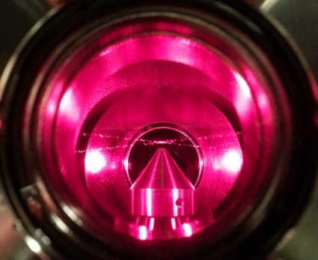
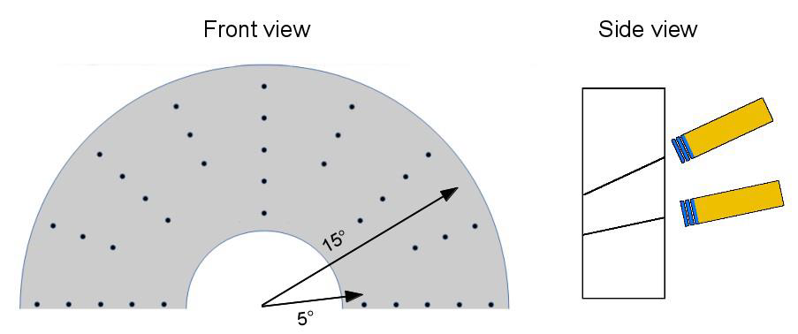
ProRad: concept of the experimental apparatus
Windowless hydrogen target
A flux of liquid hydrogen droplets interact with the electron beam.
Example: WASA pellet target
Electrons scattered at selected angles are tagged with 3 thin scintillators and detected in a calorimeter.
Mechanical definition of scattering angles via small holes machined in a thick shielding cover.
8000 pellets/s

Slide 31
ProRad: expected impact
Immediate scientific impact
Measurement of G_{E}(Q²) in a unique momentum range with marginal overlap with near future experiments.
New unique and complementary magnetic field free experimental method.
These results will contribute to a more accurate determination of the proton radius.
Local impact
Creation of an attractive pole for hadronic physics community.
Student and Post-doctorant training.
Further program, examples
Measurements of G_{E}(Q²) at higher energies and/or larger scattering angle.
Fundamental physics with polarized beam and target.

Slide 32
Axis 2: radiotherapy
Coordinator: Yolanda Prezado (IMNC)
  Principal goal : explore new original approaches in radiotherapy
  Other studies : promising for IMRT, radiobiology studies

Slide 33

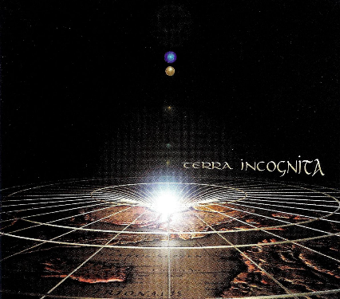
New approaches in radiotherapy
Radiotherapy (RT) is one of the most frequently used methods for cancer treatment
Treatment of some radio resistant tumors, pediatric cancers and tumors close to a delicate structure (i.e. spinal cord) is currently limited
The main challenge in RT is to find novel approaches leading to an increase of the normal tissue resistance
Tumor control
probability
Normal tissue
complication
probability
Still largely unknown how radiation physical parameters
impact biological response
Physical dose
Biological dose
Temporal
fractionation
Standard RT
Standard RT restricted to the few temporal and spatial schemes, dose rates, broad field sizes
Mainly photons
2 Gy/session, 1 session/day, 5 days/week
Dose rate~ 2 Gy/min
Field sizes > cm²
Homogeneous dose distributions
Spatial
fractionation
Biological
response

Slide 34
Possible strategies to spare normal tissue
Different particle types: very high energy electrons (VHEE)
  At hospitals mainly photons (6-18 MV) and electrons (2-25 MeV) are used.
  Compared to clinical electron beams: longer penetration depth; reduced lateral scattering (transversal widening → sparing normal tissues).
  Compared to photons: scans possible → advantageous for image-guided energy- and intensity-modulated radiation therapy. Stanford University exploring this approach with laser sources.
  Compared to protons: greater precision of the beam, lower accelerator cost; less radioprotection issues.
  Biological advantages to be established !

Slide 35
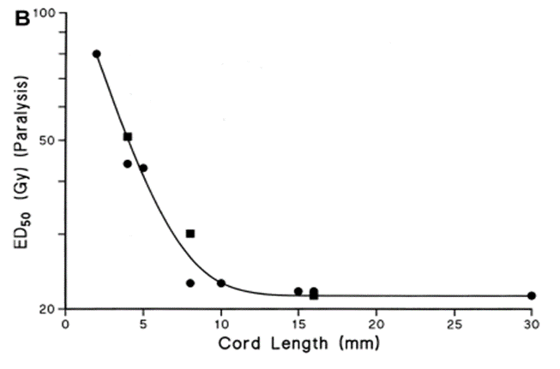

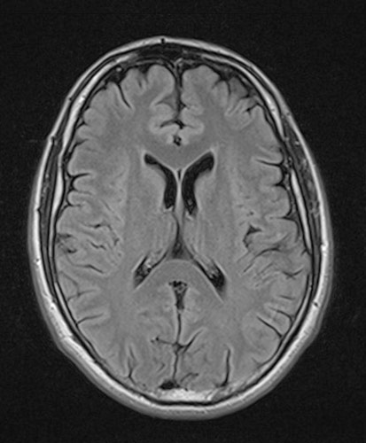
Possible strategies to spare normal tissue
X-ray minibeam radiation therapy (MBRT)
submillimetric field sizes + spatial fractionation of the dose
instead of several cm²
instead of homogeneous distributions
Spinal cord
Tolerance
Field size (mm)
MBRT
Hopewell 2000
Exponential increase of normal (rat) brain resistance.
Prezado et al., Rad. Research 2015
It opens the path for a dose escalation in the tumor.

Slide 36
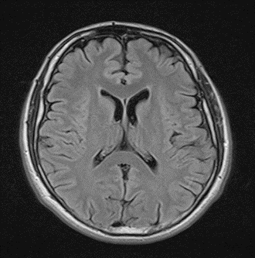
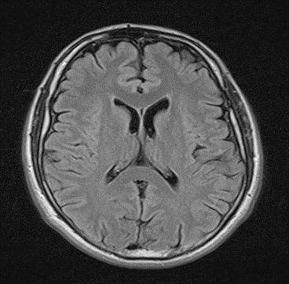
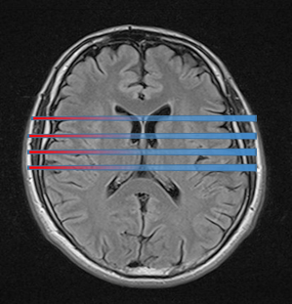
High energy electron grid therapy
Beams get wider in depth due to multiple Coulomb scattering
Normal tissues benefit from spatial fractionation of the dose while a (quasi) homogeneous dose distribution is achieved in the tumor.
View of the grid
2D dose distributions
Very high energy electrons (VHEE)
Very high energy electron Grid Therapy (eHGRT)
Novel approach in disrupture with standard RT
Spatial fractionation of the dose (MBRT)
Martinez and Prezado, Med. Phys. 2015

Slide 37

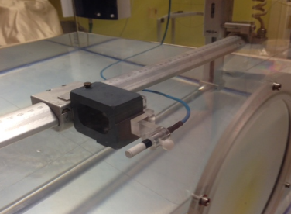

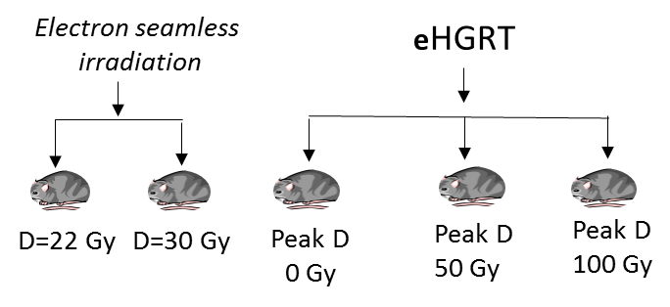
Project organization
Main objectives at PRAE
Innovative dosimetry for very small field sizes
Experimental dosimetry
Dose calculation engine
Film
Microdiamond
detector
Confirmation of the hypothesis of high normal tissue resistance
Whole rat brain irradiation
Evaluation of acute and long-term effects (one year follow-up):
Clinical status (survival, neurological damages)
MRI follow up (blood brain barrier breakdown, edemas, hemorrhages)
Histological analysis (tissue integrity, demyelination, neuronal cell loss, necrosis)
New original approach eHGRT will be studied.
Unique R&D site for radiotherapy community.
Notes:
The first step is to develop an innovative dosiumetrty able to deal with eth very small field sizes used,
Due to the challendging condictions for the expeimental dosimetry I will develop two different protocols based on filsm and a microdimadon detector respective,ly
At the end a complet set of dosimegtry data to realibale guide the biological experiments will be available
In parallel, among all the different heavy ions the optimim one will be determined based on the the amoind and type of fragementation products filling trhevalleyas and..
The next step willl be the optimization of the method of mb egeneration. The cirtaria being…..
Once these milestones achieved, a series of biological experiments will take place, The first one aims at …

Slide 38
Axis 3: Instrumentation R&D
Coordinator: Bernard Genolini (IPN)
  Principle goal is to construct versatile tool for detector R&D and tests: deliver calibrated beam with adjusted and known kinematics and number of electrons per sample
  Training of engineers and technical staff & Students’ hands-on

Slide 39
Instrumentation R&D at PRAE
Fully-equipped versatile tool for precision instrumentation R&D based on high-performance electron beam
Excellent technical performance
  Timing reference, < 10 ps bunch length
  Charge accuracy, RMS < 2×10⁻³
  Low straggling (energy >> 1 MeV)
High-performance, remotely controlled tools
  Beam position, profile and monitoring
  60 digitization channels for users on NARVAL-based data acquisition
  Motorized moving table for scans, accuracy < 500 µm
No need to place the detectors in vacuum
Notes:
The timing performance is a major difference compared to other facilities (such as Legnaro)

Slide 40
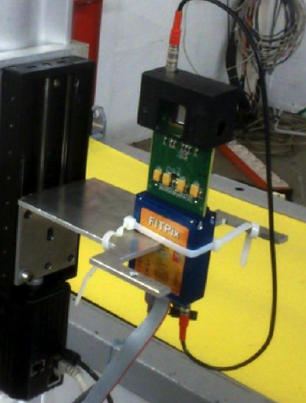
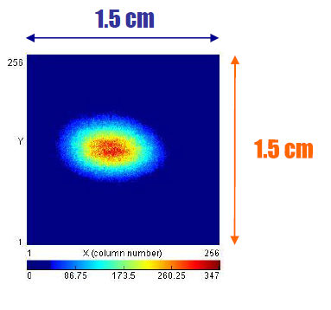
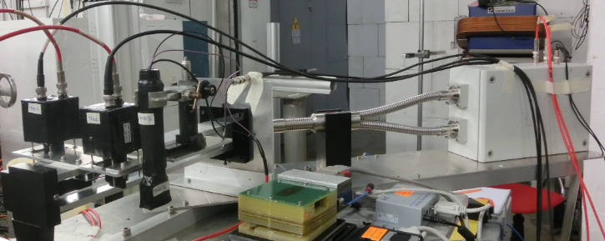
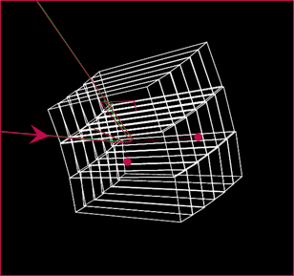
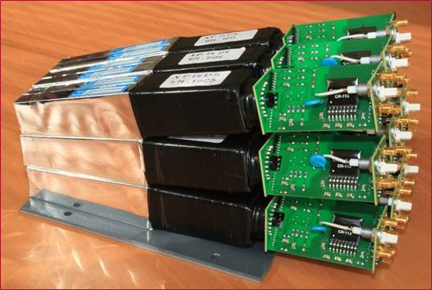
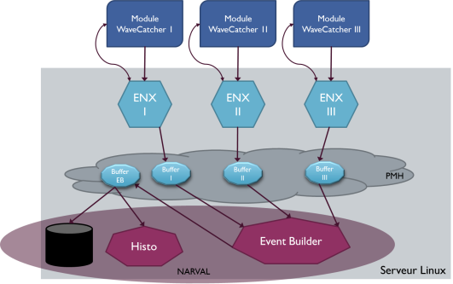
Deliverables
Timepix detector for precision spot measurement
Profiler (Timepix)
Cherenkov counter
Detector under test
Collimator
Calorimeter
Remotely controlled
2-axis trolley
  Cherenkov quartz counter for intensity monitoring
2 channel Cherenkov counters (LAL) tested at BTF (Frascati); installed in the SPS (CERN) beam pipe
  DAQ + slow control
  Calorimeter for energy monitoring
60 user digitization signals (WaveCatcher)
DCOD = NARVAL + ENX
BGO scintillator crystals in compact matrix geometry
SPS beam
Example of a calorimeter realized at IPN
Notes:
Available know-how to process the recorded traces of wavecatcher

Slide 41
Instrumentation R&D at PRAE
Local test platform for major instrumentation projects of P2IO and beyond
Science
  Available beam for the R&D and tests
  Accurate scan of detectors (uniformity)
  Time resolution
Feasibility
  Expertise of the team (CERN, JLAB, ALTO etc.)
  Upgrade of existing productions (beam control, DAQ, signal processing)
Attractivity
  Performance
  User-friendly: DAQ + available digitization channels
  Students’ hands-on
Notes:
Tried to associate detectors to existing projects.

Slide 42
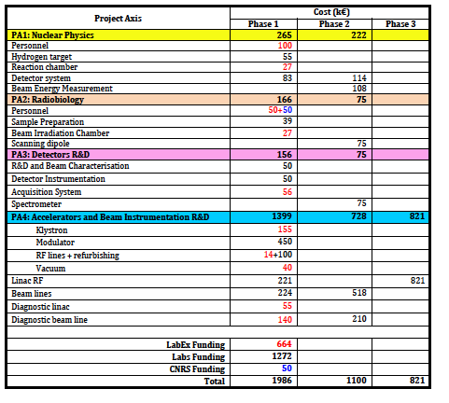
Detailed budget for the 3 phases

Slide 43
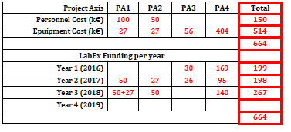
Summary budget per axis

Slide 44
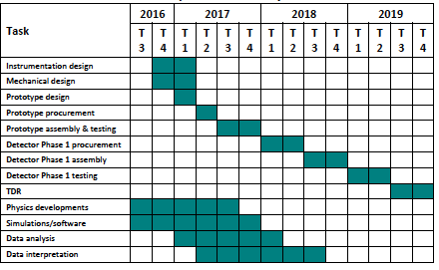
PA1: Major Tasks and Contributors

Slide 45
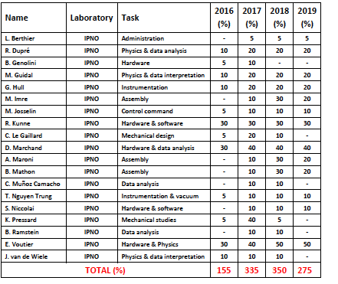
PA1: Major Tasks and Contributors

Slide 46
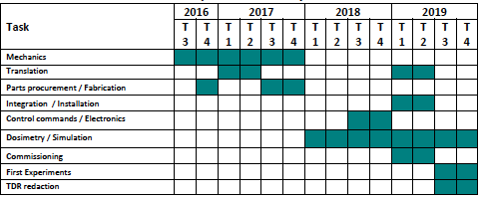
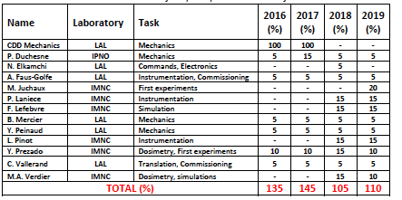
PA2: Major Tasks and Contributors

Slide 47
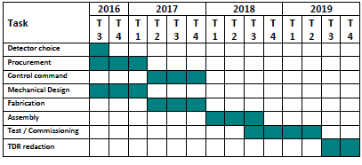
PA3: Major Tasks and Contributors

Slide 48
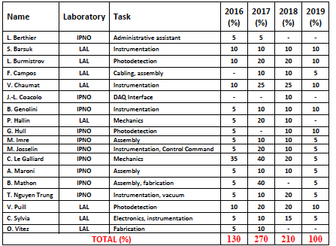
PA3: Major Tasks and Contributors

Slide 49
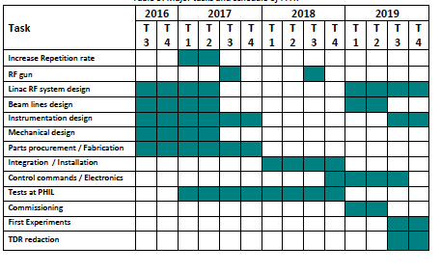
PA4: Major Tasks and Contributors

Slide 50
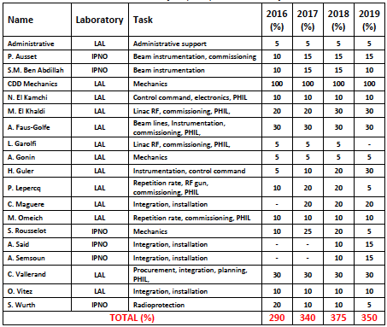
PA4: Major Tasks and Contributors

Slide 51

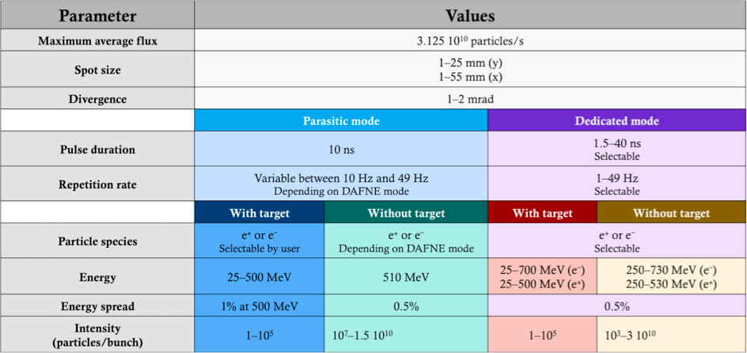
DAFNE Beam-Test Facility (BTF) is a beam transfer line designed for the optimized, stochastical production of single electrons/positrons for detector calibration purposes, or the extraction of the DAFNE LINAC electron/positron beam
Others facilities in Europe

Slide 52

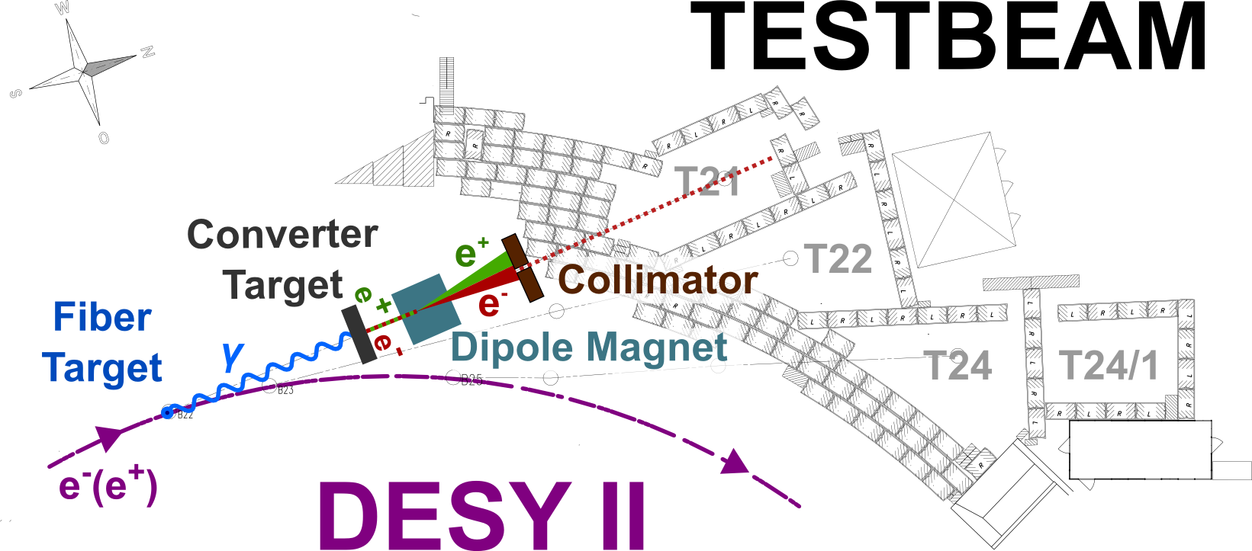
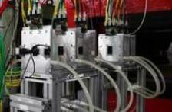
DESY operates a test beam facility with three test beam lines (21, 22 and 24). These electron or positron beams are converted bremsstrahlung beams from carbon fibre targets in the electron-positron synchrotron DESY II with up to 1000 particles per cm² and energies from 1 to 6 GeV, an energy spread of ~5% and a divergence of ~1mrad
Others facilities in Europe
Test Beams at DESY
The DATURA telescope installed in area TB21 at DESY-II test beam.

Slide 53
PRAE organization
Seminars in the key laboratories of the P2IO perimeter to inform and attract interested groups.
Workshop by the end of 2016 to inform and attract external partners from industry and research.

