Slide 1


Equipe FCC-LAL
Projet FCC
LHC
PS
FCC
SPS

Slide 2
Outline
General Description: Scientific and Technical
Resources: teams, associated partnerships and budget
Status and Perspectives
IN2P3 Perspectives

Slide 3
Project FCC – General description
Nom/acronyme projet: Future Circular Colider hh (FCC_hh)
Responsable scientifique national: A. Faus-Golfe
Responsable scientifique local: A. Faus-Golfe
SCOPE OF WORK
Collimator insertion design for FCC-hh
Contributions to evaluating the performance of the FCC-hh collimation system
The FCC-hh collimation system has to keep the beam induced energy deposition in the arc magnets below the acceptable level to avoid quenches of the superconducting magnets quench (for an assumed minimum beam lifetime) and to protect the experiments from machine-induced backgrounds. The collimator impedance has to stay within acceptable limits.
Notes:
3
Groupe Evaluation AERES 13-14 janvier 2011

Slide 4
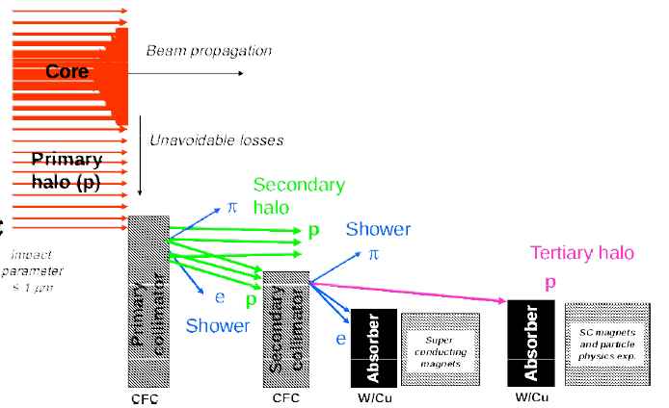
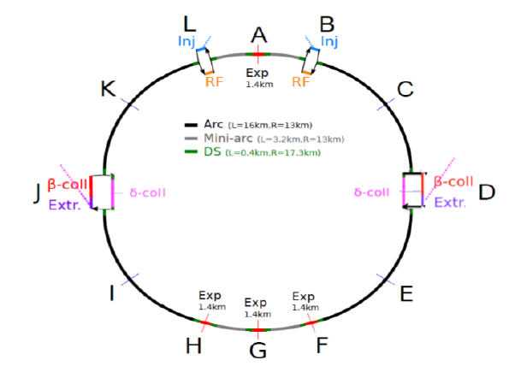
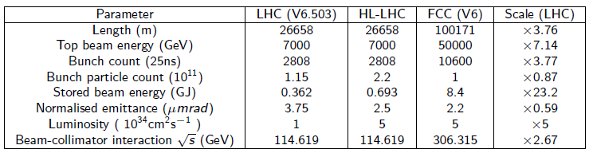
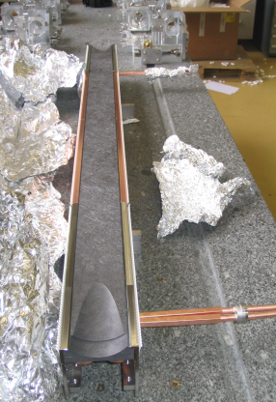
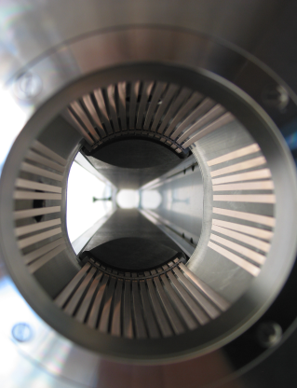
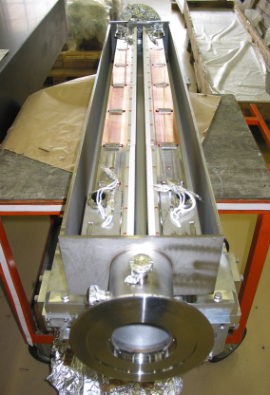
Project FCC – General description
stored energy → 23 × LHC
LHC collimators
Notes:
4
Groupe Evaluation AERES 13-14 janvier 2011

Slide 5

Project FCC - Resources
Membres de l’équipe impliqués:
A. Faus-Golfe (16%)
S. Chance (8%)
P. Bambade (8%)
Liste des personnels techniques impliqués:
CDD postdoc:
  J. Molson (100%, October 2015–October 2017)
Sources de financement 2015 (hors CDDs)
  EuroCirCol EU project ( travel expenses)
  IN2P3
Notes:
5
Groupe Evaluation AERES 13-14 janvier 2011

Slide 6
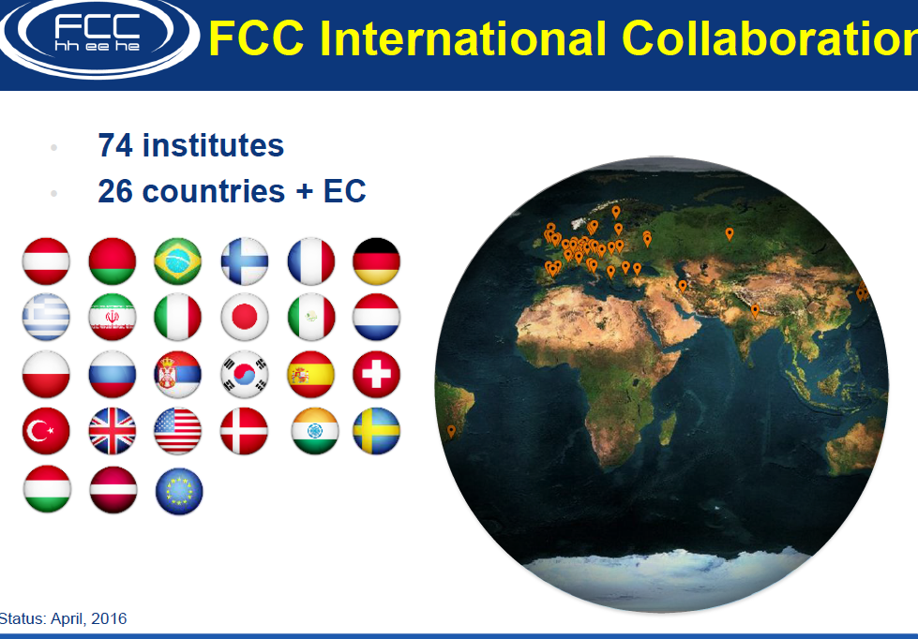


Project FCC - Resources
Autres laboratoires impliqués
  IPNO (IN2P3)
  FCC collaboration
Synergies
  HL-LHC collimation studies
  UA9-crystal collimation
  SppC project (FCPPL)
Notes:
6
Groupe Evaluation AERES 13-14 janvier 2011

Slide 7
Project FCC – Status
  Task status:
  Develop and Evaluate the FCC-hh collimation system
  Enhancing collimation system simulation codes – MERLIN and Sixtrack.
  Developed scaled optical system layouts from the LHC for the energy collimation system (with CEA).
  Developed a full ring beam pipe model.
  Performed loss maps with the nominal (V6) accelerator and collimation system layout.
  Have evaluated both the betatron and energy collimation systems.
Results are summarised in:
“Simulation of the FCC collimation system” (IPAC2016)
“MERLIN Simulations of the LHC collimation system with 6.5 TeV beams” (IPAC2016)
Notes:
7
Groupe Evaluation AERES 13-14 janvier 2011

Slide 8
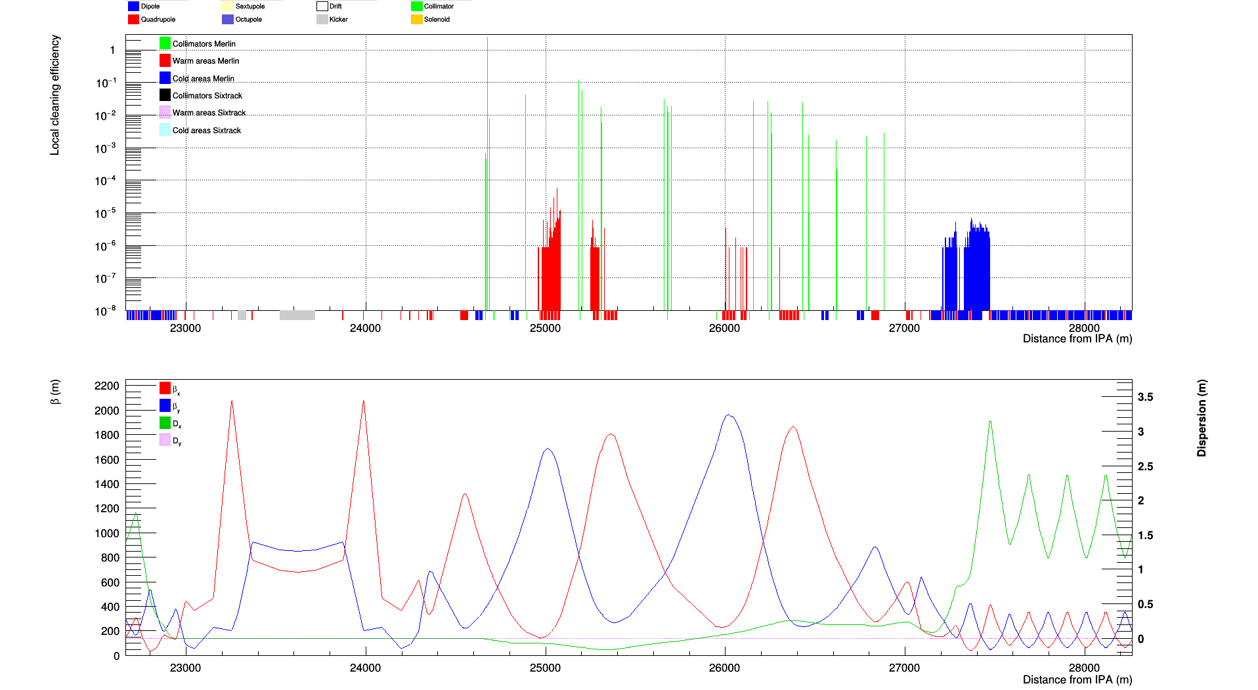
Betatron collimation region

Slide 9
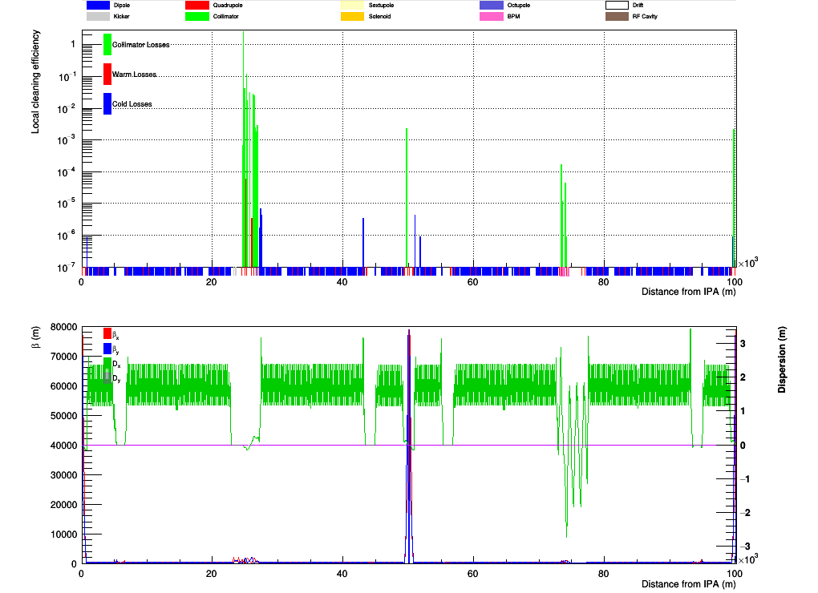
Horizontal halo betatron loss map

Slide 10
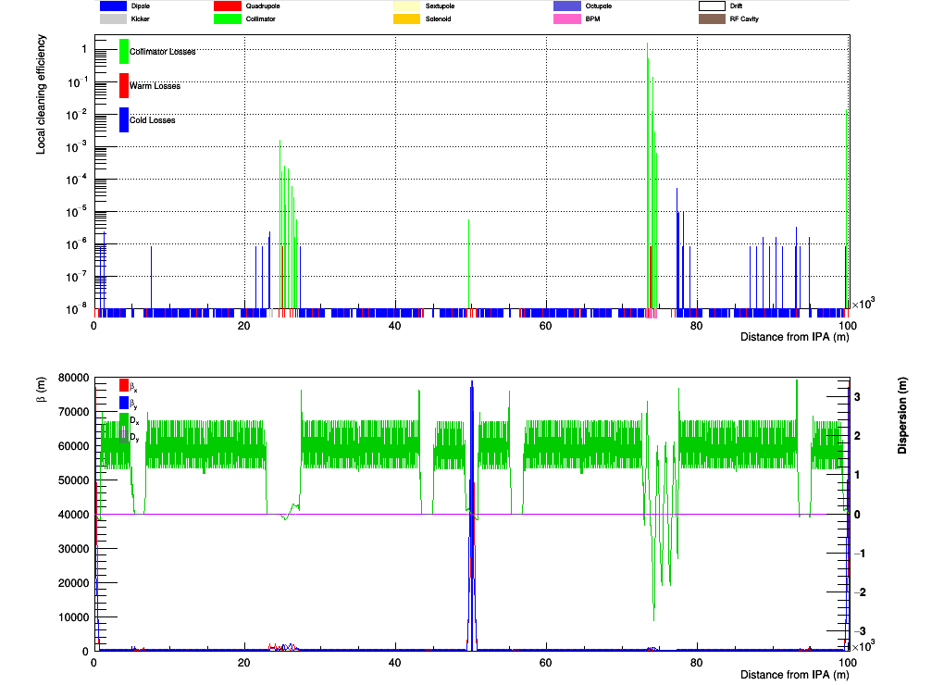
Off energy beam halo losses

Slide 11
Projet FCC – Perspectives
  On-going and Future studies in EuroCirCol framework
  Updating the beam pipe model.
  Developing tools to perform an equivalent “n1” (geometrical aperture) calculation.
  Benchmarking of the simulation codes
  The current cleaning efficiency of the collimation system is insufficient (need ~10-7)
  Develop and evaluate new collimation system layouts
Notes:
11
Groupe Evaluation AERES 13-14 janvier 2011

Slide 12
Projet FCC – IN2P3 Perspectives
  IN2P3 Perspectives
  Consolidation of the FCC-hh Accelerator contribution for IN2P3 teams, more specifically from the personnel point of view (after EuroCirCol).
  Weakness: Too small teams !
  Funding for human resources  postdocs and PhD students
  Extending the contribution to FCC Physics inside the IN2P3
Notes:
12
Groupe Evaluation AERES 13-14 janvier 2011

Slide 13
BACKUP
[ = Tous les documents jugés utiles pour la discussion]
Notes:
13
Groupe Evaluation AERES 13-14 janvier 2011

Slide 14
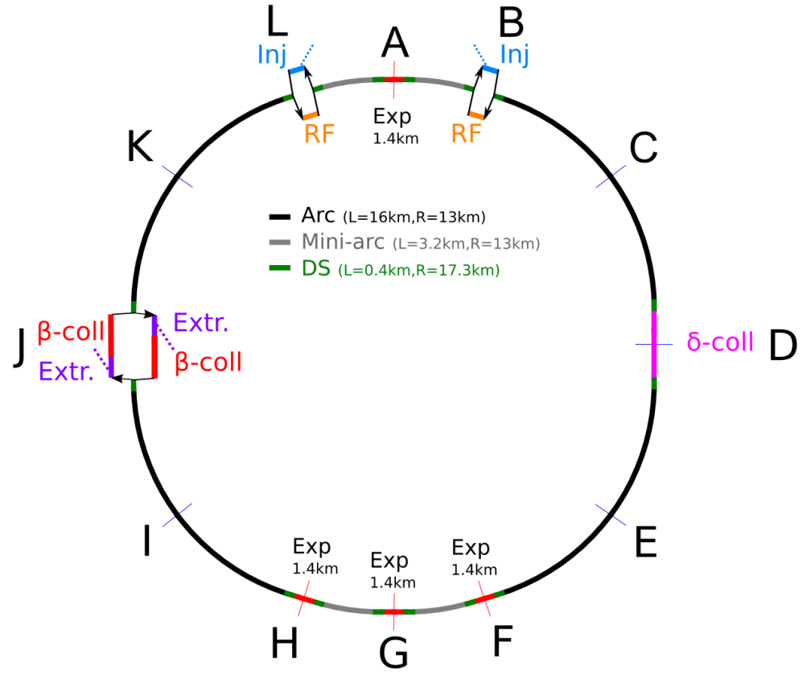
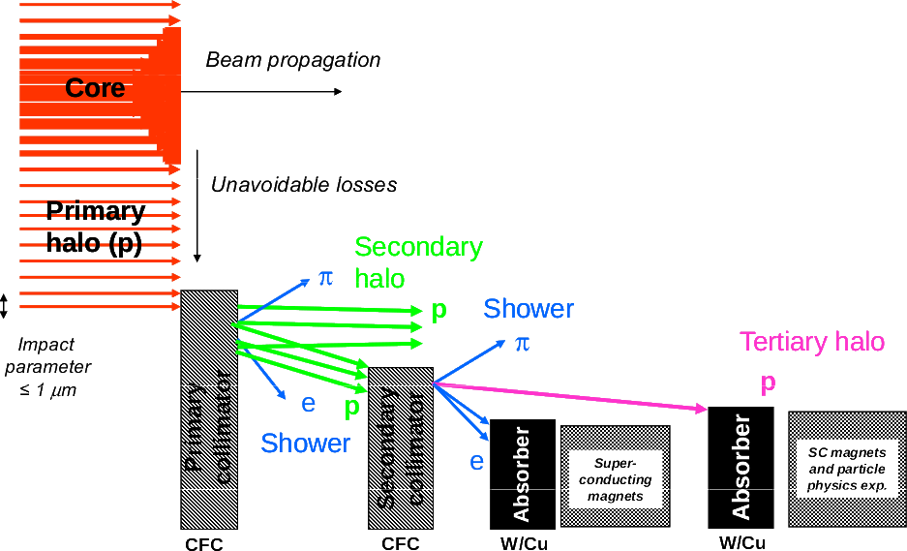
FCC-hh collimation section design and evaluation
1. Enhance collimation system simulation codes :
MERLIN and Sixtrack
2. Initial scaling of LHC optical layouts for the betatron
(with CERN) and energy (with CEA) collimation systems
3. Develop full ring beam pipe model
4. Loss maps with the nominal (V6) accelerator and
collimation system layout
5. Evaluate betatron and energy collimation systems
(cleaning efficiency ∼ 10⁻⁷)
stored energy → 23 × LHC
LHC collimators

Slide 15
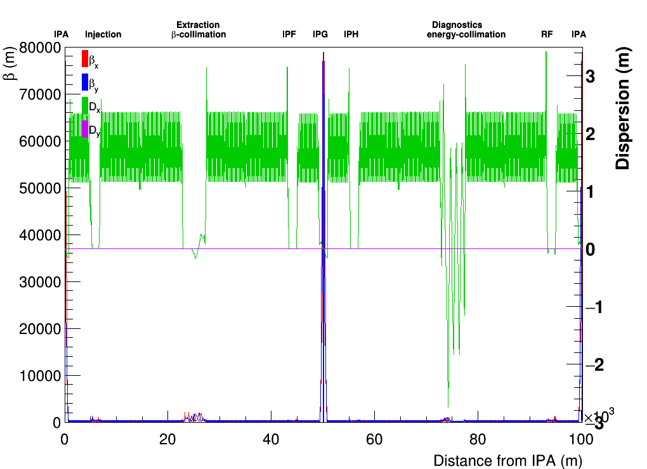
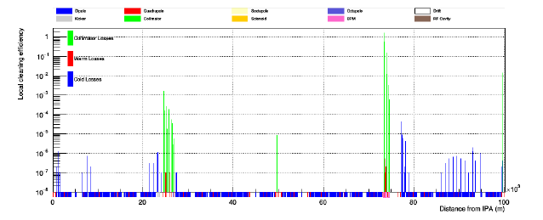
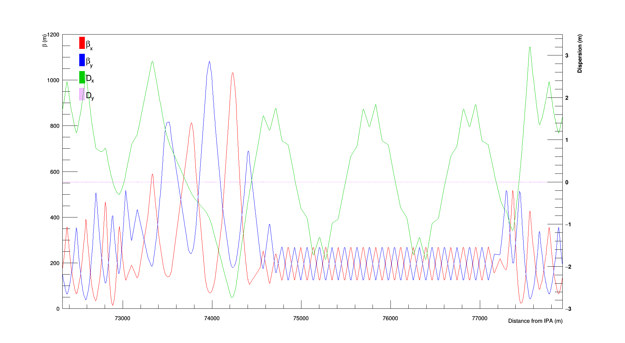
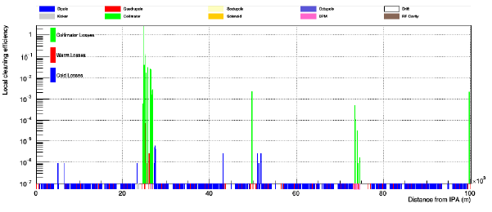
FCC-hh collimation section design and evaluation
IPNO: Antoine Lachaize (CCD-IN2P3), Luc Perrot (+ J.-L. Biarrotte)
LAL: James Molson (CDD-EurCirCol), Angeles Faus-Golfe, Philip Bambade, Sophie Chancé
Main collaborators: M. Fiascaris & S. Redaelli (CERN), B. Dalena & A. Chancé (CEA)
First betatron & energy loss maps
- non-orthogonal…
- IR losses…
First baseline full optics FCC layout

Slide 16
Argument for IN2P3 involvement & Assessment
Limited contribution to central design & operation of accelerators (exception: FCC-hh collimation at LAL and IPNO)
Significant contribution to collider R&D with strong innovation & research content (instrumentation, smart collimators, beam-beam background,…)
Strong educational impact : many PhD and master students…
Asset of IN2P3 engineering resources (electronics, mechanics,…)
IMPORTANCE
Prepare IN2P3 teams to contribute to the next big facility in HEP (international bidding for design and R&D)
Facilitate / lever IN2P3 participation to future HEP experiments
STRENGTHS
Good international visibility and integration, teams are at the state of the art
Chosen topics are generic while in context of specific projects → risk mitigation
WEAKNESSES
Balance diversity ↔ fragmentation → better articulation/coordination ?
Too small teams ! Funding for human resources → postdocs and PhD students

Slide 17
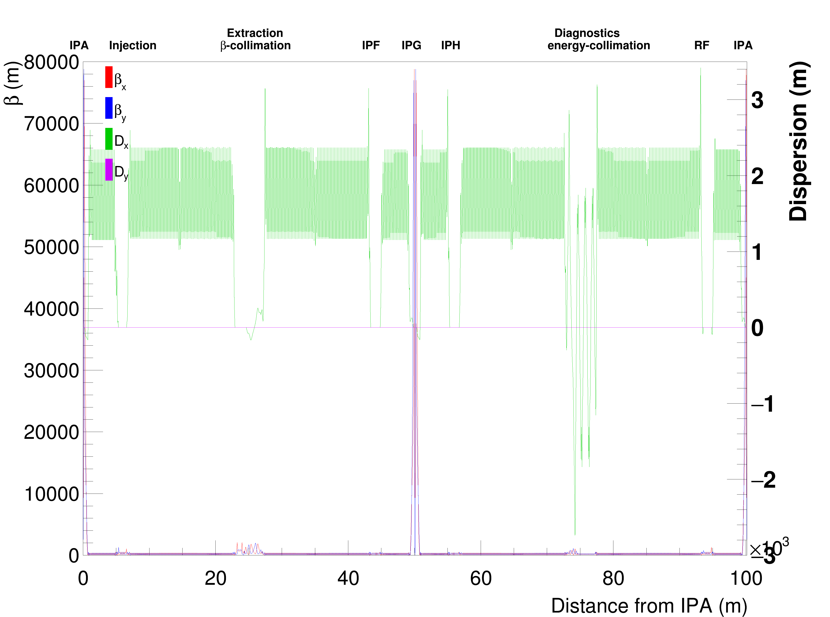
FCC baseline layout (V6)

Slide 18
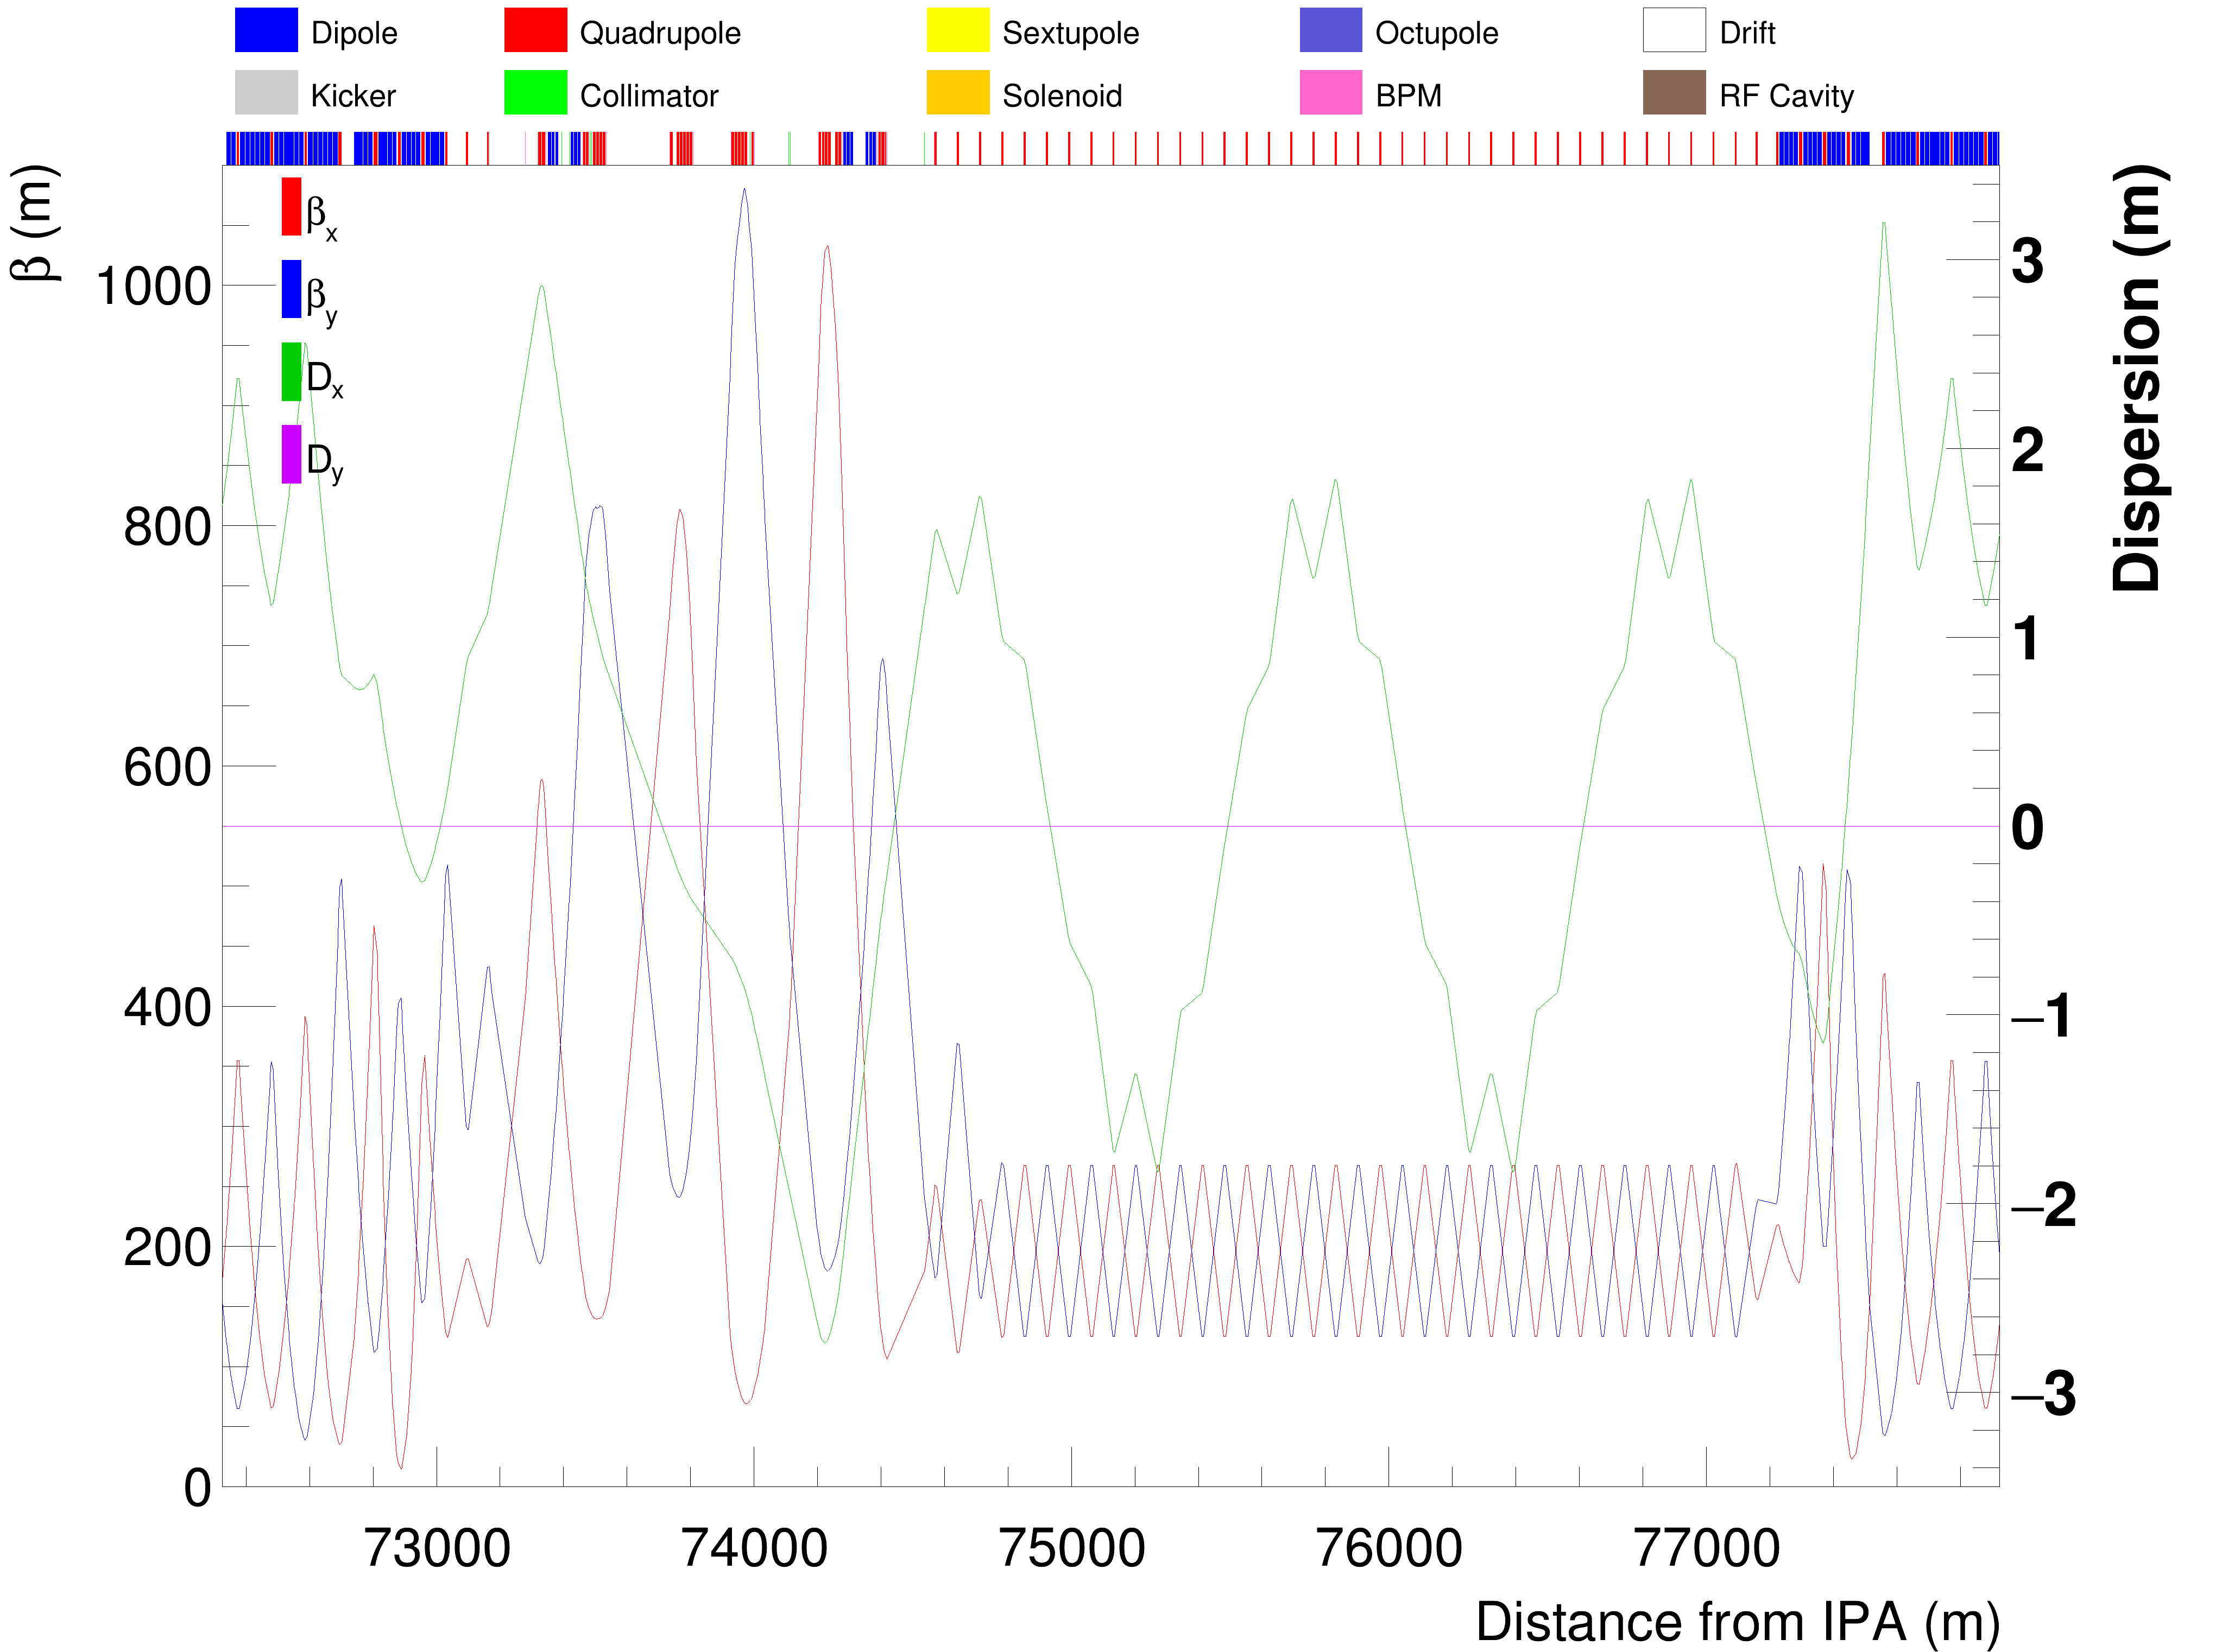
Energy collimation optics

