Slide 1
Thermomechanicle examinations for the design of the radiation cooled positron target
Sabine Riemann (DESY), Andriy Ushakov (UHH), Alexandre Ignatenko (DESY), Kahled Alharbi (DESY), Felix Dietrich (DESY, TH-Wildau), Peter Sievers (CERN)
Laboratoire l’Accélératuer Linéaire (LAL) 14.09.16

Slide 2
Outline
The radiation cooled positron target
Changes in the Models
Firetree root
Summary
Notes:
Outline:
The radiation cooled Target – a recapitulation:
Zusammenfassung des Target Models und der Idee der Strahlungskühlung
Ergebnisse von letztem Jahr zeigen – Besonders der Wäremkontakt und Transport
Modell vom letztem Jahr zeigen
Changes in the Models
Neue Modifizierte Form Zeigen
Einführung der neuen Finnform
Ansprechen der Verbindungspoblematik
Firetree Root
Die neue Verbindung einführen
Fertigungsmethoden und Einsatzgebiete zeigen
Simulationsergebnisse abhandeln
Summary

Slide 3
The radiation cooled positron target – used model
Based on a proposal of Dr. Peter Sievers (CERN)
Presented on last POSIPOL
Titan ring is connected to a Copper disc
Cooper disc radiates in to Fe-cool-bodies
The titan ring has a thickness of 14.8mm
inner titan ring (Ti)
neglected in the simulation
Ti Target
cool bodies
(Fe - assumed)
Cu radiator

Slide 4
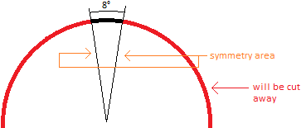
The radiation cooled positron target – the simulation set up
only a „slice“ is simulated
The issue whether or not the target will be build sliced or not is not solved
the simulations can be assumed valid for both versions
it has a length of 8°
hence 45 places can be hit
the surfaces created by cutting are symmetry areas
results on that area will be „mirrored“
ANSYS will expect the same behaviour on the other side of the mirror
Only the fins radiate (worst case)
An FLUKA input is used for 2.3 kW
This applies to all simulations

Slide 5
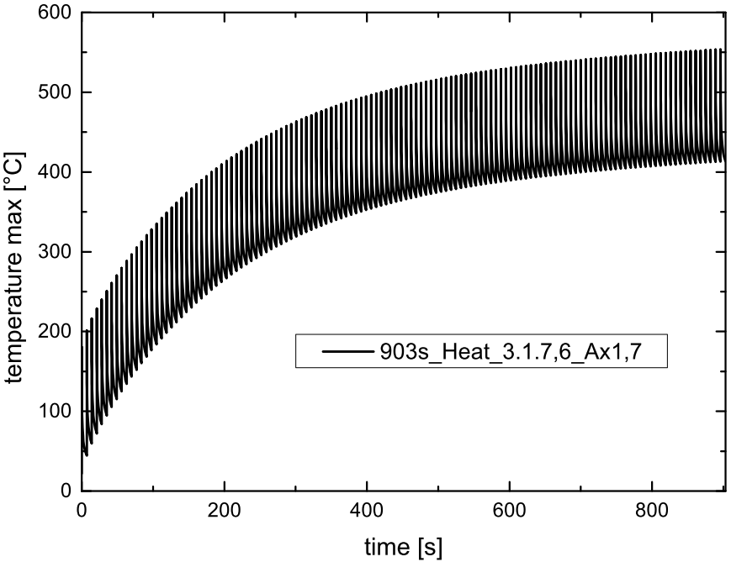
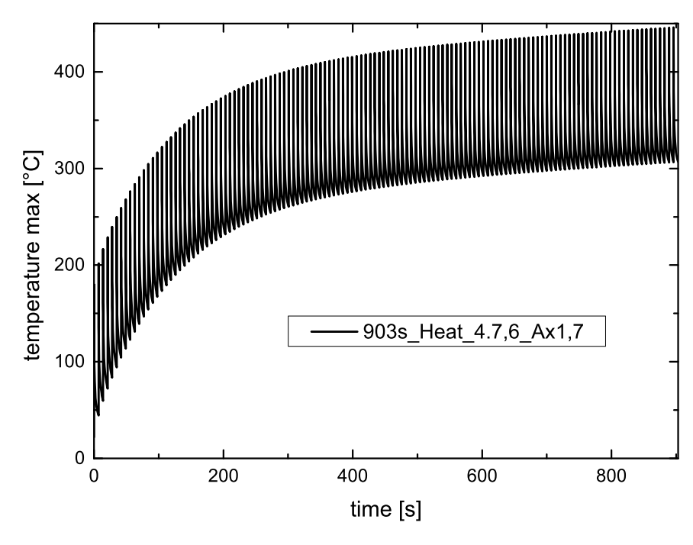
The radiation cooled positron target – Results from last year
Results from last year
Comparison of to different heights
Result was that the height is crucial for the maximum temperature
Model 1 (target height 50mm)
Model 2 (target height 40mm)

Slide 6
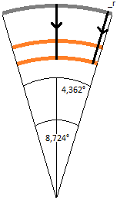
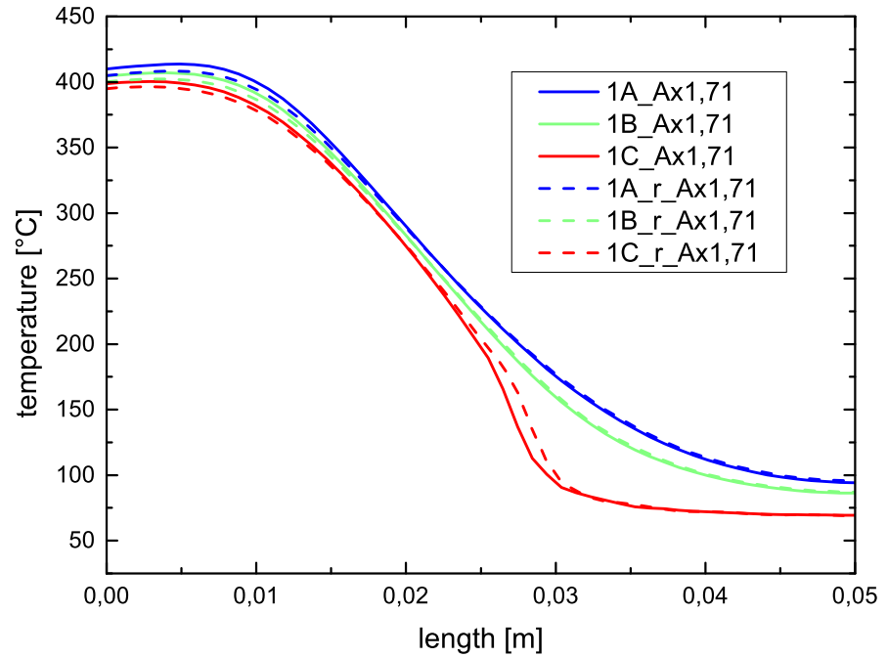
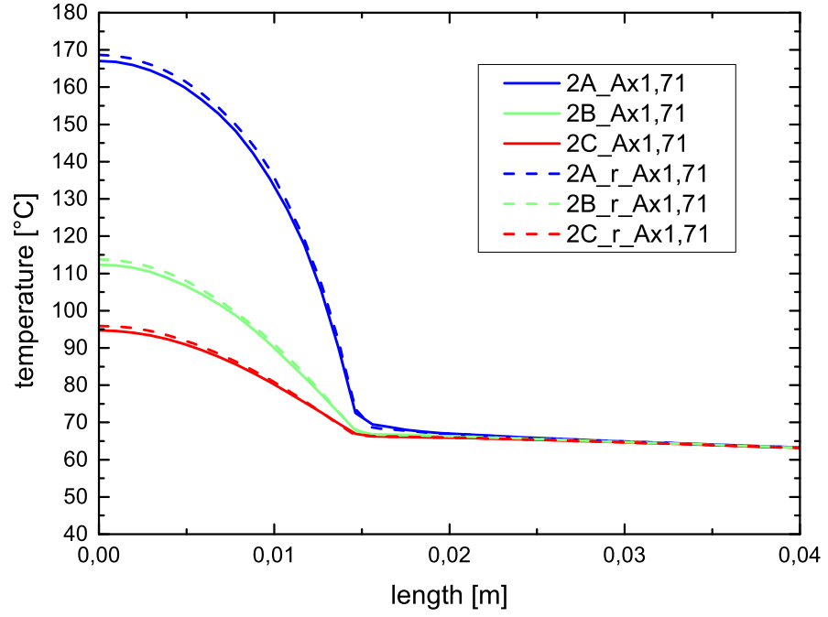
The radiation cooled positron target – Results from last year
Temperature in the Target along 6 path
target height 50mm
Time 895,58s (after 128th pulse short before 129th pulse)
index r → same path but one the side of the target (4.362°)
vertical Temperature distribution
horizontal Temperature distribution
Ti
Cu
Ti

Slide 7
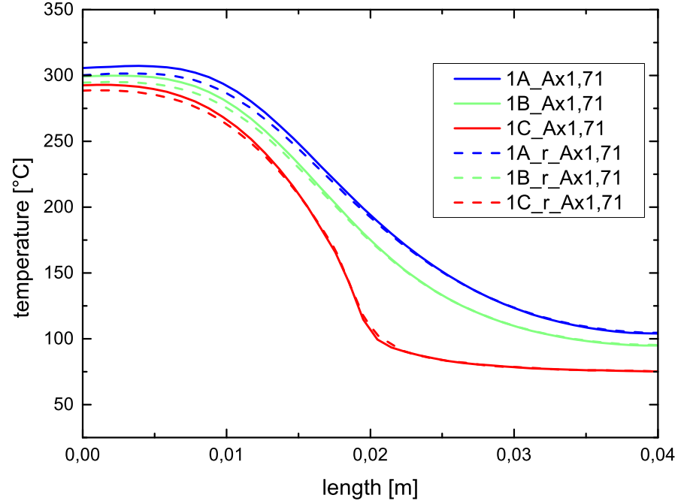
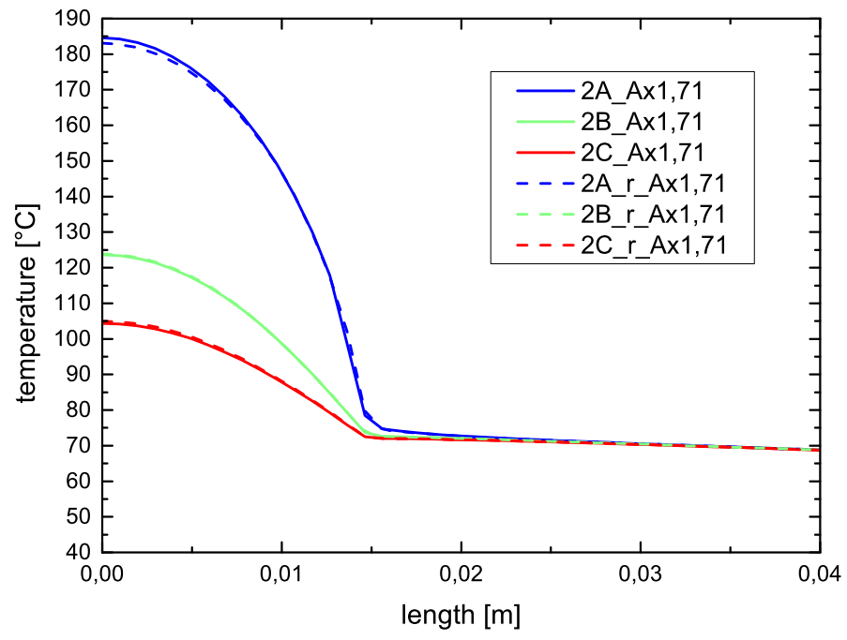
The radiation cooled positron target – Results from last year
Temperature in the Target along 6 path
target height 40mm
Time 895,58s (after 128th pulse short before 129th pulse)
index r → same path but one the side of the target (4.362°)
vertical Temperature distribution
horizontal Temperature distribution
Ti
Cu
Ti

Slide 8
Changes in the Models
Some small changes happened since then
screws were added
The „head“ was redesigned
the centre of mass is in the middle of the model
contact area height can be variated
The thickness of the titan ring was reduced to11.1 mm for tests
a new Finn form was created
Trapeze as basic form
Reduces deformation due to rotational forces
length is 15 mm (for now)
angel is 80°

Slide 9
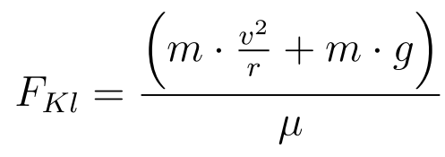
Changes in the Models – issues with the connection
The titan ring is somehow connected to the cooper disc
One option is to screw these to materials together
To dimension the screws the following should be considerate
The screws have to be preloaded with a Force to hold the Target in Place bevor it is actual in action
This force is about 3 kN (this has to be beard by to 2 or more screws)
The stress in the screws is depended on the screw parameter
It will be tested with an M5 and an M12
The number of screws depends on the thickness of the clamped components and the diameter of the screws

Slide 10
Changes in the Models – issues with the connection
The count screws is set by a rule of thumb
basic idea is called pressure cone
$l=h_{min}+d_{w}$
l=Length between screws
h_{min}= smallest height
d_{w}=diameter of the screw head
Result could be 23 mm
that means:
if the distance is less then l the cones will overlap
if it is greater then l the pressure cones will not overlap and the pressure may be not equally distributed

Slide 11
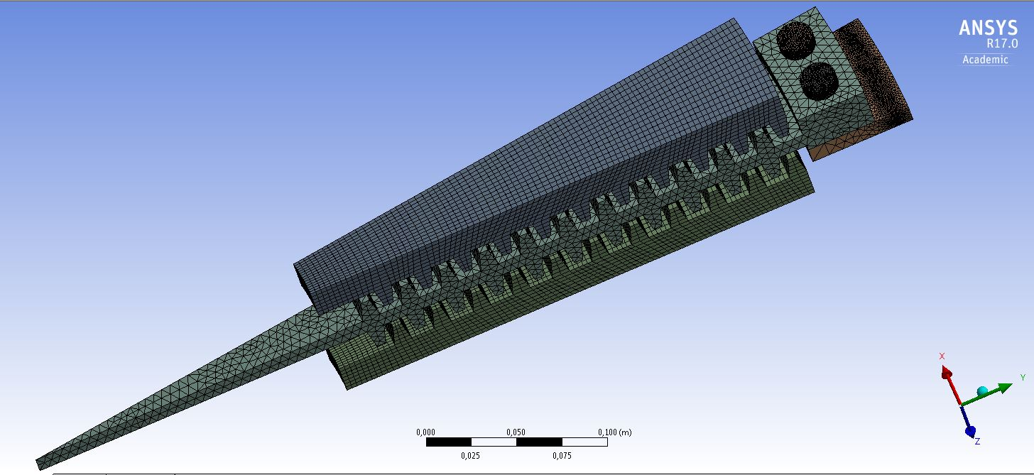
Modified Model – simulation set up
the new Model is simulated with an energy deposition of 2.3 kW
there is only a static thermal simulation
there is now a static structural analysis
including a constant rotational force
the wheel has fixed faces under the fins
Screw were fixed with Bolt pretensions and frictional connections
3 Simulations were done
M12 with 11.1 mm thickness
M12 with 14.8 mm thickness
M5 with 14.8 mm Thickness

Slide 12
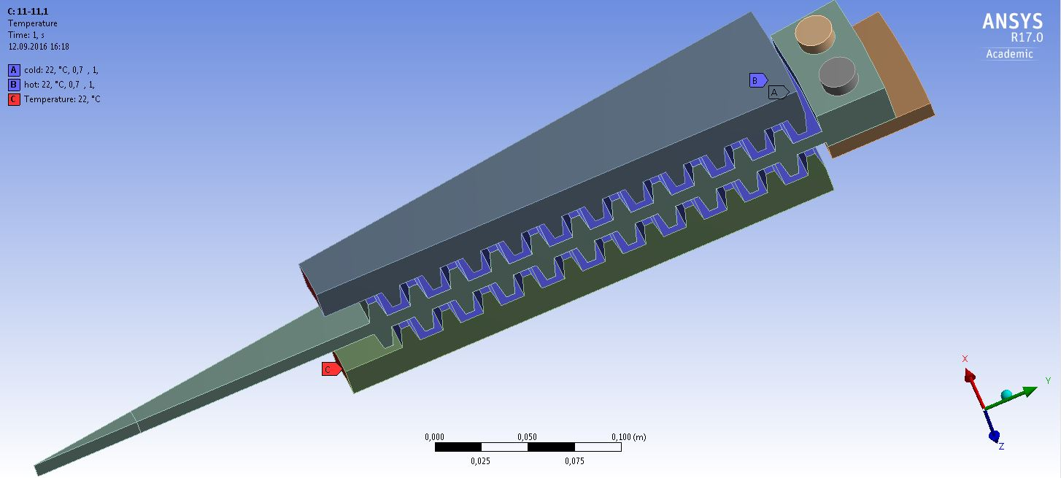
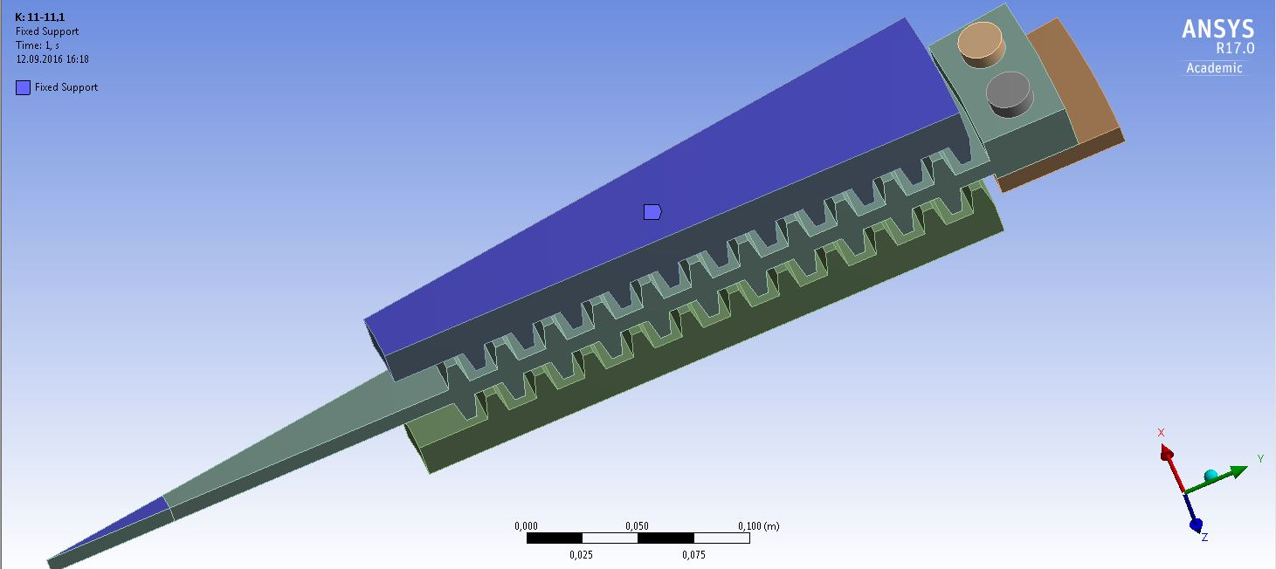
Modified Model – simulation set up
Radiating surface ~ 0,079m² per slice
11 fins are used
Bottom of the coolers is set to 22°C (it’s a constrain to simulate a cooling)
Rotational speed is 203 rad/s
Only titan ring and copper disc is rationing
Backsides of the coolers are fixed and

Slide 13
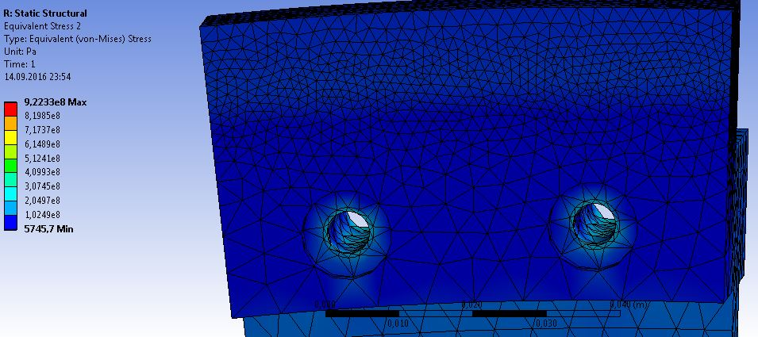
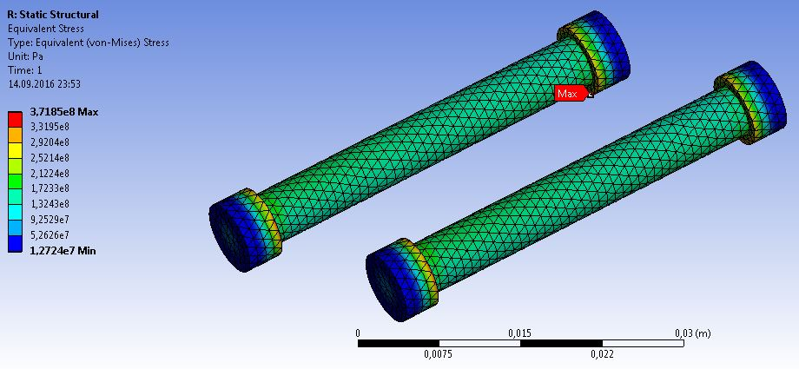
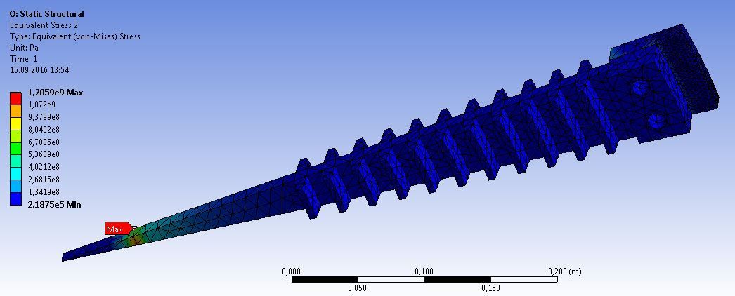
New Model – result
Max. temperature: 430.32°C (703.47 K)
located in the middle of the beam spot
Max von Mises stress: 922.33 MPa
at the fixed surface (maybe artificial)
Max. von Mises stress at the screws 371.85MPa
Max. von Mises stress at the contact surface is 167.85MPa

Slide 14
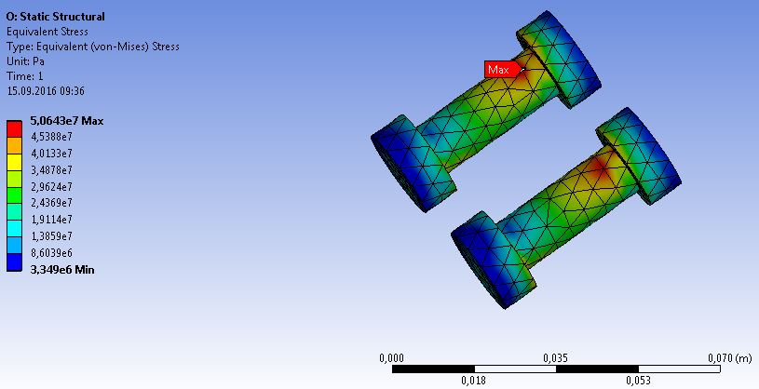
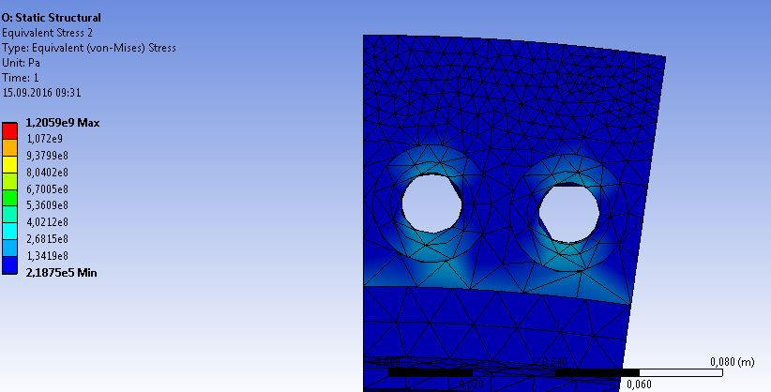
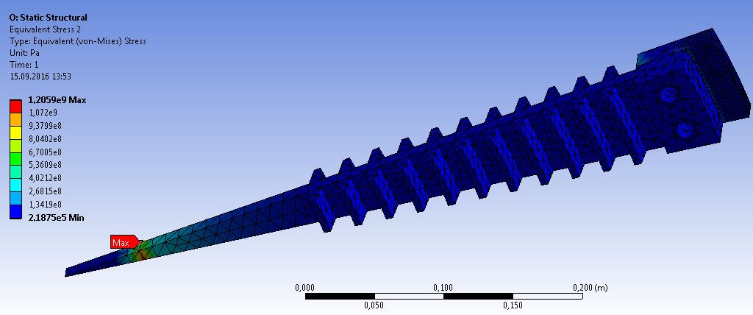
New Model – result
Max. temperature: 447.13°C (720.28K)
located in the middle of the beam spot
Max von Mises stress: 1.21GPa
at the fixed surface (maybe artificial)
Max. von Mises stress at the screws 50.64MPa
Max. von Mises stress at the contact surface is 197.19MPa

Slide 15
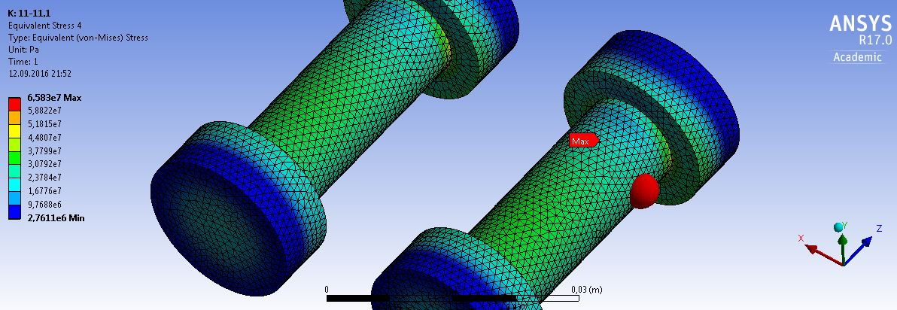
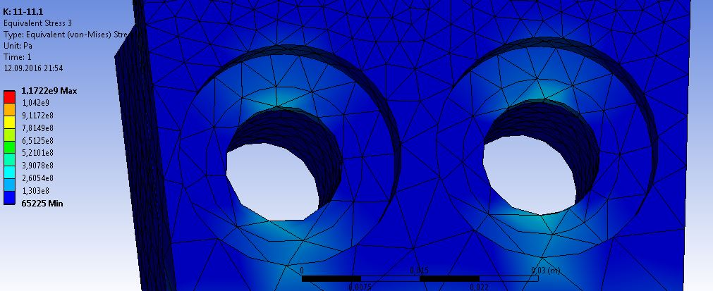
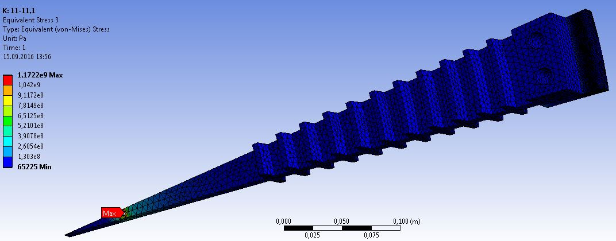
New Model – result
Max. temperature: 282.71°C (555.86 K)
located in the middle of the beam spot
Max von Mises stress: 1,17GPa
at the fixed surface (maybe artificial)
Max. von Mises stress at the screws 65,83MPa
Max. von Mises stress at the contact surface is 203,8MPa

Slide 16
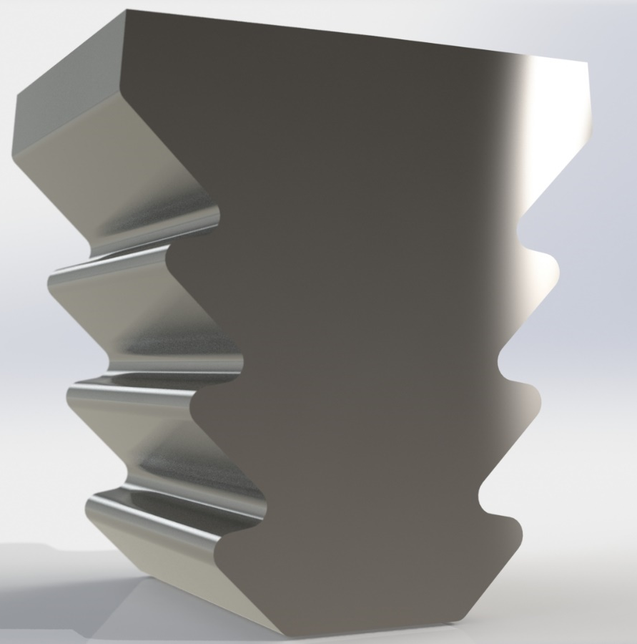
Fire-tree-root
Is used in Turbine to connect wings to a carrier wheel
Is used in extreme environments
Experience in manufacturing exist
Can be created by high speed milling (costume tools exist)

Slide 17
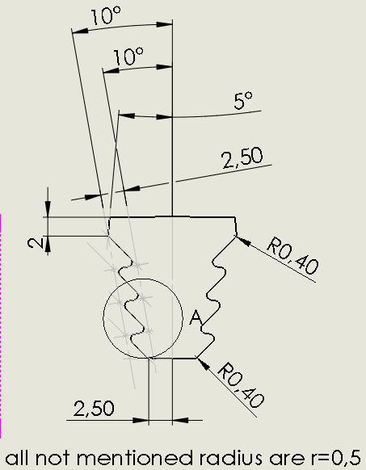
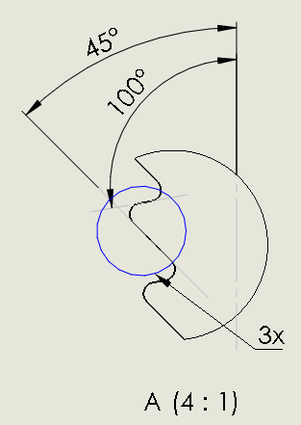
Fire-tree-root – model
Basic plain is an isosceles Trapezoid with an angel of 10°
To a parallel line the spokes are build
the bottom face is 5mm long

Slide 18
Fire-tree-root– simulation set up
there is only a static thermal simulation
there is a static structural analysis
including a constant rotational force
the wheel has fixed faces under the fins
Two Simultaions were done
14.8 mm Thickness
11.1 mm Thickness

Slide 19
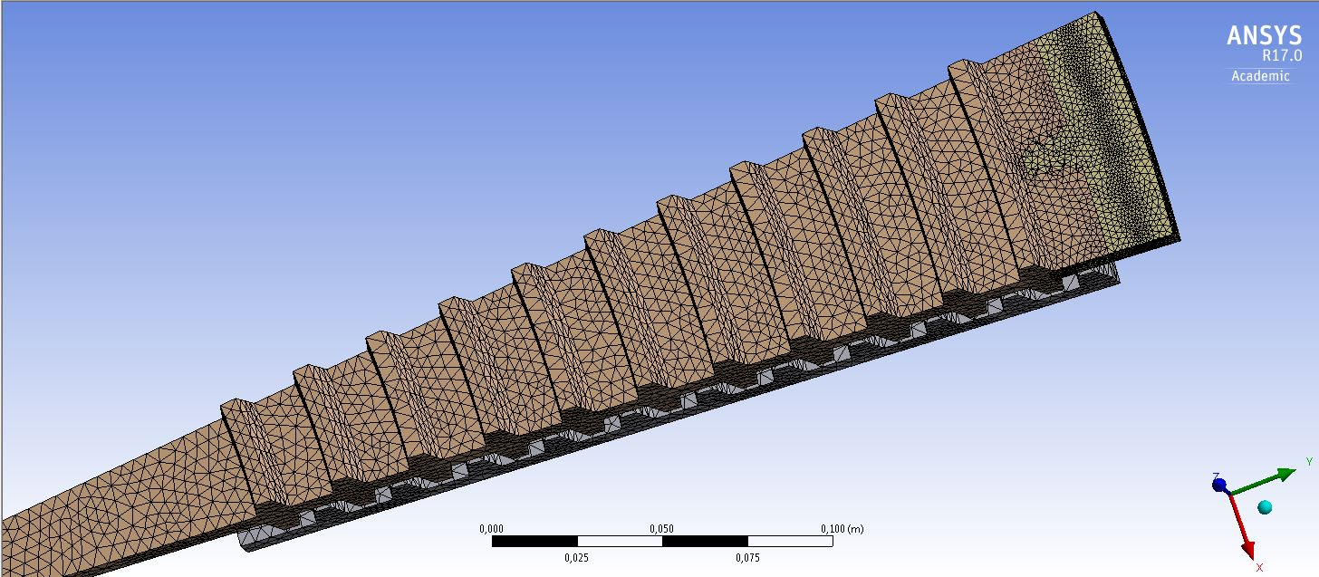
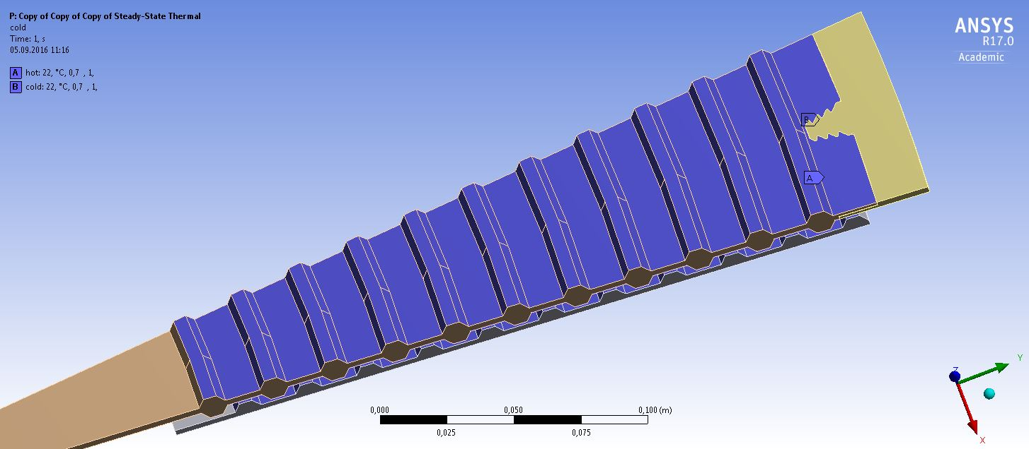
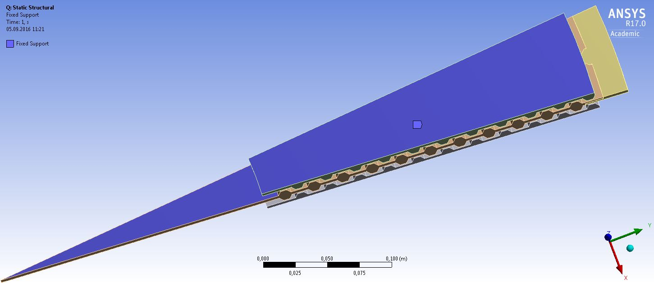
Fire-tree-root – results
Titan ring is bonded to copper disc at the fire tree
Radiating surface ~ 0,079m² per slice
11 fins are used
Bottom of the coolers is set to 22°C (it’s a constrain to simulate a cooling)
Rotational speed is 203 rad/s
Only titan ring and copper disc is rationing
Backsides of the coolers are fixed and

Slide 20
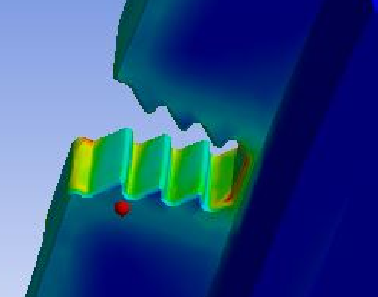
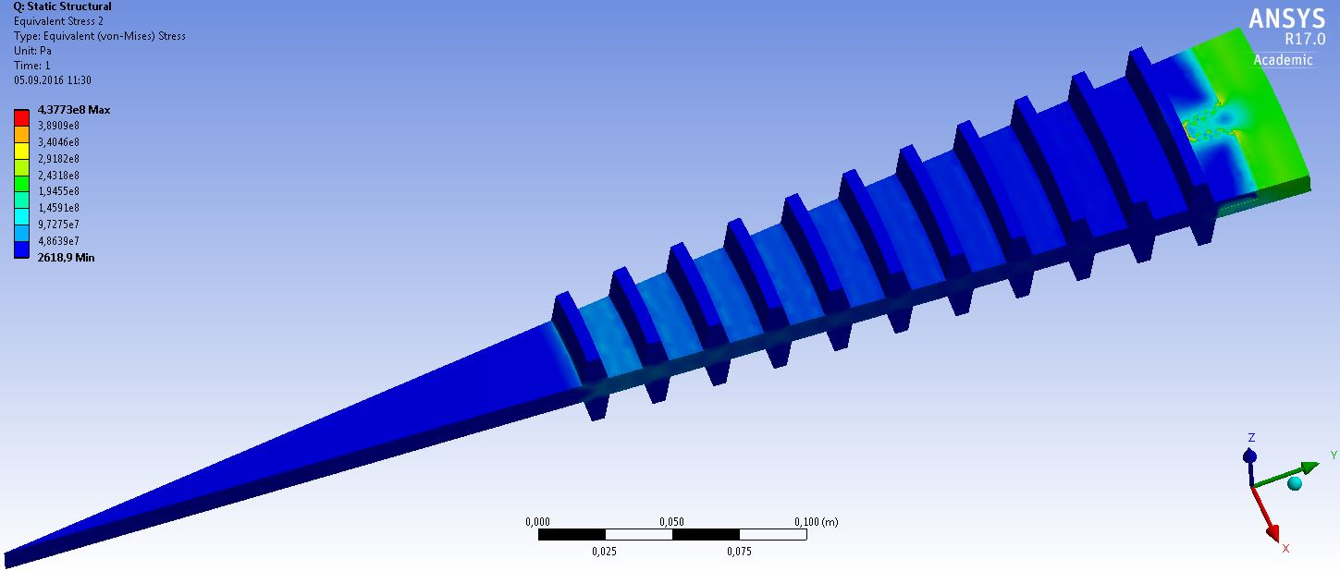
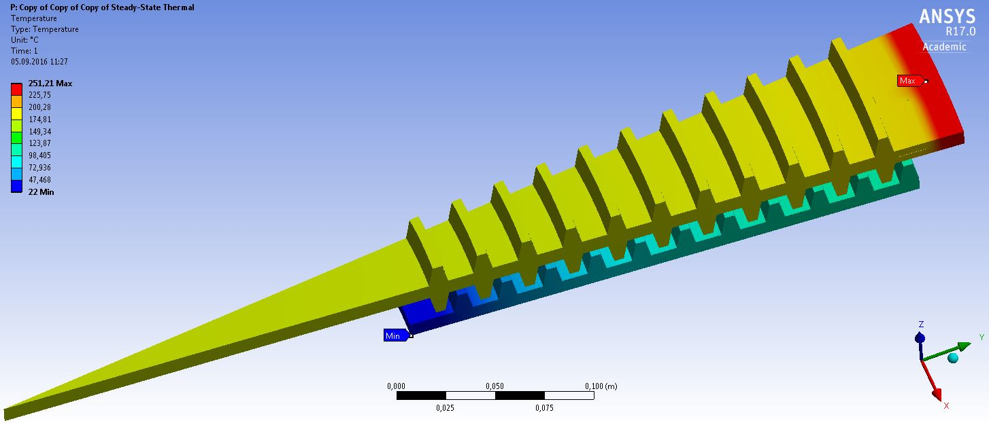
Fire-tree-root – results
Max equilibrium temperature is 251.21 °C (524.36K)
located over the fire tree ,at the exit side, in the middle of the beam spot
Static simulation shows max. von Mises Stress of 43.77 MPa
locates at the bottom of the fire-tree notch

Slide 21
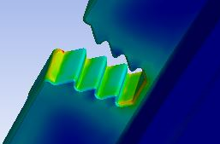
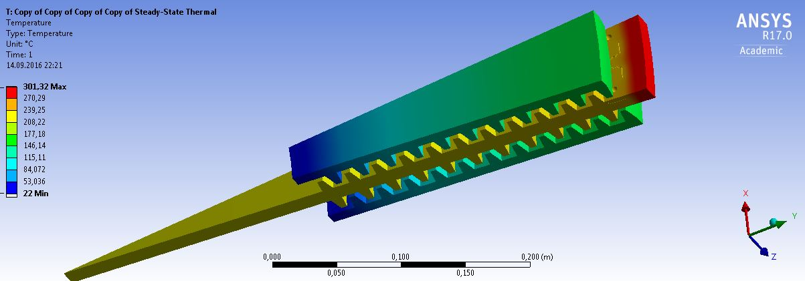
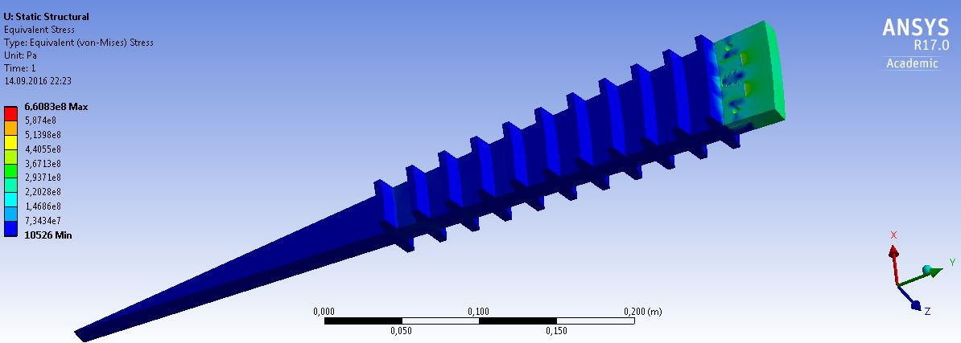
Fire-tree-root – results
Max equilibrium temperature is 301.31 °C (574.46K)
located over the fire tree ,at the exit side, in the middle of the beam spot
Static simulation shows max. von Mises Stress of 66,08 MPa
locates at the bottom of the fire-tree notch

Slide 22
Summary
Connections between copper and Titan are still problematic
Both connections shows advantages and disadvantages
The fire-tree has lower temperature and lower weight but more stress (even too much)
has to be redesigned
bigger
or more trees
the connection with screws has lower stress but higher weight
to high stress at the fixed surfaces

