Slide 1
Status: Cooling of the ILC e+ target
by thermal radiation
POSIPOL2016, LAL, Orsay
16th September 2016
Felix Dietrich, Alexander Ignatenko, Sabine Riemann (DESY),
Andriy Ushakov (Hamburg U), Peter Sievers (CERN)

Slide 2
Outline
Status
Radiative thermal cooling of e+ target
temperature distribution
Design considerations – update
Summary

Slide 3
e+ target for E_{cm} = 250 … 500GeV
E_{cm} and luminosity determine energy deposition in target
Ø = 1m; 2000rpm, 0.4X0 Ti6Al4V (P_{e+} ≤30%)
E_{dep} ≤ 7kW → cooling by thermal radiation is an option
Polarization upgrade:
higher peak load ⬄ higher peak temperatures
higher average temp in target
E_{beam} [GeV] | E_{dep} [kW] | ΔT_{max}/pulse [K] | dpa | E_{dep} [kW] | ΔT_{max}/pulse [K]
 | Nominal luminosity |  |  | High luminosity
120 | 5.0 | 66 | 0.035 | - | -
175 (ILC EDMS) | 3.9 | 125 | 0.06 | - | -
250 (ILC EDMS) | 2.0 | 130 |  | 4.1 | 195
250 | 2.3 | 85 | 0.05 | 4.6 | 128
A. Ushakov,
2015
A. Ushakov,
Update 2015

Slide 4
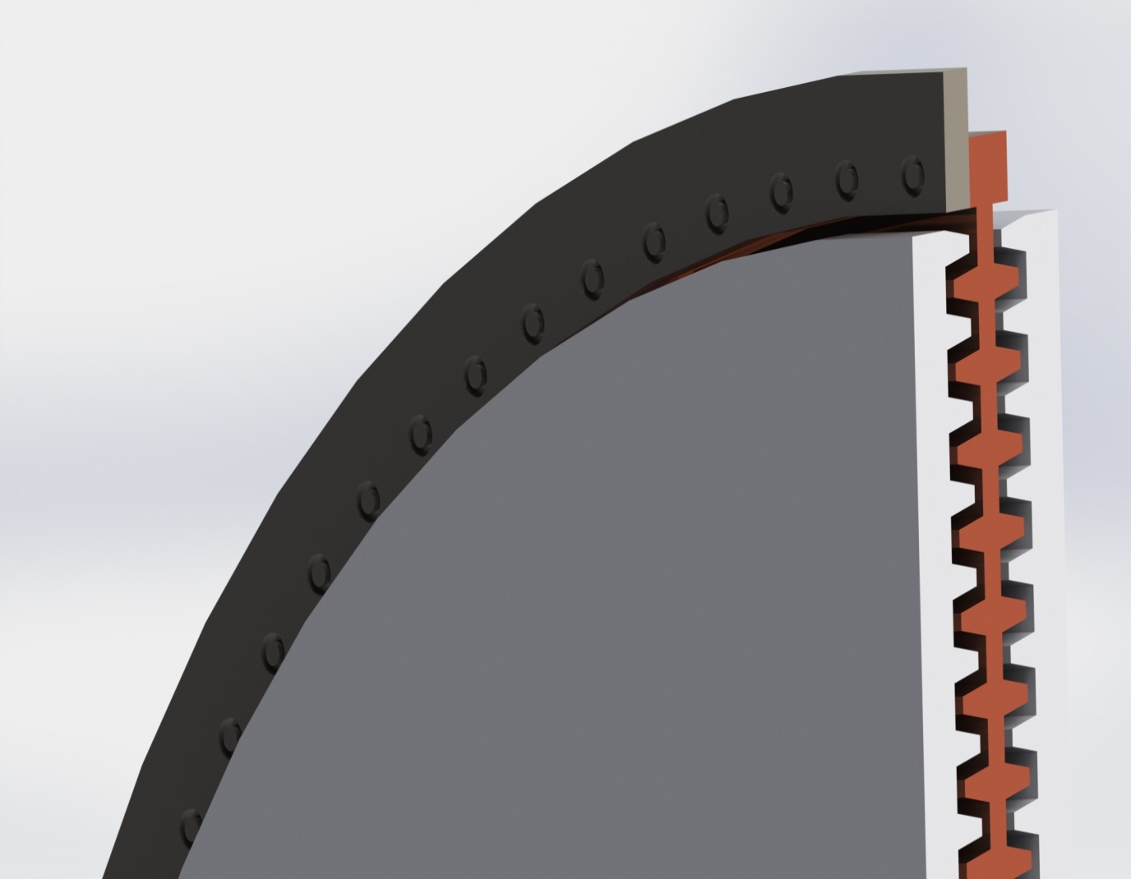
Radiative cooling model so far
photons
e+ target located close to FC
Rotating wheel consists of Ti rim (e+ target) and Cu (radiator)
Heat path:
thermal conduction Ti → Cu
Thermal radiation from Cu to stationary water cooled coolers
Target, radiator and cooler are in vacuum
Radiating area is adjusted by fins
Goal:
keep target temperature
below limit for failure
of Ti6Al4V
Reliable fatigue limit at
elevated temperatures?
Ti6Al4V
Radiator
Cooler (Cu)
Sketch, no technical drawing!
Felix Dietrich

Slide 5
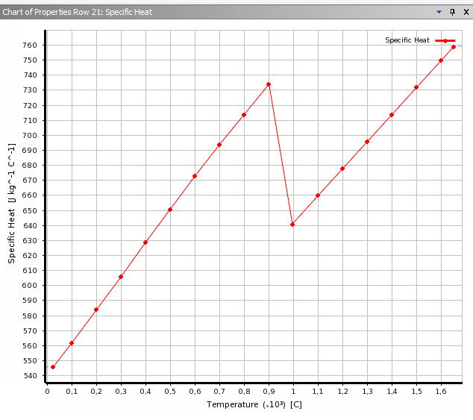
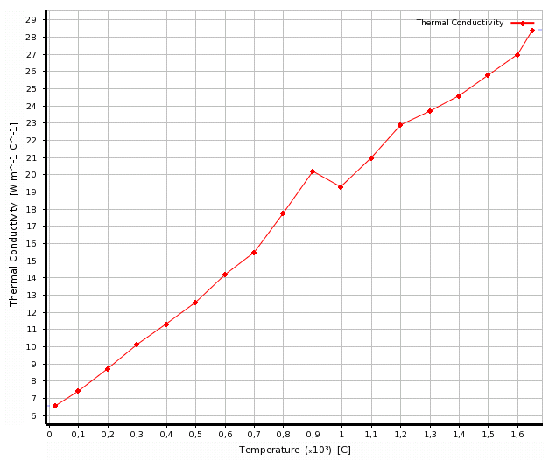
Temperature development in target (+radiator)
FEM to calculate temperature evolution in real model; here ‘estimation by hand’
Material parameters c, λ, ε depend on temperature and long-term load
Heating due to
energy deposition
Thermal conduction
through material
Radiation from
surfaces
Specific heat [J/(kg C)]
Thermal conductivity [W/(m C)]
K.C. Mills, 2002,
Recommended Values of
Thermophysical Properties
For Selected Commercial
Alloys, p. 217,
referenced by J. Yang
200 400 600 800 1000 1400
T [C]
200 400 600 800 1000 1400
T [C]

Slide 6
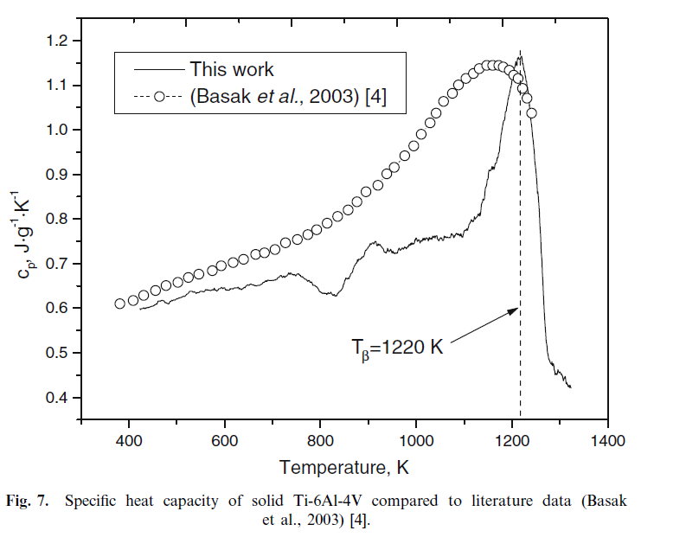
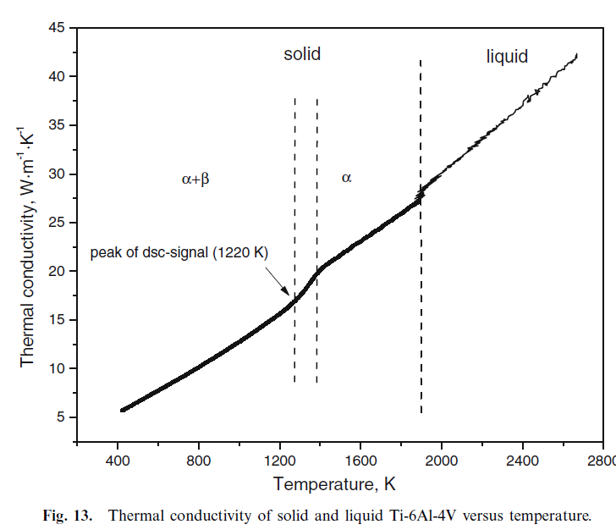
Temperature development in target (+radiator)
FEM to calculate temperature evolution in real model; here ‘estimation by hand’
Material parameters c, λ, ε depend on temperature and long-term load
Heating due to
energy deposition
Thermal conduction
through material
Radiation from
surfaces
Boivineau et al., Int. Journ.
of Thermophysics,
Vol. 27, No.2 March 2006

Slide 7
Heating to equilibrium
Neglect heat conduction and thermal radiation → average T in material increases
Assume 2.3kW at target
target rim height h = 2cm (4cm)
→ V_{rim} ~ 924cm³ (1.8dm³)
Average rim temperature T_{ave} = 300C (ΔT=270K) reached after
254sec (~4.2min) for h=2cm;
497sec (~8.3min) for h=4cm
Heating of rim+radiator takes correspondingly longer
Taking into account thermal radiation and time for heat transfer to radiator, few hours needed to achieve equilibrium (see our talks at POSIPOL14+15 and LCWS15 and Felix’ talk)

Slide 8
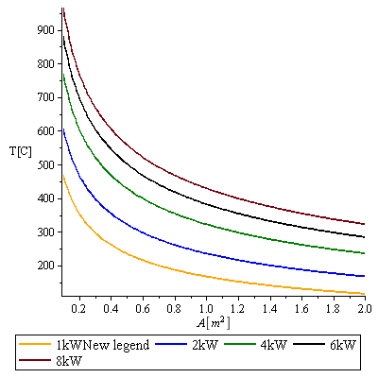
Thermal radiation
Consider radiation off target rim only,
r = 0.5m, h=2cm, d=1.5cm
A ~ 0.17m², ε = 0.6
2.3kW ⬄ T_{target} (ave)~530C
So far, we concentrated in our T⁴ cooling models on radiation from radiator by optimizing the design towards a large area with fins, but there is also substantial thermal radiation off the rim
low heat conductivity of Ti ⬄ high average temperature of rim
despite small rim area substantial cooling by thermal radiation off the target rim
T_{average}[°C]
ε=0.6

Slide 9
Heat transfer target to radiator
Ti
Ti
Spinning target⬄ ~6.5s between load cycles
Heat moves $\sqrt{λt/ρc}$ ~ 0.5cm in 6.5sec
→ accumulation of heat in the target
Temperature flow to radiator depends on s
Average heat transfer through rim
A_{contact} ~470cm², λ~10W/(m K)
dQ/dt = 2.3kW: T_{max-ave} (Ti) – T_{contact} ~ 100K (s=1.5cm)
~ 150K (s=2.5cm)
Additional cyclic temperature rise by pulse (80…200K)
Cyclic peak temperatures in target can exceed 500˚C, in particular for large s
need design with short heat transfer path through Ti rim to keep the average T_{target} as low as possible
for high power deposition (⬄ high lumi) even average temperature could be >500C
s
Cu
Cu

Slide 10
Estimated average temperature in T rim and Cu radiator
Consider thermal radiation from rim and radiator
Case (1): rim 0.082m² + radiator 1m²
Case (2): rim 0.082m² + radiator 2m²
Case (3): Only rim, 0.16m²; no radiator
Emissivity ε=0.6
Estimates give the principal behavior and only approximate temp values. Real temperatures need simulations, they depend on radiator design and Ti-Cu contact
T_{ave}[K]
E_{dep}[kW]

Slide 11
Percentage of power radiated by target rim
Case (1): rim 0.082m² + radiator 1m²
Case (2): rim 0.082m² + radiator 2m²
Depending on energy deposition, target rim size and radiator area, thermal radiation off the rim is efficient and can reach 35% of E_{dep}
P_{rim-rad}[%]
E_{dep}[kW]

Slide 12
Due to low thermal conductivity of Ti6Al4V, peak and average temperatures in target are substantially determined by target dimension (height)
Ti-Cu contact as well as radiator surface are important to remove the heat
However
we need a heavy wheel (>100kg) to provide a radiator area of ~2m²
A lower radiating surface of 1m² increases the average temperature in the target by only ~70K.
Reduction of # of fins by factor 2 reduces wheel weight by ~20kg
Idea: Are higher target rim temperatures acceptable?
After our first target material tests we feel encouraged to accept higher target temperatures.
Similar approach is followed by M. Breidenbach
Stress resistivity at elevated temperatures??

Slide 13
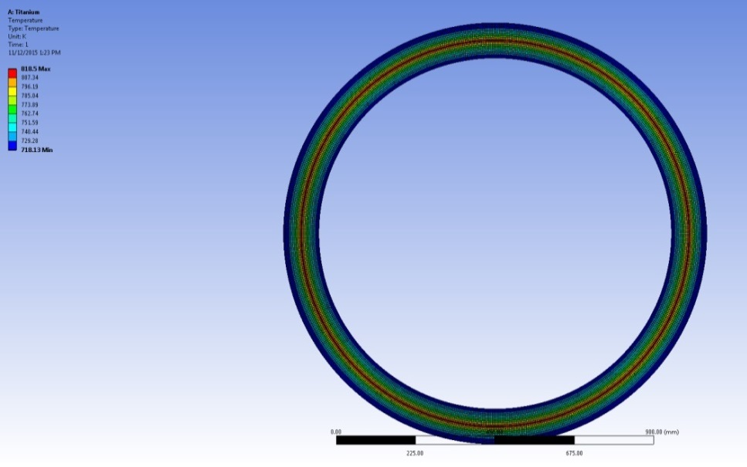
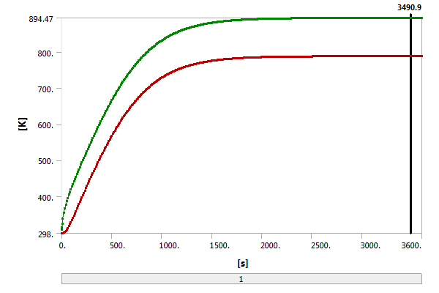
Target studies at SLAC (M. Breidenbach, M. Oriunno)
Private communication after LCWS15
(See also Marty’s talk at LCWS15)
Approach:
use high T material Ti-SF61
Study for P = 7.74kW
1312 pulses with 10Hz
Transient with emissivity 0.4
λ (W.m-1.K-1) | ε = 0.4 | ε = 0.6
21 | 894 (621) | 814 (541)
8 | 984 (711) | 904 (631)

Slide 14
Stress in target and radiator
Depends on:
design
Load by pulse ⬄ Instantaneous and average heating
Rotation
Eddy current
Imbalances (ignored so far)
Stress resistivity at elevated temperatures??
Thermal and mechanical stress limits for target and radiator material at high temperatures, under irradiation

Slide 15
Stress due to heating
Instantaneous heating
Pulse ⬄ ΔT = 80K … 200K
Ti rim σ ~ 100…260MPa
ILC e+ target: ~2×10⁶ loads per year (4000h) ⬄
fatigue stress limit for Ti alloy ~600MPa at room temperature but considerably lower at elevated temprature
Average heating
Depends on design
Heated rim and radiator:
Hoop stress in ring: σ_{H} = E α ΔT if expansion is prevented
Ti rim @ 500C → σ_{H} would be ~420MPa
Expansion of rim + radiator is not restricted → increase of rim circumference u,
Δu = 1.3cm (Δr = 2mm)
Spatial expansion V_{rim}(heated) = γ·V_{20˚C}·ΔT
Ti: ΔV ~ 1.2% for ΔT=500K (~ 2% for 850K)
Cu: ΔV ~ 6.6% for ΔT=200K (~ 11.5% for 350K)

Slide 16
Further stress load
Rotation ⬄ tangential and radial forces
thin ring approximation for target rim: σ_{t} ~ ρr²ω² = 50MPa
Assuming sliced target, (~40 pieces for nominal lumi),
height ~2cm (3cm) → F_{c}=mrω² ~2.2kN (3.3kN)
With connecting area A~12cm² → σ~2MPa (3MPa)
→ no problem
→ Sliced target
minimizes stress in (non-uniformly heated) target rim and radiator
Main stress contribution from cyclic energy deposition by photon beam
Ti-Cu contact
must work well for all temperatures
Calculation of stress at the contact Ti to radiator needs FEM methods
Possibilities considered
Peter’s proposal: use bolts + plate springs
Felix’ (also Marty Breidenbach’s) proposal: use multiple dovetail connection for tight connection between Ti and Cu
Status and more details in Felix’ talk
Ti
Cu

Slide 17
Eddy currents
See talks at ALCW15, POSIPOl15
no problem for 5Hz, τ_{pulse}~1ms, and 0.5T at target
Pulsed braking power ⬄ intermittent force on the target shaft and bearings (P. Sievers: ~100N in 1ms)
→ tight control of the wheel velocity, motor torque
→ vibrations have to be studied

Slide 18
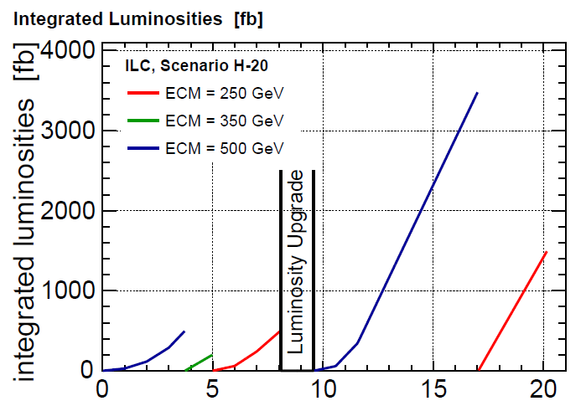
Expected target load in the first years
Running scenarioH-20 start with E_{cm}=500GeV (500fb⁻¹), followed by E_{cm}=350GeV (200fb⁻¹); and 250GeV (500fb⁻¹); 1326 bunches per pulse during the first years.
Average E deposition: 2.3kW (500GeV), 3.9kW (350GeV), 5kW (250GeV)
→ Estimated peak temperatures for 2m² (1m²) radiator area:
~400C (500C) at 500GeV
~450C (550C) at 350GeV
~470C (570C) at 200GeV, 5Hz, 230m undulator length
Cyclic load stress due to γ beam ≤200MPa (nominal L, no e+ pol upgrade)
Beam test studies at microtron in Mainz show that Ti6Al4V should stand this

Slide 19
Ti alloy parameters at high temperatures
Ti6Al4V (http://asm.matweb.com/search/SpecificMaterial.asp?bassnum=MTP642 )
Ti-SF61(Ti-5.9Al-2.7Sn-4Zr-0.45Mo-0.35Si-0.22Y), see also http://amt-advanced-materials-technology.com/materials/titanium-high-temperature/ :
“This Titanium alloy could be used up to 620°C for long service times. …highest creep resistance … The fatigue strength is very high up to 820°C…”
 | ρ [g/cm³] | λ [W/mK] | α [10⁻⁶/K] | T_{melt} [C] | E [GPa] | UTS [MPa] | YS [MPa] | Elong [%] | Fatigue [MPa, 10⁷] | β-trans. [C]
 |  |  |  |  |  | RoomTemp
Ti-SF61 | 4.56 | 6.7 | 8.3 | 1650 | 120 | 1068 | 1050 | 11 | 195@760C
 |  |  |  |  |  | 600C
 |  |  |  |  |  | 752 | 655 | 16
 |  |  |  |  |  | Room temp
Ti6Al4V | 4.43 | 8 |  | 1604 | 113.4 | 950 | 880 | 14 | 510 unn. 240n. | 980

Slide 20
Thoughts for improvements
Assuming radiator surface of 1m²,
at least 20-40% of the deposited power are radiated from the target rim
average target temperature increases less than 100K in comparison to 2m² radiator area
Ti6Al4V seems stable up to T~700C average temperatures (see our material tests at MAMI, Alexandr’s talk)
Use Ti alloy developed for high temperature applications ? (M. Breidenbach: Ti-SF61)
High temperature Ti alloy + lower radiator area → Optimization of target shape? Increase radiating target area by factor 2 or ~1.5
Split target in 2 parts and add a stationary cooler fin between them outside the beam area
→ Lower e+ yield due to larger effective distance to
FC (but this could help to increase e+ polarization)
A. Ushakov estimate: Yield reduction by ~10% for
10mm gap between target parts
Do not touch beam path region but increase outer target
surface
(Rough sketches, no technical drawings!)

Slide 21
Summary
Radiative cooling will work
Under study:
Efficient contact between target rim and radiator
Optimize target+radiator surface + material
Mechanical issues
Polarized positrons
Realistic undulator spectrum (see Khaled’s and Ian’s talks)
Polarization upgrade
PEDD and target design
photon collimation?
Polarization measurement at the e+source
Cyclic load tests at MAMI (see also Alexandr’s talk)
Check target material properties at high temperatures and high load
Target and exit window material
Photon dump
… was not subject of this talk
‘Extrapolation’ of photon collimator studies (see http://arxiv.org/abs/1412.2498 ) show that a graphite dump is possible, but should be either moved (as the dump window) or consist of cooled rods

Slide 22
Thank you!

Slide 23
Temperature distribution at the target rim
adjust revolution frequency to distribute energy deposition almost uniformly over rim
for example:
bunch train occupies angular range θ_{pulse}
f_{rev} = 1922rpm instead of 2000rpm
→ pattern: 1st second: 0, 144, 288, 72, 216,
2nd second: 0 + θ_{pulse} ….,
3rd second: 0 + 2θ_{pulse} ….
after ~7s the rim is almost uniformly heated
unbalances due to non-uniform heating are avoided

