Slide 1
Effects of correlated thermal vibrations of crystal atoms on bremsstrahlung and dechanneling
POSIPOL 2016
Orsay , 14-16 Septembre
X. Artru
Institut de Physique Nucléaire de Lyon

Slide 2
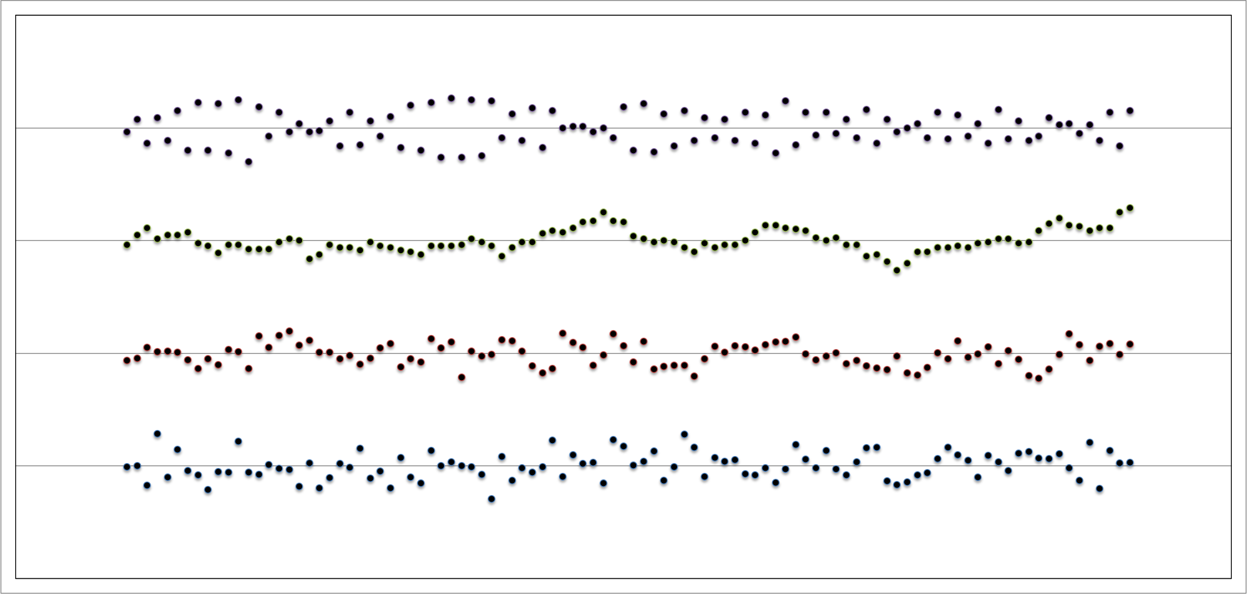
How do atomic chains vibrate ?
β=+0.0
β=+0.5
β=+0.9
β=-0.9

Slide 3
Spring model for the atomic string vibration
correlated vibrations
Spring of constant K’
Spring of constant K
Atomic string axis

Slide 4
Gaussian Monte Carlo model
One draws at random the transverse positions u₁ = (x₁,y₁), u₂ , …. , u_{n} , .... of the atoms
Without correlations : generate each u_{n} independently, with the Gaussian distribution
P(u_{n}) ≈ exp{ - u_{n}² / <u²>_{th} }
With correlations :
Start from u₁ = 0 (for instance)
Generate u₂ , u₃ , …. by iteration, with following the distribution
P(u_{n+1}) = C/(2π) exp{ - C (u_{n+1}- β u_{n} )² }
Thus, <u_{n+1}> = β u_{n} ; β measures the strength of the correlation. |β| < 1
C is related to <u²>_{th} by 1/C = (1 – β²) <u²>_{th} .
The correlation between u_{n} and u_{n+p} decreases like β^{|p|} .
The correlation range is 1/Log(1/β)

Slide 5
Effect of the correlation on dechanneling
A group of N successive atomic nuclei having equal transverse positions u_{n} = u_{n+1} = …. , u_{n+N} , scatters an aligned particle beam as strongly as one super-nucleus of charge N×Z .
The mean square momentum transfer is <q²> = N² <q₁²> ,
intead of N <q₁²> for nonaligned nuclei.
Classical explanation : q = Σ_{n} q_{n} ; q_{n} ≈ (2 Zα) b_{n}/b_{n}² ;
b_{n} = impact parameter = r_{particle} – u_{n}
This is still approximatively true if |u_{n} –u_{m}| << |b|
In reality, N is limited by non-perfect beam alignment and trajectory bending : N ~ N_{eff}

Slide 6
Dechanneling simulation (for axially channeled e⁻)
screening
Momentum transfer from 1 atom :
q (b) = - 2Zα b { (b² + r²_{nucl.})⁻¹ - (b_{n}² + r²_{atom}) ⁻¹ }
Channeling potential :
Ideal atomic string : U(b) = (Zα/a) Log { (b² + r²_{nucl.}) /(b_{n}² + r²_{atom} )) } + Cte
After convolution with atom vibrations :
U(b) ≈ - (Zα/a) Log { (b² + r²_{nucl.} + <u²>_{th}) /(b_{n}² + r²_{atom} + <u²>_{th})) }
Simulation of the electron motion by binary collision :
v_{n+1} = v_{n} + E⁻¹ q(r_{n} – u_{n})
r_{n+1} = r_{n} + a v_{n}
Parameters :
Z = 14 (like Si)
r_{nucl.} = 1 fm
r_{atom} = 0.05 nm
a =0.2 nm
<r²>_{th} = (0.0042 nm)²
E = 100 MeV
b_{n}

Slide 7
Preliminary numerical results
- Incidence angle : v_{in} = 0
- Incidence points : |r_{in}|= (a/2) × k (k = 0, 1, … 9)
-> transverse energies between - 481 eV and - 4 eV
We take two definitions of the dechanneling length L_d = a × n_d :
n_d1 = No of the first binary collision after which E_{T} > U(a/2)
n_d2 = No of the first binary collision after which r_{n} > a/2 (= 0.1nm)
Results :
Correlation strength β <n_d1> <n_d2>
0. 546 1629
0.5 491 1470
0.9 391 1174
- 0.9 516 1564

Slide 8
Results
Incidence angle : v_{in} = 10⁻³ ( ≈ 1/3 θ_{Lindhard})
Incidence points : |r_{in}|= (a/2) × k (k = 0, 1, … 4)
-> transverse energies between - 431 eV and - 22 eV
Correlation strength β <n_d1> <n_d2>
0. 678 1784
0.5 600 1617
0.9 464 1297
- 0.9 630 1681

Slide 9
Decomposition of <u²>_{th} in phonons
medium wavelength ~ 10 a
shortest wavelength = 2a
<u²>_{th} ≈ (ρ_{A} m_{A})⁻¹ × integral of d³K/ω { 1/2 + 1/[exp(ω/kT)-1] }
~ integral of dK for long wavelength (K = 2π/λ)
-> typical wavelength ~ 4a
-> β ~ exp(-1) ~ 0.4
4a

Slide 10
Quantum approach
Consider a group of N successive atomic nuclei of transverse positions u_{n} , u_{n+1} , …. , u_{n+N}
In the Born approximation, the scattering cross section by this group is
(dσ /d²q)_{group}= (dσ/d²q)_{1-atom} × |F(q)|²
with F(q) = Σ₁^{N} exp(i q.r_{n})
|F(q)|² = N + Σ_{n,m} exp[i q.(r_{n}-r_{m})]
The interference term is positive when |r_{n}-r_{m}| is smaller than 1/q
In our Gaussian Monte-Carlo model we obtain
<|r_{n}-r_{m}|²> = 2 <u²>_{th} × (1-β^{|n-m|})
and
|F(q)|² = Σ_{n,m} exp{ - (1-β^{|n-m|}) <u²>_{th} q² }
-> The larger is β, the stronger is scattering.
interference

Slide 11
Conclusion
The correlations between the vibration of neighbouring atoms[*] decreases the dechanneling length.
This is shown both in classical approach (binary collision model) and in the quantum Born approximation.
An effect of ~ 30% could occur. It depends on the phonon spectrum.
Since the scattering is stronger, the Incoherent Bremsstrahlung should also be more powerfull (compared with simulation without correlation)
[*] for a fixed value of <u²>_{th}

